Slide 1
The AISL Program
FY 18,19, 20
Overview of NSF Solicitation 17-573
Advancing Informal STEM learning (AISL)
Directorate for Education and Human Resources
Division of Research on Learning in Formal and Informal Settings

Slide 2
Contents
Program Priorities
Audiences for AISL projects
Program Solicitation
  Revisions & Additions
  Project Types
  Research & Evaluation
  Review Criteria
Proposal Review Process
Resources
Contact Information
Notes:
This is our agenda for today focusing on an overview of the AISL program and solicitation, the project types we fund; suggestions for preparing a competitive proposal, and how your proposal will be reviewed, including specific criteria. We’ll briefly describe other NSF programs you might be interested in. Again, we can answer your questions during our live Teleconferences on Sept. 22 or 29 or anytime via email.

Slide 3
AISL Program
Advancing – Innovative projects that advance the field through building knowledge via innovative approaches and research.
Informal – Learning that is lifelong, life wide, & life deep. Learning that occurs outside formal schooling systems.
STEM – Not just focused on science, but all of NSF-funded STEM, including social and behavioral sciences.
Learning – Learning outcomes typically include: interest, engagement, motivation, behavior, identity, persistence, understanding, awareness, knowledge, and use of STEM content and practices, and 21st century skills.
Notes:
Al

Slide 4
AISL
Program Overview
Notes:
We’ll start with on overview of the AISL program and solicitation.

Slide 5
AISL priorities
Notes:
The AISL program has six priorities it believes are essential for achieving its goals. These priorities are also strategies to incorporate as approaches to the work.

Slide 6

Maximizing Strategic Impact
How does the project address important areas for continued development and advances the informal STEM learning field overall, not simply the project impact for the target audiences or communities?
Notes:
Strategic suggests planned intent or focus
Impact must go beyond project-level impact.
Note that strategic impact can be achieved regardless of the size of the organization (or the population of the communities that they serve) or the size of the target audience.

Slide 7

Enhancing Knowledge Building
How does the project advance
the knowledge base of the
informal STEM learning field?
Knowledge generation may focus on developing, testing, and/or implementing innovative research, models, resources, and tools for informal learning environments.
The theoretical and empirical justification for the proposed project must be clearly articulated.
Notes:
Foci of investigations may include, for example, "what is happening," "to what extent," "why," "how," "what works for whom," and "under what circumstances."
The “Discover Research” tab on the informalscience.org website may be helpful in finding current research, literature reviews, research agendas, etc. related to learning STEM in informal settings.
Projects should build from the current literature and practice. Projects may also consider building from or critiquing relevant research agendas or literatures about informal STEM learning that have been developed in recent years.
Definitions of research and evaluation vary across the field of informal STEM education. It is not the goal of this solicitation to set definitions for these approaches. Instead, the AISL program seeks to advance the collective understanding of learning STEM in informal environments and to provide appropriate means for communicating what has been learned. Thus, each proposal should identify how it builds knowledge. It should make a case for how it is doing so, using appropriate resources from research and evaluation

Slide 8
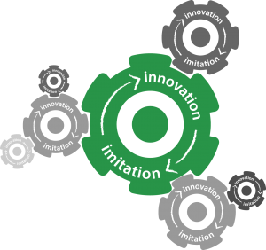
Promoting Innovation
In a manner similar to NSF programs that fund the frontiers of STEM research, AISL seeks to fund projects at the frontiers of STEM learning in informal
environments that will
advance the
state-of-the-art.
Notes:
Innovation may be framed in different ways and serve different purposes.
Innovation may build on or extend current work or it might take that work in a totally different direction.
For the informal education field, innovation might
address immediate challenges and opportunities;
anticipate different structures, functions, and purposes of informal STEM education;
challenge existing assumptions about learning and learning environments; or
envision the future needs of diverse learners, educators, and STEM professionals in the U.S.

Slide 9

Advancing Collaboration
This priority has two aspects.
Projects should:
leverage resources of partners; and
evidence more focused, reflective approach(es) to building collaborations.
Collaborations should be
integral components of the
work funded.
The term “collaboration” is used to cover a wide variety of activities: collective impact, partnerships, inter-disciplinary work, networks, alliances, etc.
Notes:
Successful projects will generally involve interdisciplinary teams. In all cases, proposals must describe the expertise needed for the work, how this expertise is incorporated in the project, and who is responsible for each component.

Slide 10
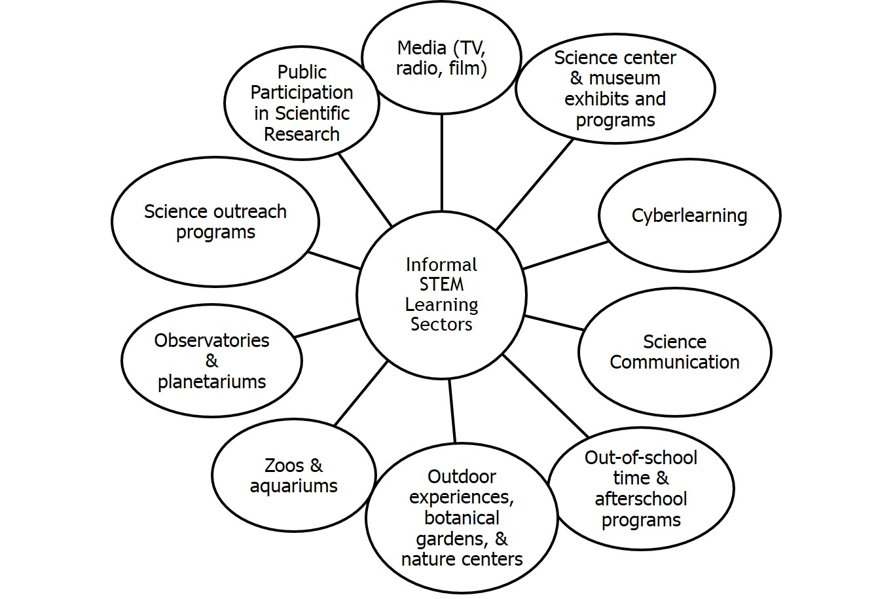
Strengthening Infrastructure & Building Capacity
Notes:
Building infrastructure and/or capacity is critical for advancing the field of informal science education.

Slide 11

Broadening Participation
The AISL program contributes to NSF’s mission by supporting projects to engage professionals and publics from populations typically underrepresented in the STEM fields.
As of FY15, there are additional solicitation-specific criteria for projects in which broadening participation is a
primary goal.
Notes:
Projects focused on young people can contribute to informing how the nation prepares this increasingly diverse cohort for rapidly changing occupations in STEM-related fields.
Projects focused on professionals can contribute to research on STEM learning outcomes, organizational capacity, and field-wide mechanisms for expanding access to STEM resources and experiences.
AISL is particularly interested in receiving proposals from organizations that serve underrepresented minorities (URMs).
Two criteria:
Does the proposal identify the characteristics and needs of the targeted underrepresented groups (public or professional) to be served?
Does it include explicit plans or strategies for addressing or accommodating the specific interests, community or cultural perspectives, and educational needs of participants of the identified underrepresented groups?

Slide 12
AISL audiences
Notes:
The AISL program is interested in supporting audiences both public and professional

Slide 13

Public Audiences
As per the solicitation, these may include: “learners of any age, educational level, geographic, or cultural background, including those from groups underrepresented in STEM or underserved in STEM.”
Be clear about your audience(s) and why they have been selected.
Describe the proposed work from their point of view. What needs does this work help meet/resolve?
Reviewers want to know
that applicants really know
their audiences.
Source: http://participation.cymru/en/
Notes:
Don’t forget
The AISL program is keenly interested in projects that support understanding issues of access to informal STEM learning opportunities for
individuals/groups from populations typically underrepresented in STEM,
people in rural as well as urban communities,
adults across the lifespan,
early childhood, and
intergenerational and family groups.

Slide 14

Professional Audiences
This includes individual(s) who are “involved in aspects of research or development of STEM learning by the public in informal environments.”
Similar to public audiences, for professional audiences it is also important to:
Be clear about your audience(s) and why they have been selected.
Describe the proposed work from their point of view. What needs does this work help meet/resolve?
Notes:
Can include
STEM educators,
evaluators,
education and learning researchers,
technologists,
media professionals, or
STEM professionals doing outreach in informal settings.
Graduate students and post-docs may also be included as professional audiences.
IMPORTANT
You may focus on public audiences, professional audiences or both.
Be clear about the target audience(s) and how the project's design and STEM learning component(s) are relevant and appropriate for the proposed target audiences and age levels.

Slide 15
NSF 17-573
AISL Program Solicitation

Slide 16
Revisions & Additions
REVISED
Exploratory Pathways projects renamed: “Pilots & Feasibility Studies”
Reworked evaluation section
Two supplemental documents are eliminated
“Small” Conference proposals = up to $75,000
Notes:
REVISED
Exploratory Pathways projects renamed: “Feasibility & Pilot Studies”
Further clarifies research and evaluation for AISL projects
NEW
Limits on # of proposals for organizations and PIs
New proposal type: “Literature reviews, syntheses, meta-analyses”

Slide 17
Revisions & Additions (cont.)
NEW
Limits on # of proposals
  PI/Co-PI is limited to three (3);
  Organizations may be the lead on up to three (3)
New proposal type: “Literature Reviews, Syntheses, Meta-analyses”
Project Description is expanded to 18 pages (except for Conference proposals)
Minimum one-year budget amount is $75,000 for an organization in collaborative proposals uploaded as separate submissions from multiple organizations

Slide 18
Project
Types
Notes:
BOB SPEAKS:
Project types are similar to those in the previous solicitation, but one new type has been added: Collaborative Planning.

Slide 19
Pilots & Feasibility Studies
Exploratory development work or feasibility studies:
Should be positioned to potentially lead to field-advancing proposals of other project types.
Should produce evidence, findings and/or deliverables that form basis for further work and help you make better decisions.
Should state how project informs future work & advances field
Funding up to $300,000 (duration up to 2 years)
Notes:
Feasibility study:
an assessment of the practicality of a proposed project. A feasibility study aims to objectively and rationally uncover the strengths and weaknesses of an existing business or proposed venture, opportunities and threats present in the environment, the resources required to carry through, and ultimately the prospects for success. (Wikipedia)
looks at the viability of an idea with an emphasis on identifying potential problems and attempts to answer one main question: Will the idea work and should you proceed with it? [Wolfe, L. (2017, Mar). How to Write a Feasibility Study Step by Step (blog post). https://www.thebalance.com/what-is-a-feasibility-study-3514853]
Pilot study
A pilot study, pilot project or pilot experiment is a small scale preliminary study conducted in order to evaluate feasibility, time, cost, adverse events, and effect size (statistical variability) in an attempt to predict an appropriate sample size and improve upon the study design prior to performance of a full-scale research project. (Wikipedia)
It can refer to so-called feasibility studies …. [it] can also be the pre-testing or 'trying out' of a particular research instrument [van Teijlingen and Hundley. (2001), The importance of pilot studies. Social Research Update. http://sru.soc.surrey.ac.uk/SRU35.html]
Proof-of-Concept
a realization of a certain method or idea to demonstrate its feasibility, or a demonstration in principle, whose purpose is to verify that some concept or theory has the potential of being used. A proof of concept is usually small and may or may not be complete. (Wikipedia)
Funding is for up to $300,000 over 2 years.

Slide 20
Literature Reviews, Syntheses & Meta-analyses
Focuses on a problem requiring further understanding.
Pulls together literature(s)/research findings in a theoretical way.
Builds (creates new) knowledge.
Proposes directions for future research and practice.
Funding up to $250,000 (duration up to 2 years)
Definitions of these categories differ, so be clear about what you are proposing and why.
Notes:
Lit Reviews
These are not simply about description (e.g., a literature review does not just say what is “out there”).
They must be focused on a particular problem/construct. They should be a critique.
They are different from the lit review section of a proposal which summarizes (describes) the strengths and weaknesses of previous research for the purpose of establishing that previous findings and claims are relevant to the proposed focus of a proposal.
Syntheses
An analysis and interpretation of the findings from selected studies.
Uses a deliberate process of selecting studies with an emphasis on bringing together, analyzing, and interpreting findings across the selected studies.
Seeks to interpret findings for deeper understanding of meaning across a pool of selected studies.
Meta- syntheses
Uses a statistical procedure that aggregates and condenses a body of quantitative research studies to a common standard metric (e.g., a mean effect size)
Typically, used to summarize, replicate findings, or determine cause and effect.
These are general comments. As noted on the slide, depending on the source, some will says these terms are interchangeable. So be sure to be clear about what you’re doing and how it will ADAVANCE new understandings for the field.

Slide 21
Research in Service to Practice
Advances knowledge & provides evidence base for practice
Primary focus on research questions
Qualitative or quantitative data (evidence) and involve range of techniques
Includes literature review & detailed research plan
Researchers and practitioners are close collaborators
Funding from $300K to $2 million for 2-5 years
Notes:
Research in service to practice projects have at their core a compelling research question about practice, about how people learn and or about specific learning environments. For this project type the most energy and effort are centered around the research.
AISL research in service to practice focuses on understanding and improving practice.

Slide 22
Innovations in Development
Builds knowledge through the development of innovative products
Builds on evidence from prior practice & research
Describes an explicit theory & logic model/theory of action
Includes plan & process for design, development & implementation
Includes plan for knowledge building through research and/or evaluation
Funding: $500K to $3 million for 2-5 years
Notes:
Innovations in development projects focus on and leverage the development of a product, model, tool, or resource in order to better understand and inform practice. In general more effort and more resources will be invested in iterative development of a product—like a game or tv show—than in a Research in service to practice project type. If you're developing a large format film and exhibition that will help elucidate how people learn about some STEM subject, that's innovations in development.
If your knowledge building component is research, be sure to include a rigorous research plan in the Project Design section of your proposal. If your knowledge building component is through summative evaluation, be sure to clarify how you are building knowledge and what you are seeking to better understand about learning or informal settings.
Note the funding range.

Slide 23
Broad Implementation
Expands models, programs, technologies, assessment or other advances that have documented record of success
Expands reach: age, gender, geography, etc.
Includes plan & process for design, development, & implementation
Builds knowledge through research and/or evaluation
Funding $500K to $3 million for 2-5 years
Notes:
Broader Implementation
Similar to previous solicitation—build on programs/models/etc. previously developed that have documented evidence establishing tat they were successful and are ready for broader implementation.
Expanded reach and impact can be by age, geography, etc. Special interest in reach underserved/underrepresented.
Plan for knowledge building essential (research and evaluation)
Note: funding range

Slide 24
Conferences
Relate to AISL program goals
Focus on development of communities of practice, field-advancing practice, assessments, & research agendas
Proposals request >$75,000, due on deadline
Proposals up to $75,000 may be submitted at any time
Notes:
AISL invests in conferences, symposia, workshops that help meet program goals---build knowledge, advance field, develop new research agendas, improve practice
Note:
If your proposal requests over $75,000 it must be submitted on the regular deadline (e.g., November 6, 2017))
If under $75,000, it can be submitted at anytime:
Why have we done this: As we have limited funds, we want to consider all major investments (such as proposals over $75K) all at one time. At the same time, we have found that there are some small proposals that are timely. There is not an advantage or disadvantage to when you submit your smaller proposal. Do it when it makes most sense.

Slide 25
Research & Evaluation
Notes:
BOB SPEAKS:
So, this is what happens after NSF receives your proposal.

Slide 26
Research in AISL Projects
AISL supports research that advances knowledge and the evidence base for practices, assumptions, broadening participation, or emerging educational arrangements in STEM learning in informal environments, including the science of science communication (NAS, 2017).
Research can be supported through these mechanisms:
Literature Reviews, Syntheses, Meta-analyses
Feasibility, Pilot Studies
Research in Service to Practice projects
Can be components of Innovations in Development & Broad Implementation projects
Notes:
It is important for practice to inform the research as well as having research inform practice.
Genuine partnerships between researchers and practitioners are required, such that the project is important and relevant to both research and practice.

Slide 27
Evaluation in AISL Projects
All AISL project proposals are required to specify the evaluative processes they would employ to achieve the following two goals:
Support iterative improvement. Evaluative processes should ensure that a project gets appropriate, rigorous, external input throughout the life of the project. Such input is essential for project monitoring, management, and continuous quality improvement. External feedback should enrich (and potentially challenge) teams’ perspectives.
Promote accountability. Evaluative processes should address questions such as: Is the project addressing its stated goals? What is the quality of the work?
Notes:
Project level evaluation (this slide)
This solicitation does not intend to be prescriptive with respect to how they are achieved. There are some possibilities one can use to design evaluative processes that best align with their projects.
Evaluation and knowledge-building:
Some projects seek to achieve AISL’s knowledge-building criterion through evaluation. (Others propose research studies to build knowledge, and use evaluation primarily to monitor progress against timelines, ensure fidelity of implementation, etc.)
Evaluation for iterative/continuous improvement:
Some projects employ iterative cycles of evaluation (e.g., front end, formative, remedial) to inform work during the development and implementation of project activities. (This is often the case for proposals submitted to the Innovations in Development or Broad Implementation types; it may also be important for proposals submitted to other project types.)
External advisory boards and third-party evaluators:
Third-party evaluators and advisory board members typically contribute to the accountability component of project evaluations. These may also be used to provide the project team with feedback (on both as-needed and annual bases) on a range of issues, including the project’s research methods and analysis; how to improve engagement with a project’s target audiences; and how to effectively bridge boundaries in collaborations.
The extent of evaluation activities should be appropriate to achieving the project's goals and given the project's size and scope

Slide 28
Merit Review Criteria
Notes:
BOB SPEAKS:
So, this is what happens after NSF receives your proposal.

Slide 29
Merit Review Criteria
Intellectual Merit and Broader Impact:
1. What is the potential for the proposed activity to:
a. advance knowledge and understanding within its own field or
across different fields (Intellectual Merit); and
b. benefit society or advance desired societal outcomes
2. To what extent do the proposed activities suggest and explore creative, original, or potentially transformative concepts?
3. Is the plan for carrying out the proposed activities well-reasoned, well-organized, and based on a sound rationale? Does the plan incorporate a mechanism to assess success?
4. How well qualified is the individual, team, or institution to conduct the proposed activities?
5. Are there adequate resources available to the PI (either at the home institution or through collaborations) to carry out the proposed activities?
Notes:
These are the 2 NSF-wide review criteria: Intellectual Merit which focuses on how the proposal’s potential to advance knowledge and Broader Impact focuses on the potential to benefit society.

Slide 30
Solicitation-Specific Review Criteria
Broadening Participation
Does proposal identify characteristics and needs of targeted underrepresented groups to be served?
Does it include specifics plans or strategies for addressing or accommodating particular needs of participants of these groups?
Notes:
There are some additional solicitation specific review criteria related to NSF’s efforts to broaden participation of underrepresented groups. Reviewers will be asked to comment on these additional criteria when reviewing proposals.

Slide 31
Proposal Review Process
Notes:
BOB SPEAKS:
So, this is what happens after NSF receives your proposal.

Slide 32
Proposal Review Process
Proposal Deadlines: November 6 , 2017; November 6, 2018; November 6, 2019
Proposal Review
Each proposal is reviewed by external experts (e.g. educational researchers, content experts, educators, developers)
Each proposal receives at least 3 reviews.
Each reviewer assigns a rating to each proposal of Excellent, Very Good, Good, Fair, or Poor
Post Proposal Review
PIs are generally notified within 6 -8 months of the proposal submission date.
PIs receive reviews, comments from POs, and panel summaries (if applicable).
Reviews and panel considerations are advisory to NSF.
Notes:
-POs recruit reviewers with range of relevant expertise to sit on panels
-Each proposal gets 3-4 written reviews and a rating of E, VG, G, F, or P
Panels have a discussion about each of the proposals they review
Decide which ones are Highly competitive, Competitive, or Not Competitive
This is advisory input to POs
After panel meetings POs meet to review proposals getting high ratings/rankings and also which ones fill gaps in existing AISL portfolio
AISL POs collectively agree on which proposals should be recommended for funding; Division Director reviews/signs off; Grant is made by Division of Grants and Agreements.
If not funded, Pis will receive a decline letter with 3-4 reviewer comments, panel summaries, and comments from POs.
Balance diverse portfolio.

Slide 33
Resources
Notes:
BOB SPEAKS:
So, this is what happens after NSF receives your proposal.

Slide 34
NSF Resources
NSF Proposal & Award Policies & Procedures Guide (PAPPG), NSF 17-1, is very helpful as are FAQs: http://www.nsf.gov/bfa/dias/policy/
  IRB and other information is also on this page.
AISL-Funded Awards
http://www.nsf.gov/awardsearch/
  Put “AISL” in the search box to obtain a listing of the range of awards OR just click on the link from the AISL webpage: http://www.nsf.gov/funding/pgm_summ.jsp?pims_id=504793
  Also try key words related to your proposal topic/area; there are many search options to explore
Notes:
Additional Resources include the NSF awards search section of the website to learn what AISL has previously funded. And the Grant Proposal Guide and FAQs answers many questions about NSF policies and practices.

Slide 35
CAISE www.informalscience.org
The AISL Toolkit
http://www.informalscience.org/projects/funding/nsf-aisl
The Knowledge Base (formerly the Evidence Wiki)
http://www.informalscience.org/knowledge-base
Developing an Evaluation Plan
http://www.informalscience.org/evaluation/developing-evaluation-plan
Notes:
The Center for Advancement of Informal Science Education is an extensive website with much information and resources that can be helpful in developing a proposal.

Slide 36
Live Webinars and Webcasts
September 14, 2017, 1:00-2:30 pm EDT
How to Use informalscience.org to Make Your Case (CAISE)
September 19, 2017, 2:00-3:00 pm EDT
How to Write a Competitive AISL Proposal
September 22, 2017, 2:00-3:00 pm EDT
AISL & Broadening Participation
= = = = = = =
A detailed walk-through of AISL Solicitation 17-573 can be found under the Events link on the AISL Webpage.
Check the AISL & CAISE Webpages for more information about
these webinars and other resources.

Slide 37
Contact information

Slide 38
Contact Information
General inquiries regarding this program and program solicitation should be made to:
DRLAISL@nsf.gov
What should you do if you have a specific inquiry regarding your project or proposal?
Using the email address above, in the body of the email or as in attachment, send a brief (max 2 pages) summary of the research or R&D you are planning to conduct. The synopsis should include a very brief rationale for the work, how it will contribute to the knowledge base on informal learning, and what you believe the broader impacts to be. Be sure to also include your specific questions.
Notes:
The Center for Advancement of Informal Science Education is an extensive website with much information and resources that can be helpful in developing a proposal.

Slide 39
THANK YOU!
-------------------
Advancing Informal STEM Learning (AISL) Program
https://www.nsf.gov/funding/pgm_summ.jsp?pims_id=504793
Notes:
Julie

