Slide 1


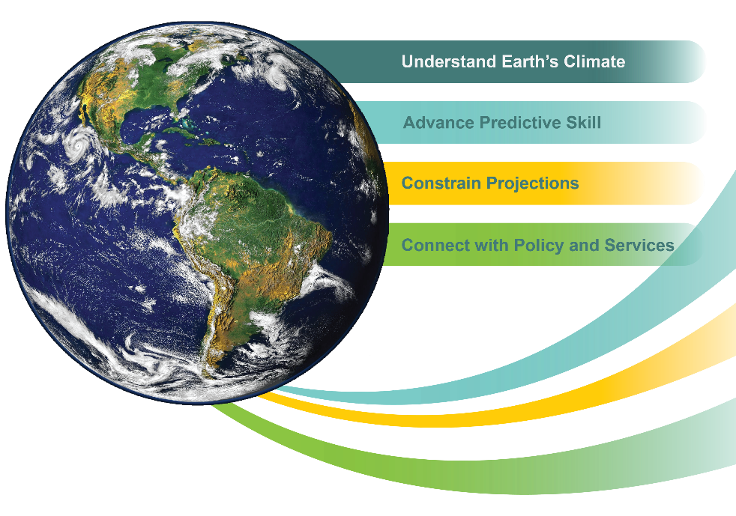
New Directions for International Climate Research:
The 10-year Strategic Plan of the World Climate Research Programme (WCRP)
by Guy P. Brasseur
Chair WCRP Joint Scientific Committee
Lecture
National Science Foundation
17 July at 12:00 noon
Room: 8080
Abstract
The World Climate Research Programme, sponsored by the World Meteorological Organization (WMO), the International Science Council (ISC) and the Intergovernmental Oceanographic Commission (IOC) of UNESCO, is developing a new Strategic Plan for the next 10 years. The plan includes four Overarching Objectives:
Fundamental understanding of the climate system
Advancing predictive skill on timescales of up to a decade
Constraining projections on decadal to centennial timescales
Connecting climate science with policy and services
It will be followed by a more detailed Implementation Plan that will take into account some of the recommendations made by a recent international review of the Programme. The lecture will present the future directions of WCRP and outline how the Programme will partner with other research and service initiatives, as well as with funding agencies.
For further information on the WCRP Strategic Plan please see:
www.wcrp-climate.org/wcrp-sp-overview
World Climate Research Programme
E-mail: wcrp@wmo.int

