Slide 1

gf
Gravitational Wave Astronomy: Future Prospects
Dr. Anne L. Kinney Assistant Director, National Science Foundation
IGC@25
LIGO/Caltech/MIT/Sonoma State (Aurore Simonnet)
Notes:
Good afternoon. Multi-messenger astrophysics allows us to probe the Universe as never before though independent and diverse cosmic messengers, each revealing a distinct perspective. Together they reveal a detailed picture that will allow us to study and understand matter, energy, and the cosmos in fundamentally new ways.

Slide 2

Notes:
[[I wouldn’t do this and EHT (too much!), I’ll let you pick which to use.]]
Last year, NSF’s IceCube Neutrino Observatory at the South Pole detected a high-energy neutrino from a distant blazar (a galaxy with a flaring supermassive black hole at its center). Ground- and space-based telescopes observed flares of light from the same source. In a major early breakthrough for WoU, this coordinated set of observations produced the first evidence of an astrophysical source of high-energy cosmic rays: a flaring blazar in the nucleus of an active galaxy.
In the animation shown here, a neutrino is emitted and travels on 4 billion light years journey through the universe. It finally enters the Antarctic ice sheet and collides with a molecule of ice, producing a secondary high-energy particle—a muon—which enters the IceCube array, producing the blue light of Cherenkov Radiation. IceCube detects this scattering of light, and sends a real-time alert to facilities around the world to follow up on, verify, and in this case, identify only the third source of extraterrestrial neutrino radiation, a flaring Blazar. ***[[Nadege, Anne asked for us to use this exact phrasing if we keep this animation.]]

Slide 3
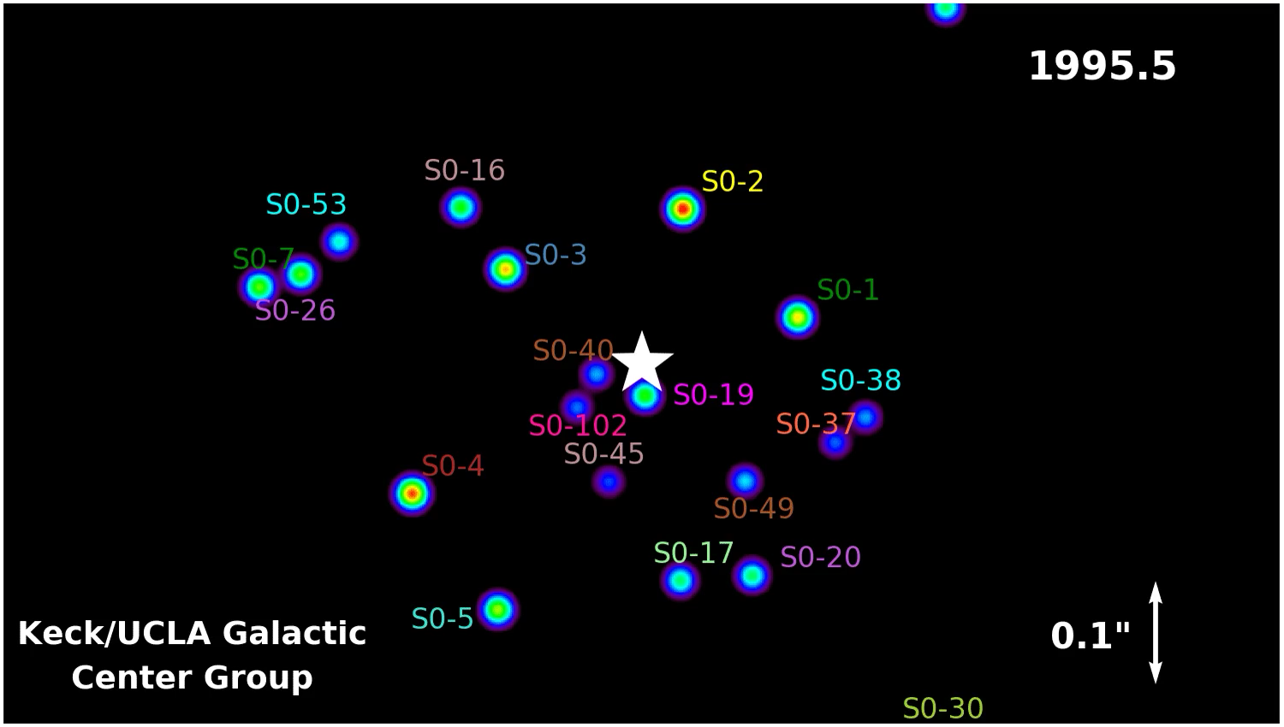
This animations was created by Prof. Andrea Ghez and her research team at UCLA and are from data sets obtained with the W. M. Keck Telescopes.

Slide 4
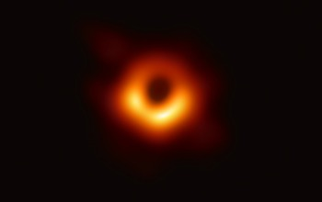
Notes:
Slides 2-3are on EHT if you want to start there, but the Director is talking about it quite a bit? Maybe use IceCube, idk

Slide 5
Notes:
S190425z Sky Map
LIGO and Virgo team members estimate that the candidate gravitational signal referred to as S190425z originated from the region outlined on the sky map. The signal likely came from two colliding neutron stars. Because only LIGO Livingston and Virgo saw the signal (LIGO Hanford was offline at the time), its localization was not very precise, covering about 18 percent of the sky. Image: LIGO/Virgo/NASA/Leo Singer (Milky Way image: Axel Mellinger)

Slide 6
What Next?
Multi-messenger astronomy contributes to our understanding of an ever-expanding invisible universe
Today’s Panel:
Dr. Sheila Rowan
Dr. Bernard Schutz
Dr. Rainer Weiss

