Slide 1



NSF Scholarships in Science, Technology, Engineering, & Mathematics (S-STEM)
Overview of Revised Solicitation
NSF 20-526
Education and Human Resources
Division of Undergraduate Education
Notes:
NSF has published a revised S-STEM solicitation, NSF 20-526 for FY20.
This powerpoint presentation highlights major changes in the new solicitation and emphasizes some important features of the S-STEM program.

Slide 2
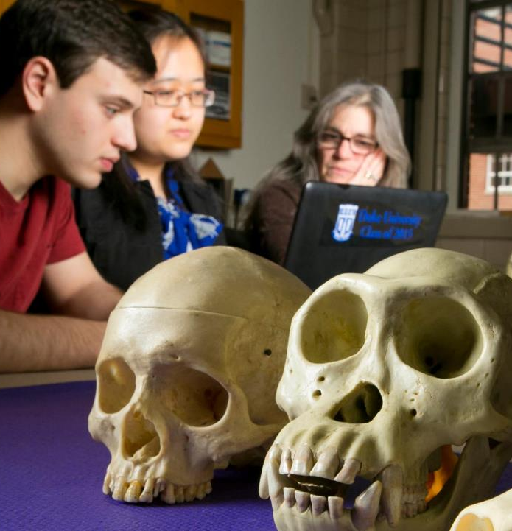
S-STEM
The S-STEM program provides Institutions of Higher Education (IHEs) with funds for scholarships to encourage and enable low-income academically talented students with demonstrated financial need to enter the workforce or graduate study following completion of associate, baccalaureate, or graduate degrees in S-STEM eligible disciplines.
Notes:
This is a congressionally mandated program that uses HI-B visa fees. The requirements for a student to receive an S-STEM scholarship are being low income, academic talent, and demonstrated financial need (only).
How can proposals promote diversity?
The student population of the school
Through recruiting applicants
But all applicants who meet the requirements should have an equal chance at getting a S- STEM scholarship

Slide 3
S-STEM Program Goals Solicitation 20-526
increase the number of low-income academically talented students with demonstrated financial need obtaining degrees in S-STEM eligible disciplines and entering the workforce or graduate programs in STEM
improve the education of future scientists, engineers, and technicians, with a focus on low-income academically talented students with demonstrated financial need
generate knowledge to advance understanding of how interventions or evidence-based curricular and co-curricular activities affect the success, retention, transfer, academic/career pathways, and graduation of low-income students in STEM
Notes:
Improve Nations STEM workforce by increasing
Number of graduates with stem degrees AS, BA, Graduate
Join and contribute to workforce
The program does this by
Providing scholarship and other support
Academically talents
Low income demonstrated financial need
We want to generate knowledge that can Inform the STEM ed community about what works, what doesn’t and why

Slide 4




Program Tracks
Institutional Capacity Building
(Track 1)
Design and Development
(Track 2)
(Track 3)
Up to $650K
Up to 5 yrs
Single
Institution
Multi-institutional
Consortia
Image courtesy of 7Crafts at FreeDigitalPhotos.net
For institutions with limited experience in implementing effective curricular and co-curricular activities
Budget, Scope, #Students, Complexity of Support Structures, Complexity of Research Questions
Up to $1M
Up to 5 yrs
Up to $5M
Up to 5 yrs
Seeks to leverage S-STEM funds with institutional efforts and infrastructure to increase and understand impacts
Deadline (All Proposals):
Last Wednesday in March, annually
Notes:
Track 1:
The institutional capacity building track is intended for institutions that have limited experience with designing and conducting NSF-funded projects -- such as the type of projects described in the other track, that is Track 2. Examples of institutions that might be appropriate applicants to S-STEM track 1 include:
Institutions who have not been funded by the NSF in the past. Or institutions with limited NSF funding.
Projects should implement and contribute knowledge about existing effective practices.
This is what is intended by institutional capacity building, providing a way for institutions with limited NSF grant experience to join the S-STEM community of practice.
Track 2:
Provide scholarships for students
Strengthen involvement of STEM faculty
Address documented institutional needs
Track 3:
Collaborate on a common interest or problem
Adapt/implement and study practices, strategies, and factors that affect student success and/or entry into STEM workforce

Slide 5
Expected Student Outcomes
Receive a degree in one of the S-STEM eligible disciplines;
Transfer from an associate to a baccalaureate degree program or from an undergraduate to a graduate program;
Enter the STEM workforce; or
Successfully overcome one or more of an institution’s self-identified attrition points

Slide 6
S-STEM activities – Flexibility needed
S-STEM projects often include activities such as
seminars,
field trips,
social activities,
student-faculty interaction outside classes
These activities may not be required.
Activities should be designed so that students who have other responsibilities can reasonably participate and reasonable absences are allowed.
Notes:
Use caution when making activities required.
In addition to scholarships for low-income academically talented students with demonstrated financial need, S-STEM projects often include activities such as seminars, field trips, social activities, student-faculty interaction outside classes, and other enrichment activities. These are valuable parts of programs. These activities may be required, as part of the scholarship program, but the requirements should be designed so that students who have other responsibilities can reasonably participate, and the requirements should be flexible enough to allow reasonable absences.

Slide 7
Student Eligibility Criteria
Low-income
The definition of low-income must be determined systematically by the institution’s financial aid office and should be applicable to the S-STEM project or any other federally-funded project that requires a definition of low-income.
Reasonable definitions include those cited for eligibility for the federal Pell grant: https://www2.ed.gov/programs/fpg/index.html
and TRIO grants
https://www2.ed.gov/about/offices/list/ope/trio/index.html
programs, but other definitions applied consistently are also possible when well justified.
Notes:
Eligibility for Pell grant (only undergraduate students):
Determined by submitting the Free Application for Federal Student Aid (FAFSA) form.
Eligibility for TRIOS grants:
The term "low-income individual" means an individual whose family's taxable income for the preceding year did not exceed 150 percent of the poverty level amount.
The poverty level amount is a function of State (Alaska and Hawaii have uniquely higher income levels) and size of family unit.

Slide 8
Student Eligibility Criteria
Academic talent
This is defined by the institution and often involves a GPA cut-off.
Projects should include plans for student probationary status and additional support if a student’s GPA falls below the set level for some period of time.
Notes:
Don’t set the GPA bar too low (e.g. 2.0 – hard to defend this as evidence of academic talent) and don’t set it too high (e.g. 3.75 you could severely limit the applicant pool).
Whatever you choose, explain the rationale for your choice.

Slide 9
Student Eligibility Criteria
Unmet financial need
Unmet financial need depends on the cost of attendance and the estimated family/student financial contribution.
The institution determines the cost of attendance.
The expected family/student contribution is defined for undergraduate students by the U.S. Department of Education rules for need-based Federal financial aid Free Application for Federal Student Aid (FAFSA), or, for graduate students, defined as financial eligibility for Graduate Assistance in Areas of National Need (GAANN).
Notes:
FAFSA: https://studentaid.ed.gov/sa/fafsa
GAANN: https://www2.ed.gov/programs/gaann/index.html

Slide 10
NSF 20-526 Solicitation: Changes
Clarification of S-STEM eligible degrees/disciplines.
Students must be enrolled at least half-time.
All proposals must include supplementary documentation about scholarships and names of degrees.
Guidance for requests for supplemental funding.
The requirement of a third-year review now only applies to Track 3 projects.
Notes:
Significant changes in the new solicitation include:
S-STEM eligible degrees and disciplines have been more clearly defined.
Business School degrees are explicitly noted as being ineligible.
PIs interested in requesting supplemental funding are encouraged to:
a. Contact their cognizant PO before submission to discuss the request
b. Reminded to follow the PAPPG guidelines for submitting requests for supplemental funding

Slide 11
NSF 20-526 Solicitation: Changes
Clarification of S-STEM eligible degrees/disciplines.
Students must be enrolled at least half-time.
All proposals must include supplementary documentation about scholarships and names of degrees.
Guidance for requests for supplemental funding.
The requirement of a third-year review now only applies to Track 3 projects.

Slide 12
Eligible degrees
Associate of
Arts
Science
Applied Science
Bachelor of
Arts
Science
Applied Science
Master of
Arts
Science
Doctoral
Notes:
Proposers are strongly encouraged to contact Program Officers before submitting a proposal if they have questions concerning degree eligibility.

Slide 13
Ineligible degrees/programs
Programs in business schools that lead to Bachelor of Arts or Science in Business Administration degrees (BABA/BSBA) are not eligible for S-STEM funding.

Slide 14
Eligible disciplines
Biological sciences (except medicine and other clinical fields)
Physical sciences (including physics, chemistry, astronomy, and materials science)
Mathematical sciences
Computer and information sciences
Geosciences
Engineering
Technology fields associated with the disciplines above (e.g. biotechnology, chemical technology, engineering technology, information technology)
Notes:
Proposers are strongly encouraged to contact Program Officers before submitting a proposal if they have questions concerning discipline eligibility.

Slide 15
NSF 20-526 Solicitation: Changes
Clarification of S-STEM eligible degrees/disciplines.
Students must be enrolled at least half-time.
All proposals must include supplementary documentation about scholarships and names of degrees.
Guidance for requests for supplemental funding.
The requirement of a third-year review now only applies to Track 3 projects.

Slide 16
Enrollment status
Students must be enrolled at least half-time, as defined by the institution.
NSF does not provide individual guidance regarding this definition.

Slide 17
NSF 20-526 Solicitation: Changes
Clarification of S-STEM eligible degrees/disciplines.
Students must be enrolled at least half-time.
All proposals must include supplementary documentation about scholarships and names of degrees.
Guidance for requests for supplemental funding.
The requirement of a third-year review now only applies to Track 3 projects.

Slide 18
Example of Required Supplementary Documentation
Scholarship Information
Name of institution | Sample University
Anticipated number of unique scholars supported | 25
Anticipated amount of each scholarship | $2,500 - $8,500
Anticipated number of years of scholarship support per scholar | 4
Degree Information
Degree Name and Discipline
Bachelor of Science in Biology
Bachelor of Arts in Biology
Bachelor of Science in Biotechnology
Notes:
This information must be submitted in the “Supplementary Documents” part of the proposal.
For multi-institution projects, this information must be submitted for each institution.

Slide 19
NSF 20-526 Solicitation: Changes
Clarification of S-STEM eligible degrees/disciplines.
Students must be enrolled at least half-time.
All proposals must include supplementary documentation about scholarships and names of degrees.
Guidance for requests for supplemental funding.
The requirement of a third-year review now only applies to Track 3 projects.

Slide 20
Requests for supplemental funding
PIs interested in submitting a request for supplemental funding should
contact their cognizant program officer before
submission to discuss the proposal idea, and
follow the guidelines for supplemental funding requests for existing awards in the PAPPG.

Slide 21
NSF 20-526 Solicitation: Changes
Clarification of S-STEM eligible degrees/disciplines.
Students must be enrolled at least half-time.
All proposals must include supplementary documentation about scholarships and names of degrees.
Guidance for requests for supplemental funding.
The requirement of a third-year review now only applies to Track 3 projects.

Slide 22
Track 3 third-year review requirements
Track 3 projects will be reviewed during their third year to determine whether satisfactory progress has been made, with continued funding contingent on the result of the third-year review.
Project teams present information on the status of project activities and outcomes to date.
A team of S-STEM staff review project documentation, acknowledge accomplishments, discuss shortcomings, and make recommendations to improve project implementation as appropriate.

Slide 23
Thank you!
NSF 20-526 https://www.nsf.gov/funding/pgm_summ.jsp?pims_id=5257
Education and Human Resources
Division of Undergraduate Education
Notes:
https://www.nsf.gov/funding/pgm_summ.jsp?pims_id=5257

