Slide 1


Atmospheric and Geospace Sciences
(AGS)
Please submit questions via
the Q&A button
Please set to
“Send anonymously”
This presentation is being recorded
DG
We will begin soon
AGS Virtual Office Hour
Topic: COVID-19 related Impacts

Slide 2

AGS
Virtual Office Hour
Topic: COVID-19 related Impacts
Welcome and Introductions
Brief Discussion of Guidance
Question and Answer Period

Slide 3
AGS Virtual Office Hour – Welcome!
  Panelists (DGA staff highlighted in yellow):
    Anjuli Bamzai – Division Director, Atmospheric and Geospace Sciences abamzai@nsf.gov
Sarah Ruth – Section Head, NCAR & Facilities sruth@nsf.gov
Mike Wiltberger- Section Head, Geospace Section mwiltberg@nsf.gov
Nick Anderson – Acting Section Head, Atmosphere Section nanderso@nsf.gov
Tracy Rozell – Program Support Manager trozell@nsf.gov
Joe Kittle – Division of Grants and Agreements jkittle@nsf.gov
Willie Mae Powell – Division of Grants and Agreements wpowell@nsf.gov
Meredith Whitty – Division of Grants and Agreements mwhitty@nsf.gov
Pam Hawkins – Division of Grants and Agreements pahawkin@nsf.gov
    Manda Adams – Program Director, Education and Cross-cutting Activities amadams@nsf.gov
Shree Mishra – Program Director, Lower Atmosphere Obs. Facilities sumishra@nsf.gov
Lisa Winter– Program Director, Magnetospheric Physics lwinter@nsf.gov
Notes:
Thursday

Slide 4
AGS Virtual Office Hour – Welcome!
  Panelists (cont.):
    Mangala Sharma – Program Director, Space Weather Research msharma@nsf.gov
Alan Liu – Program Director, Aeronomy zhualiu@nsf.gov
Soumaya Belmecheri – Program Director, Paleoclimate sbelmech@nsf.gov
Dave Verardo – Program Director, Paleoclimate dverardo@nsf.gov
Eric Deweaver – Program Director, Climate and Large-scale Dynamics edeweave@nsf.gov
Var Limpasuvan – Program Director, Climate and Large-scale Dynamics vlimpasu@nsf.gov
Sylvia Edgerton – Program Director, Atmospheric Chemistry sedgerto@nsf.gov
Anne Johansen – Program Director, Atmospheric Chemistry ajohanse@nsf.gov
Chungu Lu – Program Director, Physical and Dynamic Meteorology clu@nsf.gov
Jielun Sun – Program Director, Physical and Dynamic Meteorology jsun@nsf.gov
Facilitator: Helena Fountain – Program Specialist hfountai@nsf.gov
Notes:
Thursday

Slide 5
AGS Virtual Office Hour
Thank you for providing some initial topics for discussion. We will try to cover the most common topics in the FAQs at the end of this presentation.
After our short presentation, please submit your questions and comments via the Q&A button on your screen and set to “Send anonymously”

Slide 6
Update from the
Division of Grants and Agreements (DGA)

Slide 7
It is a challenging time
Sudden transition to 100% online teaching and research
Lab closures
Travel restrictions
Cancelled conferences
Impediments to training and education
Time spent in COVID-related campus-wide planning
Uncertainty about summer plans
Family care responsibilities

Slide 8
At NSF, we are open for business (virtually)
AGS staff are on duty and available to the community.
AGS is currently continuing to review your proposals
Some AGS programs are holding virtual panels.
AGS has (almost) no proposal deadlines and welcomes submissions at any time.
We are continuing to assess the impacts of COVID-19 on the 20/21 field campaigns and access to facilities.

Slide 9
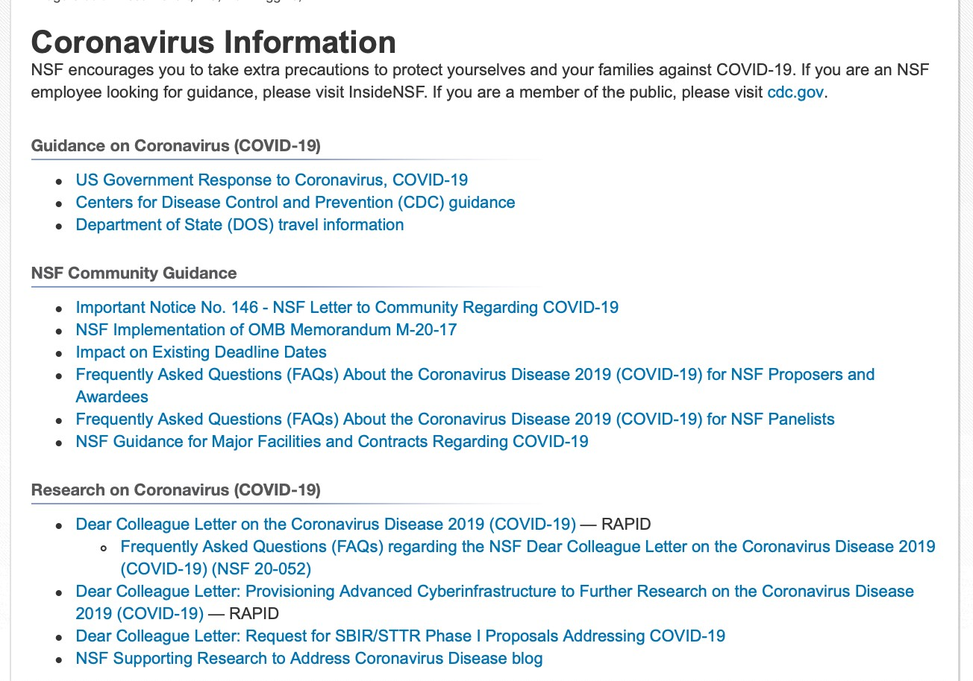
https://www.nsf.gov/news/special_reports/coronavirus/

Slide 10
Status of field campaigns and requests for projects using deployable AGS facilities
Funded projects – Most of the 2020 field campaigns have been postponed. Those that are climatologically-dependent will be planned for the same time period in 2021. Funded projects will have scheduling priority.
Requested projects – NSF is currently reviewing a set of requests, mostly for 2021 field activities. Depending on the outcome of the reviews and the availability of resources, some of these may be able to go in their requested time slot, while others will be asked to move to 2022.
Future projects – Pending the decisions on the proposals in-hand and facility availability, NSF may choose to put a temporary moratorium on field campaign Letters of Interest for 2022 field activities to allow a potential backlog to subside.

Slide 11

Current awardees: short and long-term planning
Login to Research.gov
  Check your report due dates
  Check your project end dates
  Find your managing Program Officer for each grant
Think about your project(s) and your goals
  Check your grant balances, make plans as best you can for the next few months
  If you see a need for supplemental funding to accomplish the original proposal goals, please contact your Program Officer

Slide 12
Current awardees: No-Cost Extensions (NCE)
Grantee approved NCE
  Extends award for 1 year without NSF.
  Submit request at least 10 days prior to award expiration date.
A second NCE can be requested
  Requires NSF approval
  SRO submits request via Research.gov
Do not include budget reallocation or change of scope with NCE

Slide 13
Current awardees: Additional flexibility in spending
We are committed to providing the greatest available flexibilities to support your health and safety as well as your work.
Many details are available in a memo from March 23, 2020
  Search “NSF OMB Implementation”
Flexibility in spending for salaries, reporting, charging cancelled travel, procurement requirements, closeout, etc.
Document, document, document! Institutions will need to maintain appropriate records and cost documentation.

Slide 14
FAQs NSF Proposers and Awardees
Cancelled conference: contact your Program Officer about changes to your plans.
Future/proposed conference: consider contingency plans.
Deadlines: For upcoming proposal deadlines, check Impact on Existing Deadlines .
NSF will consider extensions on a case by case basis. Contact the Program Officer.
Merit Review: NSF will continue to review proposals using ad hoc reviews and virtual panels, enabling the agency to maintain a high-quality and timely merit review process.
Access to funds: no interruption expected.
Site visits: NSF staff is not authorized to travel until at least May 29. Planned site visits during this period may be done via videoconferencing or moved to a later date.

Slide 15
FAQs on Budgets
Is there potential stimulus funding? Yes, $75M was allocated for research and education from the CARES Act (P.L. 116-136) “to prevent, prepare for, and respond to coronavirus”. Please see the Dear Colleague Letter on COVID-19 for further information (NSF 20-052)
What is the current budget status? NSF has received the full Fiscal Year appropriation for FY20 and the programs have the full amounts expected.
What is the outlook for funding in FY21 and beyond? We have no special insight into the future funding outlook beyond the President’s Budget Request.

Slide 16
FAQs on Proposals and Solicitations
Are there impacts on proposal submissions/deadlines?
  Most AGS programs do not have deadlines and are operating as usual. This includes the AGS Postdoctoral Research Fellowship (PRF). Please submit when your proposal is ready.
  For solicitations with deadlines, please see the COVID-19 page on the NSF website to see if the dates have changed. Currently, the CAREER program deadlines are not affected
  https://www.nsf.gov/bfa/dias/policy/covid19/covid19_deadlines.pdf
  Proposal processing times have not significantly changed. It is NSF’s goal to complete the merit review process within 6 months, but there are sometimes (other!) extenuating circumstances.

Slide 17
FAQs on Current Awards
What if my research is delayed? NSF provides the option for No-Cost Extensions.
Does NSF have any advice on whether to delay or cancel an activity due to COVID-19? NSF defers decisions on whether to delay or cancel an activity to the PI and Institution. We will try to provide as much flexibility as possible through no-cost extensions, re-budgeting, and supplements.
What if COVID-19 related delays result in extra costs? Please contact your program officer. NSF provides broad authority to institutions to re-budget within the existing award. Supplements are also possible.

Slide 18
Other FAQs
How to handle cancelled, non-refundable travel expenses? (DGA)
How are facilities maintaining data and observations? (Sarah Ruth)
What are the plans for post COVID-19 recovery? (Mike Wiltberger)
What is the guidance for current or upcoming REU Site PIs? (Manda Adams)

Slide 19
NSF AGS Virtual Office Hour
Questions, Comments and/or Concerns
Please share concerns, ask questions, or offer your suggestions on how NSF can better help address this national emergency.
Slides will be available on AGS Homepage.
For specific questions about your project, please contact your Program Director.
Submit your questions via the Q&A button on your screen and
set to “Send anonymously”.

Slide 20
BACKUP Slides

Slide 21
Call for RAPID proposals
NSF 20-052: Dear Colleague Letter on the Coronavirus Disease 2019 (COVID-19)
“Proposals to conduct non-medical, non-clinical-care research that can be used immediately to explore how to model and understand the spread of COVID-19, to inform and educate about the science of virus transmission and prevention, and to encourage the development of processes and actions to address this global challenge”
RAPID proposals may be for up to $200K and up to one year in duration
Email inquiry first to rapid-covid19@nsf.gov

Slide 22
REU, RET, and IRES Sites
Summer 2020:
  Grantees responsible for making decisions.
  Cancellation: contact Program Officer about potential for no-cost extension, cancellation fees may be charged to award.
  Restructuring: contact Program Officer about options, may need to submit “Changes in Objective or Scope.”
  Annual project reports due between March 1 and April 30, 2020 extended by 30 days.
  Student support: may continue to provide stipends and benefits.
Ill student:
  NSF defers to awardees to follow organizational policies.
  Recipients who incur costs related to the cancellation or pausing and restarting of activities are authorized to charge these costs to their award.
Virtual participation: Contact Program Officer with questions about supplemental funding and original scope.

Slide 23
NSF Guidance for Major Facilities and Contracts
Decisions should be made by managing organizations in consultation with medical/government authorities.
Response plans: safety of people comes first; safety and security of facility is critical.
International travel: consult the State Department Travel Advisories website.
Additional COVID-19-related costs: document carefully.
Allowable costs and performance/operational issues: contact your Program Officer and G/AO or the COR and CO as well as copying COVID19_DAS@nsf.gov

