Slide 1
Challenges and Pathways to Sustainability in Scientific Software Ecosystems
James Howison
University of Texas at Austin
School of Information
NSF CISE Distinguished Lecture
14 January 2021
This material is based upon work supported by the US National Science Foundation under Grant Nos. SMA- 1064209 (SciSIP), OCI-0943168 (VOSS) and ACI-145348 (CAREER).

Slide 2
My big question:
How does working on things made out of digital information change the way we collectively work?
Notes:
Going to explore two different affordances of software that are related to its nature as being made of information:

Slide 3

Affordance 1: Reuse
Digital information can be copied
  High design costs
  Ultra-low instantiation costs
  Cheap network distribution
Implications:
  “Write once, run anywhere”
  Think of software as an artifact
  Everyone gets a car!
Notes:
“Everyone gets a car!”

Slide 4
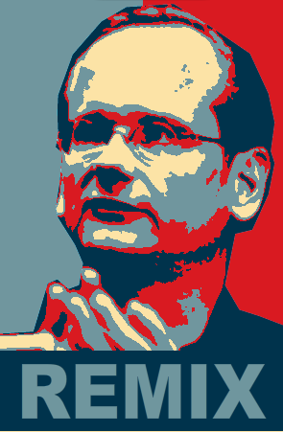
Affordance 2: Recombination
Digital information is very flexible
  Patched
  Wrapped
  Extended
  Recombined
Re-combinability is great for innovation
  Lots of new ways to do things
  But a sting in the tail?
  Software as an activity
https://www.flickr.com/photos/44551921@N04/
Schumpeter, Ethiraj and Levinthal, Baldwin and Clarke
Notes:
Archer points this out in his Chpt 5 – the progress of science is an exogenous (or structurationally linked) cause of change or pertubation in the system. He draws on Hughes “reverse salients”, points that hold back the progress of the system as a whole. The workflow idea is well understood in studies of science software (e.g., Dennis and Loft).

Slide 5

Sustainability: the condition that results when the work needed to keep software scientifically useful is undertaken
https://www.flickr.com/photos/kitch/5179039214

Slide 6
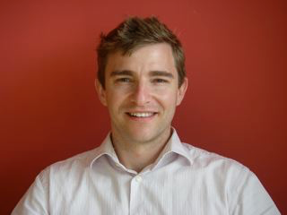
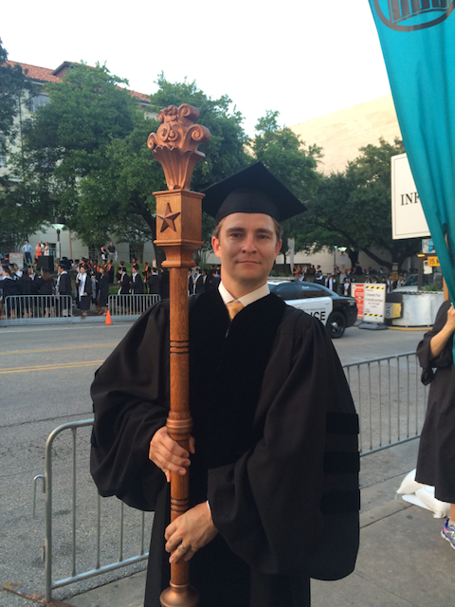
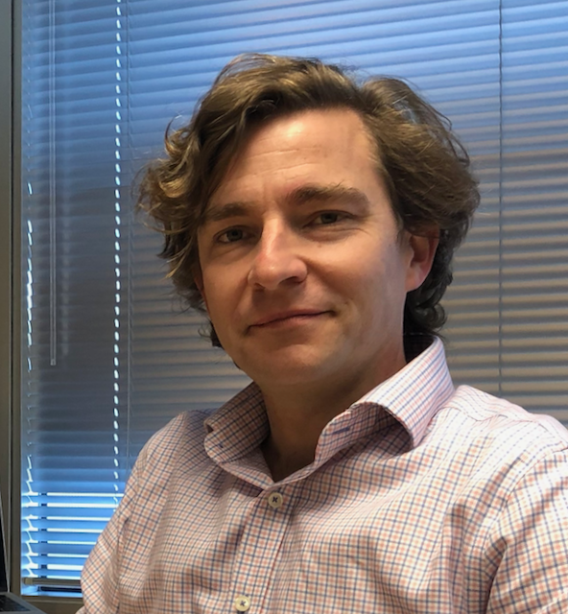
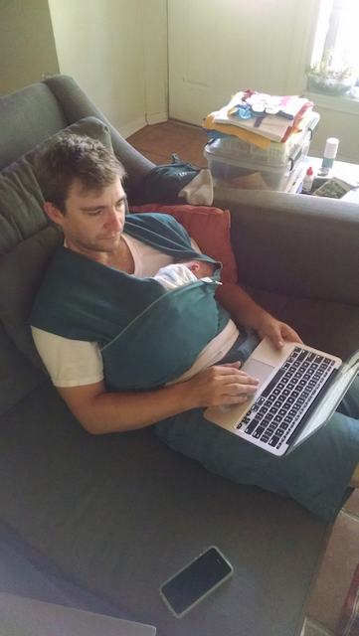
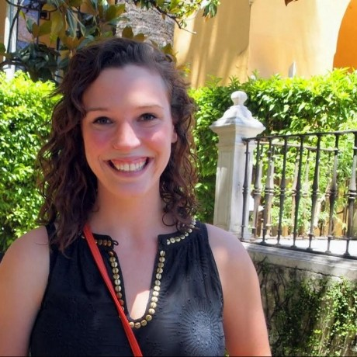
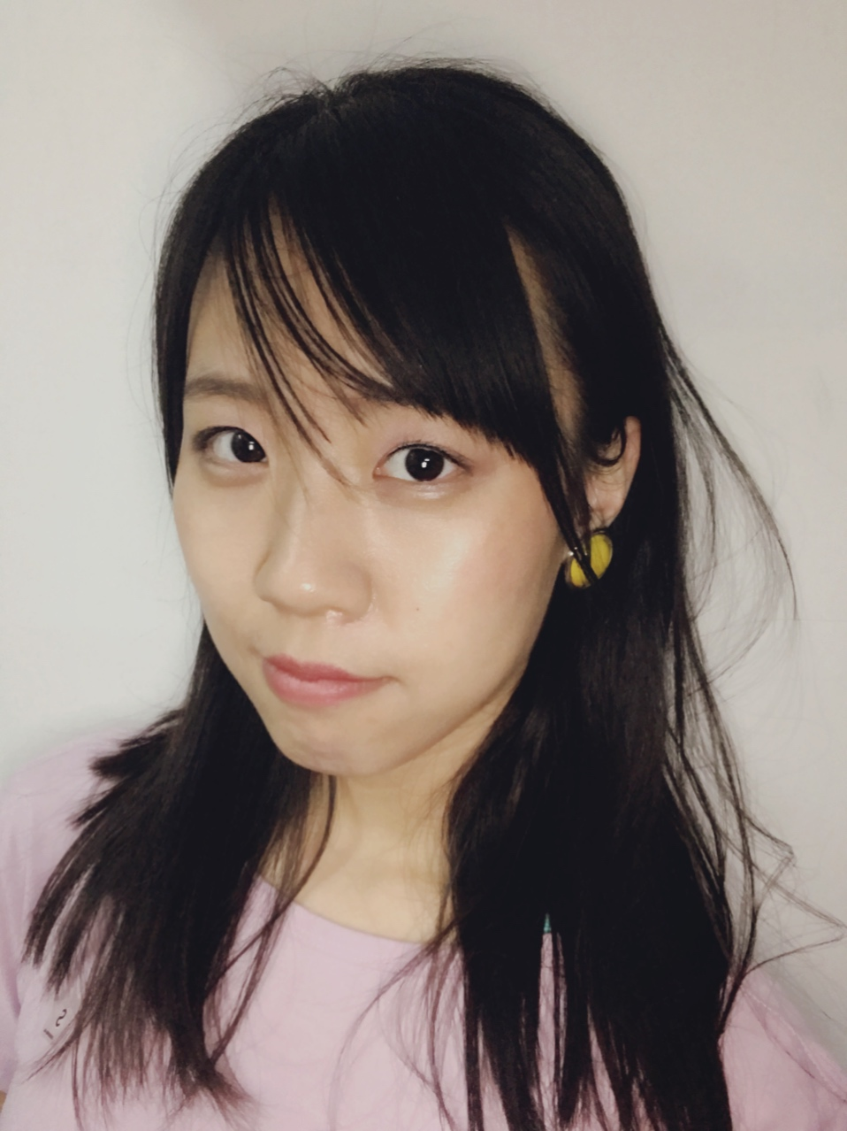
About me
Came from Australia for a PhD at Syracuse University Information School (with Kevin Crowston)
  An undergrad in economics ("Making the (cyber)world safe for capitalism"), masters study in software engineering
  A brief stint in Thailand doing old school distance education on “community management” with refugees from Burma
Postdoc at Carnegie Mellon (with Jim Herbsleb) starting study of scientific software
Formative experiences at the Consortium for the science of socio-technical systems (CSST) (Steve Sawyer, Wayne Ludders, Tom Finholt)
Inspired by those studying at intersection of science and technology studies (STS) and scholarly communication, esp. Paul Edwards, David Ribes, Janet Vertesi, and Christine Borgman. And in organization science Carliss Baldwin and Diane Bailey.
Now Associate Prof at the School of Information at University of Texas at Austin, married with a kiddo at home in the pandemic.
Grateful for a much support from NSF (VOSS, SciSIP, OCI CAREER and PECASE), with great Project Officers (Susan Winter, Sushil Prasad, and Alan Sussman)
Trying to “pay it forward” through CSST, hosting a CI-Fellow, citeas.org and softcite-dataset and work with wonderful doctoral students (Eunyoung Moon, Julia Bullard, Nick Gottschlich, Hannah Cohoon, and Caifan Du).
Notes:
Born in Uk, grew up in Australia. Undergrad at University of Sydney in economics as a social science from 1994-98, just as the internet arrived, discovering a world of people interacting and working together differently. I think the internet saved me from a career as a documentary film maker. I ended up writing an honors thesis on the political economy of the internet called "Making the (cyber)world safe for capitalism", briefly worked in consulting before a year in Thailand working with Burmese refugees (old school distance education with paper and pen workbooks!), brief stint with a non-profit working on internet policy with APEC.
In 2002 I found unread books piling higher than my bed and, like many, looked to the US for doctoral study, pleasantly surprised to discover financial support for a PhD at Syracuse University. Started hoping to study the connection between non-profits and open source, thinking that open source was altruistic and that non-profits needed tech help. Like so many I chopped that topic in half and in half again, connecting with Kevin Crowston who (with Hala Annabi) had just won a grant from the NSF via a pre-cursor of the CISE VOSS program. Priviledged to study the sources of success with Kevin, leading to my dissertation about the organization of community-led open source (which I'll talk briefly about later).
As I finished up at Syracuse I had the good fortune to hear that Jim Herbsleb at CMU was looking for a postdoc for network studies of open source (also funded by the NSF). Had a wonderful, formative, three years at CMU benefiting from the environment and mentorship. Jim and I were asking ourselves, "what's like open source but slightly different" we considered studying open hardware and robotics in Pittsburgh, and were fortunate to have a VOSS grant funded (with stimulus money as I recall) to study scientists building software. Jim introduced me to the ACM CSCW world and I was able to attend the very first CSST summer camp, again funded by NSF and organized by Wayne Lutters and Steve Sawyer (among many others). (btw, I was all set to host the 11th or 12th CSST in 2020, but we hope to get that going in person in late 2021.)
In 2011 I diverted from a flight back from CSCW in China for a job talk at Texas, where I opened with the much practiced line "How do you turn a cubic kilometer of ice into a scientific paper?" building out the answer "With a whole lot of software". With mentorship from Susan Winter, Diane Bailey, and Andrew Dillon I thrived, being able to advance the work I present today through an NSF CAREER award funded through CISE (thanks to all the program officers, including Sushil Prasad and Alan Sussman). I
It has been a great priviledge to try to give back to the community of researchers building software, through systematic data collection and theoretical models/vocabulary and reasoning that help experienced practicioners recapitulate their experience. Keynotes at ..., participation in the URSSI workshops, and bringing together org science researchers with cyberinfrastructure practicioners in an RCN with John King and Nick Berente. Thanks to all who have given me time, listened, and critiqued the work.

Slide 7
Four Parts
Images of open source peer production & software in science
Why is sustainability difficult for software in science?
Routes to sustainability via peer production
Incentivizing sustainable ecosystems
Notes:
Starting 10:05. (+5:00)

Slide 8
Part 1: Images of software work
An Image of work open source peer production
An Image of work in scientific software
Notes:
Starting: +5 (10:05)

Slide 9
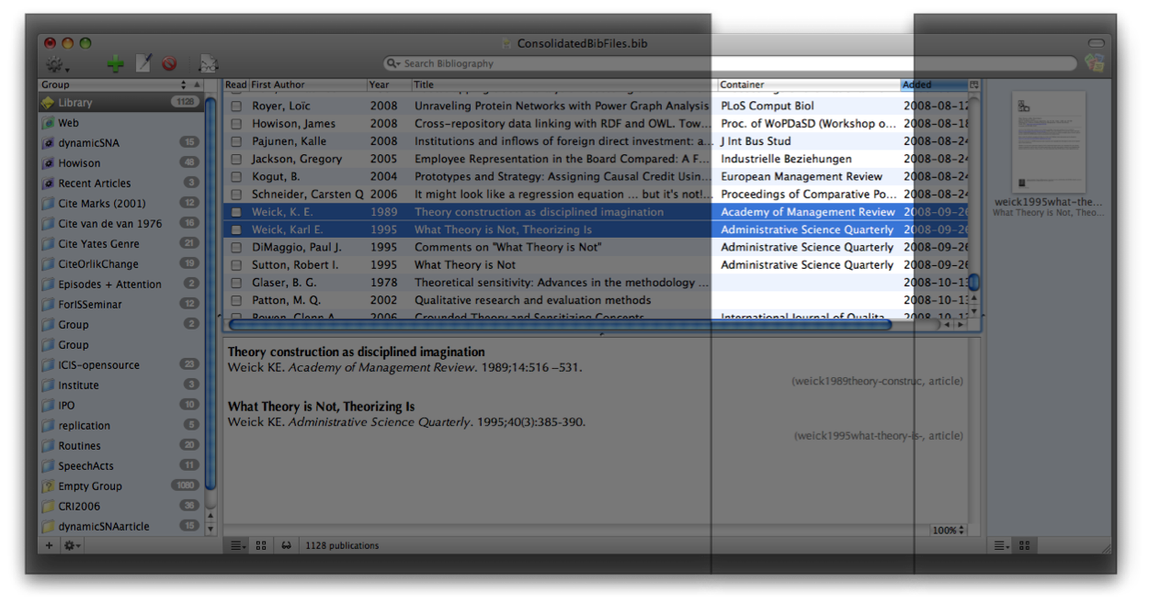
Task: The Container Column

Slide 10
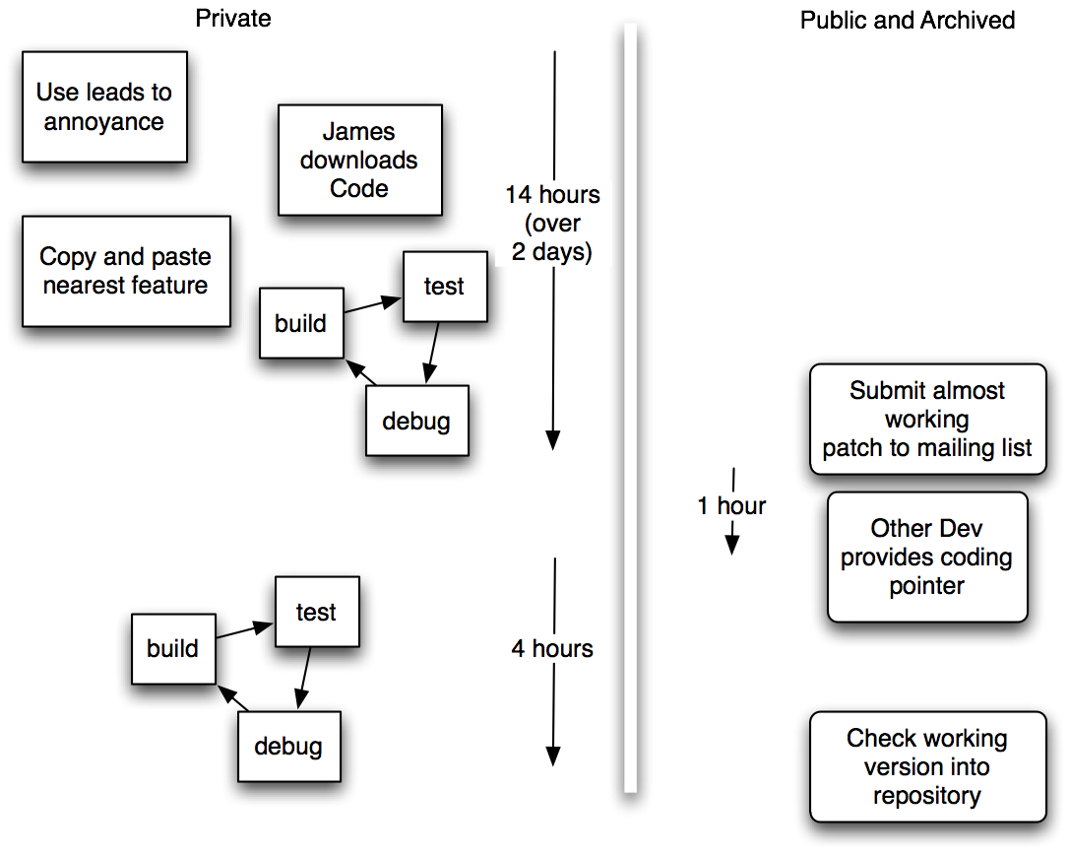
How it was built
Notes:
Tasks tended to be primarily undertaken by an individual programmer in a relatively short period of time at the developer’s own behest, motivation, and timing. Point of this is to show how work typically gets done. To give a narrative image of Solo Work.

Slide 11
Task: “Web Groups” 1
June 2003 (Email)
I really want to use this, but the conditions have never quite been right - either I was waiting for … RSS+RDF (now looks like it'll never happen) or … an XML bibliographic file format … (could happen now, but I ran out of free time).
https://sourceforge.net/mailarchive/message.php?msg_id=DF0FB757-56BA-45D7-A1EA-262EB7A5B3DC@mac.com
Notes:
The founder emphasized that the task had become “much easier” in the intervening years because of the incremental layered work of other developers; work undertaken for other features that just happened to also support Web Groups. The work taken while the task was languishing had prepared the ground so that a developer working alone in a matter of days could complete a feature that earlier had been too much work to even begin.

Slide 12
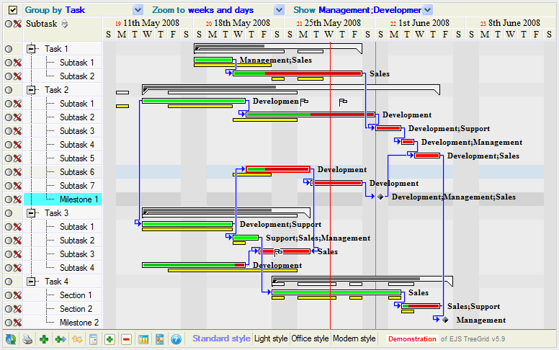
What didn’t happen
Image Credit:
TreeGrid.com marketing materials
Notes:
They didn’t break the task down into components, assign them to people and bring things back together in the end.

Slide 13
Task: “Web Groups” 2
June 2003 (Email)
I really want to use this, but the conditions have never quite been right - either I was waiting for … RSS+RDF (now looks like it'll never happen) or … an XML bibliographic file format … (could happen now, but I ran out of free time).
Jan 2007 (Email with patch):
It was much easier than I expected it to be because the existing groups code (and search groups code) was very easy to extend. Kudos - I wouldn't have tried it if so much hadn't already been solved well.
Thanks!
https://sourceforge.net/mailarchive/message.php?msg_id=DF0FB757-56BA-45D7-A1EA-262EB7A5B3DC@mac.com
https://sourceforge.net/mailarchive/message.php?msg_name=7394DD78-A02E-11D7-AFC1-0003931E45D0%40mac.com

Slide 14
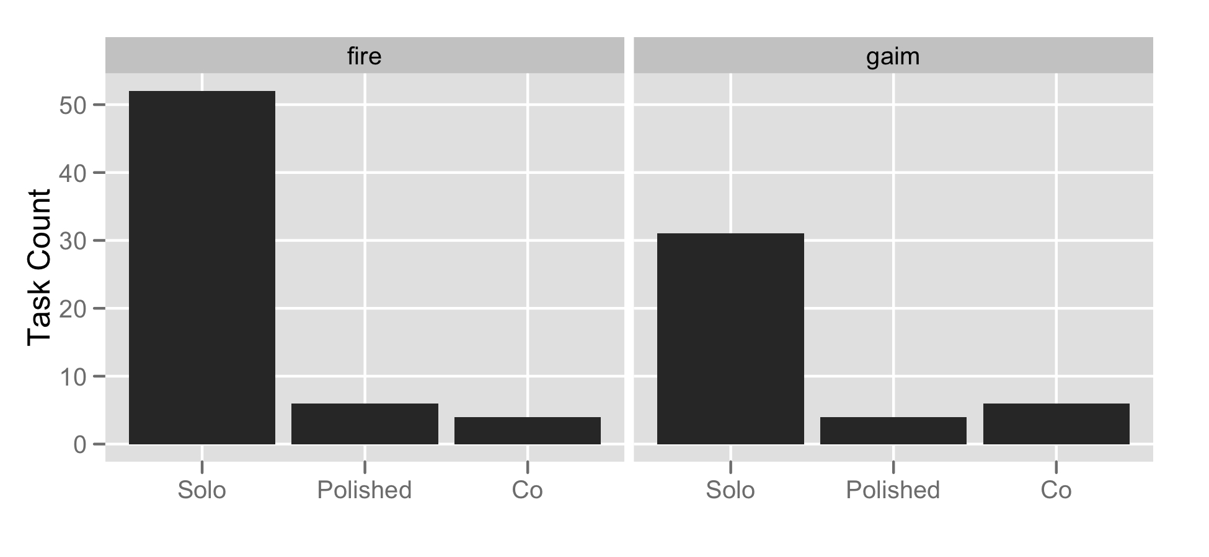
Tasks were individual
Notes:
This plus Illustrations: 5 minutes

Slide 15
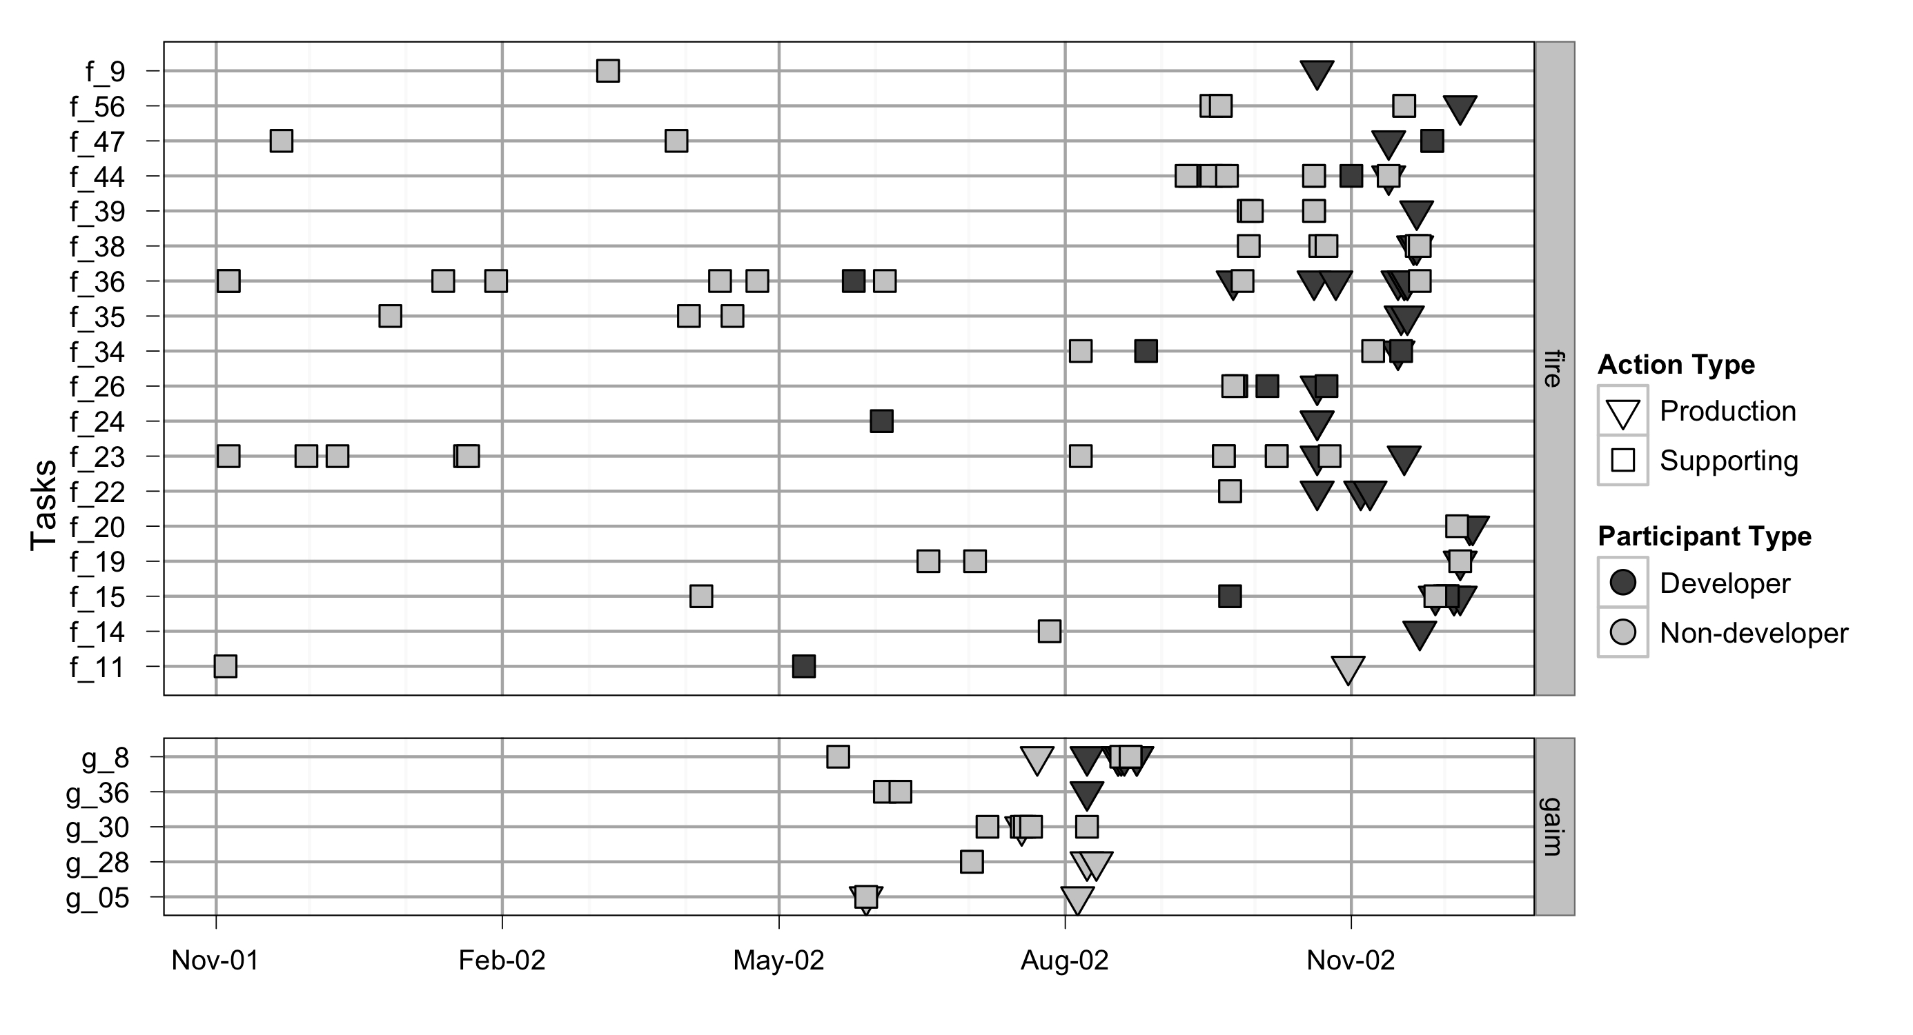
Tasks were deferred until quickly possible

Slide 16
An image of FLOSS production:
Open Superposition
Work is done in Tasks that are
  Individual
  Short
  Layered
Complex work is often deferred
  Until it is easier (doesn’t always happen!)
Other types of work build on this base
Notes:
End of Slide Timing: 20

Slide 17
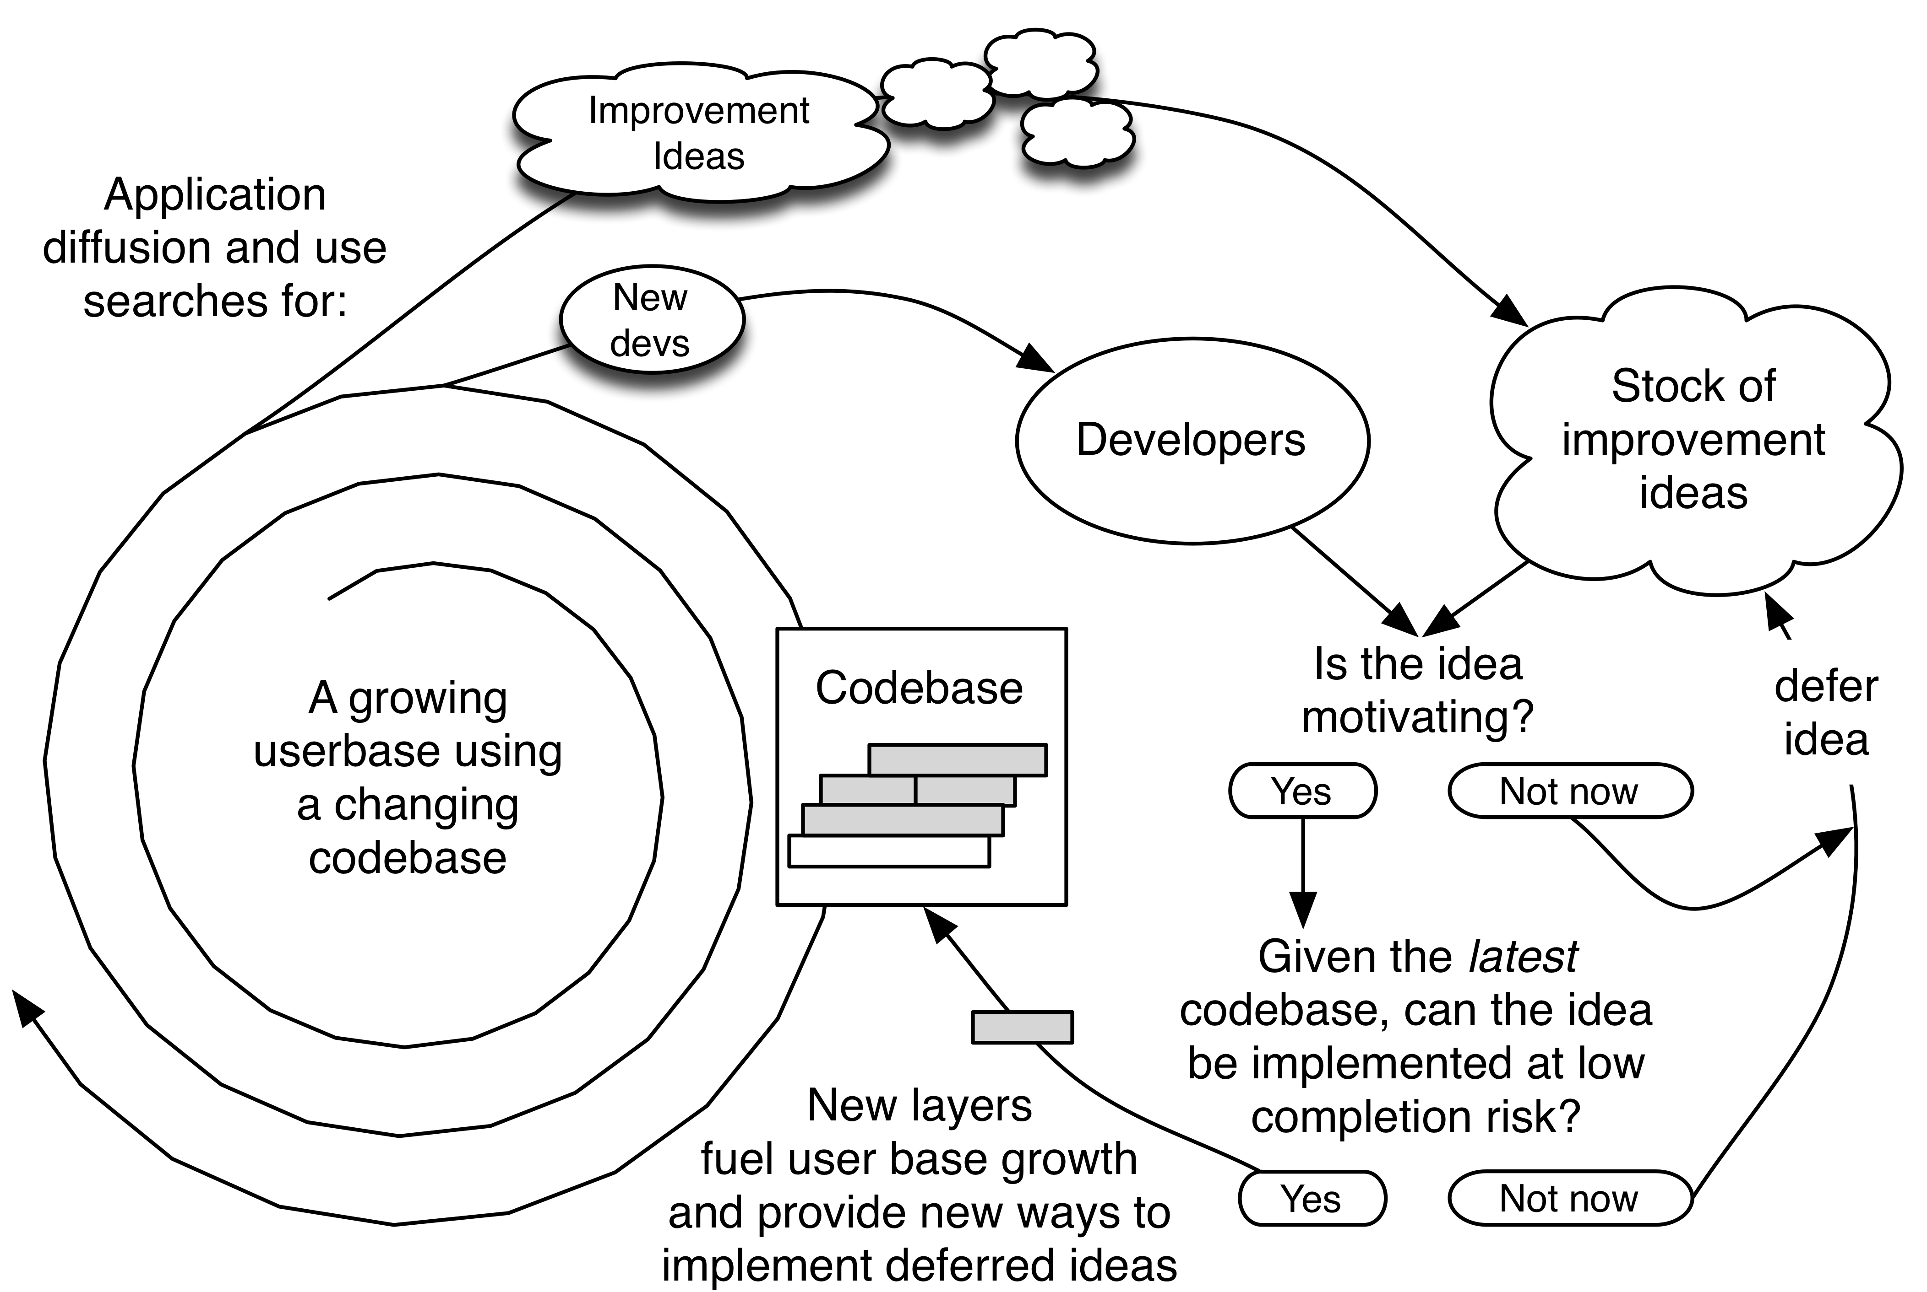
Diagram of the theory of open source
Howison, J., & Crowston, K. (2014). Collaboration through open superposition: A theory of the open source way. MIS Quarterly, 38(1), 29–50.

Slide 18
An Image of scientific software work

Slide 19
How does a a cubic km of ice become a scientific paper?

Slide 20

First find some ice
Image Credit: NASA

Slide 21
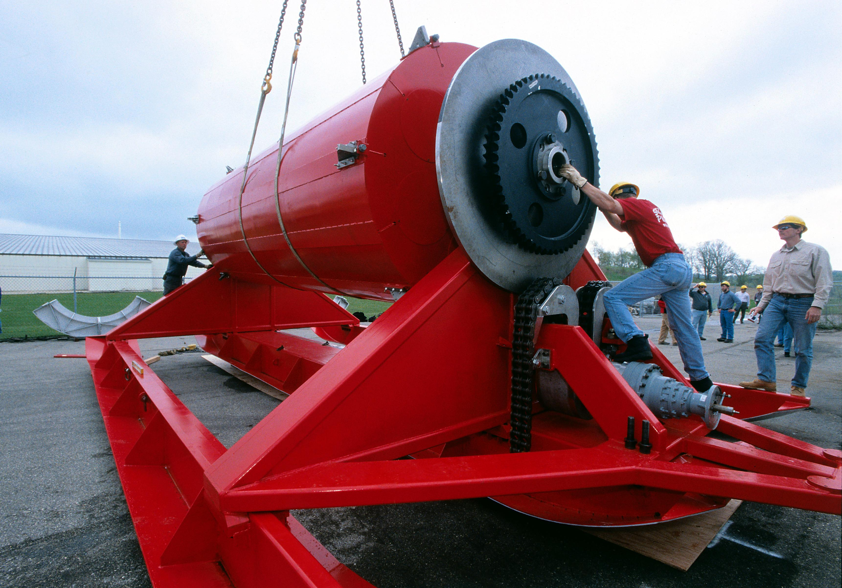
Build a big drill
Image Credit: IceCube

Slide 22
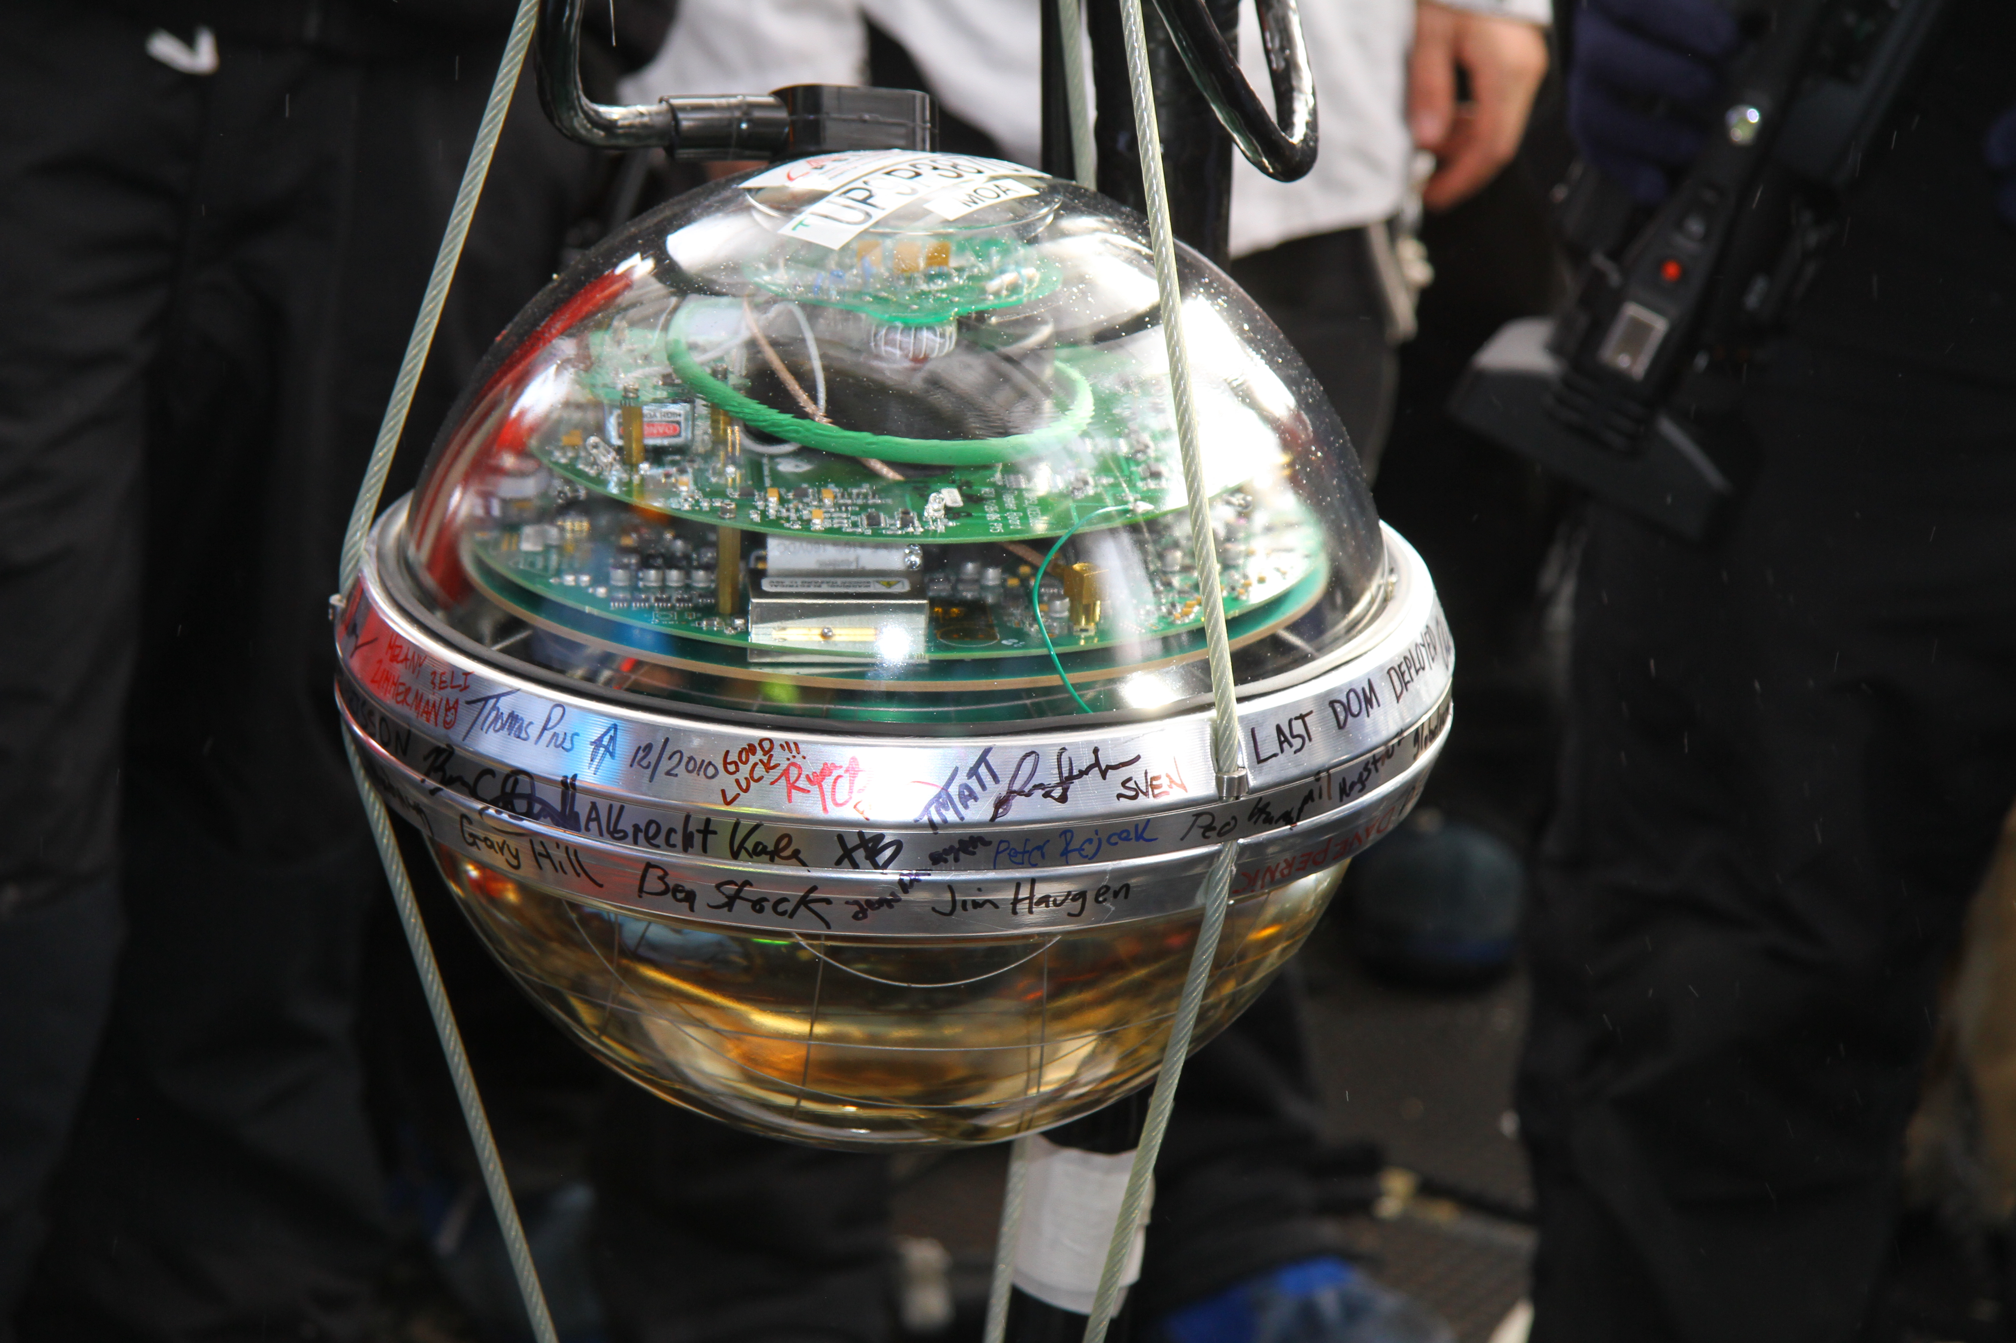
and some Digital Optical Modules
Image Credit: IceCube

Slide 23
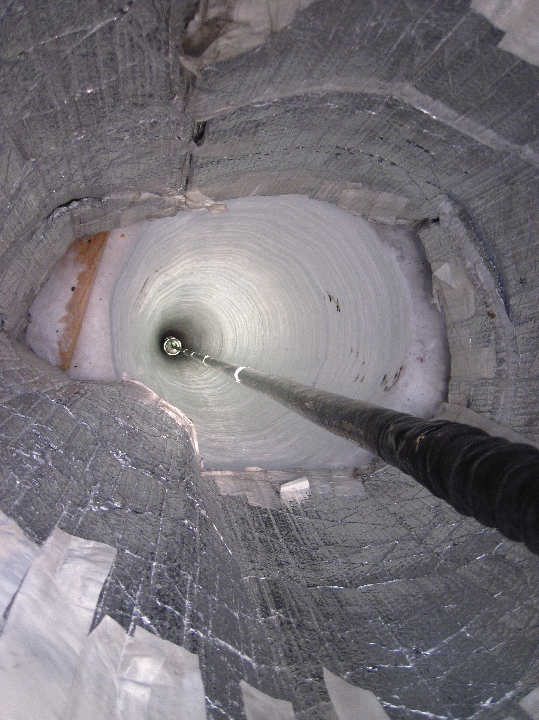
Combine
Image Credit: IceCube

Slide 24
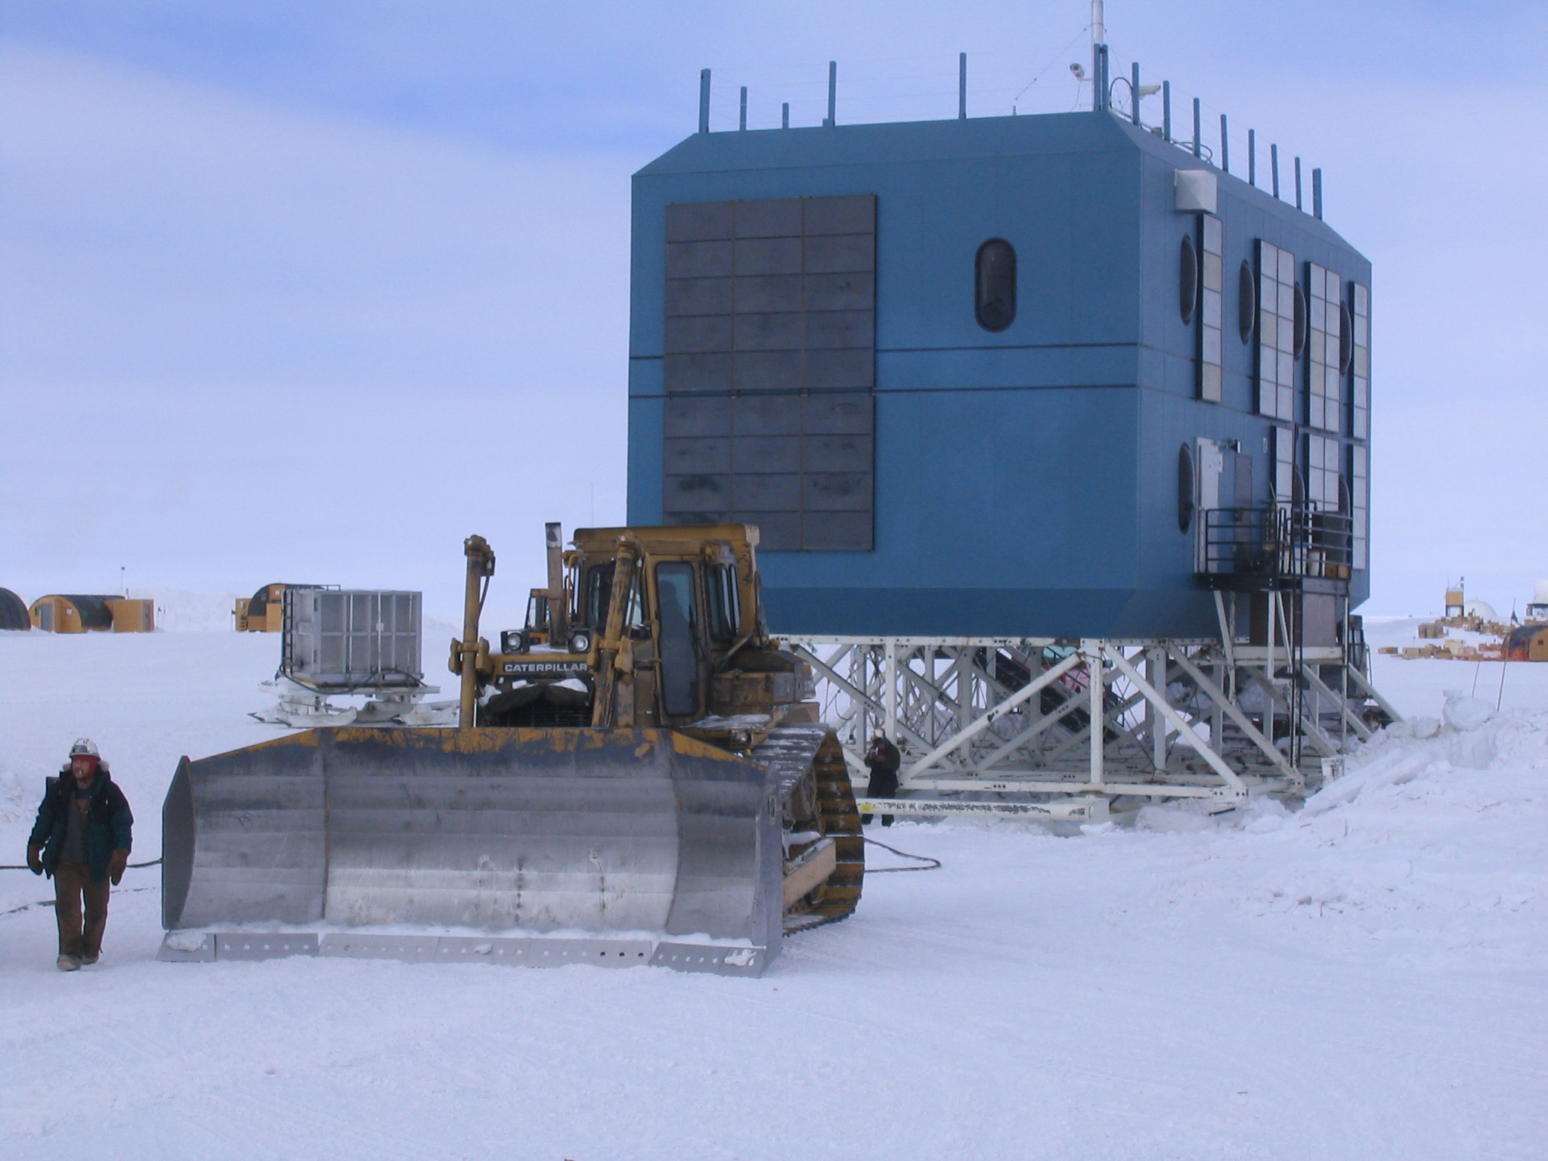
Collect and filter data
Image Credit: IceCube

Slide 25
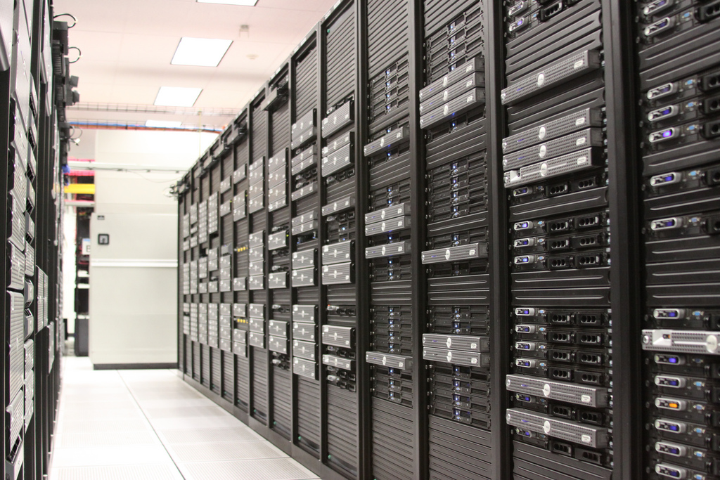
Store and analyze it
Image Credit: http://www.flickr.com/photos/theplanetdotcom
Notes:
60 Gigabytes a day.

Slide 26

Simulate light in ice
Photo credit: http://www.flickr.com/photos/rainman_yukky/

Slide 27

Simulate Atmosphere
Image Credit: NASA

Slide 28
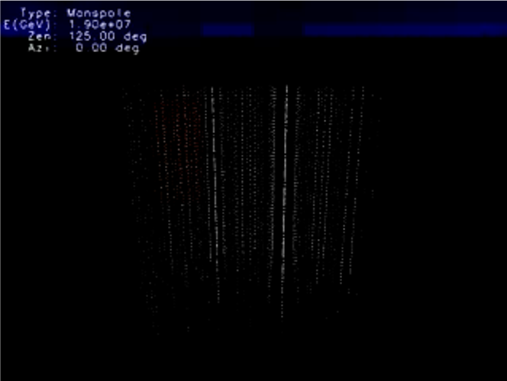
Model

Slide 29
Analyze

Slide 30
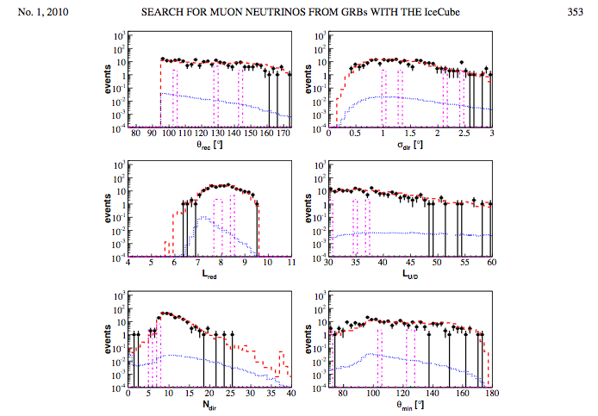
Plots

Slide 31
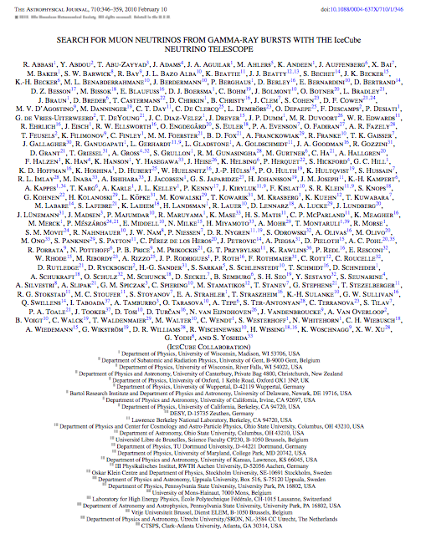
Publish

Slide 32
Software is everywhere
A point made better by many others, but particularly Edwards, P. N. (2010). A vast machine: Computer models, climate data, and the politics of global warming. MIT Press.
Notes:
Software everywhere, vital to analysis, simulation and workflows
BLAST paper is most cited
Hannay survey (40% of time)

Slide 33
Three cases with focal papers
STAR collaboration at Brookhaven national lab
SBGrid (Structural Biology Grid software distribution)
Bioinformatics study of leaf cutter ants
We documented the workflows, identifying all the software involved, then interviewed the producers of that software, focusing on incentives for doing the software work.
Howison, J., & Herbsleb, J. D. (2011). Scientific software production: Incentives and collaboration. Proceedings of the ACM Conference on Computer Supported Cooperative Work, 513–522. https://doi.org/10.1145/1958824.1958904

Slide 34
Example workflow with identified software components

Slide 35
Software as support
Notes:
Commercial off the shelf / Embedded in purchased hardware
Software developers (not scientists) employed to write/maintain code
How cited in paper:
Either not mentioned at all,
or name of company mentioned in text
Logic of correctness: it’s paid for, they test it. We use Software Engineering methods (Tests, formal review etc).

Slide 36
Collaboration service-work
Notes:
Role for software work within a large scientific collaboration
Service work, but by scientists as science
Logic of correctness: Internal review and wide use, theoretical coherence.
Reputation earned internally. Problematic: see Birnholtz, tell printer story.

Slide 37
Academic credit:
Incidental software
Notes:
Written to advance research directly
“it’s all about getting the plots”
By authors themselves, for themselves
Not released or requested by reviewers
“kleenex code”
Logic of correctness: I wrote it myself & theoretical, practice coherence.

Slide 38
Academic credit:
Parallel software practice
Notes:
Focus here is on the length and indirectness of the path of reputation through use.
Logic of correctness: publication review, wide-spread use

Slide 39
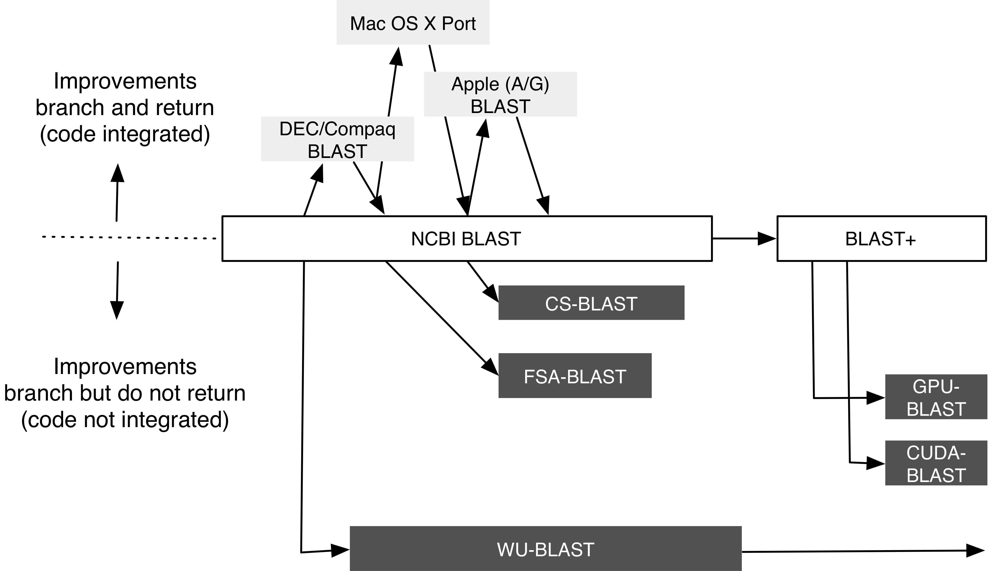
Academic reputation dampens integration
James Howison and Jim Herbsleb (2013) Sharing the spoils: incentives and integration in scientific software production. ACM CSCW

Slide 40
Part 2: Why is sustainability so challenging?
Notes:
Starting 10:20am (+20:00). Length: 10m.
Basis for this is interview study from CSCW, together with findings from other researchers.

Slide 41
How do scientists use software?
Edwards, Batcheller, Deelman, Bietz and Lee, Segal, De Roure and Gobels, Ribes and Finholt, Howison and Herbsleb
Notes:
Picture of assemblages. They pick up the software and adapt and improve it later.

Slide 42
Re-animating assemblages
Scientists pull an assemblage together, “get the plots” and often then leave it, often for months or years.
  The pace of work is generally much slower than in industry (where software is used day in and day out)
  While infrastructure runs continually, end-users often encounter it only periodically
When they return they return to extend; to use the software assemblage for new purposes, for new science, not simply to replicate/repeat.

Slide 43
What work is needed for sustainability?
Notes:
Show that the develop and maintain model relies only on the reuse affordance. Let’s look closer at Maintenance (Bietz and Lee).

Slide 44
What drives the need for work?
Difficulty of software production
Difficulty of software use
Changing scientific frontier
Changing technological capabilities (hardware and software)
Ecosystem complexity

Slide 45
Strategies for reducing needed work
Suppress the drivers
Increase the efficiency of work (e.g., Becker et al)
… but, ultimately, work is always needed …
Attract resources willing and able to do the work
Notes:
How does the way we attract resources relate to the needed work (and, in particular, to the challenges of ecosystem complexity?)

Slide 46
Resource attraction

Slide 47
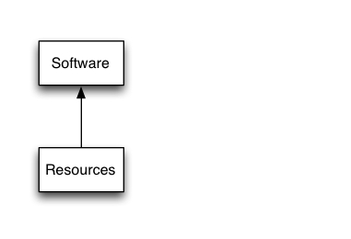
Feed back Loop Part 1

Slide 48
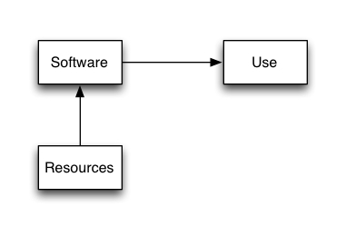
Feed back Loop Part 2

Slide 49
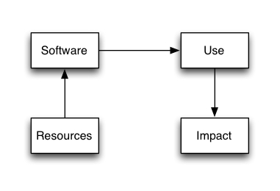
Feed back Loop Part 3

Slide 50
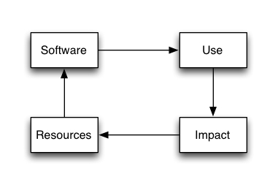
Feed back Loop Part 4

Slide 51
Modes of production
How does a project attract resources?
  Or, how does use and impact turn into resources?
Three “ideal types”:
  A commercial project
  Open source peer production
  Scientific grant making

Slide 52
A commercial project

Slide 53
Open Source Peer Production

Slide 54
Grant-making
Ribes and Finholt 2007;
Howison and Herbsleb 2011
Notes:
Grant making the flow is like this:
In a 2011 CSCW publication with Jim Herbsleb we examined three publications in key fields (Icecube, bioinformatics, structural biology). We identified

Slide 55
Summary: why so difficult?
Indirectness of resource attraction
  Reputation is a great motivator, but also problematic
Incompatible incentives for needed work
  Reputational rewards out of sync with needed work
  Citations/literature impact rewards publication not maintenance
  Grants create “service center” mentality
  See also Nadia Eghbal “Roads and Bridges” for similar issues outside science
Difficulty of work
  Availability of skilled labor
Science is unwilling to wait
Time-scale of use
  Longer cycles of use and re-use mean more change
Ecosystem complexity
  Will return to this later – different modes of production handle this differently.

Slide 56
Part 3:
Routes to Peer Production in Scientific Software
Work with Eunyoung Moon, Hannah Cohoon, and Caifan Du
Thanks especially to
  Matt Turk (from the yt project) for countless discussions
  Everyone that organized and participated in the WSSSPE workshops http://wssspe.researchcomputing.org.uk/
Notes:
Starting: 10:30 (+30m) Length: 5/Enzo 15/Panel.

Slide 57
A literature on transfer to open?
Copious literature on commercialization, “Technology Transfer” but not much on communities
Happily there are promising literatures (many funded by OCI/CISE)
  Studies of open source and online communities
    (Resnick, Crowston, Wiggins, Kittur, Kraut, Lampe, Ellison, …)
  Studies of scientific practice
    (Palmer, Borgman, Vertesi, Edwards, Olsons, Finholt, Lee/Bietz, Østerlund, Sawyer, Tapia, Ludders, …)
  Studies of infrastructural work
    (Bowker, Jackson, Vertesi, Ribes, …)
  “Meta science” publications e.g., “Ten simple rules for …” and best practices. See http://wssspe.researchcomputing.org.uk/
Notes:
Goal is to adapt and extend these literatures, building theory and actionable knowledge for practitioners

Slide 58

ENZO
Notes:
So, as an experiment to start playing around algorithm involved in AMR … I started creating this, and I also wanted to learn C++. I started creating this code. And that was eventually grown up as ENZO.
PI stitched together support, scrounging from grants, startup funds and the somewhat “fictional” 20 hours a week of graduate students

Slide 59
ENZO case study
Data:
5 interviews with participants (thanks Eunyoung Moon!)
Observation at related workshop
Publications, websites, workshop websites, source code repositories
Analysis:
  Creation of timeline
  Identification of episodes and 4 project phases (with their precipitating events)

Slide 60
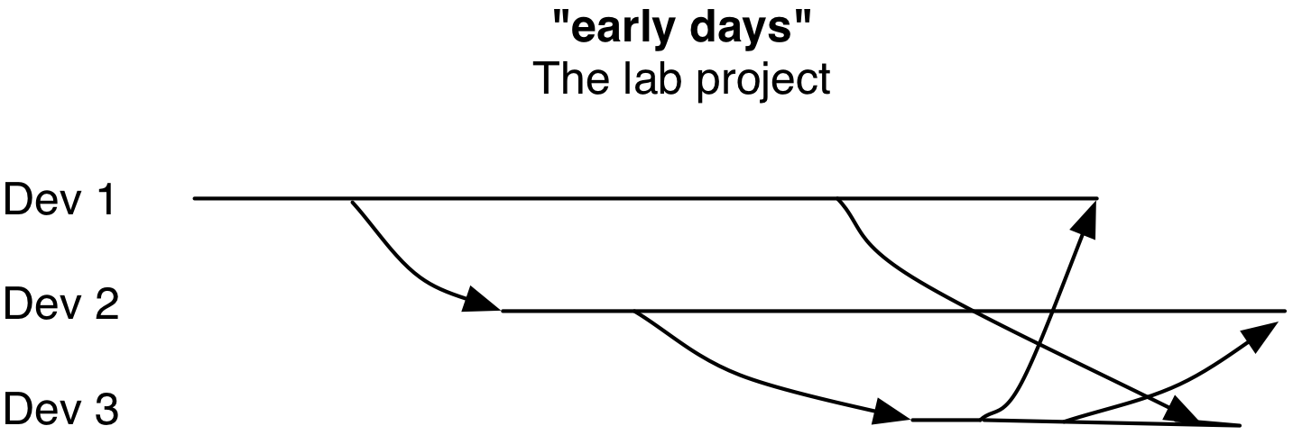
Early date of lab project
No central base to which changes are coming and going
Copy and pasting features across personal branches
Single lab
Notes:
Began in 1994, version control came around 2001

Slide 61
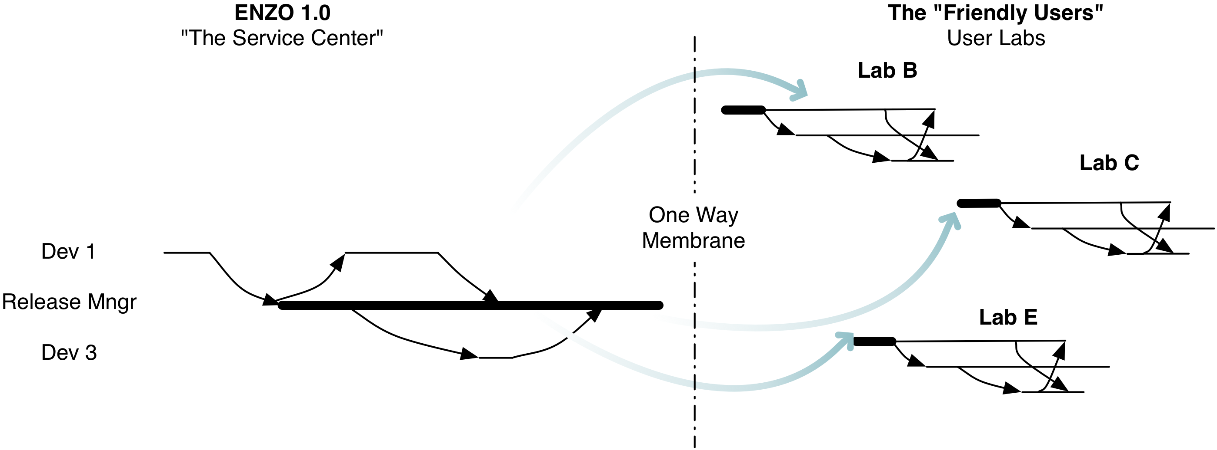
Enzo 1.0 Service Center
ENZO lab reforms as “Service Center” (grant)
Mainline branch internally, releases externally
Little expectation of contributions coming back in
“Friendly user” labs internally functioning like “early days”
Notes:
2001 through 2008

Slide 62
The “Week of Code”
Director of external lab (former post-doc) has new job at Stanford (with startup funds!)
Learns of various versions through conversations at conferences and reviewing(!)
Focus is on collaboration infrastructure, not governance.
Begin with the code of those not present
Notes:
2009

Slide 63
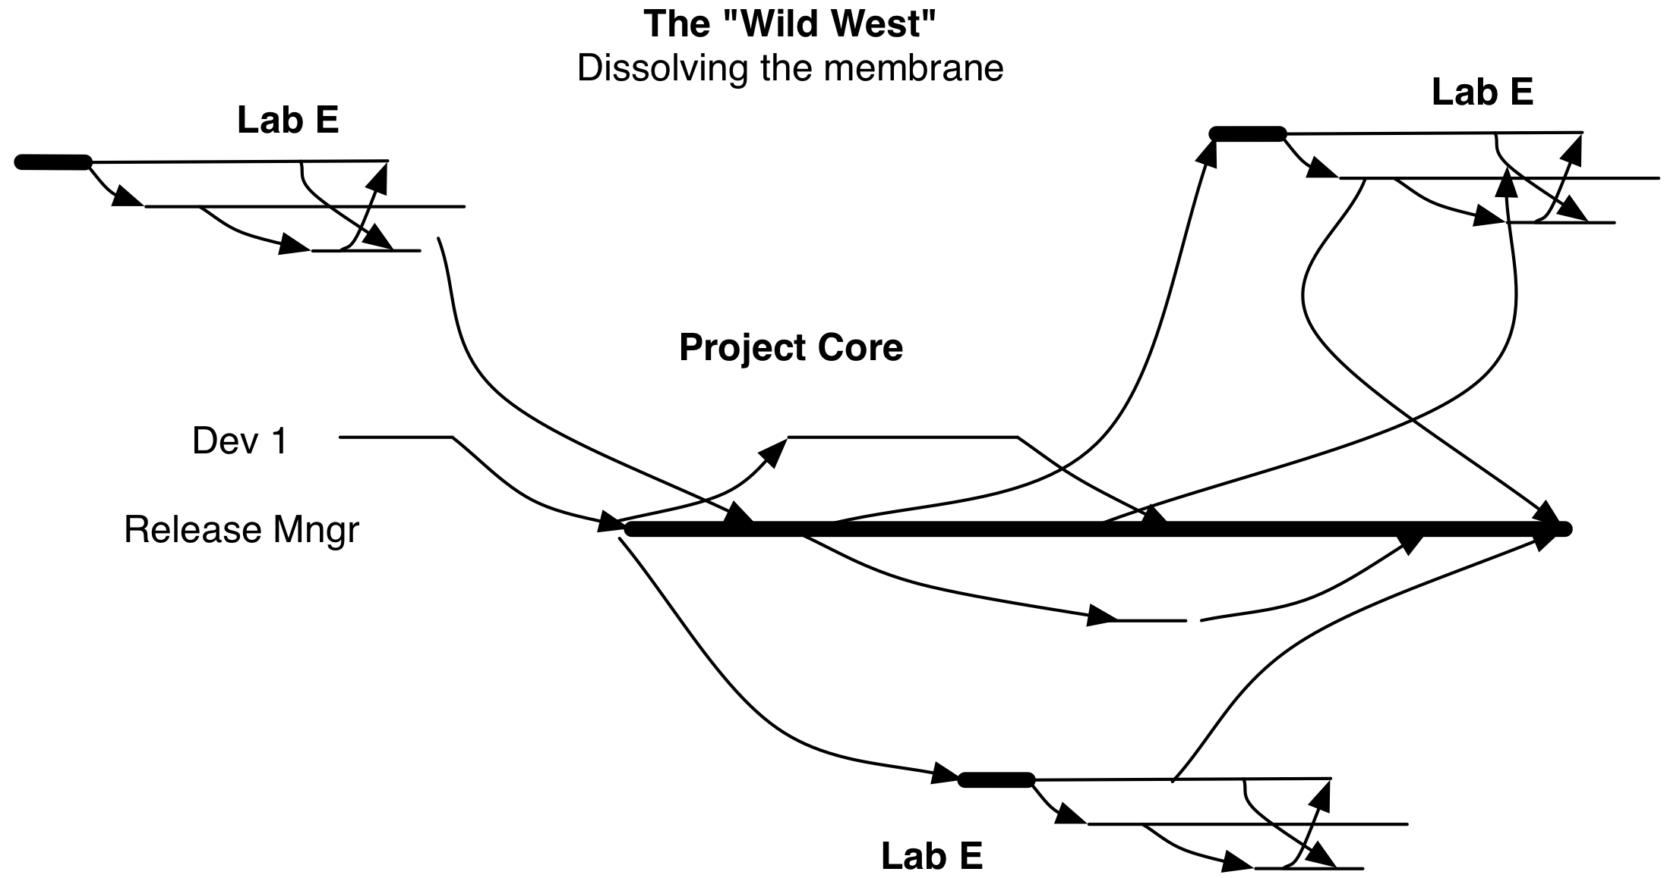
Initial open development. PI letting go of the project.
Central branch to which both core and outsiders contribute
Development continues separately in external labs
Called “Wild West” by participants, autonomy concerns.
Notes:
Initial open development. PI letting go of the project.

Slide 64
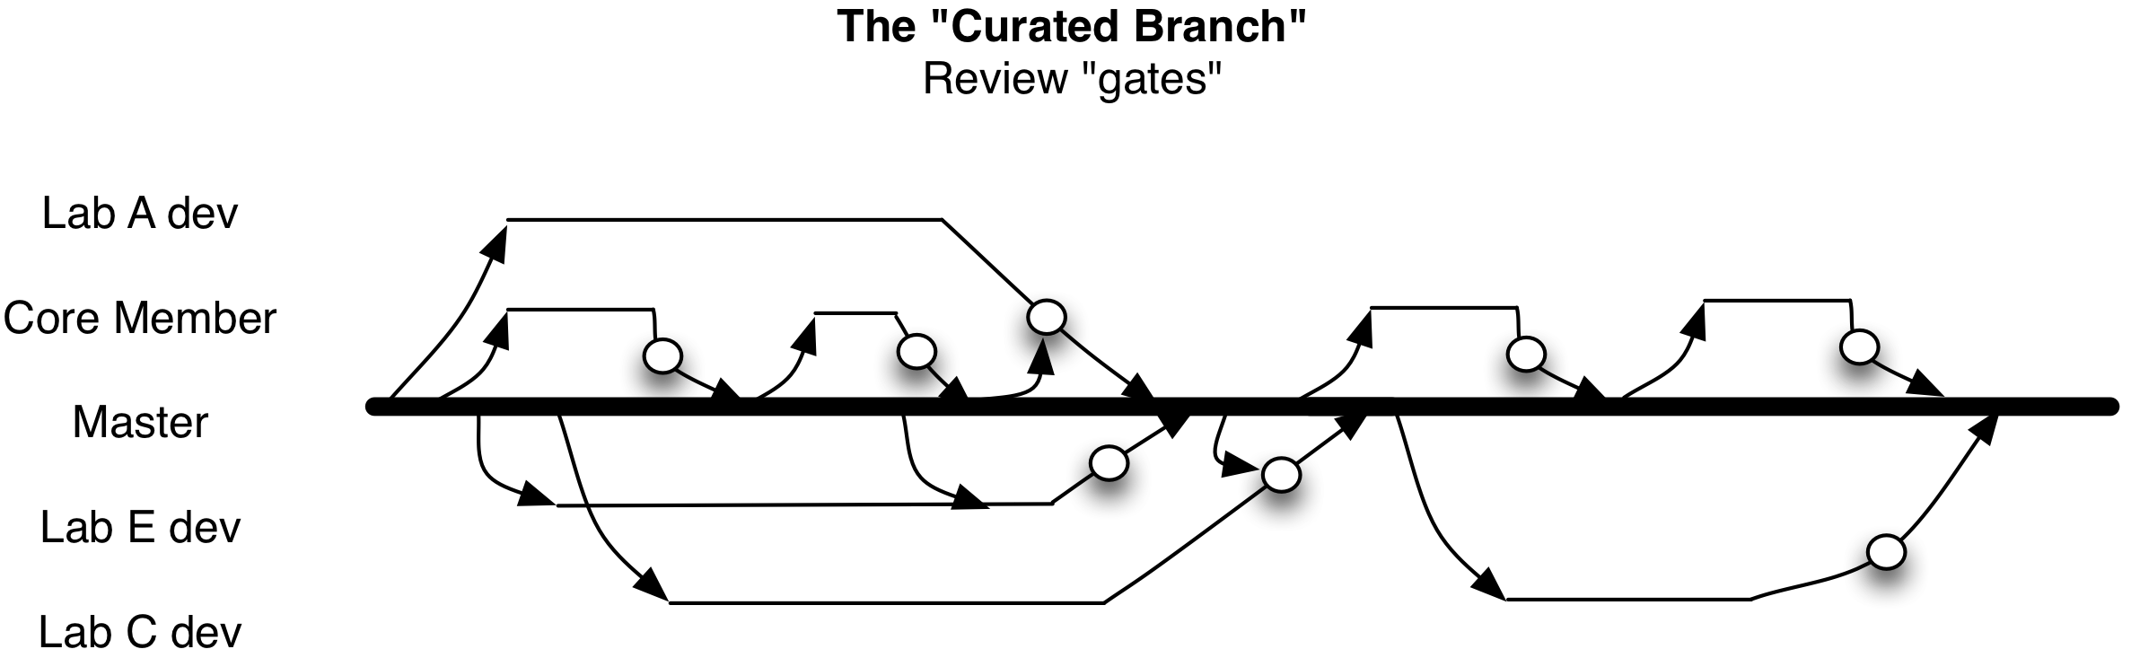
Emergence of additional structure in open phase.
Introduction of “code revision” (pull requests)
External lab members on similar footing to Core members
Review helps members not “step on each other’s work”
Notes:
Emergence of additional structure in open phase.

Slide 65
Change
What didn’t change:
  Motivations (code is side-effect of scientific inquiry, papers first, code second), not focused on commercial value
Challenges to change
  Coordination after long periods working apart
  Leadership’s feeling of responsibility and emotional connection, difficulty of passing on leadership (which eventually did happen).
  Deep concerns about giving up autonomy (being “blocked” in one’s work)

Slide 66
What worked
Collaboration technology before governance (perhaps contra “Collaboration Readiness” (Olson et al.) TORSC?).
  A scaling of the set of features of collaboration technology over time, from version control to code review
Social proof: visible action in public (Colfer and Baldwin “actionable transparency”)
Inspiration from open source
Working alongside each other, rather than with each other. Superposition rather than Teamwork.

Slide 67
Panel Study of SI2 funded software projects
SI2 program contributed to over 350 grants
Three step qualitative content analysis:
  Did the grant intend to create software
  What documents (URLs, Workshop reports, or Publications) are available?
  Read these, apply coding scheme
Interviews to confirm and deepen (interviews ongoing)
Today report on study of 92 grants that started by 2014, giving sufficient time for them to complete and observe transitions
  Of these 92 grants, 84 were judged to intend to create software
These 84 grants funded activity on 114 codebases, thus we present 114 projects observed multiple times over 5 years.
Thanks to doctoral student Hannah Cohoon (and, more recently, Caifan Du)
Notes:
Starting 10:35. Length 15m (ending 10:50).

Slide 68
Content analysis categories
Code | Description
Project Presents Separate From Grant | Does the grant support the project (e.g., pre-existing), Or is the project only there because of the grant
inviteToContribute contributionProcess | Is there an explicit invitation for outsiders to contribute? Is there a process for taking contributions?
highlightsPublication | e.g., Does the project have a “publications tab”
creditsNonPI Contributors | Are only the PIs credited “the PIs and their teams” or a wider group?
associatedRepository CodeAvailable license | Is code available? Is it openly hosted? Where? Under what license?
Collaborative setup (wiki, bugtracker) Online meetings? | What set of collaborative tools are they using?
Offline meetings | Does the project organize offline meetings, what kinds (user workshop, hackathon).

Slide 69
A taxonomy of project types
Peer production
Tool group
Author group
Lab
Business

Slide 70
Characteristics of Project Types

Slide 71
Peer Production
Group name
  Identifies as community
Website
Singular interests
Outside contributions
Invitation to contribute
Very rarely Publications
  Not featured if present
No Revenue
Notes:
Note openness of community. Invitation (and often a process of contribution), consciousness of an organizational form. Direct and simple access to source code. Demonstrating “actionable transparency”.

Slide 72
Tool Group
Group is Named
  Rarely identifies as community
Website
Singular interests
Rarely Outside contributions
Rarely an Invitation to contribute
Sometimes Publications
  Usually not featured
No Revenue
Notes:
Presence of publications and these we often coded as “Presents separate from grant” as “false”, meaning that the grant was highlighted as creating and identical to the project. From an outsider’s perspective this suggests something already set in motion, hard to join.

Slide 73
Author Group
Group is not named
  Never identifies as community
Rarely a Website
  Typically posters (SI2 meeting!)
Usually Singular interests
No outside contributions
No Invitation to contribute
Always Publications
No Revenue
Notes:
Author group was the least structured of the organizational forms that we found. Often there was not even a website (although usually a repository), but the documents we found were either publications or posters. Those posters were often created for the SI2 PI meeting and made available online. Some mentioned “open sourcing” but we did not find additional evidence of that. From an outsiders perspective not only does the project not present separately from the grant, but has the feel of a paper in progress and a great deal of uncertainty about the future prospects of the software.

Slide 74
Lab
Group is named
  Usually after the PI
Website
Diverse interests
  Link to genres of outputs inc. software
Rarely Outside contributions
Rarely an Invitation to contribute
  “Join my group as student or postdoc”
Always Publications
No Revenue
Notes:
The Lab is a well known organizational structure in scientific work. Steve Shapin has written of “Lab life” and many have written ”tales from the lab”. Here, of course, we are not necessarily talking about a “wet lab” per se, but the form with a hierarchical structure from PI (often called that directly) after whom the lab is named, and a hierarchy of researchers from possibly a professional “lab manager”, postdocs, doctoral students, other graduate students and undergrads. Often labs have a “graduates” section highlighting the career paths of previous members. Publications are always featured. The interests of a lab are diverse; software as an activity might get a sub-page, with multiple projects (at different stages of their lifecycles). Rarely is there a specific invitation or process to contribute, rather outsiders are invited to “join the lab” via employment or becoming a student.

Slide 75
Business
Group is named
Website
Singular interests
Never outside contributions
Never an Invitation to contribute
  Sometimes a separate “community”
Rarely Publications
  Not featured on website
Revenue (or at least “plans”)

Slide 76
How do projects change over time?

Slide 77
Project Transitions

Slide 78
Project Transitions with most recent status

Slide 79
Project Transitions – became inactive

Slide 80
Project Transitions – Ending as Labs

Slide 81
Project Transitions (Only those ending in peer productions)
Key finding:
The most frequent route to peer production was already being peer production!

Slide 82
Project Transitions – Only Projects that changed to Peer Production
Coded for specific organization responsible for future of project at specific times.
Hand-off
  A different organization becomes responsible for future of software. An innovation with a destination.
Reorganization
  The same organization continues but changes sufficiently to become a new configuration
Notes:
Lab transitioning (via hand-off). PI had participated in PP community before this project.
Author group 1: Three Pis from different universities. All members of a professional society with a working group for software, with an open source package. PIs not core members beforehand, but had made some contributions. Developed code separately, then worked to have it accepted with the interface handled by one PI and a student (who eventually made the PR to the peer production project). “Could you prepare maybe 8-10 slides explaining what this method is for when we meet …” PR took over three years, nearly the whole grant period (and just after). Student asked to continue making changes but had to “finish up my PhD”.
Tool group to peer production:
Repository records show primary software work done by one of two Pis working with two postdocs working primarily in the second half of the grant period. PI made some changes (including changes to licenses). Project was transferred to a company which ran it as one of their open source projects (with an invitation to contribute, and guide on contribution). That community has dozens of contributors and 100s of contributions over time.
Reorganization:
Project sponsored by a national lab over a long period, mainly internal contributors (with an “email the PI” approach to contributions). During the SI2 grant period a new website on github formed, highlighting community, adding an open invitation to contribute. Interviews indicate a throughgoing effort to identify and recruit contributors from outside. This effort was substantial but eventually successful.

Slide 83
Challenges to transition (emerging work)
Organizational change is a project in and of itself
  Reorganization was rare and itself a project far longer than the grant period, beginning before and continuing
  Different starting points have different challenges (or emphases).
Very little difference in collaboration technology use
  Version control, forums now standard and not discriminative (Neccessary but not sufficient).
Hierarchy
  Peer production implies leadership change, or at least leadership sharing. Found responsibility, emotion (and some FOMO) rather than rampant ego.
  Particularly difficult for Labs, but all grants speaks of their responsibility to deliver software (very rarely their responsibility to deliver community)
Ability to diversify resources
  Hard due to homophily. Trust relatioinships key to collaboration, easiest among “descendents” such as grade students, rarely brings in new resource sources
  Pre-existing peer production—prior to the grant being made—demonstrates the value process underlying peer production already exist
Notes:
Org change is very much like commercialization.

Slide 84
Challenges cont.
Overcoming “code dump”
  Code is not a “gift” to peer production communities, it is more a set of liabilities and responsibilities.
Potential contributors
  The step beyond “build it and they will come” is to know and cultivate an “addressable market” of contributors.
  Some interviews show vague sense of possible contributors (or skepticism); some are very specific.
Hand-offs involved relationships that already existed
  Cases showed long-term involvement
  Code is not a “gift” that communities are waiting for, it is more a set of liabilities and responsibilities.

Slide 85
See also
Trainer, E. H., Chaihirunkarn, C., Kalyanasundaram, A., & Herbsleb, J. D. (2015). From Personal Tool to Community Resource: What’s the Extra Work and Who Will Do It? Proceedings of the 18th ACM Conference on Computer Supported Cooperative Work: Social Computing, 417–430. https://doi.org/10.1145/2675133.2675172
  Discusses tasks and balance of responsibilities between those “sharing” and those “receiving”.

Slide 86
Part 4: Ecosystem Complexity
Notes:
Starting: 10:50 (+50), Length 10m. Ending 11am.
Now I want to return to one key cause of work: ecosystem complexity. Thus far we have focused on transitions within specific projects (activities with codebases); in the long-run to be sustainable any transitioning project will have to attract resources to handle this work. But codebases exist with structures of dependencies, within “stacks” of software, within “software ecosystems”. In our interviews the work needed often related to nearby projects and the users use of them (including new opportunities). And different resource attraction systems functioned differently with respect to this work.

Slide 87
the world changes …
Reanimation encounters change in the software ecosystem
  Updated packages, New packages, New interfaces
  In workflow and “below” in dependencies
This work is echoed at component producers, since components are themselves assemblages.
This is part of why Bietz and Lee (2010) found that cyberinfrastructure “maintenance” looks very much like development.
Notes:
It is far from uncommon to discover what appear to be cyclic dependencies, to require missing historical versions, or to require multiple, incompatible versions, requiring some level of jerry-rigging at points in the stack. This experience is common to those working with software, even outside science, and is described as a descent into "dependency hell."
http://en.wikipedia.org/wiki/Dependency_hell

Slide 88

the world changes (decoration image)
https://www.flickr.com/photos/mrhayata/6933963596
Notes:
In aggregate, if we pull the camera back, we can envision the world of software workflows as a pond. Changes (from many different sources) spread out through their users and demand many small changes, each of which spreads on out further. Once the ripples start to overlap, or catch up with each other, true chaos emerges.

Slide 89
What work holds a software ecosystem together (if anything)?
Sensing work
  knowing how workflows/software “out there” are changing
Adjustment
  making appropriate changes to account for changing surroundings
Synchronization
  ensuring that changes in multiple components make sense together, avoiding cascades.
Notes:
Exploding the category of maintenance work, from the perspective of a component producer.

Slide 90
Ecosystem Position
Number of users (reuse)
Diversity of use (recombination)
Notes:
You can place software along these dimensions. It’s hard to get to the top left, since as you get more users they will tend to combine your software in more ways. The bottom right is also pretty unlikely (thankfully) as useful recombinations tend to be useful to many people. Yet in some cases, especially in science, you could end up out there.

Slide 91
How do different kinds of needed work scale with ecosystem position?
New feature development/Technology adaptation
  At most linearly with more use and more diverse use
User support
  Linearly, perhaps even reducing at high numbers as users support each other (see Lakhani and von Hippel, 2003)
Sensing work
  Linearly with more diversity of use
Adjustment and synchronization
  Exponentially with diversity of use (recombination)
  Even assuming a constant rate of change of complements
Notes:
The more diverse the recombinations that your users are employing, the more points of origin for change, the more potential for cascading changes that undermine

Slide 92
Markets and ecosystem complexity
Sales provide insight (sensing) at the same time as they generate resources
  Unlike open projects and scientific software, businesses know their customers!
Emergence of Platform strategy:
  Suppress complexity by disallowing recombination between customer apps.
  Sensing undertaken by code review (via app store submission)
  Adjustment and synchronization through new releases of the core API
Notes:
Probably this splits into 2 slides

Slide 93

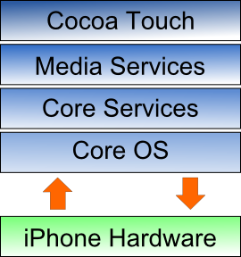
Platform strategy
The platform strategy requires power and a willingness to use it to reduce recombination.
Who in science wants to exercise that power?
Photo credit: http://www.flickr.com/photos/smemon/5324223435

Slide 94



Open Source peer production
Sensing and Adjustment:
  Contributions from the edge, driven by use value, provide direct insight into usage.
Synchronization:
  Emergence of distributions which collate the adjustments and attempt synchronization.
    Debian, Red Hat, Eclipse
  Pushing upstream uses the cheap copies affordance of software to scale adjustment.
Notes:
We do see these in science (including scientific linux, SBGrid, and coordination in specific ecosystems with increasing overlap with data science in industry, such as tidyverse and Jupyter) and some of the intentions of the SI2 mid-size projects “Integrations” were more focused here.

Slide 95
Grant funding
Little visibility into use context of software
  Developers are not front-line scientists
  No scalable way to see what is happening in use contexts beyond proposal
  Very hard to track use in scientific workflows
Service center argument places burden on core team
Success via focusing on low diversity of use/high user numbers
  Works in specific locations (e.g., BLAST)
  Often impossible, so focus on “power users” (Batcheller and Edwards)
Notes:
Echo Ribes and Finholt about the teams that prioritize research first, then software dev then maintenance. But maintenance is crucial.

Slide 96
Different organizational forms spread ecosystem management work out differently
The grant startup
The service center
The merely open project
The passively open project
The ecosystem player

Slide 97
The grant startup
A new grant to a lab
An internal team, low external transparency (like a “stealth mode” VC-funded startup)
Experimenting, not wanting to bother others until “it works”
From an ecosystem perspective, this can be very much like one big code dump, pushing sensing, adjustment, and synchronization onto end users and other projects.
Two key actions:
  Identify potential users and know what else they use
  Exchange people with dependencies and complements

Slide 98
The service center
“We’re funded to do the work for our users”
Characteristics:
  One way code membrane (we release, but don’t take contributions)
  A Helpdesk (individual tickets solved in private)
But: the team doesn’t scale to all the sensing, adjustment and synchronization needed
Key actions:
  Enroll our users, accept and learn from patches
  Take support out into public, leveraging “active users”

Slide 99
The merely open project
Projects have all the trappings of open source
  Open source license
  Hosted on github, etc.
  Core team might even work in public
But outside contributions aren’t occurring.
Openness at least means you can be “sensed” by others, but that puts the work on others.
Key actions:
  Sense how the code is used and what it is combined with
  Encouraging contributions in order to learn their uses

Slide 100
The passively open project
Project receives external contributions
  Woohoo! A great achievement.
Yet acts only as a passive “sink” for contributions
Adjustment work (contributions) stops at the project
No basis for synchronization.
Key actions needed (“reaching out”)
  Learning to pass (parts of) contributions upstream
  Making contributions to neighborhood projects

Slide 101
The ecosystem player
Funded to build community and to cultivate the work of others
Knows their “ecosystem” neighbors
Actively senses how users use their code (e.g., actively curating help discussions where ever they occur)
Has dense project co-memberships (upstream and downstream)
Works to synchronize releases with neighbors.
Key actions:
  Document what you do so that others can learn
  Document the value of what you do!

Slide 102
Improving Sensing
Fund, but more importantly develop reputational rewards to, innovation in sensing the scientific software ecosystem:
Measure diversity of use contexts, understand how users recombine: Know what generates the work.
  Go beyond single tool user-studies.
Overcome concerns about visibility and scientific competition
  Yes, privacy matters and research can be vulnerable, but users have responsibilities as well.
Identify local ecosystems
Increase visibility of software in publications
  Make specific requests for citation, test their discoverability at http://citeas.org
  Use machine learning to identify citations https://github.com/howisonlab/softcite-dataset

Slide 103
Improving Adjustment
Accept that adjustment happens best at the edge.
  But contributions require mentorship. Fund that mentorship.
Incentivize projects to be open to gathering and rationalizing outside adjustments.
Inculcate stewardship orientation within grant funded projects.
Overcome the “service center” framing
  Consider a funding program that only funds contributions to “other people’s” projects?

Slide 104
Improving Synchronization
Projects must not just “be open” but contributing upstream and downstream.
Fund software distribution work and innovation in distribution
  Distributions can manage cascades of adjustment work
Opportunities for research including simulating ecosystem impact of changes
  If we knew how tools, data and questions were linked we could test possible changes.

Slide 105
Promising developments
Work of the UK Software Sustainability Institute (Neil Chu Hong)
  https://www.software.ac.uk/
Work towards the US Research Software Sustainability Institute (URSSSI) (Dan Katz/Karthik Ram)
  Funded workshops on community incubation of projects with Apache
  http://wssspe.researchcomputing.org.uk/ (primarily US based)
Software Carpentry - Massive community effort building key collaboration skills
Software repositories work (driven by Alice Allen)
Studies of similar issues and challenges in the data world (Borgman and others)
Funding of open source communities (Ford/Sloan Infrastructure, Chan-Zuckerberg “Essential Open Source Software”)
Work towards understanding ecosystem complexity (Xalt via Bob McLay at TACC, World of Code, Software Heritage, Libraries.io, CHAOSS metrics project)
Ecosystem awareness in new NSF planning: https://www.nsf.gov/cise/oac/vision/blueprint-2019/
Industry project and ecosystem competence materials at https://www.linuxfoundation.org/en/resources/open-source-guides/

Slide 106
Takeaways
Recombination is a key affordance of software, but leads to complexity
The work needed to maintain scientific usefulness is hard to incentivize
Sustainability via transitions to peer production for ongoing sustainability are possible:
  Funding existing peer production, especially projects competent in their ecosystems
  Recognizing “the long center” and funding transition as a separate, mentored, project
Ecosystem complexity makes all this much harder
Two real options:
  Suppress recombination (probably antithetical to science)
  Gain visibility into recombination
Grant-making seems weaker than markets or open source at supporting visibility
Agencies should incentivize and fund:
  Existing peer production and transitions of “the long center” to peer production as distinct projects
  Research into visibility into infrastructure complexity and evolution
  Workforce development in peer production competencies and ecosystem competencies
Notes:
As working on digital information changes the way we work, leading to great capacities built on stacks of modular dependencies, we must sharpen our understanding and ability to influence structures. Science, in particular, has limited view here, something that must be addressed.

Slide 107
References
Graphs produced with the tidyverse software running on Rstudio.
  Wickham, H., Averick, M., Bryan, J., Chang, W., McGowan, L., François, R., … Yutani, H. (2019). Welcome to the Tidyverse. Journal of Open Source Software, 4(43), 1686. http://doi.org/10.21105/joss.01686
  Brunson. (2020). ggalluvial: Layered Grammar for Alluvial Plots. Journal of Open Source Software. http://citeas.org/cite/ggalluvial
Evidence that scientific code has a distinct culture from other programming:
  https://english.stackexchange.com/questions/20455/is-it-wrong-to-use-the-word-codes-in-a-programming-context

Slide 108
References continued
Batcheller, A. L. (2011). Requirements Engineering in Building Climate Science Software. (Ph.D. Dissertation). University of Michigan. Retrieved from http://deepblue.lib.umich.edu/handle/2027.42/86438
Bietz, M. J., Baumer, E. P., & Lee, C. P. (2010). Synergizing in Cyberinfrastructure Development. Computer Supported Cooperative Work, 19(3-4), 245–281. http://doi.org/10.1007/s10606-010-9114-y
Borgman, C. L., Wallis, J. C., & Mayernik, M. S. (2012). Who’s Got the Data? Interdependencies in Science and Technology Collaborations. Computer Supported Cooperative Work (CSCW), 21(6), 485–523. http://doi.org/10.1007/s10606-012-9169-z
Brown, D. A., Brady, P. R., Dietz, A., Cao, J., Johnson, B., & McNabb, J. (2007). A Case Study on the Use of Workflow Technologies for Scientific Analysis: Gravitational Wave Data Analysis. In I. J. Taylor, E. Deelman, D. B. Gannon, & M. Shields (Eds.), Workflows for e-Science (pp. 39–59). London: Springer. Retrieved from http://link.springer.com/chapter/10.1007/978-1-84628-757-2_4
Edwards, P. N. (2010). A vast machine computer models, climate data, and the politics of global warming. Cambridge, Mass.: MIT Press. Retrieved from http://site.ebrary.com/id/10424687
Edwards, P. N., Mayernik, M. S., Batcheller, A. L., Bowker, G. C., & Borgman, C. L. (2011). Science friction: Data, metadata, and collaboration. Social Studies of Science, 41(5), 667–690. http://doi.org/10.1177/0306312711413314
Goble, C., De Roure, D., & Bechhofer, S. (2013). Accelerating Scientists’ Knowledge Turns. In A. Fred, J. L. G. Dietz, K. Liu, & J. Filipe (Eds.), Knowledge Discovery, Knowledge Engineering and Knowledge Management (pp. 3–25). Springer Berlin Heidelberg.
Howison, J., Deelman, E., McLennan, M. J., Silva, R. F. da, & Herbsleb, J. D. (2015). Understanding the scientific software ecosystem and its impact: Current and future measures. Research Evaluation, rvv014(First published online: July 27, 2015), 17 Pages. http://doi.org/10.1093/reseval/rvv014
Howison, J., & Herbsleb, J. D. (2011). Scientific software production: incentives and collaboration. In Proceedings of the ACM Conference on Computer Supported Cooperative Work (pp. 513–522). Hangzhou, China. http://doi.org/10.1145/1958824.1958904
Howison, J., & Herbsleb, J. D. (2013). Incentives and Integration in Scientific Software Production. In Proceedings of the 2013 Conference on Computer Supported Cooperative Work (pp. 459–470). New York, NY, USA: ACM. http://doi.org/10.1145/2441776.2441828
Howison, J., & Herbsleb, J. D. (2014). The sustainability of scientific software production. Working Paper, University of Texas at Austin.

Slide 109
References continued last page
Lee, C. P., Bietz, M. J., Derthick, K., & Paine, D. (2012). A Sociotechnical Exploration of Infrastructural Middleware Development. Presented at the CSCW.
Segal, J. (2009). Software Development Cultures and Cooperation Problems: A Field Study of the Early Stages of Development of Software for a Scientific Community. Computer Supported Cooperative Work (CSCW), 18(5), -606. http://doi.org/10.1007/s10606-009-9096-9
Segal, J., & Morris, C. (2008). Developing Scientific Software. IEEE Software, 25(4), 20.
Baldwin, C. Y., & Clark, K. B. (2000). Design Rules: The Power of Modularity. Harvard Business School Press.
Becker, C., Betz, S., Chitchyan, R., Duboc, L., Easterbrook, S. M., Penzenstadler, B., Seyff, N., & Venters, C. C. (2016). Requirements: The Key to Sustainability. IEEE Software, 33(1), 56–65.
Colfer, L., & Baldwin, C. Y. (2010). The Mirroring Hypothesis: Theory, Evidence and Exceptions (Working Paper No. 10–058). Harvard Business School Finance.
Lakhani, K., & von Hippel, E. (2003). How open source software works: “free”’ user-to-user assistance. Research Policy, 32(6), 923–943.
MacCormack, A., Rusnak, J., & Baldwin, C. Y. (2006). Exploring the Structure of Complex Software Designs: An Empirical Study of Open Source and Proprietary Code. Management Science, 52(7), 1015–1030. https://doi.org/10.1287/mnsc.1060.0552
Penzenstadler, B., Bauer, V., Calero, C., & Franch, X. (2012). Sustainability in software engineering: A systematic literature review. 16th International Conference on Evaluation Assessment in Software Engineering (EASE 2012), 32–41. https://doi.org/10.1049/ic.2012.0004
Prlić, A., & Procter, J. B. (2012). Ten Simple Rules for the Open Development of Scientific Software. PLOS Comput Biol, 8(12), e1002802. https://doi.org/10.1371/journal.pcbi.1002802
Trainer, E. H., Chaihirunkarn, C., Kalyanasundaram, A., & Herbsleb, J. D. (2015). From Personal Tool to Community Resource: What’s the Extra Work and Who Will Do It? Proceedings of the 18th ACM Conference on Computer Supported Cooperative Work &#38; Social Computing, 417–430. https://doi.org/10.1145/2675133.2675172

