Slide 1


Presentation Cover Slide
Build and Broaden 2.0 (B2 2.0): Enhancing Social, Behavioral and Economic Science Research and Capacity at Minority-Serving Institutions
Directorate for Social, Behavioral and Economic Sciences
01-22-2021

Slide 2
SBE: NSF’s Social, Behavioral, and Economic Sciences Directorate
SBE researchers conduct groundbreaking research
SBE researchers create fundamental data and analytic infrastructure
SBE researchers provide essential training that empowers people and improves quality of life.

Slide 3
Intro to Build and Broaden 2.0 (B2 2.0)
Goals of Build and Broaden 2.0 solicitation:
Build research capacity
Foster research partnerships
Broaden opportunities for MSI scholars

Slide 4
Build and Broaden 2.0 Program
Full proposal deadline date:
March 5, 2021
We expect to fund between 25 and 30 awards
Types of awards supported:
  Standard Grants
  Continuing Grants
  Collaborative Proposals
  Conference Proposals
  Early-concept Grants for Exploratory Research (EAGER)
  Research Coordination Network proposals (RCN)
There are no limits on individual award funds or duration

Slide 5
Eligibility: Who may submit a proposal?
Proposals are invited from:
  A single principal investigator at an accredited minority-serving institution (MSI)
  Multiple co-investigators from one or more MSIs
  Principal investigators not affiliated with MSIs, but who apply with co-investigators from MSIs
    These proposals must describe — as a primary goal of the proposed work — how the project will foster research partnerships or capacity-building with at least one MSI.​

Slide 6
Eligibility: Is my institution or my collaborator’s institution an MSI?
For the purposes of this solicitation, MSIs include:
  Historically Black colleges and universities (HBCU),
  Hispanic-serving institutions (HSI),
  Tribal Colleges and Universities (TCU),
  Alaska Native-serving institutions or Native Hawaiian-serving institutions (ANNH),
  Predominantly Black Institutions (PBI),
  Asian American and Native American Pacific Islander-serving institutions (AANAPISI),
  and Native American-serving non-tribal institutions (NASNTI).

Slide 7
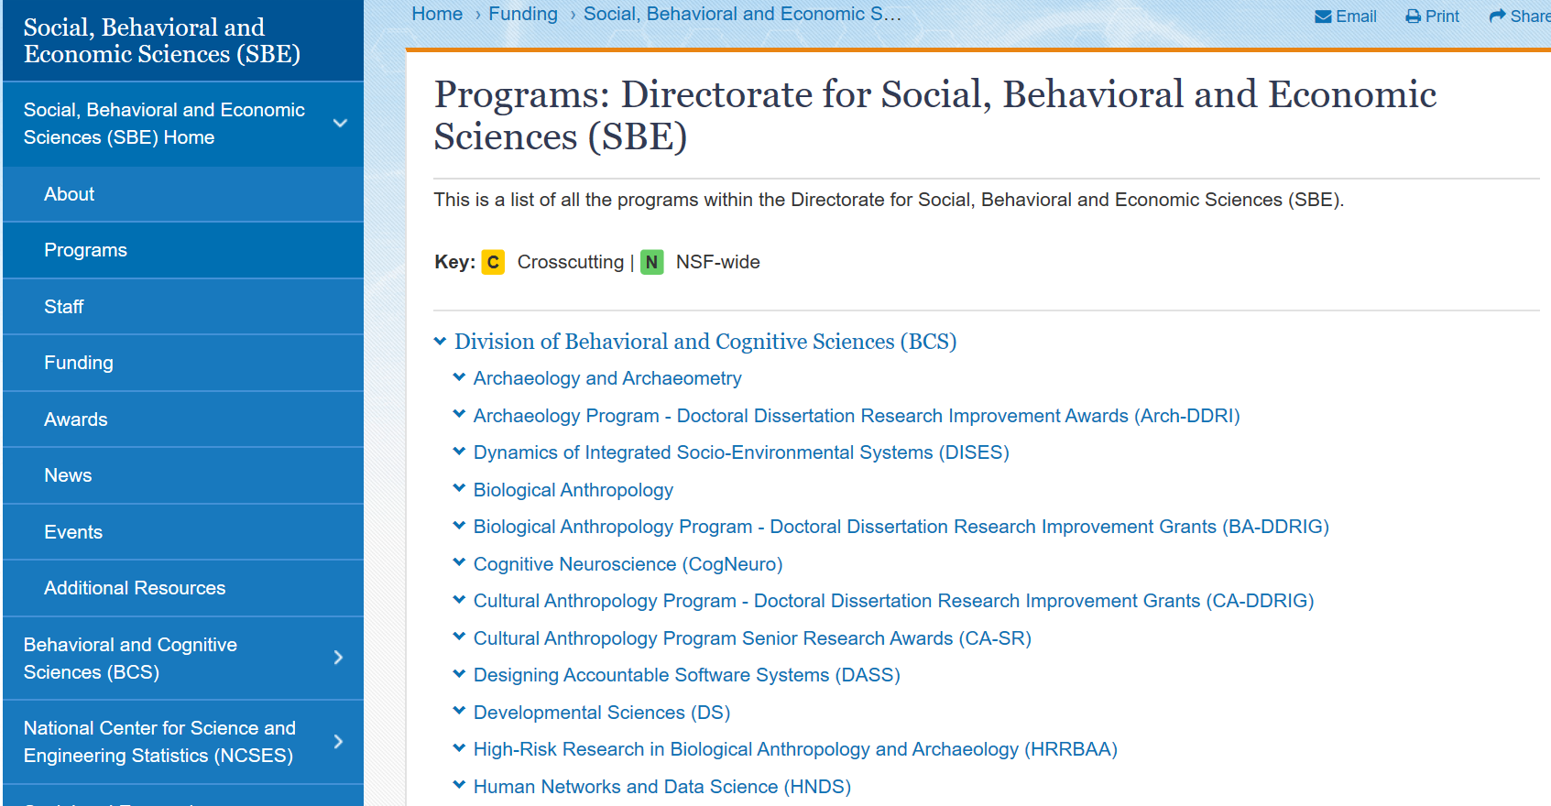
B2 2.0 Proposals may address any of the scientific areas supported by SBE

Slide 8
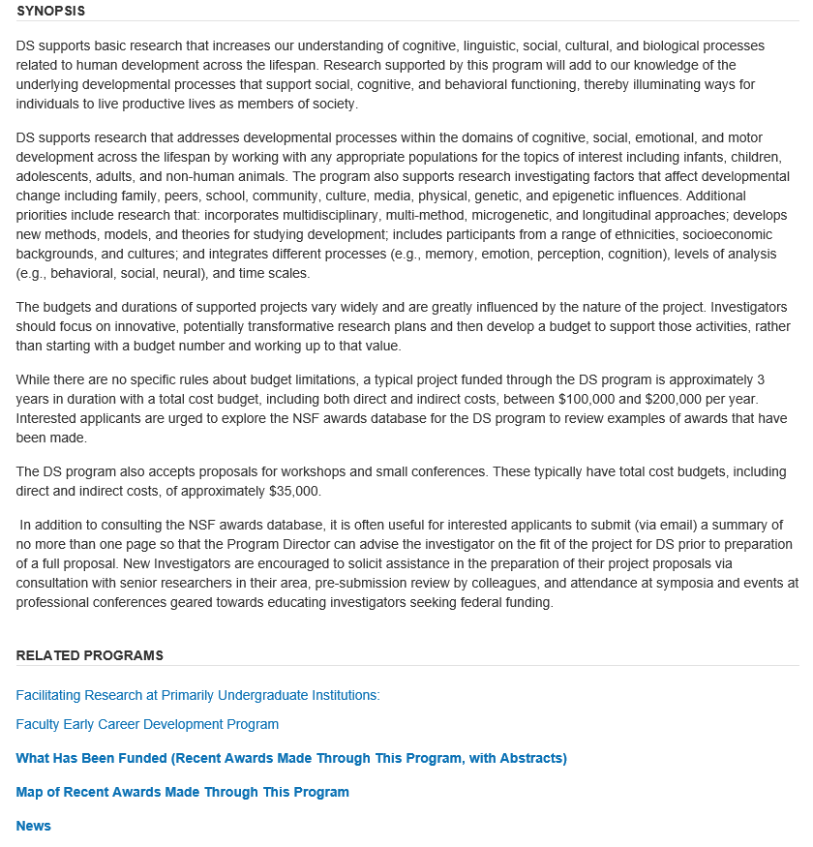
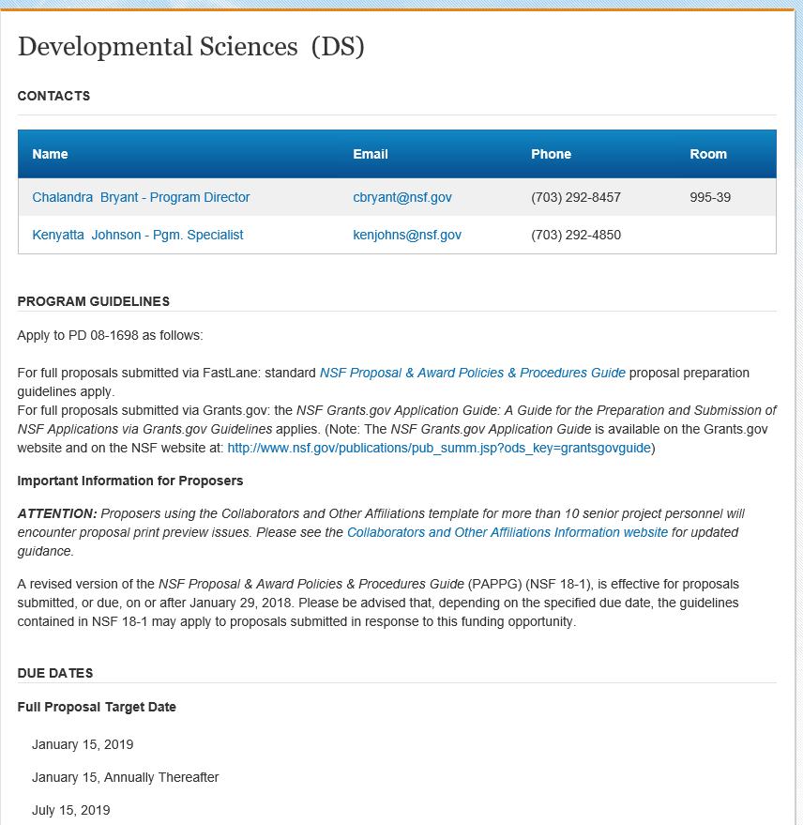
Learn more about a particular program area (e.g., Developmental Sciences)
Who is the Program Director
& how do you contact them?
How do I know if my research is a good fit for SBE?

Slide 9
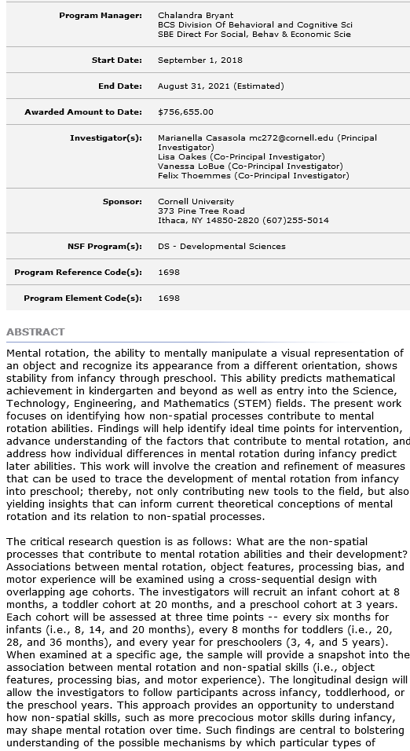
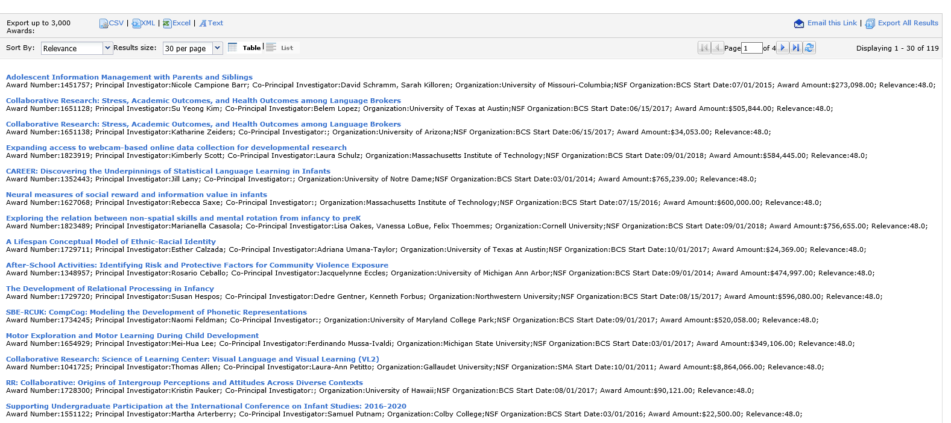
Discover what types of projects have been funded
What has been funded through a particular SBE program?
These resources may help you get a better understanding of how your proposal fits in among the research supported by SBE

Slide 10
How to submit B2 2.0 Proposals
Get support from your institution & sponsored research office early
Make sure to pay attention to internal deadlines
Communicate with NSF POs
For questions related to the use of FastLane or Research.gov, contact:
  FastLane and Research.gov Help Desk: 1-800-673-6188
  FastLane Help Desk e-mail: fastlane@nsf.gov
  Research.gov Help Desk e-mail: rgov@nsf.gov
For questions relating to Grants.gov contact:
  Grants.gov Contact Center: 1-800-518-4726; e-mail: support@grants.gov

Slide 11
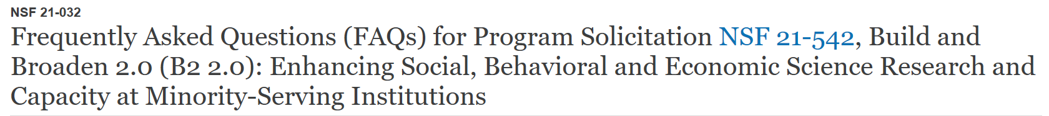
Questions about B2 2.0 before you submit your proposal?
FAQs (NSF 21-032)
B2 2.0 email address
  sbe-buildandbroaden@nsf.gov

Slide 12
Questions about B2 2.0 before you submit your proposal?
Contact the cognizant program officers for B2 2.0:
  Lee D. Walker, telephone: (703) 292-7174, email: lwalker@nsf.gov
  Josie S. Welkom, telephone: (703) 292-7376, email: jwelkom@nsf.gov
  Siobhan M. Mattison, telephone: (703) 292-2967, email: smattiso@nsf.gov
  Katherine Meyer, telephone: (703) 292-7099, email: kmeyer@nsf.gov

Slide 13
Questions related to the disciplinary area before you submit your proposal?
General questions about proposal submission can be directed to any SBE program director associated with the relevant disciplinary area of the proposal.
You may include a “one-pager” with your inquiries to SBE program directors

Slide 14
Example One-Pager
1. Intellectual Merit
2. Broader Impacts
3. Specific Aims
Background
Potential to advance knowledge
Potential to benefit society
Contribution to achievement of specific societal outcomes
Research questions and hypotheses

Slide 15
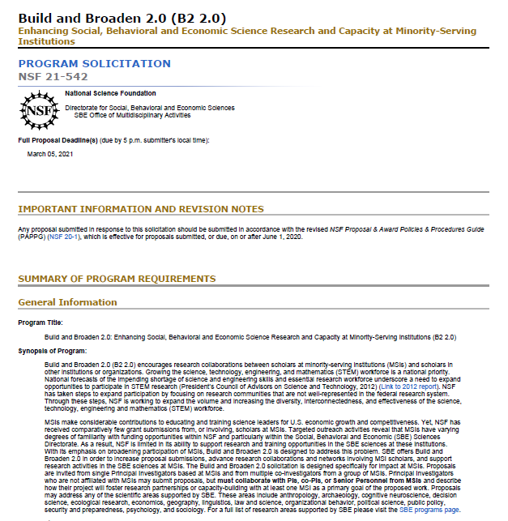

Proposal Preparation Instructions

Slide 16
Proposal Preparation Instructions: Project Summary
Must include three labeled sections:
Overview of the project, beginning with the following:
  List of Participating MSI(s)
  Description of the MSI(s) and MSI proportion of requested support
  Research discipline(s) advanced by the project
A statement on the Intellectual Merit of the project
A statement on the Broader Impacts of the project

Slide 17
Proposal Preparation Instructions: Other Required Documents
1. References Cited
2. Biographical Sketch – required to use NSF format
3. Current & Pending Support – required to use NSF format
4. Facilities Equipment and Other Resources

Slide 18
Proposal Preparation Instructions: Project Description Part 1
Must include three labeled sections:
Nature of Partnership and Investigator Roles:
  If proposal is submitted by a single PI, write “does not apply” in this section.
  If the proposal includes a partnership:
    Detail the nature of the research partnership between all participating institutions.
    Describe the roles of each PI, co-PI, Senior Personnel, and collaborator
  Proposals submitted by PIs not based at an MSI must also:
    Describe clearly the nature of the partnership with the participating MSI(s),
    Include efforts to ensure true collaborations among MSI and non-MSI participants

Slide 19
Proposal Preparation Instructions: Project Description Part 2
Must include three labeled sections:
Nature of Partnership and Investigator Roles
Intellectual Merit: Explain how the proposed work advances theory and/or basic science in one or more core SBE science areas.

Slide 20
Proposal Preparation Instructions: Project Description Part 3
Must include three labeled sections:
Nature of Partnership and Investigator Roles
Intellectual Merit
Broader Impacts: Explain how the project will enhance career development, research trajectories, collaborative research networks, or professional training for faculty and students at the participating MSI(s).

Slide 21
Proposal Preparation Instructions: Budget & Justification
Ask for what you need to execute the project.
Justify all costs and provide enough detail.
Proposals may include limited requests for resources to enable researchers at MSIs to be full and equal partners
Salary compensation could enable a reduction in teaching responsibilities.
Please refer to the PAPPG for full guidelines on salaries and wages.

Slide 22
Proposal Preparation Instructions: Supplementary Docs
Data Management Plan
  Must include a statement of how the data will be made publicly available
Collaborators and Other Affiliations Information (COA) – Required of all senior personnel
Postdoctoral Mentoring Plan: If applicable
Letters of collaboration: Not required

Slide 23
How will B2 2.0 proposals be reviewed?
B2 Review Process:
  Panel Review
  Ad hoc as necessary
  Co-review
    Suggest programs
  Please suggest reviewers for your proposal!

Slide 24
Review Criteria: Intellectual Merit
‘…the potential to advance knowledge’
  ‘…and understanding within its own field or across different fields’?
‘…suggest or explore creative, original, or potentially transformative concepts?’
‘Is the plan for carrying out the proposed activities well-reasoned, well-organized, and based on a sound rationale?’
‘How well-qualified is the individual, team, or organization to conduct the proposed activities?’
‘Are there adequate resources available to the PI…?’

Slide 25
Review Criteria: Broader Impacts
‘…the potential to benefit society and contribute to the achievement of specific, desired societal outcomes.’
Do NOT need to follow directly from research objectives (but often more coherent if they do)
Specify who benefits and how (pathways to broader impacts)
Are impacts ‘credible’?

Slide 26
Additional Solicitation Specific Review Criteria
B2 2.0 proposals will also be evaluated on the following:
Potential to increase the quantity, quality, and capacity of research at the participating MSI(s)
Impacts upon the professional development of faculty and students at the participating MSI(s)
If a partnership is proposed, the nature of the partnership among the participating institutions and investigators

Slide 27
Recap of Important Points
Eligibility: MSI scholars; scholars partnering with MSIs
Purpose: Support fundamental research in any area covered by SBE
  Infrastructure, capacity-building, training may be included, but not primary objective
When in doubt, contact a program officer

