Slide 1

Virtual Office Hour
Divisions of Biological Infrastructure, Environmental Biology, Integrative Organismal Systems, and Cellular and Molecular Biosciences
Welcome to the Virtual Office Hour. We will begin soon.
Please submit questions via the Q & A button available to you on Zoom, set to “Ask Anonymously”.
’

Slide 2
Virtual Office Hour – Welcome!
Program Directors in attendance today
Jean Gao and Dan Marenda (Division of Biological Infrastructure)
jgao@nsf.gov and dmarenda@nsf.gov
Kendra Mclauchlan and Matthew Herron (Division of Environmental Biology)
kmclauch@nsf.gov and mherron@nsf.gov
Jodie Jawor, Steve Klein, and E. Floh Thiels (Div. of Integrative Organismal Systems)
jjawor@nsf.gov, sklein@nsf.gov, and ethiels@nsf.gov
Richard Cyr, Arcady Mushegian, and David Rockcliffe (Div. of Molecular and Cellular Bio.)
rcyr@nsf.gov, amushegi@nsf.gov, and drockcli@nsf.gov

Slide 3
Virtual Office Hour – Welcome!
Division of Grants and Agreements personnel here today
Joseph Kittle – BIO/GEO/OISE/SBE Branch Chief (jkittle@nsf.gov)
Vanessa Richardson – BIO/OISE Team Lead (vlrichar@nsf.gov)
Denise Hundley – DBI/EF/IOS (dhundley@nsf.gov)
Staci Jenkins – DEB/MCB/OISE (sjenkins@nsf.gov)
Shirley Kerchner – BIO/GEO/OISE/SBE – (skerchne@nsf.gov)
Zoom and technical assistance – Mariam Tahir (MCB)

Slide 4
IOS Virtual Office Hour Questions:
Submit your questions via the Q&A box on your screen and set to “Ask Anonymously”.
For recently asked questions and future office hour topics, see our division blogs
For specific questions about your project, please contact a Program Director
See our various blogs for next month’s topics and dates

Slide 5
IOS Virtual Office Hour
Today’s Topics:
Recent solicitations and Dear Colleague Letters (DCLs)
How to prepare a great budget – Division of Grants and Agreements guests
Open question and answer period
Submit your questions via the chat/message box on your screen !

Slide 6
Recent Solicitations and DCLs
Remember – Core BIO solicitations have no deadlines and no submission limits. DBI (21-501 & 21-502), DEB (21-504), IOS (21-506), and MCB (21-509). Be sure to look carefully at solicitations for unique or special programs
NSF 21-531 Designing Synthetic Cells Beyond the Bounds of Evolution (Designer Cells) – Due date February 16, 2021
NSF 21-524 Navigating the New Arctic (NNA) – Due date March 5, 2021
NSF 21-546 Enabling Discovery through Genomics (EDGE) – Due date March 16, 2021
NSF 21-543 Integrative Research in Biology (IntBIO) – Due date March 16, 2021
NSF 21-545 Dimensions of Biodiversity – Due date March 26, 2021

Slide 7
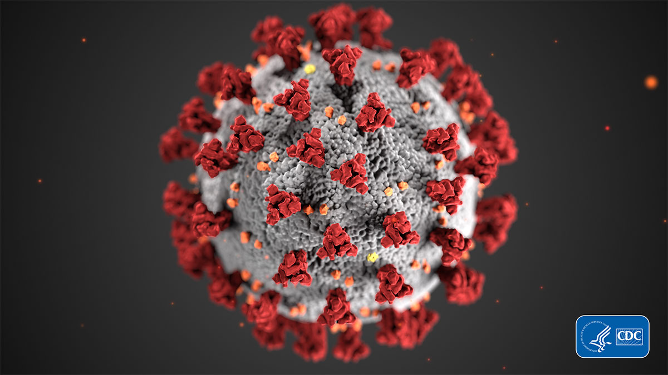
COVID-19
We recognize that developments related to COVID-19 continue to cause havoc and disruption of research programs and lives. Please see NSF’s main page for information related to OMB Memorandum M-20-17 and NSF’s implementation of the memorandum, CDC guidance, Department of State travel information, and research-related information:
https://www.nsf.gov/news/special_reports/coronavirus/
Please note: If you have an ongoing award and your research has been impacted by COVID-19 responses at your university or field site please make note of that in your annual reports in the Changes/Problems section

Slide 8
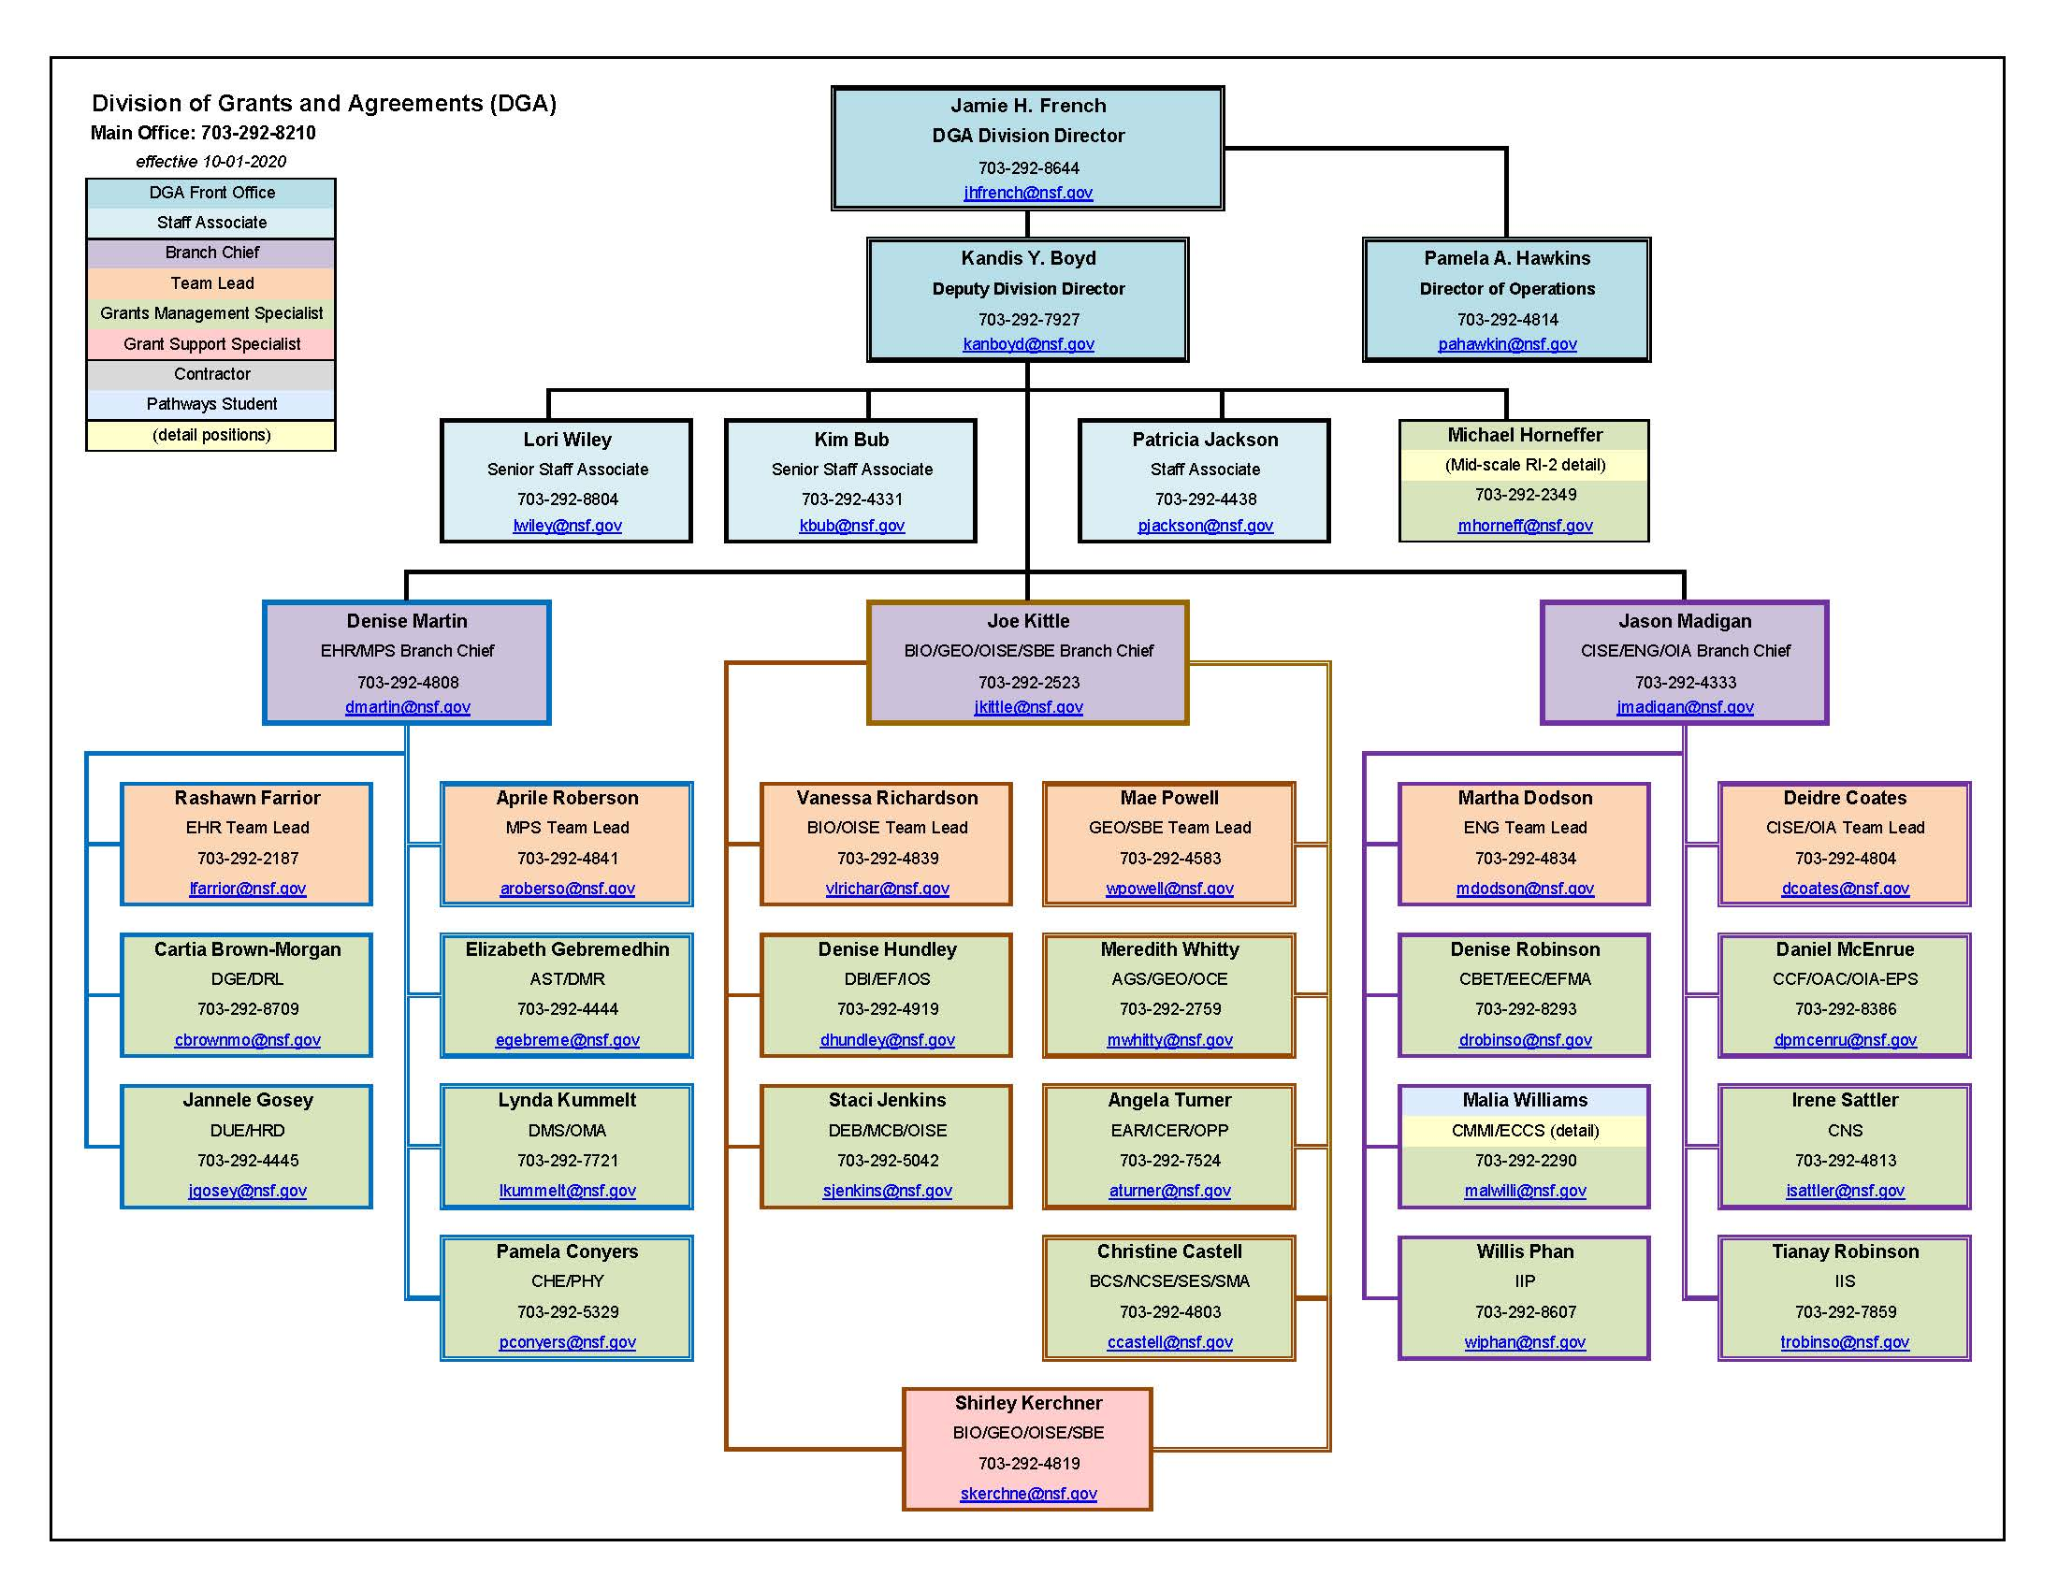
Division of Grants & Agreements (DGA)
http://www.nsf.gov/bfa/dga/docs/liaison.pdf
DGA Mission Statement
“Support the issuance of NSF assistance awards and other agreements by providing business, financial, and award administration assistance from pre-award through closeout.”

Slide 9
Common Questions for DGA During the Proposal & Award Process
Overdue Report Flags
Subaward Budgets and Budget Justifications
More Than 2 Months Salary for Senior Personnel
G.6 Other Costs in Proposal Budgets and Justifications
Supplements
Post-Award Rebudgeting Authority
Participant Support, Pre- & Post-Award

Slide 10
Resources for Proposal Preparation
& Award Administration
NSF Policies & Procedures: https://www.nsf.gov/bfa/dias/policy/
NSF Proposal & Award Policies and Procedures Guide (PAPPG): https://www.nsf.gov/publications/pub_summ.jsp?ods_key=nsf20001
PAPPG FAQs: https://www.nsf.gov/bfa/dias/policy/papp/pappg20_1/faqs20_1.pdf
NSF Award Terms & Conditions: https://www.nsf.gov/awards/managing/award_conditions.jsp?org=NSF
Prior Approval Matrix (RTC Appendix A): https://www.nsf.gov/bfa/dias/policy/fedrtc/appendix_a.pdf
The Uniform Guidance: https://www.ecfr.gov/cgi-bin/text-idx?tpl=/ecfrbrowse/Title02/2cfr200_main_02.tpl
DGA on NSF.gov: https://www.nsf.gov/bfa/dga/

Slide 11
IOS Virtual Office Hour Questions:
Submit your questions via the Q&A box on your screen and set to “Ask Anonymously”.
For recently asked questions and future office hour topics, see our division blogs
For specific questions about your project, please contact a Program Director
See our various blogs for next month’s topics and dates

Slide 12
Virtual Office Hour – Welcome!
Program Directors in attendance today
Jean Gao and Dan Marenda (Division of Biological Infrastructure)
jgao@nsf.gov and dmarenda@nsf.gov
Kendra Mclauchlan and Matthew Herron (Division of Environmental Biology)
kmclauch@nsf.gov and mherron@nsf.gov
Jodie Jawor, Steve Klein, and E. Floh Thiels (Div. of Integrative Organismal Systems)
jjawor@nsf.gov, sklein@nsf.gov, and ethiels@nsf.gov
Richard Cyr, Arcady Mushegian, and David Rockcliffe (Div. of Molecular and Cellular Bio.)
rcyr@nsf.gov, amushegi@nsf.gov, and drockcli@nsf.gov

Slide 13
Virtual Office Hour – Welcome!
Division of Grants and Agreements personnel here today
Joseph Kittle – BIO/GEO/OISE/SBE Branch Chief (jkittle@nsf.gov)
Vanessa Richardson – BIO/OISE Team Lead (vlrichar@nsf.gov)
Denise Hundley – DBI/EF/IOS (dhundley@nsf.gov)
Staci Jenkins – DEB/MCB/OISE (sjenkins@nsf.gov)
Shirley Kerchner – BIO/GEO/OISE/SBE – (skerchne@nsf.gov)
Zoom and technical assistance – Mariam Tahir (MCB)

Slide 14
Recent Solicitations and DCLs
Remember – Core BIO solicitations have no deadlines and no submission limits. DBI (21-501 & 21-502), DEB (21-504), IOS (21-506), and MCB (21-509). Be sure to look carefully at solicitations for unique or special programs
NSF 21-531 Designing Synthetic Cells Beyond the Bounds of Evolution (Designer Cells) – Due date February 16, 2021
NSF 21-524 Navigating the New Arctic (NNA) – Due date March 5, 2021
NSF 21-546 Enabling Discovery through Genomics (EDGE) – Due date March 16, 2021
NSF 21-543 Integrative Research in Biology (IntBIO) – Due date March 16, 2021
NSF 21-545 Dimensions of Biodiversity – Due date March 26, 2021

Slide 15
Resources for Proposal Preparation
& Award Administration
NSF Policies & Procedures: https://www.nsf.gov/bfa/dias/policy/
NSF Proposal & Award Policies and Procedures Guide (PAPPG): https://www.nsf.gov/publications/pub_summ.jsp?ods_key=nsf20001
PAPPG FAQs: https://www.nsf.gov/bfa/dias/policy/papp/pappg20_1/faqs20_1.pdf
NSF Award Terms & Conditions: https://www.nsf.gov/awards/managing/award_conditions.jsp?org=NSF
Prior Approval Matrix (RTC Appendix A): https://www.nsf.gov/bfa/dias/policy/fedrtc/appendix_a.pdf
The Uniform Guidance: https://www.ecfr.gov/cgi-bin/text-idx?tpl=/ecfrbrowse/Title02/2cfr200_main_02.tpl
DGA on NSF.gov: https://www.nsf.gov/bfa/dga/

