Slide 1


Presentation Cover Slide
2024 American National Election Study Competition
A Search for
Gold-Standard Innovation
Directorate for Social, Behavioral and Economic Sciences
07-27-2021

Slide 2
SBE: NSF’s Social, Behavioral, and Economic Sciences Directorate
SBE researchers conduct groundbreaking research
SBE researchers create fundamental data and analytic infrastructure
SBE researchers provide essential training that empowers people and improves quality of life.

Slide 3
2024 ANES Solicitation
Letter of Intent Due:
September 20, 2021
Full Proposal Deadline:
December 10, 2021
We expect to fund one or two awards
Up to $14 million, pending availability of appropriations
Award to start July 2022 (FY22-FY25)

Slide 4
American National Election Studies (ANES)
Data
Random samples
Cross-sectional and panel
Innovation
Question-wording, design and sampling
Dissemination
Undergraduate and graduate students
Public use by journalists
FTF, phone and web surveys
Integration of administrative, social media data
Cooperation with other national surveys
Scholarly research

Slide 5
We seek innovation
We are interested in proposals that offer ways to rigorously evaluate and improve every aspect of the project, including, but not limited to:
questionnaire design,
question wording,
fidelity of response options,
sampling of historically-underrepresented groups,
sample weighting frameworks,
use and potential integration of multiple types of data,
cooperation/integration with other surveys such as the CSES and GSS

Slide 6
ANES Proposals may address any of the excellence areas supported by previous ANES awards:
Continuity: Collection of individual-level data from weeks preceding and immediately following the 2024 presidential election
Quality: Innovations to improve data quality and the scientific or public value of the data
Access: Research community engagement; Using modules to expand capacity; Data dissemination and access

Slide 7
Eligibility: Who may submit a proposal?
Proposals are invited from:
  Universities, colleges or non-profit organizations/research labs
  One proposal per institution
  PIs limited to one proposal

Slide 8
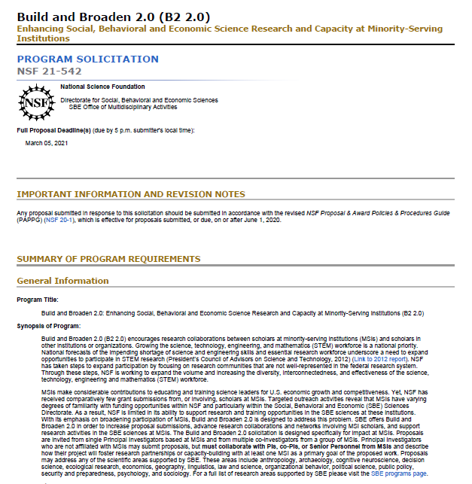

Proposal Preparation Instructions

Slide 9
Letter of Intent
Due September 20, 2021
Including:
  Title of project
  Names and affiliations of PIs and other senior personnel (4 maximum)
  Names of other participating institutions (2 maximum)
Failure to submit will disqualify proposal

Slide 10
Full Proposal
Due December 10, 2021
Including sections on:
  Management Plan
  Continuity of ANES principles
  Data Quality and Accessibility
  Innovations
  Expected Significance

Slide 11
Proposal Preparation: Project Description
Five Labeled Sections: - #1
Proposal Preparation: Project Description
Five Labeled Sections
Management Plan:
  Structure of PI/senior personnel team
  Qualifications of senior personnel/consultants

Slide 12
Proposal Preparation: Project Description
Five Labeled Sections: - #2
Proposal Preparation: Project Description
Five Labeled Sections
Management Plan
Continuity of ANES Principles:
  Continuation of projects dependent on ANES
  Proposed improvements

Slide 13
Proposal Preparation: Project Description
Five Labeled Sections: - #3
Proposal Preparation: Project Description
Five Labeled Sections
Management Plan
Continuity of ANES Principles
Data Quality and Accessibility:
  Release of data in timely manner
  Development of appropriate cyberinfrastructure
  Integration of newly produced data with past data

Slide 14
Proposal Preparation: Project Description
Five Labeled Sections: - #4
Proposal Preparation: Project Description
Five Labeled Sections
Management Plan
Continuity of ANES Principles
Data Quality and Accessibility
Innovations:
  Such as: Sampling, privacy, data, new research trends, data and measures
  And others that enhance the scientific and public value of the ANES

Slide 15
Proposal Preparation: Project Description
Five Labeled Sections: - #5
Proposal Preparation: Project Description
Five Labeled Sections
Management Plan
Continuity of ANES Principles
Data Quality and Accessibility
Innovations
Expected Significance:
  Intellectual Merit
  Broader Impact
  Creating new opportunities for STEM under-represented groups

Slide 16
Questions about the 2024 ANES competition?
  Jan Leighley, telephone: (703) 292-2686, email: jleighle@nsf.gov
  Lee D. Walker, telephone: (703) 292-7174, email: lwalker@nsf.gov
We thank you for your many contributions to the ANES and to NSF—past, present and future . . .

Slide 17
Conclusion
2024 American National Election Study Competition
A Search for
Gold-Standard Innovation
Directorate for Social, Behavioral and Economic Sciences
07-27-2021

