Slide 1
NSF Research Traineeship
(NRT)
NSF 21-536
SBE Webinar
Monday August 9, 2021
NRT Program Directors:
Daniel Denecke
ddenecke@nsf.gov
Vinod Lohani
vlohani@nsf.gov
Next Full Proposal deadline: September 6, 2021 (FY2022)
Notes:
Thank you for this chance to share some information with you all about the NSF Research Traineeship or NRT program.
We will be talking about a relatively new solicitation released last fall the earliest next deadline for which is September 6. If you have not yet started in on a proposal, you will probably want to consider applying for the September deadline of the following year.

Slide 2
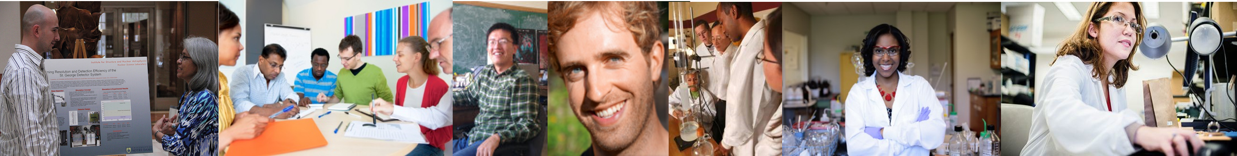
NSF Research Traineeship
Encouraging the development of innovative models for interdisciplinary/convergent STEM graduate training
Key Traineeship Elements
Interdisciplinary/Convergent Research & Training
Inclusive Workforce Development
Institutional Transformation
Notes:
Goal = encourage
Key elements elements:
* inclusive in two senses of the word – broad and diverse

Slide 3
NRT Awards and Eligibility
(NSF 21-536)
Track 1: Up to $3 million for projects up to 5 years (R1 and non-R1 institutions are eligible)
Track 2: Up to $2 million for projects up to 5 years (R1 institutions are not eligible for Track 2 awards)
Minority Serving Institutions are encouraged to apply for all tracks for which they are otherwise eligible
Anticipate 18-20 awards
All awards:
  Include minimum $34k for 12 months per trainee
Full Proposal Deadline(s) (due by 5 p.m. submitter's local time):
September 6, 2021 (FY2022)
September 6, Annually Thereafter
See the NRT landing page for webinar, FAQ, and schedule of Q&A sessions:
https://nsf.gov/funding/pgm_summ.jsp?pims_id=505015
Notes:
Begin with some key information about the program and then my colleague and I will go into some detail about what we are looking for in successful proposals.
Labor Day – PAPPG, automatically due the following day.

Slide 4
What’ New in 21-536
A Letter of Intent (LOI) is no longer required
Two tracks
Added AI and QISE to priority areas
An external evaluator is no longer required
12-month minimum of trainee support no longer must be continuous
FY2022 proposals must be submitted via Fastlane or Grants.gov (not Research.gov)
See solicitation NSF 21-536 for other changes
Notes:
If you have applied in the past, some changes to keep in mind for this most recent solicitation:

Slide 5
Architecture
of an NRT
Institutional Change
Workforce Development
Research
Interdisciplinary/Convergent
Training
Notes:
These are the core building blocks or cornerstones of every NRT.

Slide 6
Interdisciplinary/Convergent Research
Intra-disciplinary
Multi-disciplinary
Cross-disciplinary
Inter-disciplinary
Trans-disciplinary
Convergence
Notes:
The first building block is highly convergent or interdisciplinary research. A key emphasis of the NRT program is a requirement that projects be on an "interdisciplinary or convergent" research theme.
Depicted here is a spectrum of potential relationships among disciplines from:
Intradisciplinary: Working within a single discipline
Multidisciplinary: Working with others from different disciplines, each using their disciplinary knowledge
Cross-disciplinary: Working in one discipline, but considering the perspective or tools in another discipline
NRT Proposals rather in this highlighted area:
Interdisciplinary: Integrating knowledge and methods from different disciplines, resulting in a synthesis of approaches
Transdisciplinary: Creating a new approach beyond disciplinary perspectives
Convergence (NSF definition): Research driven by a specific and compelling problem where there is deep integration across disciplines, potentially leading to new frameworks, paradigms or disciplines

Slide 7
Interdisciplinary/Convergent Research (continued)
Interdisciplinary/Convergent Research
Thematic area = open, but 2021 priority areas encouraged
FY2022 Priority Areas
AI – new
QISE – new
HDR
FW-HTF
WoU
NNA
QL
URoL
Notes:
Research topics of national importance.
Open – some identified include: NSF 10 Big ideas
Recent solicitations have invited proposals on any topic, but with an emphasis on the six research themes among the Big Ideas.
Those identified here lend themselves to convergent approaches; cutting edge fields where work often of high societal import is left to be done.
Common question is must NRT proposals address one of named themes and is there a preference?

Slide 8
Architecture of an NRT - 2
Institutional Change
Workforce Development
Research
Interdisciplinary/Convergent
Training
Architecture
of an NRT
Notes:
Another core element is the quality of the training plan,
must emphasize that the bar is very high for innovation here, as much as for research.

Slide 9
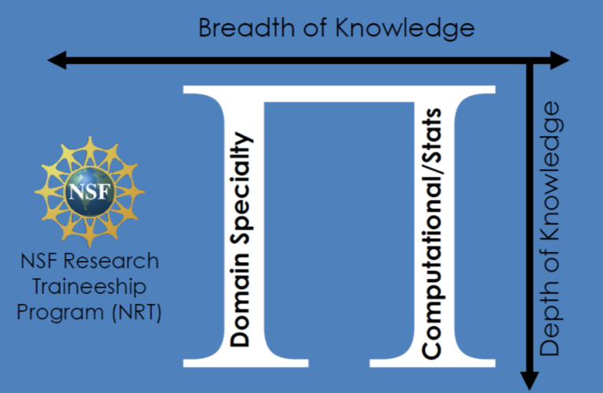
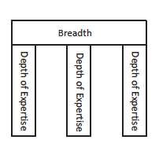
Training
PI-shaped training model
Comb-shaped training model
Example:
Computational
Science

Slide 10
Training (continued)
Training
Integrate training and research
Do not extend time to degree
Carefully consider the content-area and career-aligned skillsets
Who is a trainee?

Slide 11
Architecture of an NRT - 3
Institutional Change
Workforce Development
Research
Interdisciplinary/Convergent
Training
How do you know if your NRT model is working?
Architecture
of an NRT
Notes:
Workforce Development: Is this addressing a workforce need? Will students have opportunities to pursue a range of careers with their degrees?
Institutional Change: proposals should reflect that you have thought about sustainability of successful elements beyond funding period.
Also important to think carefully about evaluation.
In some respects, the cement that holds all these building blocks together is a strong evaluation plan.
Evaluation deserves serious consideration. We are looking for strong, thoughtful, and comprehensive plans to evaluate all of the research activities and of the educational activities, as well as of how well their integration results in the transformations sought.

Slide 12
Evaluation & Assessment
are critical project components
Unbiased evaluator
Potential to develop sustainable in-house capacity
Include evaluator in the proposal preparation
Ensure program is benefiting from feedback (formative and summative assessment)
Notes:
Requirements will be very clear in the solicitation but some tips about broader principles behind what we will be looking for are:

Slide 13
NSF & NRT Merit Review Criteria
NSF criteria
  Intellectual merit: research & training/eval
  Broader impacts: beyond diversity
NRT-specific criteria
  Integration of research & education
  Interdisciplinarity/convergence
  Professional development/training
  Integrating diversity
  Evaluation

Slide 14
NRT Proposal Preparation Tips
Follow the solicitation guidelines
Heed all “musts” and check all checkboxes
  Allow sufficient time for submission by deadline
  Heed institutional and PI and/or co-PI limitations regarding #’s of submissions
  Pay attention to limits and guidelines on:
    institutional letter of support and/or
    Required letters of collaboration from other NRT-eligible organizations that appear in the budget and/or
    Other, optional letters of support
  New NSF-wide PAPPG and Biosketch guidelines
Notes:
And finally, here are some ”tips” to help ensure that your proposal meets the requirements and expectations of NSF and the NRT program.

Slide 15
NRT Proposal Preparation Tips (continued)
NRT Proposal Preparation Tips
Follow the solicitation guidelines
Heed all “musts” and check all checkboxes
  Allow sufficient time for submission by deadline
  Heed institutional and PI and/or co-PI limitations regarding #’s of submissions
  Pay attention to limits and guidelines on:
    institutional letter of support and/or
    Required letters of collaboration from other NRT-eligible organizations that appear in the budget and/or
    Other, optional letters of support
  New NSF-wide PAPPG and Biosketch guidelines
Notes:
And finally, here are some ”tips” to help ensure that your proposal meets the requirements and expectations of NSF and the NRT program.

Slide 16
SBE-based NRT Recent Awards
1922697 Vanderbilt University. Neurodiversity Inspired Science and Engineering (NISE)
  A training program in an interdisciplinary field of Neurodiversity Inspired Science and Engineering (NISE), which links human-technology frontiers (HTF) research and education across STEM disciplines through a cohesive focus on autism. The project anticipates providing a unique and comprehensive training opportunity for one hundred fifty (150) MS and PhD students, including forty-five (45) funded trainees, from computer science, mechanical engineering, data science, psychology, organizational science, and neuroscience.
2021628 Rutgers University. Socially Cognizant Robotics for a Technology Enhanced Society (SOCRATES)
  This training program aims to instill an awareness of human involvement into every phase of the design of new technology, so that these technologies can provide positive human value wherever they are introduced. The training program anticipates training over 35 graduate students (MS and PhD), including 17 NRT-funded trainees, by integrating technology domains (robotics, machine learning and computer vision) with social and behavioral sciences (psychology, cognitive science, and urban policy planning).
2021713 University of Maine. Systems Approaches to Understanding and Navigating the New Arctic (SAUNNA)
  A training program in the interdisciplinary field of Arctic systems science. The project anticipates training 57 MS and Ph.D. students, including 20 funded trainees from Ecology, Earth Sciences, Anthropology, Economics, and Marine Sciences.
2021744 University of New Mexico. Science Museums Advance Research and Training through Convergence of Objects, Data, and Inference
  A graduate education model using anthropological, biological, and geological museum collections to enable multidisciplinary research about how natural, physical, and human systems change through time and space. This award enables education, training, and mentoring activities to recruit and train a diverse set of professionals with unique intersectional expertise, and directly supports 40 trainees at the MS and PhD levels and extends program elements and benefits to 35 additional graduate (75 total) and 40 undergraduate students.
Notes:
And finally, here are some ”tips” to help ensure that your proposal meets the requirements and expectations of NSF and the NRT program.

Slide 17
Questions?
Contact NRT Program Directors:
Daniel Denecke
ddenecke@nsf.gov
Vinod Lohani
vlohani@nsf.gov
Contact NCC Member:
Wenda Bauchspies
wbauchsp@nsf.gov

