Slide 1


Social, Behavioral & Economic Sciences Postdoctoral Research Fellowship (SPRF) Program
Josie S. Welkom, Ph.D.
SPRF Program Director
National Science Foundation
09-30-2021
Notes:
Credit: NSF/Nicolle Rager Fuller

Slide 2
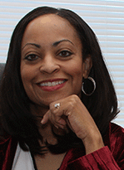
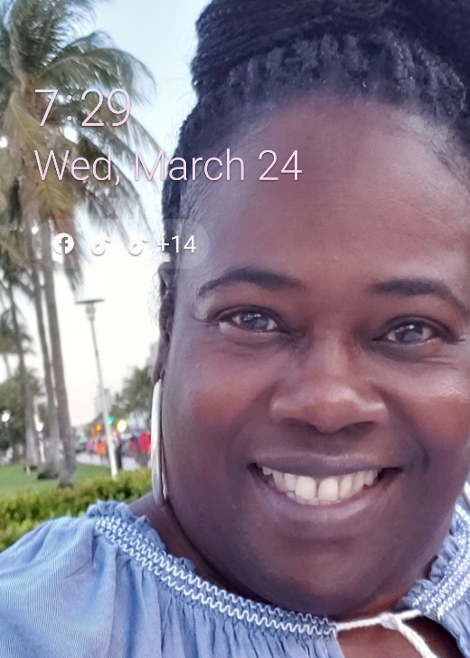
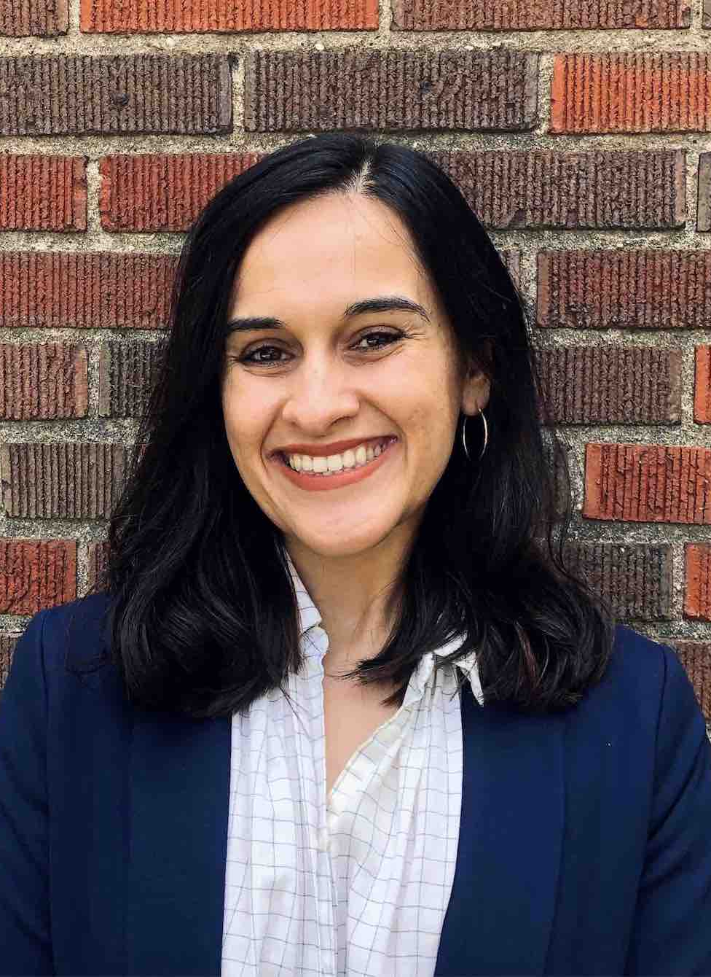
Welcome!
Lisa Jackson
SPRF Program Specialist
Kellina Craig-Henderson, Ph.D.
Deputy Assistant Director,
Directorate for Social,
Behavioral and
Economic Sciences
Eve Boyle, Ph.D.
Science & Technology
Policy Fellow
Josie S. Welkom, Ph.D.
SPRF Program Director

Slide 3
National Science Foundation (NSF)
Independent federal agency created in 1950
Funds science and engineering research
NSF Mission
To promote the progress of science;
To advance the national health, prosperity, and welfare;
To secure the national defense

Slide 4
NSF Support of Academic Basic Research in Selected Fields

Slide 5
SBE Mission
Directorate for Social, Behavioral and Economic Sciences
SBE’s mission is to promote the understanding of people and their lives by supporting research that reveals basic facets of human behavior, social organizations, and institutions
SBE also aims to provide mission-critical statistical information about science and engineering (S&E) in the U.S. and the world through the National Center for Science and Engineering Statistics (NCSES)

Slide 6
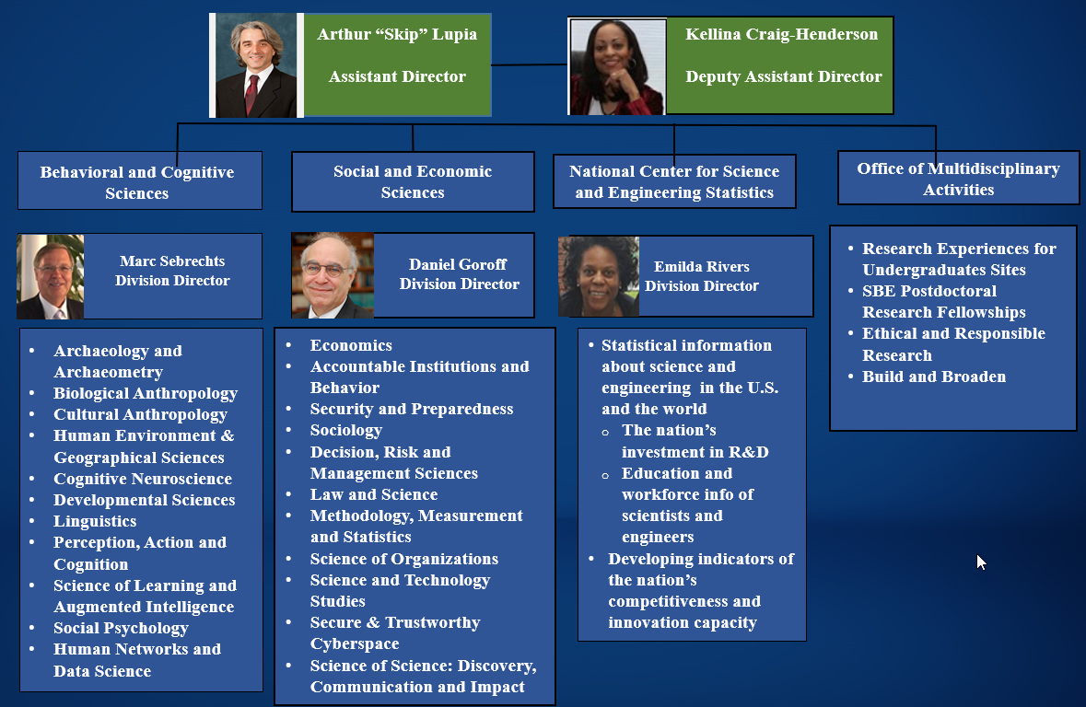
Directorate for Social, Behavioral and Economic Sciences

Slide 7
SPRF Program Information

Slide 8
SPRF Program Goals
The goals of the SBE Postdoctoral Research Fellowship (SPRF)are to:
Promote fundamental research in the SBE sciences
Enhance the participation of underrepresented groups
Provide an opportunity for independence and advanced training under the direction of a sponsoring scientist
The SPRF program seeks to encourage independence early in the Fellow's career in support of his or her research and training goals

Slide 9
SPRF Program Logistics
Individual Award - Applications are submitted directly by and awards are made directly to the Fellowship candidate
The Fellowship candidate serves as his or her own Authorized Organizational Representative (AOR)
Host Institution - Fellowship candidates identify a sponsoring scientist and a host institution
The Fellowship candidate does not have to be affiliated with the host institution at the time of submission
Includes U.S. academic institutions (colleges and universities) and non-profit U.S. organizations (independent museums, observatories, research labs, professional societies)
Sponsoring Scientist must be affiliated with the Host Institution

Slide 10
SPRF Program Tracks
Track 1:
Fundamental Research (FR)
Track 2:
Broadening Participation (BP)
Aims to support research that builds fundamental knowledge of human behavior, interaction, social and economic systems, and organizations and institutions
Aims to increase the diversity of researchers who participate in NSF programs and thereby, increase the participation of underrepresented SBE scientists in the United States
*Applicants do not have to be a member of an underrepresented group to apply to the BP-track

Slide 11
SPRF Award Budget
$138,000 for 2-years
$54,000/ year Stipend
$15,000/ year Research and Training Allowance
Expenses directly related to the conduct of the proposed research and education activities
Expenses in support of the Fellow such as office space, general purpose supplies, etc.
Expenses in support of fringe benefits

Slide 12
SPRF Eligibility Criteria
Applicants…
Must be a U.S. Citizen, national, or legally admitted permanent resident;
Doctoral degree in the SBE sciences;
Degree obtained either 36 months before or 10 months after application deadline;
Not in a tenure-track faculty position

Slide 13
SPRF Timeline
October/ November
Applications Due
December/ January
Panel Meeting
February – May
Proposal decisions sent to applicants
April – May
PO requests required document-tation from awardees
May - August
NSF issues official award letter before fellowship start date

Slide 14
Application Guidance & Tips

Slide 15
Resources

Slide 16
Think you’ve got a great idea?
Review the abstracts of the awards that have been made on the SPRF program page
Identify what is missing in the literature?
How could you contribute knowledge over the course of two-years?
Are you able to sell your research idea?
Do others in your field agree that this is an important avenue of research?
Are you well-prepared to conduct the research you are proposing?
If not, what training and mentorship would you need to be successful?
Not sure if your topic fits?
Email the SPRF PO a one-pager and request feedback

Slide 17
Areas of interest
Any topic within the purview of the SBE sciences is supported
Review SBE core programs: https://www.nsf.gov/funding/programs.jsp?org=SBE

Slide 18
Selecting a Sponsor & Host Institution
Identify what characteristics are most important to you in a mentorship relationship
Contact your potential mentor well-ahead of the application deadline and discuss your idea and their willingness to serve as your sponsoring scientist
Would your research proposal or training plan benefit from secondary mentors?
Consider whether the host institution location gives you appropriate access to the population of interest

Slide 19
NSF Review Criteria
Intellectual Merit: The Intellectual Merit criterion encompasses the potential to advance knowledge
Broader Impacts: The Broader Impacts criterion encompasses the potential to benefit society and contribute to the achievement of specific, desired societal outcomes

Slide 20
Sections of the SPRF Proposal
Project Summary - Don’t forget to include the requested information in the Overview section
Project Description
References
Biographical Sketch - Fellow and Sponsoring Scientist(s)
Budget
Budget Justification
Current and Pending Support - The current SPRF proposal counts as “pending” support
Facilities, Equipment, and Other Resources
Collaborators and Other Affiliations Document
Supplementary Documentation
Data Management Plan - The DMP is required of all proposals regardless of plans to collect data
Dissertation Abstract
Postdoctoral Mentoring Plan

Slide 21
Project Description section
Not to exceed 13 pages
Part I:Research Plan (10 pages)
Intellectual Merit
FR- and BP-specific question
Broader Impacts
Part II: Training Plan
Describe plan for career development - Do you require additional training to be successful?
Provide justification of sponsoring scientist and host institution - Will your sponsor’s expertise complement your background and training?
Include a timetable with yearly goals - Is the project feasible within 2 years? Are you being overly ambitious?

Slide 22
Budget and Budget Justification
Fixed award amount - $138k for two years
Budget justification
Must detail how you plan to spend the $30k Research and Training Allowance
Include international expenses (if any)
Complete the budget table EXACTLY as instructed in the solicitation
The stipend and Fellowship allowance should be entered in Participant Support Costs (Section F on the FastLane budget and Field E on the Grants.gov budget). Enter the $54,000 stipend in F.1 (FastLane) or E.2 (Grants.gov) and the $15,000 Fellowship allowance in F.4 (FastLane) or E.5 (Grants.gov). Enter (1) as the Total Number of Participants. An annual budget must be submitted for each of up to two years of Fellowship support.

Slide 23
Postdoctoral Mentoring Plan
Not to exceed 3 pages
Written by or from the perspective of the sponsoring scientist
Must include the following:
A statement of commitment indicating that the Fellowship candidate's proposal has been read and approved by the sponsoring scientist
A brief description of the research projects in the host research group(s)
An explanation of how the sponsor(s) will determine what mentoring the Fellowship candidate needs…and how these would be translated into a specific plan…
A description of the role the sponsor(s) will play in the proposed research and training
A description of the limitations, if any, that will be placed on the Fellowship candidate regarding the research following the Fellowship.

Slide 24
Submitting your SPRF Application
Start EARLY – Late submissions will not be accepted under any circumstance
Applicants must register in FastLane as an individual
Proposals submitted by institutions will be Returned without Review
Though you can submit through Grants.gov proposals that are not successfully transmitted to NSF by the due date will be Returned without Review
Incomplete applications or those that do not follow solicitation guidelines will be Returned without Review
Need help with your application…
Review the solicitation, PAPPG, and FAQs
Ask your mentor (sponsoring scientist)
Email the NSF program office

Slide 25
SPRF Proposal Evaluation
Proposals are evaluated on three dimensions:
The degree to which results would enhance theories and/ or methodological approaches in the SBE sciences
The strength of the proposed Fellow-Sponsoring Scientist team and host institution
The promise of the proposed Fellow’s investigation of driving research questions and future career development

Slide 26
Merit Review Panel
All proposals are reviewed in a multidisciplinary merit review panel (in-person and ad hoc reviews)
Your proposal should speak to a broad audience
Each proposal receives three independent ratings
Excellent, Very Good, Good, Fair, Poor
Proposals are discussed and ranked in panel
Highly Competitive, Competitive, Not Competitive

Slide 27
Characteristics of a Weak Proposal
Literature review is not comprehensive
Does not include relevant research
Does not acknowledge research that does not support hypotheses
Missing the basics, too many assumptions
No power analysis
Subsequent aims are contingent upon the prior aims
What is the plan B?
Too narrow of a focus
Why is this important?

Slide 28
Characteristics of a Strong Proposal
Very strong intellectual merit
PI has made a clear case for the importance of this research
PI has the skills (or a plan to receive the training) to conduct the proposed research
The research aims logically build upon one another and are specific
Attentive to broader impacts
More than dissemination
Creative and supported through partnerships
No ambiguous plans – reviewers know clearly what the PI intends
Sponsor demonstrates investment in the PI’s career development

Slide 29
Resubmissions
Get back on the horse and resubmit!
Must continue to meet eligibility criteria
Thoughtfully consider the reviews received
How are you going to address the weaknesses?
Do you need to re-vamp your proposal or make minor tweaks?
Meet with your sponsoring scientist to discuss the feedback
Discuss options for directly addressing reviews with the Program Officer

