Slide 1



Human Networks and Data Science Program
NSF 22-505
Informational Webinar
November 30, 2021

Slide 2
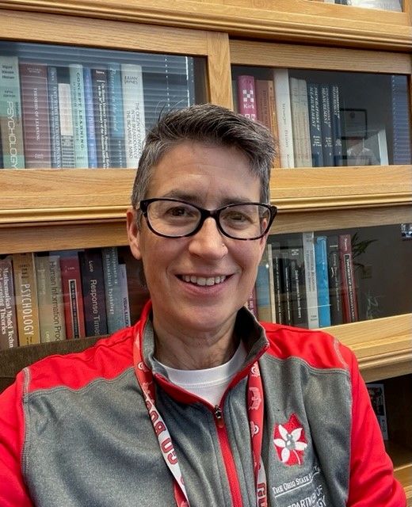


HNDS Program Staff
Don Rimon
Program Analyst
Tyler Kendall
HNDS Program Director
Trisha Van Zandt
HNDS Program Director

Slide 3
Agenda
1:00 Introductory Remarks and Introductions
1:10-1:20 Opening remarks (Marc Sebrechts)
1:20-1:40 Description of HNDS program (Trisha Van Zandt)
1:40-1:45 MMS program (Cheryl Eavey)
1:45-1:50 HEGS program (Jeremy Koster)
1:50-1:55 SAP program (Paul Huth)
1:55-2:30 Questions and answers

Slide 4
Participants
Program Directors
Trisha Van Zandt (Human Networks and Data Science)
Cheryl Eavey (Methodology, Measurement and Statistics)
Jeremy Koster (Human-Environment and Geographical Sciences)
Paul Huth (Security and Preparedness)
Division Director
Marc Sebrechts (Behavioral and Cognitive Sciences)

Slide 5

Grantsmanship 101
Read the solicitation (22-505):
https://www.nsf.gov/pubs/2022/nsf22505/nsf22505.htm
Read the Proposal & Award Policies & Procedures Guide (PAPPG; 22-1):
https://www.nsf.gov/pubs/policydocs/pappg22_1/nsf22_1.pdf
Look at the projects the program has funded (“Browse projects…” button)
Talk to the program officer before you start writing
  Prepare a 1-2 page summary
  Email the summary and request an appointment
  “Is this project appropriate for the program?”
  Office hours
If the solicitation is different from the PAPPG, follow the solicitation.

Slide 6
Human Networks and Data Science Program Description
Supports novel approaches to advancing theory in the SBE sciences:
HNDS-I: Infrastructure. Large-scale next-generation data resources that enable new kinds of data-intensive research.
HNDS-R: Core Research. Research across the SBE disciplines within contexts defined by human networks and large-scale data.

Slide 7

HNDS-Infrastructure
Funds development of data resources and relevant tools or analytic techniques that support fundamental SBE research.
Formerly RIDIR
Larger Awards, up to $1.2M
Produce a user-friendly, large-scale data resource with broad impacts across multiple disciplines or within broad disciplinary areas.
A HNDS-I proposal has special requirements.

Slide 8
HNDS-Infrastructure (continued)
February 3, 2022 deadline
Data management plan, Post-doc mentoring plan
Technical plan (2 pages)
Sustainability plan (1 page)
How will the project enable new research not otherwise possible?
Does the research team have appropriate expertise?
Consider data ethics: IRB approval, differential privacy, etc.

Slide 9

HNDS-Infrastructure Awards
dataARC (1637076)
SKOPE (1637189)
cyberSW (2121925)
NORPP (2024310)
IDEANet (2024271)
TalkBank (2117578)
Others

Slide 10
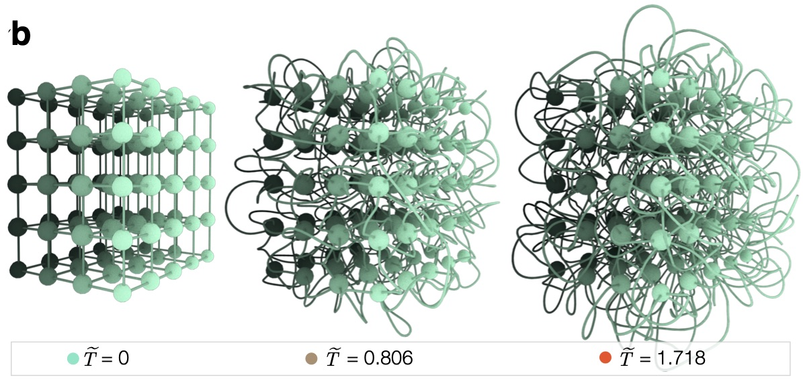
HNDS-R: Core Research
Advance theory in a core SBE discipline by the application of data and network science methods, particularly by using big data, developing complex, hierarchical, nonstationary, and/or dynamic networks, and/or mixed methods.
100% co-reviewed with other programs. Discuss which is most appropriate with the HNDS program director.
  Submit to the program that best represents the core discipline (e.g., Sociology) and choose HNDS-R as a secondary unit of consideration (UOC)
  Submit directly to HNDS-R and choose the representative program (e.g., Perception, Action & Cognition) as a secondary UOC.
Typical awards around $400K. Larger awards up to $1.2M for convergent research teams (including SBE science, computer science, statistics, applied math, etc.)

Slide 11
HNDS-R: Core Research (continued)
January 13, 2022 deadline for direct submissions to HNDS-R
Submissions to the program that best represents the project discipline:
  Use that program’s deadline.
  Make sure you follow the guidance in that program’s solicitation!
Discuss your proposal with the director of the program that best represents the project discipline.
Explicitly identify the program that best represents the project discipline in the Project Summary, put “HNDS-R:” in the proposal title, and select the secondary UOC in FastLane or Research.gov.
Your SRO can help you with the selection of the secondary UOC.

Slide 12
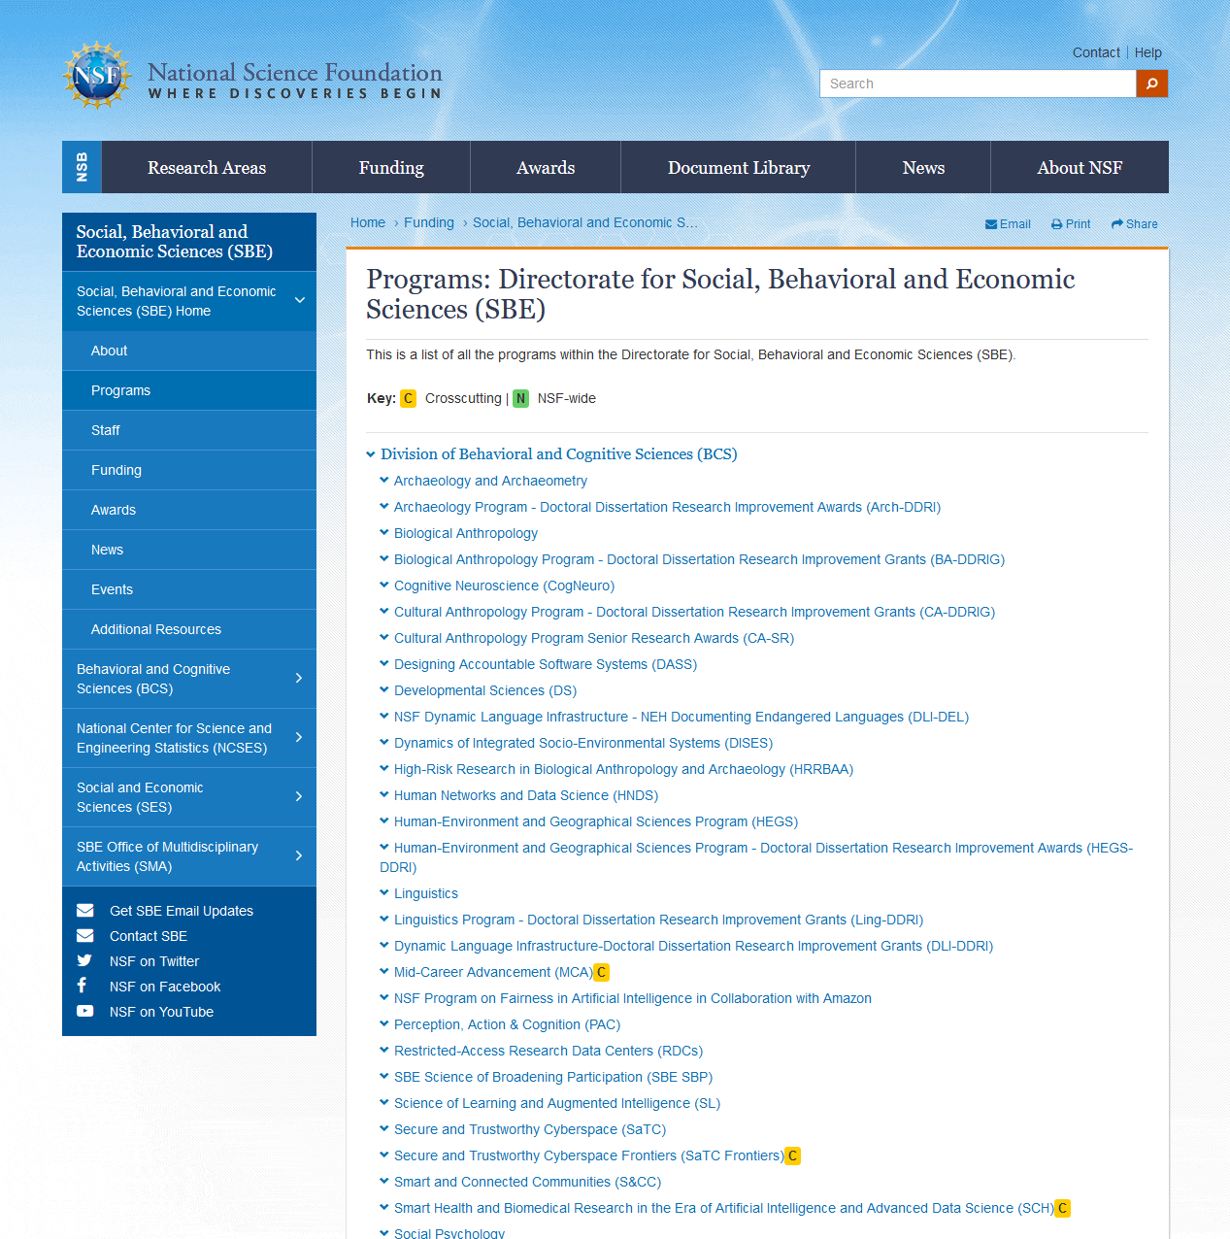
What should the representative program be?

Slide 13
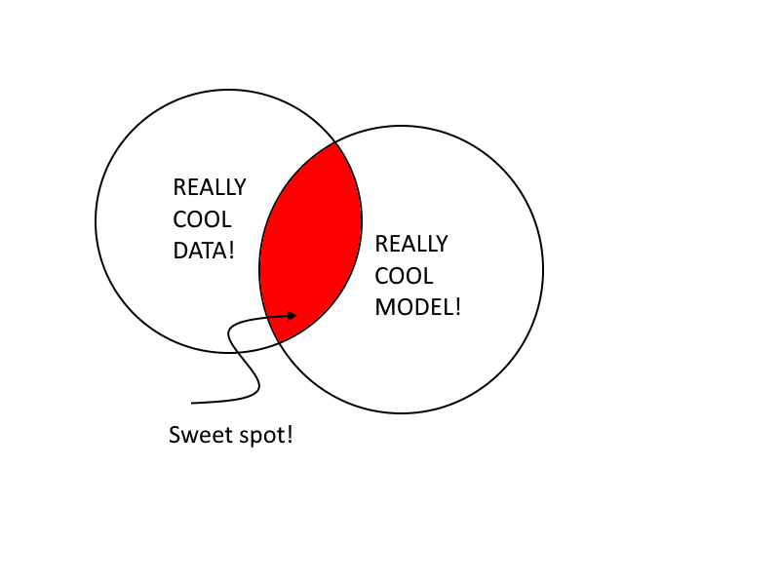
Is my project a good fit for HNDS-R?
A clearly-defined theoretical problem to be understood by way of causal mechanisms AND
Make novel use of data analytics and leverage “big” data sets AND/OR
Model human behavior using network analysis to improve understanding of how behavior and complex psycho-social systems change over time and in response to shocks/perturbations.

Slide 14

HNDS-R Projects
Measuring belief distortions to improve predictive outcomes (2153152, with Economics)
Group processes underlying deviance in online public spaces (2048670, with Sociology)
Testing quantitative predictions of sentence processing theories with a large-scale eye-tracking database (2020914, with PAC)
Dynamics of police networks (2046078, with L&S)
Elucidating the role of brain hubs in task control (2048066, with Cog Neuro)
Others

Slide 15
Methodology, Measurement, and Statistics Program (MMS)
Social and Economic Sciences (SES)
Cheryl L. Eavey
MMS Program Director
November 30, 2021

Slide 16
General Information
The Methodology, Measurement, and Statistics (MMS) Program is an interdisciplinary program in the Directorate for Social, Behavioral, and Economic Sciences
MMS supports the development of innovative analytical and statistical methods and models for those sciences
Specifically, MMS seeks proposals that are methodologically innovative, grounded in theory, and have potential utility for multiple fields within the social and behavioral sciences
More information is available on the MMS home page at Methodology, Measurement, and Statistics (MMS) | Beta site for NSF - National Science Foundation

Slide 17
Methods for Complex Data
MMS supports the development of methods for complex data
  Rank-based Inference for Complex and Noisy High-dimensional Data, SES-2019363
  Factor Based Imputation of Missing Data, SES-2018369
  Formal Privacy for Complex Data Objects, SES-1853209
  CAREER: Advancing Latent Variable Statistical Modeling for the Analysis of Big and Complex Longitudinal Data to Promote Personalized Learning, SES-1848451

Slide 18
Infrastructure Activities
MMS supports some infrastructure activities for the MMS community
  Developing a Vision for a 21st Century National Data Infrastructure for Federal Statistics and Social and Economic Research, SES-2114583
  A Robust and Reliable Resource for Accessing, Sharing, and Analyzing Confidential Geospatial Research Data, SES-2025783
  Research Data Centers: Florida Research Data Center, SES-1955355
  Partial Support for the Core Activities of the Committee on National Statistics, SES-1560294

Slide 19
Questions?

