Slide 1


Ethical and Responsible Research Solicitation 22-536
Wenda Bauchspies, PhD
Fred Kronz, PhD
Program Director
National Science Foundation

Slide 2
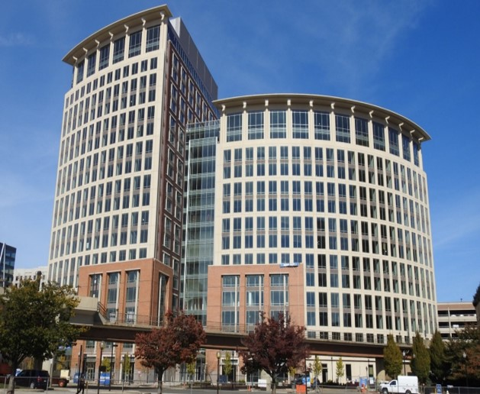
National Science Foundation
Mission: To promote the progress of science; to advance the national health, prosperity, and welfare; to secure the national defense…
Vision: A Nation that is the global leader in research and innovation

Slide 3
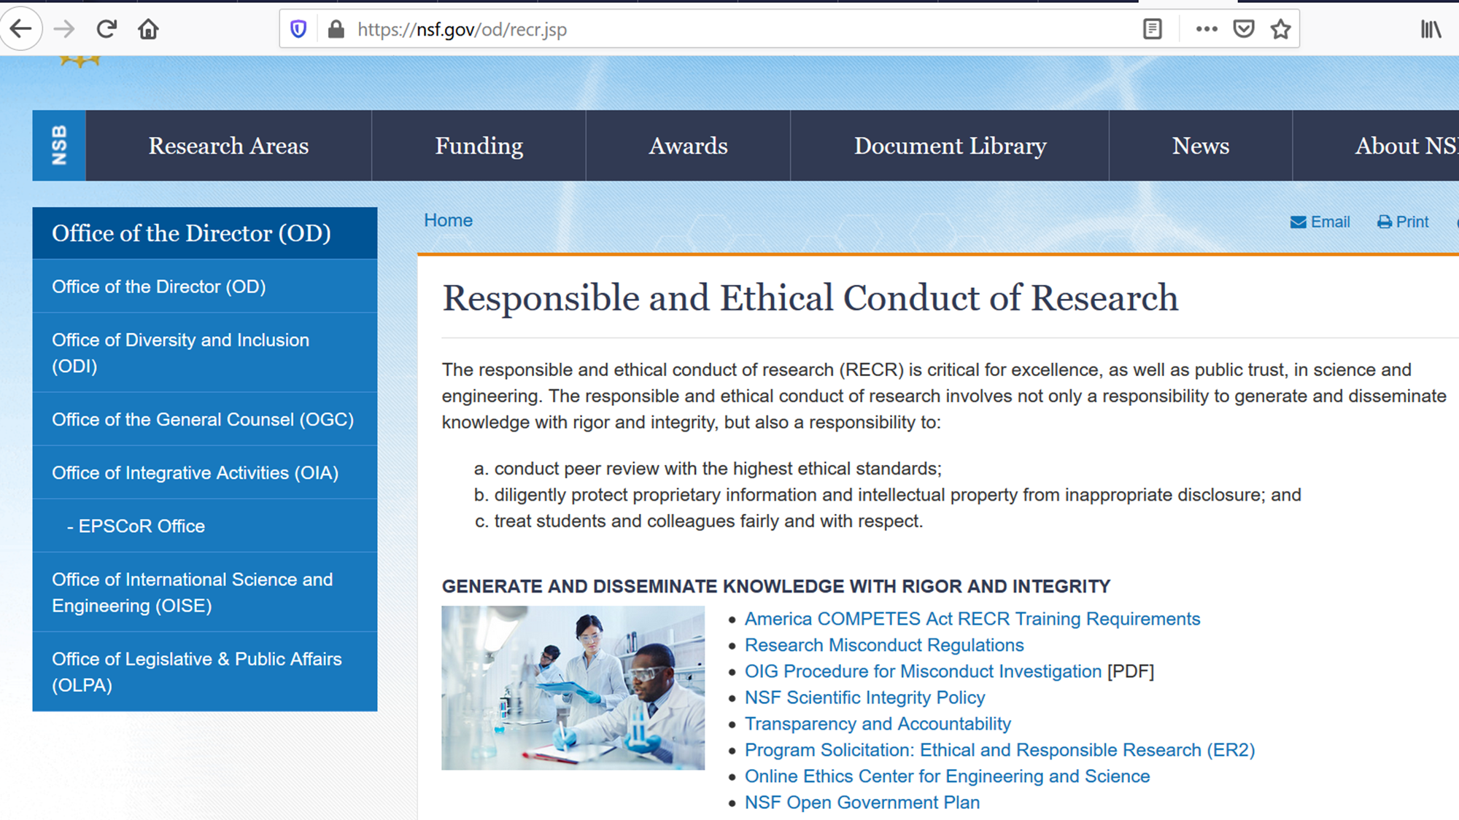
Responsible and Ethical Conduct of Research

Slide 4
Early work in Ethics at NSF
Ethics and Values Studies, and Research on Science and Technology, in the Division of Social, Behavioral and Economic Research. EVS was originally called Ethics and Values in Science and Technology (EVIST).
NSF 01152 The Societal Dimensions of Engineering, Science, and Technology (SDEST)
The Ethics and Values Studies (EVS) component supported examinations of the ethical and value dimensions in those interactions.
The Research on Knowledge, Science and Technology (RST) component supported research on social and strategic choices that influence knowledge production and innovation and their effects.

Slide 5
EESE to CCE STEM to ER2
2005 -- Ethics Education in Science and Engineering (EESE)
5 Directorates, Funding $1,550,000
2006 EESE
6 Directorates, Funding $1,550,000
2007 EESE
7 Directorates, Funding $1,850,000
2008 EESE
7 Directorates, Funding $2,400,000
2011 EESE
8 Directorates, Funding $3,000,000
2014 Cultivating Cultures for Ethical STEM
8 Directorates, Funding $3,050,000
2015 Cultivating Cultures for Ethical STEM
8 Directorates, Funding $3,150,000
Institutional Transformation Grants
2019 Ethical and Responsible Research (ER2)
8 Directorates, Funding $3,550,000
Conference Proposals & Project Incubation Proposals
2020 Ethical and Responsible Research (ER2)
8 Directorates, Funding $5,200,000

Slide 6
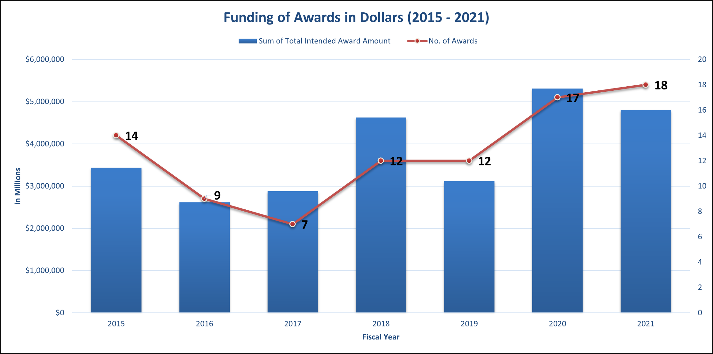
ER2 & CCE STEM: Funding Snapshot (FYs 2015 – 2021)
FY 2015: 14 awards, $3.4M
FY 2016: 9 awards, $2.6M
FY 2017: 7 awards, $2.8M
FY 2018: 12 awards, $4.6M
FY 2019: 12 awards, $3.1M
FY 2020: 17 awards, $5.3M
FY 2021: 18 awards. $4.7M

Slide 7
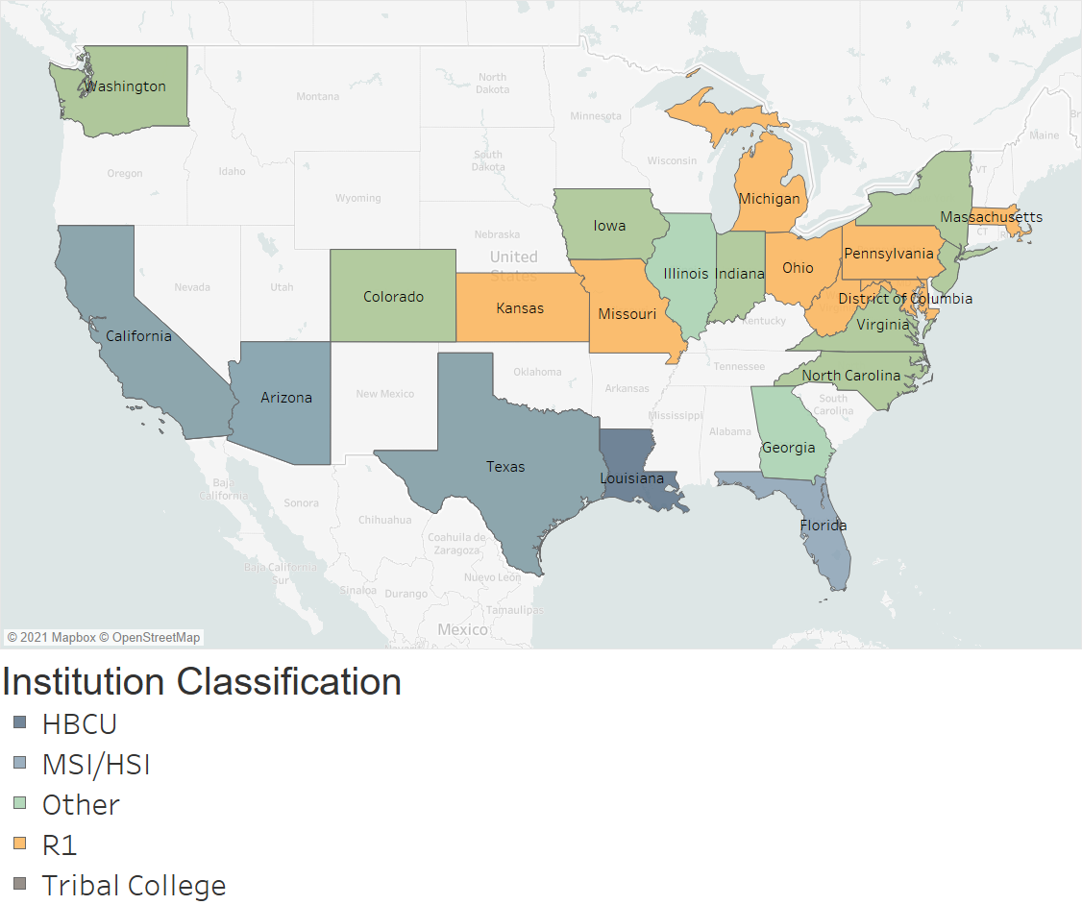
Map of ER2 & CCE STEM Awards (FYs 2015 – 2021)
Number of Awards:
1 - HBCUs
11 – MSIs/HSIs
1 - Tribal College
54 – R1s
22 – Other
States
HBCU: Louisiana
MSI/HSI: California, Arizona, Texas, and Florida
Other: Washington, Colorado, Iowa, Illinois, Indiana, New York, New Jersey, Virginia, North Carolina, and Georgia
R1s: Kansas, Missouri, Michigan, Ohio, Massachusetts, Pennsylvania, Maryland, District of Columbia, and West Virginia
Tribal College: Washington

Slide 8
ER2 New Solicitation
The limitation of one proposal per institution has been replaced with a limitation of the two proposals per Principal Investigator (PI) or Co-PI.
The synopsis, introduction and program description have been updated to reflect NSF priority areas as well as to clarify what types of research questions are of interest to the program.

Slide 9
Continued
Proposal Deadline:
January 21, 2022
January 21, Annually Thereafter
Estimated Number of Awards: 10 to 15
Anticipated Funding Amount: $5,200,000

Slide 10
Solicitation will consider proposals for four types of projects
Conference Projects with a total budget of $50,000 and a maximum duration of 12 months.
Incubation Projects with a total budget of up to $90,000 and a maximum duration of 12 months.
Research Grants with a total budget of up to $400,000 and a maximum duration of 3 years.
Institutional Transformation Research Grants with a total budget of up to $700,000 and a maximum duration of 5 years.

Slide 11
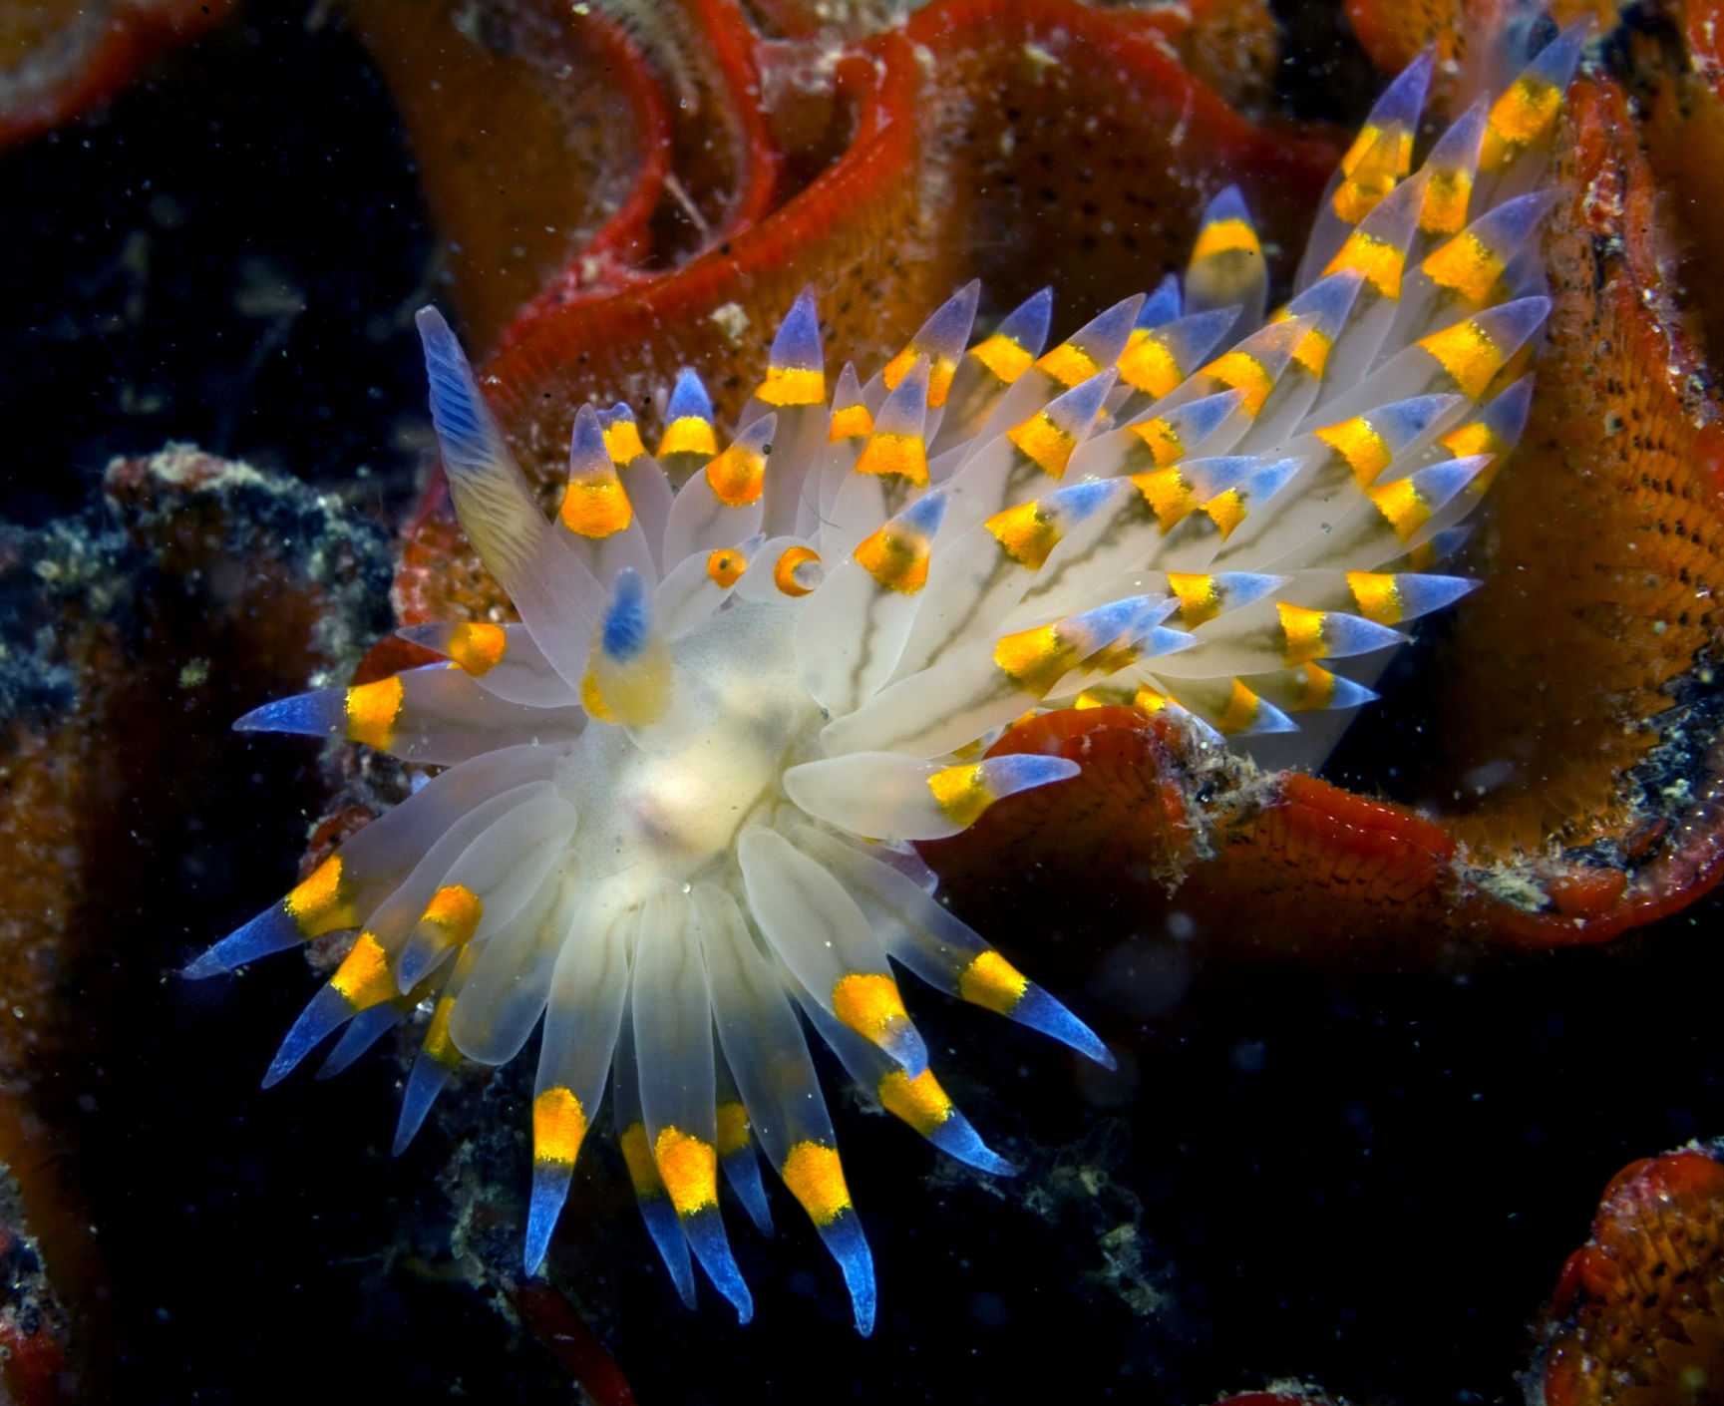
Questions? Thoughts? Comments?
Wenda K. Bauchspies
Wbauchsp@nsf.gov
Thank you.
A nudibranch, commonly known as a sea slug, travels under the North T-Pier in Morro Bay, California. Photo credit: Ken Bondy

Slide 12
Cognizant Program Officer(s)
Wenda Bauchspies (SBE), telephone: 703-292-5034, email: wbauchsp@nsf.gov
Cassandra M Dudka (OISE), telephone: (703) 292-7250, email: cdudka@nsf.gov
Andrew (Andruid) Kerne (CISE/IIS), telephone: (703) 292-8574, email: akerne@nsf.gov
Frederick M. Kronz (SBE), telephone: 703-292-7283, email: fkronz@nsf.gov
Jumoke Ladeji-Osias (ENG/EEC), telephone: (703) 292-7708, email: jladejio@nsf.gov
Elizabeth L Rom (GEO), telephone: (703) 292-7709, email: elrom@nsf.gov
George Richter-Addo (MPS), telephone: (703) 292-7528, email: grichter@nsf.gov
Michael D Steele (EHR), telephone: (703) 292-4313, email: msteele@nsf.gov

Slide 13
Responsible Conduct of Research at NSF
America COMPETES Act of 2007 :
"...each institution that applies for financial assistance from the Foundation for science and engineering research or education describe in its grant proposal a plan to provide appropriate training and oversight in the responsible and ethical conduct of research to undergraduate students, graduate students, and postdoctoral researchers participating in the proposed research project." (H.R. 2722, Section 7009)
National Academies of Sciences, Engineering, and Medicine, 2017 report Fostering Integrity in Research, notes that the core values and guiding norms underpinning research integrity are crucial to assure that new generations of researchers meet the challenges of a dynamic research environment
France Cordova’s Important Notice to Presidents of Universities and Colleges and Heads of Other National Science Foundation Grantee Organizations August 17, 2017

Slide 14
Online ethics resource centers funded by NSF
Ethics Education Library. Illinois Institute of Technology (http://ethics.iit.edu/eelibrary/).
IDEESE: International Dimensions of Ethics Education in Science & Engineering. University of Massachusetts Amherst (http://www.umass.edu/sts/ethics/);
National Center for Professional & Research Ethics. University of Illinois (https://ethicscenter.csl.illinois.edu/).
Online Ethics Center. Formerly at National Academy of Engineering and now at University of Virginia (http://www.onlineethics.org/).

Slide 15
share their findings with others via the Online Ethics Center for Engineering and Science
Award Abstract # 1355547 Becoming the Online Resource Center for Ethics Education in Engineering and Science NATIONAL ACADEMY OF SCIENCES
Award Abstract # 1835232 Transforming Ethics Education: Connecting STEM Faculty, Research Administrators, and Ethics Education Resources through the Online Ethics Center NATIONAL ACADEMY OF SCIENCES
Award Abstract # 2055332 Transforming Ethics Education: Connecting STEM Faculty, Research Administrators, and Ethics Education Resources through the Online Ethics Center THE UNIVERSITY OF VIRGINIA

