Slide 1


Presentation Cover Slide
Build and Broaden 3.0 (B2 3.0): Enhancing Social, Behavioral and Economic Science Research and Capacity at Minority-Serving Institutions
Directorate for Social, Behavioral and Economic Sciences
December 2021

Slide 2
SBE: NSF’s Social, Behavioral, and Economic Sciences Directorate
SBE researchers conduct groundbreaking research
SBE researchers create fundamental data and analytic infrastructure
SBE researchers provide essential training that empowers people and improves quality of life
Build and Broaden Program Page: https://go.usa.gov/xew62

Slide 3



Goals of Build and Broaden 3.0 (B2 3.0)
Increase MSI representation among institutions receiving competitive SBE awards
Enhance research productivity, infrastructure and capacity in SBE sciences at MSIs
Increase the number of partnerships and collaborative proposals between MSIs and non-MSIs
Build and Broaden Program Page: https://go.usa.gov/xew62

Slide 4
Program Summary
Full proposal target date:
March 1, 2022
We expect to fund between 25 and 30 awards
Types of awards supported:
Standard research
Collaborative proposals
Early-concept Grants for Exploratory Research (EAGER)
Research Coordination Network (RCN)
Conference proposals
An individual may be the PI or co-PI for only one proposal
There are no limits on individual award funds or duration
Build and Broaden Program Page: https://go.usa.gov/xew62

Slide 5
Eligibility: Who may serve as PI?
Proposals are invited from:
A full-time scientist, educator, or researcher at an accredited minority-serving institution (MSI)
A full-time scientist, educator, or researcher who is not affiliated with MSIs, but who applies with co-investigators from MSIs
These proposals must describe how the project will foster research partnerships or capacity-building with at least one MSI​
At least 50% of the overall project’s direct costs must go to the MSI
Build and Broaden Program Page: https://go.usa.gov/xew62

Slide 6
Eligibility: Which institutions may submit a proposal?
The lead institution on a B2 3.0 proposal may be any minority-serving institution or any non-MSI…
However, we strongly encourage proposals from institutions that have received less than the following amounts within the previous five years:
Fewer than $25,000,000 total in NSF awards, or
Fewer than $3,000,000 total in SBE awards
Institutions that have received funding in excess of these amounts are encouraged to collaborate with institutions that do meet these criteria
How do I find out how much funding my organization has received?
Please use the NSF Awards Advance Search tool (Link to Awards Advance Search)
Build and Broaden Program Page: https://go.usa.gov/xew62

Slide 7
Eligibility: Is my institution an MSI?
For the purposes of this solicitation, MSIs include:
Historically Black colleges and universities (HBCU)
Hispanic-serving institutions (HSI)
Tribal colleges and universities (TCU)
Alaska Native-serving institutions or Native Hawaiian-serving institutions (ANNH)
Predominantly Black institutions (PBI)
Asian American and Native American Pacific Islander-serving institutions (AANAPISI)
Native American-serving non-tribal institutions (NASNTI)
If you are unsure about your MSI status, ask administrators at your institution, or check the Department of Education website for eligibility (Link to eligibility lists for MSIs)
Build and Broaden Program Page: https://go.usa.gov/xew62

Slide 8
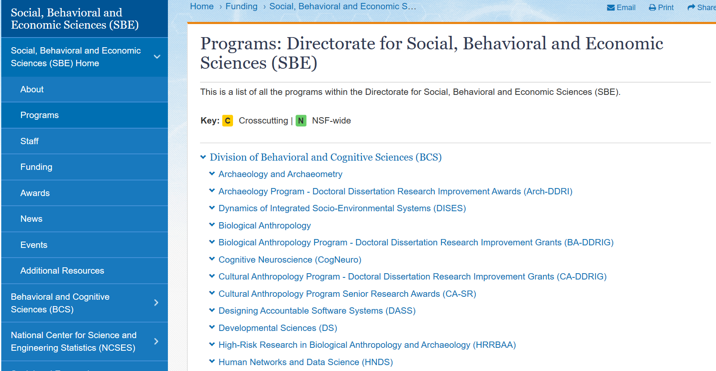
Proposals may address any scientific area supported by SBE
Build and Broaden Program Page: https://go.usa.gov/xew62

Slide 9
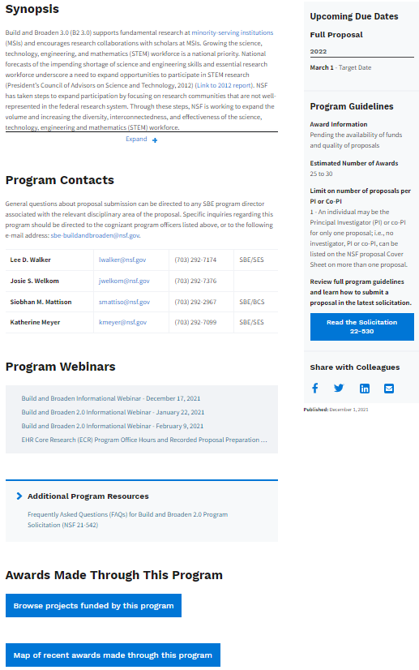
Learn more about B2 3.0
What is B2 3.0 and why was it created?
Who are the Program Directors
and how do you contact them?
What additional resources are available?
How do I know if my research is a good fit for Build and Broaden?
Build and Broaden Program Page: https://go.usa.gov/xew62

Slide 10
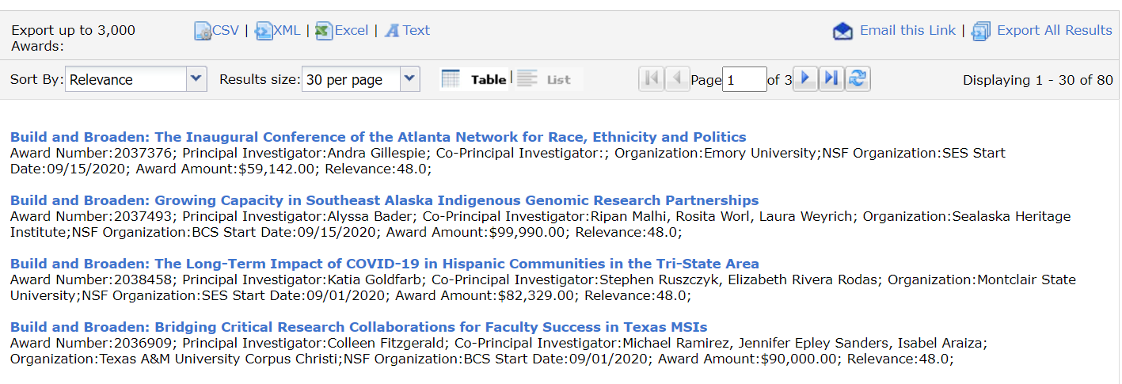
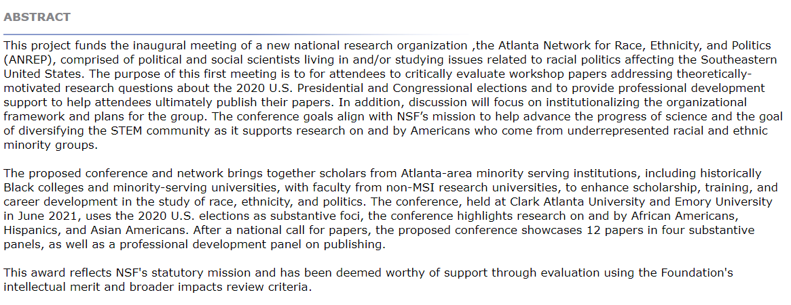
Discover funded projects and read abstracts
What has been funded through the Build and Broaden program?
You can also review the abstracts of awards.
These resources may help you get a better understanding of how your proposal fits in among the research supported by SBE.
Build and Broaden Program Page: https://go.usa.gov/xew62
Notes:
I'd mention that prior awards give a good sense of what the program funds but there are other areas that could also fit

Slide 11
How to submit B2 3.0 Proposals
For questions related to the use of FastLane or Research.gov, contact:
FastLane and Research.gov Help Desk: 1-800-673-6188
FastLane Help Desk e-mail: fastlane@nsf.gov
Research.gov Help Desk e-mail: rgov@nsf.gov
*Note: Fastlane.gov will be retired in December 2022
For questions relating to Grants.gov contact:
Grants.gov Contact Center: 1-800-518-4726; e-mail: support@grants.gov
Build and Broaden Program Page: https://go.usa.gov/xew62

Slide 12
Before you submit, be sure to:
Get support from your institution & sponsored research office early
Make sure to pay attention to internal deadlines
Communicate with Build and Broaden POs
Build and Broaden Program Page: https://go.usa.gov/xew62

Slide 13
How to contact B2 3.0 program officers
Build and Broaden contact information:
sbe-buildandbroaden@nsf.gov
Lee D. Walker, telephone: (703) 292-7174, email: lwalker@nsf.gov
Josie Welkom Miranda, telephone: (703) 292-7376, email: jwmirand@nsf.gov
Siobhán M. Mattison, telephone: (703) 292-2967, email: smattiso@nsf.gov
Katherine Meyer, telephone: (703) 292-7099, email: kmeyer@nsf.gov
For specific questions about B2 3.0, you may include a “one-pager” with your inquiries to the cognizant program officers
Build and Broaden Program Page: https://go.usa.gov/xew62

Slide 14
Example One-Pager
Background
Fit with B2 3.0 program
Research questions & hypotheses
1. Overview
2. Intellectual Merit
3. Broader Impacts
Potential to advance knowledge in fundamental SBE science
Potential to benefit society
Contribution to achievement of specific societal outcomes
Build and Broaden Program Page: https://go.usa.gov/xew62

Slide 15
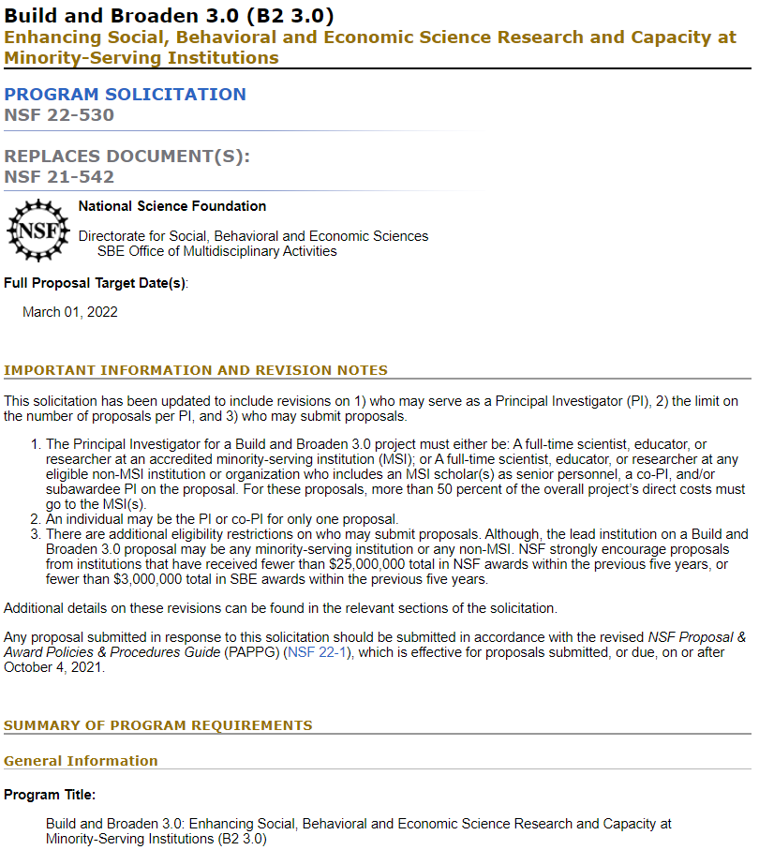

Proposal Preparation Instructions
Build and Broaden Program Page: https://go.usa.gov/xew62

Slide 16
Project Summary
Must include three labeled sections:
Overview of the project, beginning with the following:
List of Participating MSI(s)
Description of the MSI(s) and MSI proportion of requested support
Research discipline(s) advanced by the project
A statement on the Intellectual Merit of the project
A statement on the Broader Impacts of the project
Build and Broaden Program Page: https://go.usa.gov/xew62

Slide 17
Project Description Part 1
Must also include three labeled sections:
Nature of Partnership and Investigator Roles:
If proposal is submitted by a single PI, write “does not apply” in this section
If the proposal includes a partnership:
Detail the nature of the research partnership between all participating institutions
Describe the roles of each PI, co-PI, Senior Personnel, and collaborators
Proposals submitted by PIs not based at an MSI must also:
Describe clearly the nature of the partnership with the participating MSI(s),
Include efforts to ensure true collaborations among MSI and non-MSI participants
Build and Broaden Program Page: https://go.usa.gov/xew62

Slide 18
Project Description Part 2
Nature of Partnership and Investigator Roles
Intellectual Merit: Explain how the proposed work advances theory/basic science in one or more core SBE science areas
Build and Broaden Program Page: https://go.usa.gov/xew62

Slide 19
Project Description Part 3
Nature of Partnership and Investigator Roles
Intellectual Merit
Broader Impacts: Explain how the project will enhance career development, research productivity and trajectories, collaborative research networks, or professional training for faculty and students at the participating MSI(s)
Build and Broaden Program Page: https://go.usa.gov/xew62

Slide 20
Other Required Documents
1. References Cited
2. Biographical Sketch – required to use NSF format
3. Current & Pending Support – required to use NSF format
4. Facilities Equipment and Other Resources
Build and Broaden Program Page: https://go.usa.gov/xew62

Slide 21
Budget & Justification
Ask for what you need to execute the project
Justify all costs and provide enough detail
For collaborations, at least 50% of the project’s direct costs must go to the participating MSI(s)
Talk over the proposed budget with the university/college officials who ultimately submit the proposal
If the proposal is selected for funding, program officers do work with applicants on adjusting the proposed budget as needed
Build and Broaden Program Page: https://go.usa.gov/xew62

Slide 22
Budget & Salary
Program officers are attentive to how much of the requested budget goes to salary, research costs, and costs to support broader impacts
Proposals may include limited requests for resources to enable researchers at MSIs to be full and equal partners
Salary compensation could enable a reduction in teaching responsibilities (aka “teaching buyouts”)
You can request buyout if it is required to successfully pursue the proposed research
NSF does not typically pay for more than 2 months of salary, but exceptions are possible
Please refer to the PAPPG for full guidelines on salaries and wages, and contact program officers and university officials for further guidance
Build and Broaden Program Page: https://go.usa.gov/xew62

Slide 23
Supplementary Documents
Data Management Plan
Must include a statement of how the data will be made publicly available
Collaborators and Other Affiliations Information (COA) – Required of all senior personnel
Postdoctoral Mentoring Plan: If applicable
Letters of collaboration: Not required
Build and Broaden Program Page: https://go.usa.gov/xew62

Slide 24
How will B2 3.0 proposals be reviewed?
B2 Review Process:
Panel Review
Ad hoc as necessary
Co-review
Suggest programs
Please suggest reviewers for your proposal!
Aren’t submitting to B2 3.0 this cycle? Consider being a reviewer
Build and Broaden Program Page: https://go.usa.gov/xew62

Slide 25
Review Criteria: Intellectual Merit
‘…the potential to advance knowledge’
‘…and understanding within its own field or across different fields’?
‘…suggest or explore creative, original, or potentially transformative concepts?’
‘Is the plan for carrying out the proposed activities well-reasoned, well-organized, and based on a sound rationale?’
‘How well-qualified is the individual, team, or organization to conduct the proposed activities?’
‘Are there adequate resources available to the PI…?’
Build and Broaden Program Page: https://go.usa.gov/xew62

Slide 26
Review Criteria: Broader Impacts
‘…the potential to benefit society and contribute to the achievement of specific, desired societal outcomes.’
Do NOT need to follow directly from research objectives (but often more coherent if they do)
Specify who benefits and how (pathways to broader impacts)
Are impacts ‘credible’?
Build and Broaden Program Page: https://go.usa.gov/xew62

Slide 27
Additional Solicitation Specific Review Criteria
B2 3.0 proposals will also be evaluated on the following:
Intellectual quality of the proposed research and associated activities in research areas supported by SBE
Potential to increase the quantity, quality, and capacity of research at the participating MSI(s)
Impacts upon the professional development of faculty and students at the participating MSI(s)
If a partnership is proposed, the nature of the partnership among the participating institutions and investigators
Build and Broaden Program Page: https://go.usa.gov/xew62

Slide 28
Recap of Important Points
Eligibility: MSI scholars; scholars partnering with MSIs
Purpose: Support fundamental research in any area covered by SBE
Infrastructure, capacity-building, training may be included, but not primary objective
These activities should support, not supersede, the goals of the research
When in doubt: Contact a program officer
Build and Broaden Program Page: https://go.usa.gov/xew62

