Slide 1


Presentation Cover Slide
Build and Broaden 3.0 (B2 3.0): Enhancing Social, Behavioral and Economic Science Research and Capacity at Minority-Serving Institutions
Directorate for Social, Behavioral and Economic Sciences
January 2022

Slide 2
Presentation Summary
Review of the Build and Broaden program
General Proposal Preparation Guidance
Q & A
Build and Broaden Program Page: https://go.usa.gov/xew62

Slide 3
Build and Broaden 3.0
Full proposal target date:
March 1, 2022
Goal: To enhance fundamental social, behavioral, and economic science (SBE) research at minority-serving institutions (MSIs)
Anticipated number of awards: 25 – 30
  There are no limits on individual award funds or duration
Types of awards supported:
  Standard grants
  Collaborative proposals
  Early-concept Grants for Exploratory Research (EAGER)
  Research Coordination Network (RCN)
  Conference proposals
Proposals may address any scientific area supported by SBE
  Infrastructure, capacity-building, training may be included, but not primary objective
  These activities should support, not supersede, the goals of the research
Build and Broaden Program Page: https://go.usa.gov/xew62

Slide 4
Summary of eligibility requirements
Who may serve as principal investigator?
  A full-time scientist, educator, or researcher who is affiliated with an accredited minority-serving institution (MSI)…
  Or a full-time scientist, educator, or researcher who is not affiliated with an MSI, but who applies with co-investigators from an MSI
    At least 50% of the overall project’s direct costs must go to the participating MSI
***Note: An individual may be the PI or co-PI for only one proposal
Which institutions may be lead institutions on B2 3.0 proposals?
  The lead institution on a B2 3.0 proposal may be any MSI or non-MSI…
  However, NSF strongly encourages proposals from that have received fewer than $25,000,000 total in NSF awards or fewer than $3,000,000 total in SBE awards within the previous 5 years
How do I know if my institution is an eligible MSI?
  For the purposes of this solicitation, MSIs include: HBCU – HSI – TCU – ANNH – PBI – AANAPISI – NASNTI
  Ask administrators at your institution about your MSI status, or check the Department of Education website for eligibility (Link to eligibility lists for MSIs)
Build and Broaden Program Page: https://go.usa.gov/xew62

Slide 5
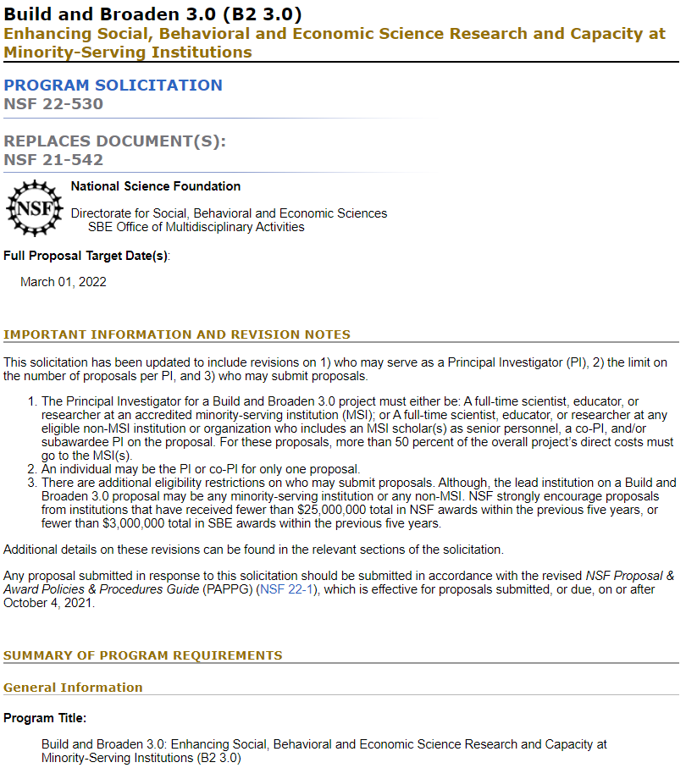

Proposal Preparation Instructions
Build and Broaden 3.0 solicitation
PAPPG
Build and Broaden Program Page: https://go.usa.gov/xew62

Slide 6
Project Summary
Must include three labeled sections:
Overview of the project, beginning with the following:
  List of Participating MSI(s)
  Description of the MSI(s) and MSI proportion of requested support
  Research discipline(s) advanced by the project
A statement on the Intellectual Merit of the project
A statement on the Broader Impacts of the project
Build and Broaden Program Page: https://go.usa.gov/xew62

Slide 7
Project Description
Intellectual Merit: Explain how the proposed work advances theory/basic science in one or more core SBE science areas
Broader Impacts: Explain how the project will enhance career development, research productivity and trajectories, collaborative research networks, or professional training for faculty and students at the participating MSI(s)
Nature of Partnership and Investigator Roles: If the proposal includes a partnership*, detail the nature of the research partnership between all institutions and describe the roles of each PI, co-PI, Senior Personnel, and collaborator.
    Proposals submitted by PIs not based at an MSI must also:
      Describe clearly the nature of the partnership with the participating MSI(s)
      Include efforts to ensure true collaborations among MSI and non-MSI participants
    *If proposal is submitted by a single PI, write “does not apply” in this section
Build and Broaden Program Page: https://go.usa.gov/xew62

Slide 8
Budget & Justification
Ask for what you need to execute the project
Justify all costs and provide enough detail
For collaborations, at least 50% of the project’s direct costs must go to the participating MSI(s)
Talk over the proposed budget with the university/college officials who ultimately submit the proposal
If the proposal is selected for funding, program officers do work with applicants on adjusting the proposed budget as needed
Build and Broaden Program Page: https://go.usa.gov/xew62

Slide 9
Budget & Salary
Program officers are attentive to how much of the requested budget goes to salary, research costs, and costs to support broader impacts
Proposals may include limited requests for resources to enable researchers at MSIs to be full and equal partners
Salary compensation could enable a reduction in teaching responsibilities (aka “teaching buyouts”)
  You can request buyout if it is required to successfully pursue the proposed research
NSF does not typically pay for more than 2 months of salary, but exceptions are possible
Please refer to the PAPPG for full guidelines on salaries and wages, and contact program officers and university officials for further guidance
Build and Broaden Program Page: https://go.usa.gov/xew62

Slide 10
How will B2 3.0 proposals be reviewed?
B2 Review Process:
  Panel Review
  Ad hoc as necessary
  Co-review
    Suggest programs
  Please suggest reviewers for your proposal!
Build and Broaden Program Page: https://go.usa.gov/xew62

Slide 11
Review Criteria
Intellectual Merit
‘…the potential to advance knowledge’
  ‘…and understanding within its own field or across different fields’?
‘…suggest or explore creative, original, or potentially transformative concepts?’
‘How well-qualified is the individual, team, or organization to conduct the proposed activities?’
‘Are there adequate resources available to the PI…?’
Broader Impacts
‘…the potential to benefit society and contribute to the achievement of specific, desired societal outcomes.’
Do NOT need to follow directly from research objectives (but often more coherent if they do)
Specify who benefits and how (pathways to broader impacts)
Are impacts ‘credible’?
Criteria specific to B2 3.0
Intellectual quality of the proposed research and associated activities in research areas supported by SBE
Potential to increase the quantity, quality, and capacity of research at MSIs
Impacts upon the professional development of faculty and students at MSIs
If a partnership is proposed, the nature of the partnership among the participating institutions and investigators
Build and Broaden Program Page: https://go.usa.gov/xew62

Slide 12
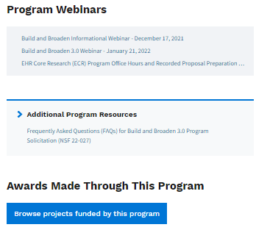
Identify supplementary resources for proposal preparation
Find copies of proposals – both funded and unfunded
  NSF cannot provide these
  Read them alongside a relevant solicitation
Utilize materials on the Build and Broaden 3.0 program page
Consult webinar materials and FAQs
Review abstracts of funded B2 projects
Build and Broaden Program Page: https://go.usa.gov/xew62
Notes:
First, find copies of funded and unfunded proposals. NSF cannot provide these, so try to leverage your professional network. You’ll want to read them alongside a relevant solicitation. This practice can help you understand the elements of successful proposals, and why some proposals may not be funded.

Slide 13
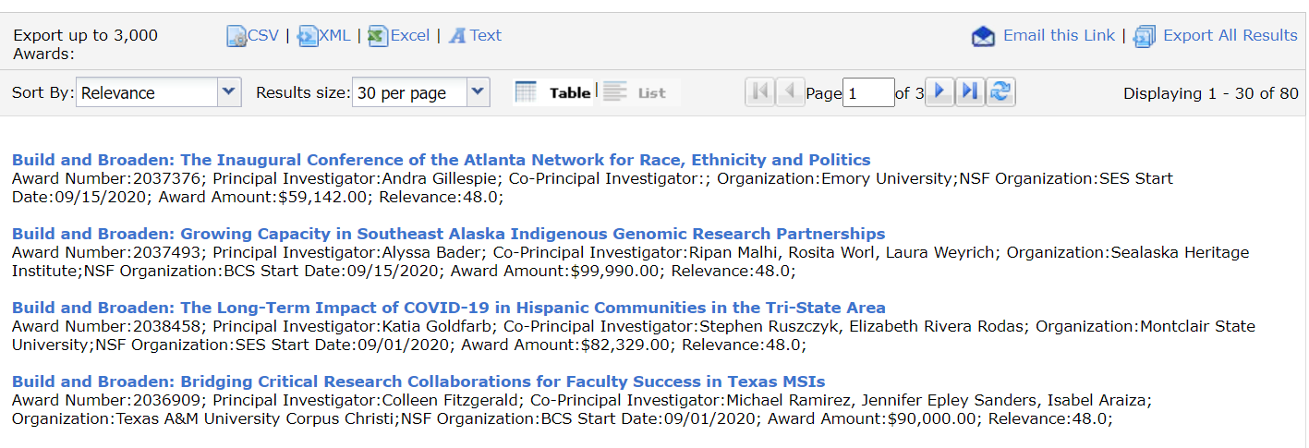
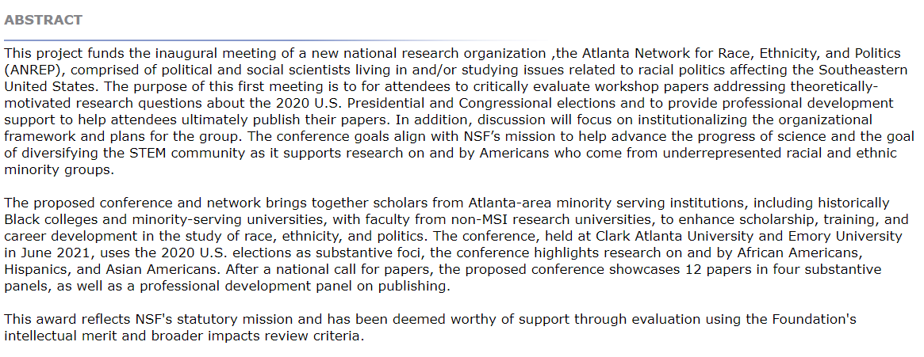
Review funded projects and read abstracts
What has been funded through the Build and Broaden program?
You can also review the abstracts of awards.
These resources may help you get a better understanding of how your proposal fits in among the research supported by SBE.
Build and Broaden Program Page: https://go.usa.gov/xew62
Notes:
I'd mention that prior awards give a good sense of what the program funds but there are other areas that could also fit

Slide 14
Make sure to prepare other required & supplementary documents
References Cited
Biographical Sketch – required to use NSF format
Current & Pending Support – required to use NSF format
Facilities Equipment and Other Resources
Collaborators and Other Affiliations Information (COA) – Required of all senior personnel
Data Management Plan
  Must include a statement of how the data will be made publicly available
  Consult guidance in Data Management Plan for SBE Proposals and Awards document
Postdoctoral Mentoring Plan: If applicable
Letters of collaboration: Not required for B2 3.0, but follow directions in the PAPPG if including
Build and Broaden Program Page: https://go.usa.gov/xew62

Slide 15
Work closely and efficiently with your institution
Get to know your SRO & the process of submitting grants at your institution
    Understand your institution’s workflow process
Communicate with research administrators early and often
Make sure ethical approvals are in the works
  You do not need to have approval at the time of proposal submission
Pay attention to internal deadlines
Identify what makes you, your institution, or research idea unique and consider how to best convey this in your proposal
Build and Broaden Program Page: https://go.usa.gov/xew62
Notes:
First, you’re going to want to get to know your sponsored research office. Try to learn as many details as you can about the process of submitting grants at your institution. This includes ethical approvals. Next, brainstorm what makes you, your institution, or research idea unique and consider how to best convey this in your proposal.

Slide 16
How to submit B2 3.0 Proposals
For questions related to the use of FastLane or Research.gov, contact:
  FastLane and Research.gov Help Desk: 1-800-673-6188
  FastLane Help Desk e-mail: fastlane@nsf.gov
  Research.gov Help Desk e-mail: rgov@nsf.gov
  *Note: Fastlane.gov will be retired in December 2022
For questions relating to Grants.gov contact:
  Grants.gov Contact Center: 1-800-518-4726; e-mail: support@grants.gov
Build and Broaden Program Page: https://go.usa.gov/xew62

Slide 17
Questions before you submit? Contact B2 program officers
Build and Broaden contact information:
  sbe-buildandbroaden@nsf.gov
  Lee D. Walker, telephone: (703) 292-7174, email: lwalker@nsf.gov
  Josie Welkom Miranda, telephone: (703) 292-7376, email: jwmirand@nsf.gov
  Siobhán M. Mattison, telephone: (703) 292-2967, email: smattiso@nsf.gov
  For specific questions about your B2 3.0 proposal, you may include a one-page project synopsis with your inquiries to the program officers
Build and Broaden Program Page: https://go.usa.gov/xew62

Slide 18
Example One-Pager
Background
Fit with B2 3.0 program
Research questions & hypotheses
1. Overview
2. Intellectual Merit
3. Broader Impacts
Potential to advance knowledge in fundamental SBE science
Potential to benefit society
Contribution to achievement of specific societal outcomes
Build and Broaden Program Page: https://go.usa.gov/xew62

Slide 19

Questions?
Contact us:
Build and Broaden email: sbe-buildandbroaden@nsf.gov
Build and Broaden Program Page: https://go.usa.gov/xew62

