Slide 1


NSF 22-533
The Future of Work at the Human-Technology Frontier: Core Research
Proposal Deadline
March 2, 2022
Transition-to-Scale Proposal Category
Notes:
This goal of this presentation is to provide guidance on the Transition-to-Scale proposal category for the National Science Foundation’s FY 2022 solicitation number NSF 22-533: Future of Work at the Human-Technology Frontier: Core Research. The intent is to provide clarification for prospective PIs who wish to submit a Transition-to-scale proposal that is responsive to the solicitation by the March 2nd deadline. Note that this presentation is not a substitute for reading the solicitation. All PIs should read the solicitation carefully as the solicitation establishes the definitive requirements for the 2022 competition. PIs are also encouraged to view the General Guidance Video, which can be found on the Program Website.

Slide 2

Objectives of the TTS Proposal Category
Support large-scale realistic deployments, built upon foundational knowledge, addressing compelling research questions about future technology, future workers, and future work.
Generate new insights that arise uniquely from application at scale.
This track is not appropriate for…
  proof-of-concept at scale for new research;
  deployment at scale without new research questions.
2
Notes:
Program objectives for the Transition-to-scale proposal category are
to support large-scale realistic deployments, built upon foundational knowledge, and addressing compelling research questions about future technology, future workers, and future work,
and to Generate new insights that arise uniquely from application at scale.
This track is not appropriate for…
proofs-of-concept at scale for new research, or
deployment at scale without new research questions.

Slide 3
Definitions of “Scale”
“Scale” comprises wider views of work, workers, workplaces, technologies, and training, including but not limited to:
Adapting successful proofs-of-concept from individual instances to entire sectors
Expanding from one work context to new work sectors or domains
Comparing across technologies, interventions, contexts
Involving more, and/or more diverse, stakeholders
Supporting increased resources for worker training and evaluation
Studying, designing, and evaluating outcomes at longer timescales
Addressing organizations at multiple resolutions: individuals, teams, projects, divisions, etc.
3
Notes:
For the purposes of the FW-HTF: Core Research solicitation, scale is defined as larger or wider views of work, workers, workplaces, technologies, and training, including but not limited to,
Adapting successful proofs-of-concept from individual instances to entire sectors
Expanding from one work context to new work sectors or domains
Comparing across technologies, interventions, contexts
Involving more, and/or more diverse, stakeholders
Supporting increased resources for worker training and evaluation
Studying, designing, and evaluating outcomes at longer timescales, and
Addressing organizations at multiple resolutions, such as individuals, teams, projects, divisions, etc.

Slide 4
Definitions of “Scale”
Proposals are not expected to address every dimension of scale.
Teams should justify the dimension(s) they choose to focus on in terms of both intellectual merit and broader impact of those choices.
Budgets should be commensurate with the degree of scale and activities, as explained in the budget justification.
4
Notes:
Proposals are not expected to address every dimension of scale.
Teams should justify the dimension(s) they choose to focus on in terms of both intellectual merit and broader impact of those choices.
Budgets should be commensurate with the degree of scale and activities, as explained in the budget justification.

Slide 5
Collaborators/Partners
Lead institution must be an institution of higher education (IHE) or a non-profit organization engaged in research activities.
Non-lead collaborative proposals may be submitted by IHEs, or a non-profit organizations engaged in research activities.
Partners included via subaward can include IHEs, non-profits, small business, large business, unions, NGOs, community organizations, etc.
TTS proposals involving foreign collaborators will be considered, provided support is requested only for the U.S. portion of the collaborative effort. Direct NSF funding to foreign organizations is not anticipated. (For more information see the NSF Proposal & Awards Policies and Procedures Guide or ask a FW-HTF Program Director.)
5
Notes:
The lead institution of a collaborative project must be an institution of higher education (IHE) or a non-profit organization engaged in research activities.
Non-lead collaborative proposals may be submitted by IHEs, or a non-profit organizations engaged in research activities.
Partners included via subaward can include IHEs, non-profits, small business, large business, unions, NGOs, community organizations, etc.
TTS proposals involving foreign collaborators will be considered as long as support is requested only for the U.S. portion of the collaborative effort. Direct NSF funding to foreign organizations is not anticipated.
For more information see the NSF Proposal & Awards Policies and Procedures Guide

Slide 6
Outcomes for TTS Projects
FW-HTF-T projects should:
Conduct fundamental research that can only be done at scale.
Set the stage for adoption/transition to practice.
Strengthen partnerships and collaborations beyond academia.
TTS is part of a “virtuous cycle”:
Address questions raised by smaller-scale research and deployment.
Uncover new fundamental research questions and opportunities.
Increase the potential impact of smaller-scale research.
Build foundations for future translation and partnerships.
6
Notes:
FW-HTF – T projects should:
Conduct fundamental research that can only be done at scale.
Set the stage for adoption or transition to practice, and
Strengthen partnerships and collaborations beyond academia.
Conceptually, Transition-to-scale is conceived as part of a “virtuous cycle” wherein projects will:
Address questions raised by smaller-scale research and deployment
Uncover new fundamental research questions and opportunities, and
Increase the potential impact of smaller-scale research
Build foundations for future translation and partnerships

Slide 7
Readiness and Rationale for Transition-to-Scale I
This section must include a “Readiness and Rationale for Transition to Scale” section that should…
Describe the theoretical and empirical basis of previous research outcomes on which the proposal is based;
Describe the research challenges involved in the proposed transition to scale; and
Relate how data collection across multiple industrial sectors or geographic locations, and at regional, national, or international level, will support these objectives.
7
Notes:
Transition-to-scale proposals must include a section titled “Readiness and Rationale for Transition to Scale”, which should…
Describe the theoretical and empirical basis of previous research outcomes on which the proposal is based;
Describe the research challenges involved in the proposed transition to scale; and
Relate how data collection across multiple industrial sectors or geographic locations, and at regional, national, or international level, will support these objectives.

Slide 8
Readiness and Rationale for Transition-to-Scale II
This section must also describe the potential to…
Improve current practices, systems, or programs for educating and preparing workers for jobs of the future;
Mitigate societal changes and risks in workplaces and jobs;
Help organizations and businesses transition to more effective models based on rigorous research findings;
Develop new and equitable opportunities for all members of our society.
8
Notes:
This section also must describe the project’s potential to
Improve current practices, systems, or programs for educating and preparing workers for jobs of the future;
Mitigate societal changes and risks in workplaces and jobs;
Help organizations and businesses transition to more effective models based on rigorous research findings, and
Develop new and equitable opportunities for all members of our society.

Slide 9
Resources for Prospective PIs
Presentations:
Overview of the FW-HTF program
The Transition-to-Scale proposal category (this presentation)
Introduction to O*NET
Office Hours:
January 26-27, 2022; 3:30-5 pm Eastern time
9

Slide 10












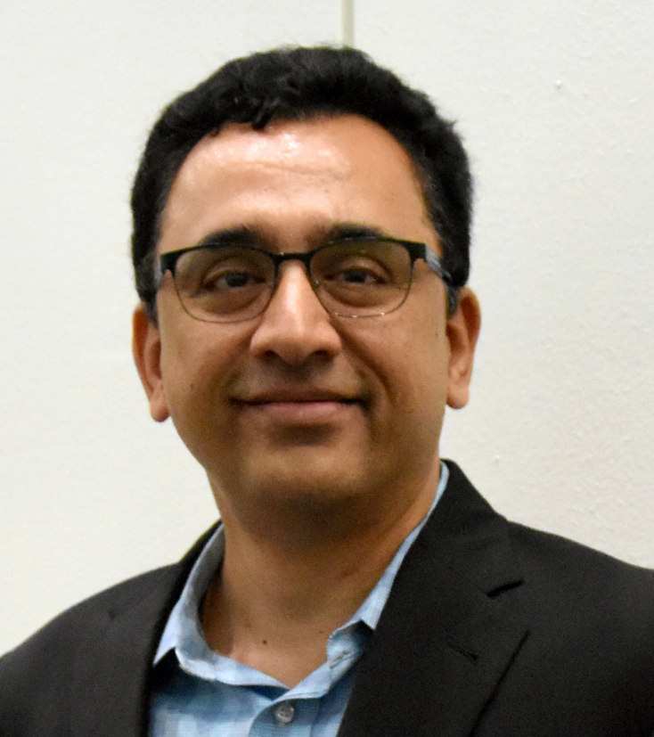
Cognizant Program Officers
Tara
Behrend
Jordan Berg
David Corman
Julie Johnson
Dan Cosley
Ruyan Guo
Martha James
Sara Kiesler
Alexandra Medina-Borja
Linda Molnar
Prabha Prabhakaran
Betty Tuller
Andruid Kerne
10
Notes:
On behalf of the Program Officers serving the Future of Work at the Human Technology Frontier program…

Slide 11
Thank you for your interest
NSF 22-533: Future of Work at the Human-Technology Frontier: Core Research (FW-HTF)
We look forward to receiving your submissions by March 2nd
Please address questions to the cognizant program officers at:
fwhtf-contacts@nsf.gov
Visit our website for past Awards and additional information:
www.nsf.gov/futureofwork
11
Notes:
… we thank you for your interest in solicitation NSF 22-533: the Future of Work at the Human-Technology Frontier: Core Research program.
We look forward to receiving your submissions by March 2n^{d}.
If questions remain, please contact the program officers at fwhtf-contacts@nsf.gov, and visit our landing page website at www.nsf.gov/futureofwork

