Slide 1
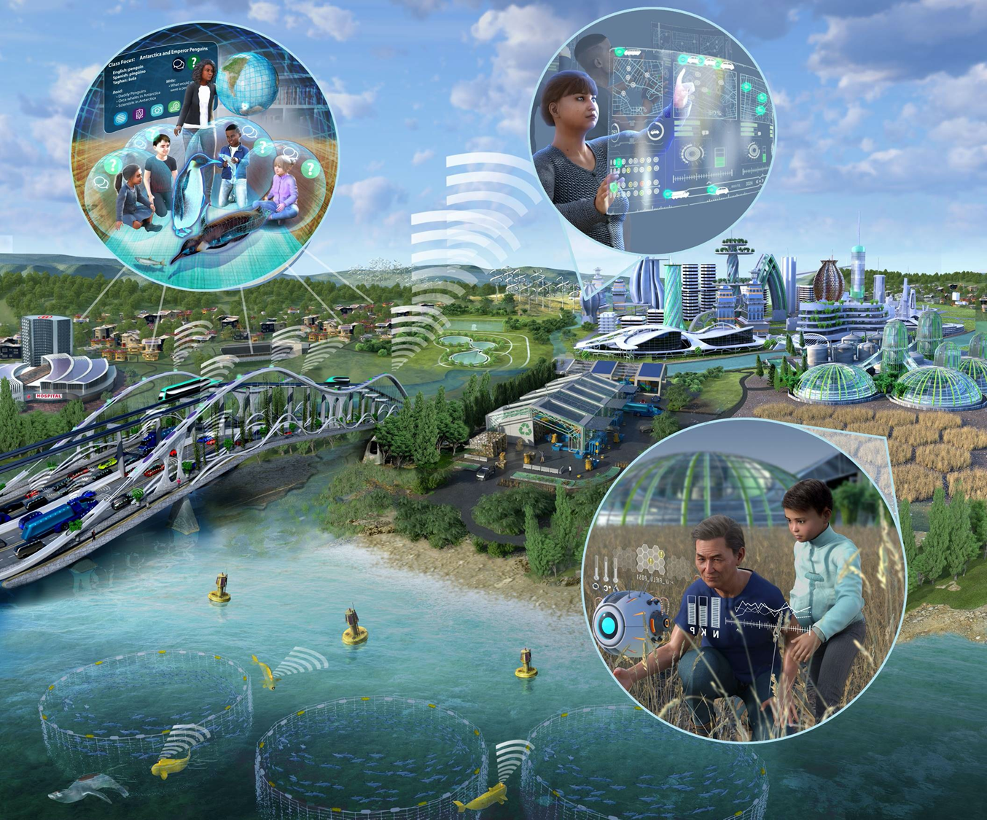

NSF 22-533 The Future of Work at the Human-Technology Frontier: Core Research
Proposal Deadline
March 2, 2022
Overview of the
FW-HTF program
Notes:
This presentation will highlight key requirements of the National Science Foundation’s FY 2022 solicitation number NSF 22-533, “Future of Work at the Human-Technology Frontier: Core Research.” The intent is to provide guidance and clarification for prospective PIs to submit a responsive proposal by the March 2rd deadline.
This presentation is not a substitute for the solicitation. Prospective PIs should read the solicitation carefully, as the solicitation establishes the definitive requirements for the FY2022 competition.

Slide 2

Steering Committee Membership
CISE: Henry Kautz
EHR: Elizabeth VanderPutten
ENG: Robert Stone†
SBE: Marc Sebrechts†
† Steering Committee Co-Chairs
CISE AD: Margaret Martonosi
EHR Acting AD: Sylvia Butterfield
ENG AD: Susan Margulies
OIA OH: Alicia Knoedler
SBE DAD: Kellina M. Craig-Henderson
Working Group Membership
CISE: Prabha Balakrishnan, David Corman, Dan Cosley, Andruid Kerne
EHR: Martha James, Julie Johnson, Alexandra Medina-Borja, Katelyn Schreyer
ENG: Jordan Berg*, Greg Formosa, Ruyan Guo
SBE: Tara Behrend*, Sara Kiesler, Betty Tuller
OIA: Linda Molnar
Stewarding Unit
ENG/EFMA: Sohi Rastegar
2
Notes:
FW-HTF is led by the Engineering and SBE Directorates, joined by the CISE and EHR Directorates and the Office of Integrative Activities. The program is stewarded by the ENG / EFMA office.
FW-HTF is overseen by a Steering Committee comprising Division Directors from ENG, SBE, CISE, and EHR.
Day-to-day operations of FW-HTF are carried out by a Working Group that models and reflects the interdisciplinary ambitions of the program.

Slide 3
The NSF “Big Ideas”
In 2016 the NSF unveiled ten bold, long-term “Big Ideas” for investment at the frontiers of science and engineering.
The Future of Work at the Human-Technology Frontier (FW-HTF), one of the Big Ideas, is one mechanism by which NSF is responding to the challenges and opportunities for the future of jobs and work.
3
Notes:
The Future of Work at the Human-Technology Frontier is one of the NSF Ten Big Ideas announced in 2016.
FW-HTF is one mechanism by which NSF is responding to the challenges and opportunities for the future of jobs and work.

Slide 4
The Challenge
The landscape of jobs and work is changing at unprecedented speed, enabled by advances in areas including emerging engineering technologies and new results in computer science; deeper understanding of societal and environmental change; advances in the learning sciences; development of pervasive, intelligent, and autonomous systems; and novel conceptions of work and workplaces.
This technological and scientific revolution offers historical opportunities, but also comes with risks, including jobs lost to automation, strains on educational resources, security and privacy threats, algorithmic bias, overdependence on technology, and the erosion of human skills.
4
Notes:
The Challenge:
* The landscape of jobs and work is changing at unprecedented speed, enabled by advances in areas including emerging engineering technologies and new results in computer science; deeper understanding of societal and environmental change; advances in the learning sciences; development of pervasive, intelligent, and autonomous systems; and novel conceptions of work and workplaces.
* This technological and scientific revolution offers historical opportunities, but also comes with risks, including jobs lost to automation, strains on educational resources, security & privacy threats, algorithmic bias, overdependence on technology and the erosion of human skills.

Slide 5
FW-HTF Vision
The overarching vision of the FW-HTF program is to support convergent research within the context of work to…
Understand and advance the human-technology partnership;
Develop new technologies to augment human performance;
Foster lifelong and pervasive learning;
Promote workers’ well-being and quality of life; and
Illuminate the emerging socio-technological landscape and understand the risks and benefits of new technologies.
5
Notes:
The Future of Work at the Human-Technology Frontier Vision
The overarching vision of the FW-HTF program is to support convergent research within the context of work, in order to…
Understand and advance the human-technology partnership;
Develop new technologies to augment human performance;
Foster lifelong and pervasive learning with technology;
Promote workers’ well-being and quality of life; and
Illuminate the emerging socio-technological landscape and understand the risks and benefits of new technologies.

Slide 6
Focus on Work
For the purposes of the FW-HTF solicitation, work is defined as mental or physical activity to achieve tangible benefit such as income, profit, or community welfare.
Research questions must intentionally target the future of work with a conceptualization of future work at the human-technology frontier that is embedded in its social and economic context.
6
Notes:
Focus on Work:
For the purposes of the FW-HTF: Core Research solicitation, work is defined as mental or physical activity to achieve tangible benefit such as income, profit, or community welfare.
Research questions must intentionally target the future of work with a conceptualization of future work at the human-technology frontier that is embedded in its social and economic context.

Slide 7

The FW-HTF Program
Convergent research integrating…
Future Work: Societal, economic, professional, occupational, industrial, educational, or national context
Future Workers: Workers as individuals or in teams, including education & training
Future Technology: Technologies to develop the human-technology partnership in future workspaces
All three elements should be synergistic components of the Intellectual Merit
Projects may weight these elements differently, but all should be present
7
Notes:
The FW-HTF Program
Projects are welcome that advance a convergent research approach, integrating and meaningfully relating future work, future technology, and future workers in a cohesive integrated effort, in which all three elements can be recognized, but none can be isolated from the others.
* This interrelationship can be visualized as three interlocking rings.
* The upper ring represents future technology: the engineering and computer science technologies that will develop the human-technology partnership in future workspaces, including offices, classrooms, warehouses, farms, & factories.
* The ring on the lower right represents future workers: considering their interests and well-being as individuals or in teams, including education and training.
* The ring on the lower left represents future work within a societal, economic, professional, occupational, industrial, educational, or national context.
* The FW-HTF program solicits projects in which all three elements are present and synergistic.
* Projects responsive to the 2022 FW-HTF solicitation may be anchored within any of the three areas as a primary component. Project leadership and personnel should reflect the proposed research objectives in all three areas.

Slide 8
Objectives
The specific objectives of the FW-HTF program are to…
Facilitate convergent research drawing upon computer science, design, engineering, learning sciences, research on adult learning and workforce training, and social, behavioral, and economic sciences;
Support deeper understanding of the societal infrastructure that accompanies and leads to new work technologies and new approaches to work and jobs, and that prepares people for the future world of work;
Develop research communities dedicated to intelligent technologies and work organization and modes inspired by positive impact on workers, work, and workplaces; means of learning and adapting to technological change; and social, economic, educational, and environmental benefits;
Promote deeper understanding of the interdependent human-technology partnership to advance societal needs; and
Mitigate potential risks arising from future work at the human-technology frontier.
8
Notes:
Objectives:
The specific objectives of the FW-HTF program are to …
Facilitate convergent research drawing upon computer science, design, engineering, learning sciences, research on adult learning and workforce training, and social, behavioral, and economic sciences;
Support deeper understanding of the societal infrastructure that accompanies and leads to new work technologies and new approaches to work and jobs, and that prepares people for the future world of work
Develop research communities dedicated to intelligent technologies and work organization and modes inspired by positive impact on workers, work, and workplaces; means of learning and adapting to technological change; and social, economic, educational, and environmental benefits;
Promote deeper understanding of the interdependent human-technology partnership to advance societal needs; and
Mitigate potential risks arising from future work at the human-technology frontier.

Slide 9
Proposal Requirements
MUST address a well-defined form of work or workplace domain to create new or improved partnerships of technology and human workers;
MUST focus on advancing fundamental understanding of future work, and potential improvements to work, workplaces, workforce preparation, or work outcomes for workers and society;
MUST be convergent research that addresses technological as well as human and societal dimensions; and
MUST incorporate a conceptualization of future work that is embedded in a social and economic context.
The ideal FW-HTF proposal is unlikely to align with the mission of any other NSF program
9
Notes:
Proposal Requirements:
Proposals that are responsive to the FY22 solicitation:
MUST address a well-defined form of work or workplace domain to create new or improved partnerships of technology and human workers;
MUST focus on advancing a fundamental understanding of future work, and potential improvements to work, workplaces, workforce preparation, or work outcomes for workers and society;
MUST propose convergent research that addresses technological as well as human and societal dimensions; and
MUST incorporate a conceptualization of future work that is embedded in a social and economic context.
The ideal FW-HTF proposal is unlikely to align with the mission of any other NSF program.

Slide 10
Proposal Submission Deadline
All FY22 FW-HTF proposals:
Due by 5 PM submitter’s local time on March 2, 2022
10
Notes:
The Proposal Submission Deadline is March 2, 2022.
Proposals must be submitted by 5 PM local time on March 2, 2022.

Slide 11
Eligibility Requirements
PIs must hold an appointment at the US-based campus or office of an eligible Institution of Higher Education or non-profit organization.
There are no restrictions beyond those outlined in the PAPPG on who may serve as Co-PI, Senior Personnel, or Consultant.
An individual may appear as PI, Co-PI, Senior Personnel, Other Personnel, or Consultant on only one proposal submitted in response to the FY 2022 FW-HTF solicitation. Subsequent submissions will be returned without review.
This eligibility constraint will be strictly enforced!
11
Notes:
Eligibility Requirements
PIs must hold an appointment at the US-based campus or office of an eligible Institution of Higher Education or non-profit organization.
There are no restrictions beyond those outlined in the PAPPG on who may serve as Co-PI, Senior Personnel or Consultant.
An individual may appear as PI, Co-PI, Senior Personnel, Other Personnel, or Consultant on only one proposal submitted in response to the FY 2022 FW-HTF solicitation.
Subsequent submissions will be returned without review.
This eligibility constraint will be strictly enforced!

Slide 12
Proposal Categories
Three Categories of FW-HTF proposals (levels are new for FY22):
Project Development (FW-HTF-P) up to $150K; period of 1 year.
Research (FW-HTF-R) up to $2M; up to 4 years.
Transition-To-Scale (FW-HTF-T) up to $4M; up to 5 years.
Grant category and budget should be justified by project scope, required resources, and envisioned outcomes.
No previous FW-HTF grant is required for submission in any category. Proposals subsequent to an FW-HTF award may build upon prior results.
12
Notes:
Three categories of FW-HTF proposals are solicited for the FY22 competition. Note that the funding levels have changed from the FY21 solicitation.
- proposals for project development grants may have budgets up to 150 thousand dollars for a period of 1 year.
- proposals for research grants may have budgets up to 2 million dollars and a duration up to 4 years.
- transition to scale proposals may have budgets up to 4 million dollars and a duration of up to 5 years.

Slide 13
Project Development Grants (FW-HTF-P)
FW-HTF-P help teams that are not yet ready for FW-HTF research projects to develop research questions, plans, and partnerships, including to...
Build multidisciplinary teams of the needed size and scope
Connect with relevant stakeholders and partners
Explore targeted work context(s) and/or dimensions of scale
Define high-impact, fundamental research questions and methods
Demonstrate intrinsic intellectual merit and broader impact
Justify the need for a project development grant, versus a full research proposal
At the conclusion of the FW-HTF-P Grant, teams should be prepared to pursue a well-defined research project responsive to the program vision.
13
Notes:
Project Development Grants support a range of planning activities that are meant to help teams that are not ready for FW-HTF research projects to formulate research questions, develop plans, and recruit partners.
Project Development proposals should
Build multidisciplinary teams of the needed size and scope
Connect with relevant stakeholders and partners
Explore targeted work context(s) and/or dimensions of scale
Define high-impact, fundamental research questions and methods
Demonstrate intrinsic intellectual merit and broader impact
Justify the need for a development grant, versus writing a full proposal
Activities within scope include, but are not limited to, travel, workshops, stakeholder meetings, data collection, and preliminary experiments.
At the conclusion of the Project Development Grant, researchers should be prepared to pursue a well-defined research project.

Slide 14
Research Grants (FW-HTF-R)
FW-HTF-R advance fundamental understanding of the human-technology partnership in the context of future work, through…
Synthesis of expertise from multiple fields and sectors;
Creation of new or expanded frameworks for research on work;
Modifications of work activities, training, workplaces, and outcomes;
Illumination of the technical, human, and social dimensions of work.
Research Grant outcomes should make fundamental, convergent contributions that shape future FW-HTF study and design, and lead to tangible social impact.
14
Notes:
Research grants support projects that will advance fundamental understanding of the human-technology partnership in the context of future work, through:
Synthesis of expertise from multiple fields and sectors;
Creation of new or expanded frameworks for research on work;
Modifications of work activities, training, workplaces, and outcomes;
Illumination of the technical, human, and social dimensions of work.
Research Grant outcomes should make fundamental, convergent contributions that shape future FW-HTF study and design, and lead to tangible social impact.

Slide 15
Transition-To-Scale Grants (FW-HTF-T)
FW-HTF-T projects will build upon prior research outcomes to examine FW-HTF research issues at scale, to better incorporate stakeholder concerns, and to accommodate diverse future work conditions. FW-HTF-T projects will…
Entail more extensive data collection at different levels – for example in different sectors or locations at regional, national, or international levels;
Document factors that may enhance, moderate, or constrain the effects of innovations in work or work organization, approaches to worker learning, or the design of new human-technology partnerships;
Inform the larger FW-HTF community's efforts to build and inform future implementation, transition-to-practice development, and impact studies
Please refer to the presentation: "Guidance on FW-HTF-T submissions"
15
Notes:
• Transition-to-scale projects will build upon prior research outcomes to examine FW-HTF research issues at scale, to better incorporate stakeholder concerns, and to accommodate diverse future work conditions.
• Transition-to-scale projects will:
Entail more extensive data collection at different levels – for example in different sectors or locations at regional, national, or international levels;
They will document factors that may enhance, moderate, or constrain the effects of innovations in work or work organization, approaches to worker learning, or the design of new human-technology partnerships;
They will inform the larger FW-HTF community's efforts to build and inform future implementation, transition-to-practice development, and impact studies
For additional information on this new award category, please refer to the accompanying presentation, "Guidance on FW-HTF-T submissions"

Slide 16
All FW-HTF Proposals: Required Sections
In addition to the required sections described in the PAPPG, the Project Description of all FW-HTF proposals MUST include the following separate sections, clearly labeled with the specified headings:
A Work Context section to clearly identify and define the work domain, workers, and workplaces;
An Integrative Research section to describe how knowledge, techniques, and expertise from;
A Methods, Measures, and Metrics section to describe how progress and outcomes of the project will be assessed.
An Access & Inclusion section to address enhancing inclusion and equity.
16
Notes:
Additional Sections Required
In addition to the standard required sections described in NSF’s Proposal & Award Policies & Procedures Guide, or PAPPG, the Project Description of an FW-HTF proposal MUST include the following separate sections, clearly labeled with these specified headings:
Work Context – This section will clearly identify and define the work domain, workers, and workplaces, and the scope and scale of outcomes and benefits envisioned;
Integrative Research – This section will describe how knowledge, techniques, and expertise from multiple fields and sectors will create new and expanded frameworks for addressing research goals;
Methods, Measures, and Metrics – This section will describe how progress and outcomes of the project will be assessed.
Access and Inclusion – This section should address meaningful enhancements to inclusion and equity in the context of the Future of Work.

Slide 17
New Requirements
New in FY22, proposals must specify O*NET code or codes corresponding to the job of focus. Overly general projects that do not correspond to a particular job are not appropriate for FW-HTF. (See supplemental webinar for guidance/instructions on O*NET codes)
Proposals must also specify three key words corresponding to the future work, future worker, and future technology in the proposal.
17
Notes:
Two new requirements should be noted.
New in FY22, proposals must specify O*NET code or codes corresponding to the job of focus. Overly general projects that do not correspond to a particular job are not appropriate for FW-HTF. (See supplemental webinar for guidance/instructions on O*NET codes)
Proposals must also specify three key words corresponding to the future work, future worker, and future technology in the proposal.

Slide 18
FW-HTF-R&T: Supplemental Documents Required
In addition to the Supplemental Documents described by the PAPPG, FW-HTF-R and FW-HTF-T proposals MUST include the following:
A Management and Coordination Plan describing specific steps the project team plans to take to achieve the goal of convergent research, in which knowledge, techniques, and expertise from multiple fields and sectors create new and expanded frameworks for addressing research goals;
A List of Project Personnel and Partner Institutions providing current, accurate information for all personnel and institutions involved in the project.
18
Notes:
In addition to the Supplemental Documents described by the PAPPG, FW-HTF-Research and FW-HTF-Transition-to-scale proposals MUST include:
A Management and Coordination Plan - describing specific steps the project team plans to take to achieve the goal of convergent research, in which knowledge, techniques, and expertise from multiple fields and sectors create new and expanded frameworks for addressing research goals;
A List of Project Personnel and Partner Institutions - providing current, accurate information for all personnel and institutions involved in the project.

Slide 19
Project Development Grants (FW-HTF-P)
No solicitation-specific supplemental documents are required for FW-HTF-P proposals. Please follow the proposal submission guidelines outlined in the FW-HTF Program Solicitation (NSF 22-533) and the NSF Proposal & Award Policies & Procedures Guide (PAPPG).
19
Notes:
No solicitation-specific supplemental documents are required for Project Development proposals.
Please follow the proposal submission guidelines outlined in the FW-HTF Program Solicitation and the NSF Proposal & Award Policies & Procedures Guide.

Slide 20
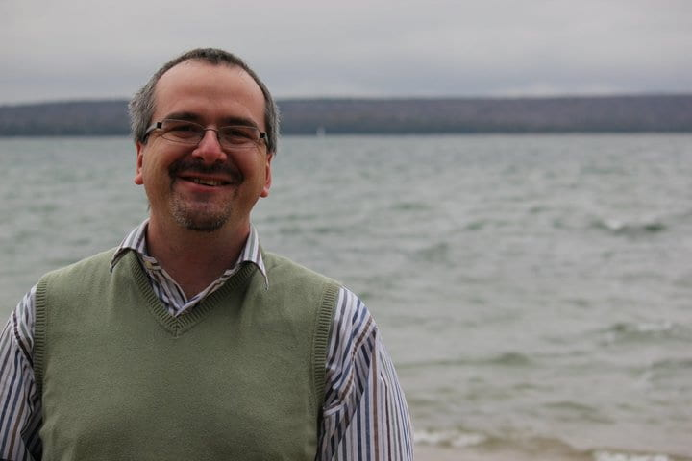

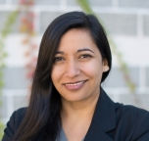
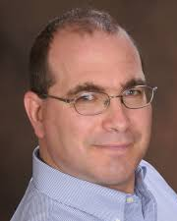

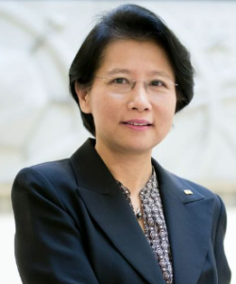





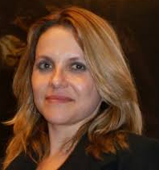
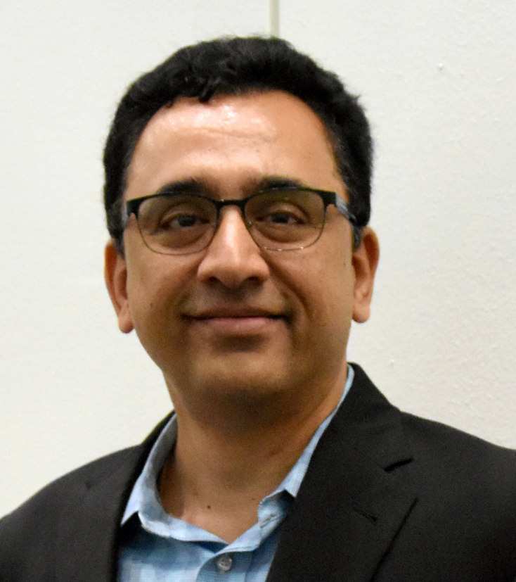
Cognizant Program Officers
Tara
Behrend
Jordan Berg
David Corman
Julie Johnson
Dan Cosley
Ruyan Guo
Martha James
Sara Kiesler
Alexandra Medina-Borja
Linda Molnar
Prabha Prabhakaran
Betty Tuller
Andruid Kerne
20
Notes:
On behalf of the Program Officers serving the Future of Work at the Human Technology Frontier program…

Slide 21
Thank you for your interest
NSF 22-533: Future of Work at the Human-Technology Frontier: Core Research (FW-HTF)
We look forward to receiving your submissions by March 2nd
Please address questions to the cognizant program officers at:
fwhtf-contacts@nsf.gov
Visit our website for past Awards and additional information:
www.nsf.gov/futureofwork
21
Notes:
… we thank you for your interest in solicitation NSF 22-533: the Future of Work at the Human-Technology Frontier: Core Research program.
We look forward to receiving your submissions by March 2, 2022.
For additional, please contact the program officers at fwhtf-contacts@nsf.gov, and visit our landing page website at www.nsf.gov/futureofwork

Slide 22
Resources for Prospective PIs
Presentations:
Overview of the FW-HTF program (this presentation)
The Transition-to-Scale proposal category
Introduction to O*NET
Office Hours:
January 26-27, 2022; 3:30-5 pm Eastern time
22
Notes:
Additional resources for PIs include:
Presentations:
Overview of the FW-HTF program (this presentation)
The Transition-to-Scale proposal category
Introduction to O*NET
Office Hours:
January 26-27, 2022; 3:30-5 pm Eastern time

