Slide 1


NSF 22-533
The Future of Work at the Human-Technology Frontier: Core Research
Proposal Deadline
March 2, 2022
Introduction
to O*NET
Notes:
This presentation will elaborate on a new key requirements of the National Science Foundation’s FY 2022 solicitation number NSF 22-533, “Future of Work at the Human-Technology Frontier: Core Research.”
This presentation is not a substitute for the solicitation. Prospective PIs should read the solicitation carefully, as the solicitation establishes the definitive requirements for the FY2022 competition.
This presentation is a resource for PIs who have not previously used The Occupational Information Network, O*NET, to classify occupations. In the slides that follow, we will demonstrate how to use this tool.

Slide 2
US Department of Labor's
Occupational Information Network (O*NET)
Open resource and source of information
Over 900 US occupations
Maintained by job analysts
Searchable and downloadable
Information about work tasks, required skills and knowledge, context, and training requirements
onetonline.org

Slide 3
All proposals are required to specify the O*NET code for their occupation of focus
The following slides provide a walkthrough about how to obtain these codes

Slide 4
Why Require O*NET Codes?
Convergence research is a means of integrating knowledge, methods, and expertise from different disciplines to solve complex problems focusing on societal needs.
A primary characteristic of convergence research is that it is driven by a specific and compelling problem.
The O*NET code requirement is intended to encourage FW-HTF projects to focus on a specific and compelling problem.
More information about convergence research can be found at https://www.nsf.gov/od/oia/convergence/index.jsp

Slide 5
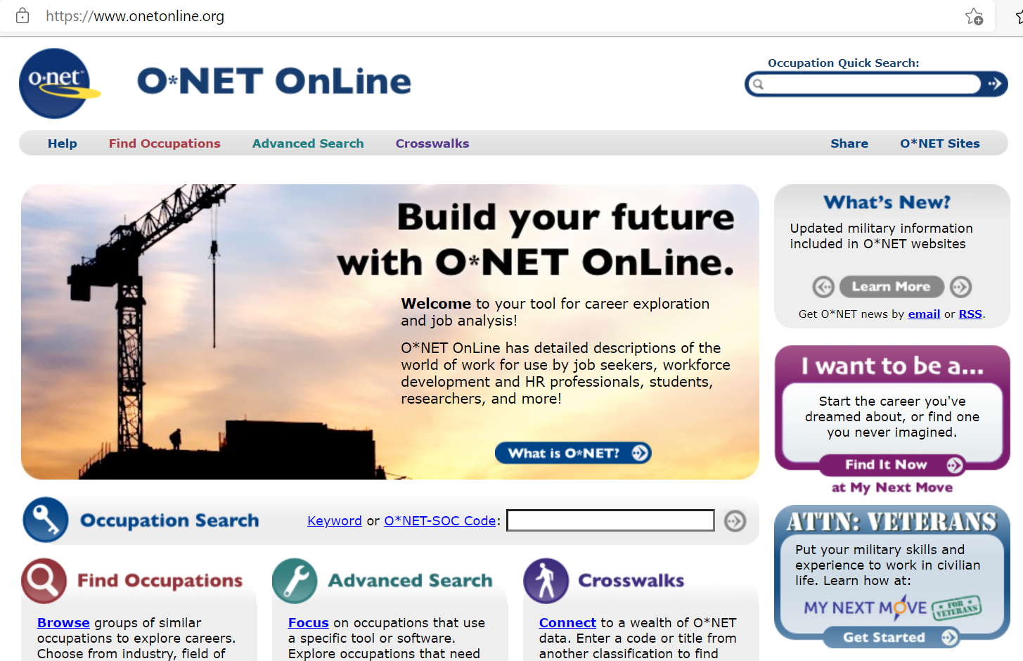

Slide 7
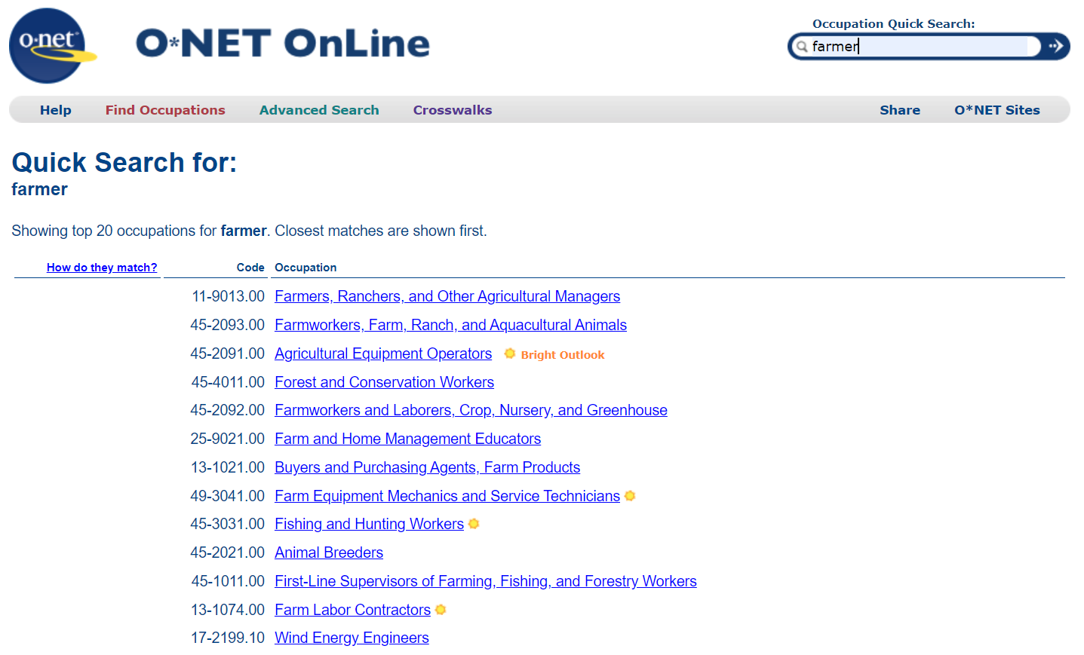

Slide 8
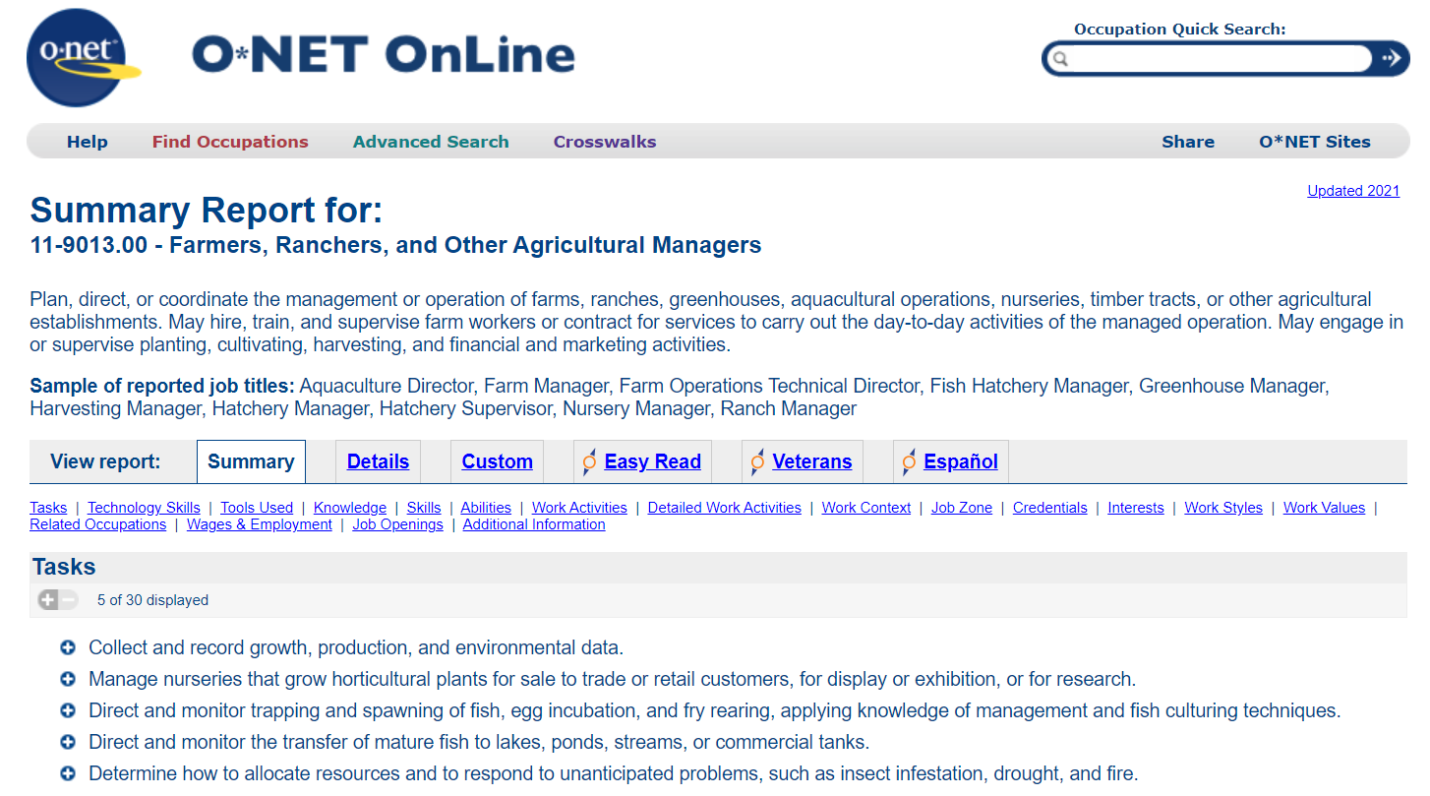

Slide 9
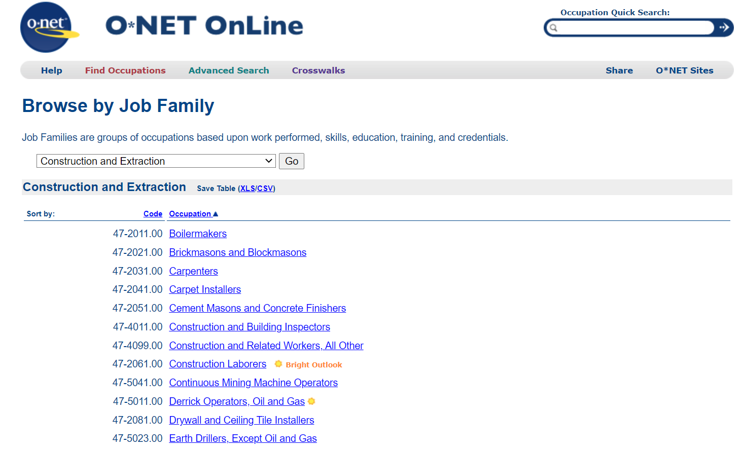
Notes:
If you are unsure of the correct job title, you can browse categories of jobs, for instance the job family of construction contains occupations such as carpenters, drillers, and brickmasons. The overarching category of "construction" is not sufficiently specific on its own, however.

Slide 10
What if your occupation is not listed?
Problem: Job does not exist yet: e.g., spaceship conductor
Solution: Choose most closely related job, e.g., "pilot"
Problem: Project deals with many kinds of jobs
Solution: Narrow it down
Problem: O*NET descriptor for occupation is inaccurate/outdated
Solution: Use the existing code and title and note any essential discrepancies in the proposal narrative

Slide 11
Notes:
When you have located the correct occupation, obtain the code and title and include this information in the proposal. No additional information from O*NET is required.

Slide 12
Resources for Prospective PIs
Presentations:
Overview of the FW-HTF program
The Transition-to-Scale proposal category
Introduction to O*NET (this presentation)
Office Hours:
January 26-27, 2022; 3:30-5 pm Eastern time

