Slide 1
Abstractions and Algorithms in
Computer Science and Computational Thinking
Al Aho
aho@cs.columbia.edu
National Science Foundation
April 7, 2022

Slide 2
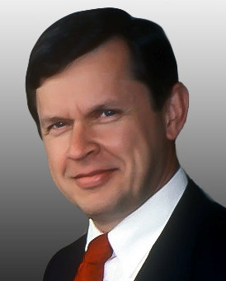
Me in one slide
BASc in Engineering Physics, U. of Toronto, 1963
PhD in EE/CS, Princeton, 1967.
MTS in the Computing Sciences Research Center at Bell Labs, 1967-90.
In the first 10 years at Bell Labs, wrote five books (including The Design and Analysis of Computer Algorithms with Hopcroft and Ullman and the first “dragon” compilers book with Ullman), 40 papers, created the Aho-Corasick algorithm and the AWK programming language with Kernighan and Weinberger.
Then, General Manager of the Information Sciences and Technologies Research Lab at Bellcore, and then Professor and Chair of CS at Columbia.
A few memorable professional activities/awards:
  served on the NSF CISE Advisory Committee (twice)
  chaired ACM SIGACT
  won the ACM A.M. Turing Award with Jeff Ullman

Slide 3
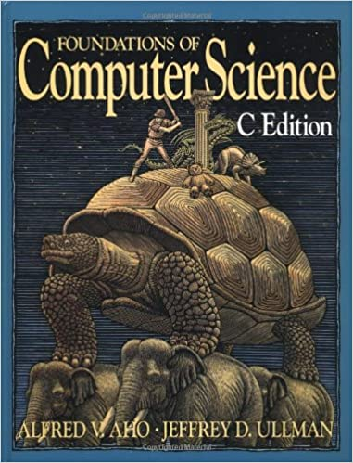
Computer Science:
The Mechanization of Abstraction
Fundamentally, computer science is a science of abstraction – creating the right model for thinking about a problem and devising appropriate mechanizable techniques to solve it.
Alfred V. Aho and Jeffrey D. Ullman
Foundations of Computer Science – C Edition
W. H. Freeman, 1995

Slide 4
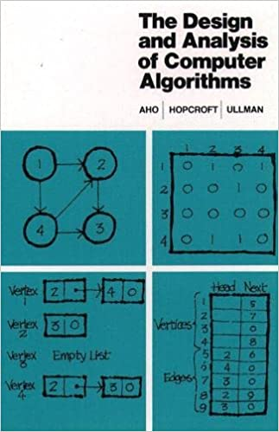
The Design and Analysis of
Computer Algorithms
The study of algorithms is at the very heart of computer science.
Alfred V. Aho, John E. Hopcroft, and Jeffrey D. Ullman
The Design and Analysis of Computer Algorithms
Addison-Wesley Publishing Company, 1974

Slide 5
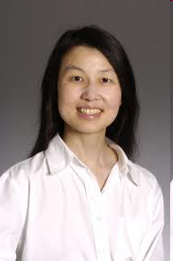
The importance of computational thinking
Computational thinking is a fundamental skill for everyone, not just for computer scientists. To reading, writing, and arithmetic, we should add computational thinking to every child’s analytical ability.
Jeannette M. Wing
Computational Thinking
Comm. ACM, 49(3), pp. 33-35, 2006

Slide 6
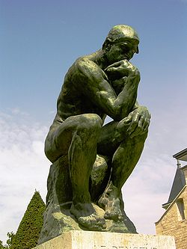
Computational thinking
The thought processes involved in formulating problems using abstractions so that their solutions can be represented as computational steps and algorithms.
Alfred V. Aho
Computation and Computational Thinking
The Computer Journal, 55(7), pp. 832-835, 2012

Slide 7
What is an abstraction?
A mathematical model with two components:
  A data model
  A set of operations for manipulating the data in that model (the “programming language” of the abstraction)
Alfred Aho and Jeffrey Ullman
Abstractions, Their Algorithms, and Their Compilers
Comm. ACM, 65(2), pp. 76-91, 2022

Slide 8
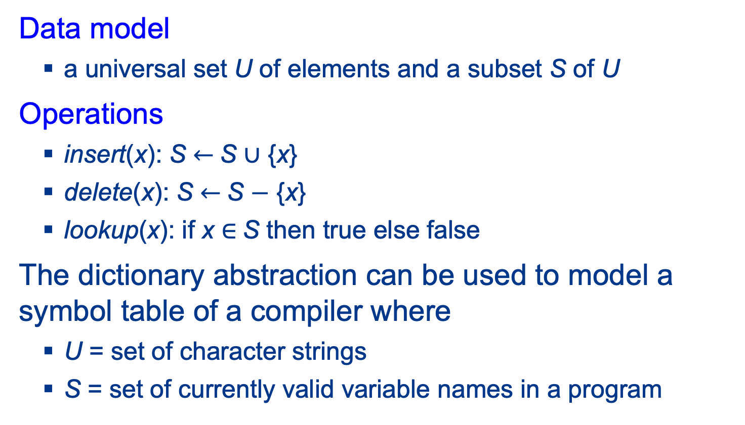
Example: the Dictionary abstraction
Data model
  a universal set U of elements and a subset S of U
Operations
  insert(x): S $←$S $∪$ {x}
  delete(x): S $←$S $−$ {x}
  lookup(x): if x $∈$S then true else false
The dictionary abstraction can be used to model a symbol table of a compiler where
  U = set of character strings
  S = set of currently valid variable names in a program

Slide 9
What is an algorithm?
Informally: a recipe for doing something
Formally: a Turing machine that halts on all
inputs

Slide 10
Taxonomy of CS abstractions based on their purpose
Fundamental abstractions to express basic algorithms and processes
Abstract implementations for fundamental abstractions
Declarative abstractions for saying what you want but not how to do it
Computational abstractions to model real machines and conventional programming languages

Slide 11
1. Fundamental abstractions: to study algorithms for common computations
Stand-alone abstractions – studied in isolation
  E.g.: dictionary, stack, queue
Embedded abstractions in a general-purpose language:
  Essentially classes + their methods, but without implementation
  E.g.: many kinds of graphs and trees

Slide 12
2. Abstract implementations: to support fundamental abstractions
  Data structures that are useful for implementing many fundamental abstractions
      E.g.: hash tables, search trees
  They admit different instantiations at the machine level.
      E.g.: a hash table could be implemented in a RAM model of a computer or in a secondary-storage model with very different notions of running time.

Slide 13
3. Declarative abstractions: to raise the level of programming
  High-level abstractions that specify what you want, but not how to do it
      Need detailed implementations to be executable
      Valuable because they make programming much easier
      Associated set of operations is usually not Turing-complete
  Examples
      Regular expressions, context-free grammars, flow graphs

Slide 14
4. Computational abstractions: to more closely model systems and PLs
  Actual machine model or directly translatable to one.
      Machines and programming languages: RAM, C++, Python.
      Parallel/distributed-machine examples: PRAM,
      MapReduce.
  Abstractions for computer-like models that are not “conventional.”
      Models of computation: Turing machines, Boolean circuits,
      quantum circuits.

Slide 15
Abstractions can be layered
Abstraction 1
Algorithm 1
Algorithm 1
Implementation
Compilation
Running time
Abstraction 2
Algorithm 2

Slide 16
Abstractions and algorithms in compiler design
Abstractions and algorithms, the two pillars of computer science and computational thinking, have transformed the field of compiler design from an art to a science.

Slide 17
What is a compiler?
compiler
semantically
equivalent
target
program
source
program
Notes:
.

Slide 18
A compiler as a composition of phases
source
program
target
program
lexical
analyzer
syntax
analyzer
semantic
analyzer
interm.
code
gen.
code
optimizer
target
code
gen.
token
stream
syntax
tree
annotated
syntax
tree
interm.
rep.
interm.
rep.
symbol table
Alfred V. Aho, Monica S. Lam, Ravi Sethi and Jeffrey D. Ullman
Compilers: Principles, Techniques, & Tools
Addison Wesley, 2007

Slide 19
Declarative abstraction for lexical analysis: regular expressions
    Data model
      Sets of strings over some finite alphabet
    Operations
      Union
      Concatenation
      Kleene star

Slide 20
Implementations of regular expression pattern matchers
  Choices using finite automata:
      Nondeterministic finite automata
        McNaughton-Yamada-Thompson construction
        yields an O(|RE| x |input|) time algorithm
      Deterministic finite automata
        Subset construction converting NFA to DFA yields an
        O(2^{|RE|} + |input|)-time algorithm
        Dynamic construction of DFA transitions yields an
        observed O(|RE| + |input|) time algorithm
Alfred V. Aho
Algorithms for Finding Patterns in Strings
Handbook of Theoretical Computer Science, Volume A, pp. 255-300, 1990

Slide 21
LEX: a lexical analyzer generator
lex
specification
lexical
analyzer
generator
LEX
lexical
analyzer
source
program
token
stream
Michael E. Lesk and Eric Schmidt
Lex – A Lexical Analyzer Generator
CSTR 39, Bell Labs 1975

Slide 22
LEX specification for a token NUM
  /* regular definitions */
  digit [0-9]
  number {digit}+
  %%
  /* translation rules */
  {number} {yylval = (int) installNum();
  return(NUM);}

Slide 23
Abstractions for syntax analyzers
  Context-free grammars (BNF)
  Knuth’s LR(k) grammars
  Syntax-directed translation scheme with semantic actions attached to the productions of a shift-reduce parsable ambiguous grammar
A. V. Aho, S. C. Johnson, and J. D. Ullman
Deterministic parsing of ambiguous grammars
ACM POPL, pp. 1-21, 1973

Slide 24
YACC: a syntax analyzer generator
yacc
specification
syntax
analyzer
generator
YACC
syntax
analyzer
token
stream
syntax
tree
Stephen C. Johnson
Yacc - Yet Another Compiler Compiler
CSTR 32, Bell Labs, 1975

Slide 25
YACC specification for a desk calculator
  %token NUM
  %left ‘+’
  %left ‘*’
  %%
  /* translation rules */
  lines : lines expr ‘\n’ { printf(“%d\n”, $1); }
  | lines ‘\n’
  | /* empty */
  ;
  expr : expr ‘+’ expr { $$ = $1 + $3; }
  | expr ‘*’ expr { $$ = $1 * $3; }
  | ‘(’ expr ‘)’ { $$ = $2; }
  | NUM
  ;
  %%
  #include “lex.yy.c”

Slide 26
Reaching definitions in the intermediate representation
  The three-address statement s: v = w + x in the intermediate representation generates a definition of variable v.
  A definition of v from a statement s reaches a statement t if there is an execution path from s to t where the variable v is not redefined (is not “killed”).
  Reaching definitions problem: determine what definitions may reach what program points.
  Reaching definitions are used to implement several important code optimizations such as constant propagation and loop-invariant code motion.

Slide 27
Data model of flow-graph abstraction for reaching definitions
  Data model
      A semi-lattice L of subsets of variable definitions
      (the data-flow values).
      A directed graph G in which each node represents
    a basic block and whose edges indicate
    which blocks can follow which other blocks.
      Associated with each node n of G are two
      members of L, one for the variable definitions reaching the beginning of n and one for the variable
      definitions reaching the end of n.

Slide 28
Operations of flow-graph abstraction for reaching definitions
  Operations
      A transfer function f_{n} associated with each node n:
        f_{n} computes the output data-flow value OUT = f_{n}(IN) associated with the end of n from the input data-flow value IN associated with the beginning of n.
      A confluence operator that computes the data-flow value
      associated with the beginning of a node from the values
      at the ends of all its predecessors in the flow graph:
        The confluence operator needs to be commutative,
        associative, and idempotent.
      Different algorithms can be used to solve for the data-flow
      values at the beginnings and ends of the nodes.
Gary A. Kildall
A unified approach to global program optimization
ACM POPL, pp. 194-206, 1973

Slide 29
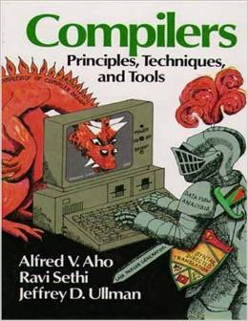
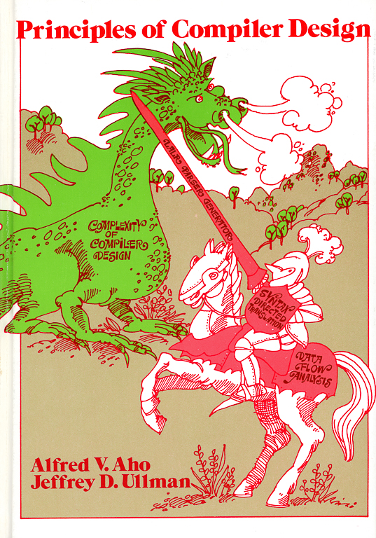
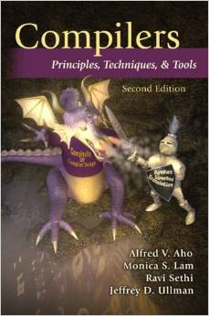
The dragon books captured the key abstractions and algorithms of compiler design
1986
type checking
run-time organization
automatic code
generation
1977
finite automata
grammars
lex & yacc
syntax-directed translation
2007
garbage collection
optimization
parallelism
interprocedural analysis

Slide 30
Impact
The FORTRAN team led by John W. Backus at IBM introduced the first commercially available compiler in 1957, which took 18 person-years to create.
Today, a team of a five undergraduate students can create their own new programming language and write a compiler for it in a one-semester programming languages and compilers course.
en.Wikipedia.org/wiki/History of compiler construction
Alfred V. Aho
Teaching the compilers course
ACM SIGCSE Bull., 40(4), pp. 6-8, 2008

Slide 31
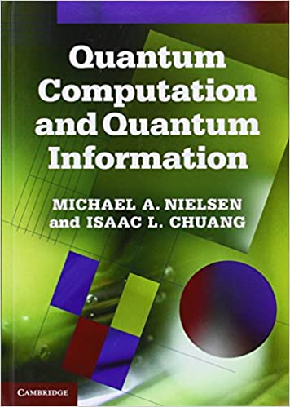
Abstractions and algorithms in quantum computing programming languages
The four postulates
of quantum mechanics
M. A. Nielsen and I. L. Chuang
Quantum Computation and Quantum Information
Cambridge University Press, 2011

Slide 32
Postulate 1: state space
The state space of an isolated physical system can be modeled by a Hilbert space, a complex vector space with an inner product.
The state of the system is completely described by a unit vector in this state space.

Slide 33
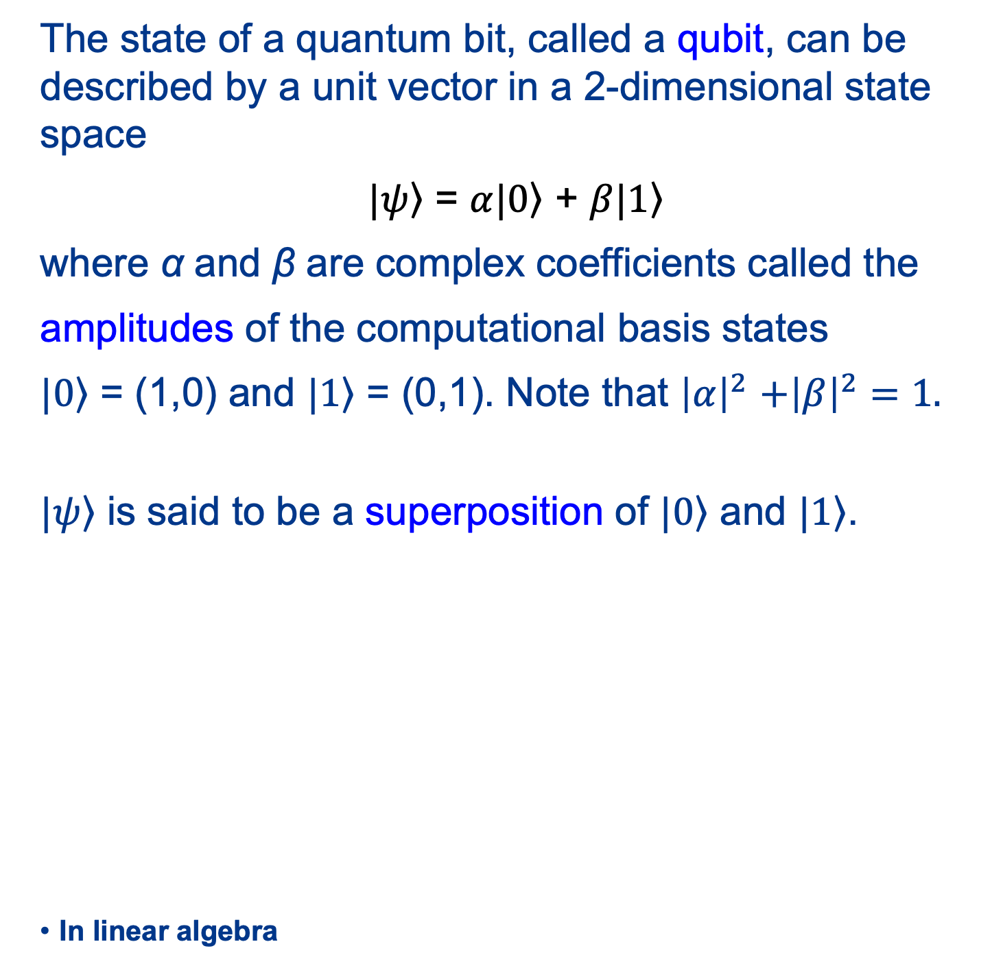
Qubit: quantum bit
The state of a quantum bit, called a qubit, can be described by a unit vector in a 2-dimensional state space
$|\left.ψ\right\rangle$ = $α|\left.0\right\rangle$ + $β|\left.1\right\rangle$
where α and β are complex coefficients called the
amplitudes of the computational basis states
$|\left.0\right\rangle$ = (1,0) and $|\left.1\right\rangle$ = (0,1). Note that ${\left|α\right|}^{2}$ $+{\left|β\right|}^{2}=1.$
$|\left.ψ\right\rangle$ is said to be a superposition of $|\left.0\right\rangle$ and $|\left.1\right\rangle$.
In linear algebra

Slide 34



Postulate 2: time evolution
The evolution of the state of a closed quantum system from one time to another can be described by a unitary operator.
A matrix U is unitary if UU$†$ = I where I is the identity. U$†$ is the conjugate-transpose of the matrix U.
U$|\left.ψ\right\rangle$
$$|\left.ψ\right\rangle$$
U
state of
the system
at time t₁
state of
the system
at time t₂

Slide 35
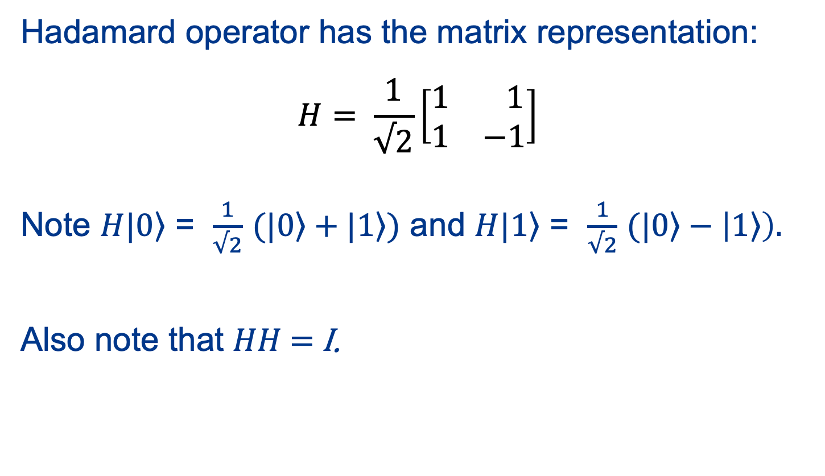
Single-qubit Hadamard quantum operator
Hadamard operator has the matrix representation:
$$H= \frac{1}{√2}\left[\begin{matrix}1 & 1 \\ 1 & −1\end{matrix}\right]$$
Note $H|\left.0\right\rangle$ = $\frac{1}{√2}$ $(|\left.0\right\rangle +|\left.1\right\rangle )$ and $H|\left.1\right\rangle$ = $\frac{1}{√2}$ $(|\left.0\right\rangle −\left|\left.1\right\rangle \right).$
Also note that $HH$ = I.

Slide 36

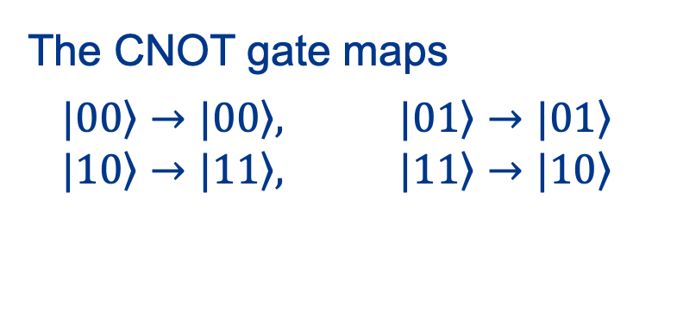
Two-qubit CNOT quantum operator
The two-qubit CNOT (controlled-NOT) operator has the matrix representation on the right:
CNOT flips the target qubit t iff the control qubit c has the value 1:
.
c
c
t
c $⊕t$
The CNOT gate maps
$$|\left.00\right\rangle →|\left.00\right\rangle , |\left.01\right\rangle →|\left.01\right\rangle$$
$$|\left.10\right\rangle →|\left.11\right\rangle , |\left.11\right\rangle →|\left.10\right\rangle$$
CNOT gate

Slide 37
Postulate 3: measurements (simplified)
To get information from a closed quantum system, measurements need be applied to the system.
A measurement returns an outcome with some probability.
The sum of the probabilities of the possible outcomes is 1.
A measurement collapses the state of a quantum system.

Slide 38
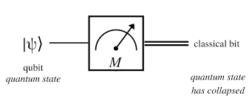
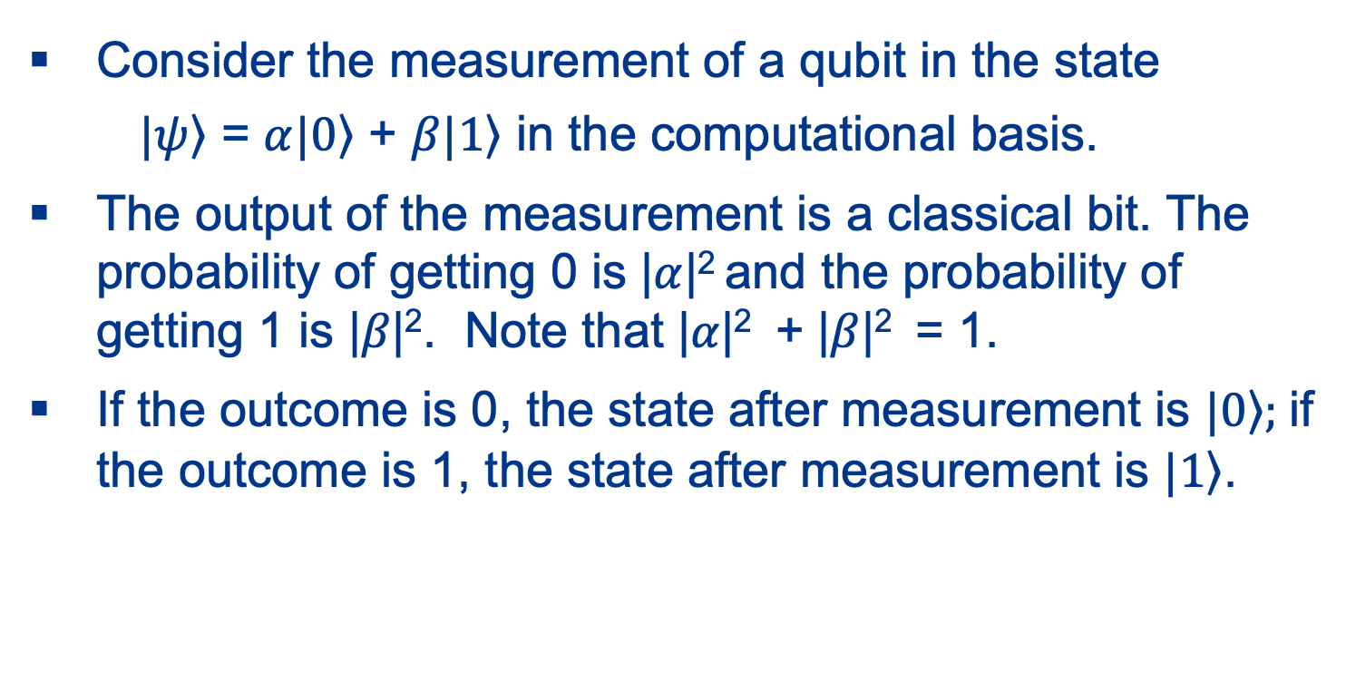
Measurement of a single qubit
Consider the measurement of a qubit in the state
  $|\left.ψ\right\rangle$ = $α|\left.0\right\rangle$ + $β|\left.1\right\rangle$ in the computational basis.
The output of the measurement is a classical bit. The probability of getting 0 is |$α$|² and the probability of getting 1 is |$β$|². Note that |$α$|² + |$β$|² = 1.
If the outcome is 0, the state after measurement is $|\left.0\right\rangle ;$if the outcome is 1, the state after measurement is $|\left.1\right\rangle$.

Slide 39

Postulate 4: composite systems
The state space of a composite physical system is the tensor product space of the state spaces of its component subsystems.
Example: If A = (a₁, a₂) and B = (b₁, b₂), then A $⊗$ B is the vector (a₁b₁, a₁b₂, a₂b₁, a₂b₂).
If C = (c₁, c₂), then A $⊗$ B $⊗$ C is the vector
(a₁b₁c₁, a₁b₁c₂, a₁b₂c₁, a₁b₂c₂,
a₂b₁c₁, a₂b₁c₂, a₂b₂c₁, a₂b₂c₂).

Slide 40
Combining quantum systems
If we combine n single-qubit systems, we get a composite system with a state space of dimension 2^{n} by taking the tensor product of the state spaces of the n single-qubit systems.

Slide 41
Abstraction for quantum systems: quantum circuits
A quantum circuit is an acyclic graph consisting of lines, quantum gates, and measurement gates.
No fan-in: logical OR is not a unitary operation.
No fan-out: in quantum mechanics, it is not possible to make a copy of an unknown quantum state (the no-cloning theorem).

Slide 42
Quantum circuit to generate
Einstein-Podolsky-Rosen states
Quantum circuit to create EPR states, also known as Bell states:
Circuit maps
Each output is an entangled state, one that cannot be written in a product form. (Einstein: “Spooky action at a distance.”)
x
H
y

Slide 43
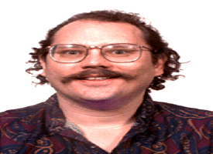
Shor’s integer factorization algorithm
Problem: Given a composite n-bit integer, find a prime factor.
Best-known deterministic algorithm on a classical computer has time complexity exp(O(n^{1/3} log^{2/3} n)) .
A hybrid classical-quantum computer can solve this problem in O(n³) operations.
Peter Shor
Algorithms for Quantum Computation: Discrete Logarithms and Factoring
Proc. 35th Annual Symposium on Foundations of Computer Science, pp. 124-134, 1994

Slide 44
Quantum computer compilers
QIR: quantum intermediate representation
QASM: quantum assembly language
QPOL: quantum physical operations language
quantum
source
program
QIR
QASM
QPOL
Front
End
Technology
Independent
CG+Optimizer
Technology
Dependent
CG+Optimizer
Technology
Simulator
Quantum Computer Compiler
ABSTRACTIONS
quantum
mechanics
quantum
circuit
quantum
circuit
quantum
device
K. Svore, A. Aho, A. Cross, I. Chuang, I. Markov
A Layered Software Architecture for Quantum Computing Design Tools
IEEE Computer, 39(1), pp.74-83, 2006

Slide 45
Conclusion
Abstractions and algorithms, the two pillars of computer science and computational thinking, have transformed the field of compiler design from an art to a science.

