Slide 1
Human-Environment and Geographical Sciences (HEGS)
Funding Opportunities Webinar
April 22, 2022
We will begin momentarily
Please submit questions via the Q&A button available to you on Zoom. Please set to “Send anonymously”

Slide 2
Questions?
Submit your questions via the Q&A box on your screen and set to “Send anonymously”
Upvote questions by clicking the thumbs up icon next to the question you most want answered
For specific questions about your project, please contact a Program Officer

Slide 3
Human-Environment and
Geographical Sciences
Welcome!
  NSF Directors and Program Officers in attendance today:
    Antoinette WinklerPrins– SBE Acting Assistant Director (anwinkle@nsf.gov)
    Tom Evans- HEGS Program Officer (tevans@nsf.gov)
    Jeremy Koster– HEGS Program Officer (jkoster@nsf.gov)
    Kendra McLauchlan – Division of Environmental Biology, Ecosystem Sciences Program Officer (kmclauch@nsf.gov)

Slide 4
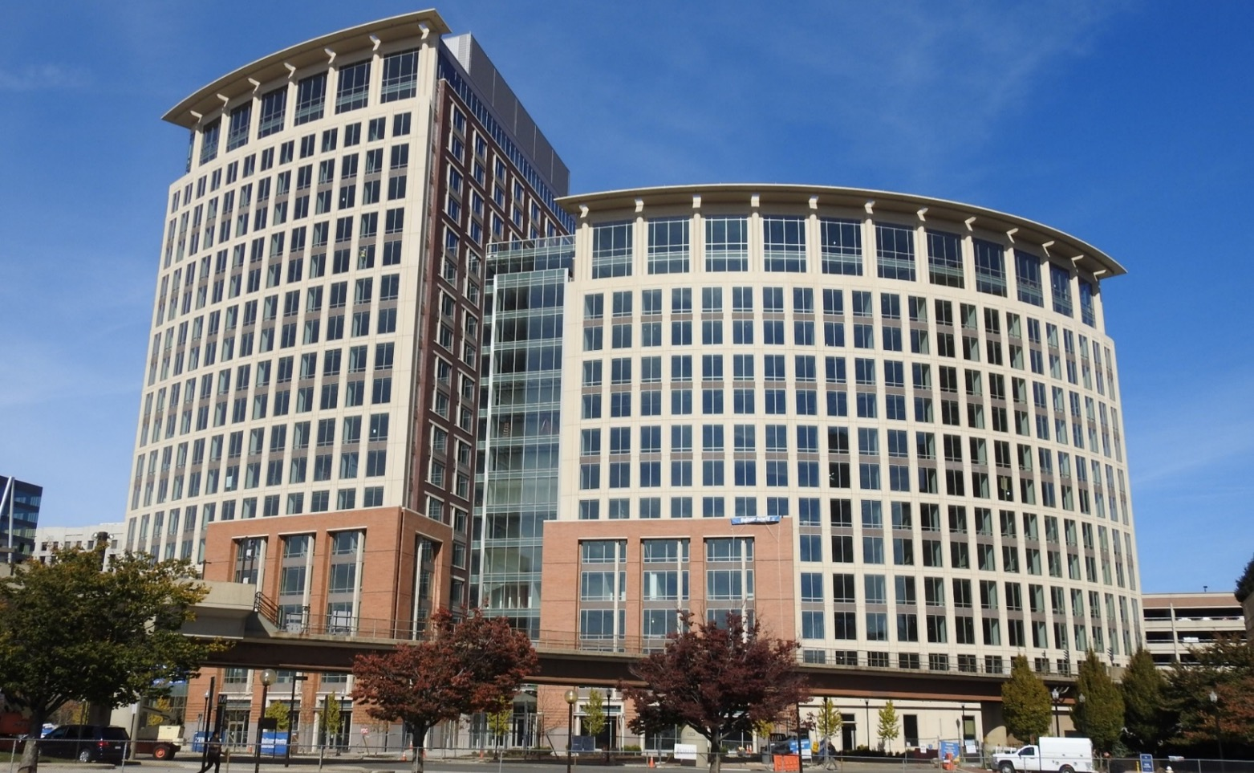
National Science Foundation
Mission: To promote the progress of science; to advance the national health, prosperity, and welfare; to secure the national defense…
Vision: A Nation that is the global leader in research and innovation

Slide 5

The Government of the United States
(the simple version)
The Constitution
Executive Branch
Legislative Branch
Judicial Branch
Department
of the Interior
Department
of Health &
Human
Services
Department
of Commerce
Department
of Defense
Many Other
Departments…

Slide 6
Org Chart: NSF Directorates and Offices
Office of
Equity and Civil Rights (OECR)
Office of the
General Counsel (OGC)
Office of
Integrative Activities (OIA)
Office of
International Science and Engineering (OISE)
Office of the Director (OD)
Director
Deputy Director
Chief Operating Officer
Office of
Legislative and Public Affairs (OLPA)
Directorate for
Biological Sciences (BIO)
Directorate for
Computer & Information Science & Engineering (CISE)
Directorate for
Education & Human Resources (EHR)
Directorate for
Engineering (ENG)
National Science Board (NSB)
Chair, Vice Chair, NSB Office Executive Officer
Directorate for
Geosciences (GEO)
Directorate for
Mathematical & Physical Sciences (MPS)
Office of
Inspector General (OIG)
Directorate for
Social, Behavioral & Economic Sciences (SBE)
Directorate for
Technology, Innovation and Partnerships (TIP)
Office of
Budget, Finance and Award Management (BFA)
Office of
Information and Resource Management (OIRM)

Slide 7



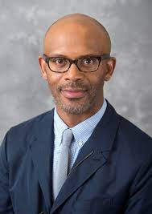


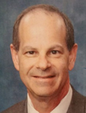


Office of the Assistant Director for SBE Sciences
Kellina Craig-Henderson
Acting Assistant Director
SMA Programs
Research Experience for Undergraduates
Postdoctoral Research Fellowship
Ethical and Responsible Research
Build and Broaden
Current SBE Newsletter
Antoinette WinklerPrins
Acting Deputy Assistant Director
Division of Social and Economic Sciences
Division of Behavioral, Cognitive Sciences
National Center for Science and Engineering Statistics
Ray Fouche
Division Director
Alan Tomkins
Deputy Division Director
Marc Sebrechts
Division Director
Steve Breckler
Acting Deputy Division Director
Emilda Rivers
Director
Vipin Arora
Deputy Director
SES Programs
BCS Programs
NCSES Programs
Decision, Risk and Management Sciences
Economics
Science and Technology Studies
Law and Science
Science of Science: Discovery, Communication and Impact
Security and Preparedness
Accountable Institutions and Behavior
Secure and Trustworthy Cyberspace
Science of Organizations
Sociology
Methodology, Measurement
and Statistics
Archaeology and Archaeometry
Biological Anthropology
Cultural Anthropology
Human-Environment and Geographical Sciences
Cognitive Neuroscience
Developmental Sciences
Linguistics/Dynamic Language Infrastructure
Perception, Action and Cognition
Science of Learning and Augmented Intelligence
Social Psychology
Human Networks and Data Science
Strengthening American Infrastructure
Information and Technology Services
Human Resources Statistics
Research and Development Statistics
Science and Engineering Indicators
Statistics and Methods
https://ncses.nsf.gov/

Slide 8












NCSES provides critical information on the scientific progress that drives American well-being
Mission: policy-neutral policy-relevant statistical data on the U.S. science and engineering enterprise often in a global context
Federal clearinghouse for data that provides key insights on the American economy, responsibility for data on:
    Research and development
    Science and engineering workforce
    US competitiveness in science, engineering, technology, and R&D
    Condition and progress of STEM education
  America’s Data Hub Consortium
8

Slide 9
Agency priorities
Convergent Research (inter/multi/trans disciplinary)
Translational, use-inspired research
Themes:
  Climate and clean energy
  Equity for underserved communities
  Research Infrastructure
  Emerging Industries/Industries of the Future
Many opportunities for the HEGS community - geographers, environmental scientists, regional scientists, urban and regional planners

Slide 10
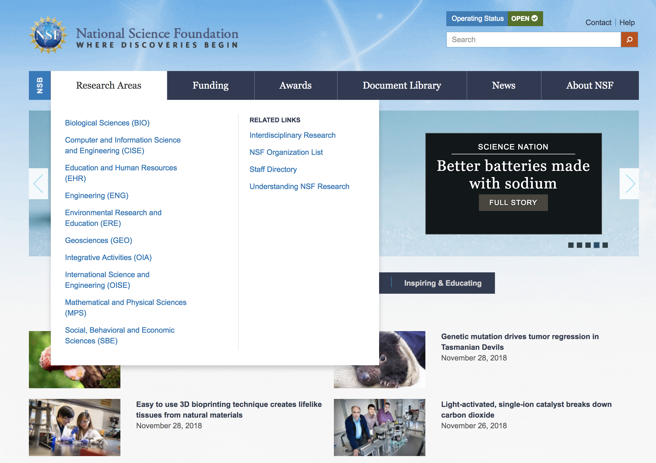
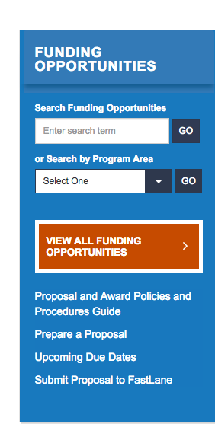
How do I find funding opportunities?
www.nsf.gov
Can search for solicitation numbers using standard search engines (“NSF 22-623”)

Slide 11

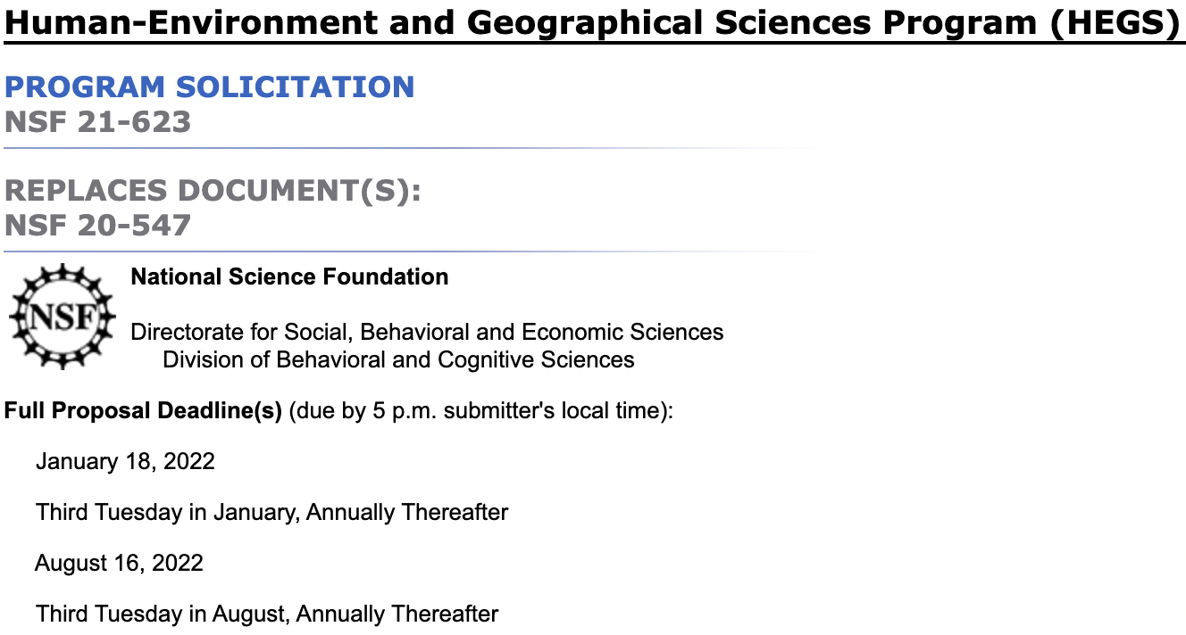
Essential Documents
PAPPG
+
Solicitation

Slide 12

How will my proposal be evaluated?
The merit review criteria
Intellectual Merit
  Potential to advance knowledge within/across fields
  Creative, original, potentially transformative concepts
  Well-reasoned and organized ideas and experiments
  Qualified investigators
  Access to adequate resources
Broader Impacts
  Potential to benefit society
  Promote training and education
  Enhance infrastructure, resources
  Engage in outreach to community
  Broaden participation of underrepresented groups in STEM
NSF SBE Broader Impacts Dear Colleague Letter

Slide 13
Broader Impacts Framework for SBE Sciences
(1) Who Can the Scientific Opportunities and Communicative Products Empower?
(2) Whose Quality of Life Can the Empowerment Improve?
(3) What Actions Make These Broader Impacts More Likely?

Slide 14
The HEGS program
Basic scientific research about the nature, causes and/or consequences of the spatial distribution of human activity and/or environmental processes
HEGS supports social science, environmental science and human-environment interactions. Qualitative, quantitative and mixed methods.
Geographic research of social dynamics, place-making, health, environmental justice, environmental perceptions AND MORE…
Geospatial research of environmental processes (management implications)
Research that is predominantly post-modern, post-structural, humanistic etc., is not a good fit for NSF

Slide 15
HEGS Supports
Research that relies on theoretical and conceptual frameworks that are grounded in geographical sciences
Research that will develop methods relevant to geographic research (including GIScience, remote sensing, geospatial, participatory mapping… AND MORE)
Research that demonstrates the relevance to people and societies

Slide 16
HEGS Key Solicitations
NSF 21-623 – Human-Environment and Geographical Sciences (FACULTY) – Mid January/Mid August
  Research Coordination Networks
NSF 22-586 – Faculty Early Career Development Program (CAREER) - Deadline July 27
NSF 21-516 – Mid-Career Advancement (MCA) - Deadline First Monday in February
NSF 14-579 - Research at Primarily Undergraduate Institutions – No deadline
NSF 21-621 – Doctoral Dissertation Research Awards (HEGS-DDRI) – No deadline
NSF 19-582 – Research Experiences for Undergraduates (REU) Site - Deadline 4th Wed in August
NSF Graduate Research Fellowships Program (GRFP)
NSF 18-584 – SBE Postdoctoral Research Fellowships (SPRF)
Dear Colleague Letter: HEGS Research Experiences for Graduates (REG) and Research Experience for Undergraduates (REU) **Supplement** -- up to $6,000 for undergrad or grad developed project

Slide 17
Many programs commonly co-review proposals submitted to HEGS
You may request co-review by another “standing” program
Program Officers may ask another program to consider co-review
There is generally no downside to co-review, but other programs may decline to co-review if there is inadequate fit.
Cultural Anthropology
Hydrological Sciences (GEOsciences)
Sociology (SBE)
Division of Environmental Biology (BIO)
Human Networks and Data Science
Measurement, Methodology, and Statistics
Decision, Risk and Management Sciences
Population and Community Ecology (BIO)
Security and Preparedness
Build and Broaden
Computer and Information Science and Engineering (CISE)

Slide 18
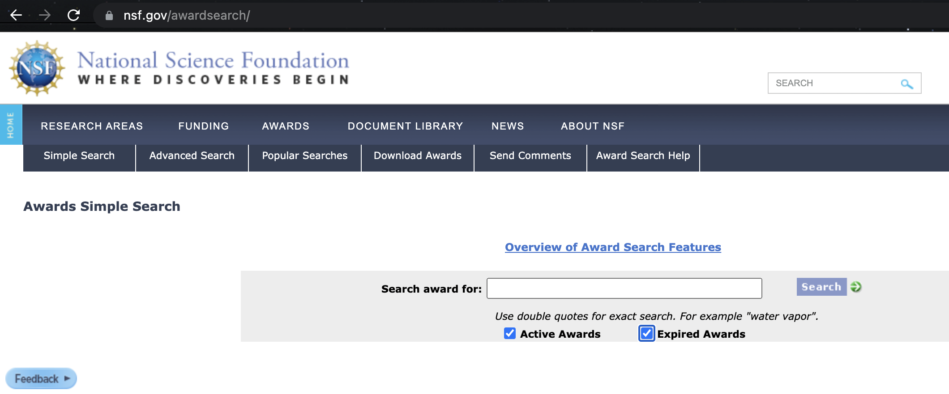
Related NSF Programs
A number of NSF programs support research by geographers and human-environment researchers.
https://www.nsf.gov/awardsearch/

Slide 19
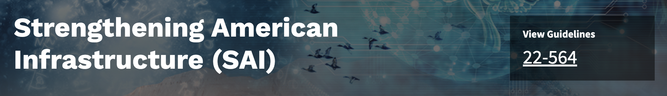
Human-centered, interdisciplinary research on infrastructure, broadly defined
“how basic knowledge of human reasoning, decision-making, governance, and social and cultural processes enables efforts to envision, build, and maintain effective infrastructure that improves lives.
Must forefront SBE disciplinary expertise (March webinar (link to view webinar))
Three tracks: Research grants (up to $750,000), Planning grants (up to $150,000, and Conference grants (up to $50,000).
https://beta.nsf.gov/funding/opportunities/strengthening-american-infrastructure-sai-1

Slide 20

Leveraging data and network science, including geospatial data and infrastructure
Two tracks – both with budgetary maximums of $1.2 million
  HNDS-Infrastructure – development of data resources and analytic methods
  HNDS-Research – advance theory in a core SBE discipline by the application of data and network science methods.
    “The HNDS-R program will co-review and co-fund projects with other SBE programs.”
Webinar link from last fall: Link to view the HNDS webinar
https://beta.nsf.gov/funding/opportunities/human-networks-and-data-science-hnds

Slide 21
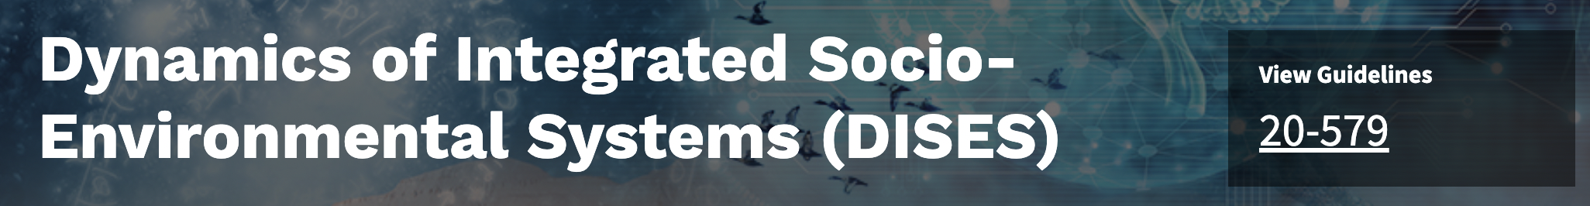
Processes and feedbacks between human and environmental components of a system
Replaces the Dynamics of Coupled Natural and Human Systems program
Budget maximum: $1.6 million
Commonly funded projects are composed of interdisciplinary teams that focus on complex interactions
Also funds Research Coordination Networks (RCN)
https://beta.nsf.gov/funding/opportunities/dynamics-integrated-socio-environmental-systems-dises

Slide 22

Convergent science on human dimensions, coastal sustainability, and coastal processes
Diverse, innovative, multi-institution awards with relevance for US coastlines
Two tracks
  Focused hubs: budgets up to $1 million per year, for 3 to 5 years
  Large-scale hubs: budgets from $2 to 4 million per year for up to 5 years.
Integrated with Broadening Participation goals
https://beta.nsf.gov/funding/opportunities/coastlines-and-people-hubs-research-and-broadening-participation-cope

Slide 23

Multidisciplinary soil science
3 to 5 years of support with a total budget no less than $600,000, and no more than $1,200,000 per project
New priority on “Socializing Soil” to better understand complex people-soil dynamics through partnerships between soil scientists and social scientists
https://beta.nsf.gov/funding/opportunities/signals-soil

Slide 24

Research on the social and ecological dimensions of warming Arctic climates
Three tracks:
  Incubator Grants with budgets up to $300,000
  Research Grants with budgets up to $3,000,000
  Collaboratory Grants with maximum durations of 5 years
“Convergent research across the social, natural, environmental, computing and information sciences, and engineering that address the interactions or connections among natural and built environments and social systems in the Arctic”
https://beta.nsf.gov/funding/opportunities/navigating-new-arctic-nna

Slide 25
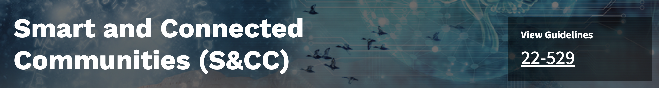
Scientific and engineering foundations of economic opportunities, security, health, accessibility and inclusivity, and overall quality of life
Prioritizes engagement with stakeholders in geographically-bounded communities to pilot intelligent technologies and infrastructural solutions that will plausibly be sustained beyond the life of the project
March webinar link: Link to view the S&CC webinar
https://beta.nsf.gov/funding/opportunities/smart-and-connected-communities-scc

Slide 26

Integrative research that advances theory on populations, hazards and the built environment
“Ultimately, research funded through this program is expected to inform how communities can cultivate and engage a broad range of physical, social and other resources to ensure improved quality of life for their inhabitants.”
https://beta.nsf.gov/funding/opportunities/humans-disasters-and-built-environment-hdbe

Slide 27
Other programs that are relevant to geographers
Remember – Many BIO solicitations have no deadlines and no submission limits.
NSF 21-504 – Division of Environmental Biology Core Programs
NSF 22-550 – Signals in the Soil – Deadline April 14
NSF 20-525 – Faculty Early Career Development Program (CAREER) - Deadline July 26
NSF 20-564 – Opportunities for Promoting Understanding through Synthesis (OPUS) - Deadline August 1
NSF 19-582 – Research Experiences for Undergraduates (REU) Site - Deadline August 25
NSF 21-584 – Research Experiences for Teachers (BIORETS) Sites - Deadline August 2
DCL 21-085 – Research Experiences for Post-Baccalaureate Students (REPS) – Target date July 2
DCL 21-021 – Career-Life Balance Supplement
BIO 18-001 – Biological Sciences Temporary/Rotator Program Officer

Slide 28
Division of Environmental Biology (DEB)
Core Solicitation NSF 22-541 Proposals accepted anytime, no PI limits
Ecosystem
Science
Population and Community Ecology
Evolutionary Processes
Systematics and Biodiversity
Science
Ecosystem structure and function across spatial and temporal (including paleo) scales
Conceptual understanding of population ecology, species interactions and community dynamics
Evolutionary dynamics and their consequences
Diversity, systematics, and evolutionary history of extant / extinct organisms in natural systems
NSF Landscape

Slide 29
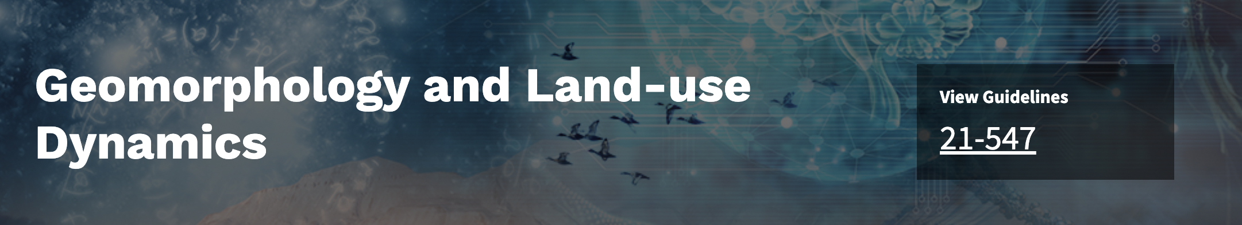
Processes that shape earth’s landscapes during the Holocene
The program encourages research that quantitatively investigates the coupling and feedback among such processes, their rates, and their relative roles, especially in the contexts of variation in biologic, climatic, and tectonic influences and in light of changes due to human impacts.
https://beta.nsf.gov/funding/opportunities/geomorphology-and-land-use-dynamics

Slide 30
Q&A Session: Questions?
Submit your questions via the Q&A box on your screen and set to “Send anonymously”
Upvote questions by clicking the thumbs up icon next to the question you most want answered
For specific questions about your project, please contact a Program Officer
  The HEGS program email is: HEGS-info@nsf.gov

