Slide 1
ACCESS PROGRAM INTRODUCTION
TOWN HALL
ACCESS PROGRAM INTRODUCTION
TOWN HALL
14Jun22 1:00-2:30 ET
Manish Parashar, CISE OAC Director
Bob Chadduck, Tom Gulbransen, Al Suarez, Program Officers
TGulbran@NSF.gov
703-292-4211

Slide 2
Agenda
Agenda:
Provide opportunity to discuss the ACCESS Program scope and governance
Convey basic themes of Stability and Expansion of users and types of uses
Highlight opportunities for researchers to influence ACCESS plans & priorities

Slide 3
Science Mission
Science Mission: Research CI is a key catalyst for discovery and innovation and plays a critical role in ensuring US leadership in S&E, economic competitiveness, and national security, consistent with NSF's mission
OAC Vision: Broad availability and innovative use of an agile, integrated, robust, trustworthy and sustainable CI ecosystem that can drive new thinking and transformative discoveries in all areas of S&E research and education
ACCESS Purpose: Support a broad and diverse set of requirements, users, and usage modes from all areas of S&E research and education in an equitably accessible, coordinated fashion, highly-cooperative services
View CI holistically
Driven by research needs
Balance stable continuity of services with innovation
Improve democratization of CI
Enable flexible management

Slide 4
Pressures Influencing OAC Visions of ACCESS Ecosystem
 |  | CI RESEARCH
opportunities |  |  |  | data, instruments
 |  |  |  | campuses
prospective |  | innovate, take risks |  | cloud
 |  |  |  | testbeds
User Communities | equity & inclusive LWD | UNIFIED ECOSYSTEM ACCESS | speed & scalable services based | Resource Providers
active |  | production, stability |  | tools
trusted, timely |  |  |  | HPC & HTC
 |  | RESEARCH CI
PEOPLE FACING
SYSTEMS FACING

Slide 5
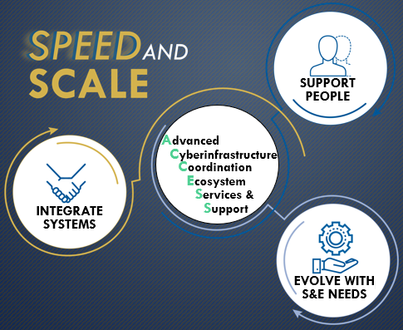
ACCESS Enhancements
Build on XSEDE successes
Wider resources beyond compute
Leverage & multiply NSF programs
Expand users, S&E uses, & experts
Lower barriers to entry
On-ramps to embed on campuses
Simple, fast allocation requests
Ideation with expert communities
Transparency of each service
Metrics to help institutions value CIP
Ecosystem = compute +
data + SW + networks + experts

Slide 6
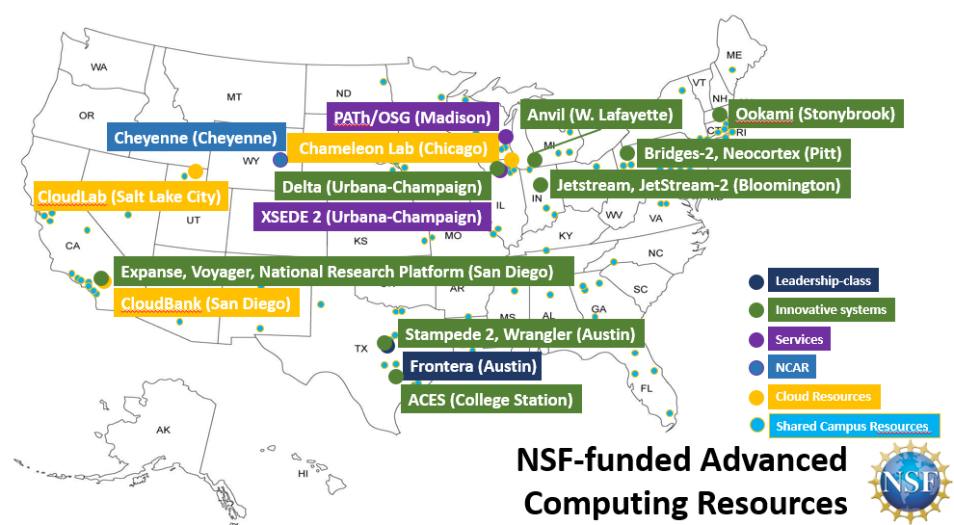
ACCESS Ecosystem of Resources: Continuity & Growth
Stability & Growth
Novel modes of S&E research – workflows, cloud, data, instruments, campuses
Known users & new communities
Learning about emerging needs
CO
ACCESS PIs
FABRIC Network (Nationwide)
Shared Campus Resources

Slide 7
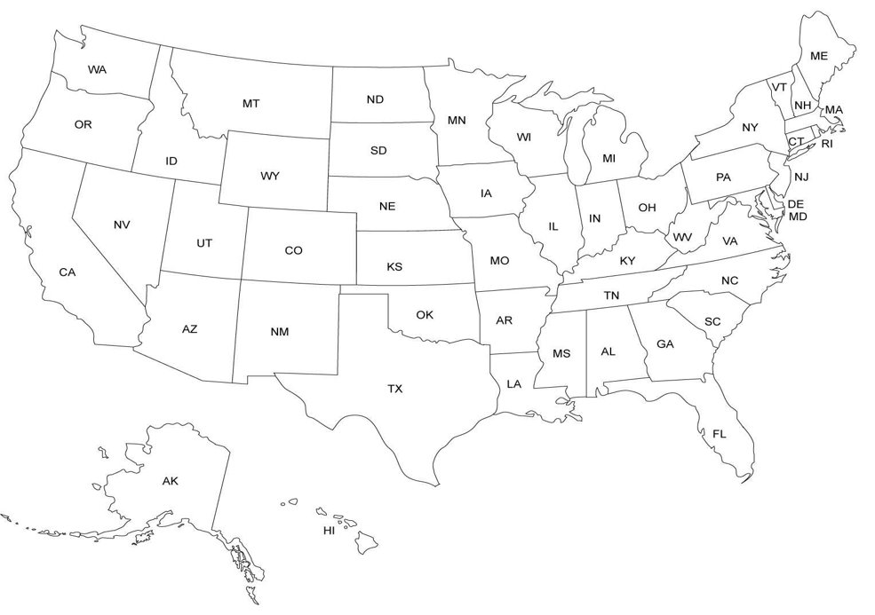
User Support Growth & Evolution
Diverse available expertise
Evolving to serve new research
Leveraging NSF programs and networks
  CC*
  CyberTeams
  RCN of CIP
  HPC provider staff
ACCESS
PIs, co-PIS
Ctrs of Excellence
ACCESS
PIs & co-PIs
Teams, Networks
HPC systems
RP staff

Slide 8
NSF Direction of ACCESS Service Tracks
Allocation Services
End User Support Services
Operations & Integration Services
Monitoring & Measurement Services
Technology Translation Services
General User Assistance
Allocation Services
Operational Support
M&M Operations
Allocation & Utilization Assistance
Innovative Pilots
Data & Networking Support
Service Model
End User Training
Service Model
Cybersecurity Support
Data Analytics Framework
Computational Science Support Network
NSF Direction of ACCESS Coordination Office Services
Executive Council
Communications & Outreach
Advisory Board

Slide 9














Access Awardees
ACCESS Awardees
RAMPS
MATCH
CONECT
M&M
OpenCI
Allocations
End User Support
Operations & Integration
Monitoring & Measurement
Coordination Office
$52.5M Investment over 5 years
70+ Researchers, Staff, Students
75+ Collaborating Institutions
Each brings experience & new ideas
Details: https://go.usa.gov/xu5r9

Slide 10
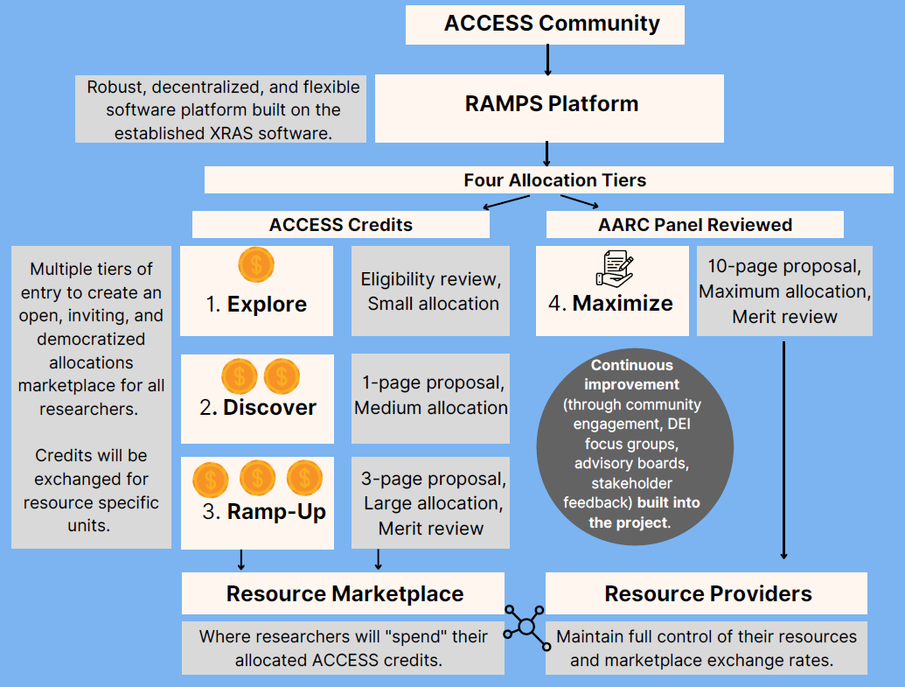
Track1 Allocation Services - RAMPS $7.5M over 5 years
Shawn Brown, Carnegie-Mellon Univ
Laura Herriott, UIUC
David Hart, UCAR
Continuity of provider to XSEDE
As-is process for large requests
==================
Democratized marketplace of consumer & provider choices
Easier Application tiers Explore, Discover, Ramp-up, Maximize
“On-RAMPS” for campus portals
Units of “ACCESS Credits” scaled by pool of requesters
Unit conversion rates set by resource providers

Slide 11
RAMPS Innovative Pilots
“Exploratory pilots developed and implemented through
continuous feedback and software development best practices”
1. Variable Marketplace: Supply/demand-based conversion rates; incentives based on metrics; targeting special projects/domains
Partners: Bridges-2, Jetstream2, University of Pittsburgh CRC, TACC Frontera
2. Regional & Campus On-RAMPS: Placing the RAMPS interface in partner institutions; virtual datacenter of the nation’s advanced resources
Partners: MGHPCC, RMACC, Tribal Consortium Research Network, Alabama A&M, Navajo Technical University,
U. of Delaware, U. of New Mexico, U. of Puerto Rico–Mayaguez
3. Integrating Commercial & Academic Clouds: Allocating vendor-donated cloud credits
Partners: CloudBank (UC San Diego), Jetstream2, University of Pittsburgh
4. Allocating CI Resource Workflows: Requesting “packages” of resources to support complex workflows
Partners: funcX (Universities of Chicago / Illinois), Science Gateways Community Institute (SGCI)
5. Allocating Sensor Nets & Instrumentation: Processes for significantly different CI
Partners: Engineering IT Shared Services (UIUC), NCAR Earth Observing Laboratory, Sage Continuum
(Northwestern University), Carnegie Mellon University - Cloud Lab Initiative

Slide 12
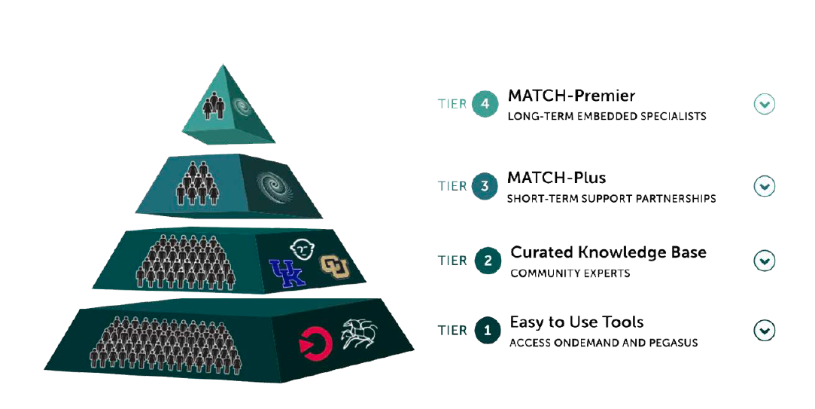
Track2 End User Support Services - MATCH $10M over 5 years
Shelley Knuth, CUBoulder
Ewa Deelman, USC, John Goodhue, MGHPCC
James Griffioen, UK David Hudak, OSU
Retain XSEDE major supporters ==================
Enable innovative research through equitable and scalable support
Four tiers of support levels
Tools, growing knowledge base
Match-making with experts
Student engagement
Engagement from community
Financial incentives

Slide 13
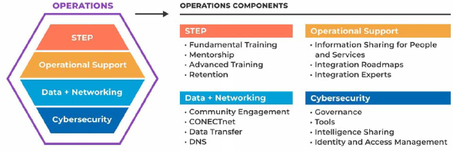
Track3 Operations & Integration Services - CONECT $20M over 5 yrs
Amy Schuele, UIUC
Derek Simmel, CMU, JP Navarro, UChicago
Winona Snapp-Childs, IU, A. Withers, UIUC
Central IAM & security council
Tech Stack of ticketing
Concierge Integration Experts
==================
Integration Roadmaps
Platform of CI Descriptions & Research Resource Discovery
Help Ivy.AI chatbot knowledgebase
Education/internships embedded

Slide 14
Track4 Monitoring & Measurement Services $10M over 5 years
Thomas Furlani, Roswell Park (UBuffalo)
R. DeLeon, J. White, M. Jones, UBuffalo
Abani Patra, Tufts
Incumbent provider to XSEDE
Seamless transition
==================
Open XDMoD broader use
Open framework for creative, ad hoc analytics
Analytics for National CI
Workload performance analyses
Network traffic leverage NetSAGE
Application diagnose/optimize
CI configuration simulator
Energy use pilot

Slide 15
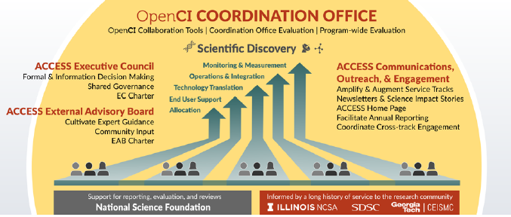
ACCESS Coordination Office Services $5M over 5 years
John Towns, UIUC
Timothy Boerner, UIUC
Shawn Strande, UCSD
Lizanne DeStefano, Georgia Tech
Complete XSEDE awareness
Emphasis on seamless transition
==================
Facilitate shared governance via EC and EAB
Collaboration portal to support inter-track communications
Branding to be developed
Coordinate outreach, DEI, and evaluation efforts program-wide
Stakeholder communications on ACCESS impact & opportunities
Informal co-advisors from five large programs

Slide 16
Opportunities for Researcher Involvement
NSF Direction of ACCESS Service Tracks
RAMPS
Allocations
MATCH
User Support
CONECT
Ops. & Integr.
Monitoring & Measurement
Allocation Services
General User Assistance
Operational Support
M&M Operations
Allocation & Utilization Assistance
Innovative Pilots
Data & Networking Support
Service Model
End User Training
Cybersecurity Support
Service Model
Computational Science Support Network
Data Analytics Framework
NSF Direction of ACCESS Coordination Office
Executive Council
Communications & Outreach
Advisory Board

Slide 17
Access Program Introduction
ACCESS PROGRAM INTRODUCTION
Leadership
Tom Gulbransen, PD, CISE/OAC TGulbran@NSF.gov
Shawn Brown, PI, CMU/PSC STBrown@PSC.edu
Shelley Knuth, PI, CU Boulder Shelley.Knuth@Colorado.edu
Amy Schuele, PI, UICU Aschuele@Illinois.edu
Tom Furlani, PI, Roswell Park/UBuffalo Furlani@Buffalo.edu
John Towns, PI, UIUC Jtowns@Illinois.edu

