Slide 1

Mid-scale Research Infrastructure-1
FY 23 Competition
Webinar for CISE Community
October 28, 2022
Times: 2:00p.m. – 3:00 p.m. Eastern
Deep Medhi, Program Director

Slide 2
Mid-scale RI-1 Working Group at NSF
OIA | Randy Phelps | rphelps@nsf.gov
BIO | Sridhar Raghavachari | sraghava@nsf.gov
CISE | Deep Medhi | dmedhi@nsf.gov
EHR (EDU) | Jill Nelson | jnelson@nsf.gov
ENG | Aranya Chakrabortty | achakrab@nsf.gov
GEO | Frank Rack | frack@nsf.gov
MPS | John Papanikolas | jpapanik@nsf.gov
SBE | Joseph Whitmeyer | jwhitmey@nsf.gov
OISE | Maija Kukla | mkukla@nsf.gov
EPSCoR | Chinonye Whitley | cwhitley@nsf.gov

Slide 3
Outline
Research Infrastructure Overview
Mid-scale RI Overview
Mid-scale RI-1
Previous Mid-scale RI-1 from CISE
General Q&A

Slide 4
A Sketch of NSF and CISE Infrastructure Programs
Mid-Scale-
2
Mid-Scale Research Infrastructure 2
Solicitation 21-537
$20M-100M per award
Mid-Scale Research Infrastructure 1
Solicitation 22-637
$4-20M per award
Advanced
Computing
Systems &
Services
20M
Mid-Scale-1
10M
Size
Above all: Infrastructure is not just hardware!
Think broadly about Infrastructure to include software, data and people!
5M
CSSI Frameworks
CCRI
MRI
CSSI Elements
CC*
1M
Individual/Institutional
Community

Slide 5
NSF Research Infrastructure (already funded for CISE community use)
Frontera
PAWR
20M
Chameleon CloudLab
FABRIC EduceLab
SAGE
Internet Observatory
GIMI3S
10M
Size ($)
CloudBank
FAB
AmLight-ExP
PAWR includes:
COSMOS,POWDER,
AERPAW, ARA
5M
1M
Individual/Institutional
Community

Slide 6

Mid-scale Research Infrastructure
Many important potential experiments and facilities fall between the $100K to $4M Major Research Instrumentation (MRI) program and the > $100M Major Multi-user Facilities range.
This gap results in missed opportunities that may leave essential science undone.
NSF needed a new agile process for funding experimental research capabilities in the mid-scale range.
  Mid-scale RI-1: $4 - <$20 M
  Mid-scale RI-2: $20 - $100 M

Slide 7
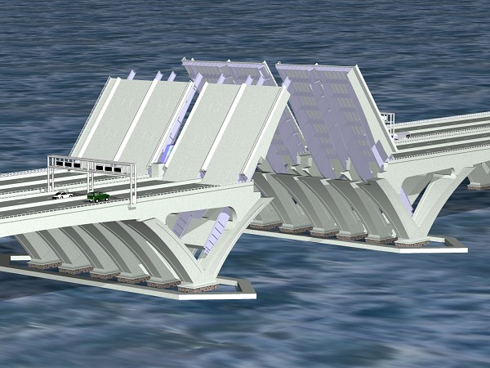
Mid-Scale Research Infrastructure (Mid-scale RI)
Mid-scale RI-2
Mid-scale RI-1
MREFC
MRI
Notes:
Illustration from: https://www.google.com/search?client=firefox-b-1&biw=1312&bih=695&tbm=isch&sa=1&ei=IahxW8zdBMy7zwLKsraYCw&q=photo+wolson+bridge+open&oq=photo+wolson+bridge+open&gs_l=img.3...35484.40440.0.40846.7.7.0.0.0.0.144.446.6j1.7.0....0...1c.1.64.img..0.0.0....0.EdHtYhPDgec#imgrc=cYkP7Zix7-UIMM:

Slide 8
Mid-scale RI
Research Infrastructure (RI) NSF definition
Any combination of facilities, equipment, instrumentation, or computational hardware or software, and the necessary human capital in support of the same.
Mid-scale RI-1: examples
Implementation projects that may include any combination of equipment, instrumentation, cyberinfrastructure, broadly used large-scale datasets, and the commissioning and/or personnel needed to successfully complete the project,
Design efforts intended to lead to eventual implementation of a mid-scale class project.
Mid-scale RI-2: examples
Implementation projects only

Slide 9
Mid-scale RI-1 (NSF 22-637) due dates
Preliminary Proposal (Required)
January 05, 2023
Full Proposal Deadline (By Invitation Only)
May 05, 2023

Slide 10

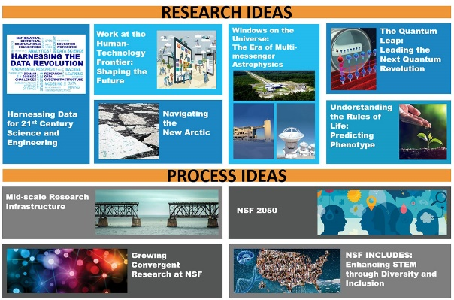
Mid-scale RI-1 projects should
Emphasize strong scientific merit.
Fill a research community-defined scientific need or enable a national research priority to be met.
Enable US researchers to remain competitive in a global research environment.
Involve the training of a diverse workforce engaged in the design and implementation of STEM infrastructure.

Slide 11
Mid-scale RI-1 will NOT support
Science and engineering research not part of validation of operational readiness;
Post-implementation research, operations, or maintenance;
Projects with a total project cost outside of the limits of this solicitation;
General-purpose buildings, support systems and equipment not directly required for the implementation and eventual operation of the proposed infrastructure;
Multiple pieces of infrastructure or instrumentation packaged together to meet the minimum TPC but not functioning as an integrated system;
Other organized activities, e.g., research centers, that are not consistent with the definition of NSF mid-scale RI provided in this solicitation.

Slide 12
MSRI-1: Cyberinfrastructure (CI) projects
Projects should significantly enable new S&E research at the community, regional, national and international scales.
Projects must be strongly driven by
  the identified research needs of one or more science and engineering communities supported by NSF
  advance the Nation’s holistic research cyberinfrastructure ecosystem (i.e., spanning one or more of data, software, networking, and/or cybersecurity), and
  comprise innovative, focused technical and operational objectives.
  Projects that are primarily focused narrowly on data storage or seek support for broadly provisioned high-performance computing resources will not be supported by the Mid-scale RI-1 program.

Slide 13
Mid-scale RI-1: Two types of projects
Implementation Projects
e.g., Acquisition, Assembly, Construction and Commissioning:
  Enable well-defined, limited-term research experiments with broad community buy-in and shared data resources and/or
  Shared-use, mid-scale infrastructure for broad community use.
  $4 million ≦ Total Project Cost < $20 million
Design Projects: May cover activities that lead to preparation for implementation of a future mid-scale class project¹.
$600,000 ≦ Total Project Cost < $20 million
¹NSF makes no commitment to the implementation of projects supported through the design track of Mid-scale RI-1.

Slide 14
Mid-scale RI-1: types of projects
Implementation Projects
$4M≦ Project Cost < $20M
e.g., Acquisition, Assembly, Construction and Commissioning
Enable well-defined, limited-term research experiments with broad community buy-in and shared data resources and/or
Shared-use, mid-scale infrastructure for broad community use.
Design Projects
$600K ≦ Project Cost < $20M
May cover activities that lead to preparation for implementation of a future mid-scale class project.

Slide 15
Mid-scale RI looks for
Projects with National Importance
For Implementation:
  An RI that enables well-defined, limited-term research experiments with broad community buy-in and shared data resources and/or b) shared-use, mid-scale infrastructure for broad community use.

Slide 16
Mid-scale RI-1 (NSF 22-637)
Project Execution Plans (PEP)
A Project Execution Plan (PEP) describes the management and project execution processes that are used to ensure that a project’s scope is completed on time and within budget.
The document defines the project scope; the organizational framework and overall management systems for the project; and identifies roles and responsibilities of the project participants.
It also describes the formal change control process by which the Project scope, cost, schedule, budget profile, and PEP may be revised.
Project Execution Plan (PEP) is for the construction stage and that the requirement is for performance measurement and management

Slide 17
Mid-scale RI-1 (NSF 22-637)
Project Execution Plans (PEP)
Section 5 of NSF’s Research Infrastructure Guide, or RIG, available at
provides guidance specific to Mid-Scale RI Projects.
Note that PEP should be appropriately scaled for the complexity of the project, and may not require all the elements described elsewhere in the RIG.
The template for a Mid-scale RI PEP is available at https://www.nsf.gov/bfa/lfo/docs/Mid-scale_Project_PEP_Template_v2022.doc
NSF Research Infrastructure Guide 21-107, see Section 5:
https://www.nsf.gov/pubs/2021/nsf21107/nsf21107.pdf

Slide 18
Mid-scale RI-1 (NSF 22-637)
Established Program to Stimulate Competitive Research
(EPSCoR)
Mid-scale RI-1 proposals from institutions located in eligible EPSCoR jurisdictions are highly encouraged.
For EPSCoR co-funding, the lead submitting organization must be located in an eligible EPSCoR jurisdiction, with the infrastructure physically located in an eligible EPSCoR jurisdiction (generally but not necessarily the same jurisdiction).
For geographically distributed infrastructure, some sites may be located in non-EPSCoR jurisdictions, but the primary management location will be in an EPSCoR jurisdiction.

Slide 19
Foundation-wide Award for mid-scale RI-1
Two rounds of competition so far (FY19 and FY21)
FY19 awards:
  10 awards: 6 implementation projects, 4 design projects
  Average Award amount: Implementation: $14.8 M; Design: $7.1 M
FY21 awards:
  10 awards: 6 implementation projects, 4 design projects
  Average Award amount: Implementation: $14.9 M; Design: $10.2 M

Slide 20
Mid-scale RI-1s Awards: CISE-related
FY19 awards
  FABRIC (implementation)
  SAGE (implementation)
FY21 awards
  EduceLab (implementation)
  GMI3S (design)
  Internet Observatory (implementation): CISE is secondary

Slide 21
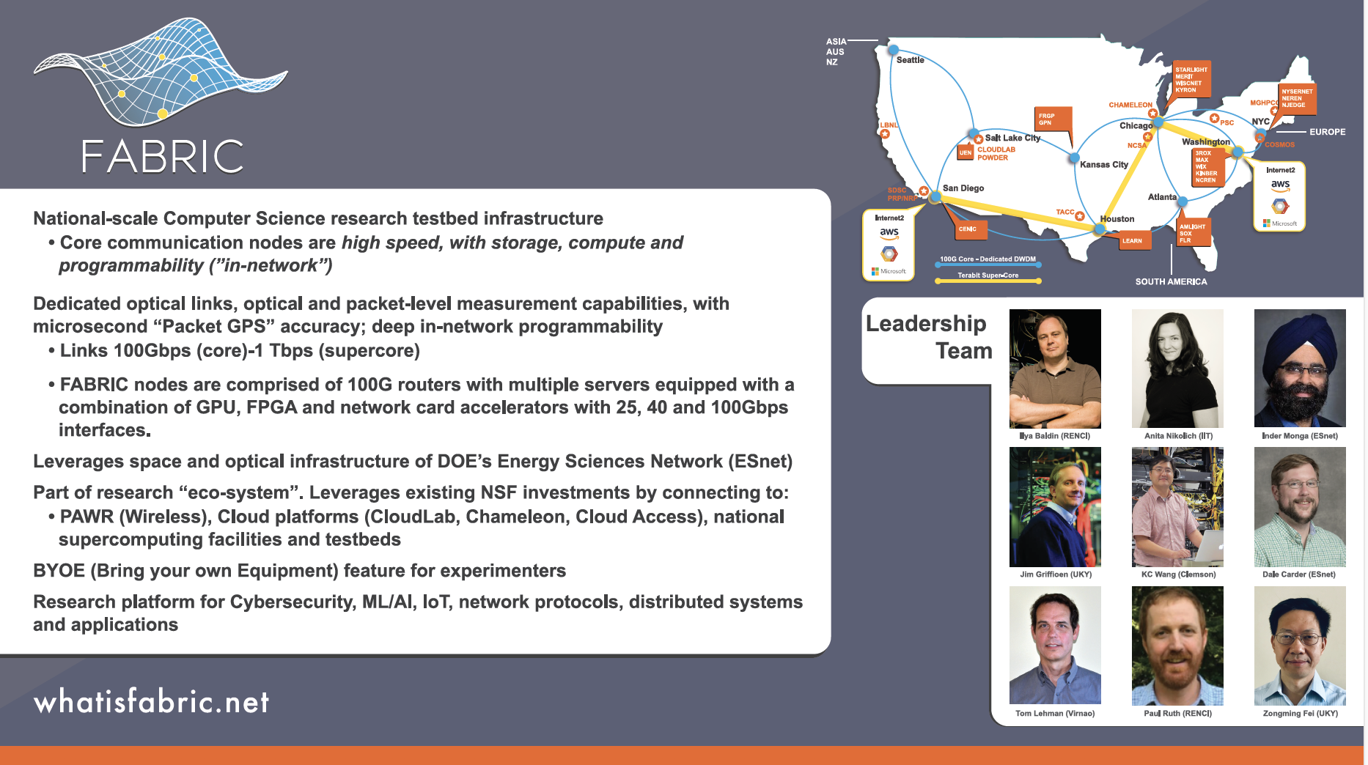
Award # 1935966 for $ 19,980,601, 4-year duration

Slide 22

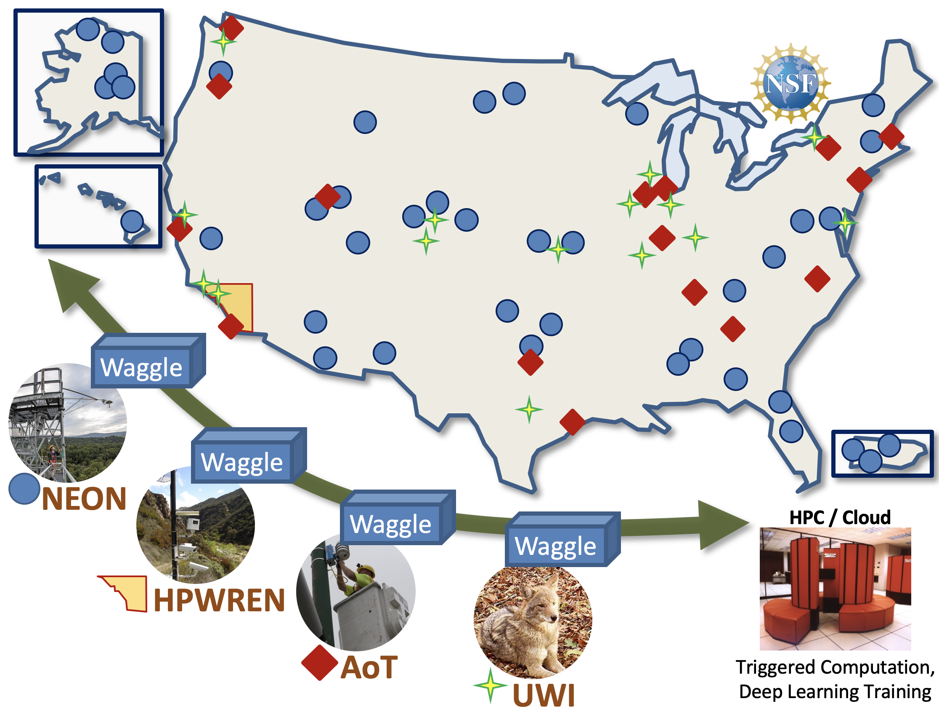





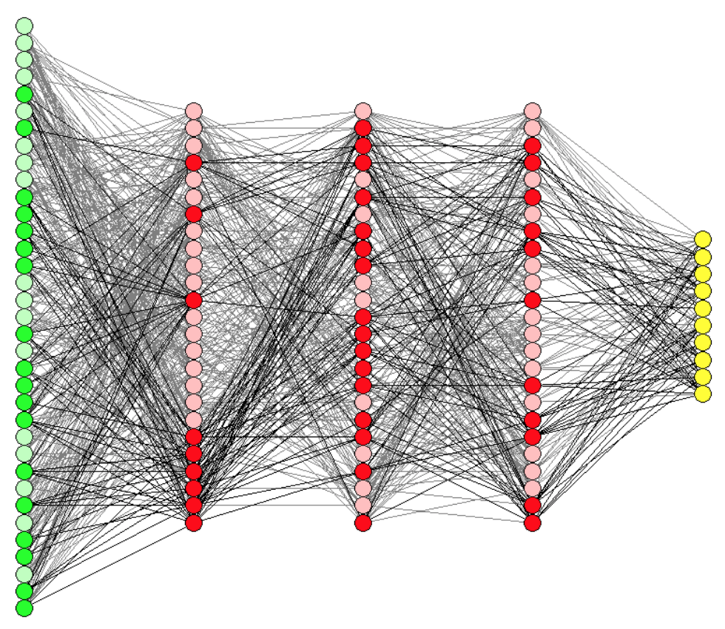



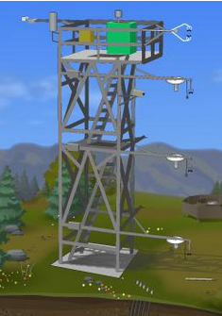
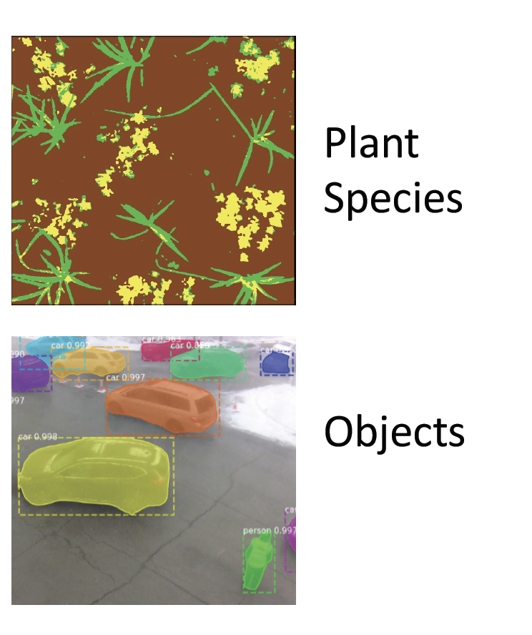




Award #1935984
A Software-Defined
Sensor Network
- Cyberinfrastructure for
AI at the Edge
sagecontinuum.org
Leadership Team
SAGE
Science Justification
Understanding resilience —why do ecosystems, cities, neighborhoods respond differently to phenomena such as gradual changes in ecological diversity, increased severe weather, or catastrophic events? What are the mechanisms of resilience, or indices of fragility?
Research Community Benefits
New cyberinfrastructure for exploring machine learning in a national-scale instrument network
Flexible national-scale measurement infrastructure
New measurements via software-defined sensors
Cyberinfrastructure Use Modalities
Open Data, Open Calibration, Education
Triggered Computation
Scheduled Edge Computation
Machine Learning for the Edge (AI@Edge)
Pete Beckman
(NU; Director)
Nicola Ferrier
(NU; Deputy Dir.
Ilkay Altuntas
(SDSC; Data)
Charlie Catlett
(UChicago; AoT)
Scott Collis
(NU; ARM)
Valerie Taylor
UChicago; Broader Impacts)
Software-Defined Sensors
Education & Training
Raw data
Results
Adaptive control
Triggers
Jim Olds
(GMU; Life Sci, Risk)
Dan Reed
(Utah; Architecture)
Multimessenger: Adaptive Sensing
Broadening Participation
SAGE: A cyberinfrastructure to bring diverse disciplinary expertise to bear on complex questions, revealing the hidden layer of mechanisms and relationships to understand the causality inherent in these systems and at their intersections. SAGE will enable convergent science teams to integrate concepts and methods from different disciplines and conducting research on shared infrastructure that is generative and diverse.
Eugene Kelly
(CSU; NEON)
Irene Qualters
(LANL; Advisory Committee Chair)
Award # 1935984 for $9 M, 3-year duration

Slide 23
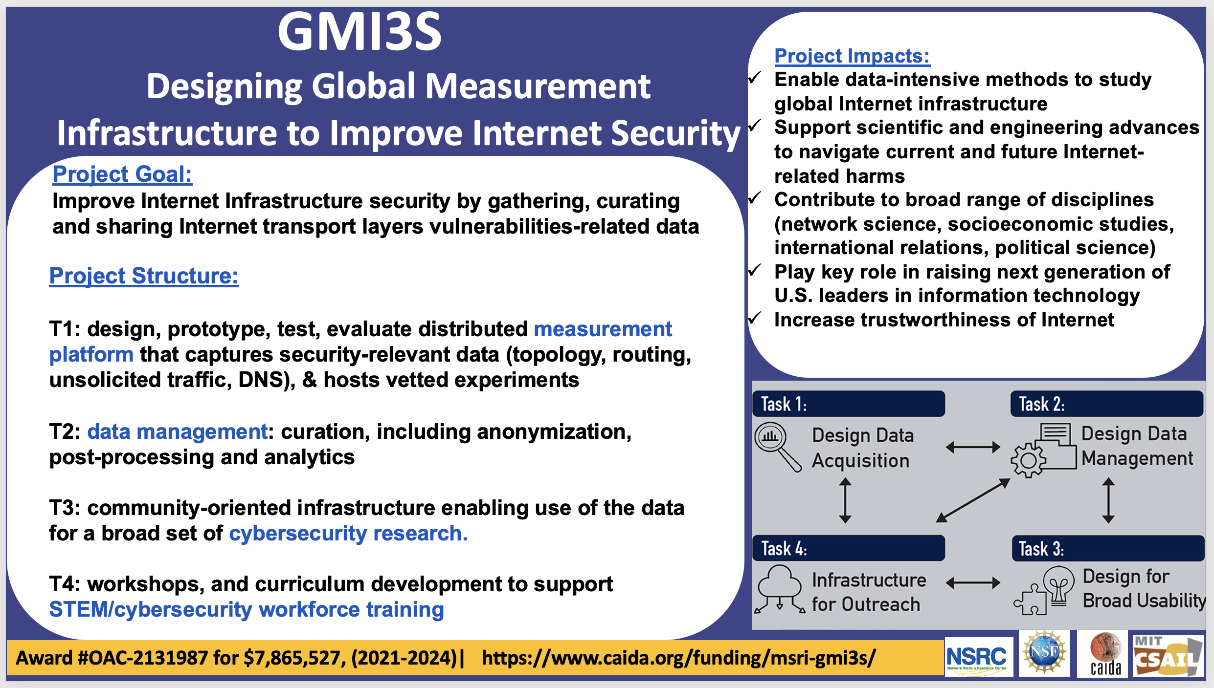
GMI3S
PI: KC Claffy, University of California-San Diego

Slide 24
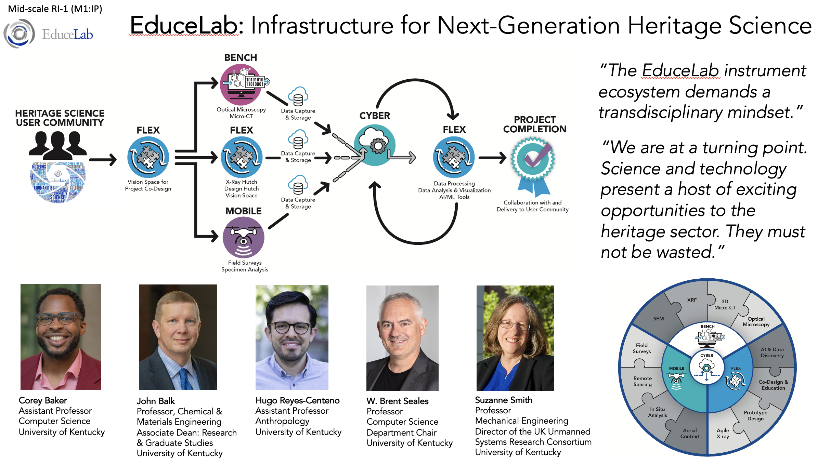
Award # 2131940 for $14M, 5-year duration

Slide 25
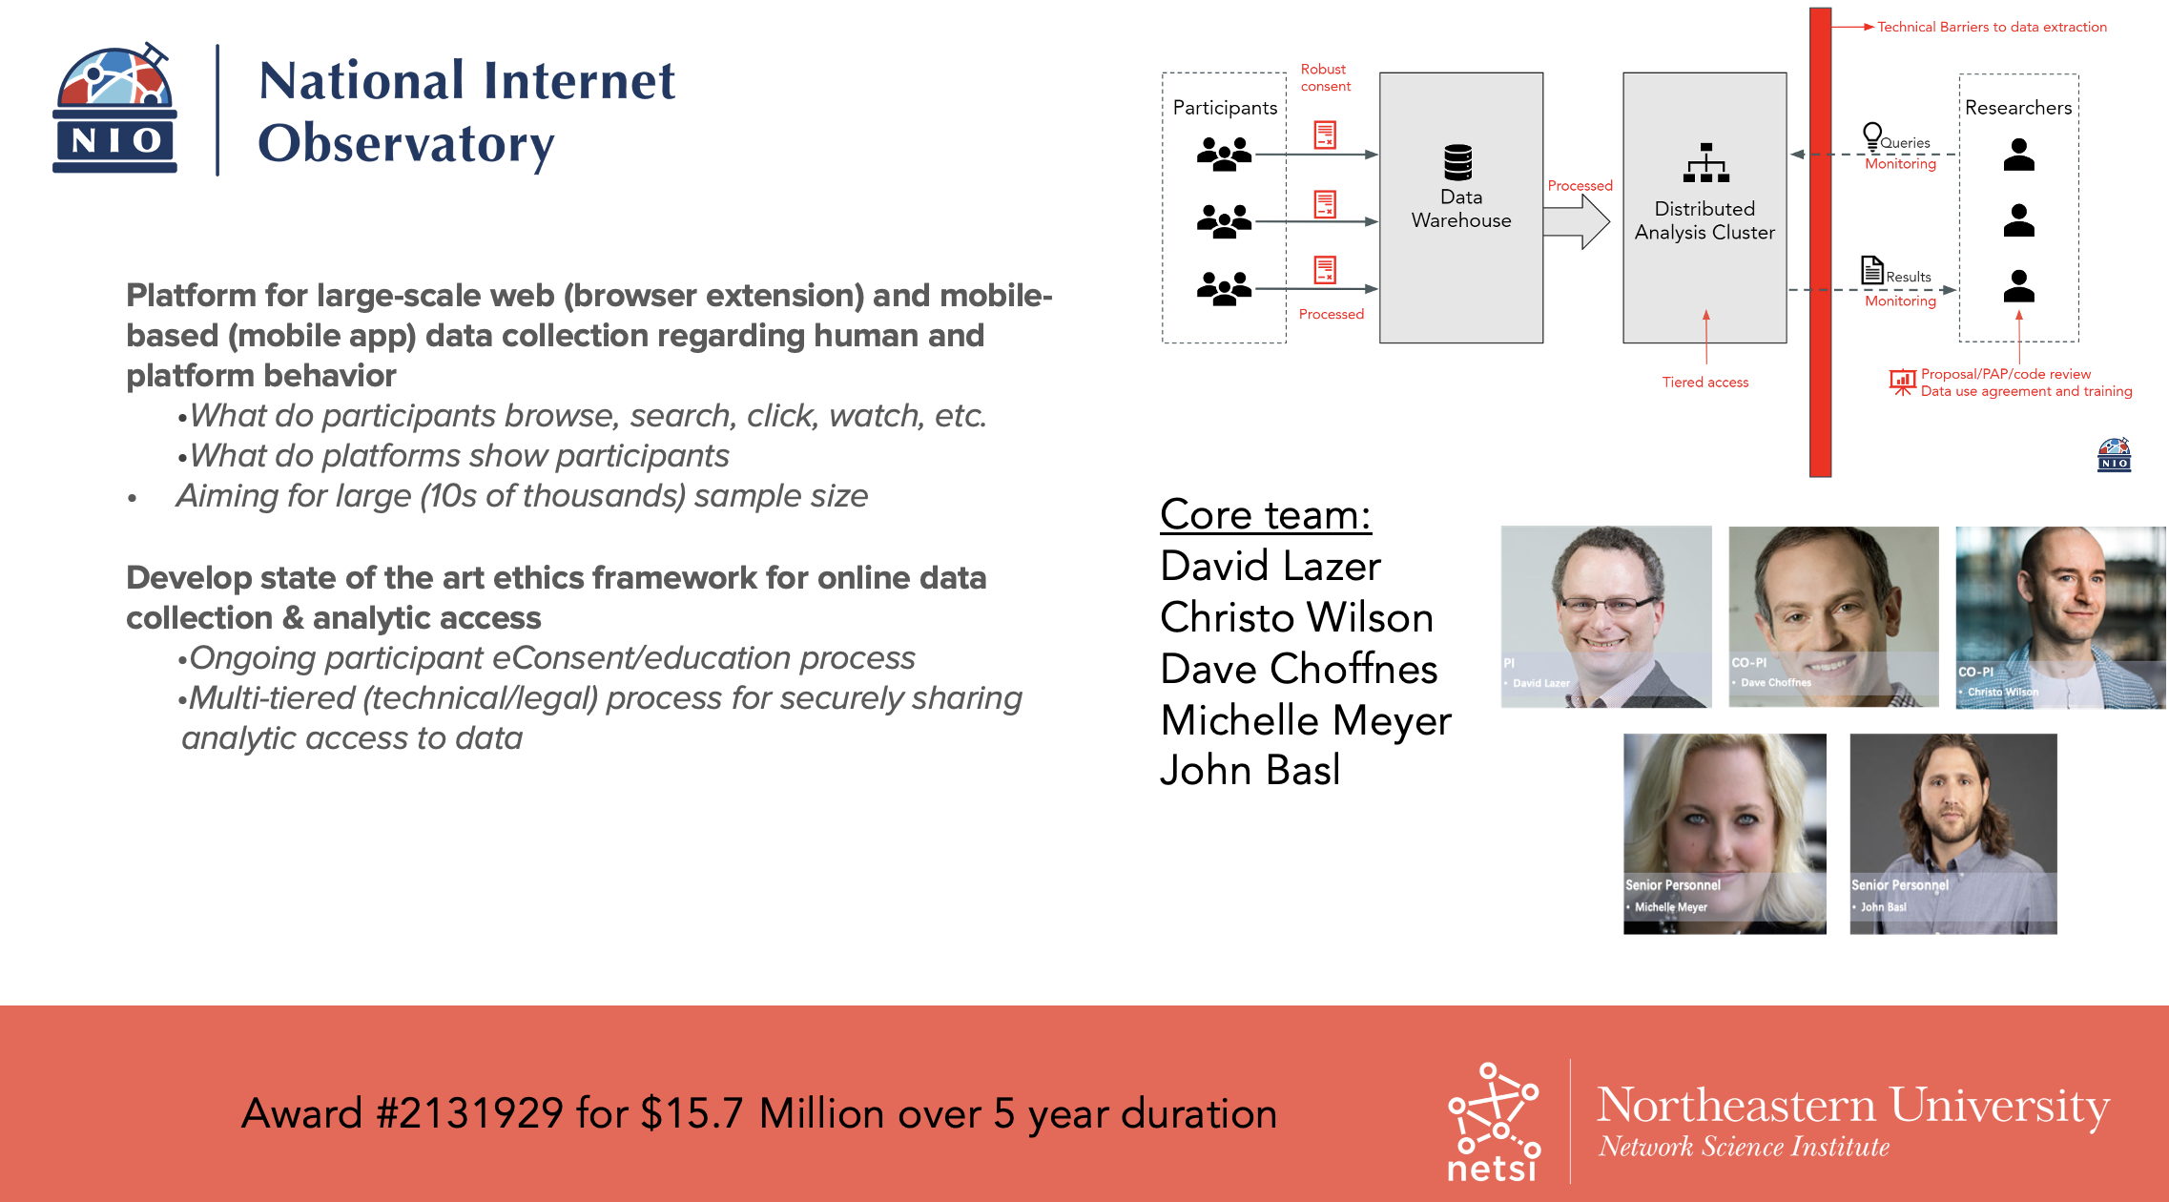
Award #2131929

Slide 26
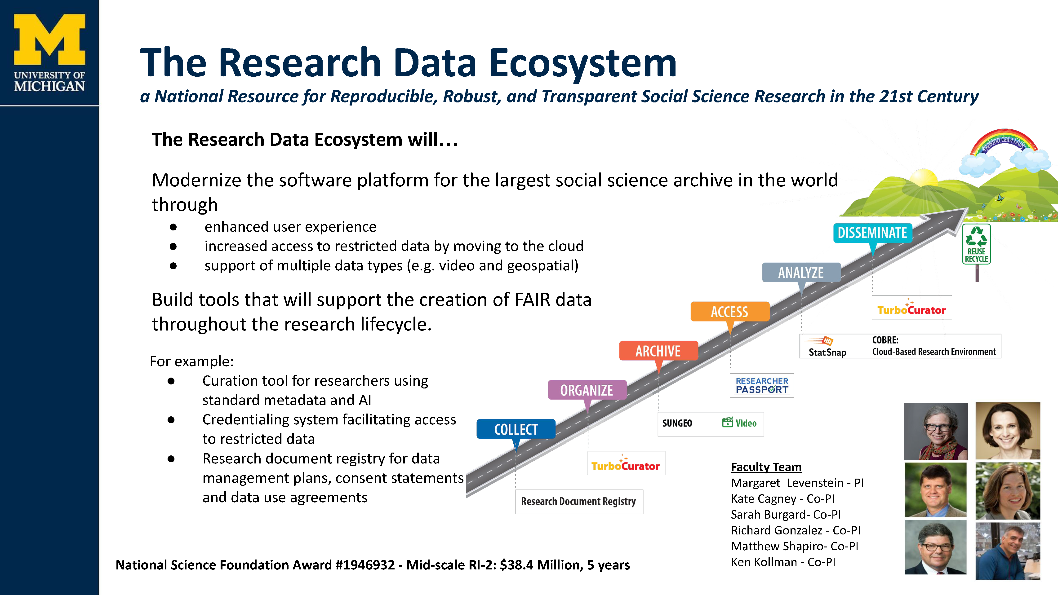
Mid-scale RI-2 award: Example
ICSPR (Inter-university Consortium for Political and Social Research), is a social science archive that
has 17,735 studies with over 6M variables and over 100K publications associated with the data

Slide 27
Guidance on Proposals for Research Cyberinfrastructure Projects
The Mid-scale RI-1 and RI-2 programs will consider proposals for research cyberinfrastructure (CI) projects that aim to significantly enable new science and engineering research at the [community, regional,] national, and international scales.
Such research CI proposals must be strongly driven by the identified research needs of one or more science and engineering communities supported by NSF, advance the Nation’s holistic research cyberinfrastructure ecosystem (i.e., spanning one or more of data, software, networking, and/or cybersecurity), and comprise innovative, focused technical and operational objectives.
Proposals that are primarily focused narrowly on data storage or seek support for broadly provisioned high-performance computing resources will not be supported.
Prospective principal investigators (PIs) with questions should contact the respective Mid-scale RI program team.

Slide 28
CISE Emphases¹
CISE has long supported RI projects at a range of scales: CISE Community Research Infrastructure (CCRI), NSF Major Research Instrumentation (MRI), and now NSF Mid-scale RI. (See example investments on next slide)
CISE encourages the community to prepare for potential future opportunities like the NSF Mid-scale RI programs noted above. CISE emphasizes interest in innovative and integrative mid-scale RI projects in areas not already well-supported by existing programs and guided by the following principles:
Science-driven: Clearly identifies the target CISE areas, and/or other disciplinary research areas as appropriate; evidences the stated community need(s) for the RI and existing gap(s), for instance, through consensus community reports from workshops², blue ribbon panels, and agency survey results³; and articulates the intended positive impacts of the RI on the target community/communities. Projects that are motivated by and align with NSF initiatives such as the NSF Big Ideas and other national priorities, and/or that collaboratively address the needs of more than one research domain supported by NSF directorates, are particularly welcomed. Demonstrating community buy-in is a fundamental characteristic of successful mid-scale RI projects.
Holistic and integrative: Seeks to innovatively bring together a range of CISE and/or other research disciplines as appropriate to address the identified infrastructure objectives. This might include computing, software, data, networking, algorithms and other research and infrastructure areas supported by CISE, along with those supported by other NSF directorates. This also comprises well-developed plans for student training and the involvement of a diverse workforce in all aspects of the mid-scale RI activities.
Service, performance, and sustainability oriented: Led by a team that demonstrates technical and project management experience and expertise in designing, developing, and delivering sustained operational resources and capabilities for the CISE and/or other research discipline users as appropriate. This includes application of established principles and practices for project development and management, user-informed system design, service-oriented user operations, and setting and measuring against performance objectives and success metrics.
¹ See CISE Dear Colleague Letter NSF 20-091, Encouraging Mid-scale Research Infrastructure in Computer and Information Science and Engineering, https://www.nsf.gov/pubs/2020/nsf20091/nsf20091.jsp
² For example, see the report of the 2020 Midscale Experimental Research Infrastructure Forum (MERIF), https://drive.google.com/file/d/18PT0QbivWwWxHFXPkftC0T9ywrk00fUO/view?usp=sharing
³ For example, see responses to NSF Requests for Information on community needs for cyberinfrastructure, https://www.nsf.gov/cise/oac/ci2030/rfi_responses.jsp and https://www.nsf.gov/cise/oac/datacirfi/rfi_responses.jsp.

Slide 29
CISE Research needs Infrastructure
For any research topic, funding agencies have a responsibility to ensure broad access to the research resources and infrastructure needed to advance it.
Post-Moore
AI
Designing Beneficial Sociotechnical Systems
Semiconductor Fab Facility Access
Access to Quantum Computing Prototype Platforms
Access to data repositories at-scale
Access to lots of compute cycles, often specialized to particular modeling or training needs
Connectivity: Access to forward-looking testbeds
Edge-to-Cloud: Ability to richly interconnect resources in large-scale protootyping
Smart X: Sensor platforms and data to gather information from users and the environment

Slide 30
Mid-scale RI-1 FAQs
Q: Should we submit using Research.gov?
A: Yes. Research.gov does have the functionality to allow for submission of preliminary proposals. Select "Prepare New Preliminary Proposal" in Research.gov.
Q: The solicitation refers to “Major Multi-user Facilities” for large (>$100 million) projects. Why are these no longer referred to as “Major Research Equipment and Facilities Construction”, or “MREFC” projects?
A: “MREFC” is a funding line in the NSF budget that is approved during the Congressional appropriations process. Mid-scale RI-2 projects in the $20-$100 million range, solicitated through a separate solicitation, are funded through MREFC along with Major Facilities projects that exceed $100 million.

Slide 31
Mid-scale RI-1 FAQs
Q: These are large projects so why are we limited to identify only a single PI and up to four co-PIs?
A: The NSF Cover Sheet allows for only a single PI and up to four co-PIs with those titles. Other major participants may be designated as “Senior Personnel”. For both preliminary and full proposals, Biographical Sketches are required for the PI, all co-PIs, and any additional Senior Personnel at all participating organizations. Additionally, Collaborators and other affiliations (COA) must be separately provided for each individual identified as Senior Personnel on the project as a Single Copy Document. For Full proposals only, Current and Pending Support must also be provided for the PI, all co-PIs and Senior Personnel in the designated section of the proposal.

Slide 32
Mid-scale RI-1 FAQs
Q: We have a project that spans multiple directorates at NSF. How do we coordinate submission and especially long-term operations and maintenance issues?
A: NSF reserves the right to place a proposal in the proper division(s) for review and consideration of possible long-term O&M support for awarded infrastructure. As PIs, you can help by: a) following solicitation instructions including listing on the first line of the Project Summary the most relevant Directorate(s) / Division(s) for review of the proposal; b) be clear in the proposal about the impacts on research areas that span multiple directorates; c) describe an operations plan that adequately addresses access to the infrastructure by all involved disciplines; and d) include as a Single Copy Document suggested reviewers and their expertise in the research areas covered by the proposal.

Slide 33
Mid-scale RI-1 FAQs
Q: How will pre-proposal review be handled for inter-disciplinary proposals, spanning the science of multiple directorates? Will they be less favored over proposals that target the science within a specific directorate?
A: Truly multi-/inter-disciplinary proposals may be co-reviewed and potentially supported by more than one NSF Directorate. Multi-directorate proposals will not be disfavored and are encouraged.

Slide 34
Mid-scale RI-1 FAQs
Q: What level of detail should be in a pre-proposal? Should it focus exclusively on the science, or should I try to address all aspects that you expect to see in a full proposal, but at a coarse-granular detail? I am afraid that I will get dinged on aspects that I have answers to but did not think was important to include in a pre-proposal.
A: Follow solicitation guidance. There should be a strong focus on the scientific justification and research community priority. A compelling need for the infrastructure should be made clear.

Slide 35
Mid-scale RI-1 FAQs
Q: How detailed should the cost estimates be?
A: It is understood that cost estimates will undergo refinement as projects evolve. For pre-proposals, preliminary estimates are appropriate, but the basis for those estimates must be clear. Budget contingency, when applicable, should be included as part of the total amount of Other Direct Costs under section G.6 on the standard NSF budget form. Copies of vendor quotations should not be included in preliminary proposals.

Slide 36
Mid-scale RI-1 FAQs
Q: If I write a pre-proposal with a budget that is close to $20 million, and I receive a subsequent invitation for a full proposal that has a refined budget of $20 million or greater, will it still be considered for Mid-scale RI-1 support? Will it be moved to the Mid-scale RI-2 program, with a larger total project cost range?
A: In either the preliminary or full proposal stage, the total project cost may come in at just below $20M, but Mid-scale RI-1 will not accept proposals with budgets of $20 million or greater at either stage of the competition. If a refined budget for an invited full proposal is $20 million or greater, the project will have to be descoped, or withdrawn. This also applies if internal NSF review reveals that the budget as proposed is inadequate to complete the project. Projects outside of budgetary guidance will not be shifted among Mid-scale RI-1/2 programs.

Slide 37
Mid-scale RI-1 FAQs
Q: The solicitation says that “Design” awards are intended to facilitate progress toward readiness for a mid-scale range implementation project (having a total project cost of $4-$100 million). Is it really the intent of the program to limit design proposals to work on projects that will not exceed $100M?
A: Major Facility projects with costs exceeding $100 million have well-defined “gateways” for design stages that Mid-scale RI design projects don’t necessarily satisfy. A Mid-scale RI-1 design award supports progress toward implementation of mid-scale range projects. As designs mature, the anticipated total project cost for implementation may push a project outside of the eligibility for Mid-scale RI support. Per the solicitation, successful award of a Mid-scale RI-1 design project does not imply NSF commitment to the future implementation of the project.

Slide 38
Mid-scale RI-1 FAQs
Q: We know that we need to add support letters for from the industry partners, stakeholders, and other potential users of our proposed infrastructure in the full proposal round. Do we also need to mention this list in the pre-proposal? Does the pre-proposal need some proof that these companies or organizations are willing to support us?
A: Letters or statements of collaboration are not permitted in preliminary proposals. Any involvement of industry or organization partners, stakeholders and potential collaborators in the project should be discussed in the Project Description and/or the Facilities, Equipment and Other Resources Section, or if appropriate in the Budget Justification and Supplemental Documents list of partners if funded through subawards.

Slide 39
Mid-scale RI-1 FAQs
Q: When will decisions about full-proposal invitations be made?
A: Our goal is to invite full-proposals by mid-/late-March. Full proposals may be submitted only if invited.
Q: If I am not invited to submit a full proposal after preliminary proposal review, may I elect to submit one as an “uninvited” full proposal?
A: No. Full proposals may be submitted only if invited. “Uninvited” full proposals will be returned without review.
No cost sharing in either Mid-scale RI program!

Slide 40
Mid-scale RI-1 FAQs
Q: Our project will require ongoing Operations and Maintenance (O&M) support from NSF. How do we ensure that support is available?
A: After Mid-scale RI-1 infrastructure is implemented, NSF has an expectation that ongoing O&M support will be available so that the infrastructure will lead to advance in science and engineering research. The source of the O&M support may or may not be provided by NSF, depending on the project, with an outline of anticipated plans in the preliminary proposal and a more detailed O&M plan in the full proposal.

Slide 41
Mid-scale RI-1 FAQs
Q: The solicitation stipulates that the funds provided through it should be used for design and implementation (including commissioning), but not for operation and maintenance (O&M). Would this cover things such as:
Hardware purchase and initial hosting during implementation/commissioning phase (YES)
Software development and testing (YES)
Operating and maintaining the testbed during implementation and commissioning (YES)
Initial outreach activities to publicize the testbed and educate experimenter community (YES)
Support for early user access to e.g., build repeatable artifacts for experimenting with their selected systems (appliances that can be stood up by other users to experiment) (Within reason)

Slide 42
Mid-scale RI-1 FAQs
Q: What type of “brick and mortar” construction will the Mid-scale RI-1 program support?
A: The program will not support the construction of new buildings from the ground up. Exceptions are when the actual outer shell is integral to the scientific functioning of the infrastructure. The program will support the renovation and repurposing of existing space as necessary as part of the infrastructure investment.

Slide 43
Mid-scale RI-1 FAQs
Q: What happens if NSF does not want to support operations, just based on the pre-proposal? Should my team try to get buy-in from NSF even at the pre-proposal stage?
A: It is highly advisable to contact the relevant NSF program officer when considering the submission of a pre-proposal. Those discussions should include consideration of other NSF program support for O&M. The proposal could provide several O&M support scenarios.

Slide 44
Mid-scale RI-1 FAQs
Q: What is your estimated number of awards?
A: 5 to 10
Q: Can I submit to both Mid-scale RI-1 and Mid-scale RI-2?
A: A PI may submit a preliminary proposal to each of Mid-scale RI-1 and Mid-scale RI-2 only if the proposals are for two substantially different projects. You should decide to submit to either Mid-scale RI-1 or Mid-scale RI-2 based on the budget, scope, and readiness of your project.
The review process is different for the two programs so proposals will not be moved from one program to the other.

Slide 45
Mid-scale RI-1 FAQs
Q: Do the scope, budget, and senior personnel in the preliminary proposal and full proposal have to be the same?
A: The scope should be the same, with reasonable changes made as planning evolves from the preliminary proposal stage to the full proposal stage. The preliminary budget is an estimate and changes may be made when developing the budget for the full proposal. Please provide a basis of estimate in the full proposal. Any changes to the budget that occur between the preliminary and full proposals should remain within the scope of the original solicitation. The full proposal may have more senior personnel than the preliminary proposal. Please communicate this change to the cognizant PO via email to aid in managing potential conflicts of interest.

Slide 46
Mid-scale RI-1 FAQs
Q: Will a Mid-Scale RI submission count towards policies that some Directorates have that limit the number of proposal submissions an individual PI may submit annually?
A: No. Submitting a proposal for conducting your research is a different activity than submitting for a Mid-scale RI project.
Q: Will these solicitations be offered again?
A: NSF expects to issue solicitations for both Mid-scale RI programs every two years; however, this is pending future availability of funds.

Slide 47
Mid-scale RI-1 FAQs
Q: What type of student training is expected during a design or implementation project?
A: The Mid-scale RI Programs will support training students to design, assemble, test, and commission Mid-scale RI projects as appropriate. The Programs will not support training students on how to utilize that infrastructure for research purposes.
Q: Can the proposal request support to fund workshops to train researchers and students to use the infrastructure?
A: No. Any training activities should be associated with the design, building, and commissioning of the mid-scale research infrastructure projects.

Slide 48
Mid-scale RI-1 FAQs
Q: Are technicians allowed to set up equipment and get it up and running?
A: Mid-scale RI-1 will support commissioning as defined in the MFG (see section 3.4.2.15), but will not provide support for subsequent maintenance and operations of the equipment or personnel support.
Q: Can a proposal include faculty salary? Is there a limit?
A: Faculty summer salary necessary to complete the proposed activities may be requested. Requests for more than two months of summer support must be justified per the PAPPG.

Slide 49
Mid-scale RI-1 FAQs
Q: Can I include ship time in my budget request?
A: It depends. Ship time associated with deploying or creating a test bed for infrastructure is allowable and should be included. Ship time associated with recovery, research, or operations and maintenance of the infrastructure should not be included.
Q: Can a proposal request support for organisms that serve as a critical piece of the infrastructure development?
A: No.

Slide 50
Mid-scale RI-1 FAQs
Q: My idea is not ready for Mid-scale RI. Is there any planning grant?
A: CISE researchers may submit a Planning-M proposal to the CCRI solicitation (22-509, https://www.nsf.gov/pubs/2022/nsf22509/nsf22509.htm) to do appropriate planning activities towards submission of a future Mid-scale RI proposal.

Slide 51
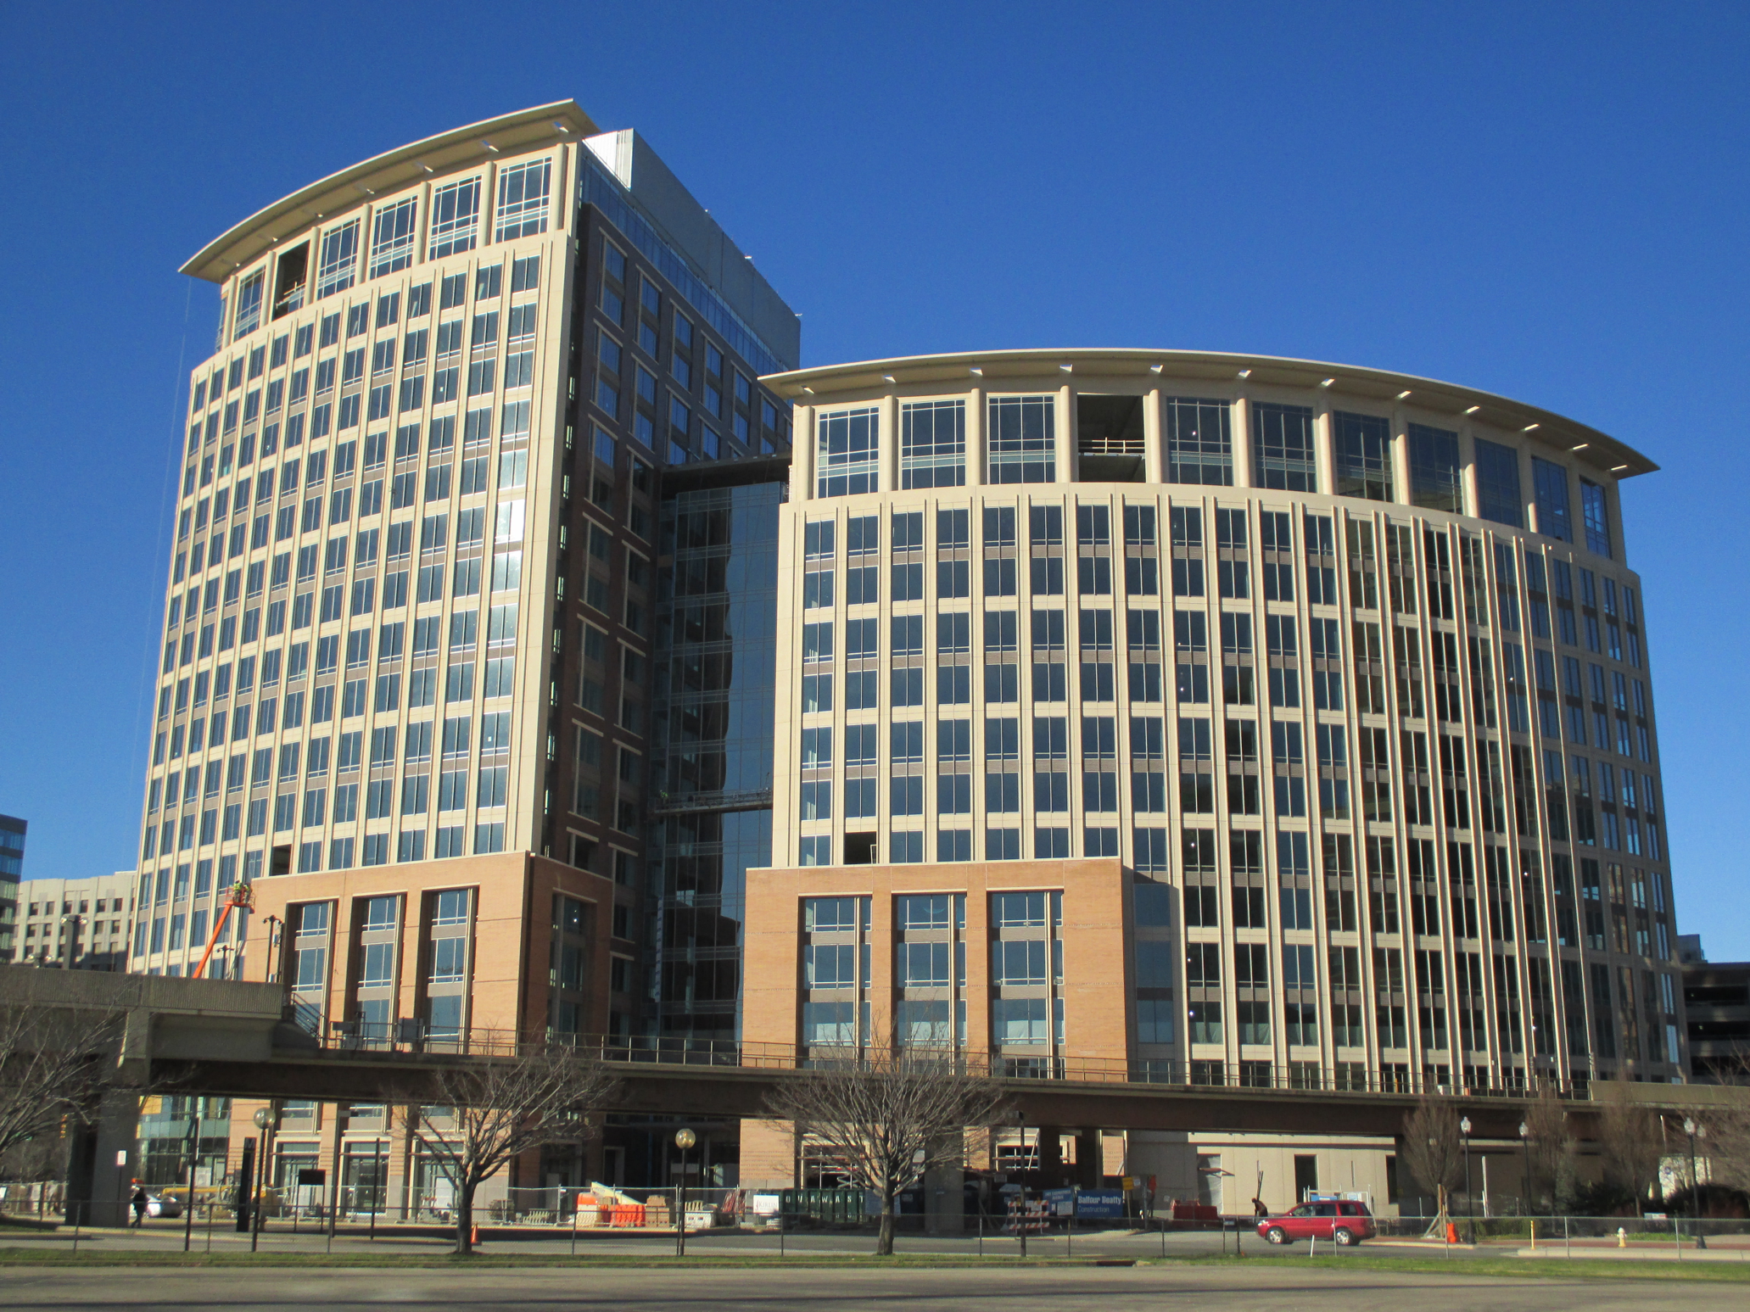
Thank You!
51

