Slide 1
CyberTraining and SCIPE Solicitation Webinar
Office of Advanced Cyberinfrastructure (OAC)
Dec 14, 2022
Ashok Srinivasan, asriniva@nsf.gov
Tom Gulbransen, tgulbran@nsf.gov
Juan (Jenny) Li, jjli@nsf.gov
Solicitation deadline: 23 Feb 2023
CyberTraining: www.nsf.gov/pubs/2023/nsf23520/nsf23520.htm
SCIPE: https://www.nsf.gov/pubs/2023/nsf23521/nsf23521.htm
Notes:
Manish talked about the bigger picture of OAC.
Welcome everyone to the webinar today on CyberTraining and SCIPE.
Good afternoon. My name is Jenny Li, I am a program director of CISE/OAC. Last year, Ashok and I ran this webinar with Alan. Time flies, it has been almost one year.
The good news is that our program has grown. Last year, we received a large number of proposals, and our program has grown into two programs, Cybertraining and SCIPE. The two combined together are larger than the last year’s program. Well done everyone and we look forward to your submissions again.
Now let me introduce two of my colleagues. Ashok is the lead for the new Cybertraining program and Tom is the co-lead of the new SCIPE program. Let’s welcome Ashok and Tom to present the rest of slides and all three of us will stay to answer questions in the end.

Slide 2


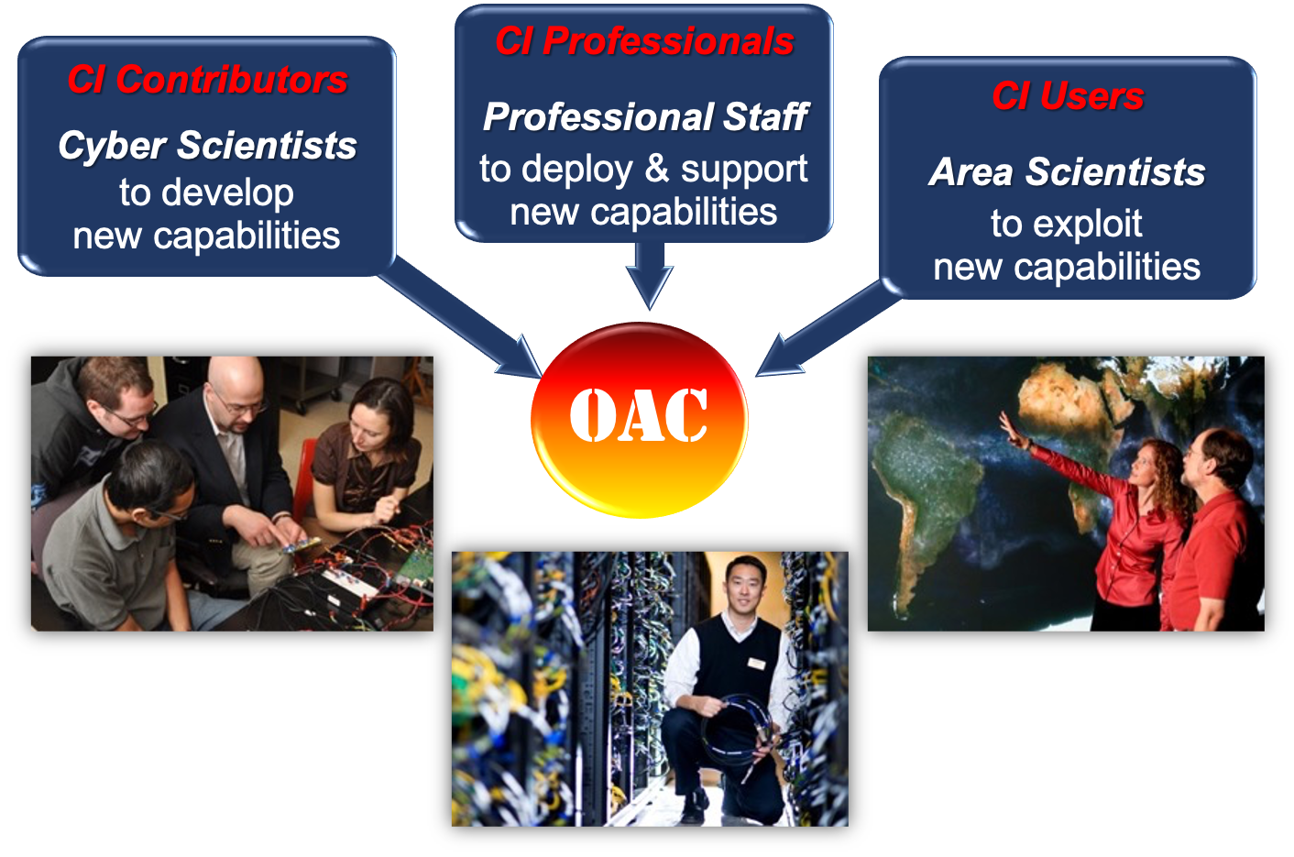
Webinar Outline
CyberTraining – Training-based Workforce Development for Advanced Cyberinfrastructure
SCIPE – Strengthening the Cyberinfrastructure Professionals Ecosystem
Questions and answers
Notes:
Thanks Jen.
- We will start this presentation with an overview of the CyberTraining program, followed by SCIPE. We will highlight important aspects, with the details left to the solicitation.
- We will then take questions from the webinar participants.
A recording of this webinar will be available on the program page.
For the purpose of these solicitations, CI refers to advanced cyberinfrastructure, which includes resources, tools, methods, and services for advanced computation, large-scale data handling, networking, and security to enable and transform science and engineering research.
The target communities at various stages of their career pipelines comprise undergraduate and graduate students, researchers, and educators, as well as CI Professionals
- The CyberTraining and SCIPE programs focus on three different scientific communities:
CI Contributors are computational and data scientists and engineers who research and develop new CI capabilities, new approaches, and new methods.
CI Users are domain scientists and engineers who want to effectively exploit advanced CI capabilities and methods for their research.
Finally, CI Professionals constitute the community of research CI and professional staff who deploy, manage, and support the effective use of research CI.

Slide 3
Webinar Goals
Orient potential proposers
  Provide the motivation for different OAC programs
Summarize the CyberTraining and SCIPE programs and their review criteria
Improve the alignment of proposals with the program goals
Answer questions
Notes:
This webinar intends to orient the research community to the revised CyberTraining and SCIPE solicitations and summarize the program and review criteria.
We will then answer questions.
We hope that these will improve your understanding of the solicitations and help better align your proposals to the program goals.

Slide 4
Relevant CI-Related Programs
What will your project focus on?
Develop software or data repository
Perform research that will enable future CI
Support research that uses CI, foster CIP careers
Provide training
What gap will you fill?
Increase community CI for research or education
Increase knowledge needed for CI
Increase support for CIP career & research by underserved groups
Increase research workforce to leverage CI
What will your project deliver?
Community-sustained CI
Techniques that will enable CI and a CI prototype
Research support in CI, CIP career paths
Scalable and sustainable training program
CSSI
OAC CORE
SCIPE
CyberTraining
Programs have specific purposes, however, are not necessarily mutually exclusive
Notes:
OAC has several programs related to CI that may include some overlap in goals. We present a somewhat idealized view that may enable you to choose the right program for your needs.
However, this is a simplified view, and the solicitations would provide more detailed guidance. So, please use this only as a high-level view.
If you want to develop a software or data repository, then you may wish to look at the CSSI program. You would produce a community-sustained CI to enhance the CI ecosystem available for research or education.
If you want to perform research that will enable future CI, you may want to look at the OAC Core program. You would typically develop techniques and a CI prototype that will yield the knowledge needed for future production-CI.
If you want to support research that uses CI and also foster CIP professionals’ careers, then the SCIPE program may suit you. You would support research that leverages CI and establish career paths. This may particularly benefit groups that are currently underserved with respect to the use of CI for research.
If you want to provide training on CI for research purposes, then the CyberTraining program may interest you. You would deliver scalable and sustainable training to help increase the research workforce that can leverage CI.

Slide 5
CyberTraining
Motivation
Advanced CI has a transformative impact on a variety of scientific research domains
The research workforce will benefit from innovative disciple-appropriate training and curriculum materials
There is a need to foster broad adoption of CI resources, tools, and methods by diverse research communities
Notes:
- The CyberTraining program is motivated by the increasing role of advanced CI in enabling science across a variety of domains.
The research workforce would benefit from innovative training and curricular materials that are tailored for the targeted disciplines.
There is also a need to foster broader adoption of existing CI resources, tools, and methods by diverse research communities.

Slide 6
CyberTraining Solicitation Goals
Long-term vision: Computational and Data-driven Science for All scientists and engineers
  Prepare, nurture, and grow the scientific research workforce, including students, instructors, and research CI professionals
Ensure broad adoption of CI tools, methods, and resources
Integrate CI and CDS&E skills into undergraduate and graduate curricula
  Address emerging needs and unaddressed bottlenecks through innovative and scalable training
  Catalyze research with training and educational activities
Broaden CI access and adoption by varied institutions, scientific communities, and underrepresented groups.
Notes:
The CyberTraining program seeks to prepare, nurture, and grow the national scientific research workforce for creating, utilizing, and supporting advanced cyberinfrastructure to enable and potentially transform fundamental science and engineering research and contribute to the nation's overall economic competitiveness and security.
The projects should aim to contribute to the larger goal of an educational ecosystem enabling “Computational and Data-driven Science for All scientists and Engineers”
This embraces computation as the third pillar and data-driven science as the fourth pillar of the scientific discovery process -- in addition to the traditional first and second pillars of theory and experimentation.
The specific goals of this solicitation are
(i) to ensure broad adoption of CI tools, methods, and resources by the research community in order to catalyze major research advances; and
(ii) to integrate core literacy and discipline-appropriate advanced skills in advanced CI as well as computational and data-driven science and engineering into the nation’s educational curriculum and instructional fabric, spanning both undergraduate and graduate courses to advance fundamental research.
We are particularly keen on broadening CI access to groups that are currently underserved in its use.
This solicitation calls for innovative and scalable training, education, and curriculum and instructional materials - targeting one or both of the solicitation goals - to address emerging needs and unresolved bottlenecks in scientific and engineering research workforce development, from the postsecondary level up to the level of active researchers.

Slide 7
NSF-Wide Participation
Directorate | Divisions
CISE | OAC (lead), CCF, CNS, IIS
ENG | CMMI, CBET
GEO | All
EDU | DGE
MPS | AST, CHE, DMR, PHY
SBE | SES
OAC contacts: Ashok Srinivasan and Juan (Jenny) Li
Notes:
- The CyberTraining program is led by the Office of Advanced Cyberinfrastructure (or OAC) in the Directorate for Computing and Information Science & Engineering.
It has participation across the National Science Foundation from
All 3 other division in CISE
the Division of Graduate Education (DGE) in the Directorate for STEM Education (EDU)
Most divisions within the Directorates for Engineering (ENG) and Geosciences (GEO),
The Astronomy, Materials, Chemistry and Physics divisions in the Directorate for Mathematical and Physical Sciences (MPS),
as well as the Directorate for Social Behavioral and Economic Sciences (SBE).
Directorates and divisions have specific programmatic areas of interest that are described in the solicitation.
Let me highlight that one intent of the CyberTraining program is to stimulate co-funding between OAC and one or more science or engineering domain directorates or divisions.
Therefore, prospective PIs are strongly encouraged to contact the Cognizant Program Officers in OAC as well as in the participating directorates/divisions relevant to their proposals to ascertain whether the focus and budget of the proposed activities are appropriate for this solicitation.
If you send Jen or me a one-page summary and identify other divisions of interest, we will share it with the other division PDs.

Slide 8
Project Classes
Pilot: Exploratory projects, $300K over 2 years
Small implementation: $500K over 4 years
Medium implementation: $1M over 4 years
Identify challenges in research workforce development
(a) Broaden use of CI resources (b) CI skills training – expected to coordinate with ACCESS (access-ci.org)
Scalability and sustainability of the training program
Recruitment and evaluation plans
Collective impact strategy
Fostering a suitable community
Pilot
At least one option in #2
Small
Medium
Notes:
We now review the key provisions for the current solicitation.
There are three project classes, defined as:
Pilot projects, with total budgets of up to $300,000 and with duration up to two years, are exploratory activities that may lead to Implementation projects.
Implementation projects can be either Small (with total budget up to $500,000) or Medium (with total budget up to $1,000,000) with duration up to four years. Implementation projects make CI training and educational activities or curricular and instructional materials broadly accessible to a significant portion of a community for one or more disciplines.
Medium Implementation projects also foster a community to catalyze the adoption of advanced CI methods or to incorporate training resources and materials into the curriculum.
All proposals should have well-identified proposal elements that clearly address the solicitation-specific review criteria listed here, in addition to addressing the standard NSF intellectual merit and broader impact criteria.
Reviewers will be asked to evaluate these aspects by addressing the following questions:
A rationale for challenges identified for research workforce development;
The strength of the project’s plan to address one or more of the solicitation goals, namely (a) to broaden the use of CI methods and resources by the research community, and/or (b) to integrate CI skills into the institutional and disciplinary curricular and instructional fabric,
Note that at least one goal must be addressed.
Strong implementation projects, though, tend to have both components.
The potential for scalability and sustainability;
The soundness of the participant recruitment and project evaluation plan;
The effectiveness of the proposed “collective impact” strategy to establish a coordination network and a backbone organization (or, the Effectiveness of an alternative strategy);
The soundness of plans for fostering a suitable community;
Pilot projects must address items 1 and 2. Small Implementation projects must address items 1-5, and Medium Implementation projects must also address item 6.
- I want to clarify that research in education is outside the scope of this solicitation.

Slide 9
Programmatic Areas of Interest
Common theme: research and education-related projects in the science/engineering domain
More effective use of CI to catalyze research advances and address fundamental knowledge gaps
See the solicitation for descriptions of each directorate/division’s priorities and interests
Notes:
In the solicitation, each participating division/directorate has included its programmatic areas of interest.
A common theme is to provide discipline-appropriate training on CI for research purposes.
Please see the solicitation for details.

Slide 10
SCIPE
Motivations
Strengthening ≡ democratizing, connecting, recognizing
CI ≡ Systems, Software, Data, Services, Networking
Developers, Users, Admins, Mentors, Computational Scientists
Ecosystem of interdependencies & interfaces
Leveraging existing program investments
Expanding institutional recognition of careers
Notes:
Hello, TY for your interest, TG from…
SCIPE as a new program can be framed by a few definitions and general perspectives.
We anticipate strengthening to occur in at least 3 ways:
numerous ways that can lead to broader involvement – you are invited to craft means to engage/invite more widely
while more/new individuals become proficient – you are invited to increase their connectivity with PIs & awareness in both directions
the profession itself also deserves strengthening – you are invited to increase institutional-ization of skills, services, career pathways
The ecosystem boundaries ought to be seen as inclusively as possible, both from technologies we’re working with, as well as the range of job titles who can be strengthened.
Please note that SCIPE program is intended to have formal and informal connections with multiple OAC initiatives, for example the ACCESS program’s comp sci support network.
We look forward to your ideas for how best to cultivate and motivate the bissel threads that can connect CIP with S&E researchers & CI stakeholders.

Slide 11
SCIPE Solicitation Goals
Long-term vision: Research CI ecosystem with a scalable, agile, diverse, and sustainable network of CI Professionals that can ensure broad adoption of advanced CI resources and expert services, including platforms, tools, methods, software, data, and networks for research communities, to catalyze major research advances, and to enhance researchers' abilities to lead the development of new CI
Creation of science-driven, researcher-facing CIP communities regionally or by disciplines which will collaborate with ACCESS Computational Science Support Network
Democratization of involvement in the research CI profession
Institutional recognition of career pathways that embed CI professionals more deeply into the research enterprise
Notes:
SCIPE proposals ought to describe how they will advance OAC’s long-term vision. Not required to touch every facet.
The introductory remarks about strengthening and connecting do require collaboration between CI professionals and researchers from specific domains to be served by advanced CI methods.
Such collaborations are expected to ensure that CI professional expertise and services will target unmet, valuable needs of S&E research.
Which unmet needs? We invite you to describe them, e.g. are there needs for AI/ML applied to one discipline or perhaps more generally applicable?
Are there unmet needs for specialized skills or methods within particular HPC architectures used by your collaborators?
It is not required that you propose how to do this by yourselves – the ACCESS program offers utilities and communications avenues you can exploit.
You are invited to propose Democratization methods aimed wherever and however you foresee that inclusion of diverse new participants can be achieved efficiently and sustainably.
How will institution(s) improve recognition and ongoing development of CIP both technically and from the perspective of vested interests in their long-term fit in the research enterprise.

Slide 12
NSF-Wide Participation
Directorate | Divisions
CISE | OAC (lead), CCF, CNS, IIS
ENG | CMMI, CBET
GEO | AGS, EAR, OCE, OPP
EDU | DGE
MPS | AST, CHE, DMR, PHY
SBE | SES
TIP | RIE, PFI
OAC contacts: Tom Gulbransen
Notes:
Please do reach out to POs in Directorates suitable to your collaboration

Slide 13
SCIPE Program Context
FUNDING
WHO ARE CIP?
IDEAL FOR PIs WHO …
Approximately $15M for up to 4 awards
Support for research CI professionals’ services
Up to 4 FTEs per year for up to 5 years
NSF directorates co-funding based on relevance: CISE, ENG, GEO, MPS, EHR, SBE, TIP
Longer term plans requested for sustaining CI professionals
Develop, manage, and support effective use of research CI
Want to accelerate the adoption of research CI
Are ready to connect & coordinate with S&E research communities
Seek to strengthen & broaden the diversity of the CIP workforce
Whose institutions will develop sustainable long-term career paths for CIPs
Includes scientists, IT professionals, and engineers who research and develop new CI capabilities, approaches, and methods
Various facings: CI system administrators, CI research staff, research software engineers, data curators, CI facilitators, Computational scientists
Notes:
The level of funding, as always depends on availability. And as always, serving multiple Directorates creates the possibility of recruiting co-funding.
Please note SCIPE is about deploying and maintaining readiness of CI Professional services – as contrasted with CyberTraining tools or curricula or student development
Funding considerations will include assessment of your proposed approach to funding the CIP positions post-award.
Proposals are welcome to focus on any one, or more, of the unique facings of CIP. Again, the selected foci should be science-driven.
The ideal proposals are framed in part by the 4 criteria listed.

Slide 14



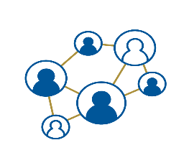












Elements of the CI Ecosystem
CyberTraining, RCN:CIP, CyberTeams, RCD-Nexus
CI Professionals
SCIPE (examples)
ACCESS Program
S&E Research
Domain PIs,
AI Institutes, ACCORD
Gateways,
CloudLab, CloudBank
HPC Systems
Pegasus, OnDemand
Notes:
This slide is intended to offer a visual backdrop to reiterate OAC’s view of the advanced CI ecosystem wherein CIP will prosper
The ACCESS program offers you superstructure or CNS of people, systems to be allocated, and user communications mechanisms.
XSEDE provided superb CIP help via extended collaborative support services – which worked beautifully to deploy ~24 FTE CIPs to help users.
ACCESS is democratizing to an even bigger ecosystem of collaborative support services.
The ecosystem can be depicted as layers of investments.
OAC invests in foundational HPC systems, plus data, networks, cloud
Portfolios of S&E research grants in each Directorate or cross-directorates, AI institutes
OAC deploys grants and Coop Agreements in LWD to optimize HPC use by S&E research
LWD creates communities, promotes CI leadership, and provides training opportunities.
SCIPE seeks to further institutionalize CIPs’ careers by embedding their valuable roles within regional or discipline-tailored research enterprises

Slide 15
Questions?
Please post your questions in the Question/Answer window
You may also email us later
Notes:
Here are some common questions.
We invite your questions via the Q&A feature in zoom or email us later.
Please check our answers to others’ questions in case we have already answered the question that you planned to ask.
Some answers would be oral, while others would be in the question/answer window.
We start with some questions that we have previously received.

Slide 16
Common Questions
Q1. Is consultation with a Cognizant Program Officer required?
  No, but it is strongly encouraged that you consult with us (with OAC leading this solicitation) and any other Cognizant Program Officer at least a month in advance of the solicitation deadline, and note this in a Single Copy Document.
Notes:
Many Cognizant Program Directors could not be here, but their directorates’ and divisions’ programmatic areas of interest are in the solicitation, which we encourage you to read carefully.
Q1. Is consultation with a Cognizant Program Officer required?
No. But it is is strongly encouraged that you consult with me (with OAC leading this solicitation) and any other Cognizant Program Officer by sending a 1-page project summary containing sections on project overview, intellectual merit and broader impact and a few keywords at least a month in advance of the solicitation deadline, and include this in a Single Copy Document submitted as part of your proposal.

Slide 17
Common Questions
Q2. Can my project primarily train/re-train for jobs in the IT industry?
  No, all proposals, including cybersecurity proposals, must be relevant to
    Scientific Research Workforce Development, and
    Advanced Cyberinfrastructure
  Cybersecurity proposals must be relevant to the scientific research workflow
  This relevance will vary from undergrads, to grads, to CI professionals, and across disciplines.
Notes:
Q2. Can my project primarily train or re-train for jobs in the IT industry?
No, ALL proposals, including cybersecurity proposals, must be relevant to
Scientific Research Workforce Development, and
Advanced Cyberinfrastructure.
Cybersecurity proposals must be relevant to the scientific research workflow.
This relevance will, of course, vary from undergrad students to grad students, to postdocs, to CI professionals, and across disciplines.

Slide 18
Common Questions
Q3. Must you already have a Small-size Implementation award before seeking a Medium-size Implementation award?
  No
Notes:
Q3. Do you need to have a Small-size Implementation award before proposing a Medium-size Implementation project?
No.

Slide 19
CyberTraining and SCIPE Solicitation Webinar
Office of Advanced Cyberinfrastructure (OAC)
Dec 14, 2022
Ashok Srinivasan, asriniva@nsf.gov
Tom Gulbransen, tgulbran@nsf.gov
Juan (Jenny) Li, jjli@nsf.gov
Solicitation deadline: 23 Feb 2023
CyberTraining: www.nsf.gov/pubs/2023/nsf23520/nsf23520.htm
SCIPE: https://www.nsf.gov/pubs/2023/nsf23521/nsf23521.htm
Webinar Recording: https://beta.nsf.gov/events/cybertraining-scipe-program-webinar
Notes:
Please feel free to contact us for clarifications.
The recording of this webinar will be available on the webinar site with the link shown here.

