Slide 1

Cybersecurity Innovation for
Cyberinfrastructure (CICI)
NSF 23-517
Webinar: January 10, 2023
Robert Beverly and Kevin Thompson
Office of Advanced Cyberinfrastructure (OAC)
Computer & Information Science & Engineering (CISE)

Slide 2
Webinar Goals
Describe CICI program and objectives
Detail NSF 23-517 solicitation and changes
Help guide proposal alignment with program
Answer questions from audience

Slide 3
Webinar Goals
Describe CICI program and objectives
Detail NSF 23-517 solicitation and changes
Help guide proposal alignment with program
Answer questions from audience

Slide 4
Orientation: OAC and Scientific Cyberinfrastructure
Office of Advanced Cyberinfrastructure: Supports and coordinates the development, acquisition and provisioning of state-of-the-art cyberinfrastructure resources, tools and services essential to the advancement and transformation of science and engineering.
Cyberinfrastructure: Computation, data, software, networking and workforce to facilitate scientific discovery and innovation.

Slide 5




OAC: Cyberinfrastructure that Enables Research Across Science Disciplines
Astronomy
Physics
Challenges:
Large instruments producing
Big data requiring
Big compute for
Highly collaborative scientists in
Different specializations across
Widely Distributed infrastructure that must be
Available, ensure
Workflow Integrity, and be
Easy to use while adhering to
Regulatory or policy requirements
Computational Bio
Material Science
Climatology
Evolutionary Bio
Notes:
Idea here is to emphasize the wide array of science that OAC supports, and some of the common challenges we face… then make the point that security permeates through all of these challenges in one way or another.

Slide 6





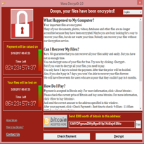


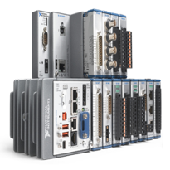


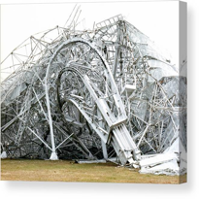
The Unique Research Cyberinfrastructure Ecosystem
MISSION
HARDWARE
APPLICATIONS
ENTERPRISE:
SCIENCE CI:
PHYSICAL ENVIRONMENT
OPERATING SYSTEM
RISK

Slide 7






The Why: R&E Cybersecurity Provides Benefits Across an Organization
RESEARCH
OFFICE
SCIENTIST
COLLEAGUE
MANAGEMENT
INFO TECH
PUBLIC
Do research!
Share Data + resources
Reproducibility
Integrity
Reputation
Finance
Protect IP
Availability
Trust in science

Slide 8
Cybersecurity Innovation for Cyberinfrastructure (CICI)
The objective of the CICI program is to develop, deploy and integrate solutions that benefit the broader scientific community by securing science data, workflows, and infrastructure.
EXAMPLE WORKFLOW:
Instruments
Data
Acquisition
Preprocessing
Data
Movement
Data Storage
and Sharing
Compute
and Analytics
Dissemination
“Secure” in science CI content is often much more than confidentiality – consider e.g., importance of integrity, provenance, PII, availability

Slide 9
Cybersecurity Innovation for Cyberinfrastructure (CICI)
Support applied research to secure science data, workflows, and infrastructure
Develop, deploy, and integrate solutions that benefit the broader scientific community
Operationalize emerging cybersecurity techniques into the science CI domain
Develop new cybersecurity approaches specific to science CI domain and requirements

Slide 10
OAC CI Cybersecurity Vision
“Agile, integrated, robust, trustworthy, and sustainable CI ecosystem that drives new thinking and transformative discoveries in all areas of S&E research and education“
Cybersecurity
Collaborative
Computing
Accessible
Networking
Science & Discovery
Robust
Data
Reproducible
RESEARCH CYBERINFASTRUCTURE

Slide 11
Webinar Goals
Describe CICI program and objectives
Detail NSF 23-517 solicitation and changes
Help guide proposal alignment with program
Answer questions from audience

Slide 12
NSF 23-517: CICI Program Areas
 | Applied research to:
Usable and Collaborative Security for Science (UCSS) | Facilitate scientific collaboration, adopt security into scientific workflows. Overcome security and usability obstacles to data and resource sharing.
Reference Scientific Security Datasets (RSSD) | Capture science-specific workflow/workload behavior. Gather and curate canonical science workload datasets that can facilitate techniques to help secure science CI.
Transition to Cyberinfrastructure Resilience (TCR) | Improve the robustness and resilience of scientific cyberinfrastructure through testing, evaluation, hardening, validation, and transition of novel cybersecurity research

Slide 13
CICI Program Area Key Themes
Applied security research to benefit science, domain scientists, and scientific CI
Recognize and leverage inherent differences in science CI ecosystem (data, software, workflows and workloads)
Consider usability, adoption, and empowering domain scientists
Transition cybersecurity research into science CI
Discover (and mitigate) weaknesses and vulnerabilities in science CI

Slide 14
NSF 23-517: CICI
Continues commitment to three primary areas from 2022 solicitation:
  UCSS and RSSD: small, up to $600k / 3 years
  TCR: medium, up to $1.2M / 3 years
Two due dates:
  February 17, 2023
  February 1, 2024
Anticipate supporting 12-20 awards total / year

Slide 15
Successful CICI proposals describe
Non-cybersecurity Science drivers (applications and users)
The scientific infrastructure / environment that will benefit
Unique properties of the scientific domain or CI that influence the desired security functionality, design, or mechanisms
Threat model in the science domain
Plan for gathering quantitative metrics to assess security benefits
https://www.nsf.gov/awardsearch/advancedSearchResult?ProgEleCode=8027

Slide 16
What CICI is not
Not appropriate mechanism for non-security infrastructure efforts
  Not intended to support pure infrastructure operation
Not for cybersecurity research without a domain science driver or target science cyberinfrastructure
Not intended to support basic cybersecurity or privacy research
  Better served by Secure and Trustworthy Cyberspace (SaTC) program

Slide 17
Proposal Preparation
The NSF proposal and award process is detailed in the Proposal & Award Policies & Procedures Guide (PAPPG, NSF 22-1).
https://www.nsf.gov/pubs/policydocs/pappg22_1/
Proposal titles “CICI:[UCSS,RSSD,TCR]:title”
  E.g., “CICI:RSSD:An amazing proposal”
Must be submitted via research.gov or grants.gov (not FastLane)!

Slide 18
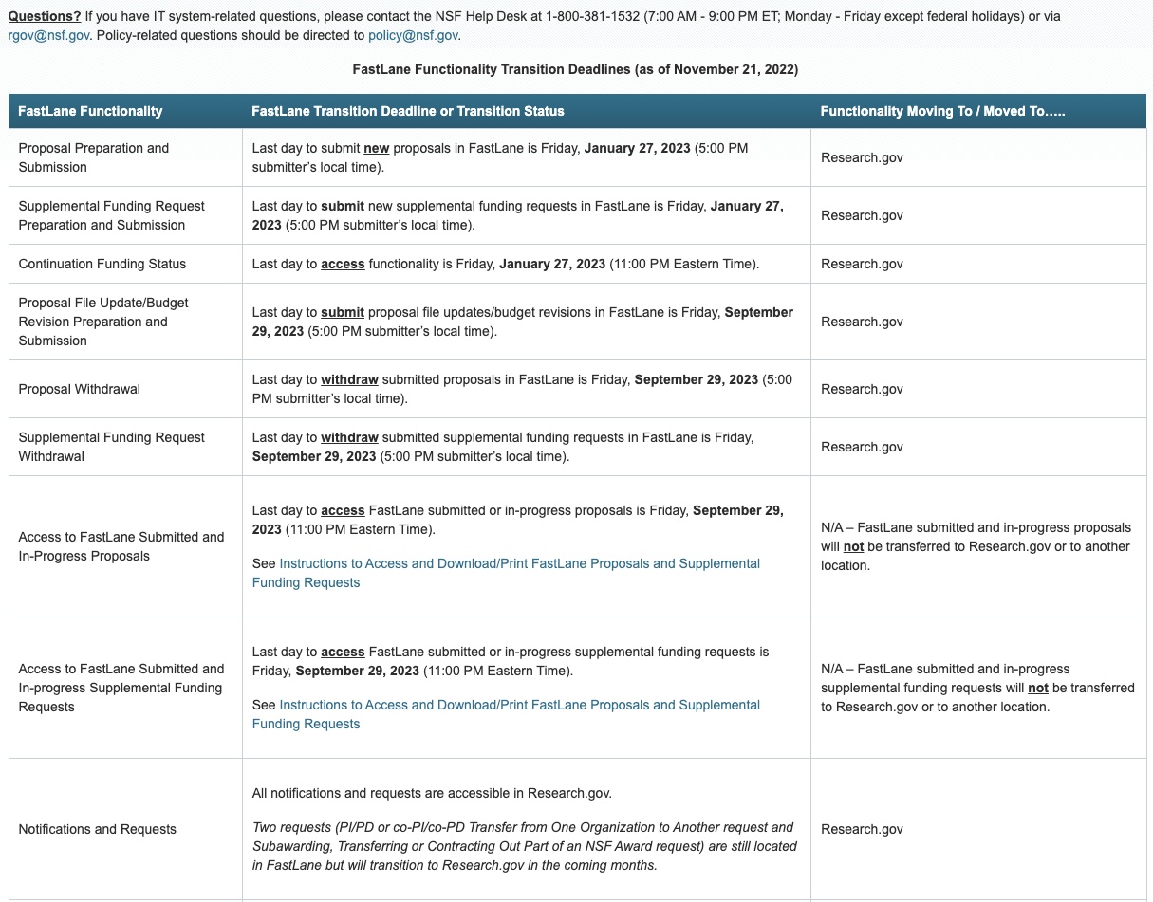
Fastlane System Decommissioning: removed as submission option
https://www.research.gov/research-web/content/fldecomm

Slide 19
Eligibility
Proposals may only be submitted by:
  Universities and Colleges
  Non-profit, non-academic organizations
Limit on Number of Proposals per PI/Co-PI/Senior Personnel: 2
  An individual may participate as Principal Investigator, co-Principal Investigator or other Senior Personnel on no more than two CICI proposals.

Slide 20
Webinar Goals
Describe CICI program and objectives
Detail NSF 23-517 solicitation and changes
Help guide proposal alignment with program
Answer questions from audience

Slide 21
Review Criteria
Reviewers and review panel will address:
Intellectual Merit,
Broader Impacts, and
CICI Specific Review Criteria
in their reviews, panel discussions, and panel summaries
Standard NSF Review Criteria

Slide 22
CICI Specific Criteria
Project Motivation and Impact
Science-driven
Innovation
Cyberinfrastructure Plans
Project plans, and system and process architecture
Building on existing, recognized capabilities
Measurable Outcomes
Sustained and sustainable impacts
Close collaborations among stakeholders

Slide 23
CICI Specific Criteria
Project Motivation and Impact
Science Driven
To what extent is the proposed project science-driven? How will the project outcomes fill well-recognized science and engineering needs of the research community? What will be the broader impacts of the project, such as its benefits to science and engineering communities beyond its initial targets, under-represented communities, and education and workforce development? The project description should provide a compelling discussion of the potential to benefit its intended as well as broader communities.
Innovation
To what extent is the proposed project innovative? What innovative and transformational capabilities will the project bring to its target communities? How will the project integrate innovation and discovery into the project activities?

Slide 24
CICI Specific Criteria
Cyberinfrastructure Plans
Project plans, and system and process architecture
How well detailed are the project plans, and logical and physical architectures? The project plan should include user interactions and provide a timeline including a proof-of-concept demonstration or prototyping of the proposed system or framework.
Building on existing, recognized capabilities
To what extent does the proposed project build on existing, recognized capabilities? How will the project activities build on and leverage existing NSF, national, and open source cyberinfrastructure and cybersecurity investments, as appropriate?
Close Collaboration among stakeholders
To what extent does the proposed project involve close collaborations among stakeholders? How will the project activities engage cyberinfrastructure (CI) experts, specialists, and scientists working in concert with the relevant domain scientists who are users of CI?

Slide 25
CICI Specific Criteria
Measurable Outcomes
Sustained and Sustainable Impacts
How will the project’s outcomes and its activities have long-term impacts, and how will these be sustained beyond the lifetime of the award, as appropriate? Are the sustainability approaches following well-established models?

Slide 26
CICI Schedule
Deadlines for NSF 23-517:
February 17, 2023
February 1, 2024
Schedule:
    NSF targets a 6-month dwell time

Slide 27
Webinar Goals
Describe CICI program and objectives
Detail NSF 23-517 solicitation and changes
Help guide proposal alignment with program
Answer questions from audience

Slide 28
Thank you!
Questions?
During Webinar: Via Zoom Q&A
Anytime: {rbeverly,kthompso}@nsf.gov

