Slide 1

An Overview of High Performance Computing and Future Requirements
Jack Dongarra
University of Tennessee
Oak Ridge National Laboratory
University of Manchester

Slide 2
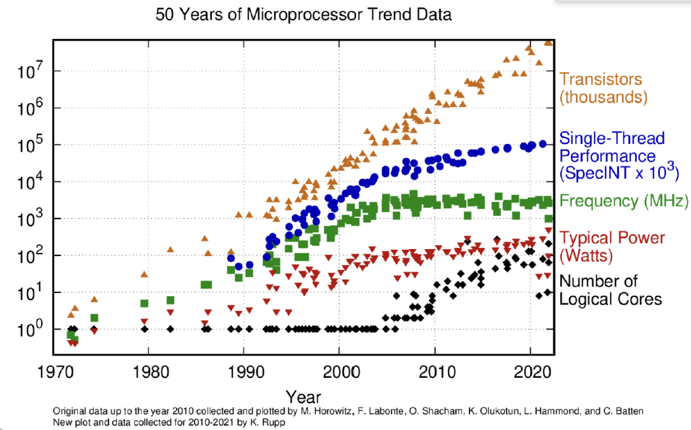
The Message
Computing is in rapid transition
  Smartphones and cloud services are eating the world
HPC change is also in the wind
  Greater performance now requires more $, €, ¥
Transistors are getting more expensive
  End of Dennard scaling and slowing of Moore’s Law
Loci of technology innovation and money have shifted
Notes:
Dennard scaling is that the energy per transistor would decrease as the number of transistors on the circuit increased. That is as transistors became smaller, their power density (power per unit area) also decreased, allowing for more transistors to be placed on a given area of a chip without increasing power consumption.

Slide 3
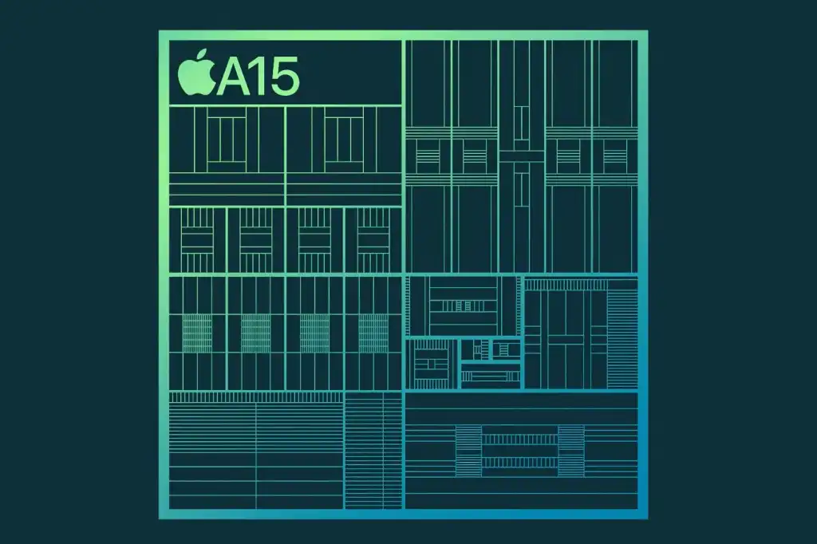
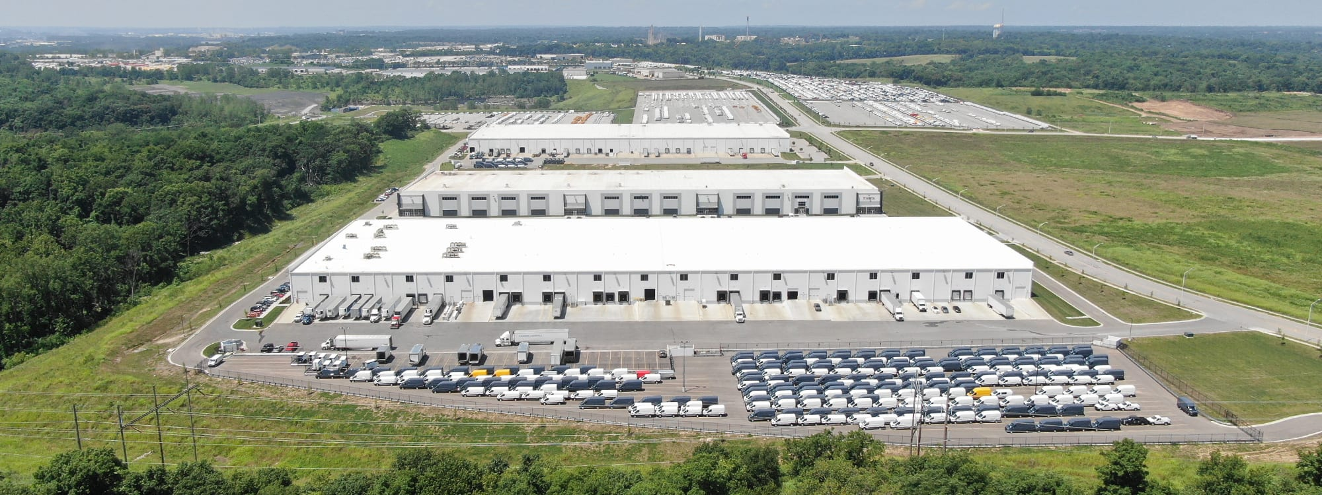
A Changing World
Computing pervades all aspects of society
  Socialization and communication
  E-commerce and business
  Research and development
Apple, Samsung, and Google
  Dominate the world of smartphones
  Design their own silicon
Google, Microsoft, Amazon, Facebook
  Dominate the NASDAQ (market cap > $1T)
  Baidu, Alibaba, and TenCent are not far behind
  Also designing their own silicon

Slide 4
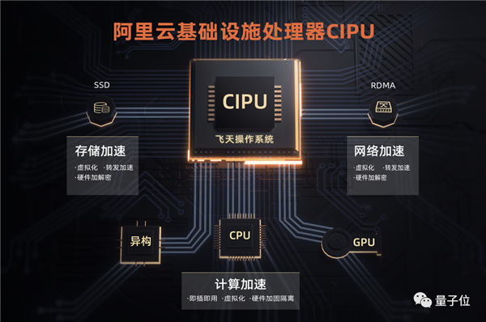
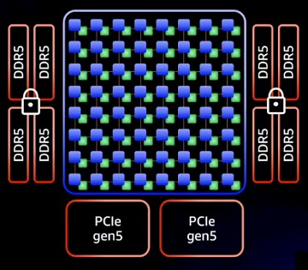
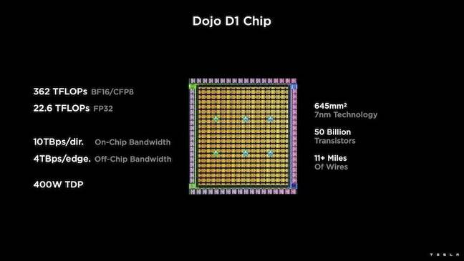
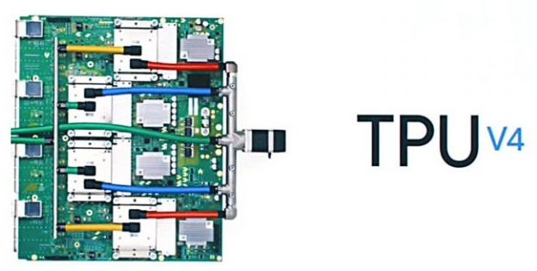
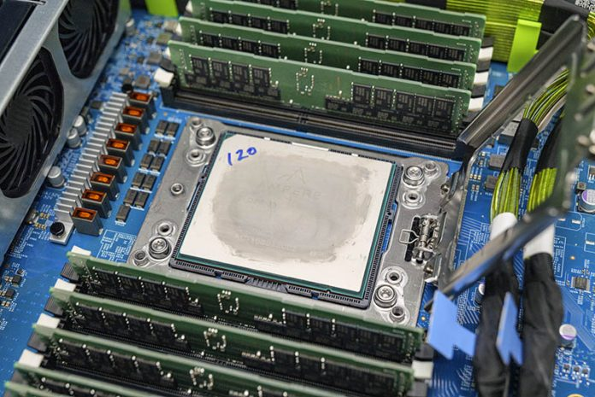
Cloud vendors
Alibaba
  CIPU, 128 core ARM based
  Alibaba’s Elastic Compute Service
AWS Graviton3
  64 ARM Neoverse V1 cores, chiplet design
  55 billion transistors, DDR5 memory
Google TPU4
  2X TPU3 performance
  4096 units per “pod”
Microsoft Azure
  Ampere Alta ARM processors
  Project Catapult/Brainewave
Even car makers
Tesla

Slide 5
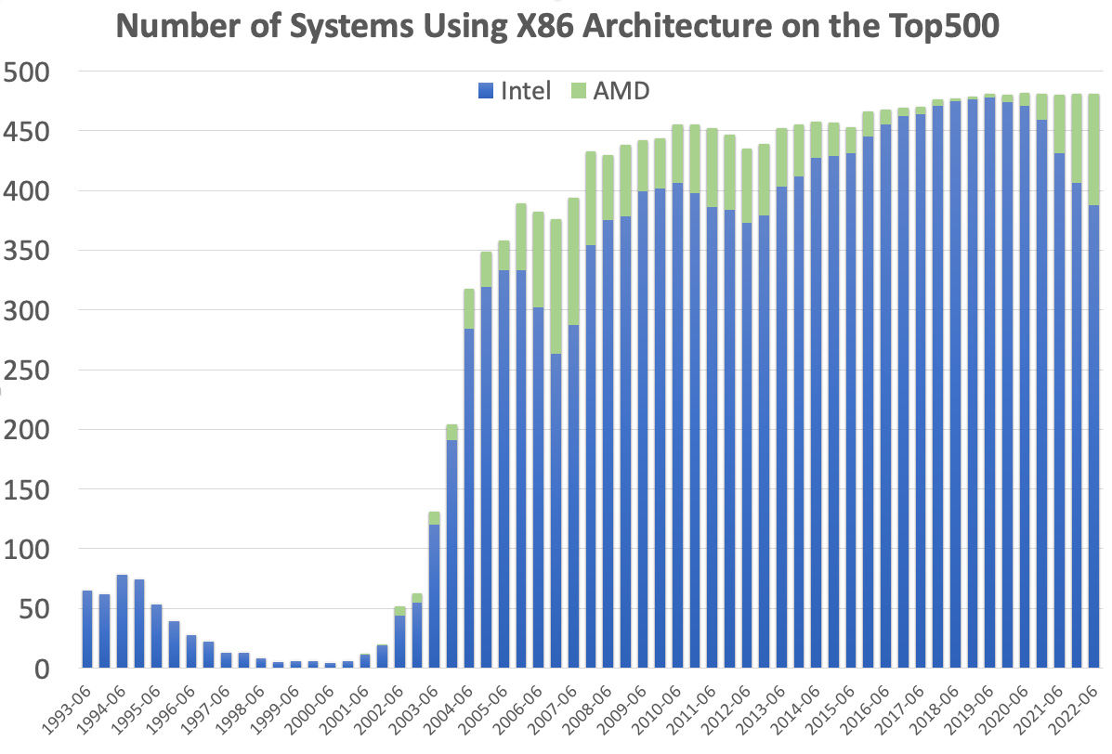
HPC is a Monoculture – Processors
TOP500 list began in 1993
  65 systems used Intel’s i860 architecture
  Remainder had specialized architectures, mainly vector based
Most recent TOP500 list
  78% of systems used Intel processors
  Another 19% used AMD processors
97% of the systems use x86-64 architecture
    Many use GPU accelerators

Slide 6
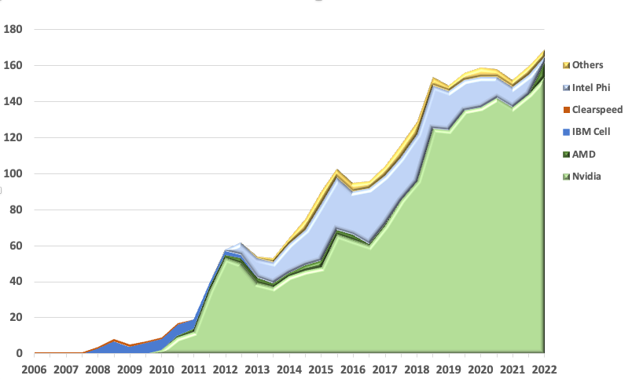
HPC Monoculture – Accelerators/Interconnects/OS
Nvidia dominates accelerators
Interconnects are mainly Ethernet/InfiniBand
  426 of the Top500
Linux is standard everywhere

Slide 7
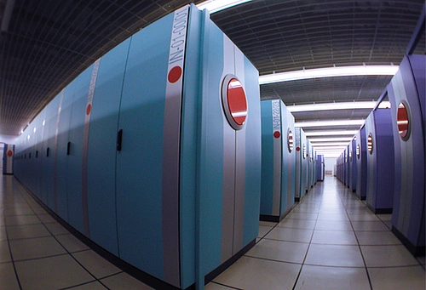
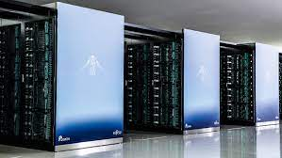
Japan and the United States
U.S. Advanced Simulation and Computing (ASC) program is driven by the national defense
  Systems have been used only for domestic missions
  Involved only modest investments in industrial R&D
  Relied on U.S. produced software and applications
  Commodity microprocessors (and later GPUs)
Japanese Earth Simulator (ES) developed for basic research
  No defense mission
  Access was shared internationally
  Major ES investment supported NEC’s SX-6 vector technology
  Software from abroad, modified and enhanced in Japan
Fujitsu’s development of the Fugaku supercomputer, based on custom processors with ARM cores and vector instructions, has followed in this Japanese tradition

Slide 8
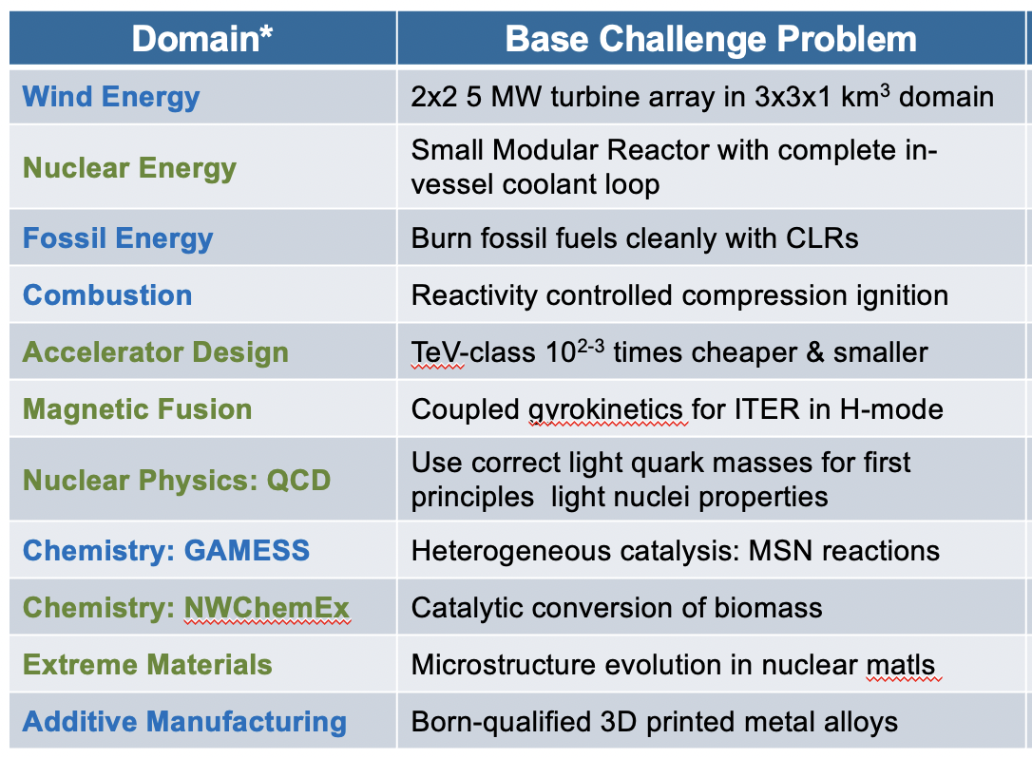
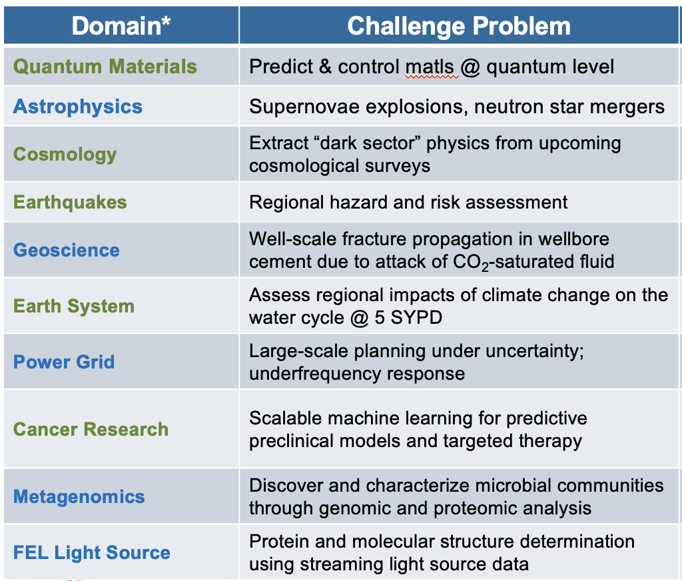
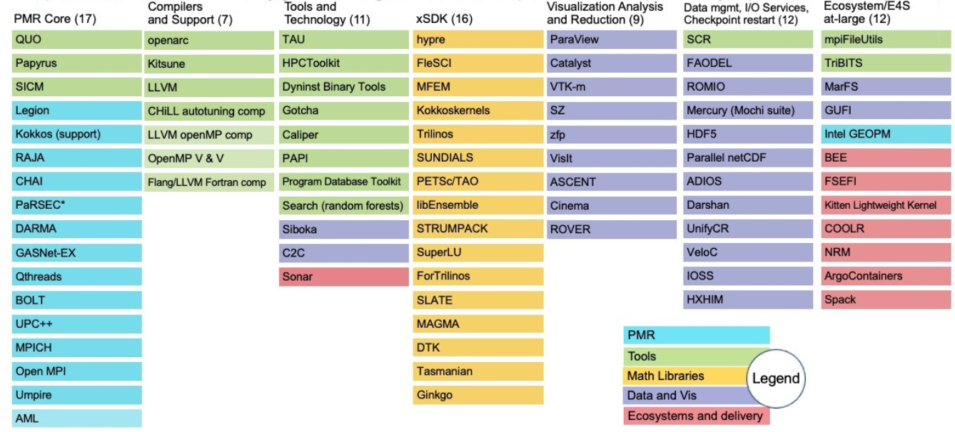
DOE: Exascale investing > $4 B in total, over 7 years
What do you get for $4 B?
3 computers
  $600M each
  $400M Non Reoccurring Engineering (NRE)
21 Applications
AMD Based
(Up & running)
Intel Based
(Being installed)
AMD Based
(Planned)
A bunch of software (84 projects)
1000 people working on ECP, and the project will end in 11 months. There is no follow-on project of this scale!!

Slide 9
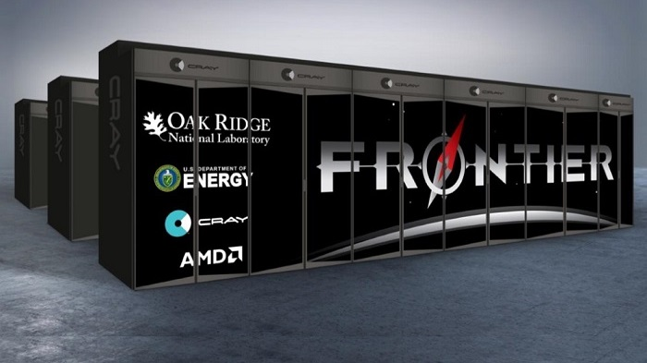
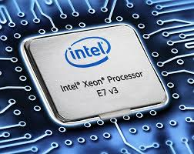
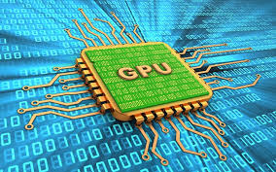
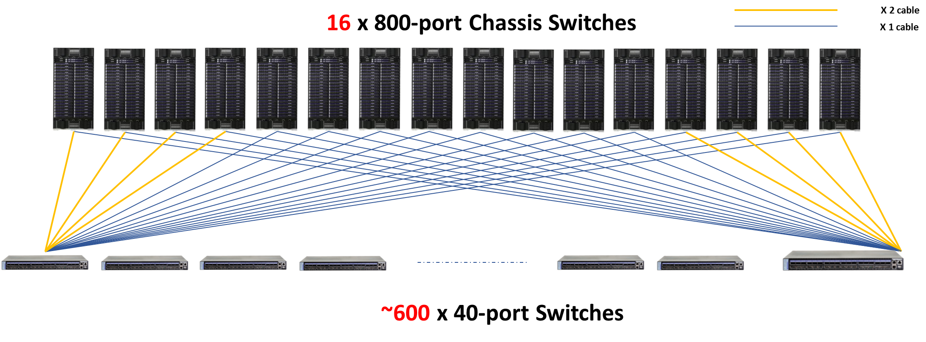
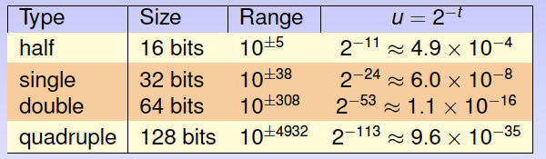
Today’s HPC Environment for Scientific Computing
ORNL Frontier, 2 Eflop/s,
8.8 x 10⁶ Cores, 9408 nodes, 30 MW
(node = 1-AMD CPU + 4-AMD GPUs)
> 98% of performance from GPUs
Highly parallel
  Distributed memory
  MPI + Open-MP programming model
Heterogeneous
  Commodity processors + GPU accelerators
Communication between parts very expensive compared to floating point ops
Floating point hardware at 64, 32, 16, & 8 bit levels

Slide 10
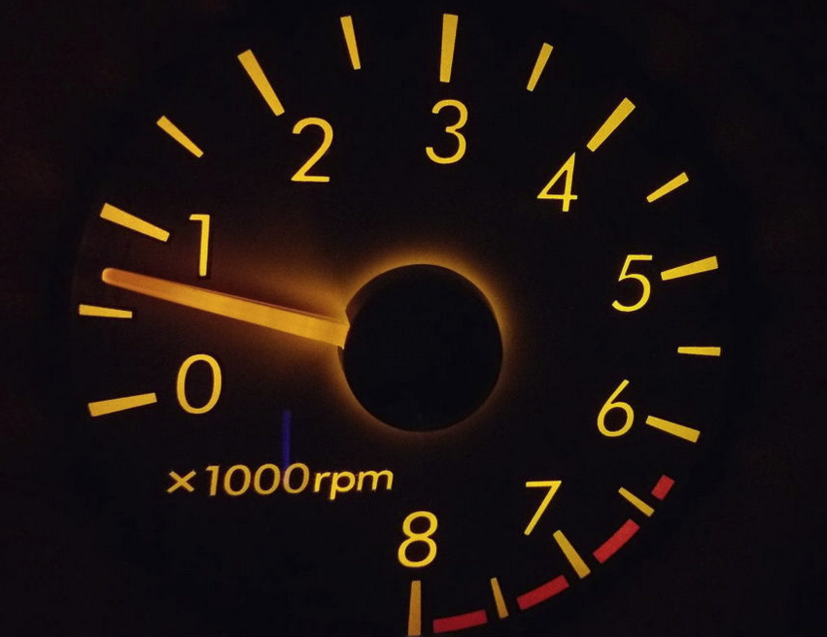

The Fastest Supercomputers are at an Exaflop.
What’s an Exaflop?
1 flop = Addition or Multiplication of 64-bit floating point numbers
Exaflop is a billion-billion (10¹⁸) floating point operations per second
If each person on Earth completed 1 calculation per second, it would take more than 4 years to do what an Exascale computer can do in 1 second.

Slide 11
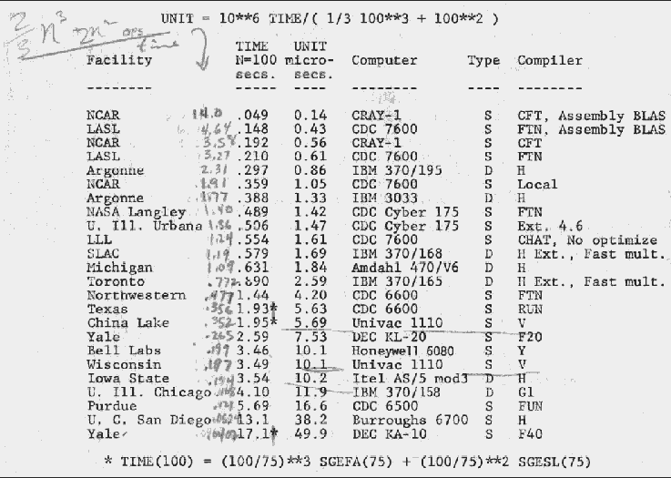
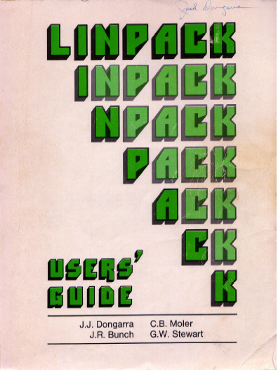
An Accidental Benchmarker
Appendix B of the Linpack Users’ Guide
  Designed to help users estimate the
  run time for solving systems of equation using the Linpack software.
First benchmark report from 1977;
  Cray 1 to DEC PDP-10
LINPACK was an NSF Project w/ ANL, UNM, UM, & UCSD
We worked independently and came to Argonne in the summers
Top 23 List from 1977
Performance of solving Ax=b using LINPACK software
1979
1979

Slide 12
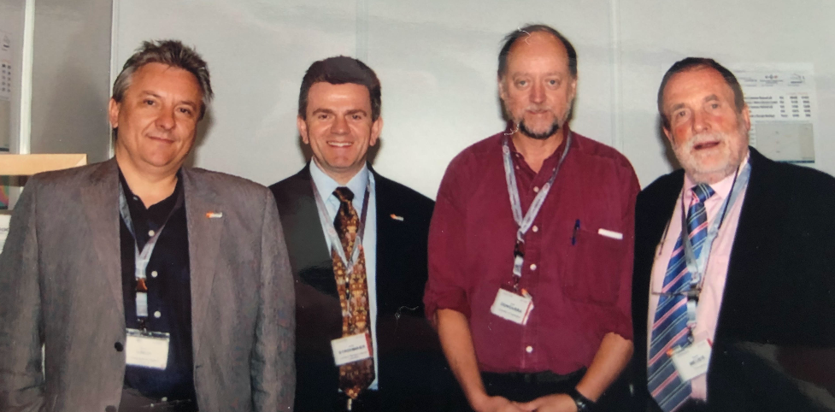

Top500 Since 1993
Hans Meuer and Erich Strohmaier had a list of fastest computers ranked by peak performance.
I had a list of benchmark results and we put the two lists together.
Listing of the 500 most powerful computers in the World.
Yardstick: Performance for
Ax=b, dense problem
Maintained and updated twice a year:
SC‘xy in the States in November
Meeting in Germany in June
TPP performance
Rate
Size

Slide 13
Performance Development of HPC over the Last 30 Years from the Top500
100 Eflop/s
10 Eflop/s
4.8 EFlop/s
1 Eflop/s
100 Pflop/s
1.1 EFlop/s
#1 in 1997 - Hitachi CP-PAC with 2048 Processors at
Center for Computational Science, University of Tsukuba
10 Pflop/s
SUM
1 Pflop/s
100 Tflop/s
1.73 PFlop/s
N=1
10 Tflop/s
1 Tflop/s
1.17 TFlop/s
My Laptop: 426 Gflop/s
N=500
7 times faster than LANL’s CM-5
100 Gflop/s
59.7 GFlop/s
10 Gflop/s
# 1 in 1993 - Thinking Machine CM-5 with 1024 Processors at
Los Alamos Nat Lab used for nuclear weapons design
1 Gflop/s
422 MFlop/s
100 Mflop/s
Notes:
Statistical significant inflection point in June 2008 for end of the list

Slide 14





November 2022: The TOP 10 Systems (53% of the Total Performance of Top500)
Rank | Site | Computer | Country | Cores | Rmax [Pflops] | % of Peak | Power [MW] | GFlops/Watt
1 | DOE / OS Oak Ridge Nat Lab | Frontier, HPE Cray Ex235a, AMD 3rd EPYC 64C, 2 GHz, AMD Instinct MI250X, Slingshot 10 | USA | 7,733,248 | 1,102 | 65 | 21.1 | 52.2
2 | RIKEN Center for Computational Science | Fugaku, ARM A64FX (48C, 2.2 GHz), Tofu D Interconnect | Japan | 7,299,072 | 442. | 82 | 29.9 | 14.8
3 | EuroHPC /CSC | LUMI, HPE Cray EX235a, AMD 3rd EPYC 64C, 2 GHz, AMD Instinct MI250X, Slingshot 10 | Finland | 1,268,736 | 304. | 72 | 2.94 | 52.3
4 | EuroHPC/CINECA | BullSequana XH2000, Xeon Platinum 8358 32C 2.6GHz, NVIDIA A100 (108C), Quad-rail NVIDIA HDR100 | Italy | 1,463,616 | 175. | 68 | 5.6 | 31.1
5 | DOE / OS Oak Ridge Nat Lab | Summit, IBM Power 9 (22C, 3.0 GHz), NVIDIA GV100 (80C), Mellonox EDR | USA | 2,397,824 | 149. | 74 | 10.1 | 14.7
6 | DOE / NNSA L Livermore Nat Lab | Sierra, IBM Power 9 (22C, 3.1 GHz), NVIDIA GV100 (80C), Mellonox EDR | USA | 1,572,480 | 94.6 | 75 | 7.44 | 12.7
7 | National Super Computer Center in Wuxi | Sunway TaihuLight, SW26010 (260C), Custom Interconnect | China | 10,649,000 | 93.0 | 74 | 15.4 | 6.05
8 | DOE / OS NERSC - LBNL | Perlmutter HPE Cray EX235n, AMD EPYC 64C 2.45GHz, NVIDIA A100, Slingshot 10 | USA | 706,304 | 64.6 | 71 | 2.59 | 27.4
9 | NVIDIA Corporation | Selene NVIDIA DGX A100, AMD EPYC 7742 (64C, 2.25GHz), NVIDIA A100 (108C), Mellanox HDR | USA | 555,520 | 63.4 | 80 | 2.64 | 23.9
10 | National Super Computer Center in Guangzhou | Tianhe-2A NUDT, Xeon (12C) , MATRIX-2000 (128C) + Custom Interconnect | China | 4,981,760 | 61.4 | 61 | 18.5 | 3.32
Notes:
So it's not that I want to beat China per se; it's that I want us to have parity with them. I don't want to rely on them for the chip technology embedded in the supercomputers we use for national security. I don't want to rely on them for the low level software that runs my supercomputer because they figured out the parallelism before we did. I don't want to rely on them, or anyone else, for my own standard of living, for my safety and security, for the inventions that propel us forward, for open dialog and communications, all of which rely on supercomputing. I want the U.S. to be self reliant, capable and responsible for our own prosperity. »•« If we are to be partners in a world of global competition, I want us to come from a position of strength based on the best U.S. industry, academia and the national labs have to offer. That's what put us and has kept us in the leadership role we enjoy today in supercomputing. It's imperative we now begin to push forward on the necessary technology to ensure a continued leadership position. The stakes are very high
5.2 X Titan
1.4 X all DOE

Slide 15

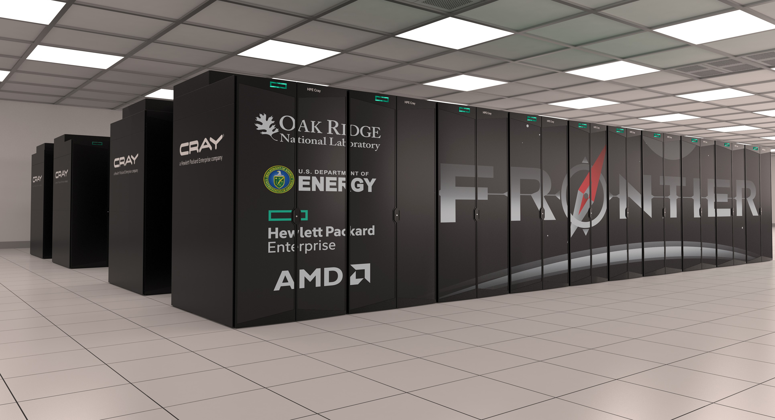
Current #1 System Overview
System Performance
Each node has
The system includes
Peak performance of 2 Eflop/s for modeling & simulation
Peak performance of 11.2 Eflop/s for 16 bit floating point used in for data analytics, ML, and artificial intelligence
  1-AMD EPYC 7A53 CPU w/64 cores (2 Tflop/s)
    < 1% performance of the system
  4-AMD Instinct MI250X GPUs
  Each w/220 cores (4*53 Tflop/s)
    99% performance of the system
  730 GB of fast memory
  2 TB of NVMe memory
  9408 nodes
    37,632 GPUs
    8.88M Cores
  Cray Slingshot interconnect
  706 PB (695 PB Disk + 11 PB SSD)

Slide 16
Performance Development
1 Eflop/s
1.1 EFlop/s
100 Pflop/s
10 Pflop/s
1 Pflop/s
100 Tflop/s
10 Tflop/s
1 Tflop/s
100 Gflop/s
10 Gflop/s
59.7 GFlop/s
1 Gflop/s
100 Mflop/s
Tflops (10¹²)
Achieved
ASCI Red
Sandia NL
Pflops (10¹⁵)
Achieved
RoadRunner
Los Alamos NL
Eflops (10¹⁸)
Achieved
O(10 ³)
11 Years
O(10 ³)
14 Years
Frontier ORNL

Slide 17
Projected Performance Development
100 Eflop/s
10 Eflop/s
SUM
1 Eflop/s
8 Years for 1 Order of Magnitude
100 Pflop/s
N=1
10 Pflop/s
N=500
1 Pflop/s
100 Tflop/s
Notes:
No500 is lagging 10x by end of decade if this continues
EXP(0.325x) top500 last old
Exp(0.2124 x ) top500 last new
Exp(0.1843 x) scalar
Exp(0.219 x) accelerator
Exp(0.3061 x) top500 average prior 2013
Exp(0.1379 x) top500 average post 2013 => *2.28 in 6 lists since 2008

Slide 18
Plot of the Top500 Systems by Performance
Tflop/s

Slide 19
Plot of the Top500 Systems by Performance
Tflop/s
53% of the Total Performance of Top500 inTop10

Slide 20
Plot of the Top500 Systems by Performance
Tflop/s
NSF’s 9 Centers in the Top500
19 | Frontera | Texas Advanced Computing Center/Univ. of Texas
51 | Stampede2 | Texas Advanced Computing Center/Univ. of Texas
141 | Delta | NCSA
154 | Anvil | Purdue University
257 | Grace | Texas A&M University
287 | Expanse | UCSD/San Diego Supercomputer Center
337 | Longhorn | Texas Advanced Computing Center/Univ. of Texas
402 | Grace-GPU | Texas A&M University
452 | Rockfish | Johns Hopkins University

Slide 21
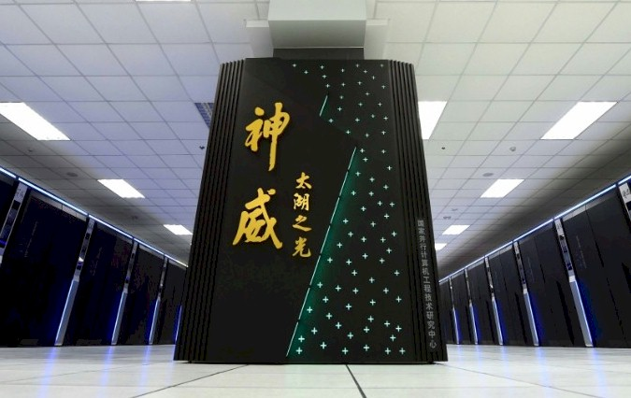
China
Supercomputers
Rumored 2 Exascale Systems in Chinese
Qingdao Marine Sunway Pro "OceanLight" (Shandong Prov)
  Completed March 2021, 1.3 EFlops Rpeak and 1.05 EFlops Linpack
  ShenWei post-Alpha CPU ISA architecture with large & small core structure
  Est 96 cabinets x 1024 SW39010 390-core 35MW
  Science on this machine won Gordon Bell Prize in 2021
NSCC Tianjin Tianhe-3
  Dual-chip FeiTeng ARM and Matrix accelerator node architecture
  Est -1.7 EFlops Rpeak
China: Top consumer and producer overall.
5 main manufactures of HPC in China: Lenovo, Sugon, Inspur, Huawei, NUDT

Slide 22
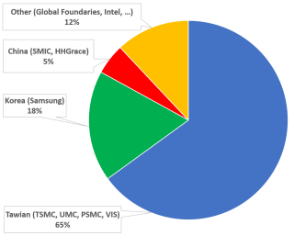
semiconductor foundries

Slide 23
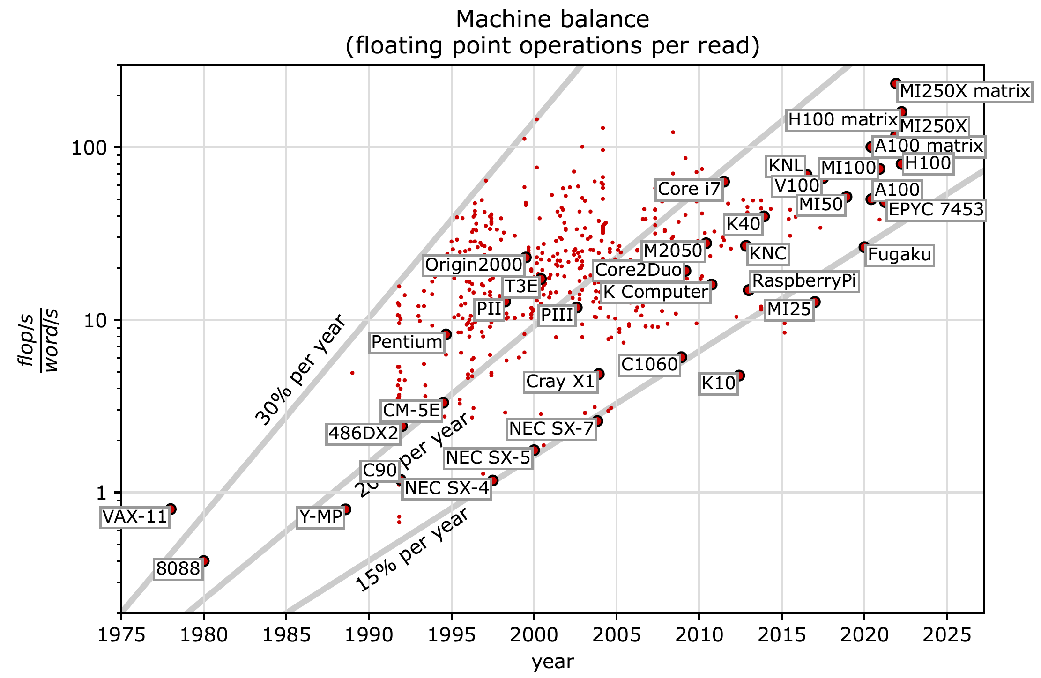
When We Look at Performance in Numerical Computations …
Machine Balance
Ratio of Fl Pt Ops per Data Movement over Time
Data movement has a big impact
Performance comes from balancing floating point execution (Flops/sec) with memory->CPU transfer rate (Words/sec)
  “Best” balance would be 1 flop per word-transfered
Today’s systems are close to 100 flops/sec per word- transferred
  Imbalanced: Over provisioned for Flops
Figure from Mark Gates UTK
Graph from Mark Gates
Plot for 64-bit floating point data movement & operations
(Bandwidth from CPU or GPU memory to registers)

Slide 24
Performance and Benchmarking Evaluation Tools
Linpack Benchmark - Longstanding benchmark started in 1979
  Lots of positive features; easy to understand and run; shows trends
However, much has changed since 1979
  Arithmetic was expensive then and today it is over-provisioned and inexpensive
Linpack performance of computer systems is no longer strongly correlated to real application performance
  Linpack benchmark based on dense matrix multiplication
Designing a system for good Linpack performance can lead to design choices that are wrong for today’s applications

Slide 25
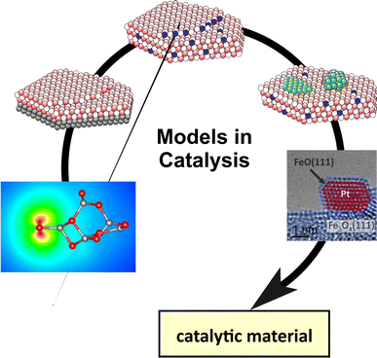
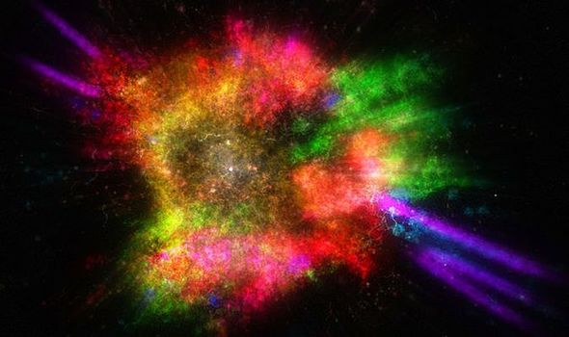
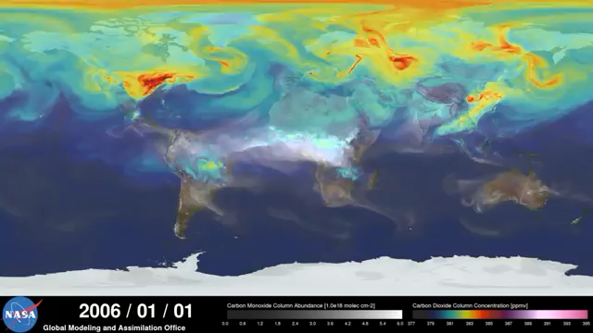
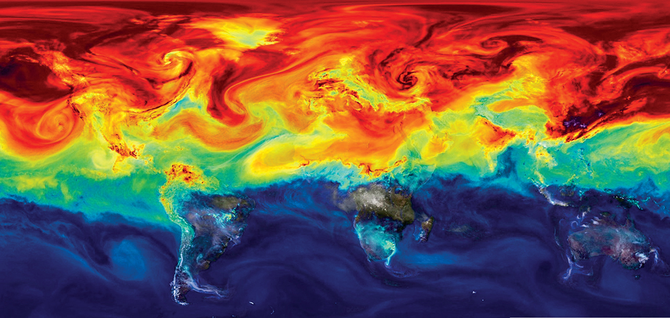
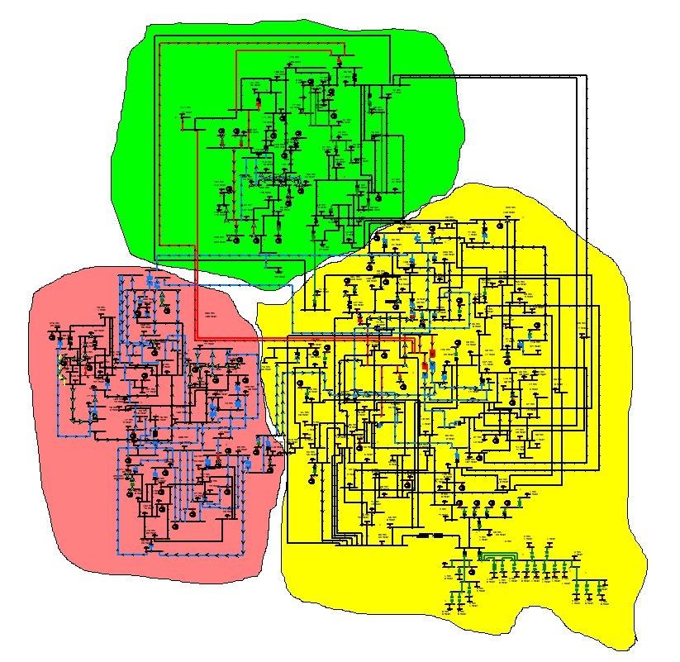
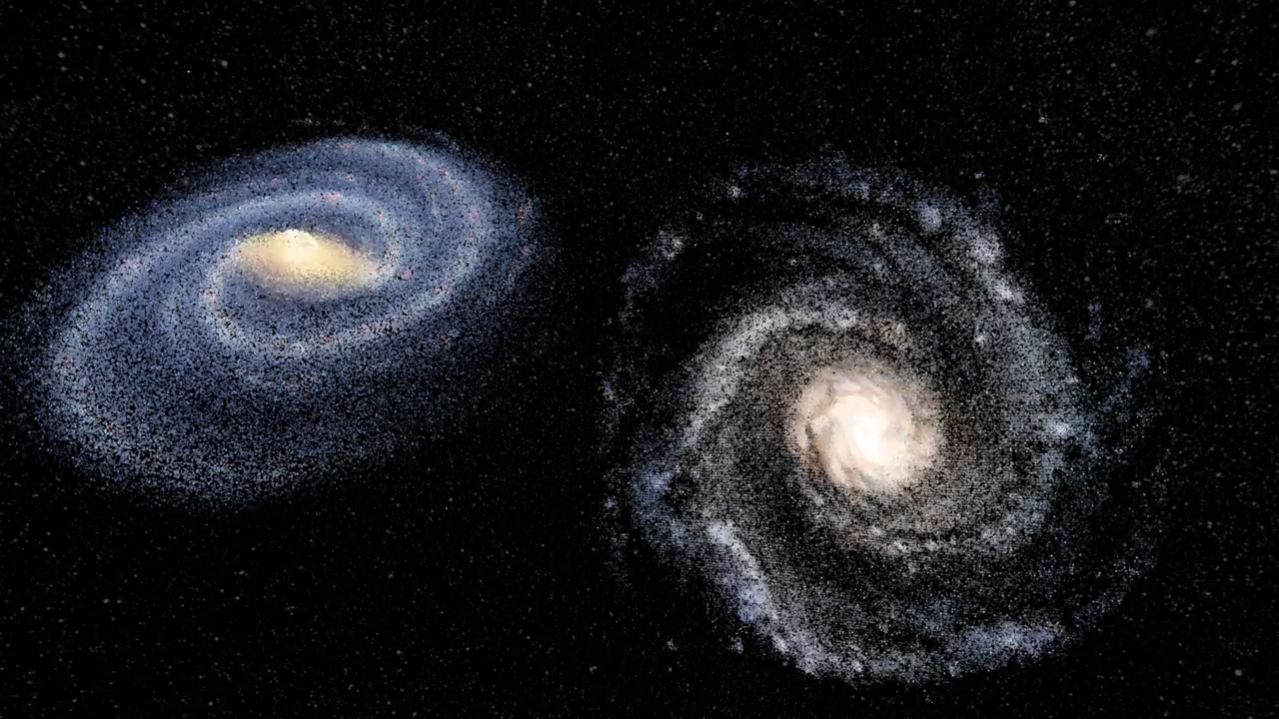
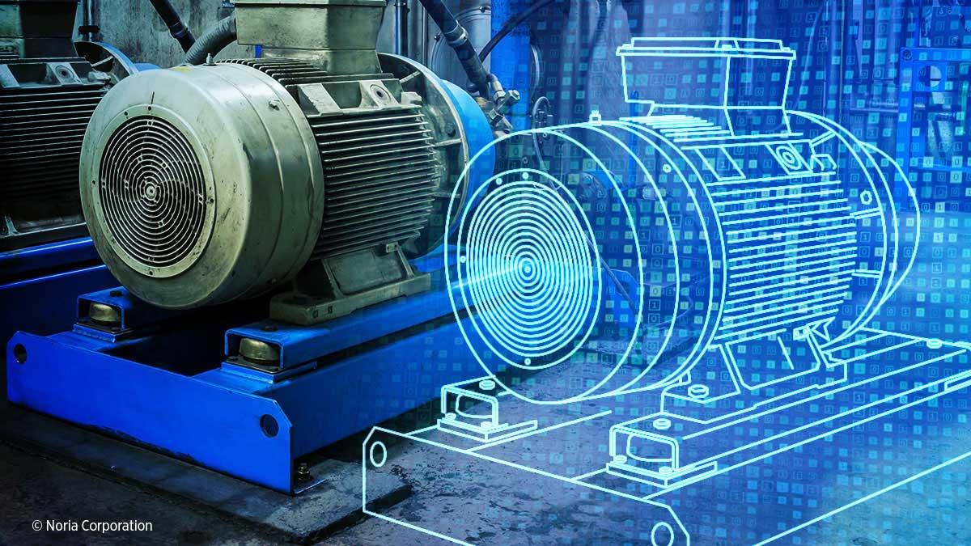
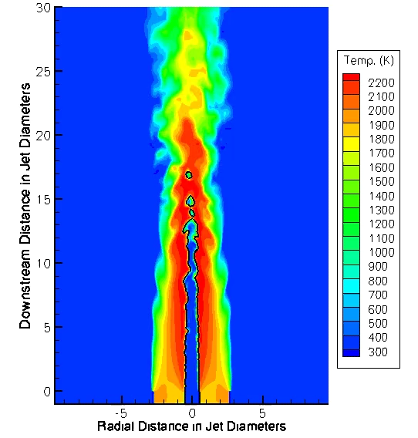

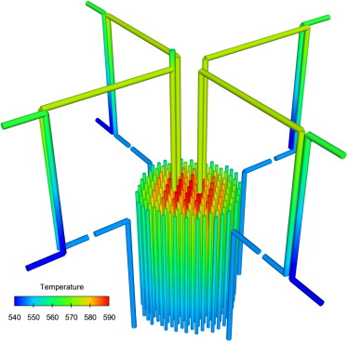
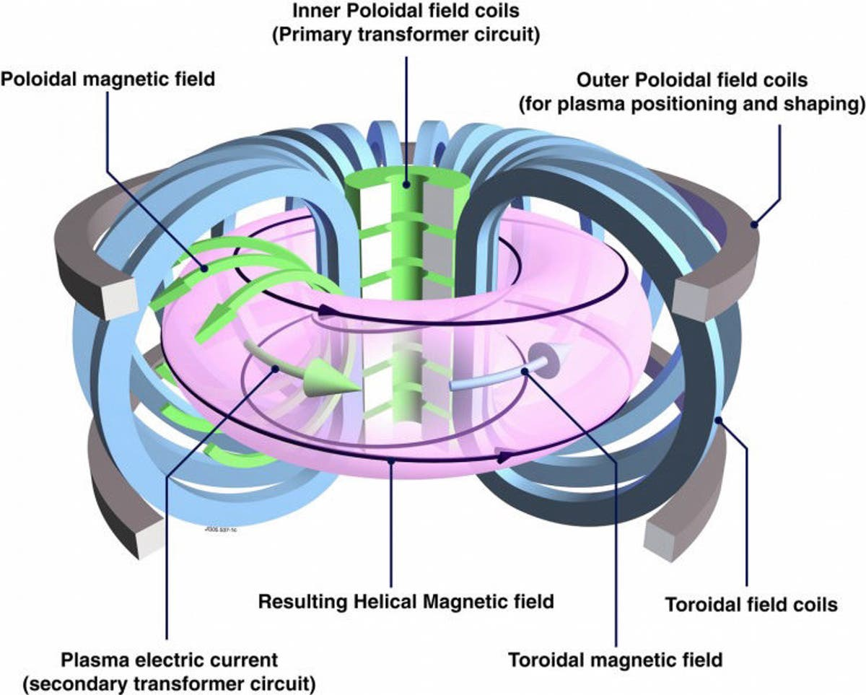
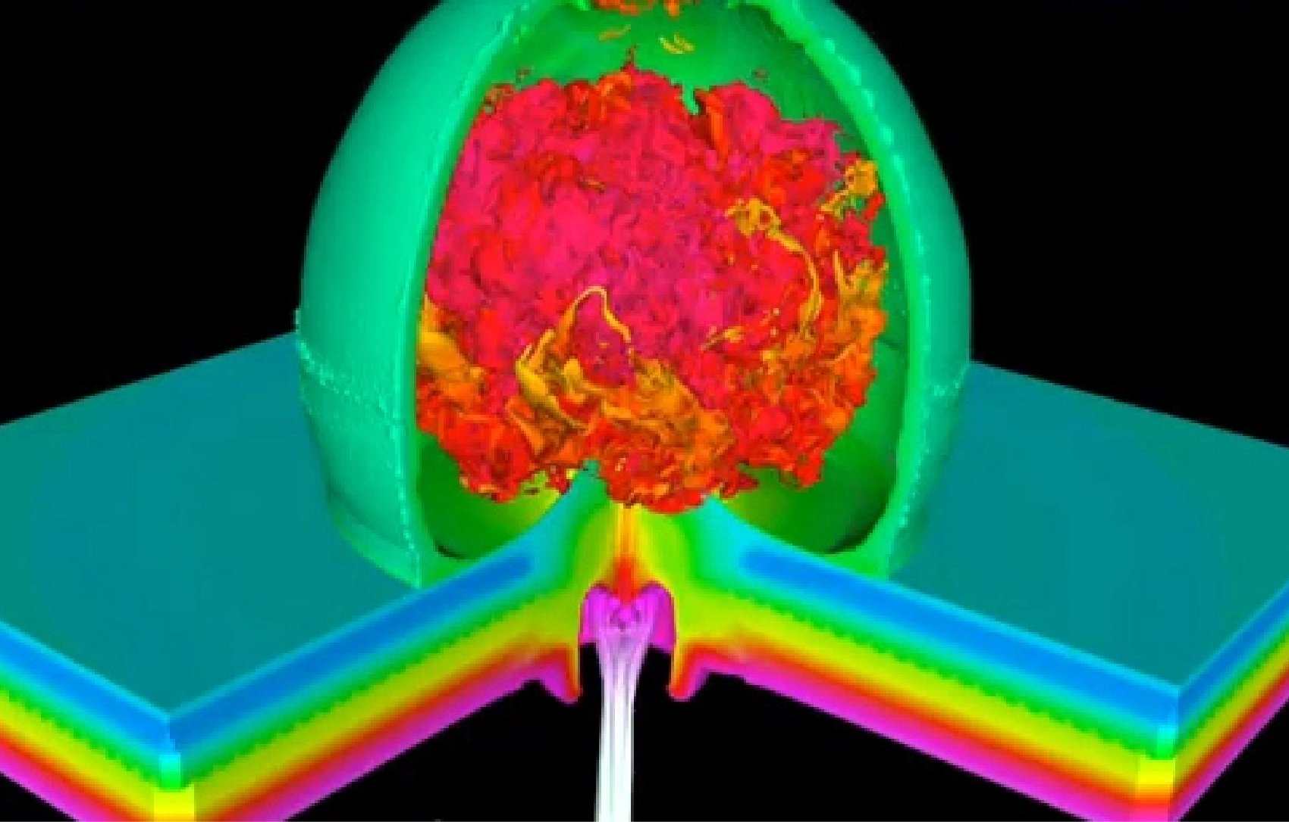
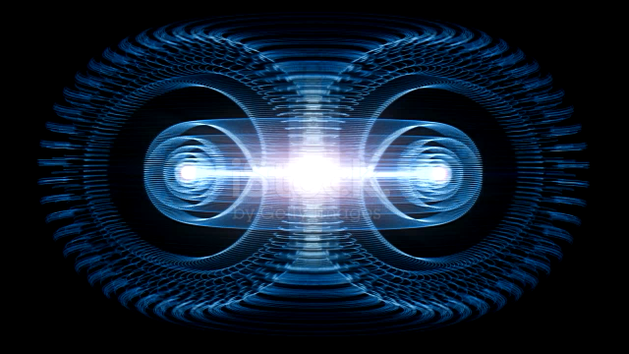
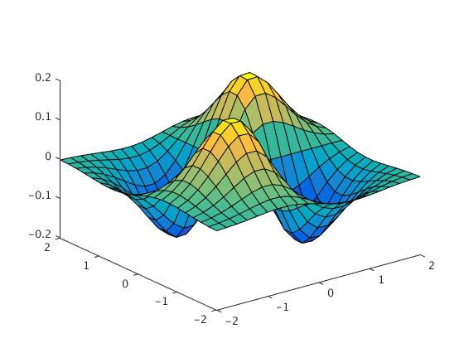
Today’s Top HPC Systems Used to do Simulations
Climate
Combustion
Nuclear Reactors
Catalysis
Electric Grid
Fusion
Stockpile
Supernovae
Materials
Digital Twins
Accelerators
…
Usually 3-D PDE’s
  Sparse matrix computations, not dense

Slide 26
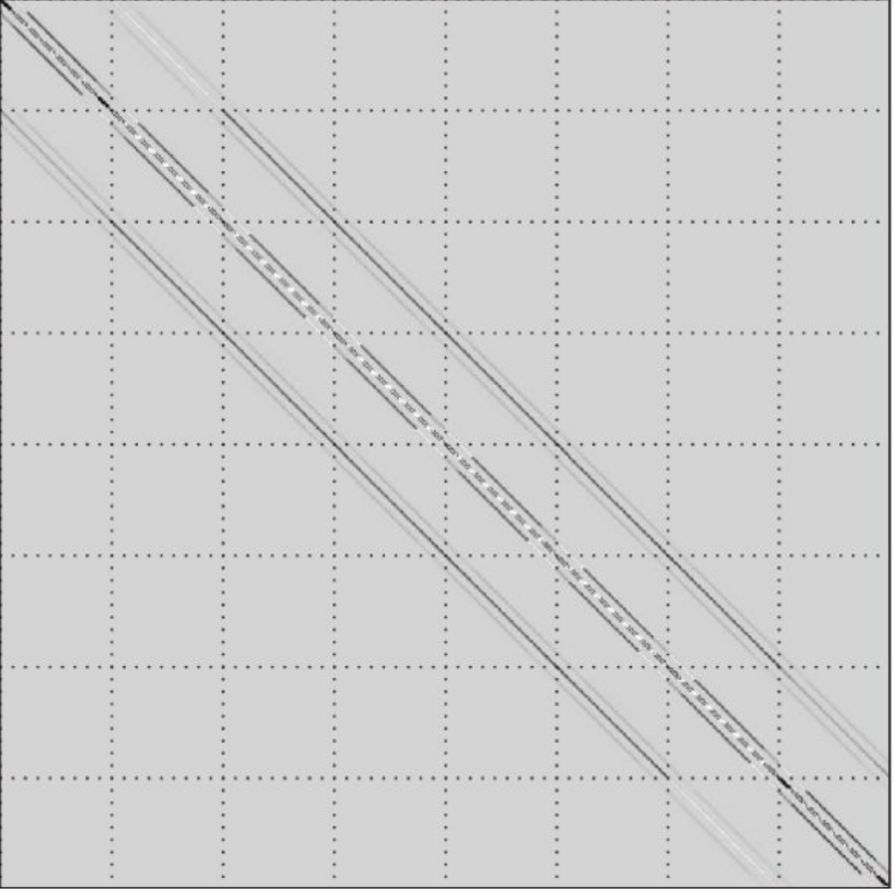
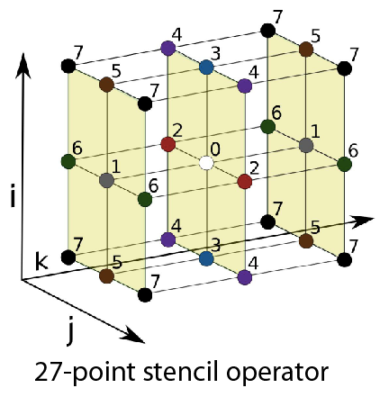
HPCG Results; The Other Benchmark
hpcg-benchmark.org With Piotr Luszczek and Mike Heroux
High Performance Conjugate Gradients (HPCG).
Solves Ax=b, A large, sparse, b known, x computed.
An optimized implementation of PCG contains essential computational and communication patterns that are prevalent in a variety of methods for discretization and numerical solution of PDEs
Patterns:
  Dense and sparse computations.
  Dense and sparse collectives.
  Multi-scale execution of kernels via MG (truncated) V cycle.
  Data-driven parallelism (unstructured sparse triangular solves).
Strong verification (via spectral properties of PCG).

Slide 27

HPCG Top 10, November 2022
Rank | Site | Computer | Cores | HPL Rmax (Pflop/s) | TOP500 Rank | HPCG (Pflop/s) | Fraction of Peak
1 | RIKEN Center for Computational Science Japan | Fugaku, Fujitsu A64FX 48C 2.2GHz, Tofu D, Fujitsu | 7,630,848 | 442 | 2 | 16.0 | 3.0%
2 | DOE/SC/ORNL USA | Frontier, HPE Cray Ex235a, AMD 3rd EPYC 64C, 2 GHz, AMD Instinct MI250X, Slingshot 10 | 8,730,112 | 1,102 | 1 | 14.1 | 0.8%
3 | EuroHPC/CSC Finland | LUMI, HPE Cray EX235a, AMD Zen-3 (Milan) 64C 2GHz, AMD MI250X, Slingshot-11 | 2,174,976 | 304 | 3 | 3.41 | 0.8%
4 | DOE/SC/ORNL USA | Summit, AC922, IBM POWER9 22C 3.7GHz, Dual-rail Mellanox FDR, NVIDIA Volta V100, IBM | 2,414,592 | 149 | 5 | 2.93 | 1.5%
5 | EuroHPC/CINECA Italy | Leonardo, BullSequana XH2000, Xeon Platinum 8358 32C 2.6GHz, NVIDIA A100 SXM4 40 GB, Quad-rail NVIDIA HDR100 Infiniband | 1,463,616 | 175 | 4 | 2.57 | 1.0%
6 | DOE/SC/LBNL USA | Perlmutter, HPE Cray EX235n, AMD EPYC 7763 64C 2.45GHz, NVIDIA A100 SXM4 40 GB, Slingshot-10 | 761,856 | 70.9 | 8 | 1.91 | 2.0%
7 | DOE/NNSA/LLNL USA | Sierra, S922LC, IBM POWER9 20C 3.1 GHz, Mellanox EDR, NVIDIA Volta V100, IBM | 1,572,480 | 94.6 | 6 | 1.80 | 1.4%
8 | NVIDIA USA | Selene, DGX SuperPOD, AMD EPYC 7742 64C 2.25 GHz, Mellanox HDR, NVIDIA Ampere A100 | 555,520 | 63.5 | 9 | 1.62 | 2.0%
9 | Forschungszentrum Juelich (FZJ) Germany | JUWELS Booster Module, Bull Sequana XH2000 , AMD EPYC 7402 24C 2.8GHz, Mellanox HDR InfiniBand, NVIDIA Ampere A100, Atos | 449,280 | 44.1 | 12 | 1.28 | 1.8%
10 | Saudi Aramco Saudi Arabia | Dammam-7, Cray CS-Storm, Xeon Gold 6248 20C 2.5GHz, InfiniBand HDR 100, NVIDIA Volta V100, HPE | 672,520 | 22.4 | 20 | 0.88 | 1.6%
Think of a race car that has the potential of 200 MPH but only goes 2 MPH!
Think of a race car that has the potential of 200 MPH but only goes 2 MPH!

Slide 28
Rank
Peak Performance
HPL Performance

Slide 29
Rank
Peak Performance
HPL Performance
HPCG Performance

Slide 30
Recently we have seen AI & ML take off
AI and ML have been around for a long time as research efforts.
Why Now?
  Flood of available data (especially with the Internet)
  Increasing computational power
  Growing progress in available algorithms and theory developed by researchers.
  Increasing support from industries.

Slide 31
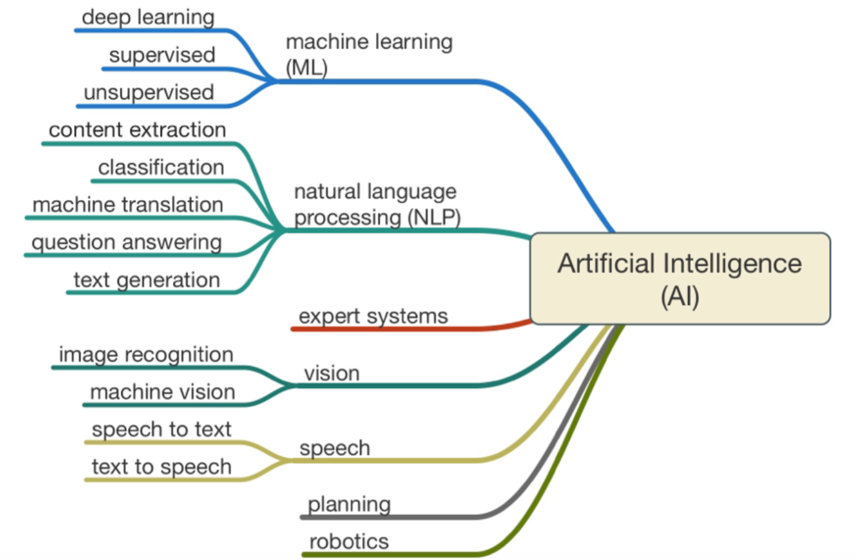
Artificial Intelligence

Slide 32


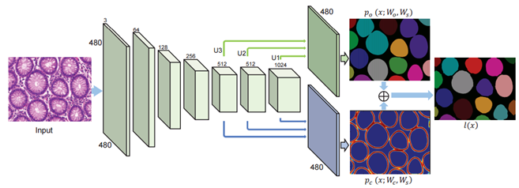
Machine Learning in Computational Science
Many fields are beginning to adopt machine learning to augment modeling and simulation methods
Climate
Biology
Drug Design
Epidemology
Materials
Cosmology
High-Energy Physics
Notes:
Machine learning is a subfield of computer science that evolved from the study of pattern recognition and computational learning theory in artificial intelligence.
Machine learning explores the study and construction of algorithms that can learn from and make predictions on data.
Recently there have been a number of breakthrough examples
Programs that can beat humans at the game of GO (which is much harder than Chess)
(computers used machine learning and played each other plus humans)
Programs that learn how to write letters and symbols after only one example…
Programs that can recognize handwriting with > 99.9 % accuracy
Programs that can identify objects in scenes
Programs that can drive cars (Tesla, Google)

Slide 33
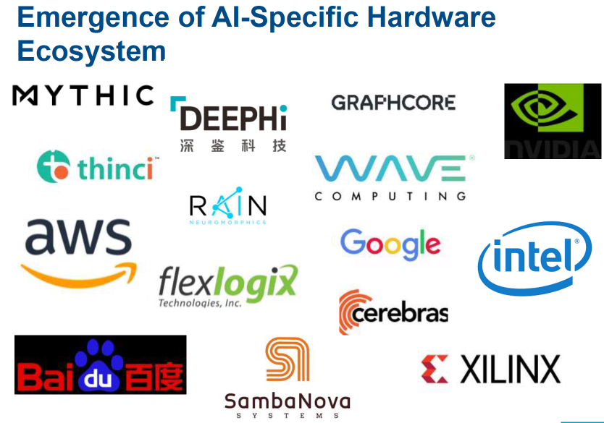
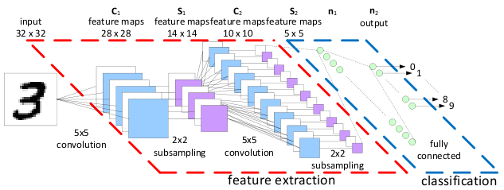
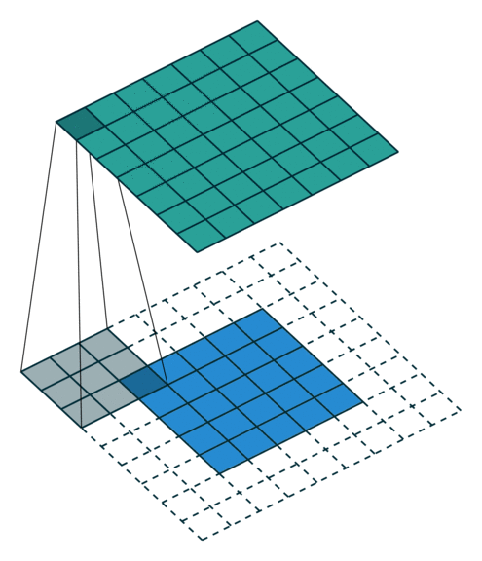
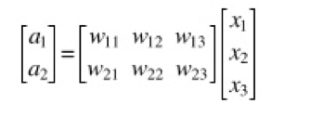
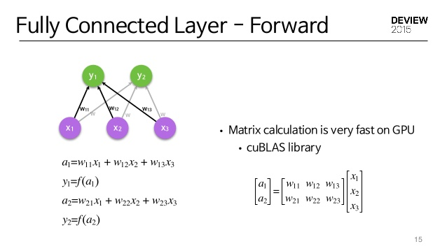
Deep Learning Needs Small Matrix Operations
Matrix Multiply is the time-consuming part.
Convolution Layers and Fully Connected Layers require matrix multiply
There are many GEMM’s of small matrices, perfectly parallel, can get by with 16-bit floating point
x₁
w₁₁
x₁
w₂₁
y₁
x₂
w₁₂
w₁₃
w₂₂
y₂
x₃
w₂₃
Convolution Step
In this case 3x3 GEMM
Fully Connected
Classification

Slide 34

Follow the Money
market capitalizations
Reed, Gannon, Dongarra, “Reinventing High Performance Computing: Challenges and Opportunities,” arXiv:2203.02544

Slide 35
HPC: From Diversity to Monoculture
1993*
Thinking Machines
CM-5 (LLNL)
|
SGI Challenge
Announced
|
Cray T-3D
2001*
NUDT Tianhe-1A
(NSC Tianjin)
|
NSF TeraGrid
(NCSA/SDSC)
2012
Cray Blue Waters
(NCSA)
2019
HPE Acquires
Cray
1968
IBM S/360 Model 91
(NASA Goddard)
1986
BBN Butterfly+
1981
Caltech Cosmic Cube+
2011*
Fujitsu K (RIKEN)
1999
X86-64
2016
US Exascale Project
Launched
1964
IBM S/360
Announced
1977
DEC VAX
Announced
1980
Texas TRAC+
1988
Intel iPSC/2
1996
SGI Acquires
Cray Research
2012*
Cray Titan
(ORNL)
|
IBM BlueGene/Q*
(LLNL)
|
1996*
Hitachi SR2201 & CP-PACS
(Tokyo and Tsukuba)
1972
Illinois ILLIAC IV+
1982
NYU Ultracomputer+
Stanford DASH+
2004*
IBM Blue Gene/L
(LLNL)
1976
Cray-1
(LANL)
|
2018*
IBM Summit
(ORNL)
2021*
HPE Frontier
(ORNL)
1961
IBM 7030
Stretch (LLNL)
1984
Illinois Cedar+
1988
Cray Y-MP
(NASA Ames)
2000*
IBM ASCI White
(LLNL)
2009*
Cray Jaguar
(ORNL)
1994
MPI Standard
2013*
NUDT Tianhe-2A
(NCSS Guangzhou)
1984
CMU WARP+
1997*
Intel ASCI Red
(SNL - 1 teraflop)
1970
CDC 7600
(LANL/LLNL)
1993
HPF Standard
1965
CDC 6600
(LANL/LLNL)
2002*
NEC Earth Simulator
(JAMSTEC)
2008*
IBM Roadrunner
(LANL - 1 petaflop)
2016*
Sunway TaihuLight
(NCSS Wuxi)
2020*
Fujitsu Fugaku
(Japan RIKEN)
1979
Goodyear MPP+
1991
Linux
1995
Convex C1
Alliant FX/8
2002
HP Acquires
Compaq
2008
Google Cloud
Announced
2021
Google TPU v4
1998
Compaq
Acquires DEC
1994*
Fujitsu Numerical
Wind Tunnel
(Nat Aero Japan)
|
Beowulf Clusters+
|
Intel Paragon (SNL)
2021
Amazon AWS
Graviton3
1982
Cray X-MP
(Digital Productions)
2006
Amazon AWS
Announced
2000
Tera Acquires
Cray from SGI
2010
Microsoft Azure
Announced
2021
Alibaba CIPU
2007
Apple iPhone
Announced
2022
Microsoft Azure
ARM Ampere
1960
1970
1980
1990
2000
2010
2020
CPU
Vector
MPP/SMP
Micro
Micro/GPU
Clouds
* Denotes #1 rank on Top500
+ Denotes research prototype
* Reed, Gannon, Dongarra, “HPC Forecast: Cloudy and Uncertain,” Communications of the ACM (February 2023)
Notes:
This slide is important, but it It takes some explanation to point out that diversity started to fade out around 1998. and by 2005 all we had was rather predictable evolution of micro/gpu. And eventually only one vendor left in the US.

Slide 36
Some truisms
Smartphone and cloud services companies are cash rich (i.e., exothermic)
Designing, building, and deploying hardware/software at unprecedented scale
Advanced computing, including HPC, requires ongoing (NRE) investment
  This NRE (i.e., serious money) is required to develop new technologies and systems
Traditional computing vendors are now smaller players in the computing ecosystem
  Many are dependent on government investment (i.e., endothermic) for NRE investments
AI is fueling a revolution among businesses and researchers
  They are rethinking how they approach both problems and their solutions

Slide 37
Conclusions
The computing ecosystem is in enormous flux, creating both opportunities and challenges for the future of advanced scientific computing
Looking forward, it seems increasingly unlikely that future high-end HPC systems will be procured and assembled solely by commercial integrators from only commodity components
Advances will require embracing end-to-end design, testing and evaluating advanced prototypes, and partnering strategically … real co-design.
Leading edge, HPC computing systems are increasingly similar to large-scale scientific instruments (LHC, LIGO, SKA) with limited economic incentives for commercial development

Slide 38


Chiplets: Integrating Multiple Functions
Rather than fabricating a monolithic system-on-a-chip, chiplet technology combines multiple chips, each representing a portion of the desired functionality, possibly fabricated using different processes by different vendors and perhaps including IP from multiple sources
Chiplet designs are part of the recent offerings from Intel and AMD
  Amazon’s Graviton3 also uses a chiplet design with seven different chip dies
  Advanced Query Accelerator (AQUA) for AWS Redshift, Amazon’s powerful and popular data warehouse service, relies on a package of custom ASICs and FPGA accelerators

Slide 39




The Take Away
“There’s plenty of room at the Top: What will drive computer
performance after Moore’s law?”
HPC Hardware is Constantly Changing
  Scalar
  Vector
  Distributed
  Accelerated
  Mixed precision
Three computer revolutions
  High performance computing
  Deep learning
  Edge & AI
Algorithm / Software advances follows hardware.
  And there is “plenty of room at the top”
Feynman’s 1959
Lecture @ CalTech
Notes:
Scientists supported by NSF advanced computing increasingly include a “long tail” of users with more modest requirements for advanced computing than those with research applications that require parallel computers with a large number of tightly coupled processors. The latter applications cannot be run (or run with acceptable efficiency) on smaller systems or on current commercial cloud systems.

Slide 40
The advantages of using the cloud for supercomputing are:
Accessibility: Cloud-based supercomputing makes high-performance computing resources accessible to a wider range of users, including individuals and organizations with limited budgets or technical expertise.
Scalability: Cloud-based supercomputing resources can be scaled up or down as needed, allowing users to easily access the resources they need for specific tasks and projects.
Flexibility: Cloud-based supercomputing resources can be accessed from anywhere with an internet connection, making it easier for users to collaborate and share data and results.
Cost efficiency: Cloud-based supercomputing can be more cost-effective than traditional supercomputing solutions, especially for organizations that only need supercomputing resources on an as-needed basis.
Easy maintenance: Cloud-based supercomputing resources are managed by the provider, reducing the maintenance and technical support burden for users.
Reliability: Cloud-based supercomputing providers often have extensive infrastructure and resources to ensure high levels of uptime and reliability.
Innovation: Cloud-based supercomputing can drive innovation by making cutting-edge computing resources accessible to a wider range of users, allowing for new discoveries and breakthroughs in fields such as science, engineering, and medicine.

Slide 41
The disadvantages of using the cloud for supercomputing are:
Latency: The distance between the user and the cloud servers can result in higher latency, affecting the speed and responsiveness of the system.
Bandwidth: High-bandwidth applications can be limited by the available network bandwidth, leading to slower performance and increased costs.
Security: Storing sensitive data in the cloud can be a concern, as there are security risks such as hacking, data theft, and unauthorized access.
Cost: Cloud-based supercomputing can be expensive, especially for large-scale and long-term projects, due to the cost of hardware, network, and data storage.
Interoperability: Different cloud providers may use different technologies and standards, making it difficult to move data and applications between them.
Reliability: The reliability of cloud-based supercomputing depends on the availability and stability of the cloud infrastructure, and may be impacted by outages, maintenance, or other disruptions.
Customization: Customizing a cloud-based supercomputing system to specific needs can be difficult, as the provider may limit the ability to install specific software or make configuration changes.

Slide 42
53% of the Total Performance of Top500 inTop10

Slide 43

Roles for Artificial Intelligence

Slide 44
HPC, NRE, and the long tail
Goal of any business is maximizing profits
  Sell MANY units with LOW margin
  Sell a FEW units with HIGH margin
Margin is price MINUS costs
Costs include
  Non-recurring engineering (NRE)
  Manufacturing
  Sales, marketing, …
Performance
Top 10

Slide 45
Some Truisms
The smartphone and cloud services companies are cash rich (i.e., exothermic), and they are designing, building, and deploying their own hardware and software infrastructure at unprecedented scale
Advanced computing of all kinds, including high-performance computing, requires ongoing non-recurring engineering (NRE) investment to develop new technologies and systems
The traditional computing vendors are now relatively small players in the computing ecosystem, and many are dependent on government investment (i.e., endothermic) for the NRE needed to advance the bleeding edge of advanced computing technologies
Dennard scaling has ended and continued performance advances increasingly depend on functional specialization via custom ASICs and chiplet-integrated packages
Moore’s Law is at or near an end, and transistor costs are likely to increase as features sizes continue to decrease
AI is fueling a revolution in how businesses and researchers think about problems and their computational solution
Nimble hardware startups are exploring new ideas, driven by the AI frenzy
Talent is following the money and the opportunities, which are increasingly in a small number of very large companies or creative startups

Slide 46










Generational Paradigm Shifts
Accelerated Clusters
x86 Linux Clusters
Massively Parallel
Processors
TMC CM-5
Shared Memory
Multiprocessors
SGI Power Challenge
Vector Supercomputers
Cray-1

Slide 47
A Computing Revolution is Underway
What is the future of advanced computing?
Continued innovation in advanced high-performance computing will require rethinking some of our traditional approaches and assumptions
  How, where, and when academia, government laboratories, and companies spend finite resources
  Where and how we expand the talent base

Slide 48
Some Key Maxims
Maxim One: Semiconductor constraints dictate new approaches
  The “free lunch” is over; leading to packaging multiple chips; chiplets and the need for interoperability standards
Maxim Two: End-to-end hardware/software co-design is essential
  Given current semiconductor constraints, substantially increased system performance will require more intentional end-to-end co-design (e.g., Japanese Fugaku)
Maxim Three: Prototyping at scale is required to test new ideas
  Semiconductors, chiplets, AI hardware, cloud innovations – the computing system is now in great flux
Maxim Four: Space of leading edge HPC applications is far broader than in the past
  Traditional 3D PDE’s AND AL/ML are here to stay (e.g., Science 2021 Breakthrough of the Year was for AI-enabled protein structure prediction)
Maxim Five. Cloud economics have changed the supply chain ecosystem
  The largest HPC systems are now dwarfed by the scale of commercial cloud infrastructure and social media company deployments. Government investment small compared to the scale of commercial cloud investments and their leverage with those same vendors
Maxim Six: The societal implications of technical issues really matter
* Reed, Gannon, Dongarra, “HPC Forecast: Cloudy and Uncertain,” Communications of the ACM (February 2023)

Slide 49






Future HPC Systems Will be Customized…
You will be able to dial up what you need in your computer for your application mix …
CPU
GPU
FPGA
ML
ASIC
Neuromorphic
Quantum
Neural Engine
Tensor
Optical

Slide 50
Future HPC Systems Will be Customized…
You will be able to dial up what you need in your computer for your application mix …
CPU
GPU
FPGA
ML/AI
ASIC
Neuromorphic
Quantum
Neural Engine
Tensor
Optical

