Slide 1

Wireless Networking from
Technology For All to sub-THz
Edward Knightly http://networks.rice.edu

Slide 2
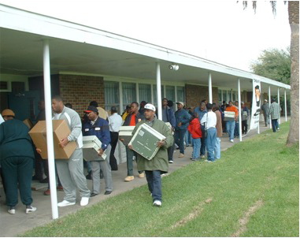
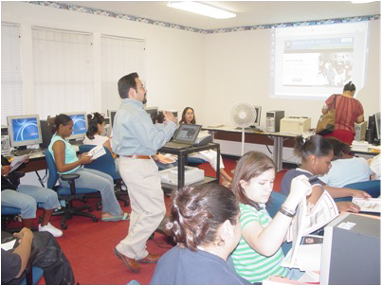

Technology For All Wireless Project
2003 NSF ITR grant on “Transit Access Points”
Houston Chronicle front page story
Challenge from Technology For All founder
  Mission: “Empower under-resourced communities through technology”
  Missing link: broadband access

Slide 3
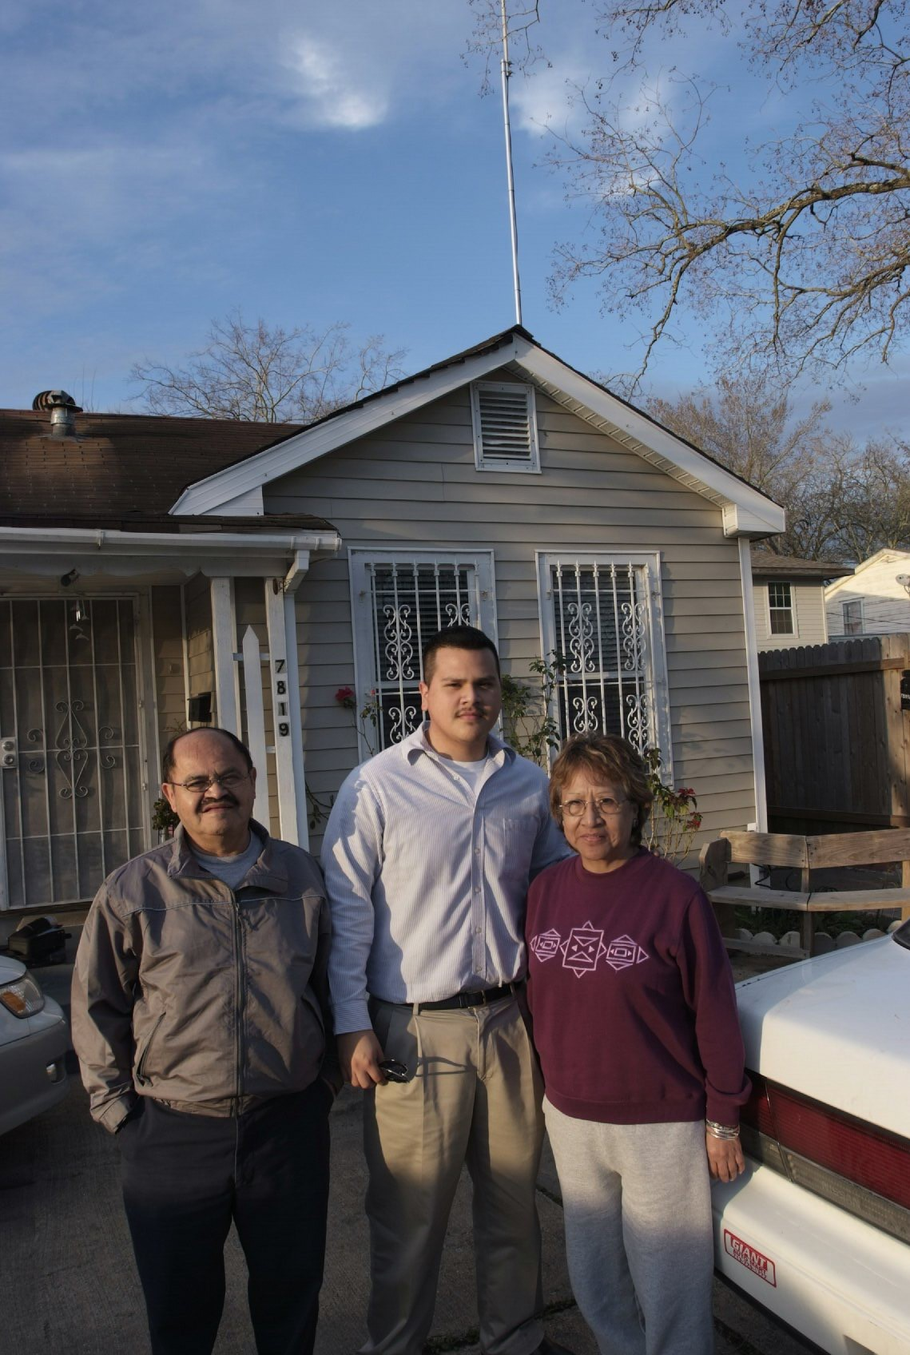
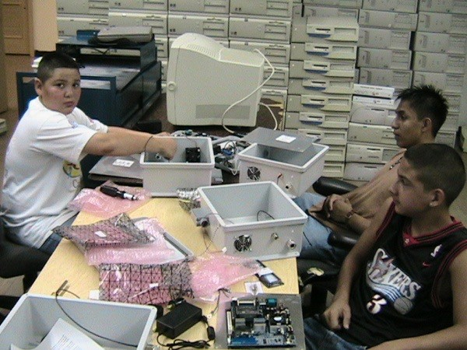
Lab to Urban Field Trial
Expanded goal: urban-scale deployment
Custom s/w and h/w TAPs
  Access tier for all neighbors in the block
  Multi hop backhaul to inter-connect
  Capacity injection to scale capacity

Slide 4
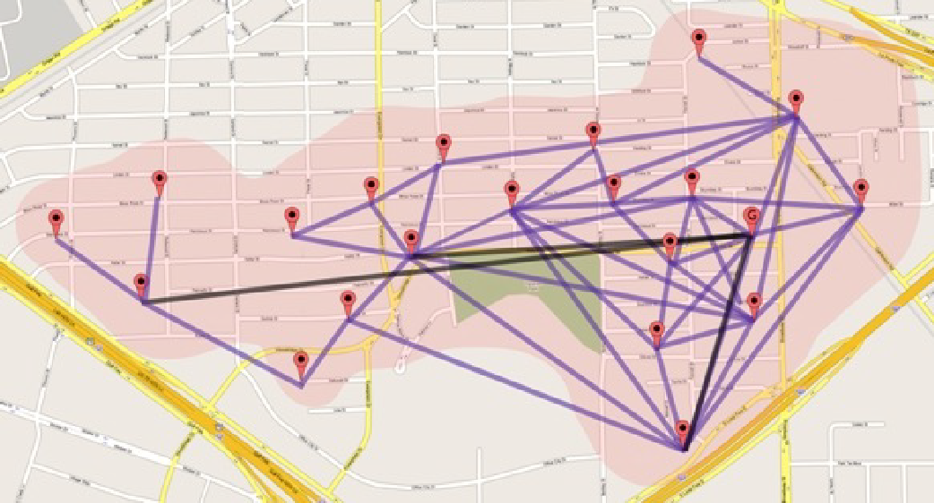
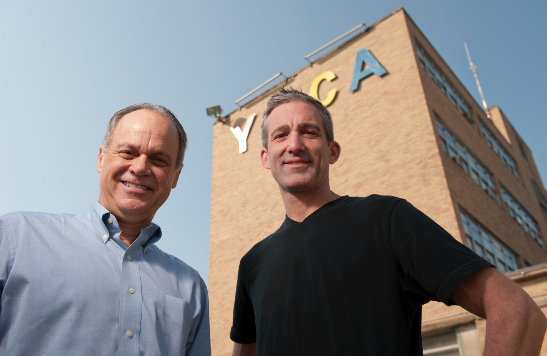
Result: First Multi-tier Urban Mesh Network
ISP for over 1,000 users/km² in Houston’s under-served under- resourced neighborhoods
At scale experimental research in wireless networks
  Asymmetric topology and starvation
  Network architecture
  Multi-hop congestion mechanisms
  Network measurement and modeling

Slide 5
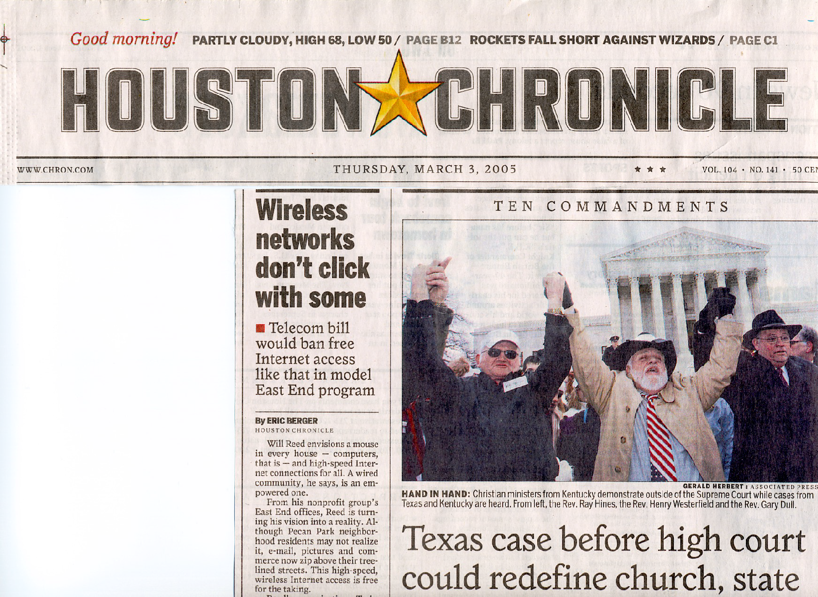
Outlawed?

Slide 6
Impacts
Disruptive industry shift
  Wi-Fi as a public Internet entry point
  Mesh networking industry: $5B today
Standards
  IEEE 802.11s (mandatory since Wi-Fi 5)
Societal: Broadband for underserved communities
  Transformative impact for education and job search
  Previously, “digital citizen” limited to higher incomes

Slide 7
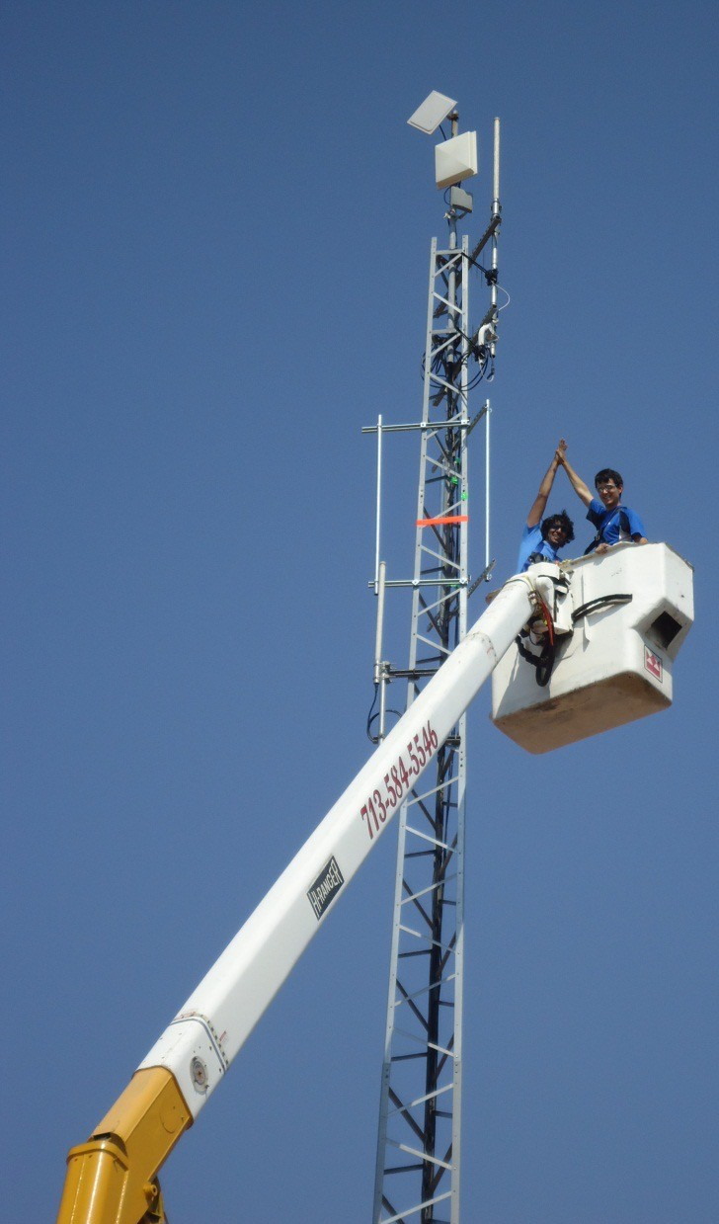
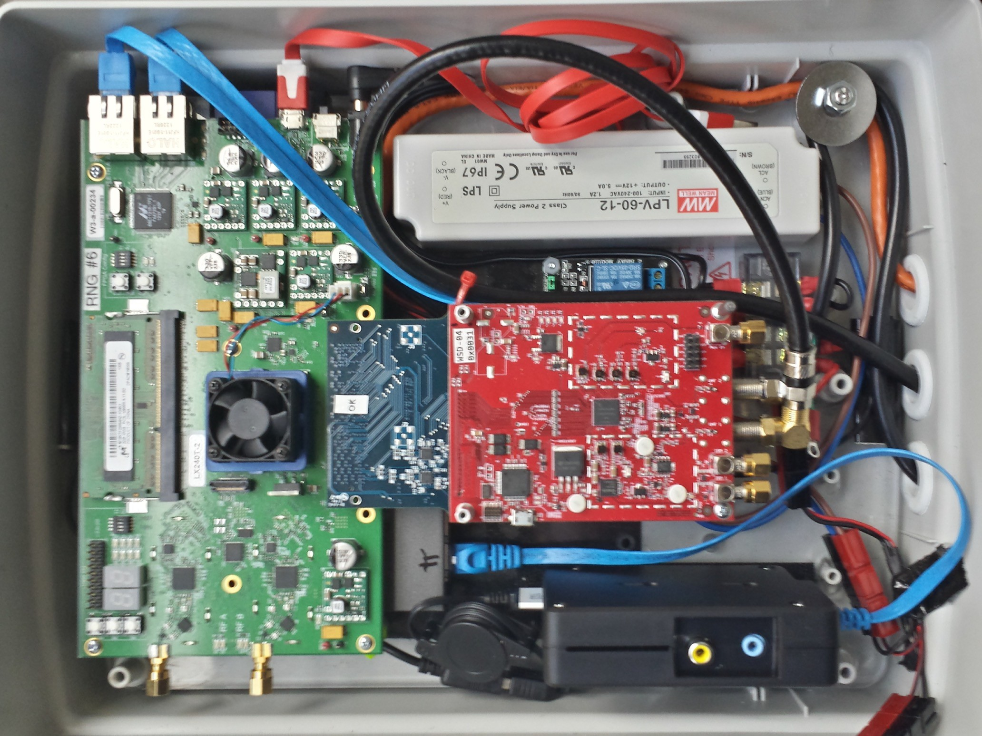
Houston Super Wi-Fi Trial
Community challenge: reliability (coverage gaps)
NSF NetSE large and MRI
First residential Super Wi-Fi
  Unused UHF TV channel
  Tower to home
– Research in spectrum sharing and
diverse spectrum access
TAPs FPGA
and custom UHF front end

Slide 8
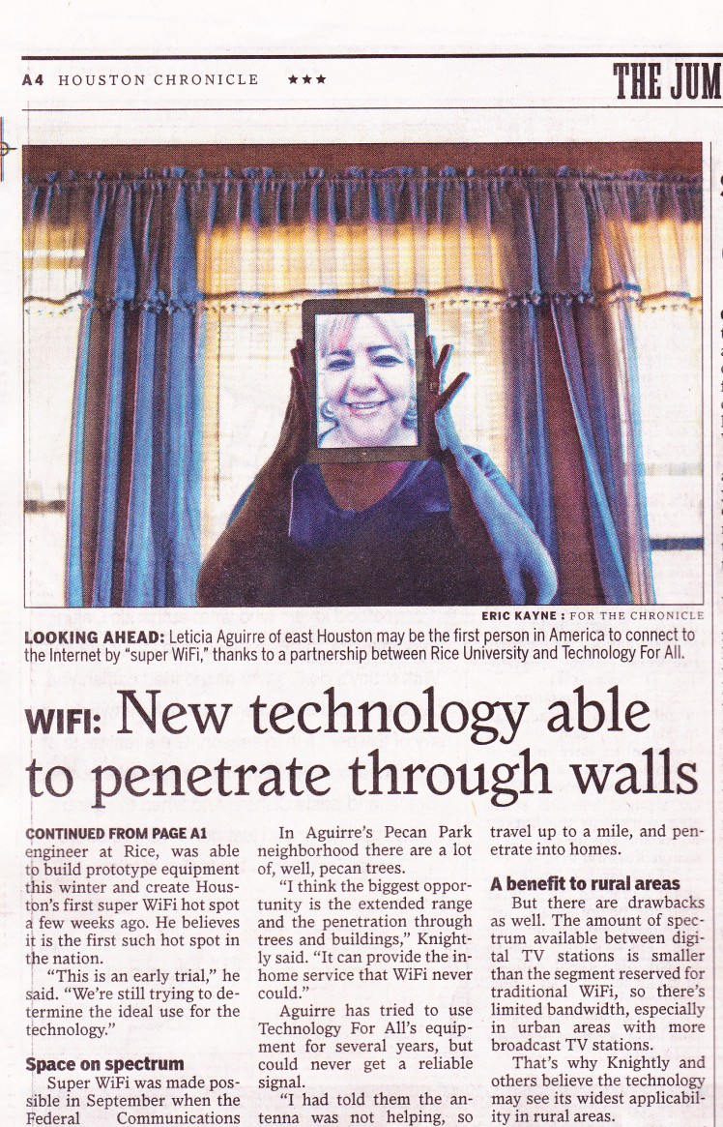
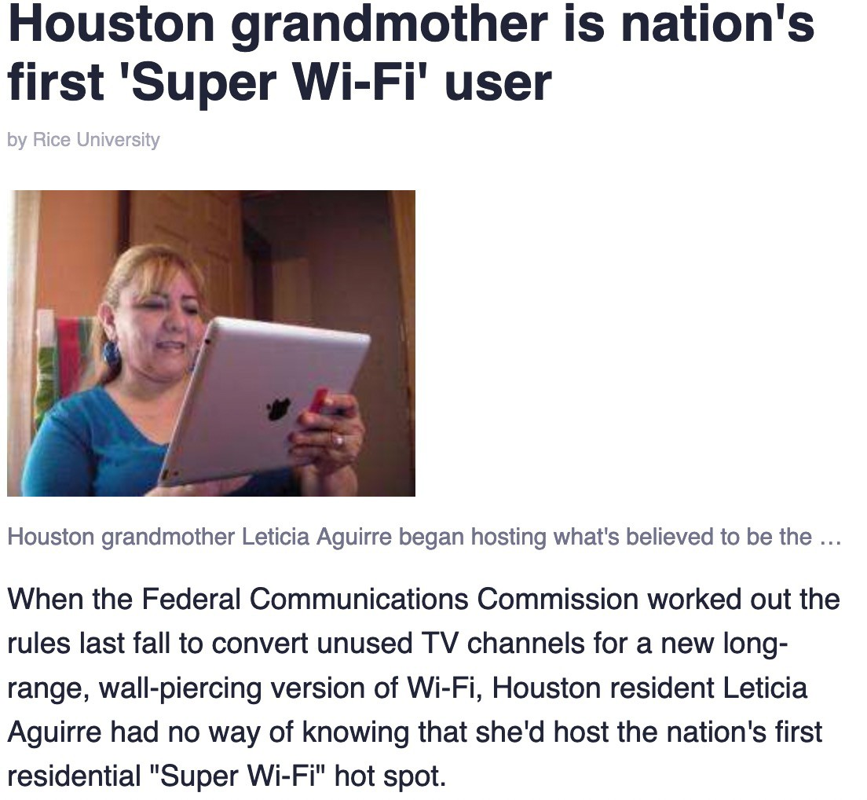

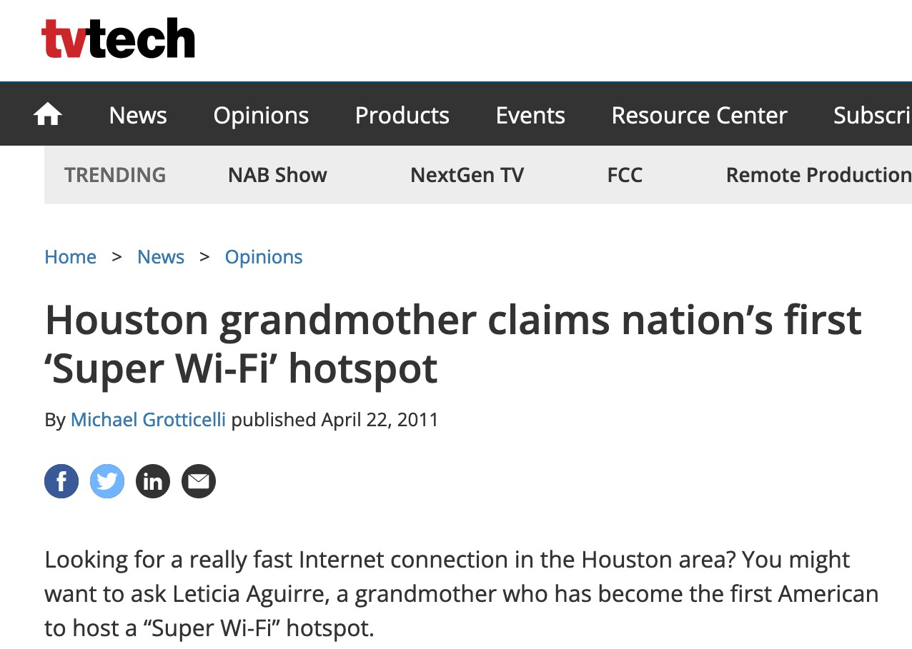

The Press…

Slide 9

Next Day…
Incumbents (TV broadcasters) did not want to share spectrum
Critical for operational network to demonstrate value of shared spectrum and unlicensed spectrum

Slide 10
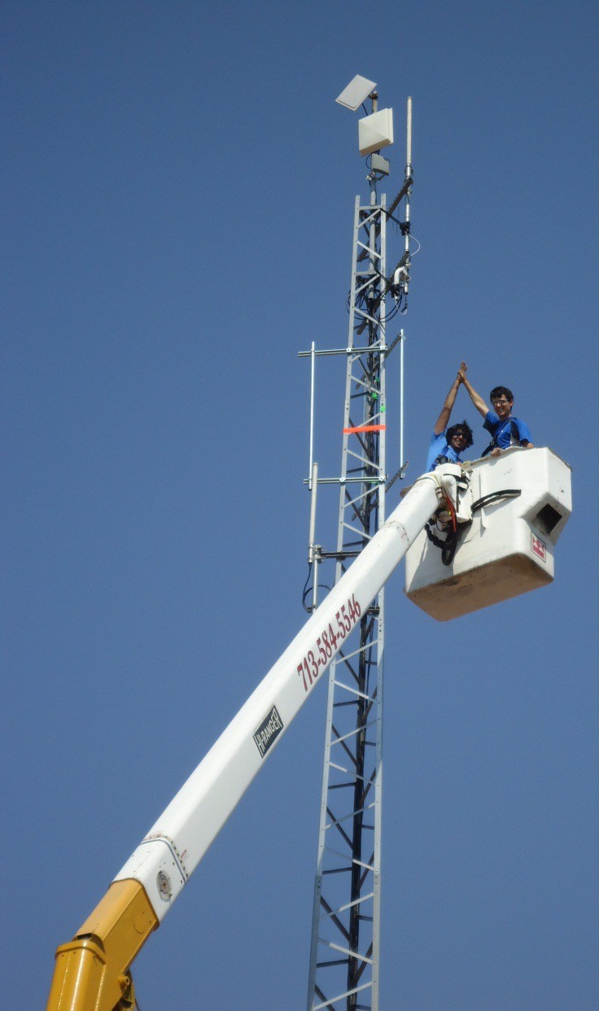


Today…
FCC continues to open spectrum for unlicensed and shared access
Spectrum sharing capabilities in Wi-Fi APs
– Wi-Fi in 6 GHz bands
5G deployments in CBRS and diverse spectrum
Spectrum from 100 MHz to 6 GHz
Massive MIMO

Slide 11

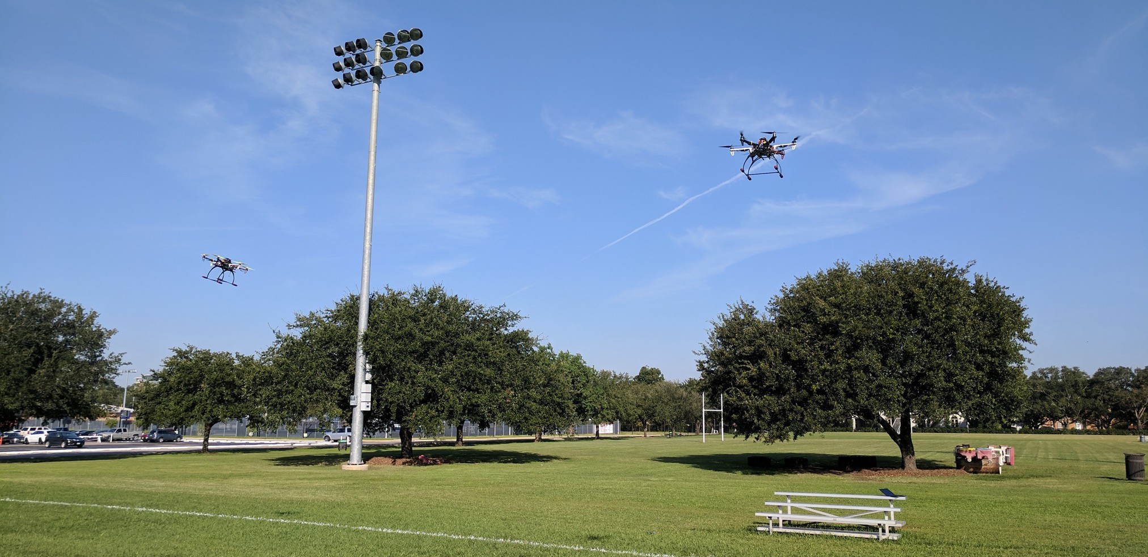
Looking Forward: The Next Wireless Network
New capabilities and performance milestones
  Tb/sec, mobile, low latency, robust, and secure
Millimeter wave to sub-THz spectrum
  GHz vs. MHz scale bandwidth
  High resolution sensing fused with communications
  High directivity for spatial multiplexing
Newly enabled applications
  High resolution sensing with UAV networks
  Wireless virtual and augmented reality: 10’s of Gb/sec/m²

Slide 12
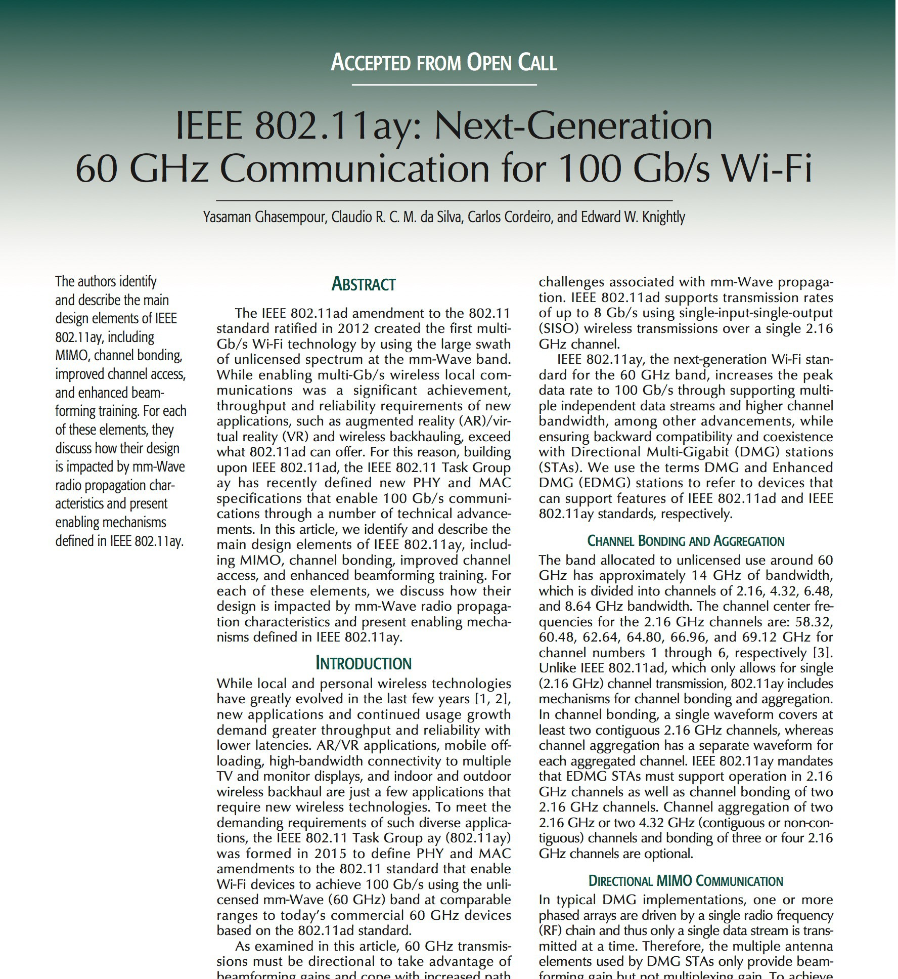
State of the Art: Wi-Fi at 60 GHz

Slide 13




Wi-Fi at 60 GHz
Antenna array with analog/RF beam steering
Predefined codebook weights create virtual “sectors”
Up to 128 sectors per device (3° beam width)
Mechanisms to select and adapt sectors
Multiple streams (MIMO) for 11ay
!"
%
"
!#
%#
RF
!$
%$
!"
%
"
!#
%#
RF
!$
%$
Edward Knightly

Slide 14


Wi-Fi Beam Training
Sector Level Sweep
  Test transmission in each direction
  Transmit sector ID coded in transmission
  Receiver “quasi omni-directional” antenna pattern
  Receiver identifies strongest TX sector and feeds back
  Repeat in both directions

Slide 15
Wi-Fi Beam Training
Sector Level Sweep
  Test transmission in each direction
  Transmit sector ID coded in transmission
  Receiver “quasi omni-directional” antenna pattern
  Receiver identifies strongest TX sector and feeds back
  Repeat in both directions

Slide 16




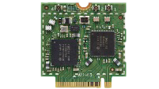
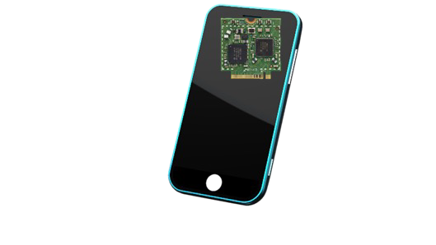

Directional Beams and Mobility
Sector sweep yields best beam pair, until…
Mobility-induced beam misalignment
rotation
translation

Slide 17



Directional Beams and Mobility
Blockage due to environmental mobility

Slide 18


Directional Beams and Mobility
Blockage due to environmental mobility

Slide 19
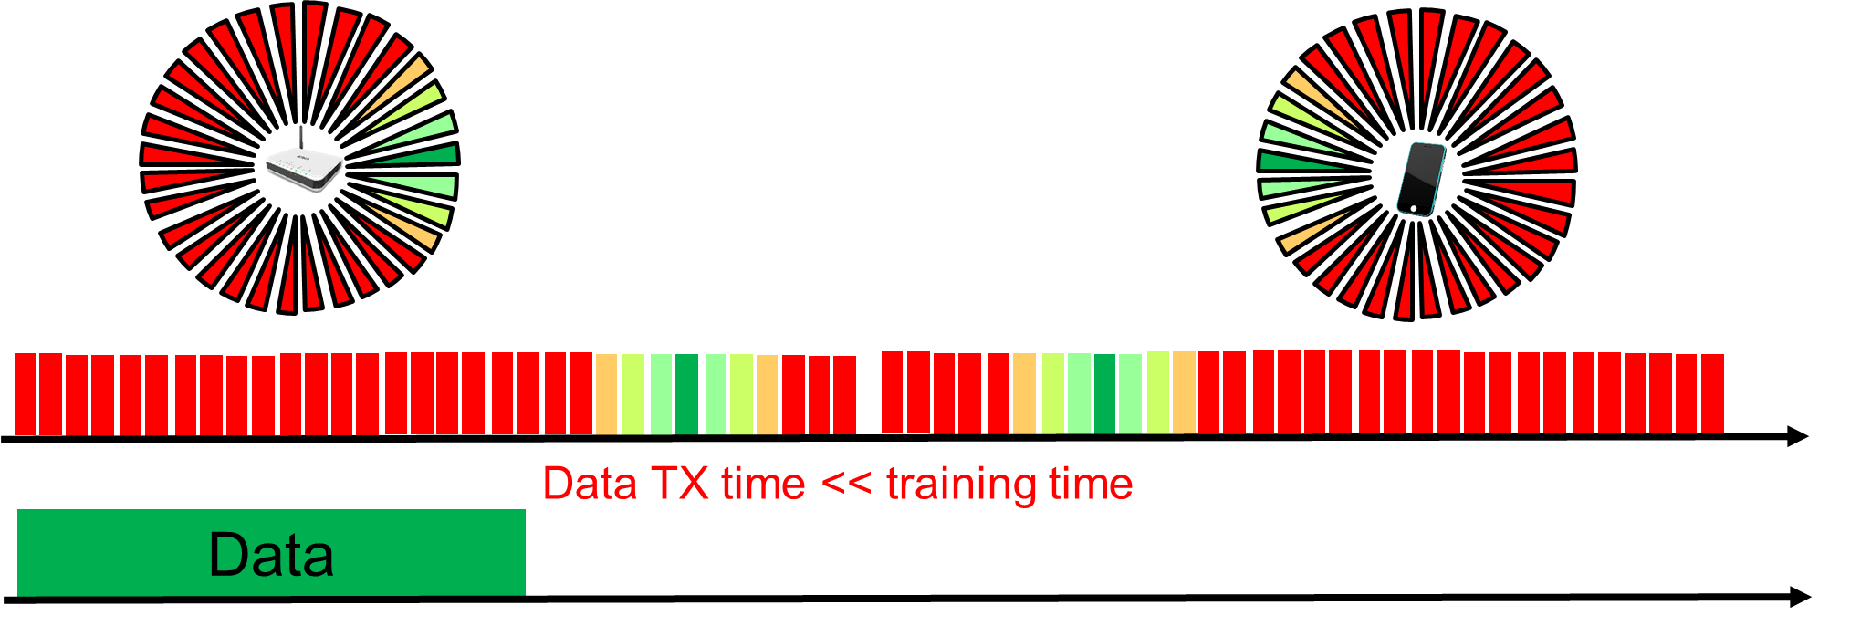
Timescales of Mobility Induced Outage
Blockage and misalignment can break links
  Temporary outage until re-aligned
Training overhead to recover from link breakage
  Training time can exceed data transmission time
  Each sector is a short control message with PHY/MAC headers
  Exhaustive search over all sectors at both ends

Slide 20
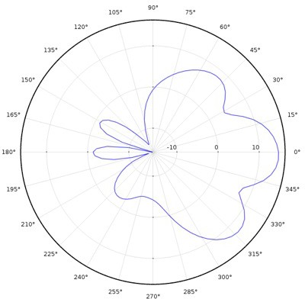
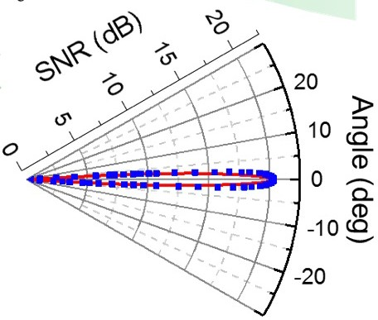
Control Plane Challenge
Frequent re-training and overhead to maintain directional link can yield throughput << PHY rate
High directivity for higher data rate increases control plane overhead
Can we rapidly re-steer beams?

Slide 21
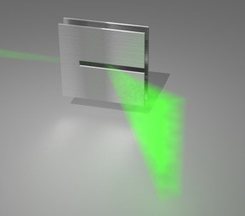



“New” Devices Above 100 GHz
Leaky Wave Antenna (LWA)
  Metal parallel-plate waveguide
  Narrow slot open in one side
  Angular dispersion: higher input frequencies emit at lower angle
b
𝑐
𝜙
!
𝜙# = sin
$%
2𝑏𝑓
𝑧
𝜙!
𝜌

Slide 22
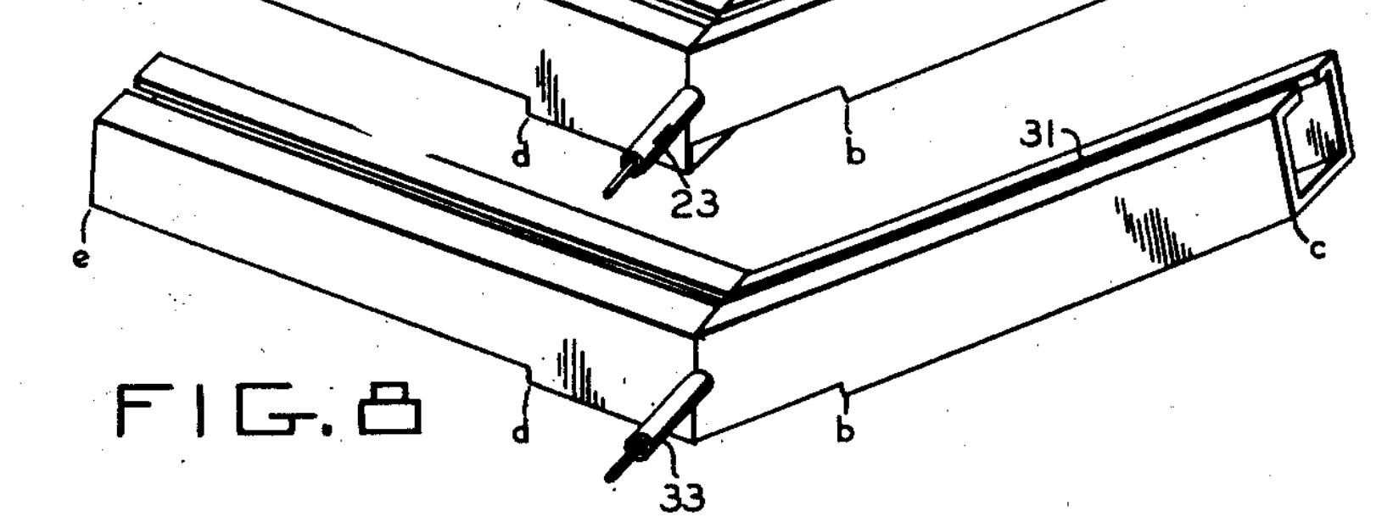
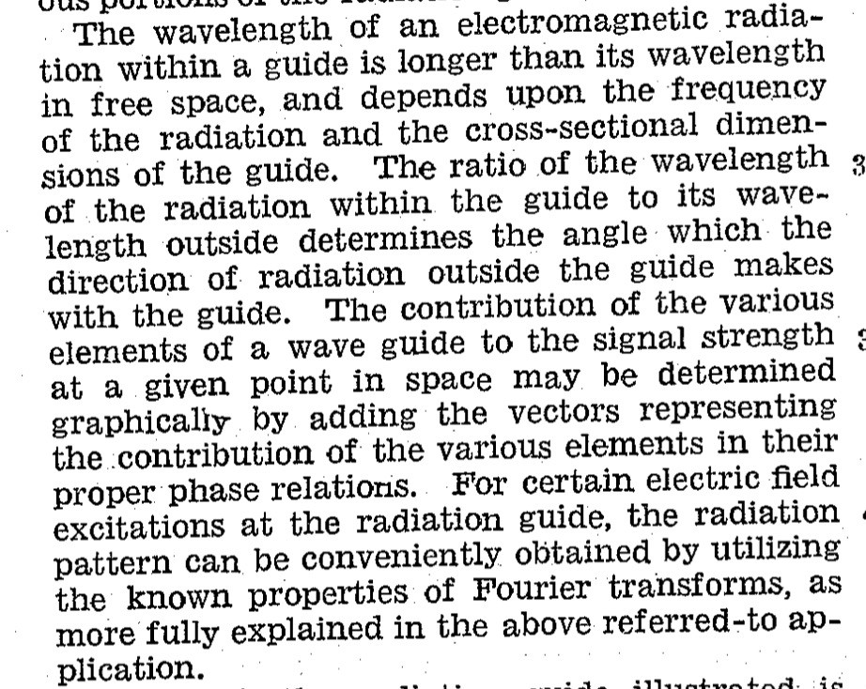

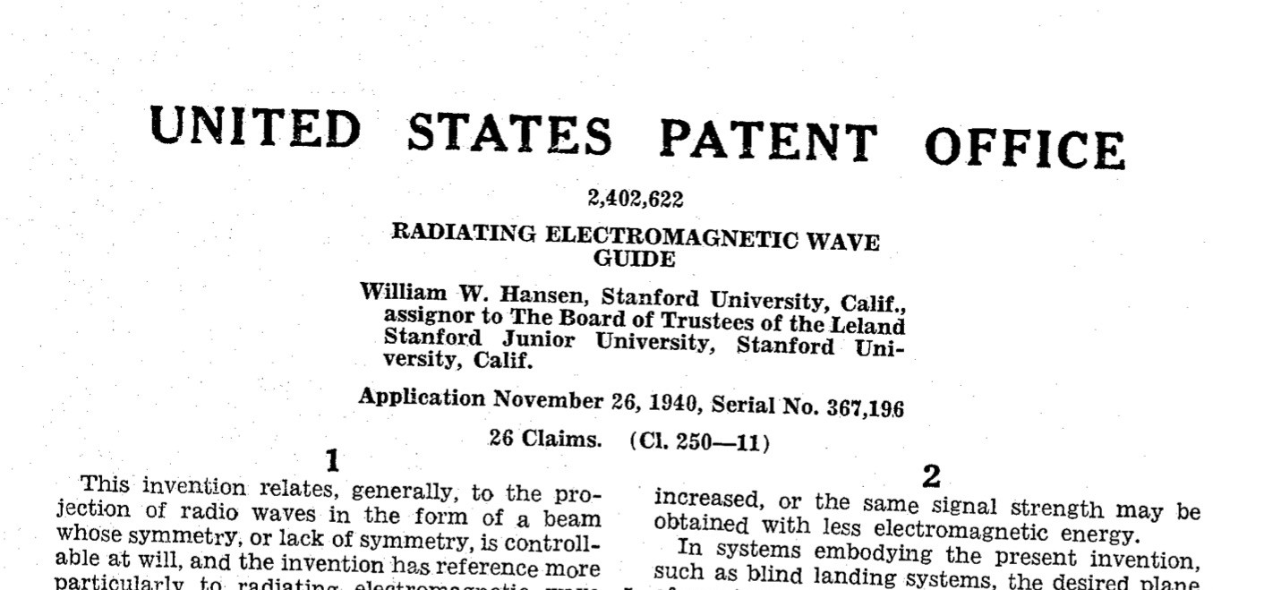
Leaky Wave Antenna

Slide 23
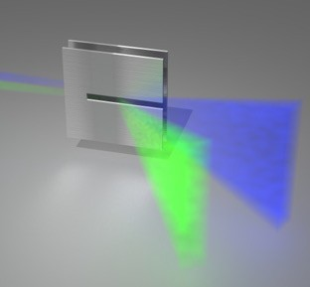
Couples Emission Angle & Frequency
𝑐
0.9
𝜙 = sin$%
#
2𝑏𝑓
0.8
Spectral Peak (THz)
0.7
0.6
0.5
0.4
0.3
0.2
f (THz)
0.1
10
20
30
40
50 60
∅! (𝑑𝑒𝑔𝑟𝑒𝑒𝑠)
70
80
Emission Angle (°)
^{f}blue ^{>f}green
Yields highest frequency beam steering mechanism to date
One antenna beam steering (without phased array, without MIMO)
Where to steer? Where is the client?

Slide 24
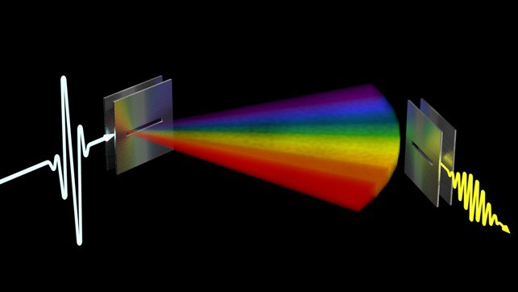
Key Idea: THz Rainbow
Idea: excite the Leaky Wave Antenna with a broadband pulse (all frequencies!)
Emits in all directions
Each direction has its own spectral signature

Slide 25
One Shot Location Discovery
With a single nano-second scale transmission, all receivers know their relative angle
  No trial-and-error testing of directions
  No phase information needed
  No array signal processing

Slide 26
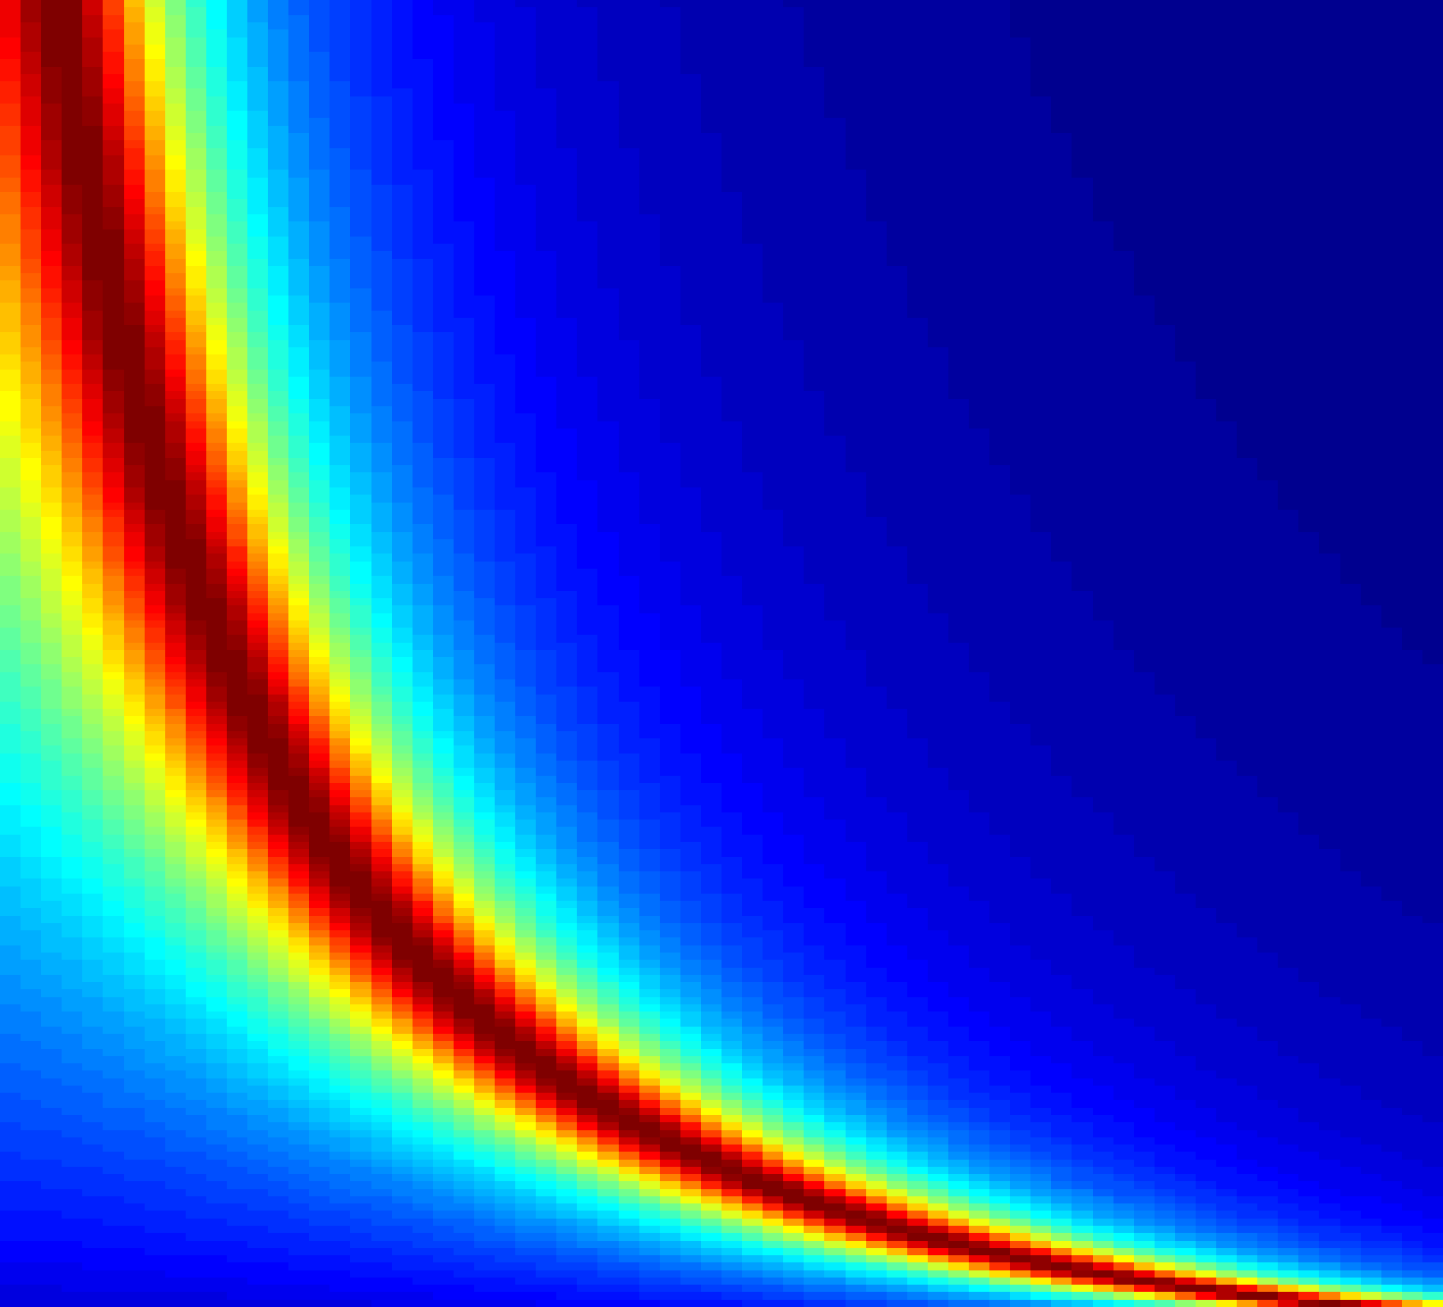
Modeling Reception
Maxwell’s Equations predict peak emission angle
Can also characterize decay as move off peak using LWA parameters
𝑐
E (�) = sinc ρ_{Λ}(k_{PPWG} − jα − k₀ cos �)(L 2)7_{ϑ}
𝜙 = sin$%
#
2𝑏𝑓
0.9
1
0.6
0.9
0.8
0.8
Spectral Peak (THz)
0.7
Frequency (THz)
0.7
0.5
0.6
0.6
0.5
0.4
0.5
0.4
0.4
0.3
0.3
0.3
0.2
0.2
0.2
0.1
0.1
10
20
30
40 50
Emission Angle (°)
60
70
80
Edward Knightly
10
20
30
40 50
Angle (degrees)
60
70
80

Slide 27
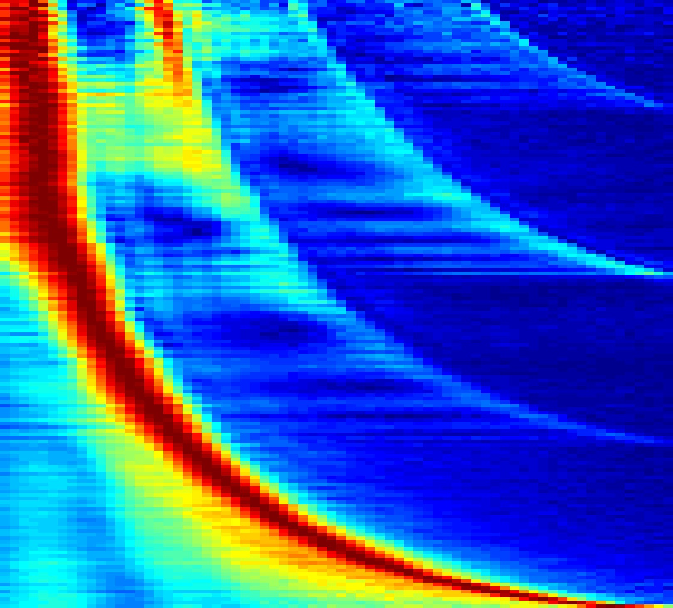
Inference Approach
Spectral signature for each angle of the rainbow
  Inspired by EM analysis
  Angle of arrival estimate is best match
  LWA imperfections and higher modes (TE₂, TE₃, and TE₄)
Theory vs. Practice
1
1
0.9
0.9
0.6
0.6
0.8
0.8
Frequency (THz)
0.5
0.7
Frequency (THz)
0.5
0.7
0.6
0.6
0.4
0.5
0.4
0.5
0.4
0.4
0.3
0.3
0.3
0.3
0.2
0.2
0.2
0.1
0.2
0.1
10
20
30
40 50
Angle (degrees)
60
70
80
10
20
30
40 50
Angle (degrees)
60
70
80
Edward Knightly

Slide 28
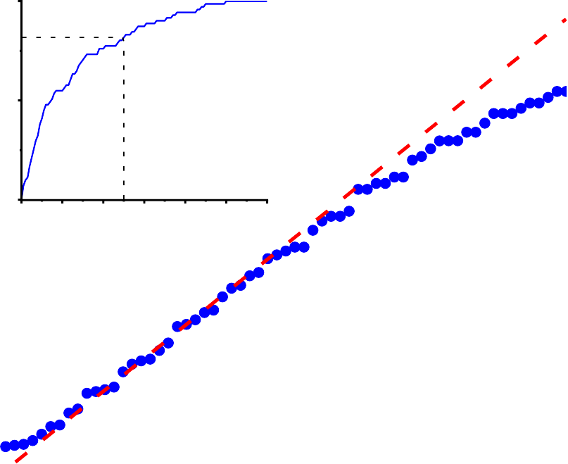
Angle Inference Accuracy
AoA estimation error
< 5º in over 80% of cases
Spectrum only, no phase information needed
A single-shot measurement
80
Empirical distribution function
1.0
70
0.5
Estimated angle (degrees)
60
0.0
0
2 4 6 8 10
Estimation error (degrees)
12
50
40
30
20
10
30 40 50 60
Measured angle (degrees)
10
20
70
80
Y. Ghasempour et al., Nature Communications, 11(1):2017, April 2020.

Slide 29
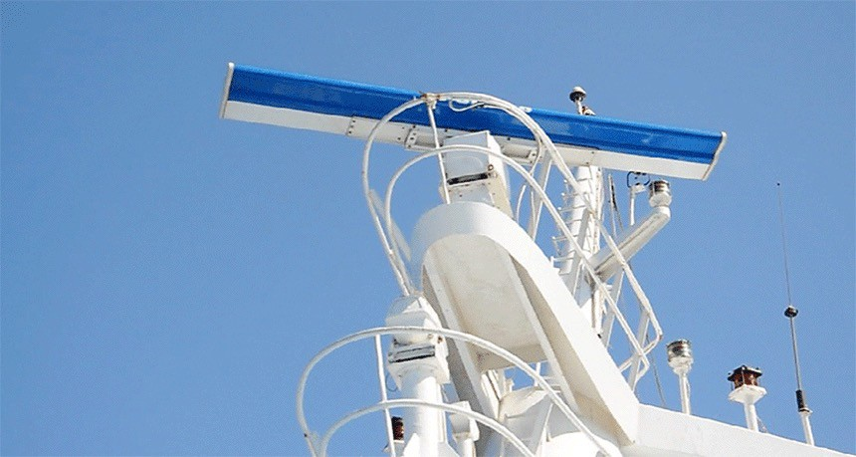
Radar
Radar sweeps directions, mechanically or electronically
Image source: Wikipedia

Slide 30

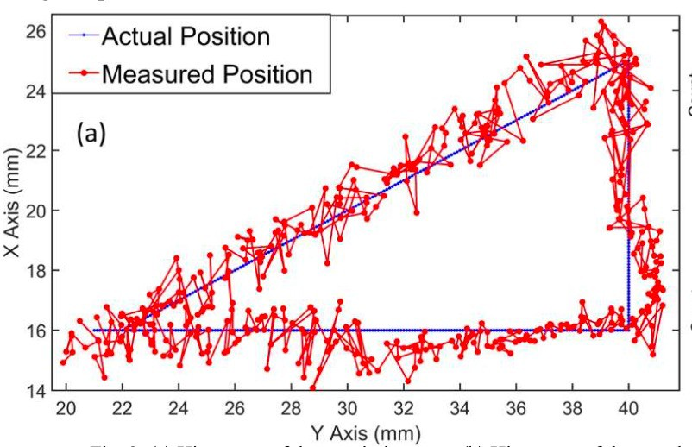

New Sensing Capabilities
THz Radar with LWA: frequency embeds location information
Experiment (Mittleman Lab): move metal rod with 10 mm radius along triangle
  Accuracy of 1 mm and 1.2º
  Real time computation 200 msec
Object
R
φ
leaky-wave waveguide
Y. Amarasinghe et al., Optics Express 28, 17997 (2020)
Edward Knightly

Slide 31
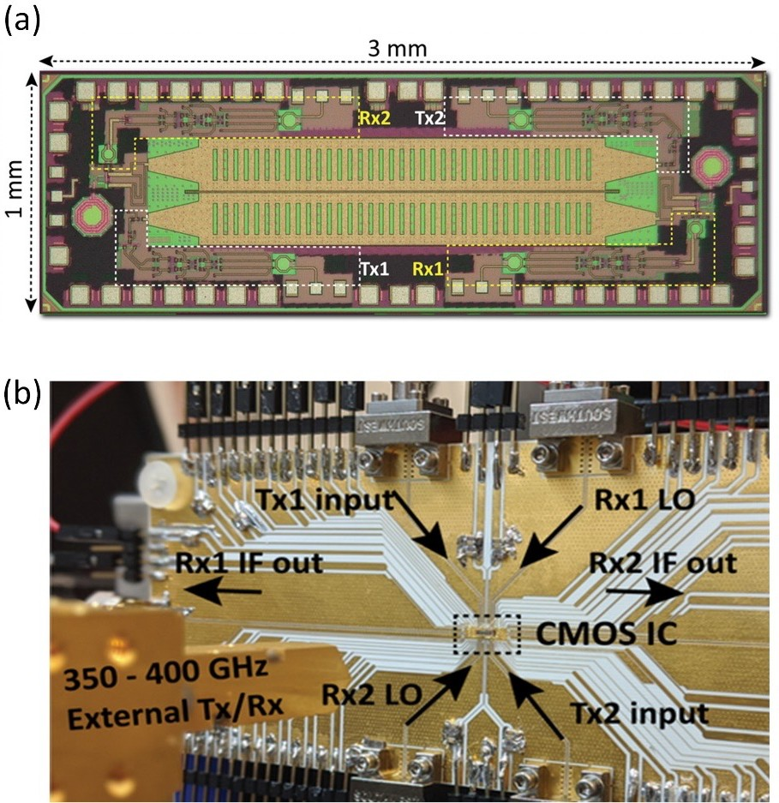
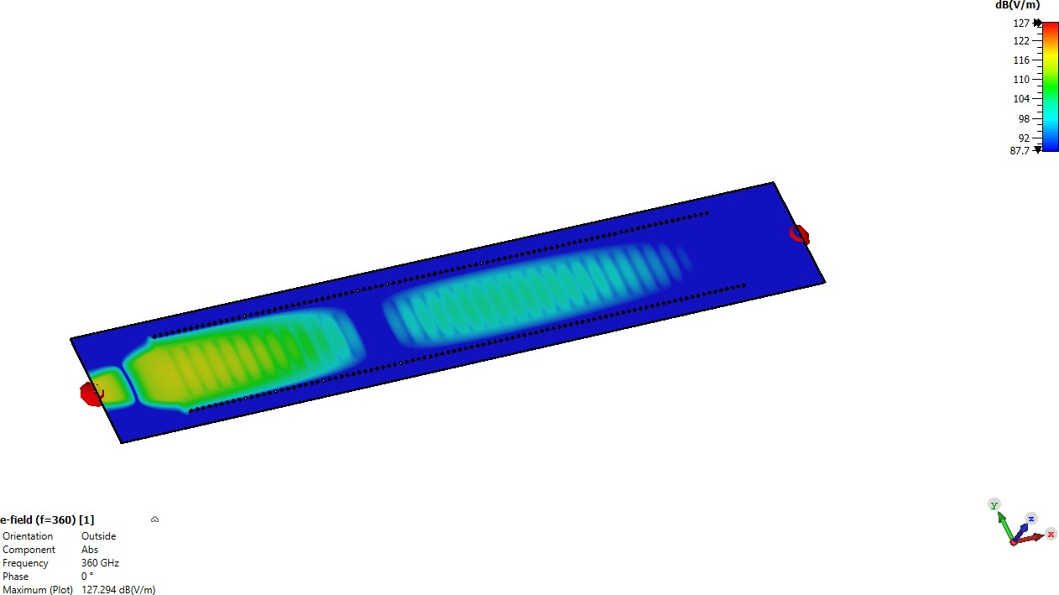
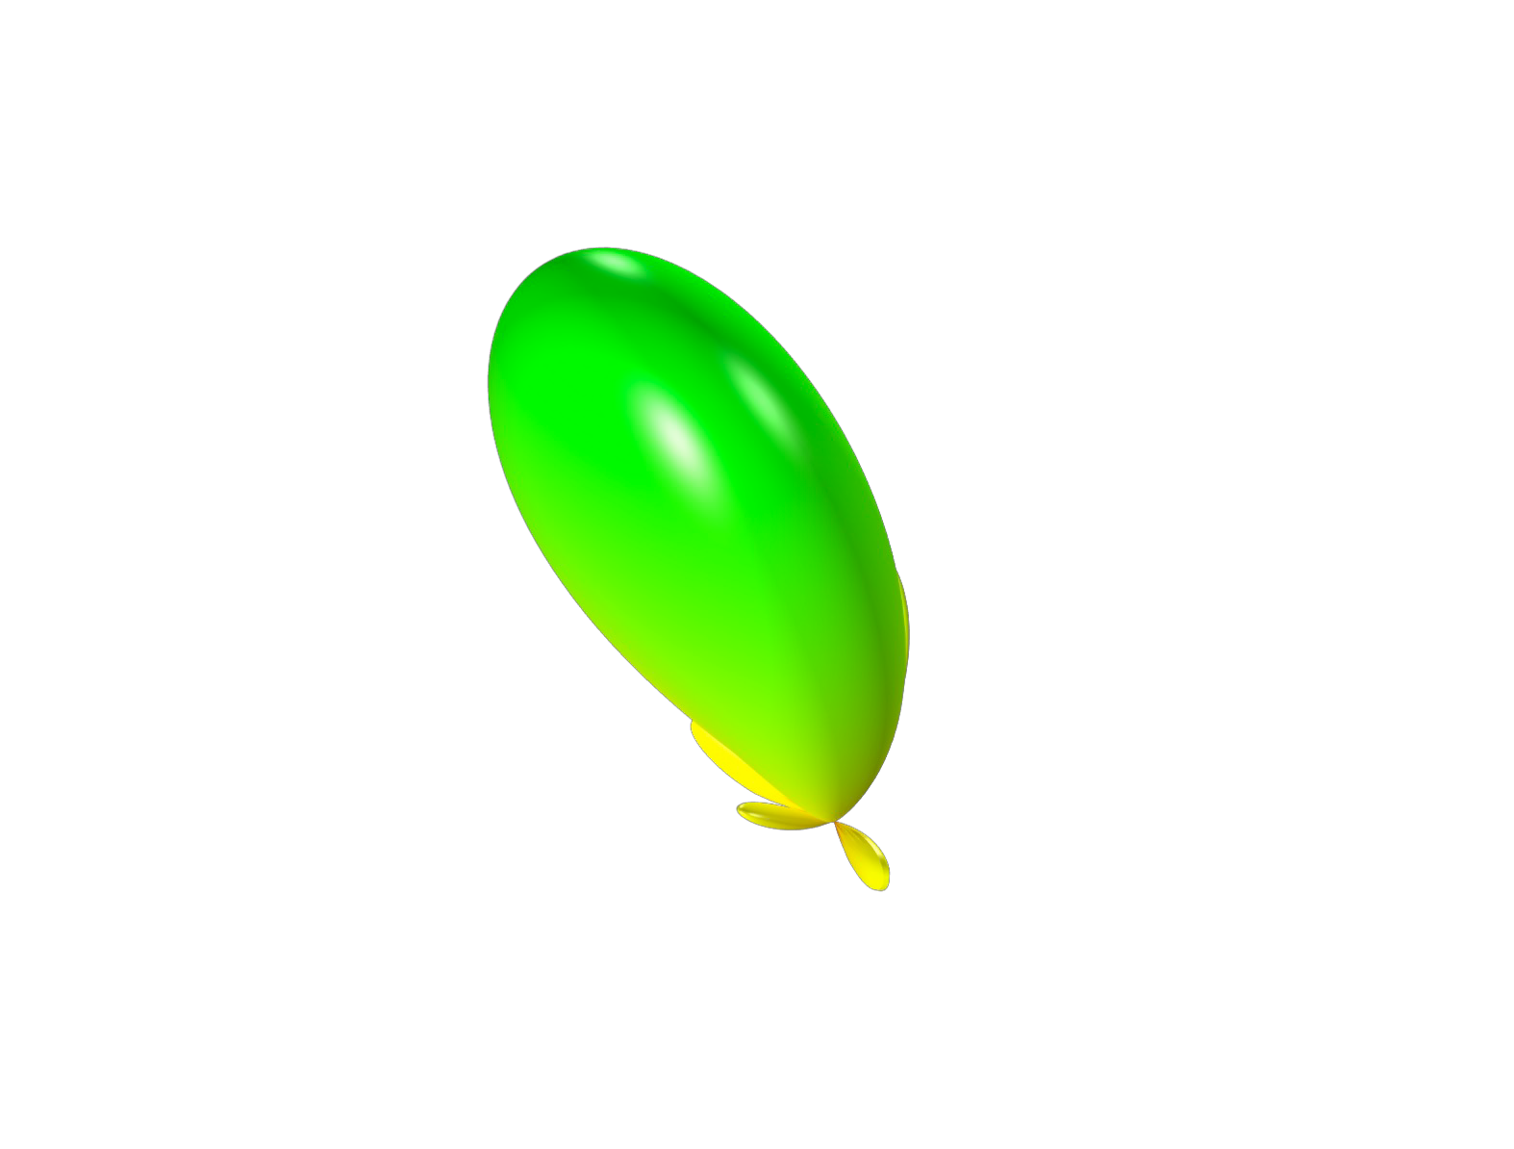
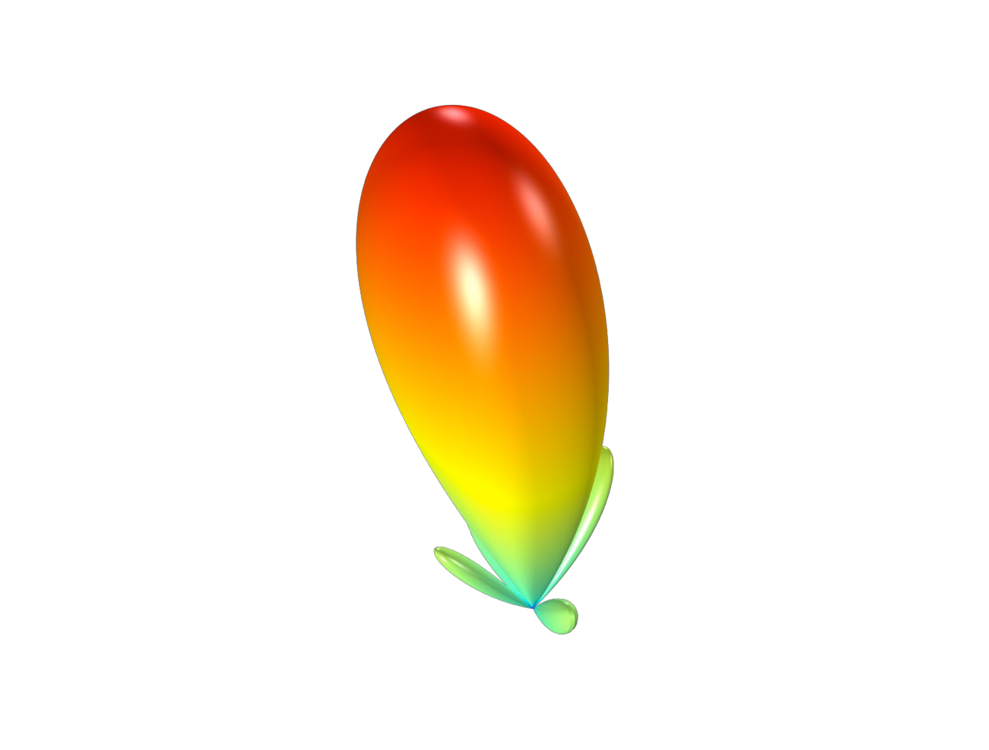




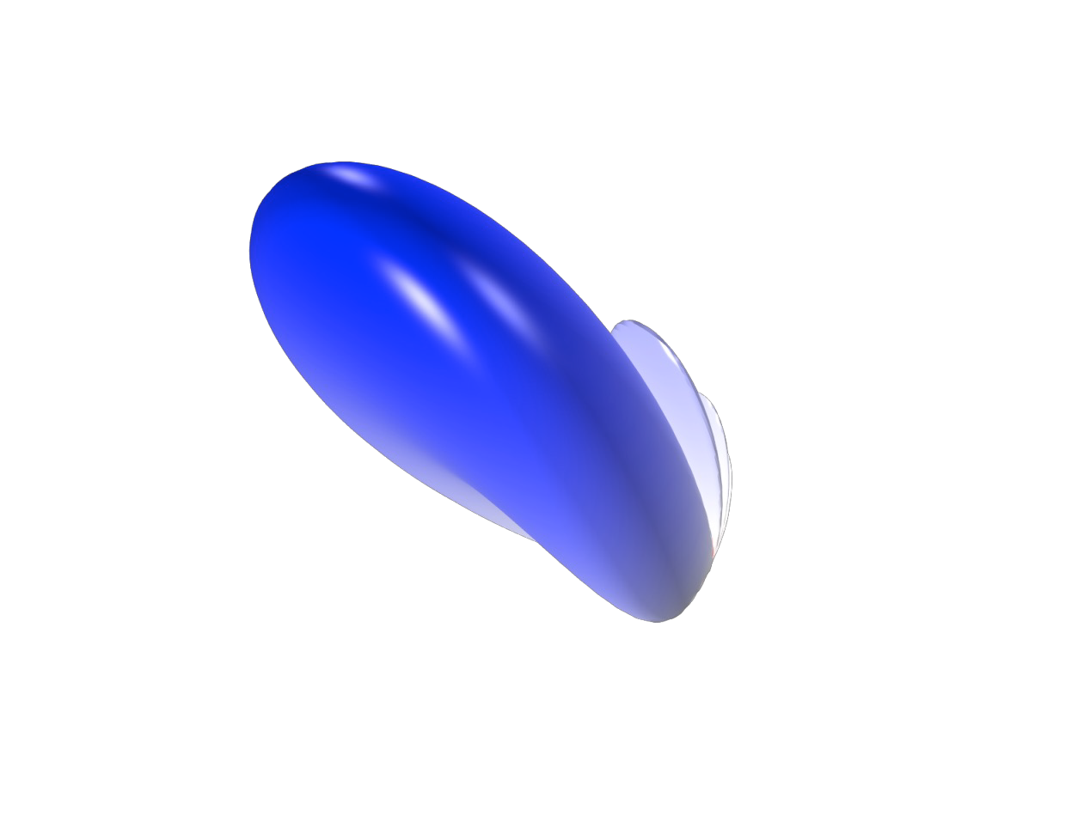
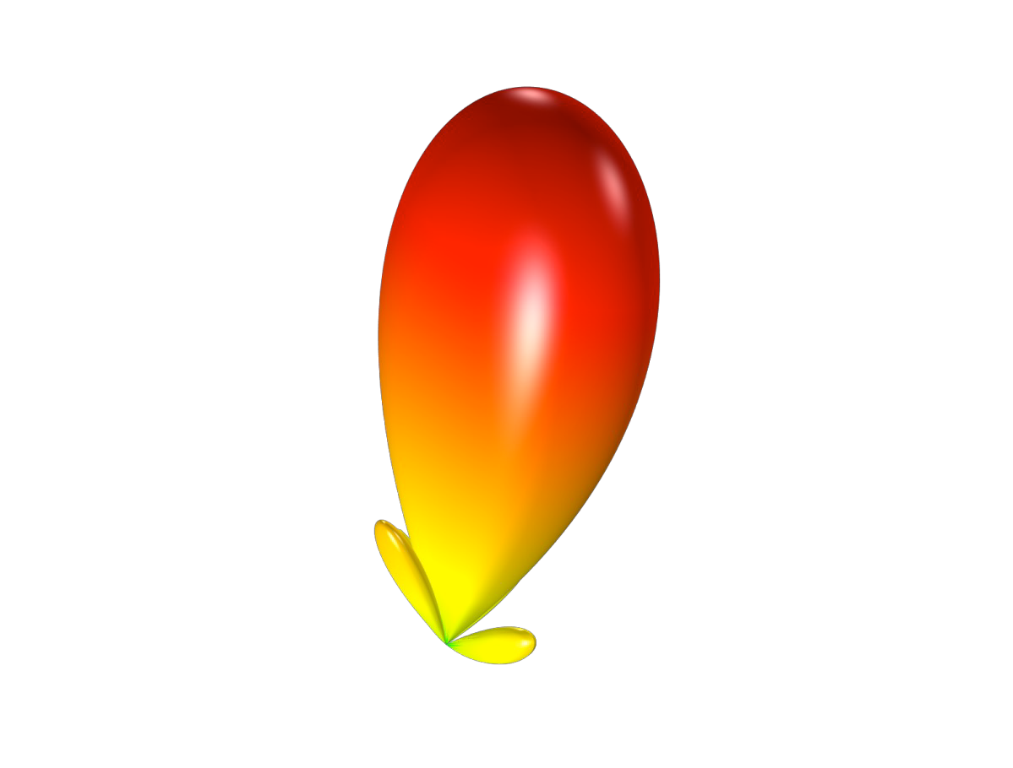
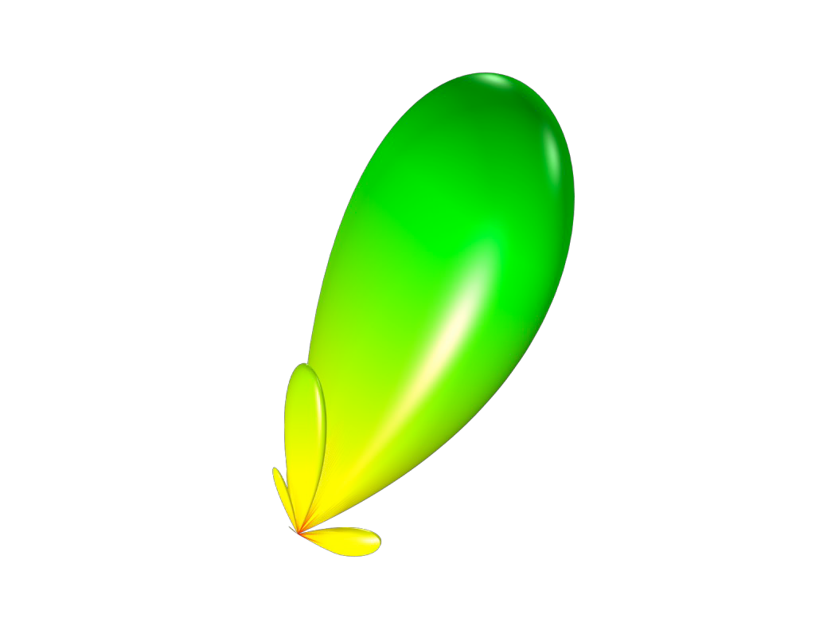


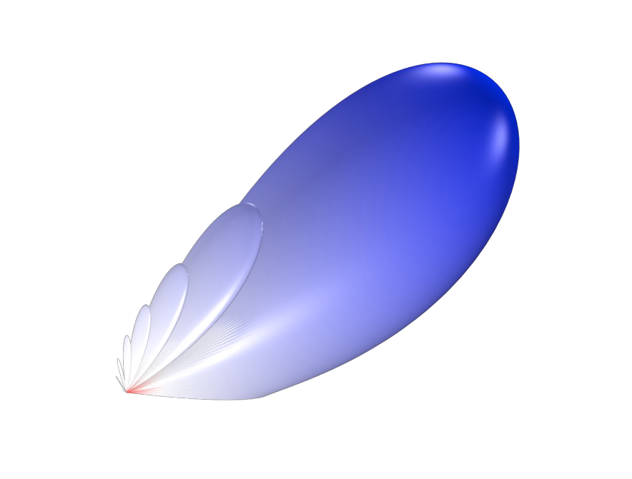
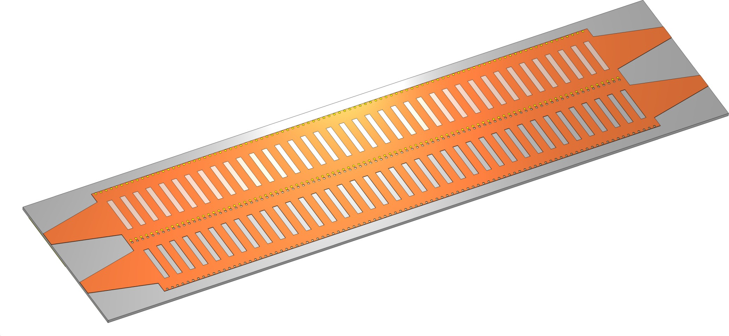
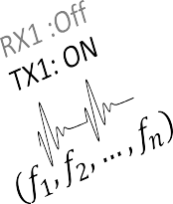
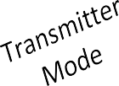

CMOS Circuit Realization from 360-400 GHz
𝑃𝑜𝑟𝑡 3
𝑃𝑜𝑟𝑡
4
𝑃𝑜𝑟𝑡 1
𝑃𝑜𝑟𝑡 2
H.Saeidi, et al., "THz Prism: One Shot Simultaneous Localization of Multiple Wireless Nodes with Leaky-wave THz Antennas and Transceivers in CMOS," IEEE J.Solid-State Circuits , vol. 56, no. 12,
pp. 3840-3854, Dec. 2021.

Slide 32
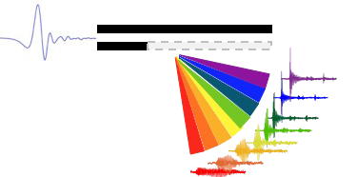
Sensing and Communication Take Away Message
Beam ID x
Phased array
Unique ID for each beam
Trial-and-error testing
micro-second scale
Array processing localization
New devices and physics
Single antenna
Spectral signature at each angle
All directions at once
Nano-second scale
Fast high-resolution radar

Slide 33





Final Challenge
Final Challenge:
Blockage without Specular NLOS Path
Blockage due to environmental mobility
Suppose there is no wall

Slide 34


Final Challenge
Final Challenge:
Blockage without Specular NLOS Path
Blockage due to environmental mobility
Suppose there is no wall
Objective: curve the beam around the obstacle

Slide 35
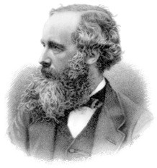
Programming Wavefronts
Can we curve a beam? Does Maxwell object?
Airy beams
  Quadratic path
  Satisfy Maxwell’s Equations
  A solution to Helmholtz equation
How to generate one?

Slide 36
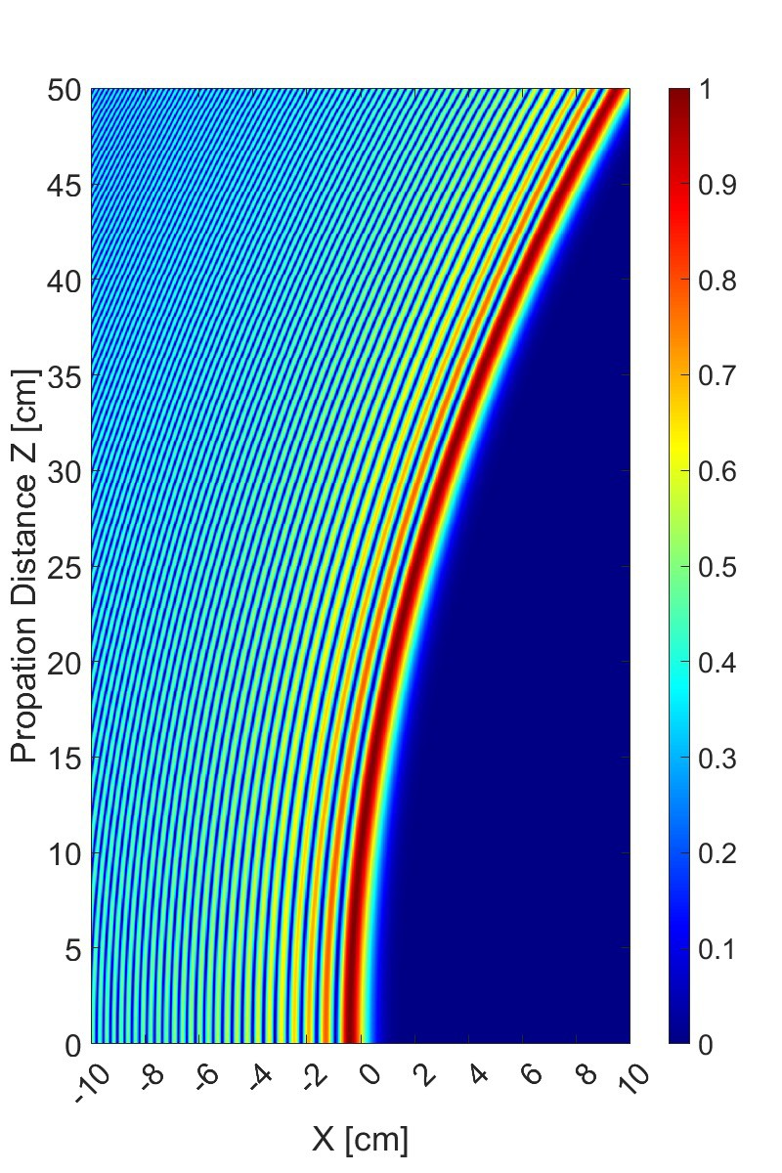


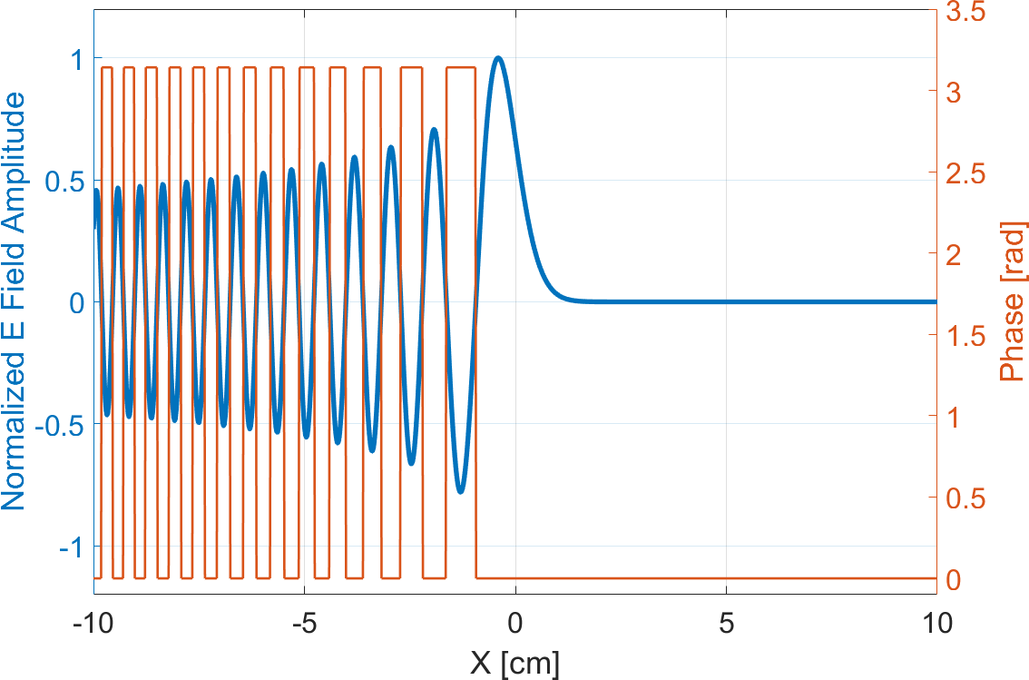
Airy Beam Theory
Launch wave with initial spatial profile (amplitude and phase of radiating elements located at position x):
𝑥
Yields a quadratically curved wave
Φ 𝑥 = 𝐴𝑖𝑟𝑦 𝑒𝑥𝑝 𝑎 ^{𝑥}
𝑥₎
𝑥₎
1
* _{𝑡}+
𝐴𝑖𝑟𝑦 𝑥 = _{𝜋} -
cos ₃ + 𝑥𝑡
𝑑𝑡
)

Slide 37
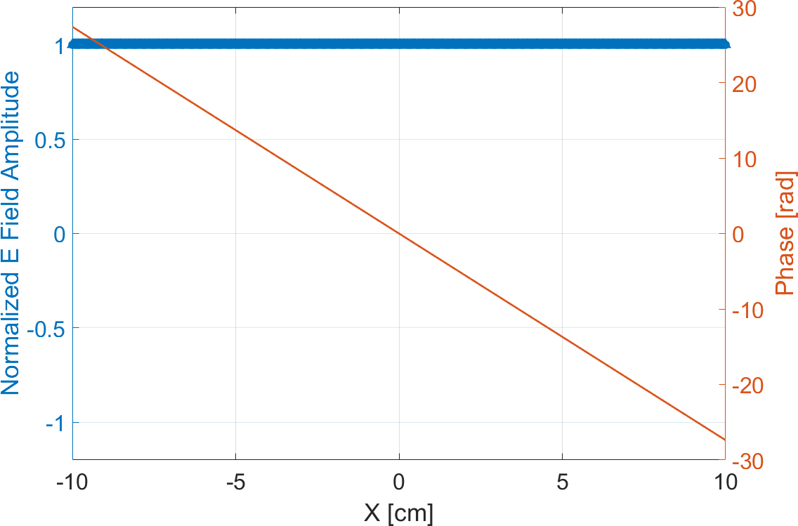
Airy Beam vs. Traditional Beamforming
Beamforming
Constant amplitude profile
Linear phase profile (slope controls steering direction)
Airy beam
Non linear amplitude profile
Alternating phase profile [0, 𝜋]

Slide 38
How to Realize Airy Profile
Approach
  Discretize the Airy beam’s spatial profile Φ 𝑥
  Radiate waves from multiple points in space, each wave having the required profile
Transmit maximum
amplitude and no
Solution space
  Antenna array: lacks the spatial resolution and array size
  Metasurface: 2-D structure with sub- wavelength meta-atoms that shape wave’s profile
phase offset here
Transmit nothing here (near 0)

Slide 39
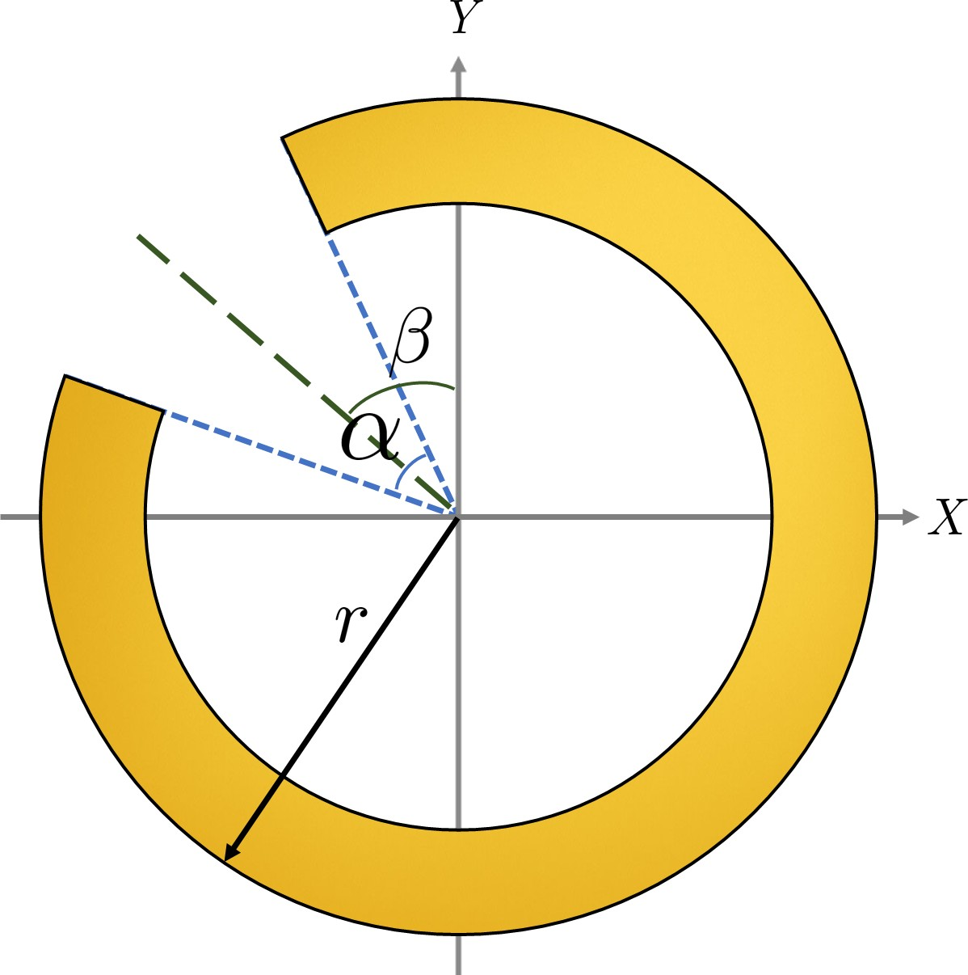

Building Block: Meta Atom
Meta Atom: radiating element
  Sub-wavelength size metallic structure
  Acts as a very small antenna
  Split Ring Resonator
  Parameters to control amplitude, phase, and polarity
    radius 𝑟
    opening angle 𝛼
    orientation angle β
Atom-by-atom configuration
  Working together, provide the desired function Φ 𝑥

Slide 40
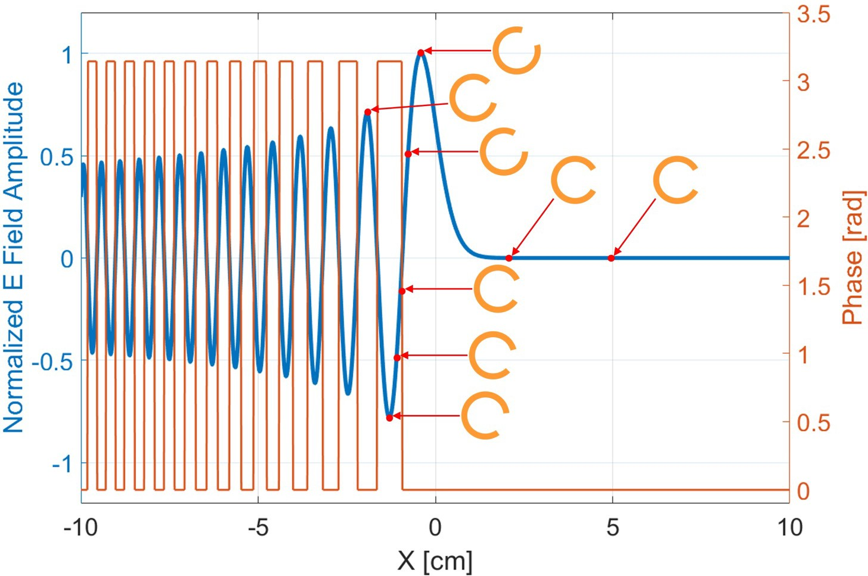

Airy Metasurface Design
Select meta-atom orientation to match the function Φ 𝑥
Tile on the metasurface (in columns along x)

Slide 41
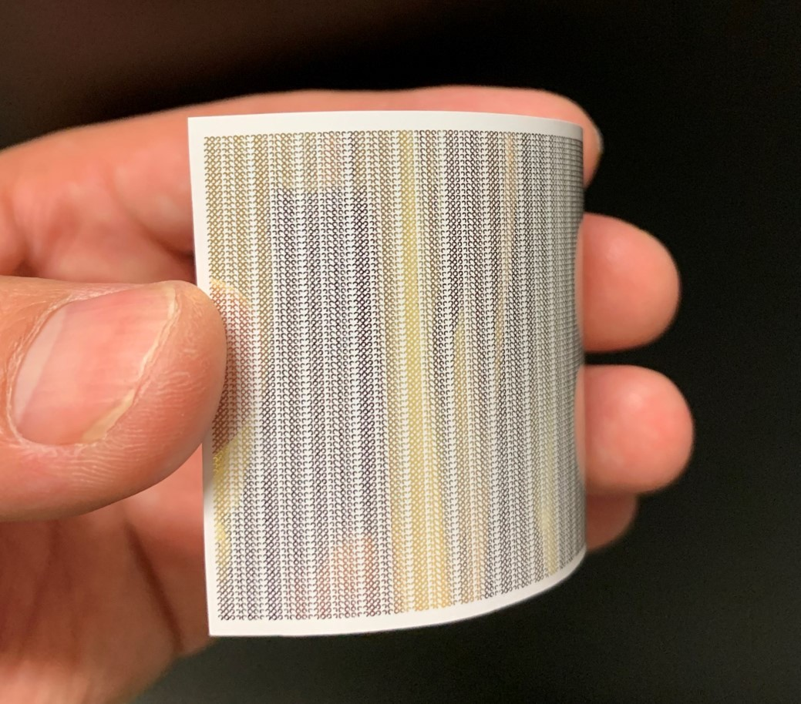

Fabricating Metasurfaces
Hot stamped static MS
Rapid prototyping
Inexpensive
CMOS programmable MS
Programmable
Open/short ring segments
H. Guerboukha et al., Optics Express 2021.
S. Venkatesh et al., Nature Electronics 2020.

Slide 42

Airy Metasurface Experiments
Setup
  Small-scale experiment with sub 𝜇W TDS transmitter
  Hot-stamped 150 GHz transmissive metasurface
Curved profile
Less than model
  Spatially sampled Φ 𝑥
  Imperfect meta-atoms
Edward Knightly

Slide 43

Future Work: Airy Networks
At scale experiments including obstacles
Control plane: how to aim the curve ball
  Where is the target?
  Best curvature profile and steering angle
  Programmable metasurface
Data plane
  Sending data
J. Jornet, E. Knightly, and D. Mittleman, “Wireless Communications, Sensing, and Security above 100 GHz,” Nature Communications, 2023
Image source: The Indian Express

Slide 44
Upcoming Wireless Advances
Network design, optimization and management to harness new antenna and metasurface capabilities
Radically transformed networks architectures fusing diverse spectrum from sub 6 GHz to THz
Programmable, low cost, energy efficient components
Sensing and learning including physical models vs. black box
New applications and use cases

Slide 45

Summary

Slide 46




Acknowledgements
Ph.D. students and alumni at http://networks.rice.edu
Collaborators at Rice and beyond:
  Dan Mittleman at Brown University
  Josep Jornet at Northeastern University
  Kaushik Sengupta at Princeton University
Sponsors

