Slide 1

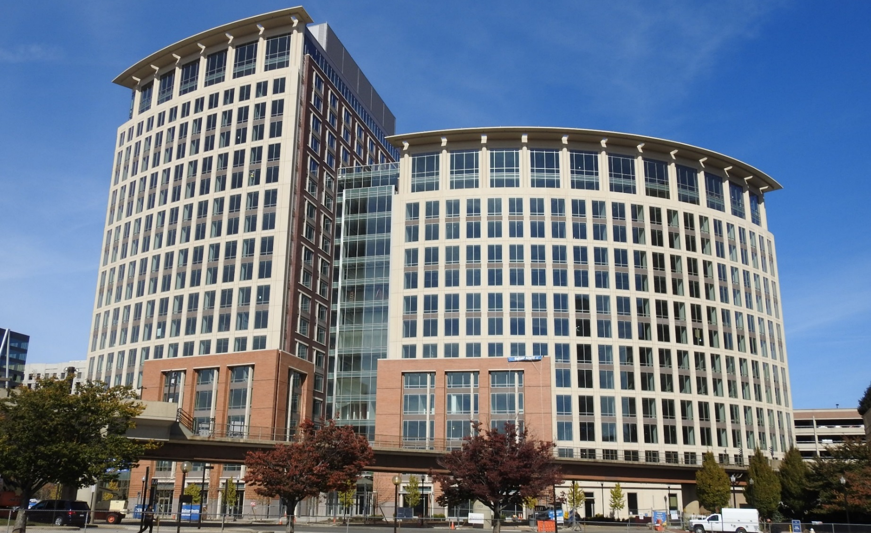




Webcast on Solicitation NSF 23-506
Expanding AI Innovation through
Capacity Building and Partnerships (ExpandAI)
NSF Mission:
“To promote the progress of science;
to advance the national health,
prosperity, and welfare; to secure
the national defense...”

Slide 2
Webinar Outline
Part I: NSF Overview
Part II: AI Institutes Program Overview
Part III: Expand AI Program Overview
Part IV: Concept Outlines
Part V: Eligibility – CAP & PARTNER Proposals
Part VI: Proposal Preparation and Submission
Part VII: Capacity Building Pilots – CAP
Part VIII: Partnerships – PARTNER
Part IX: Expand AI FY 2023 - Important Dates
Breakout Sessions
Q&A

Slide 3
Part I: NSF Overview

Slide 4
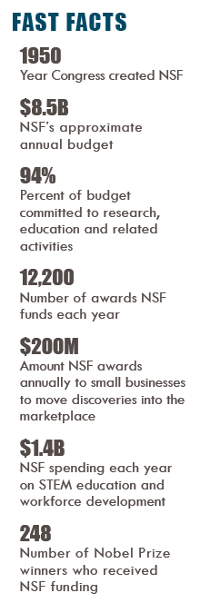
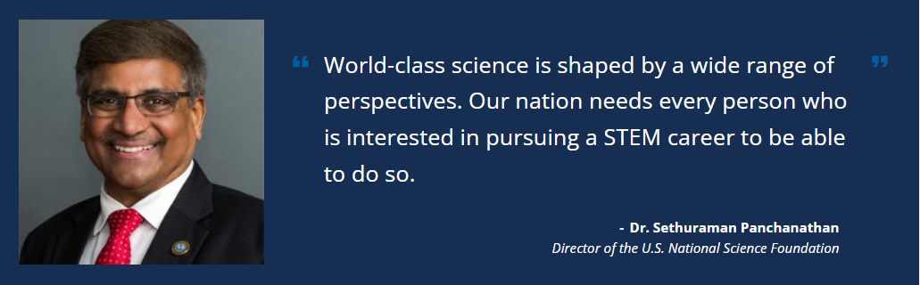








Fast Facts
8 NSF Directorates:
Technology Innovation and Partnerships
BIO
ENG
MPS
CISE
SBE
EDU
GEO
TIP
NSF Solicitations are organized by NSF Unit (Directorate, Division) or Program
Some Solicitations are cross-cutting, spanning multiple units e.g. NSF 23-506 ExpandAI

Slide 5
Part II: AI Institutes Program

Slide 6
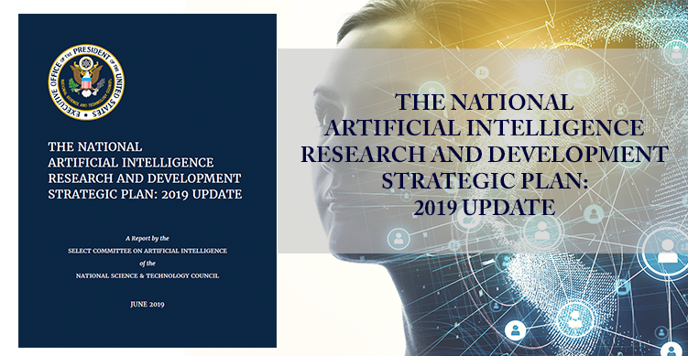
National AI Strategy
Sustained, long-term support
Maintain and grow U.S. Leadership in AI
Core missions:
  advance fundamental knowledge of AI;
  advance use-inspired work to solve real-world problems of importance to the U.S. economy
  grow the U.S. AI workforce and build pathways for students from diverse backgrounds.
National AI R&D Strategic Plan
All NSF Directorates
20+ funding divisions/programs
+ partners

Slide 7














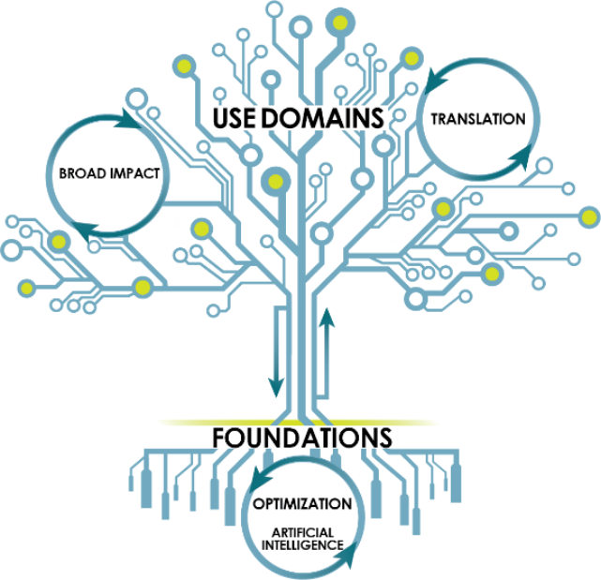














AI Institutes: multisector collaboration featuring Government + Academia and their partners in the Institutes
AI Institutes:
multisector collaboration featuring Government + Academia and their partners in the Institutes

Slide 8
National AI Research Institutes Program NSF 22-502
NSF and USDA-NIFA - 18 AI Research Institutes funded as of October 2022
Broad spectrum of AI research: foundational and use-inspired
Critically important to US competitiveness, food security, public safety, education, etc.
Currently six thematic areas:
Theme 1: Next-Generation Cybersecurity
Theme 2: Neural/Cognitive Foundations of AI
Theme 3: AI for Climate-Smart Agriculture and Forestry
Theme 4: AI for Decision Making
Theme 5: Trustworthy AI
Theme 6: AI-Augmented Learning
advances in machine learning
big data
AI-driven
economic growth
industry re-vitalization
quality of life improvement
enhanced learning
cheap memory
increased computing power

Slide 9
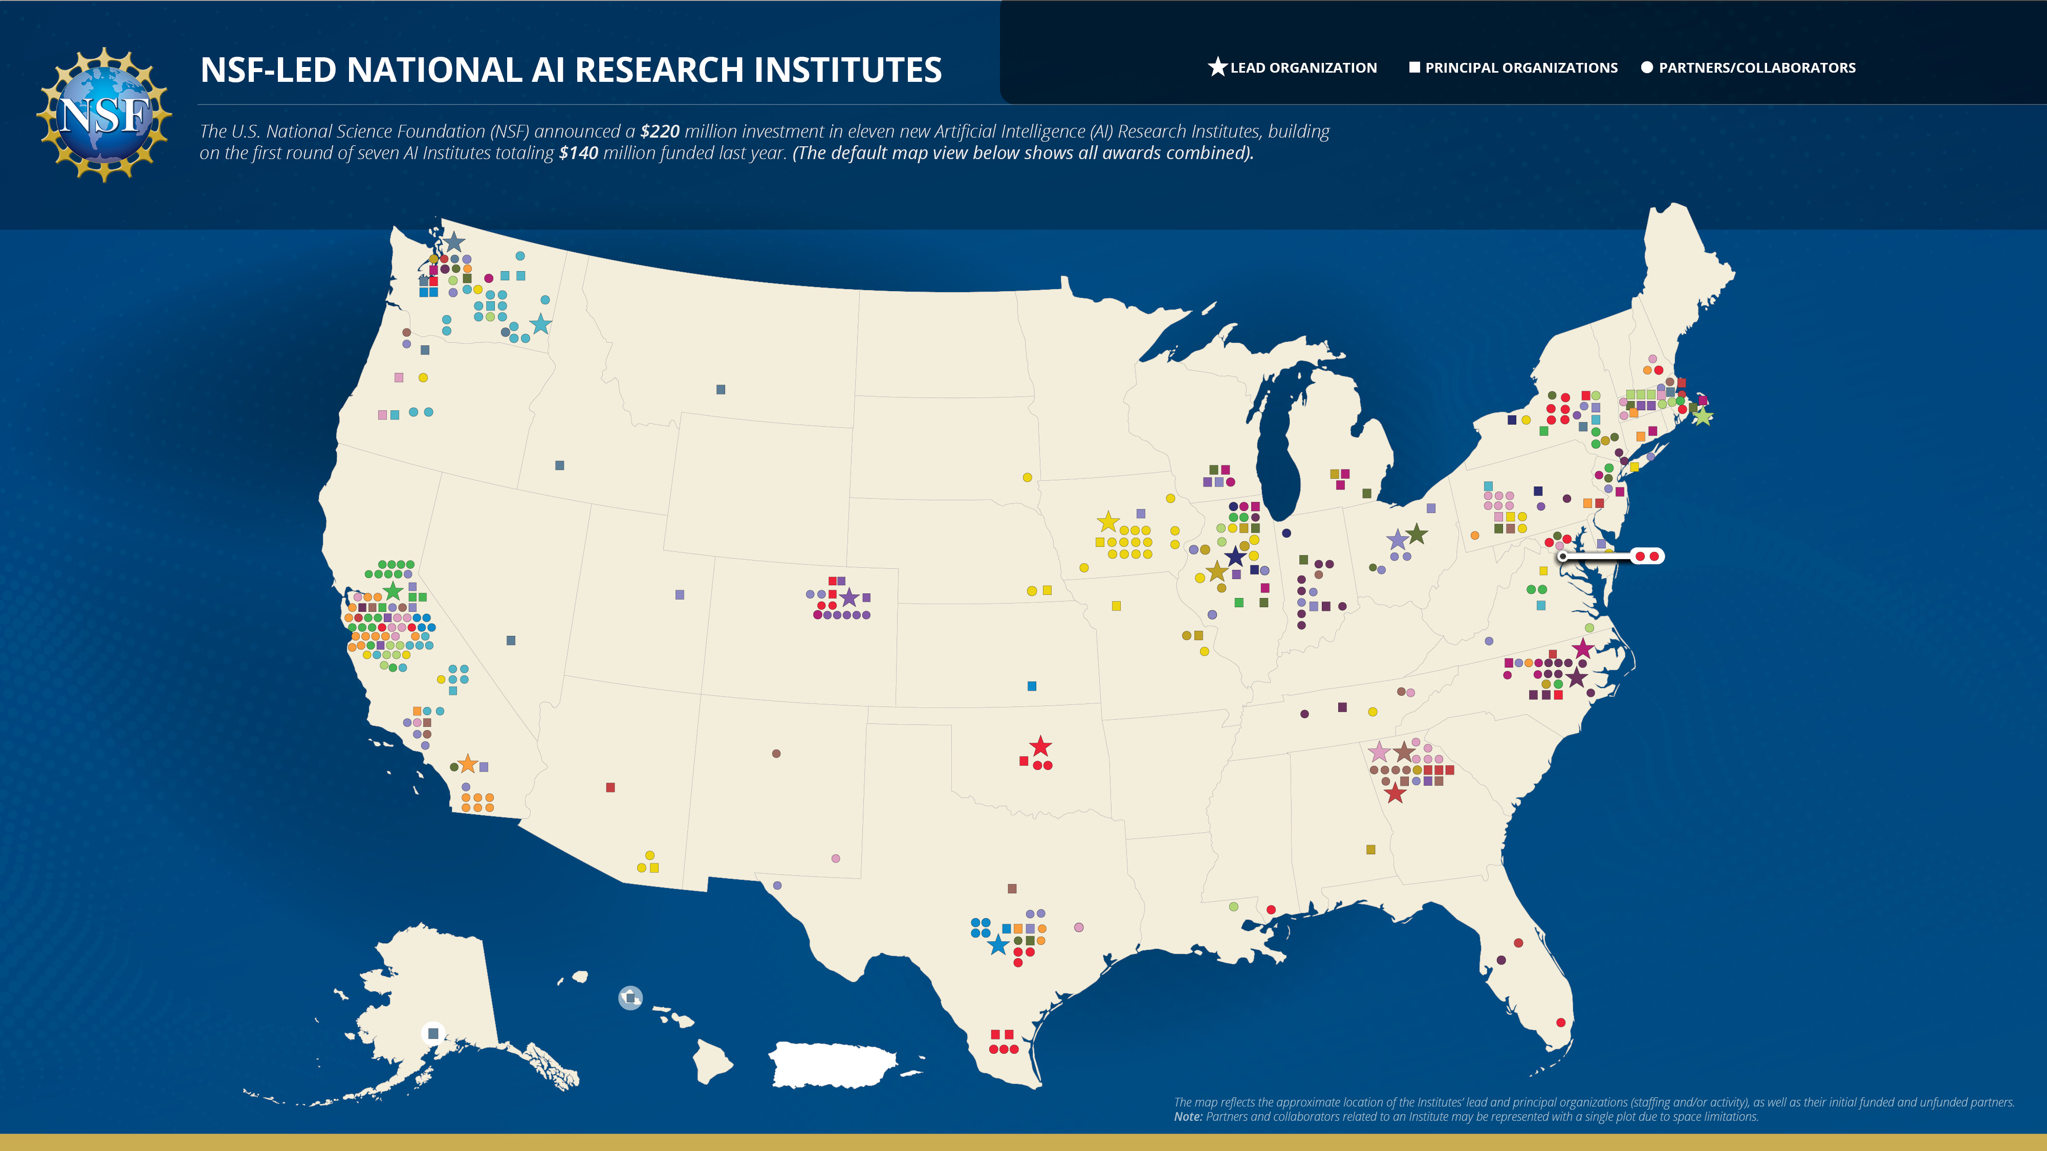
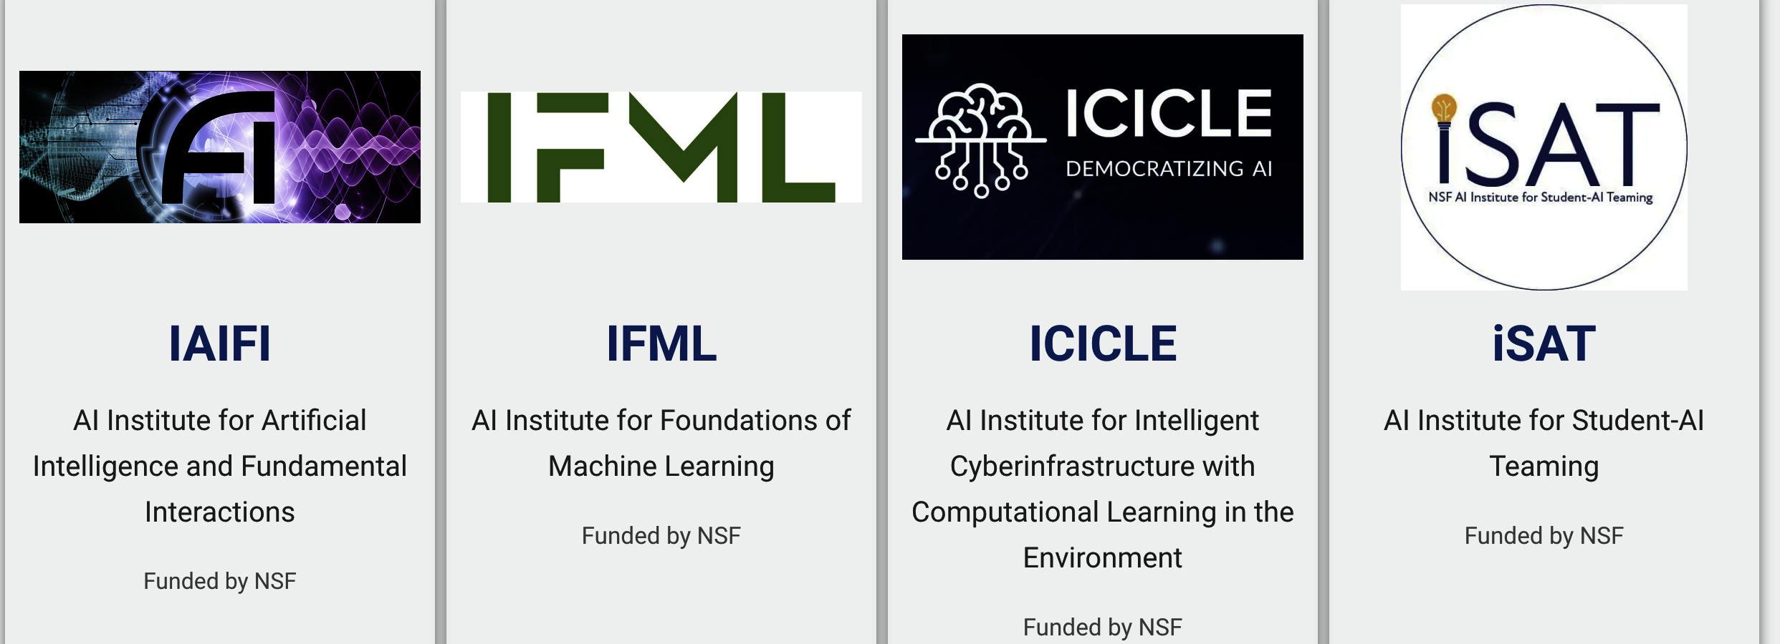
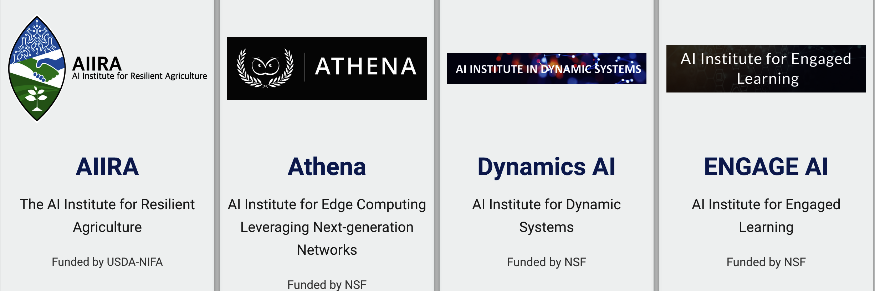
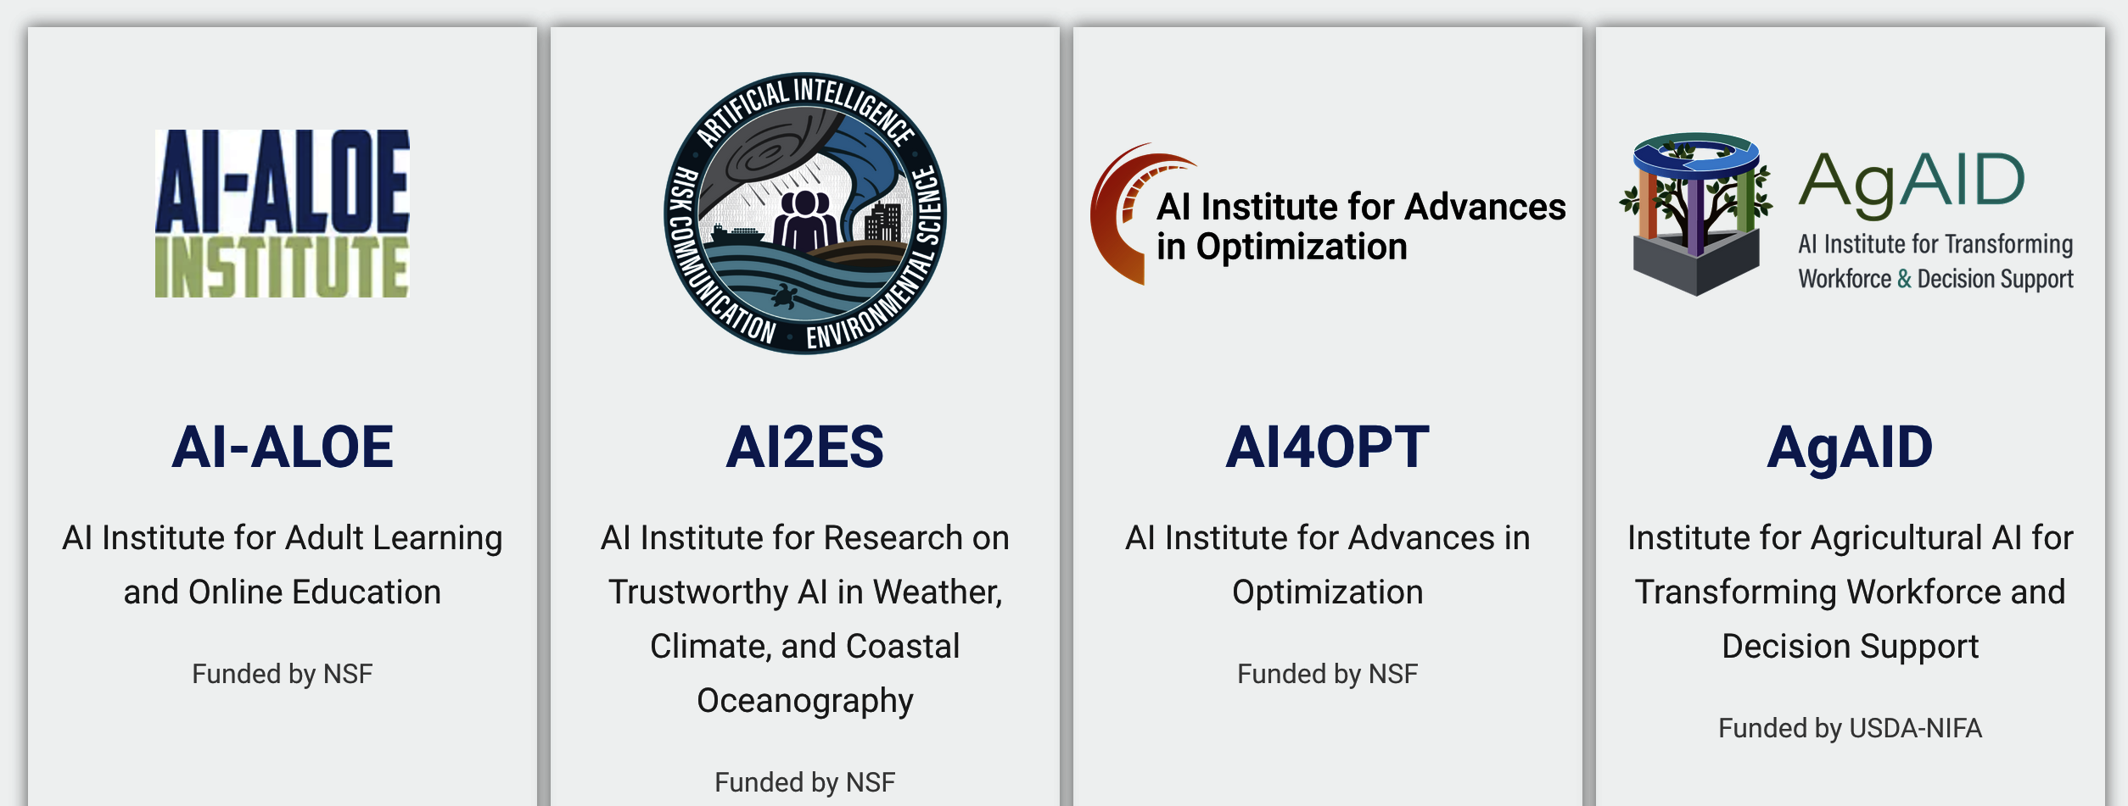
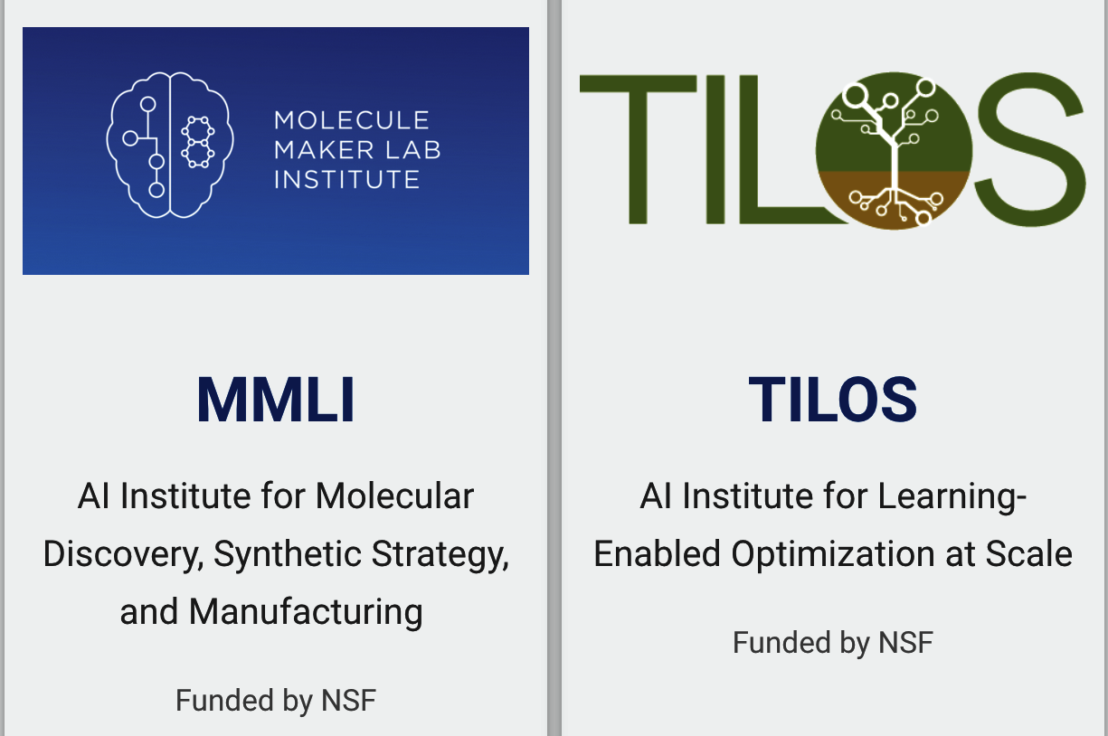
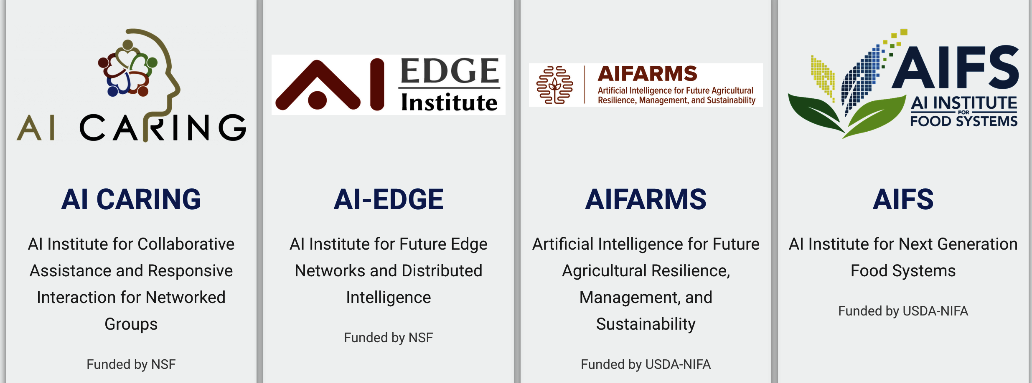
Eligible Organizations
19 Institutes, 122 eligible organizations
spanning 40 States
Will grow in FY23

Slide 10

Part III: Expand AI Program Overview
Notes:
Image Credit: MIT Sloan Management Review

Slide 11
Program Goal:
Diversify participation in AI research, education & workforce development through capacity development and partnerships with National AI Research Institutes
Minority-serving institutions (MSIs) are a source of untapped talent critical to future AI innovation and responsible AI research through inclusive participatory design
Where MSIs are not yet significantly engaged in AI research and education there is enormous potential to develop talent through federally supported AI research
ExpandAI promotes capacity development for new AI programs at MSIs, as well as partnerships between MSIs and AI Institutes

Slide 12





MSI Capacity Building & Partnership with AI Institutes
Minority-Serving Institutions
HBCU
TCU
National AI Institutes
ANSI
Build
Capacity
OTHER MSIs
PBI
HSI
Partnerships
NHSI

Slide 13
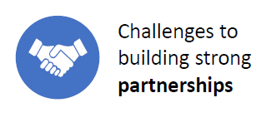
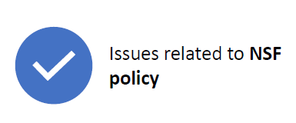
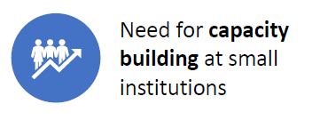
ExpandAI Program Rationale
NSF supports growth of interdisciplinary research by diverse community for advancement of AI-driven innovation
Program promotes
Capacity development for new AI programs at MSIs
Partnerships between MSIs and AI Institutes
Flexible Approach, Recurring Contiguous Submission Windows (no single date deadline)
Capacity
Partnership
Approach
Build AI capacity
MSI-specific goals
Institution support
Path to partnership
Leverage AI Institutes
MSI-led awards
Institute subawards
Shared vision and goals
Institute integration plans
Lower barriers to success
Concept outlines
Submission windows
Flexible submissions

Slide 14
Expand AI Program (NSF 23-506)
VIRTUAL OFFICE HOURS
Tues Feb 21, 2023, 2-3pm
Tues Mar 21, 2023, 2-3pm
Tues April 18, 2023, 2-3pm
Tues May 16, 2023, 2-3pm
Tues June 20, 2023, 2-3pm
WEBINARS
Thur Feb 16, 2023, at 2pm-3.30pm EST
Thur Mar 16, 2023, at 2pm-3.30pm EST
Register in advance at:
https://nsf.zoomgov.com/webinar/register/WN_eFcqrhKCRYmTxzPtPRufOw
Concept Outline (2 pages)
Proposal Submission
Two Tracks
Track 1: Capacity Building Pilots
Track 2: Partnerships
Planning/Growth efforts
Exploration of future partnerships
Scale up established AI research, education programs,
initiate new collaborations
Expected Outcomes
Expected Outcomes
enhancement of foundational or use-inspired AI research
academic pathways for AI teaching and learning
enhanced AI research infrastructure
increase in participation of underrepresented investigators
enhancement of existing/initiation of new projects by virtue of new collaboration
community building activities to further develop common interests
potential and plans for scaling nascent programs;
evaluation plan for measuring growth and mutual benefit of activities
$400,000 for up to 2 years
Recurring submission windows in 2023
Jan 9, 2023 - Mar 13 , 2023 Mar 14 , 2023 – Jun 26, 2023
June 27, 2023 - Oct 20, 2023
$300,000 - $700,00 per year
for up to 4 years

Slide 15
Estimated Program Budget FY 2023
Overall: $10-17million available to support 15 – 25 awards:
10-15 Capacity Building Pilots (CAP) awards
5-10 Partnership (PARTNER) awards
CAP award - standard grant up to $400,000 total budget over two years
PARTNER award - continuing award in the range of $300,000 to $700,000/year for up to 4 years

Slide 16
ExpandAI Participating Agencies
NSF Units
  Directorate for Biological Sciences (BIO)
  Directorate for Computer and Information Science and Engineering (CISE)
  Directorate for Education and Human Resources (EDU)
  Directorate for Engineering (ENG)
  Directorate for Mathematical and Physical Sciences (MPS)
  Directorate for Technology, Innovation and Partnerships (TIP)

Slide 17

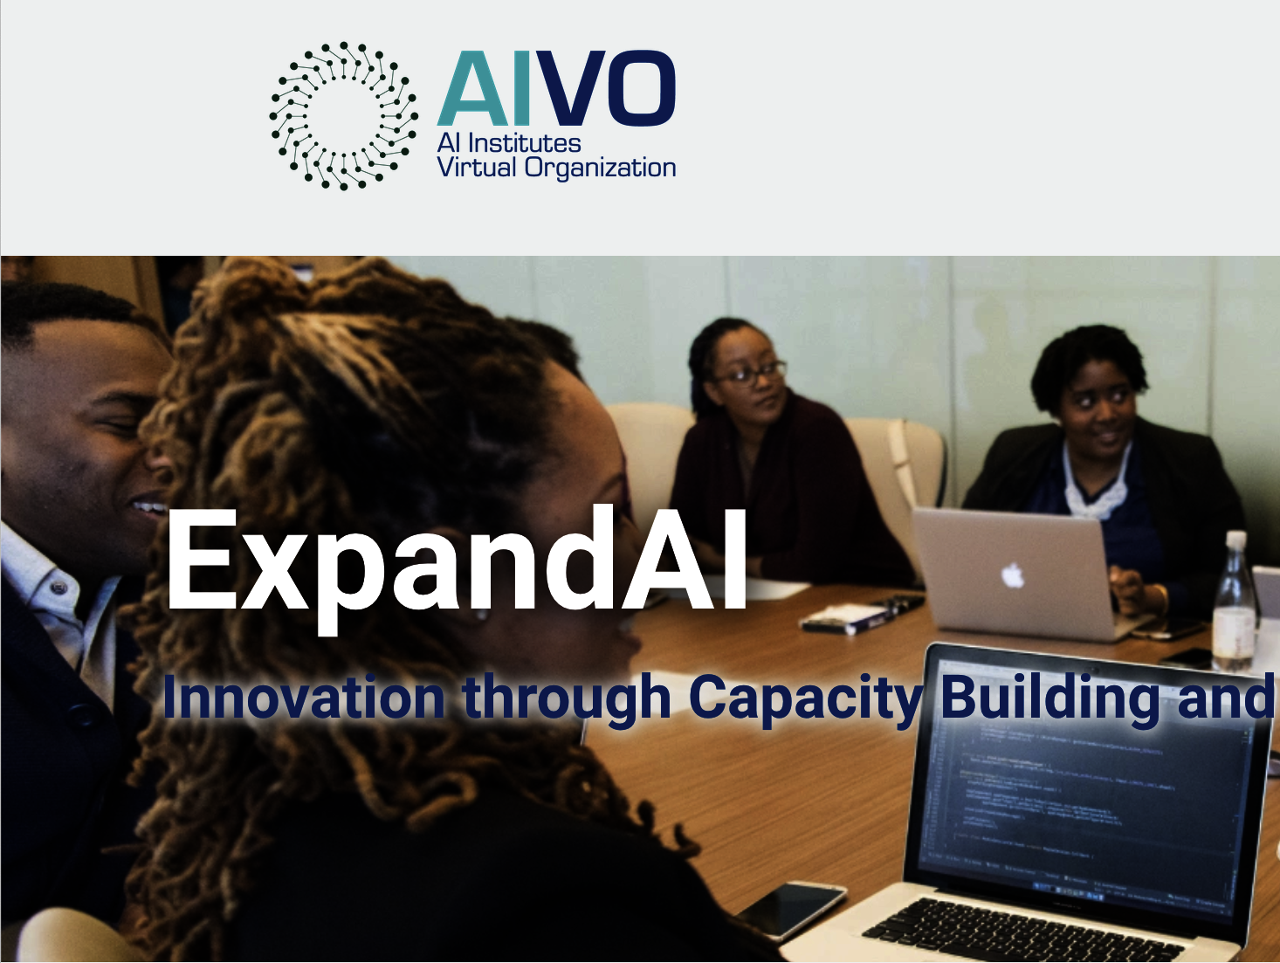


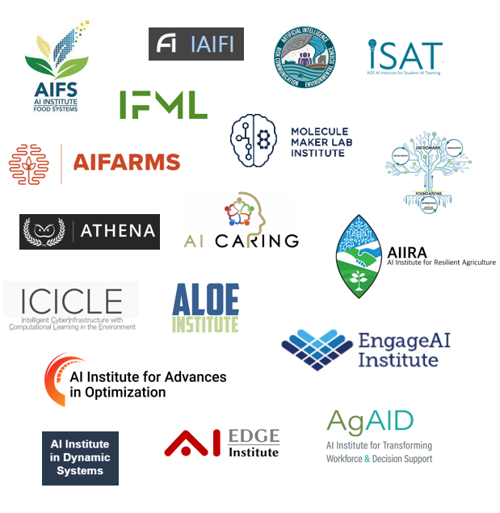
How AIVO supports ExpandAI
Hundreds of eligible MSIs
Facilitator and Resource Center
Directory of Institute contacts
Advice on partnership inquiries
Future: Resources for capacity development activities?
https://aiinstitutes.org/institutes/ExpandAI/
Partnership Inquiries
Resource Search
18 Institutes, 122 eligible organizations
Will grow in FY23

Slide 18
ExpandAI
Program Contacts
Jim Donlon, CISE/IIS, ExpandAI Program co-lead
Abby Ilumoka, EHR/DUE, ExpandAI Program co-lead
Neeti Pokhriyal, CISE/IIS, Science Fellow, AI Institutes
Rebecca Hwa, CISE/IIS (AI Institutes Program co-lead)
Michelle Rogers, CISE/EWF (ExpandAI co-author)
Subrata Acharya, CISE/EWF
Rebecca Shearman, TIP/ITE (ExpandAI co-author)
Jeremy Guinn, EHR/HRD (ExpandAI co-author)
Amy Baylor, EHR/DRL (ExpandAI co-author and AI Institutes PO)
Christine Grant, ENG/EEC (ExpandAI co-author)
Kemi Ladeji-Osias, ENG/EEC (ExpandAI co-author)
Aranya Chakrabortty, ENG/ECCS
Shahab Shojaei-Zadeh, ENG/CBET (ExpandAI co-author and AI Institutes PO)
Stacey Levine, MPS/DMS (ExpandAI co-author)
Andreas Berlind MPS/AST (ExpandAI co-author)
ExpandAIProgram@nsf.gov

Slide 19
Part IV: Concept Outlines

Slide 20
Concept Outlines
All proposers must receive an official invitation via the Concept Outline process to submit a full proposal to the solicitation
Two-page Concept Outline gives NSF the ability to review for appropriateness to the program objectives prior to the full proposal submission process
This ensures that proposers do not expend time or resources preparing full proposals that do not have strong potential to be responsive to program objectives
Concept Outlines are required for both tracks (CAP and PARTNER)
Concept Outlines may be submitted by an eligible PI and are reviewed on an ongoing basis (no limit on # of Concept Outlines per institution)
Send Concept Outline as PDF attachment in email to: ExpandAIProgram@nsf.gov
For PARTNER concepts, cc: one co-PI for each AI Institute
Format SUBJECT: "CO: [Title as appears in Concept Outline]". (e.g., "CO: CAP: AI Capacity Building in XYZ University").
​

Slide 21
Eligibility & Review of Concept Outlines
Eligibility to Submit Concept Outline: Concept Outlines may be submitted by any eligible PI in the organization
NSF will review Concept Outlines on an ongoing basis for potential to be responsive to ExpandAI program objectives
NSF will respond to submitter with a Program Officer Concurrence Email as invitation to submit a full proposal within 12 months of date of email
Proposer that has received an invitation to submit a full proposal must wait for that proposal to be submitted and resolved before submitting another Concept Outline.
If the Concept Outline is not responsive to ExpandAI program objectives, proposer will receive notice not to submit a proposal
Proposers not invited to submit a full proposal in response to a Concept Outline may submit a new Concept Outline after the start of the next submission window (sooner, by exception, if specifically invited by the program)
Proposers who do not receive an invitation to submit a proposal are not eligible to apply for ExpandAI funding. Proposals will be RWR

Slide 22
Anatomy of a Concept Outline
Five key elements:
1. TITLE: [CAP or PARTNER]: Concise, descriptive title of project
2. Names of PIs/Co-PIs: List up to five. For PARTNER concepts, include the prospective co-PI from relevant AI Institute
3. MSI STATUS: (all concept outlines) Describe the lead institution’s MSI status and address the relevant requirements for Eligible Institutions of Higher Education
4. CURRENT AI CAPACITY: (250 words) Briefly describe the lead institution’s AI capacity in research, instruction, and infrastructure as it relates to the proposed concept. For concepts targeting Track 1 CAP, demonstrate a compelling institutional need for capacity building in AI. For concepts targeting Track 2 PARTNER, describe a suitable foundation for success in the collaboration described in Partnership Goals.
5. GOALS:
CAPACITY BUILDING GOALS: (required for CAP, optional for PARTNER, up to 500 words). Describe outcomes and benefits of capacity building. Outline goals and any preliminary plans that might be fully described in the full proposal’s Capacity Building Plan.
OR
PARTNERSHIP GOALS: (required for PARTNER only, up to 500 words). Identify the organizations and their prospective collaborative work in some unifying theme or focus. Outline shared goals of the organizations and identify any prospective projects and collaborative arrangements that might be fully described in the Full proposal’s Partnership Roadmap. Also describe any initial commitments to participate obtained from relevant AI Institute Director

Slide 23
Part V: Eligibility - CAP & PARTNER Proposals

Slide 24
Institutional Eligibility
ExpandAI proposals may be submitted only by accredited Institutions of Higher Education (IHEs) that belong to at least one of the following 7 MSI classifications:
1. Alaska Native Serving Institutions (ANSI) - Accredited IHEs that award bachelor level degrees that have a 20 percent or greater enrollment of Alaska Native undergraduate students.
2. Hispanic Serving Institutions (HSI) - Accredited IHEs that award bachelor level degrees that have a 25 percent or greater full-time equivalent enrollment of Hispanic undergraduate students
3. Historically Black Colleges and Universities (HBCU) - Identified in the Higher Education Act of 1965, as amended, as any accredited historically black college or university that was established prior to 1964, whose principal mission was, and is, the education of Black Americans
4. Predominantly Black Institutions as defined by the Department of Education that award bachelor level degrees

Slide 25
Institutional Eligibility (contd.)
5. Native Hawaiian Serving Institutions (NHSI) - Accredited IHEs that award bachelor level degrees that have a 10 percent or greater enrollment of Native Hawaiian undergraduate students
6. Native American-serving, non-Tribal Institutions and Tribal Colleges and Universities (TCU) – see solicitation
7. Other Minority-Serving Institutions (MSI) - Accredited IHEs that award bachelor level degrees that have an aggregate undergraduate enrollment of African Americans/Blacks, Hispanic Americans, American Indians, Alaska Natives, Native Hawaiians, and Native Pacific Islanders exceeding 50 percent of total undergraduate enrollment

Slide 26
PI Eligibility
Who May Serve as PI:
The Principal Investigator must hold a full-time faculty appointment or be a senior administrator at an eligible Institution as defined in the 'Eligible Institutions of Higher Education' section of the solicitation.
In PARTNER proposals only, a co-PI must be identified to represent each partnering AI Institute. That co-PI must be verified by the Institute Director in the Institute Integration Plan as being among the senior personnel of the institute at the time of submission.

Slide 27
Part VI: Proposal Preparation and Submission

Slide 28
Proposal Submission (CAP & PARTNER)
The ExpandAI program has recurring proposal submission windows. Unlike deadlines, submission windows allow proposers the flexibility to submit a full proposal at any time during the specific dates listed
On each submission window closing date, the proposal submission system will shut down at 5:00 p.m. submitter's local time.
The system will then reopen for new submissions the morning of the next window, with the exception of the final submission window.

Slide 29
Limit on Number of Proposals per Organization
An organization may submit one proposal per submission window. An organization must wait for a determination from NSF (e.g., Award, Decline, or Returned Without Review) on the pending proposal before submitting a new proposal in the next window.
Declined proposals require a new invitation to submit (via the Concept Outline process) and significant revision, while proposals Returned Without Review may be submitted using the same invited Concept Outline (assuming that the proposal is received within one year of the original Concept Outline invitation)
Also, an organization that has received an invitation to submit a full proposal must wait for that proposal to be submitted and resolved before submitting another Concept Outline
Limit on Number of Proposals per PI or co-PI: There are no restrictions or limits.

Slide 30
Proposal Submission - Window Dates
(due by 5 p.m. submitter's local time)
Eligible MSIs can submit a Concept Outline at any time. MSIs that have been invited to submit a full proposal can submit a proposal based on the Concept Outline at any time during one of the submission windows listed below:
Proposal Submission Windows
January 09, 2023 - March 13, 2023
March 14, 2023 - June 26, 2023
June 27, 2023 - October 20, 2023
January 08, 2024 - March 11, 2024
March 12, 2024 - June 24, 2024
June 25, 2024 - October 18, 2024
January 06, 2025 - March 10, 2025
March 11, 2025 - June 23, 2025
June 24, 2025 - October 17, 2025

Slide 31
Preparation of Full Proposals
For CAP and PARTNER proposals:
Full Proposals submitted via Research.gov - NSF Proposal and Award Policies and Procedures Guide (PAPPG) guidelines apply. The complete text of the PAPPG is available electronically on the NSF website at: https://www.nsf.gov/publications/pub_summ.jsp?ods_key=pappg.
Full Proposals submitted via Grants.gov: NSF Grants.gov Application Guide: A Guide for the Preparation and Submission of NSF Applications via Grants.gov guidelines apply (Note: The NSF Grants.gov Application Guide is available on the Grants.gov website and on the NSF website at: https://www.nsf.gov/publications/pub_summ.jsp?ods_key=grantsgovguide).

Slide 32
Part VII: Expand AI Capacity Building Pilots - CAP

Slide 33
Track 1: CAP Proposals
Capacity Building Pilots (CAP) are planning and growth efforts focused on the establishment of AI activities at the funded MSI and the early exploration of future synergistic partnerships that have the potential to be part of prospective ExpandAI Partnerships.
Successful pilots will result in establishing new AI research capacity, education/workforce development in AI, and/or AI infrastructure capacity at the proposing institution and, potentially, a basis for future AI partnerships.
CAP activities should plan for engaging appropriate communities to test the feasibility of partnerships as well as developing plans for continuing capacity development.
Plans should consider required research infrastructure, plans to leverage established groups in related research areas, and inclusion of faculty training and research experiences that emphasize the diversification of investigators.

Slide 34
Track 1: CAP Proposals (contd)
Proposals must articulate a clear vision motivating the capacity building activities, with a focus on long-term benefits to the MSI
Benefits to MSI include enhanced faculty capacity for foundational and/or use-inspired AI research or new effective models for increased education and career pathways in AI.
Proposals to this track must include a strong Institutional Need and Support Statement containing
an assessment of the current AI research and instructional capacity and infrastructure, a demonstration of institutional need for capacity building in AI
a statement of the commitment of institutional support for the proposed activities.
Proposals that substantiate a strong case in the need and support statement are likely to be the most competitive.

Slide 35
Track 1: CAP Proposals (contd.)
Successful proposals will feature a Capacity Building Plan that features clear and measurable outcomes/benefits of capacity building. Suitable activities for such a plan are:
establishment or significant enhancement of foundational or use-inspired AI research, marked by increased faculty research output;
design of academic pathways or innovative models for teaching and learning in AI, incorporating how students learn effectively in AI activities, and bringing AI disciplinary advances into the undergraduate and graduate experience;
establishment or significant expansion of AI career pathways for students resulting from new AI activities;
enhanced AI research infrastructure;
significant increase in the participation of investigators and students who have been traditionally underserved and underrepresented in AI; and
a plan for objective process evaluation in support of the proposed efforts.
Above list is representative of suitable activities and outcomes for CAP track, however, activities need not be limited to this list, and proposals do not have to include every type of outcome represented in list. Proposers are encouraged to select and integrate the activities most appropriate for their institutional context and their vision for capacity building toward partnerships.
Early partnership development between the proposing MSI and one or more AI Institutes is neither required nor encouraged in a CAP proposal.

Slide 36
Part VIII: Expand AI Partnerships - PARTNER

Slide 37
Track 2: PARTNER Proposals
PARTNER track is an opportunity for MSIs to scale up already-established AI research and/or education programs and to initiate/leverage new collaborations with AI Institutes.
Partnerships must reflect multi-organization collaborations submitted by an MSI and will include a subaward to an AI Institute.
PARTNER projects are centered around shared, complementary goals. Proposals will be submitted as single-organizational collaborative proposals.
Proposing MSI in this track is not required to have previously been awarded a CAP project under this program

Slide 38
PARTNER Proposals
PARTNER proposals:
must include collaboration with one or more AI Institutes, or with any of the collaborative organizations directly funded under an AI Institute award
collaboration(s) must be proposed in form of subaward(s) under lead institution
PARTNER proposals must constitute an authentic and significant new partnership that has the clear potential to build on the institution’s current AI capacity as well as leverage the intrinsic strengths and talents of the MSI

Slide 39
PARTNER Proposals
Organizations Eligible as AI Institutes SubAwardees
Subaward(s) may be made to the AI Institute lead organization or any of the sub-awardee organizations in that Institute’s award budget
Current AI Institutes: A listing of Institutes and links to their web sites can be found at AI Institutes Virtual Organization (AIVO)

Slide 40
PARTNER Proposals (contd.)
MSIs applying for PARTNER track must demonstrate readiness to leverage external expertise and financial resources to focus on medium- and long-range plans to leverage new partnerships to develop AI capacity
This may include (but is not limited to) further development of the MSI’s envisioned methodological thrusts, use cases, educational and/or workforce development activities, and the potential for the MSI to expand and scale these efforts through formal, mutually beneficial partnerships.
PARTNER proposals must feature a compelling Partnership Roadmap for collaborative work in some unifying theme or focus

Slide 41
Effective Partnership Roadmaps
Effective roadmaps should be depicted visually (e.g., conceptual diagram, logic model, table, etc.) as well as fully explained by a descriptive narrative.
Specifically, Roadmaps might address:
enhancement of existing projects by virtue of new collaboration;
initiation of new projects made possible by the collaboration;
community building activities (e.g., workshops) to further develop common interests, objectives, and further growth of the partnership;
potential and plans for scaling nascent programs;
an evaluation plan for measuring the growth and mutual benefit of activities in all projects.

Slide 42
PARTNER Proposals (contd.)
Proposals to this track must include a strong Institutional Need and Support Statement from proposing MSI which demonstrates institutional commitment for proposed activities as well as contain an assessment of
current AI research and instructional capacity infrastructure
progress in AI capacity development and how that relates to the outlook for partnership development
PARTNER proposals must include an Institute Integration Plan submitted by the collaborating institute demonstrating thoughtful and well-resourced commitment to coordination mechanisms that will bring together the various participants of the project.

Slide 43

Part IX: FY 2023 Important Dates

Slide 44
ExpandAI Important Dates FY2023
October 17, 2022: Solicitation Posted, Concept Outlines Accepted
Thursday Jan 19,2023: First Live Webinar, 2pm – 3.30pm (EST)
Thur Feb 16, 2023: Second Live Webinar, 2pm – 3.30pm (EST)
Thur Mar 16, 2023: Third Live Webinar, 2pm – 3.30pm (EST)
Monthly Office Hours: Nov 2022 – June 2023 (third Tues of every month)
Jan 9 – Mar 13 , 2023: First Submission Window (invited proposals only)
Mar 14 – Jun 26, 2023: Second Submission Window (invited proposals only)
Jun 27 – Oct 20, 2023: Third Submission Window (invited proposals only)

Slide 45
Proposal Administration Schedule
Concept Outlines will be reviewed by NSF and a response provided within about 3 weeks
Cap Proposals will be ad-hoc reviewed and a response provided within 3 months of receipt
PARTNER proposals will be reviewed within 6 months of receipt

Slide 46
Typical
Breakout Sessions 2.45pm-3pm
AI INSTITUTE | WEBINAR DATE | PRESENTER NAME | PRESENTER DETAILS
Molecule Maker Lab Institute (MMLI) | FEB 16 2023 | Celine Young | Managing Director, Molecule Maker Lab Institute
 |  |  | University of Illinois at Urbana-Champaign
 |  |  | Vice Chancellor Research Institutes
 |  |  | Carl R. Woese Institute for Genomic Biology
 |  |  | 1206 West Gregory Drive | Room 104
 |  |  | Urbana, IL 61801
 |  |  | 217-265-4228 | chyoung@illinois.edu
USDA-NIFA/NSF AI Institute for Next Generation Food Systems (AIFS) | FEB 16 2023 | Steve Brown | Associate Director
 |  |  | USDA-NIFA/NSF AI Institute for
 |  |  | Next Generation Food Systems (AIFS)
 |  |  | University of California, Davis
 |  |  | sfbrown@ucdavis.edu
AI Institute for Artificial Intelligence and Fundamental Interactions | FEB 16 2023 | Marisa LaFleur | Project Manager, IAIFI | she/her
 |  |  | mlafleur@mit.edu | 617-253-4162
 |  |  | Office: 26-557, Laboratory for Nuclear Science
Institute for Foundations of Machine Learning (IFML) | FEB 16 2023 | Dr. Adam Klivans | Professor of computer science and Director IFML

Slide 47
Questions?
Q&A 3pm-3.30pm
Thank You for Listening!

