Slide 1
Your Proposal Was Declined;
Now What?
Division of Information and Intelligent Systems (IIS)
Office Hours, 1:00 – 2:00 PM ET
February 16, 2023
Cristina Negoita, Moderator, IIS
Wei Ding, Program Director, Information Integration and Informatics
Juan Wachs, Program Director, Robust Intelligence

Slide 2
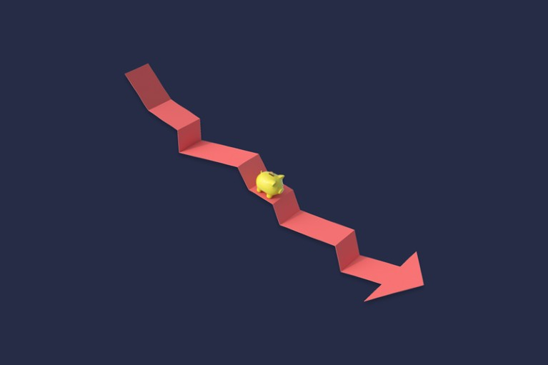
Rejection Hurts
Credit: Adapted from Getty

Slide 3
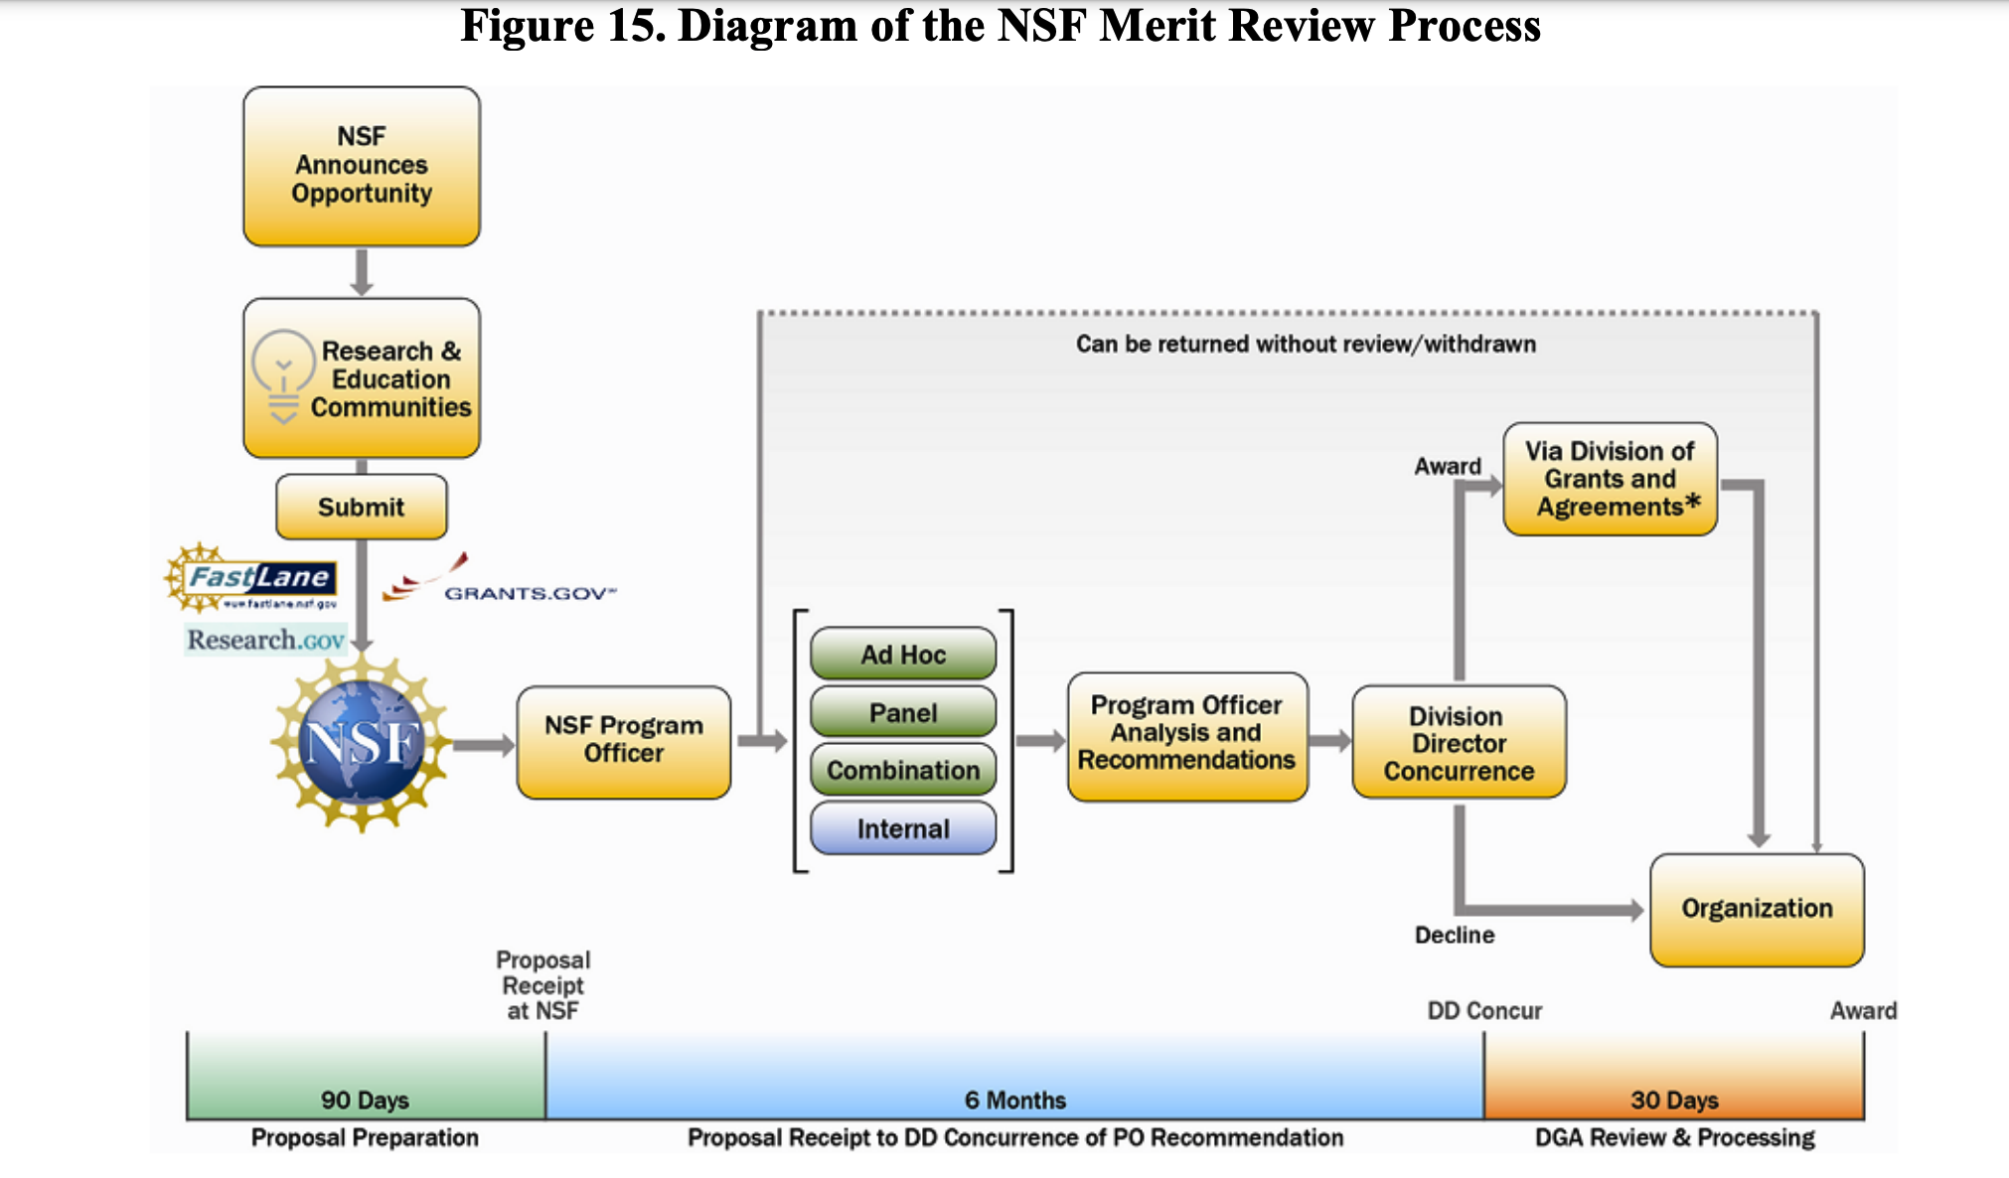

Overview of Process

Slide 4
The Process of Rejection and Trying Again
You receive the reviews and summary, now what?
  Take your time to process
    Read carefully
    Communicate with your project members
  How to interpret the scores
    LC, NC, and even C or HC
  Talk to the NSF PD
    Be positive and constructive
    Take your time to listen
Trying again, not a resubmission
  Read carefully the policy of the NSF program
Q&A Session

Slide 5
Join IIS’s New listserv
Join the electronic mailing list (LISTSERV) for forthcoming announcements and opportunities to serve on review panels by sending an e-mail message to LISTSERV@LISTSERV.NSF.GOV from the mailing address at which you want to receive announcements.
  The body of the message should read Subscribe IIS_News [your full name].
  The message is case sensitive; so capitalize as indicated!
  Don't include the brackets.
  The Subject line should be blank
  For example, for Robin Smith to subscribe, the message would read
  Subscribe IIS_News Robin Smith.
  You will receive a confirmation of your subscription along with instructions on using the listserv.
  LISTSERV@LISTSERV.NSF.GOV

