Slide 1
Programming Uncertain Computations
Michael Carbin, MIT EECS & CSAIL
with Eric Atkinson, Brett Boston, Jonathan Frankle, Jesse Michel, Alex Renda, Benjamin Sherman, Cambridge Yang, Charles Yuan, Tian Jin, Logan Weber, Ellie Cheng, Charith Mendis, Tom Chen, Saman Amarasinghe, Karolina Dzigiute, Dan Roy

Slide 2
What is an uncertain computation?

Slide 3
Computing Stack
Application |  | Libraries
Compiler and Runtime System
Operating System
Hardware System

Slide 4
Hardware Errors
Application |  | Libraries
Compiler and Runtime System
Operating System
Hardware System

Slide 5
Examples
~175 Issues in Current Errata for Intel 6th Generation (Sept. 2018)
SKL057: Cache Performance Monitoring Events May be Inaccurate SKL082: Processor May Hang or Cause Unpredictable Behavior
“Under complex microarchitecture conditions, processor may hang with an internal timeout error ... or cause unpredictable system behavior.”

Slide 6
In Practice
Consumer: “Intel Skylake bug causes PCs to freeze during complex workloads: Bug discovered while using Prime95 to find Mersenne primes.”
http://arstechnica.com/gadgets/2016/01/intel-skylake-bug-causes-pcs-to-freeze-during-complex-workloads/
Supercomputer: “Researchers performed a study in 2010 on the then most powerful supercomputer, called Jaguar. The study found that [uncorrectable] errors occurred about once every 24 hours in Jaguar’s 360 TB of memory.”
http://spectrum.ieee.org/computing/hardware/how-to-kill-a-supercomputer-dirty-power-cosmic- rays-and-bad-solder
Cores That Don’t Count. Hochschild, et al., HotOS 2021 (Google) Silent Data Corruptions at Scale. Dixit et al., arXiv 2021 (Facebook)

Slide 7
How do people cope with this problem?

Slide 8
Transient Errors: i.e., nondeterministic errors.
How do people cope with this problem?

Slide 9





What do you do?
do {
z = x + y;
z = x + y; z’ = x + y;
} while (z != z’);
Replication:
Von Neumann. Probabilistic logics and the synthesis of reliable organisms from unreliable components. 1956

Slide 10
What if we just let errors happen?

Slide 11
Jacobi Iterative Method
while(<convergence condition>) {
for (int i = 0; i < x.length; ++i) {
float sigma = 0;
for(int j = 0; j < x.length; ++j) {
if (j != i) {
float delta = A[i][j] * last_x[j]; sigma = sigma + delta;
}
}
float num = b[i] -. sigma; x[i] = num /. A[i][i];
}
}

Slide 12
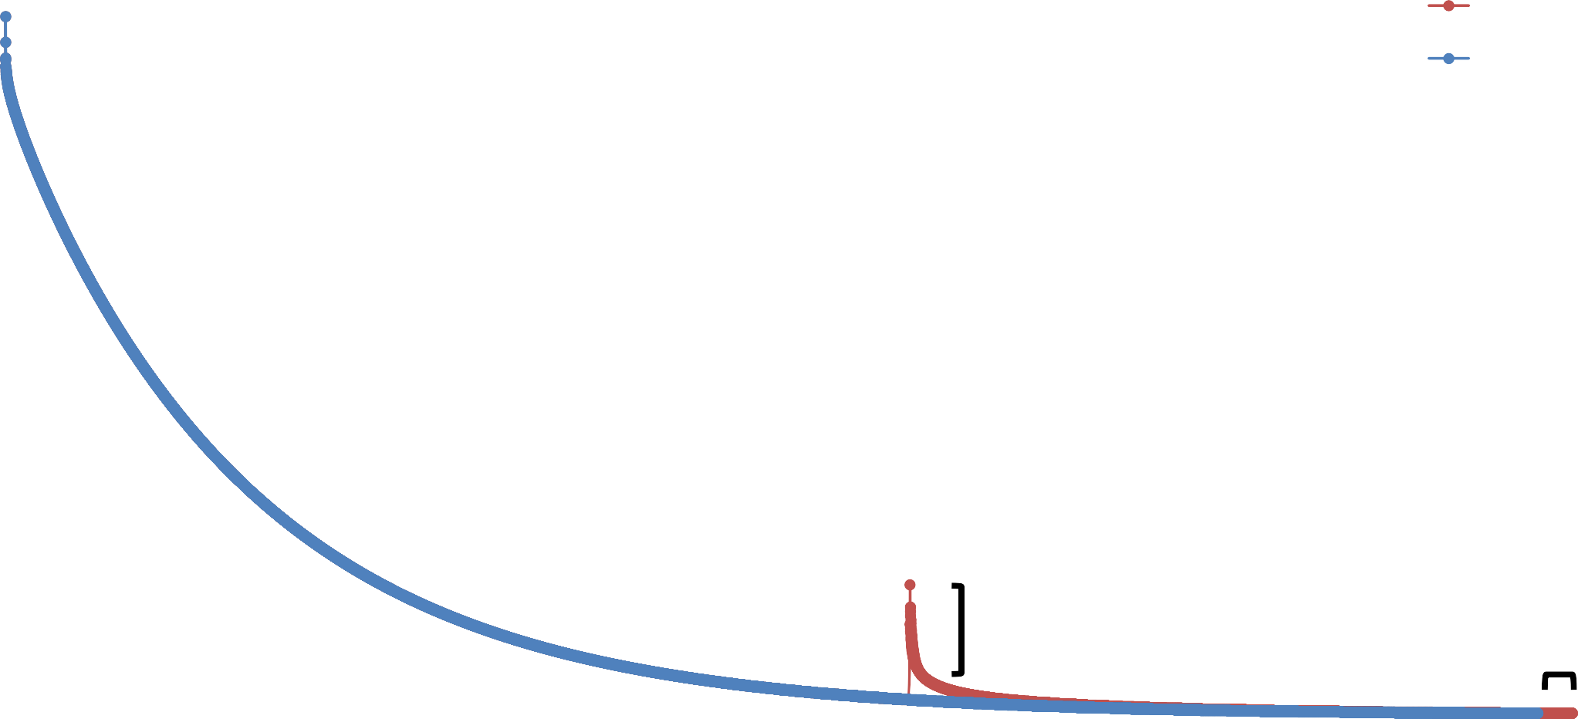
Jacobi Iterative Method (with Error)
3000
Errant
2500
Original
Norm of Residual
2000
1500
1000
~5500
500
𝜖 = 450
Δ𝑇 = 2.6%
0
0
2000
4000
6000
8000
10000
12000
14000
16000
18000
Iteration

Slide 13






Alternative Approach
do {
Replication:
z = x + y;
z = x + y; z’ = x + y;
} while (z != z’);
50% overhead with clever tricks and hardware support.
z = x + y;
z = x + y;
Approximation:
2.6% overhead. But, intermediate results or – in general – final results may differ by 𝝐.

Slide 14
Uncertain Computations
Results computed with a given imprecision or inaccuracy, 𝝐.

Slide 15
Uncertainty (Upwards)
Application |  | Libraries
Compiler and Runtime System
Operating System
Hardware System
Heterogenous and statistical computational substrates:
CPU, GPU, accelerator, reduced precision, stochastic, analog, quantum.

Slide 16
Uncertainty (Downwards)
Application |  | Libraries
Compiler and Runtime System
Operating System
Hardware System

Slide 17
Uncertainty (Downwards)
Environment
Application |  | Libraries
Compiler and Runtime System
Operating System
Hardware System

Slide 18
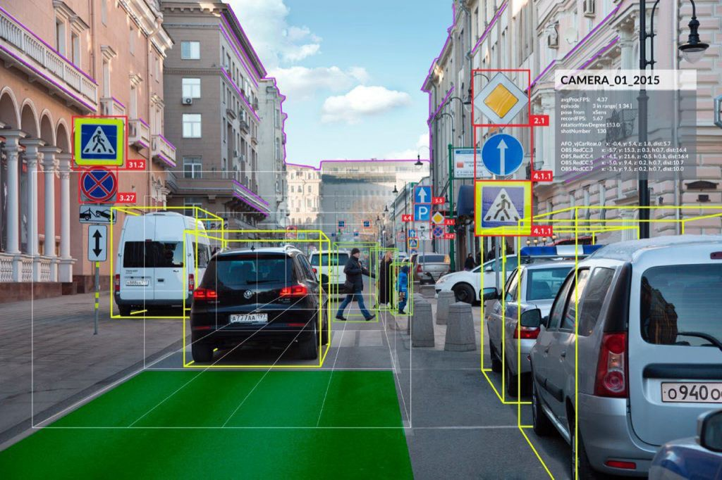
Uncertainty (Downwards)
Environment is only partially observable.
Sensing and data is noisy.
Environment models only correct with a given probability.
Credit: Jeremy Cohen

Slide 19

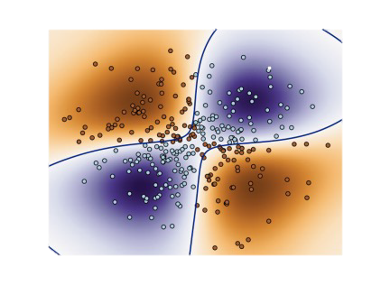





Uncertain Computations
Image Processing, Machine Learning, Computer Vision, Quantum
Results are only known or computable to a given imprecision, 𝝐.

Slide 20
Programming Uncertain Computations
Results computed with a given imprecision or inaccuracy, 𝝐.
Uncertainty reflects imprecision due to:
Sensing, hardware, numerics, algorithms, learning.
Benefits:
Capability, performance, and resilience
Research question:
How to program systems to leverage uncertainty?

Slide 21
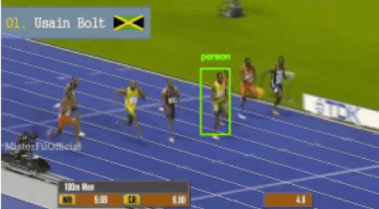





Programming Uncertain Computations
Semantics
Programming Methodology Reasoning
float num = b[i] -. sigma; x[i] = num /. A[i][i];
Leto
Real-Valued, Nondeterministic, Probabilistic
(LICS 18, ICFP 19, PLDI 20, OOPSLA 20, POPL 21)
Execution Model
SMT
Solver
SMT
Solver
“sort list”
Program
Invariant Inference
Verifier
✘
Representations
Surrogate Programming
(Onward! 21)
Verification and PAC Learning
(OOPSLA 18, OOPSLA 20, IJCAI 22, AAAI 23)
Efficient Probabilistic Inference and Deep Learning
(PLDI 20, POPL 21, OOPSLA 21, OOPSLA 22, ICLR 19,
ICLR 20, ICML 20, NeurIPS 20, ICLR 21, NeurIPS 22)

Slide 22
A Compiler (Simplified)
Source Code
Machine Code
Compiler

Slide 23
A Compiler (Simplified)
Lexing Parsing
Type checking
Optimizing Code generation
Source Code
Intermediate Representation
Machine Code
Front End
Back End

Slide 24
Compiler Backend
a = const 7
b = load b_ptr
c = add a b
Transformation Space
a = const 7
b = load b_ptr
c = add a b

Slide 25
Compiler Backend
a = const 7
b = load b_ptr
c = add a b
Transformation Space
Performance Model
𝑝𝑒𝑟𝑓
( )
= 3
a = const 7
b = load b_ptr
a = const 7
b = load b_ptr
c = add a b
𝑝𝑒𝑟𝑓
(
b = load b_ptr a = const 7
c = add a b
) = 2
c = add a b

Slide 26
Compiler Backend
a = const 7
b = load b_ptr
c = add a b
Transformation Space
Search Strategy
Performance Model
Transformation Space
𝑝𝑒𝑟𝑓
( )
= 3
a = const 7
b = load b_ptr
b = load b_ptr a = const 7
c = add a b
a = const 7
b = load b_ptr
c = add a b
𝑝𝑒𝑟𝑓
(
b = load b_ptr a = const 7
c = add a b
) = 2
c = add a b

Slide 27
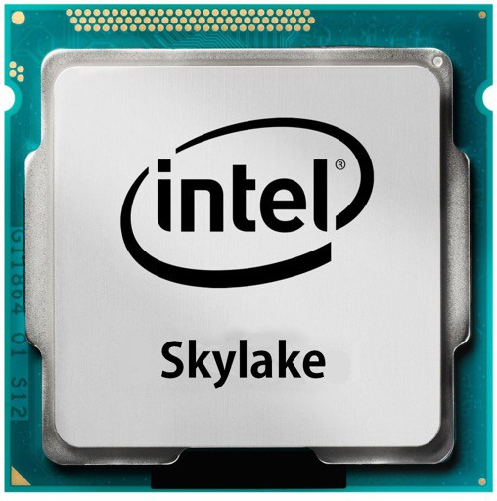
Performance

Slide 28

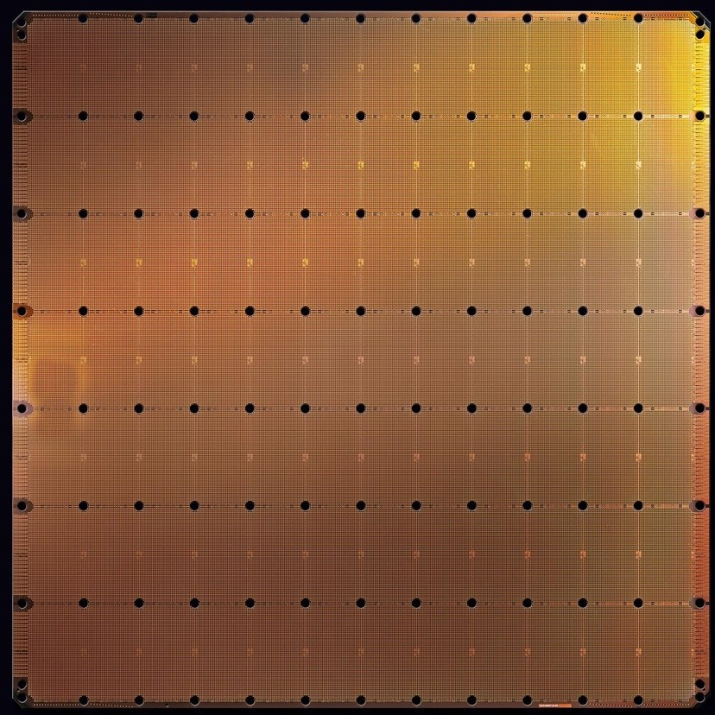
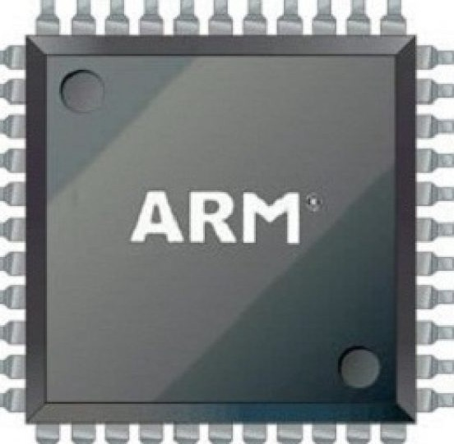
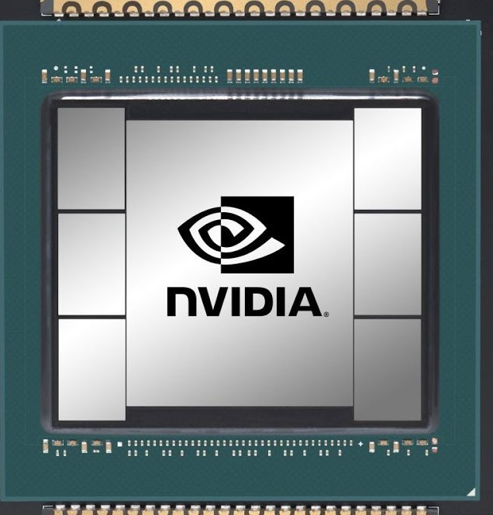
Diversity in Performance

Slide 29

















The Emerging Systems Challenge
Performance Model
Compiler
Hardware Specification (Architect)

Slide 30

The Emerging Systems Challenge
Performance Model
Compiler
Hardware Specification (Architect)
Behavioral Model

Slide 31











Diversity in Results
Traditional
Quantum/Analog/ Stochastic/Approx.

Slide 32
The Emerging Systems Challenge
Performance Model (Learned)
Compiler
Hardware Specification (Architect)
Behavioral Model (Learned)

Slide 33

The Emerging Systems Challenge
Performance Model (Learned)
Compiler
Hardware Specification (Architect)
Behavioral Model (Learned)

Slide 34
Performance Modeling
Critical for compilation, performance engineering, and debugging.
𝑝𝑒𝑟𝑓 (
) = 2
mov ebx, [ecx] add ecx, ebx shl eax, 0x02
The throughput of a sequence of instructions—the number processor clock cycles taken to execute the sequence when looped in steady state.

Slide 35
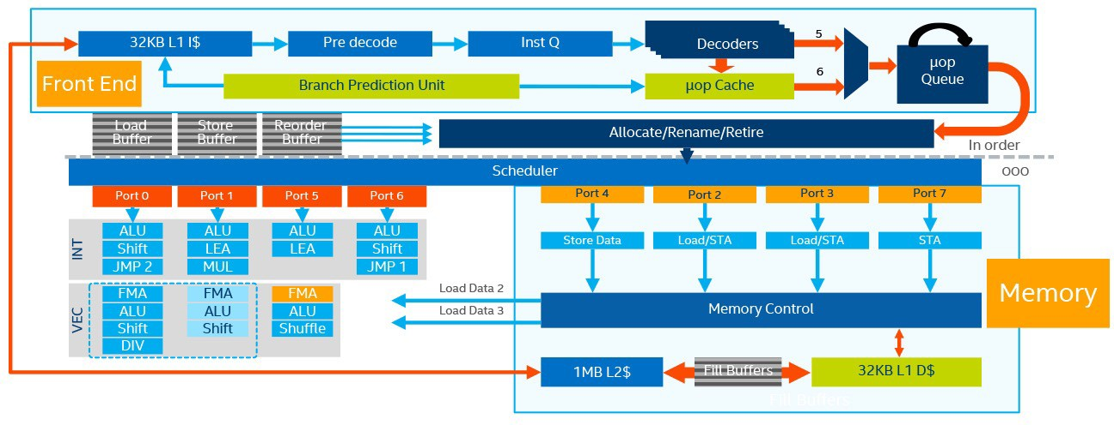
Modern Microarchitecture (Skylake)

Slide 36
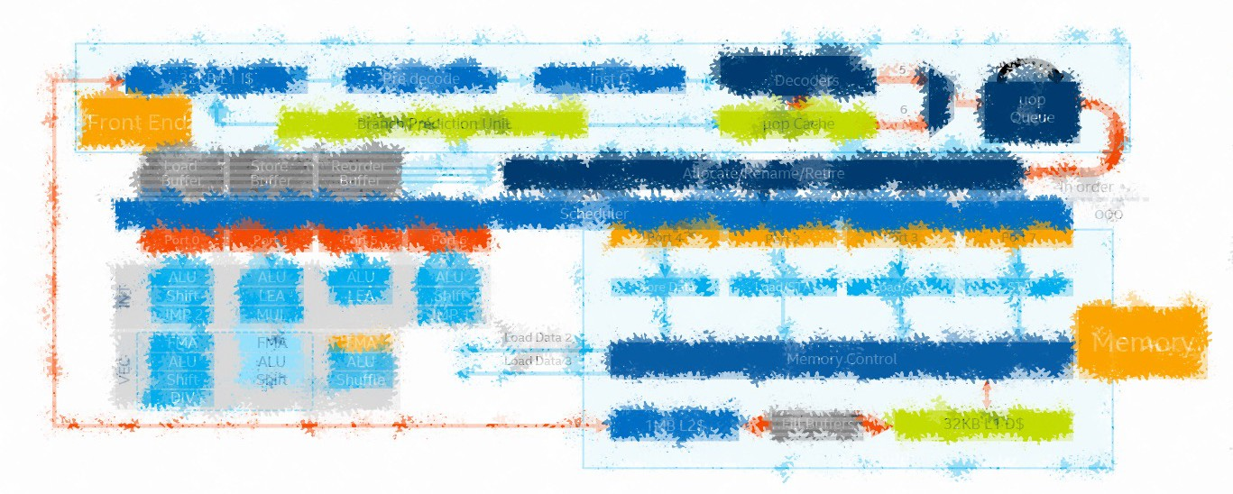
Modern Microarchitecture (Skylake)

Slide 37

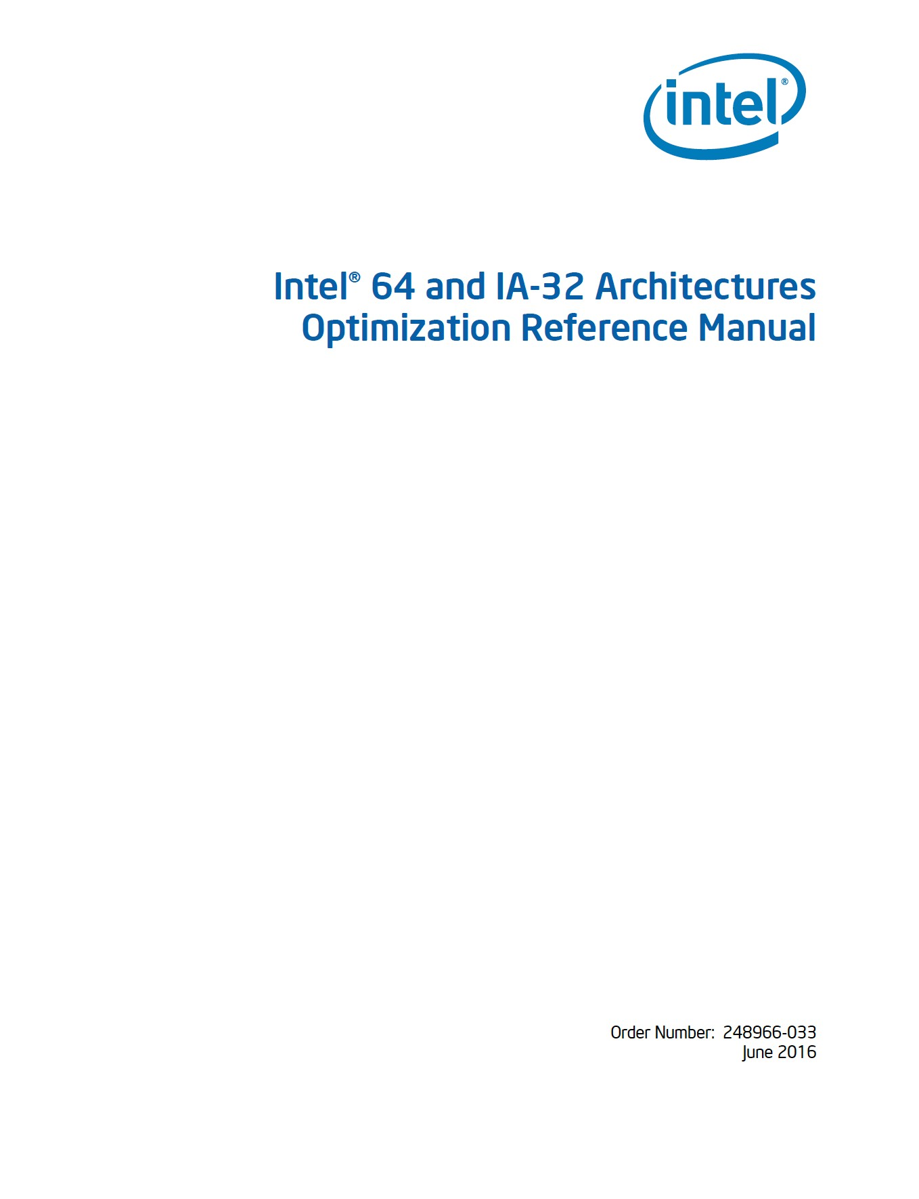

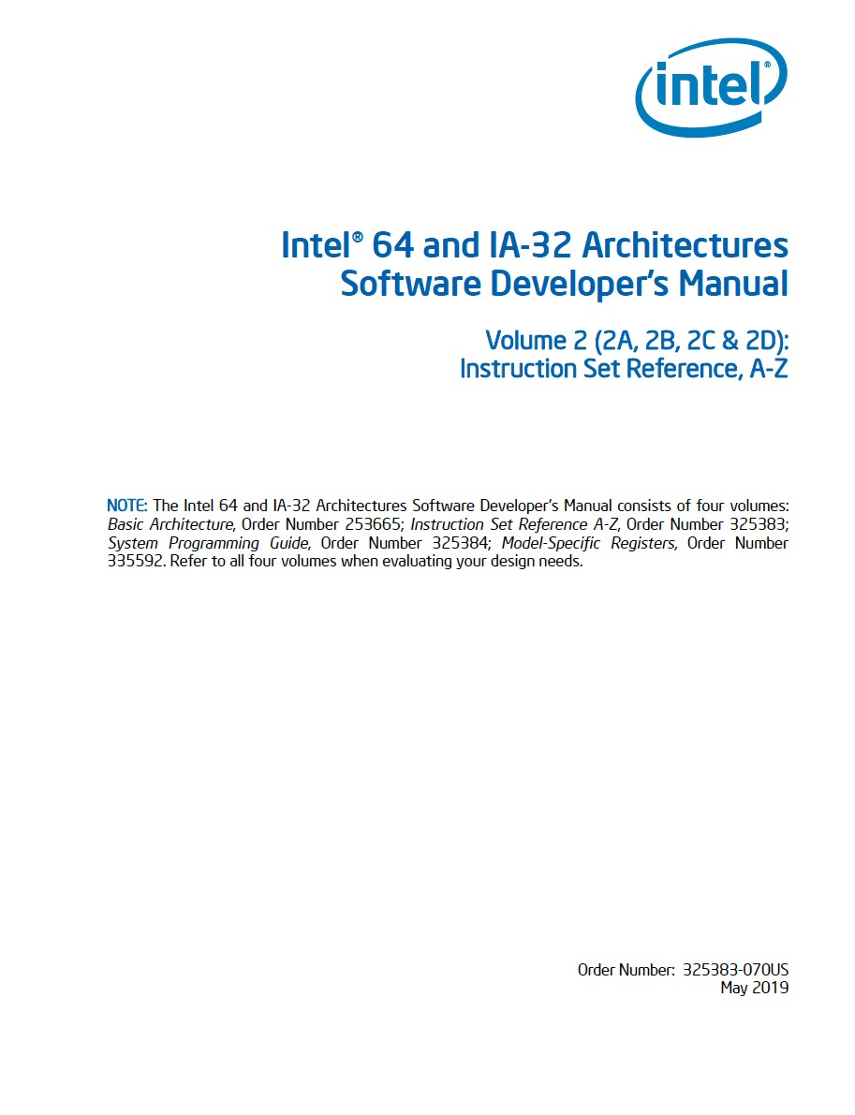
Design Documents
672 pages
2242 pages
Intel Manual
  Instruction specifications
  Optimizations
  CPU Parameters

Slide 38
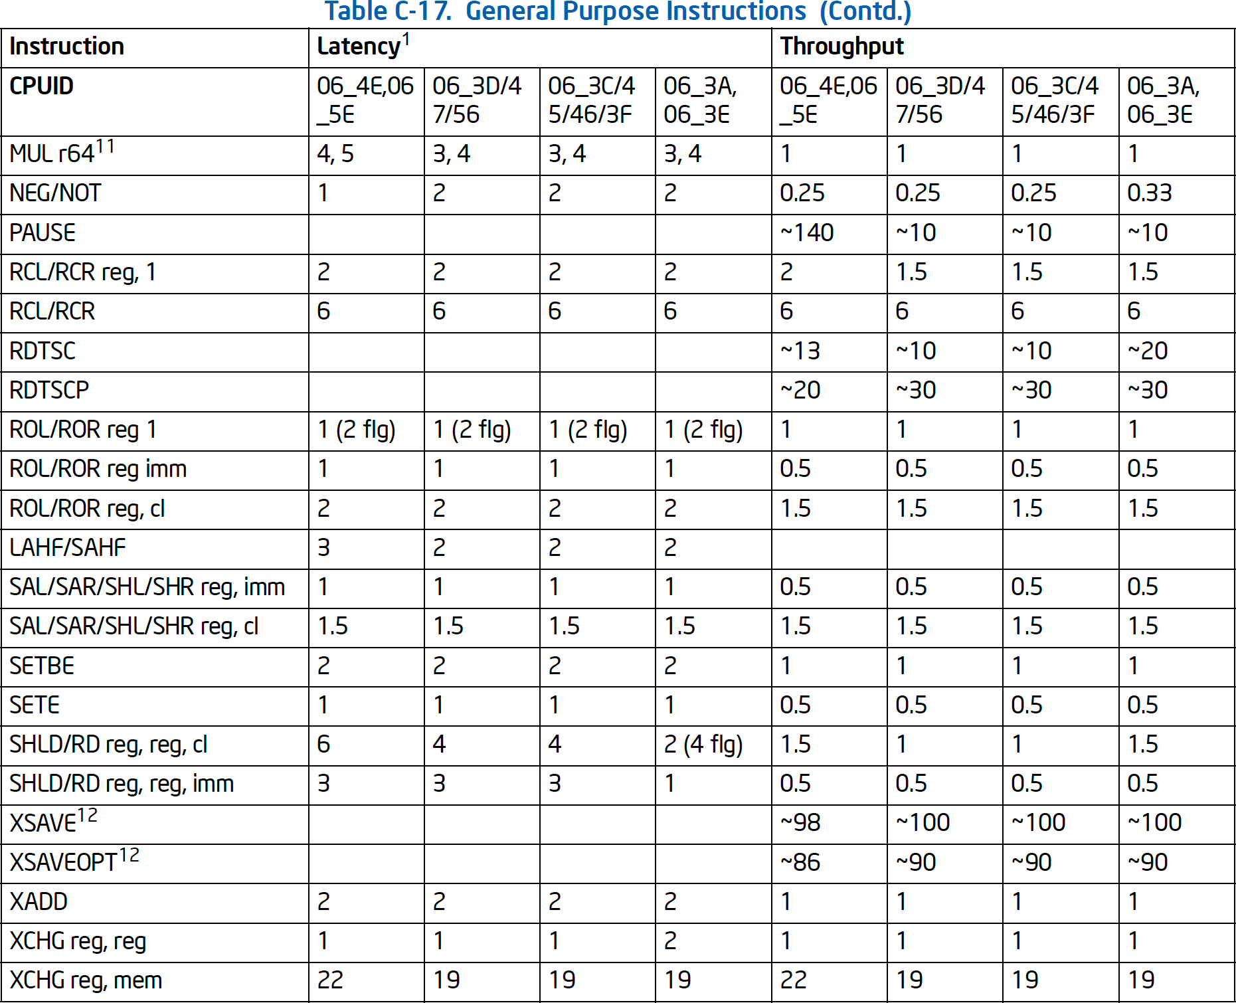
Instruction Tables

Slide 39

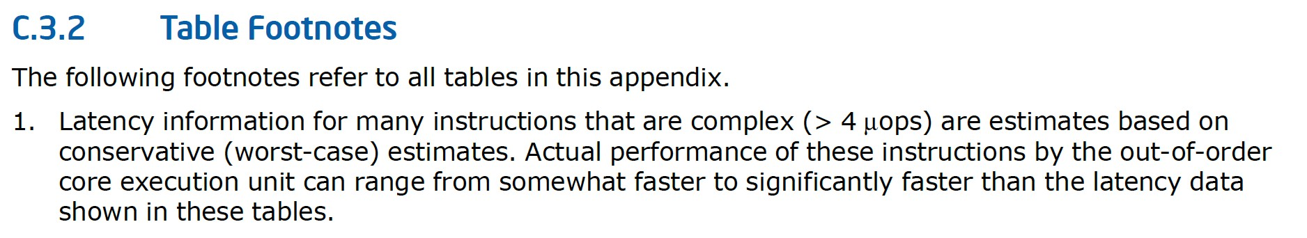
Instruction Tables

Slide 40
Modern Microarchitecture

Slide 41
Modern Performance Model
Decoder
Scheduler
Execution Units

Slide 42


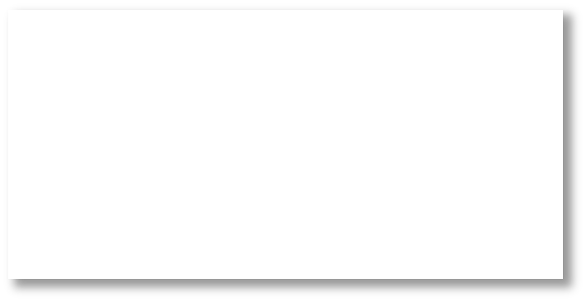
Modern Performance Model
Decoder
mov ebx, [ecx] add ecx, ebx shl eax, 0x02
Scheduler
2
Execution Units

Slide 43


Example
How many cycles to compute 100 iterations of:
vxorps xmm0 xmm0, xmm0

Slide 44
Example
How many cycles to compute 100 iterations of:
vxorps xmm0 xmm0, xmm0
Intel Instruction Set Reference Page 1955 of 2242:

Slide 45

Example
How many cycles to compute 100 iterations of:
r1 = r1 xor r1
Intel Instruction Set Reference Page 1955 of 2242:

Slide 46
Example
How many cycles to compute 100 iterations of:
r1 = r1 xor r1
Intel Instruction Set Reference Page 1955 of 2242:
Intel Architectures Optimization Reference Manual 655 of 672:
Instruction | Latency | Throughput
r1 = r2 xor r3 | 1 | 0.33

Slide 47
Example
How many cycles to compute 100 iterations of:
r1 = r1 xor r1
Intel Instruction Set Reference Page 1955 of 2242:
Intel Architectures Optimization Reference Manual 655 of 672:
?
Instruction | Latency | Throughput
r1 = r2 xor r3 | 1 | 0.33

Slide 48




Modeling Execution
Cycle Boundary
LLVM: 100
r1 = r1 xor r1
r1 = r1 xor r1
r1 = r1 xor r1
Instruction | Latency | Throughput
r1 = r2 xor r3 | 1 | 0.33

Slide 49
Modeling Execution
Cycle Boundary
LLVM: 100
r1 = r1 xor r1
r1 = r1 xor r1
r1 = r1 xor r1
Instruction | Latency | Throughput
r1 = r2 xor r3 | 1 | 0.33

Slide 50




Modeling Execution
Cycle Boundary
LLVM: 100
Optimized: ?
r1 = r1 xor r1
r1 = 0
r1 = r1 xor r1
r1 = 0
r1 = r1 xor r1
r1 = 0
Instruction | Latency | Throughput
r1 = r2 xor r3 | 1 | 0.33

Slide 51

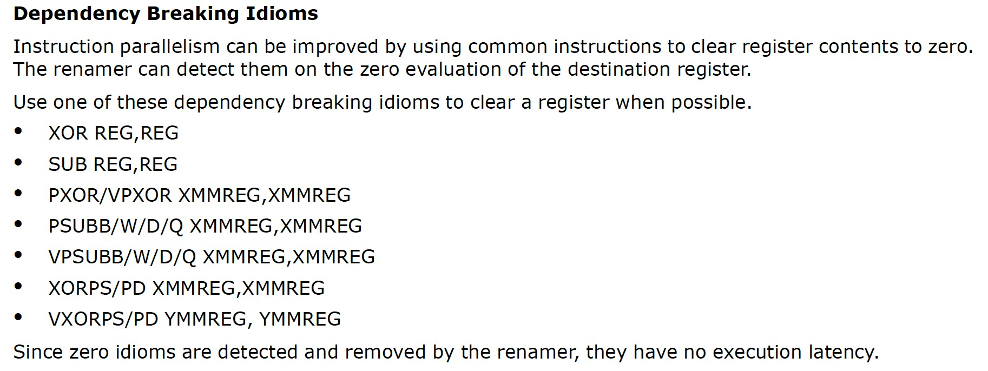




Modeling Execution
LLVM: 100
r1 = r1 xor r1
r1 = r1 xor r1 r1 = r1 xor r1
Intel IACA: 25
r1 = 0
r1 = 0
r1 = 0
r1 = 0
Instruction | Latency | Throughput
r1 = r2 xor r3 | 1 | 0.33

Slide 52
Modeling Execution
LLVM: 100
r1 = r1 xor r1
r1 = r1 xor r1 r1 = r1 xor r1
Intel IACA: 25
r1 = 0
r1 = 0
r1 = 0
r1 = 0
Instruction | Latency | Throughput
r1 = r2 xor r3 | 1 | 0.33

Slide 53
Modeling Execution
LLVM: 100
Intel IACA: 25
r1 = r1 xor r1
r1 = 0
r1 = r1 xor r1
r1 = 0
r1 = r1 xor r1
r1 = 0
Instruction
Latency
Throughput
r1 = 0
r1 = r2 xor r3
1
0.33

Slide 54
Modeling Execution
Cycle Boundary
LLVM: 100
Optimized: ?
r1 = r1 xor r1
r1 = 0
r1 = r1 xor r1
r1 = 0
r1 = r1 xor r1
r1 = 0
Instruction | Latency | Throughput
r1 = r2 xor r3 | 1 | 0.33

Slide 55
Modeling Execution
Cycle Boundary
LLVM: 100
Optimized: ?
r1 = r1 xor r1
r1 = 0
r1 = r1 xor r1
r1 = 0
r1 = r1 xor r1
r1 = 0
Instruction | Latency | Throughput
r1 = r2 xor r3 | 0 | 0.33

Slide 56
Modeling Execution
Cycle Boundary
LLVM: 100
Optimized: 33
r1 = r1 xor r1
r1 = 0
r1 = r1 xor r1
r1 = 0
r1 = r1 xor r1
r1 = 0
Instruction | Latency | Throughput
r1 = r2 xor r3 | 0 | 0.33

Slide 57
Modeling Execution
Cycle Boundary
Measurement/_{: 25}
LLVM: 100
Optimized: 33
Intel IACA
r1 = r1 xor r1
r1 = 0
r1 = r1 xor r1
r1 = 0
r1 = r1 xor r1
r1 = 0
Instruction | Latency | Throughput
r1 = r2 xor r3 | 0 | 0.33

Slide 58
Modeling Execution
Cycle Boundary
Measurement/_{: 25}
LLVM: 100
Optimized: 33
Intel IACA
r1 = r1 xor r1
r1 = 0
r1 = 0
r1 = r1 xor r1
r1 = 0
r1 = 0
r1 = r1 xor r1
r1 = 0
r1 = 0
Instruction | Latency | Throughput
r1 = r2 xor r3 | 0 | 0.33
r1 = 0

Slide 59
Modeling Execution
Cycle Boundary
Measurement/_{: 25}
LLVM: 100
Optimized: 33
Intel IACA
r1 = r1 xor r1
r1 = 0
r1 = 0
r1 = r1 xor r1
r1 = 0
r1 = 0
r1 = r1 xor r1
r1 = 0
r1 = 0
Instruction | Latency | Throughput
r1 = r2 xor r3 | 0 | .25
r1 = 0

Slide 60
Modeling Execution
Instruction | Latency | Throughput
r1 = r2 xor r3 | 1 | 0.33
LLVM: 100
What is the development methodology?
Instruction | Latency | Throughput
r1 = r2 xor r3 | 0 | .25
Measurement/_{: 25} Intel IACA

Slide 61


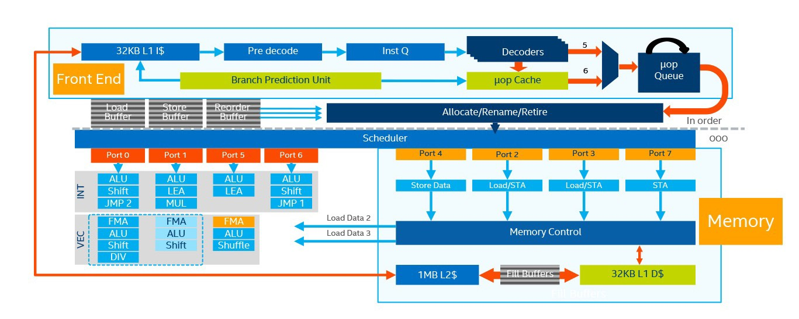
Development Methodology
Decoder
Scheduler
Execution Units

Slide 62
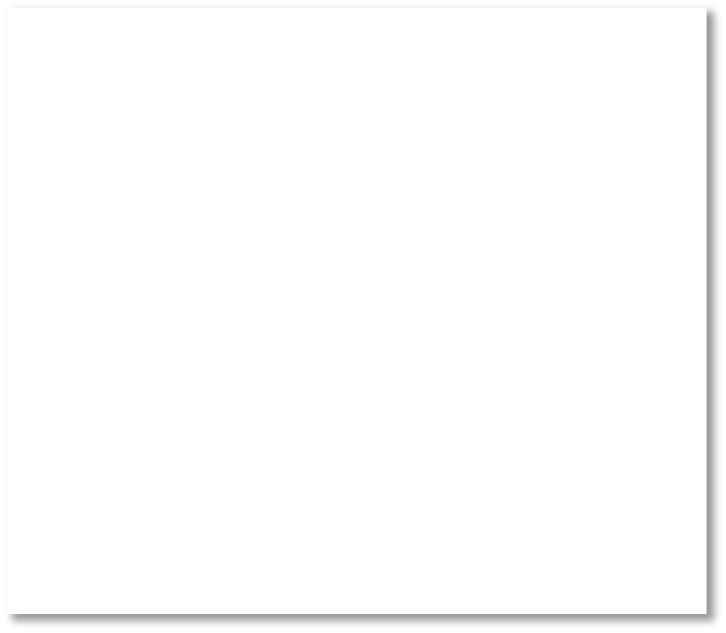




Development Methodology
Dataset
Decoder
Scheduler
mov ebx, [ecx] add ecx, ebx ] shl eax, 0x02 _{x]}
add eax, 0x01 shr eax, 0x04
Execution Units
mov ebx, [ecx
add ecx, ebx
f
mov ebx, [ec
add ecx, ebx

Slide 63








Development Methodology
Dataset
Decoder
Scheduler
mov ebx, [ecx] add ecx, ebx ] shl eax, 0x02 _{x]}
add eax, 0x01 shr eax, 0x04
Execution Units
mov ebx, [ecx
add ecx, ebx
f
mov ebx, [ec
add ecx, ebx

Slide 64




Development Methodology
Dataset
Decoder
Scheduler
mov ebx, [ecx] add ecx, ebx ] shl eax, 0x02 _{x]}
add eax, 0x01 shr eax, 0x04
Execution Units
mov ebx, [ecx
add ecx, ebx
−
=
f
mov ebx, [ec
add ecx, ebx

Slide 65
Development Methodology
Refine
Dataset
Decoder
Scheduler
mov ebx, [ecx] add ecx, ebx ] shl eax, 0x02 _{x]}
add eax, 0x01 shr eax, 0x04
Execution Units
mov ebx, [ecx
add ecx, ebx
−
=
f
mov ebx, [ec
add ecx, ebx

Slide 66
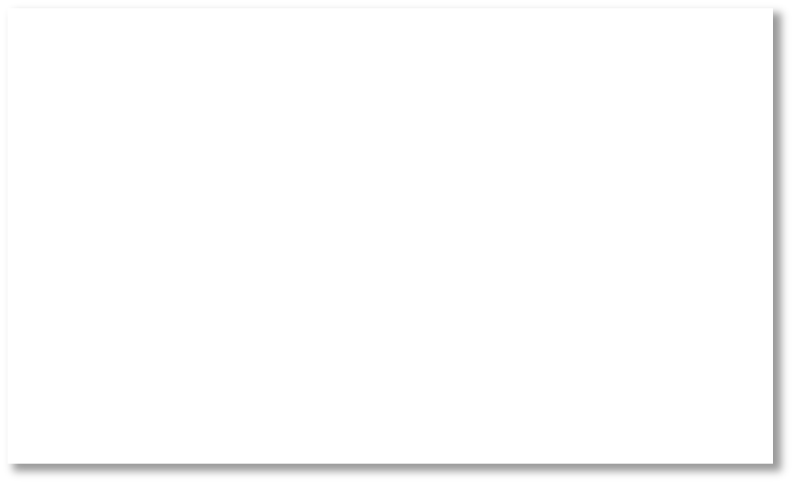
Development Methodology
Refine
Dataset
mov ebx, [ecx] add ecx, ebx ] shl eax, 0x02 _{x]}
add eax, 0x01 shr eax, 0x04
mov ebx, [ecx
add ecx, ebx
−
=
f
mov ebx, [ec
add ecx, ebx

Slide 67
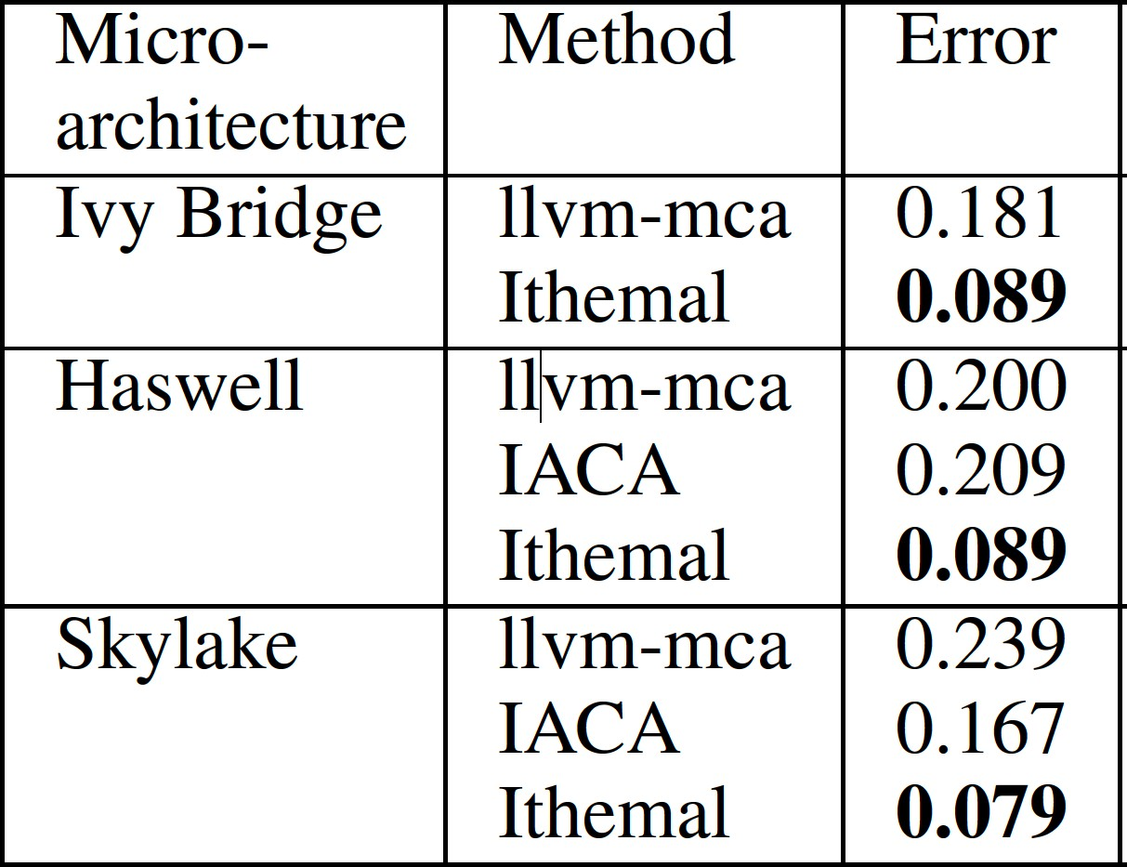
Ithemal
State-of-the-art performance
  Half the error of LLVM and Intel’s IACA
Mendis, Renda, Amarasinghe, and Carbin. Ithemal: Throughput Prediction with DNNs. ICML 2019
Chen et al., BHive: A Benchmark Suite and Measurement Framework for x86-64 Basic Blocks. IISWC 2019

Slide 68
Ithemal
State-of-the-art performance
  Half the error of LLVM and Intel’s IACA
Hierarchical Recurrent Neural Network
Mendis, Renda, Amarasinghe, and Carbin. Ithemal: Throughput Prediction with DNNs. ICML 2019
Chen et al., BHive: A Benchmark Suite and Measurement Framework for x86-64 Basic Blocks. IISWC 2019

Slide 69
Ithemal
State-of-the-art performance
  Half the error of LLVM and Intel’s IACA
Hierarchical Recurrent Neural Network
Novel throughput measurement system
  Invariants: no cache misses, preemptions, etc.
Mendis, Renda, Amarasinghe, and Carbin. Ithemal: Throughput Prediction with DNNs. ICML 2019
Chen et al., BHive: A Benchmark Suite and Measurement Framework for x86-64 Basic Blocks. IISWC 2019

Slide 70
Ithemal
State-of-the-art performance
  Half the error of LLVM and Intel’s IACA
Hierarchical Recurrent Neural Network
Novel throughput measurement system
  Invariants: no cache misses, preemptions, etc.
Dataset
  1.4M basic blocks: linux shared libraries, SPEC2006, SPEC2006, polybench, NAS, clang, python 2.7, python 3.5, firefox, rhythmbox,
Mendis, Renda, Amarasinghe, and Carbin. Ithemal: Throughput Prediction with DNNs. ICML 2019
Chen et al., BHive: A Benchmark Suite and Measurement Framework for x86-64 Basic Blocks. IISWC 2019

Slide 71
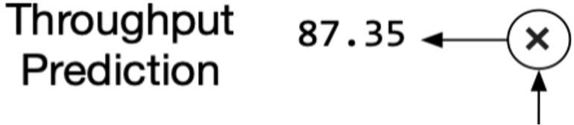
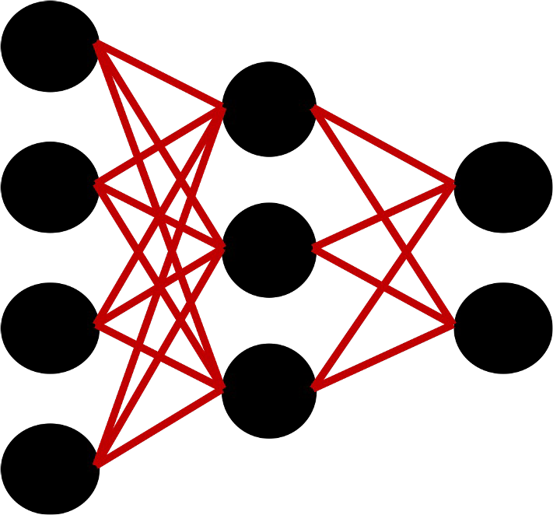
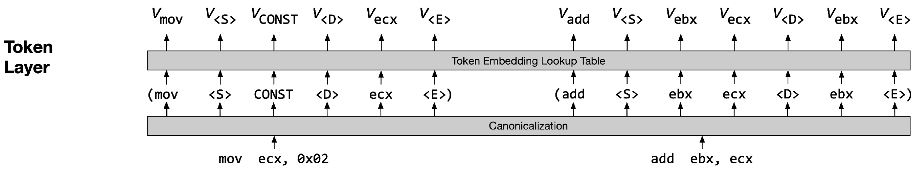
Ithemal
Token embeddings

Slide 72
Ithemal
Token embeddings

Slide 73
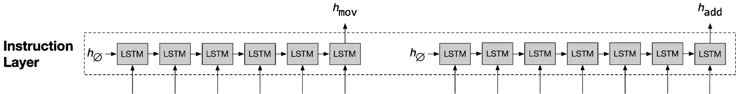
Ithemal
Instruction embeddings

Slide 74
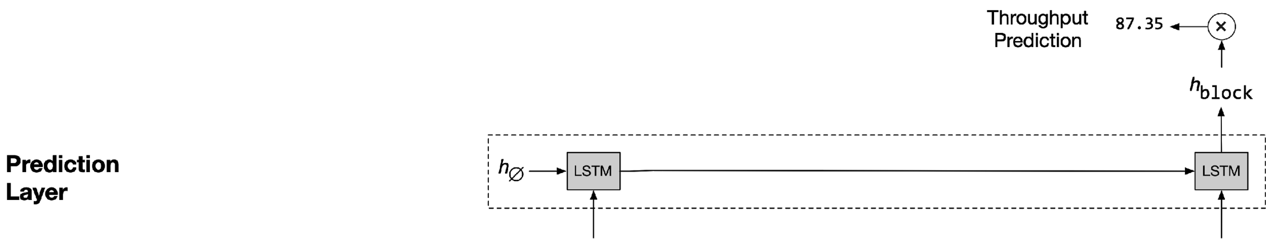
Ithemal

Slide 75
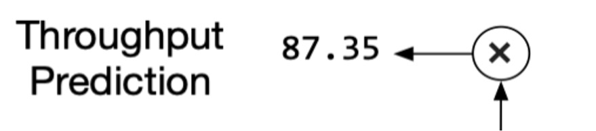
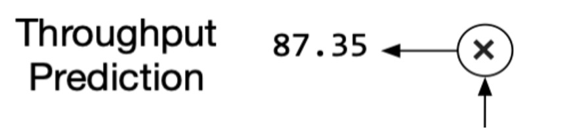
Ithemal
Token embeddings

Slide 76
Ithemal
Learned Representation (no features required)
Token embeddings

Slide 77
Modeling Execution
Ithemal: 26.8
Measurement/_{: 25}
LLVM: 100
Optimized: 33
Intel IACA
r1 = r1 xor r1
r1 = 0
r1 = 0
r1 = r1 xor r1
r1 = 0
r1 = 0
r1 = r1 xor r1
r1 = 0
r1 = 0
Instruction | Latency | Throughput
r1 = r2 xor r3 | 1 | 0.33
r1 = 0

Slide 78
Standard Development Methodology
Refine
Dataset
Decoder
Scheduler
mov ebx, [ecx] add ecx, ebx ] shl eax, 0x02 _{x]}
add eax, 0x01 shr eax, 0x04
Execution Units
mov ebx, [ecx
add ecx, ebx
−
=
f
mov ebx, [ec
add ecx, ebx

Slide 79
Ithemal
Refine
Dataset
mov ebx, [ecx] add ecx, ebx ] shl eax, 0x02 _{x]}
add eax, 0x01 shr eax, 0x04
mov ebx, [ecx
add ecx, ebx
−
=
f
mov ebx, [ec
add ecx, ebx

Slide 80
Ithemal
Refine
Dataset
mov ebx, [ecx] add ecx, ebx ] shl eax, 0x02 _{x]}
add eax, 0x01 shr eax, 0x04
mov ebx, [ecx
add ecx, ebx
−
=
f
mov ebx, [ec
add ecx, ebx
Interpretability?

Slide 81
Neurosymbolic
Refine
Dataset
Decoder
Scheduler
mov ebx, [ecx] add ecx, ebx ] shl eax, 0x02 _{x]}
add eax, 0x01 shr eax, 0x04
mov ebx, [ecx
add ecx, ebx
−
=
f
mov ebx, [ec
add ecx, ebx

Slide 82
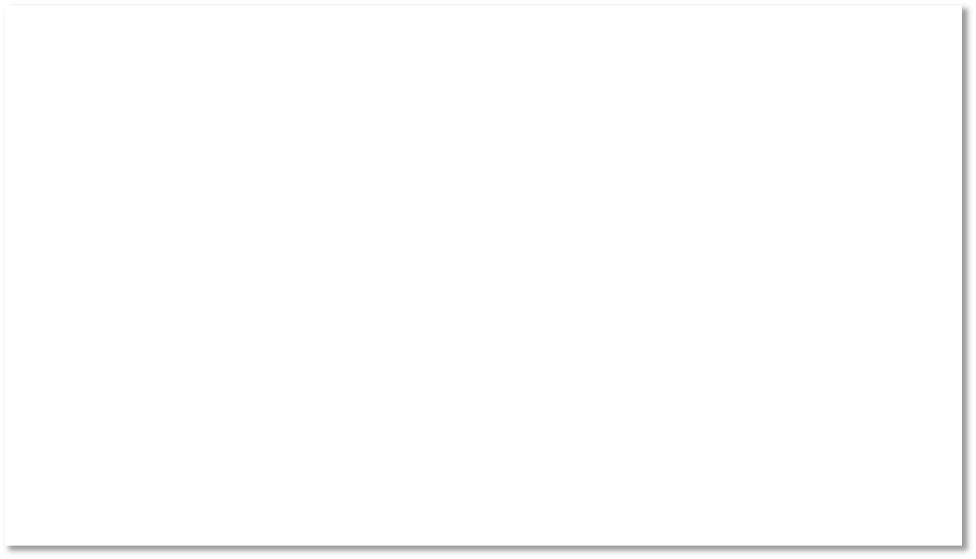
Modeling Execution
Ithemal: 26.8
Measurement/_{: 25}
LLVM: 100
Optimized: 33
el IACA
Int
r1 r1 = 0
r1 r1 = 0
r1 r1 = 0
r1 = r1 xor
r1 = 0
Can we learn LLVM’s
r1 = r1 xor
parameters?
r1 = 0
r1 = r1 xor
r1 = 0
Instruction | Latency | Throughput
r1 = r2 xor r3 | 1 | 0.33
r1 = 0

Slide 83
llvm-mca
Register Renamer
Execution Units
Load/Store Unit
lea
r12, [rbx-0x40]
…
Dispatcher
Issuer
Retire Control
41 cycles
cmp rdx, r14
Reorder Buffer
10KLoC C++ program with 11,000 integer-valued parameters
DiffTune: Optimizing CPU Simulator Parameters with Learned Differentiable Surrogates Renda, Chen, Mendis, and Carbin (MICRO 2020)

Slide 84
llvm-mca
Register Renamer
Execution Units
Load/Store Unit
Dispatcher
lea
r12, [rbx-0x40]
…
Issuer
Retire Control
41 cycles
cmp rdx, r14
Reorder Buffer
DispatchWidth k instructions/cycle 1 parameter (global)

Slide 85
llvm-mca
Register Renamer
Execution Units
Load/Store Unit
lea
r12, [rbx-0x40]
…
Dispatcher
Issuer
Retire Control
41 cycles
cmp rdx, r14
Reorder Buffer
DispatchWidth k instructions/cycle 1 parameter (global)
ReorderBufferSize
k instructions
1 parameter (global)

Slide 86
llvm-mca
Register Renamer
Execution Units
Load/Store Unit
Issuer
lea
r12, [rbx-0x40]
…
Dispatcher
Retire Control
41 cycles
cmp rdx, r14
Reorder Buffer
WriteLatency ReadAdvanceCycles k-j cycles before defs can be used
up to 4 parameters (per inst)
DispatchWidth k instructions/cycle 1 parameter (global)
ReorderBufferSize
k instructions
1 parameter (global)

Slide 87
llvm-mca
Execution Units
Register Renamer
Load/Store Unit
lea
r12, [rbx-0x40]
…
Dispatcher
Issuer
Retire Control
41 cycles
cmp rdx, r14
Reorder Buffer
WriteLatency ReadAdvanceCycles k-j cycles before defs can be used
up to 4 parameters (per inst)
PortMap
{Port0: 1 cycle
Port3: 2 cycles} 10 parameters (per inst)
DispatchWidth k instructions/cycle 1 parameter (global)
ReorderBufferSize
k instructions
1 parameter (global)

Slide 88
llvm-mca
Register Renamer
Execution Units
Load/Store Unit
lea
r12, [rbx-0x40]
…
Dispatcher
Issuer
Retire Control
41 cycles
cmp rdx, r14
Reorder Buffer
10KLoC C++ program with 11,000 integer-valued parameters

Slide 89

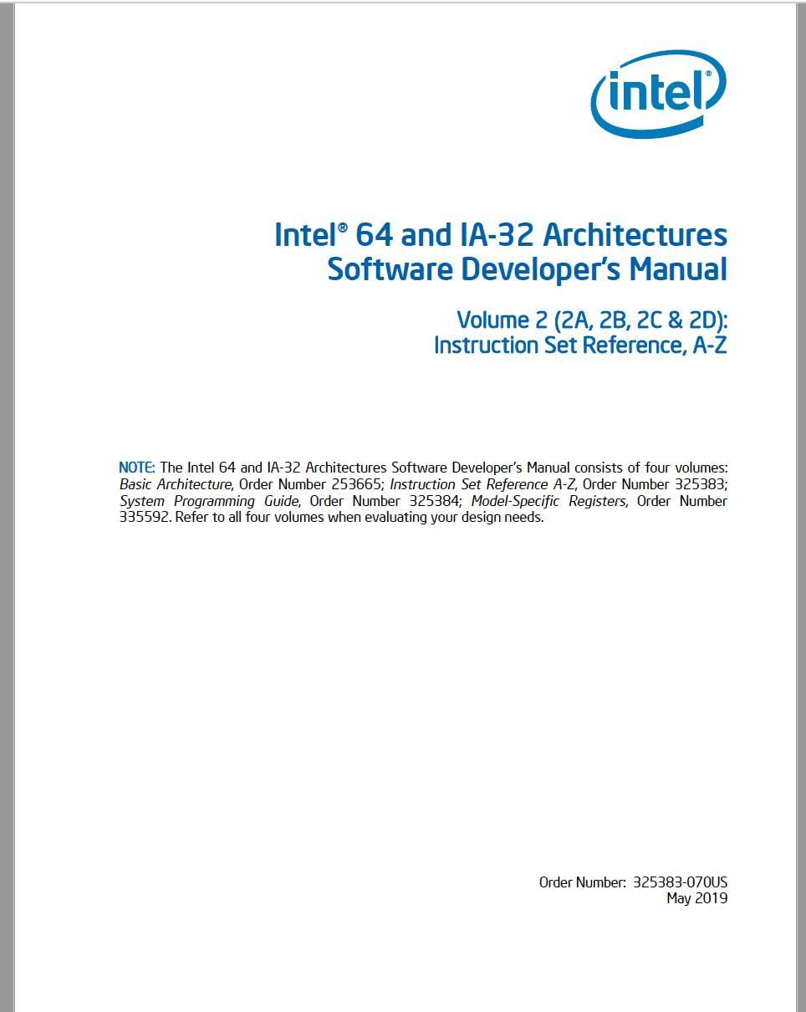
Design Documents
672 pages
2242 pages
Intel Manual
  Instruction specifications
  Optimizations
  CPU Parameters

Slide 90
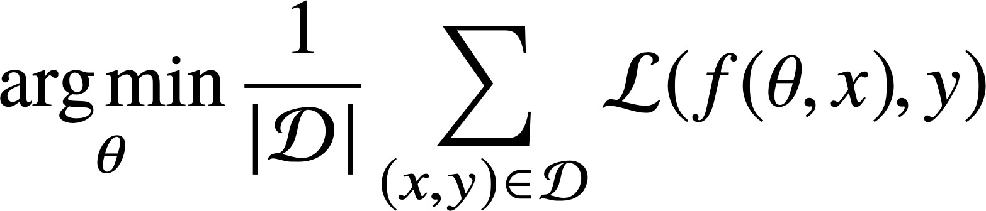
DiffTune: differentiable surrogate optimization
Optimization Problem
(Stochastic) Search: the parameter space is too large! (10^{19,336} possible configurations)

Slide 91
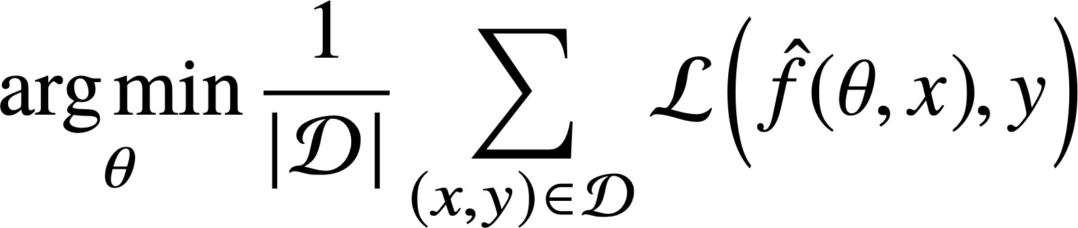

DiffTune: differentiable surrogate optimization
Optimization Problem
Surrogate Optimization Problem
𝑓# (surrogate): a neural network that approximates behavior of the simulator – conditioned on a set of simulator parameters.
Enables gradient-based optimization.

Slide 92
SHR64mi Timing
4
Ground truth
3
2
1
Timing
1
2
3
4
5 6
DispatchWidth
7
8
9
10

Slide 93

SHR64mi Timing
4
Ground truth llvm-mca
3
2
1
Timing
1
2
3
4
5 6
DispatchWidth
7
8
9
10

Slide 94
SHR64mi Timing
4
Ground truth llvm-mca Surrogate
3
Timing
2
1
1
2
3
4
5 6
DispatchWidth
7
8
9
10

Slide 95
DiffTune: differentiable surrogate optimization
Optimization Problem
Surrogate Optimization Problem
𝑓# (surrogate): a neural network that approximates behavior of the simulator – conditioned on a set of simulator parameters.
Enables gradient-based optimization.

Slide 96
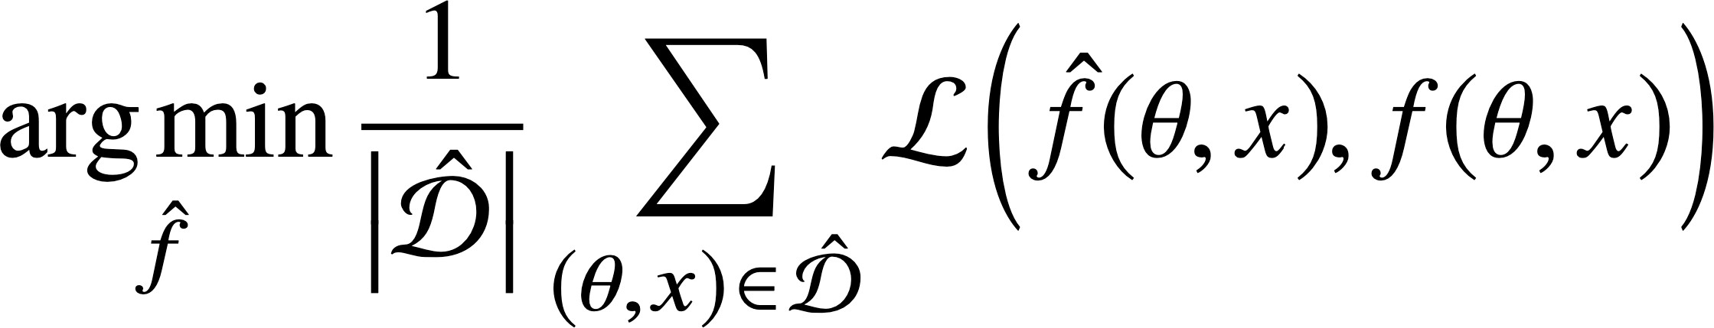
DiffTune: differentiable surrogate optimization
Optimization Problem
Surrogate Optimization Problem
Ithemal
Surrogate Learning Problem

Slide 97
Results
102
Expert
105
DiffTune
113
OpenTuner
131
50%
40%
30%
20%
10%
0%
> |  |  | 100 | > |  |  | 100 | > |  |  | 100 | > |  |  | 100
 |  |  |  |  |  |  |  |  |  |  |  |  | 35
 | 34
 |  |  |  |  |  |  |  |  | 27
 |  |  |  |  |  |  |  |  |  |  |  |  |  | 26
 |  | 25 |  |  | 25
 |  |  |  |  |  | 24
 |  |  |  |  |  |  |  |  |  | 23
Mean Absolute Percentage Error (MAPE)
Ivy Bridge
Haswell
Skylake
Zen2

Slide 98
Modeling Execution
Ithemal: 26.8
Measurement/_{: 25}
LLVM: 100
Optimized: 33
Intel IACA
r1 = r1 xor r1
r1 = 0
r1 = 0
r1 = r1 xor r1
r1 = 0
r1 = 0
r1 = r1 xor r1
r1 = 0
r1 = 0
Instruction | Latency | Throughput
r1 = r2 xor r3 | 1 | 0.33
r1 = 0

Slide 99
LLVM with DiffTune: 27
Modeling Execution
Ithemal: 26.8
Measurement/_{: 25}
LLVM: 100
Optimized: 33
Intel IACA
r1 = r1 xor r1
r1 = 0
r1 = 0
r1 = r1 xor r1
r1 = 0
r1 = 0
r1 = r1 xor r1
r1 = 0
r1 = 0
Instruction | Latency | Throughput
r1 = r2 xor r3 | 1 | 0.33
r1 = 0

Slide 100


The Emerging Systems Challenge
Performance Model (Learned)
Compiler
Hardware Specification (Architect)
Behavioral Model (Learned)

Slide 101


The Emerging Systems Challenge
Performance Model (Learned)
Compiler
Hardware Specification (Architect)
Behavioral Model (Learned)

Slide 102
The Emerging Systems Challenge
Performance Model (Learned)
Compiler
Hardware Specification (Architect)
Behavioral Model (Learned)
Compiler Auto-Vectorization using Imitation Learning Mendis, Yang, Pu, Amarasinghe, and Carbin (NeurIPS 19)

Slide 103
Standard Development Methodology
Refine
Dataset
Decoder
Scheduler
mov ebx, [ecx] add ecx, ebx ] shl eax, 0x02 _{x]}
add eax, 0x01 shr eax, 0x04
Execution Units
mov ebx, [ecx
add ecx, ebx
−
=
f
mov ebx, [ec
add ecx, ebx

Slide 104
Ithemal (Neural)
Refine
Dataset
mov ebx, [ecx] add ecx, ebx ] shl eax, 0x02 _{x]}
add eax, 0x01 shr eax, 0x04
mov ebx, [ecx
add ecx, ebx
−
=
f
mov ebx, [ec
add ecx, ebx

Slide 105
DiffTune (Neurosymbolic)
Refine
Dataset
Decoder
Scheduler
mov ebx, [ecx] add ecx, ebx ] shl eax, 0x02 _{x]}
add eax, 0x01 shr eax, 0x04
mov ebx, [ecx
add ecx, ebx
−
=
f
mov ebx, [ec
add ecx, ebx

Slide 106
The Future of Software
Refine
Dataset
Decoder
Scheduler
mov ebx, [ecx] add ecx, ebx ] shl eax, 0x02 _{x]}
add eax, 0x01 shr eax, 0x04
“sort list”
mov ebx, [ecx
add ecx, ebx
−
=
f
mov ebx, [ec
add ecx, ebx

Slide 107
Uncertainty (Downwards)
Environment
Application |  | Libraries
Compiler and Runtime System
Operating System
Hardware System

Slide 108
Uncertainty (Downwards)
Environment is only partially observable.
Sensing and data is noisy.
Environment models only correct with a given probability.
Credit: Jeremy Cohen

Slide 109
Uncertainty (Upwards)
Environment
Application |  | Libraries
Compiler and Runtime System
Operating System
Hardware System
Heterogenous and statistical computational substrates:
CPU, GPU, accelerator, reduced precision, stochastic, analog, quantum.

Slide 110
Jacobi Iterative Method (with Error)
3000
Errant
2500
Original
Norm of Residual
2000
1500
1000
~5500
500
𝜖 = 450
Δ𝑇 = 2.6%
0
0
2000
4000
6000
8000
10000
12000
14000
16000
18000
Iteration
Leto (OOPSLA ‘18)

Slide 111
Uncertainty
Environment
Application |  | Libraries
Compiler and Runtime System
Operating System
Hardware System

Slide 112
Uncertainty
Environment
Application |  | Libraries
Compiler and Runtime System
Operating System
Hardware System
Neurosymbolic programs, including large language models

Slide 113
Programming Uncertain Computations
Semantics
Programming Methodology Reasoning
float num = b[i] -. sigma; x[i] = num /. A[i][i];
Leto
Real-Valued, Nondeterministic, Probabilistic
(LICS 18, ICFP 19, PLDI 20, OOPSLA 20, POPL 21)
Execution Model
SMT
Solver
SMT
Solver
“sort list”
Program
Invariant Inference
Verifier
✘
Representations
Surrogate Programming
(Onward! 21)
Verification and PAC Learning
(OOPSLA 18, OOPSLA 20, IJCAI 22, AAAI 23)
Efficient Probabilistic Inference and Deep Learning
(PLDI 20, POPL 21, OOPSLA 21, OOPSLA 22, ICLR 19,
ICLR 20, ICML 20, NeurIPS 20, ICLR 21, NeurIPS 22)

Slide 114
Programming Uncertain Computations
Semantics
Programming Methodology
Surrogate Programming
(Onward! 21)
Reasoning
float num = b[i] -. sigma; x[i] = num /. A[i][i];
Leto
Real-Valued, Nondeterministic, Probabilistic
(LICS 18, ICFP 19, PLDI 20, OOPSLA 20, POPL 21)
Execution Model
SMT
Solver
SMT
Solver
“sort list”
Program
Invariant Inference
Verifier
✘
Representations
Verification and PAC Learning
(OOPSLA 18, OOPSLA 20, IJCAI 22, AAAI 23)
Efficient Probabilistic Inference and Deep Learning
(PLDI 20, POPL 21, OOPSLA 21, OOPSLA 22, ICLR 19,
ICLR 20, ICML 20, NeurIPS 20, ICLR 21, NeurIPS 22)

Slide 115
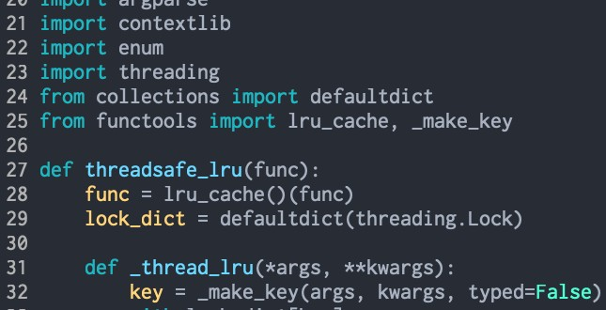
Modeling Program Behavior
Surrogate: model the input-output (I/O) behavior of a program
Program
Outputs
Inputs
Program
≈
Inputs
Surrogate
Outputs

Slide 116
Towards a Theory of Learning Surrogates
Programs are functions, ⟦𝑝⟧. Literature [1,2] provides rough sample complexity bounds on neural networks’ ability to learn classes of functions
Idea: programs also have intensional representations that we can analyze and leverage to provide better bounds.
Fine-Grained Analysis of Optimization and Generalization for Overparameterized Two-Layer Neural Networks.
Arora, Du, Hu, Li, and Wang, 2019
One Network Fits All? Modular versus Monolithic Task Formulations in Neural Networks Agarwala, Das, Juba, Panigrahy, Sharan, Wang, Zhang, 2021

Slide 117
Towards a Theory of Learning Surrogates
if (…)
Problem Statement: to learn I/O behavior of this program, how to generate inputs to sample program behavior?
According to the data distribution? Uniformly?
f
g

Slide 118
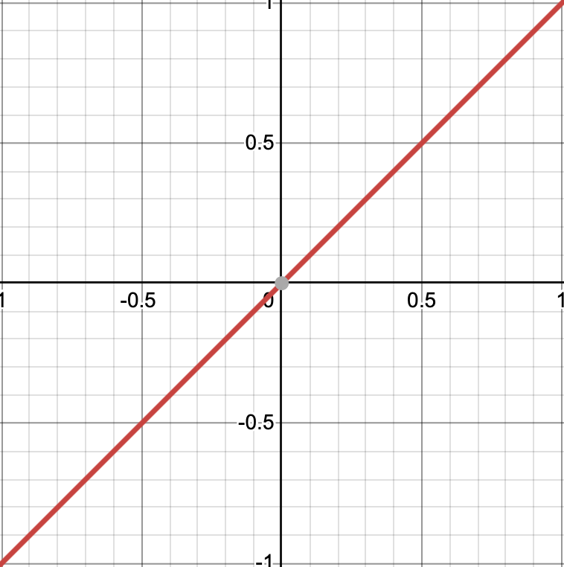
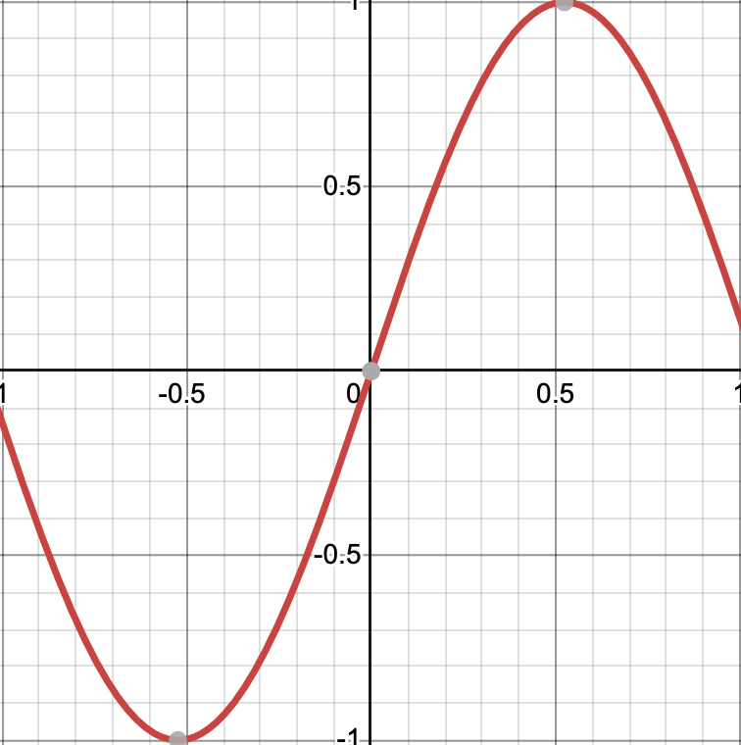
Towards a Theory of Learning Surrogates
if (…)
Problem Statement: to learn I/O behavior of this program, how to generate inputs to sample program behavior?
According to the data distribution? Uniformly?
Approach: guide samples towards more complex functionality
(determined through program analysis).
f
g

Slide 119



Preliminary Results
Ground truth
Uniform sampling
Guided Sampling

Slide 120
Programming Uncertain Computations
Semantics
Programming Methodology
Reasoning
✘
Verification and PAC Learning
(OOPSLA 18, OOPSLA 20, IJCAI 22, AAAI 23)
float num = b[i] -. sigma; x[i] = num /. A[i][i];
Leto
Real-Valued, Nondeterministic, Probabilistic
(LICS 18, ICFP 19, PLDI 20, OOPSLA 20, POPL 21)
Execution Model
SMT
Solver
SMT
Solver
“sort list”
Program
Invariant Inference
Verifier
Representations
Surrogate Programming
(Onward! 21)
Efficient Probabilistic Inference and Deep Learning
(PLDI 20, POPL 21, OOPSLA 21, OOPSLA 22, ICLR 19,
ICLR 20, ICML 20, NeurIPS 20, ICLR 21, NeurIPS 22)

Slide 121
Reasoning
Safety: does program satisfy basic invariants?
Generalization: does it return expected results on unseen inputs?
Robustness: do system behaviors change under slight perturbations of data? Interpretability: can I understand and triage failures?

Slide 122
Jacobi Iterative Method (with Error)
3000
Errant
2500
Original
Self-stabilizing Algorithm
Norm of Residual
2000
Δ𝑇 = 𝑂(log(𝝐))
1500
1000
~5500
500
𝜖 = 450
Δ𝑇 = 2.6%
0
0
2000
4000
6000
8000
10000
12000
14000
16000
18000
Iteration
Leto (OOPSLA ‘18)

Slide 123
Takeaway
Landscape of software systems is changing:
Probabilistic, heterogenous execution substrates.
Computations in partially observable environments.
Computations with opaque machine learning components.
Consequence: results computed with a given imprecision or inaccuracy.
Opportunity to deliver reliable systems by delivering a sound software development methodology that addresses system challenges.

