Slide 1

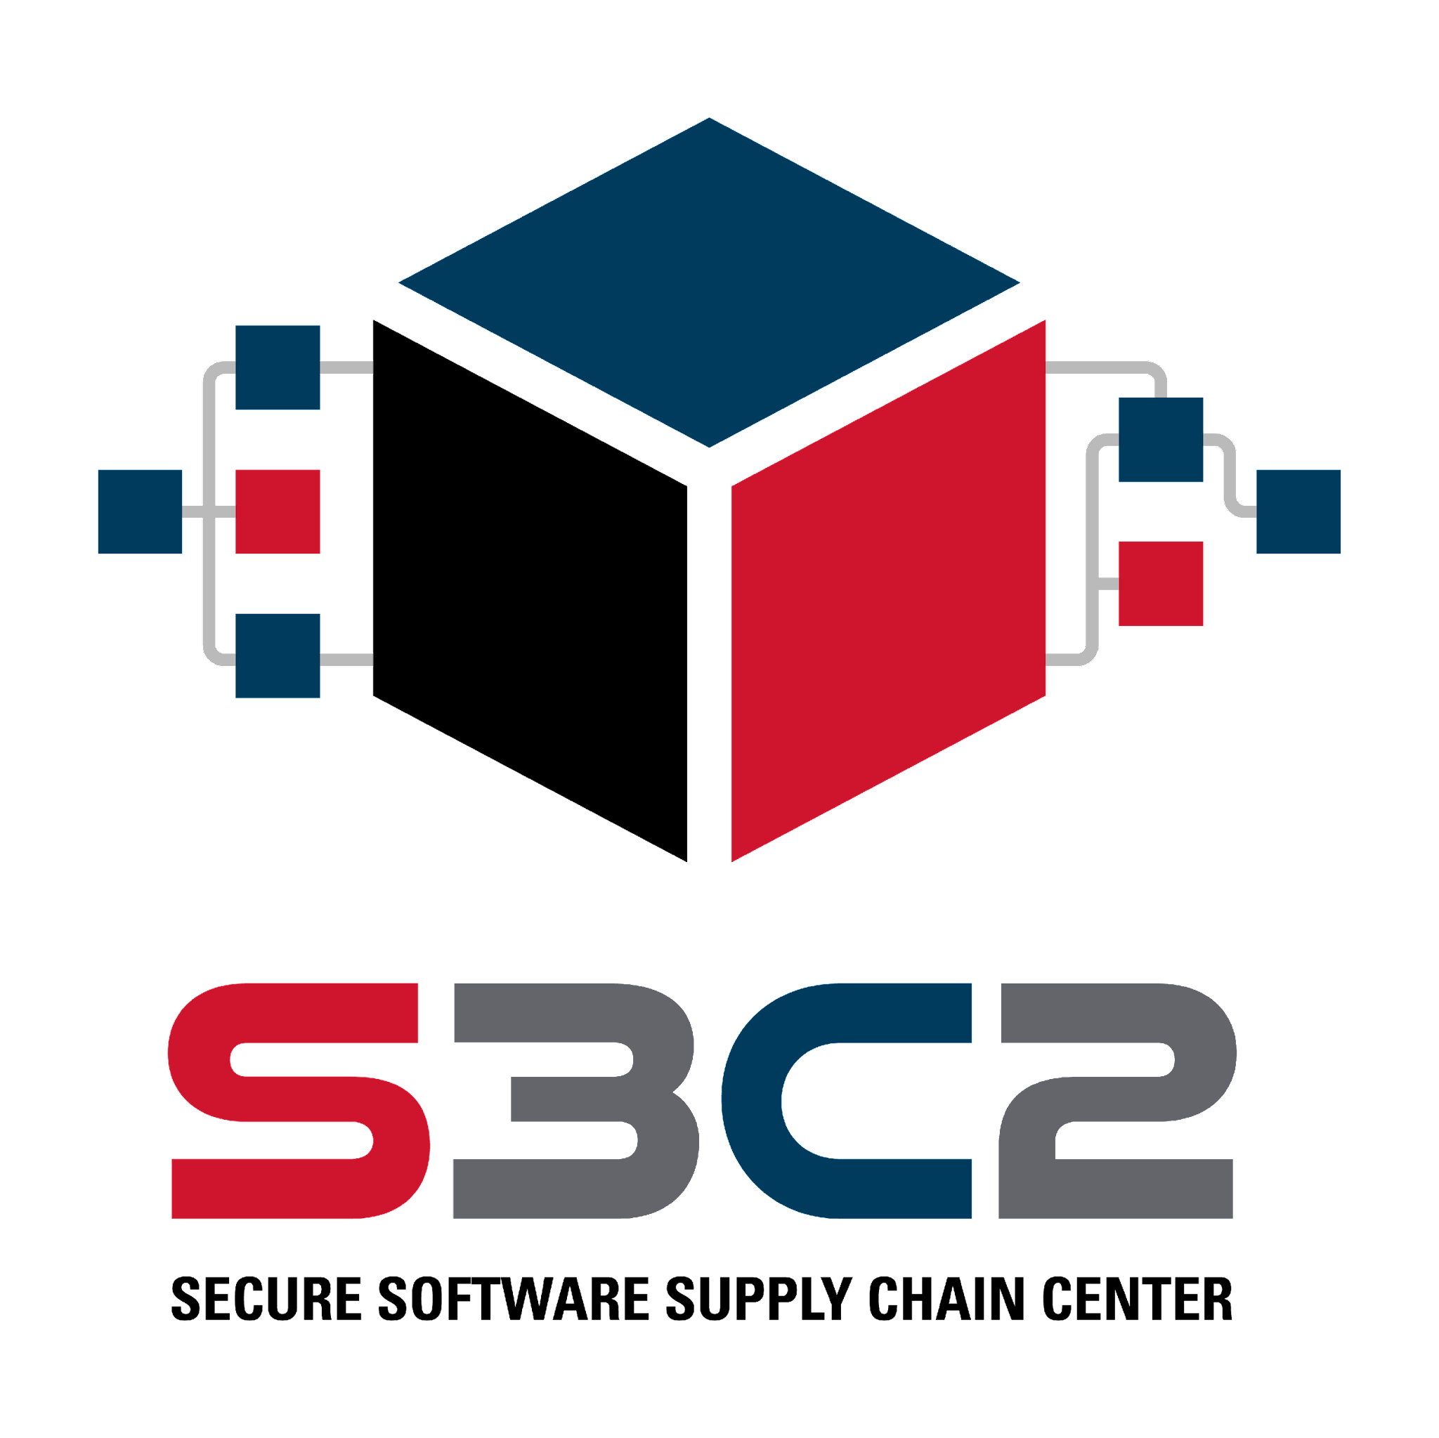
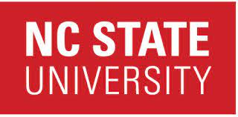
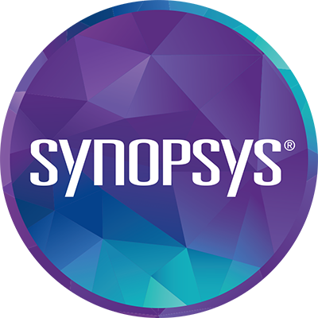
How are We Doing with Adopting Tasks to Reduce Software Supply Chain Security Risk?
Laurie Williams

Slide 2




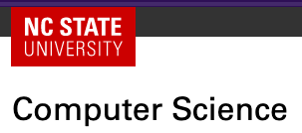
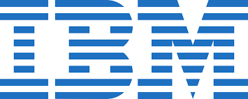

Let life surprise you

Slide 3




Digital innovation depends on third-party software
Innovation, competitive advantage
Sonatype finds 747% average increase in open
source supply chain attacks over the last three years.
Notes:
Software is everywhere -- from our phones to our cars, to our refrigerators, to our lightbulbs, and especially in the critical infrastructure like the power grids. What most members of the general public and even the technical community may not understand is that the foundation of most software, even proprietary software produced by companies like Microsoft or Apple is open source software -- which is below the surface of the water line. Anecdotally, 80% of all software is open source software -- the common, basic functionality. The innovation --the tip of the iceberg -- is the proprietary, innovative software distinguishing its products from its competitors and providing exciting new solutions. What many people may not realize is that most of the software in our phones, cars, and the power grid is developed all over the world by good developers and potentially by bad developers, even nation-state actors who could and are causing great harm -- but it can get much worse. But, if software vendors had to develop the functionality below the water line because of fear about these developers all over the world -- innovation would grind to a halt. That would be like Tesla not trusting the screws it buys and needing to start manufacturing screws themselves. Plummeting trust in the software supply chain may decelerate digital innovation if the software industry feels the need to divert resources to reduce risks

Slide 4
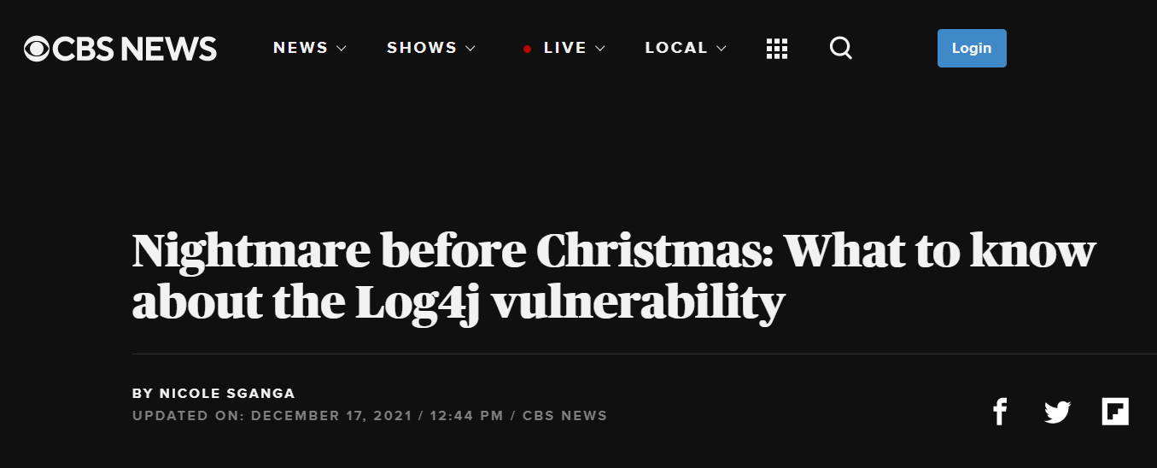

Oops! Accidental dependency vulnerability
Seventyfour i/stock.adobe.com
Yingyaipumi/stock.adobe.com
Notes:
the log4j vulnerability accidentally injected by a well-meaning developer and this vulnerability was exploited by attackers once discovered. Is a remotely exploitable vulnerability in Log4j, an open-source, Java-based logging framework that is a component of Apache web servers
log4j-core, the vulnerable version of the module, was the 252nd most popular component by download volume in Sonatype’s Maven Central code repository out of a total population of 7.1 million artifacts - that’s the top 0.003% percentile

Slide 5

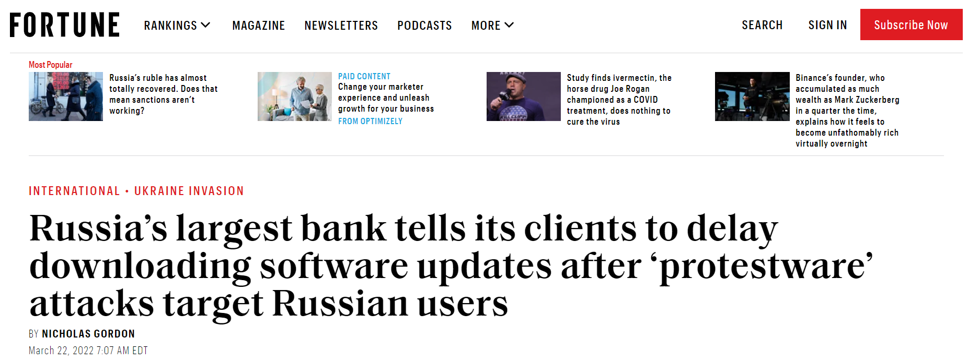


Code dependencies as an attack vector
Code dependencies as a weapon
Siridhata/stock.adobe.com
Sergey Nivens /stock.adobe.com
Notes:
On this slide are headlines that appear to the general public - in places like CBS News and Fortune that are actually supply chain attacks. Both the log4j and the Russian protestware headlines are instances of vulnerabilities in the code dependencies of the software supply chain - the log4j vulnerability accidentally injected by a well-meaning developer and this vulnerability was exploited by attackers once discovered. The protestware is an instance of a vulnerability maliciously and intentionally injected to cause harm.

Slide 6
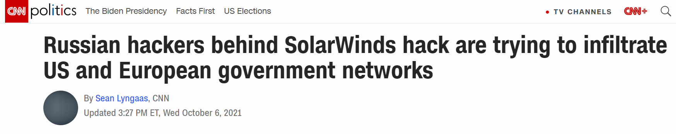

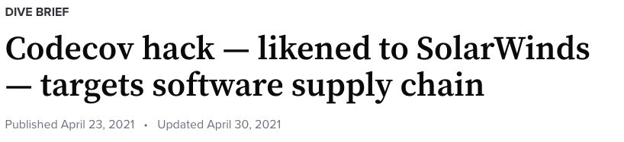

Build infrastructure as an attack vector
Notes:
Other high profile attacks that hit the popular press were Solarwinds and Codecov. These are both examples of attackers using the build infrastructure in the software supply chain to launch attacks.

Slide 7

Large Language Models (LLMs) as an attack vector
Notes:
Other high profile attacks that hit the popular press were Solarwinds and Codecov. These are both examples of attackers using the build infrastructure in the software supply chain to launch attacks.

Slide 8
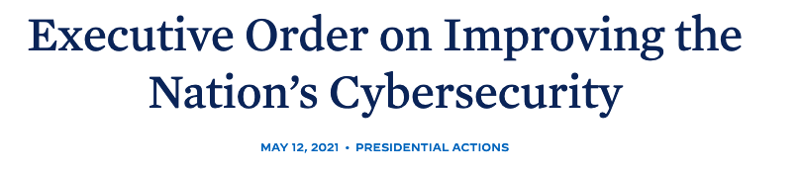
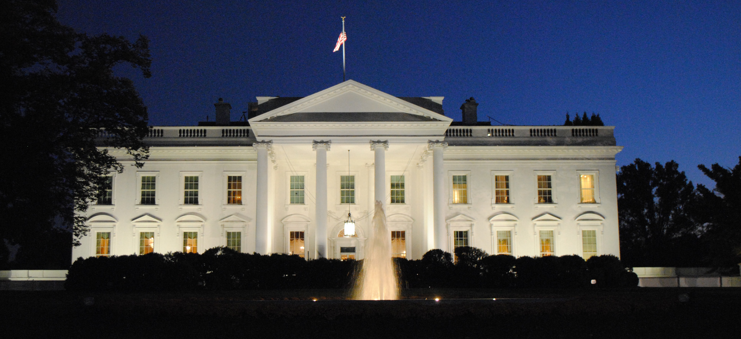
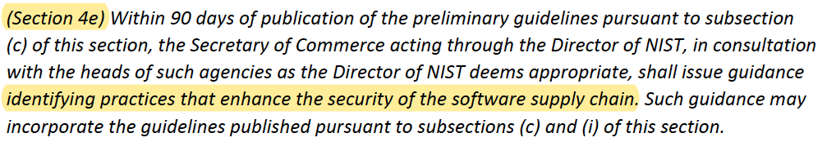
Supply Chain as an (inter)national priority
Photo by Tabrez Syed on Unsplash
Notes:
Several industry studies have substantiated the growth of the use of the software supply chain as an popular attack vector. In its 7th annual State of the Software Supply Chain report, Sonatype reported a 650% increase in supply chain attacks in 2021 on top of a 430% increase in 2020. Argon reports that software supply chain attack more than tripled in 2021.
A result of this growth and other security breaches resulted in the White House issuing an Executive Order on Improving the Nation’s Cybersecurity -- with one whole section dedicated to software supply chain security. Software supply chain security is a national priority.

Slide 9

But, what “should” we do?
And, what’s everyone else doing?

Slide 10

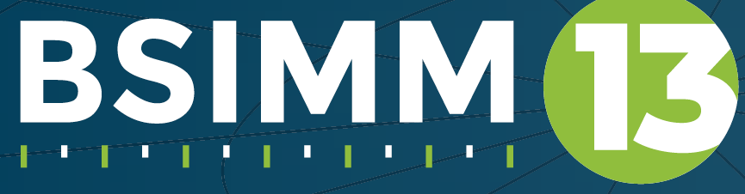
Doing secure software supply chain science: an empirical study
7 companies
“early adopter/
progressive/leader”
43 interviews
[more to come]
~1.5 hours/each
Andrey Kiselev/stock.adobe.com

Slide 11
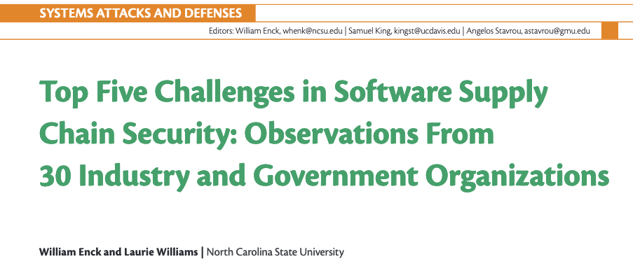
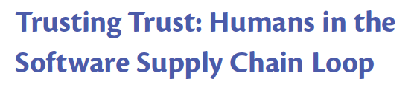
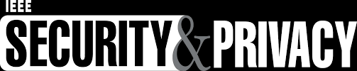
Six Secure Software Supply Chain Summits (~60 people)
“The Executive Order is forcing industry to adopt security practice that should have been adopted 20 years ago. We want to actually be more secure, not just comply.”
chrt2hrt / stock.adobe.com
Notes:
Participants are free to use the information received, but neither the identity not the affiliation of the speaker(s) n or those of any other participants may be revealed to encourage honest, intimate sharing in a trusted environment.
Diverse domains, company sized, geographies, company maturity – though all from the US.

Slide 12

Chatham House Rules and other non-disclosures
I could tell you, but then
I’d have to kill you.
chrt2hrt / stock.adobe.com
Notes:
Participants are free to use the information received, but neither the identity not the affiliation of the speaker(s) n or those of any other participants may be revealed to encourage honest, intimate sharing in a trusted environment.
Diverse domains, company sized, geographies, company maturity – though all from the US.

Slide 13

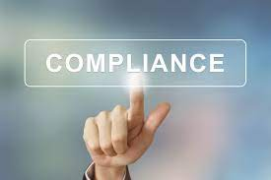
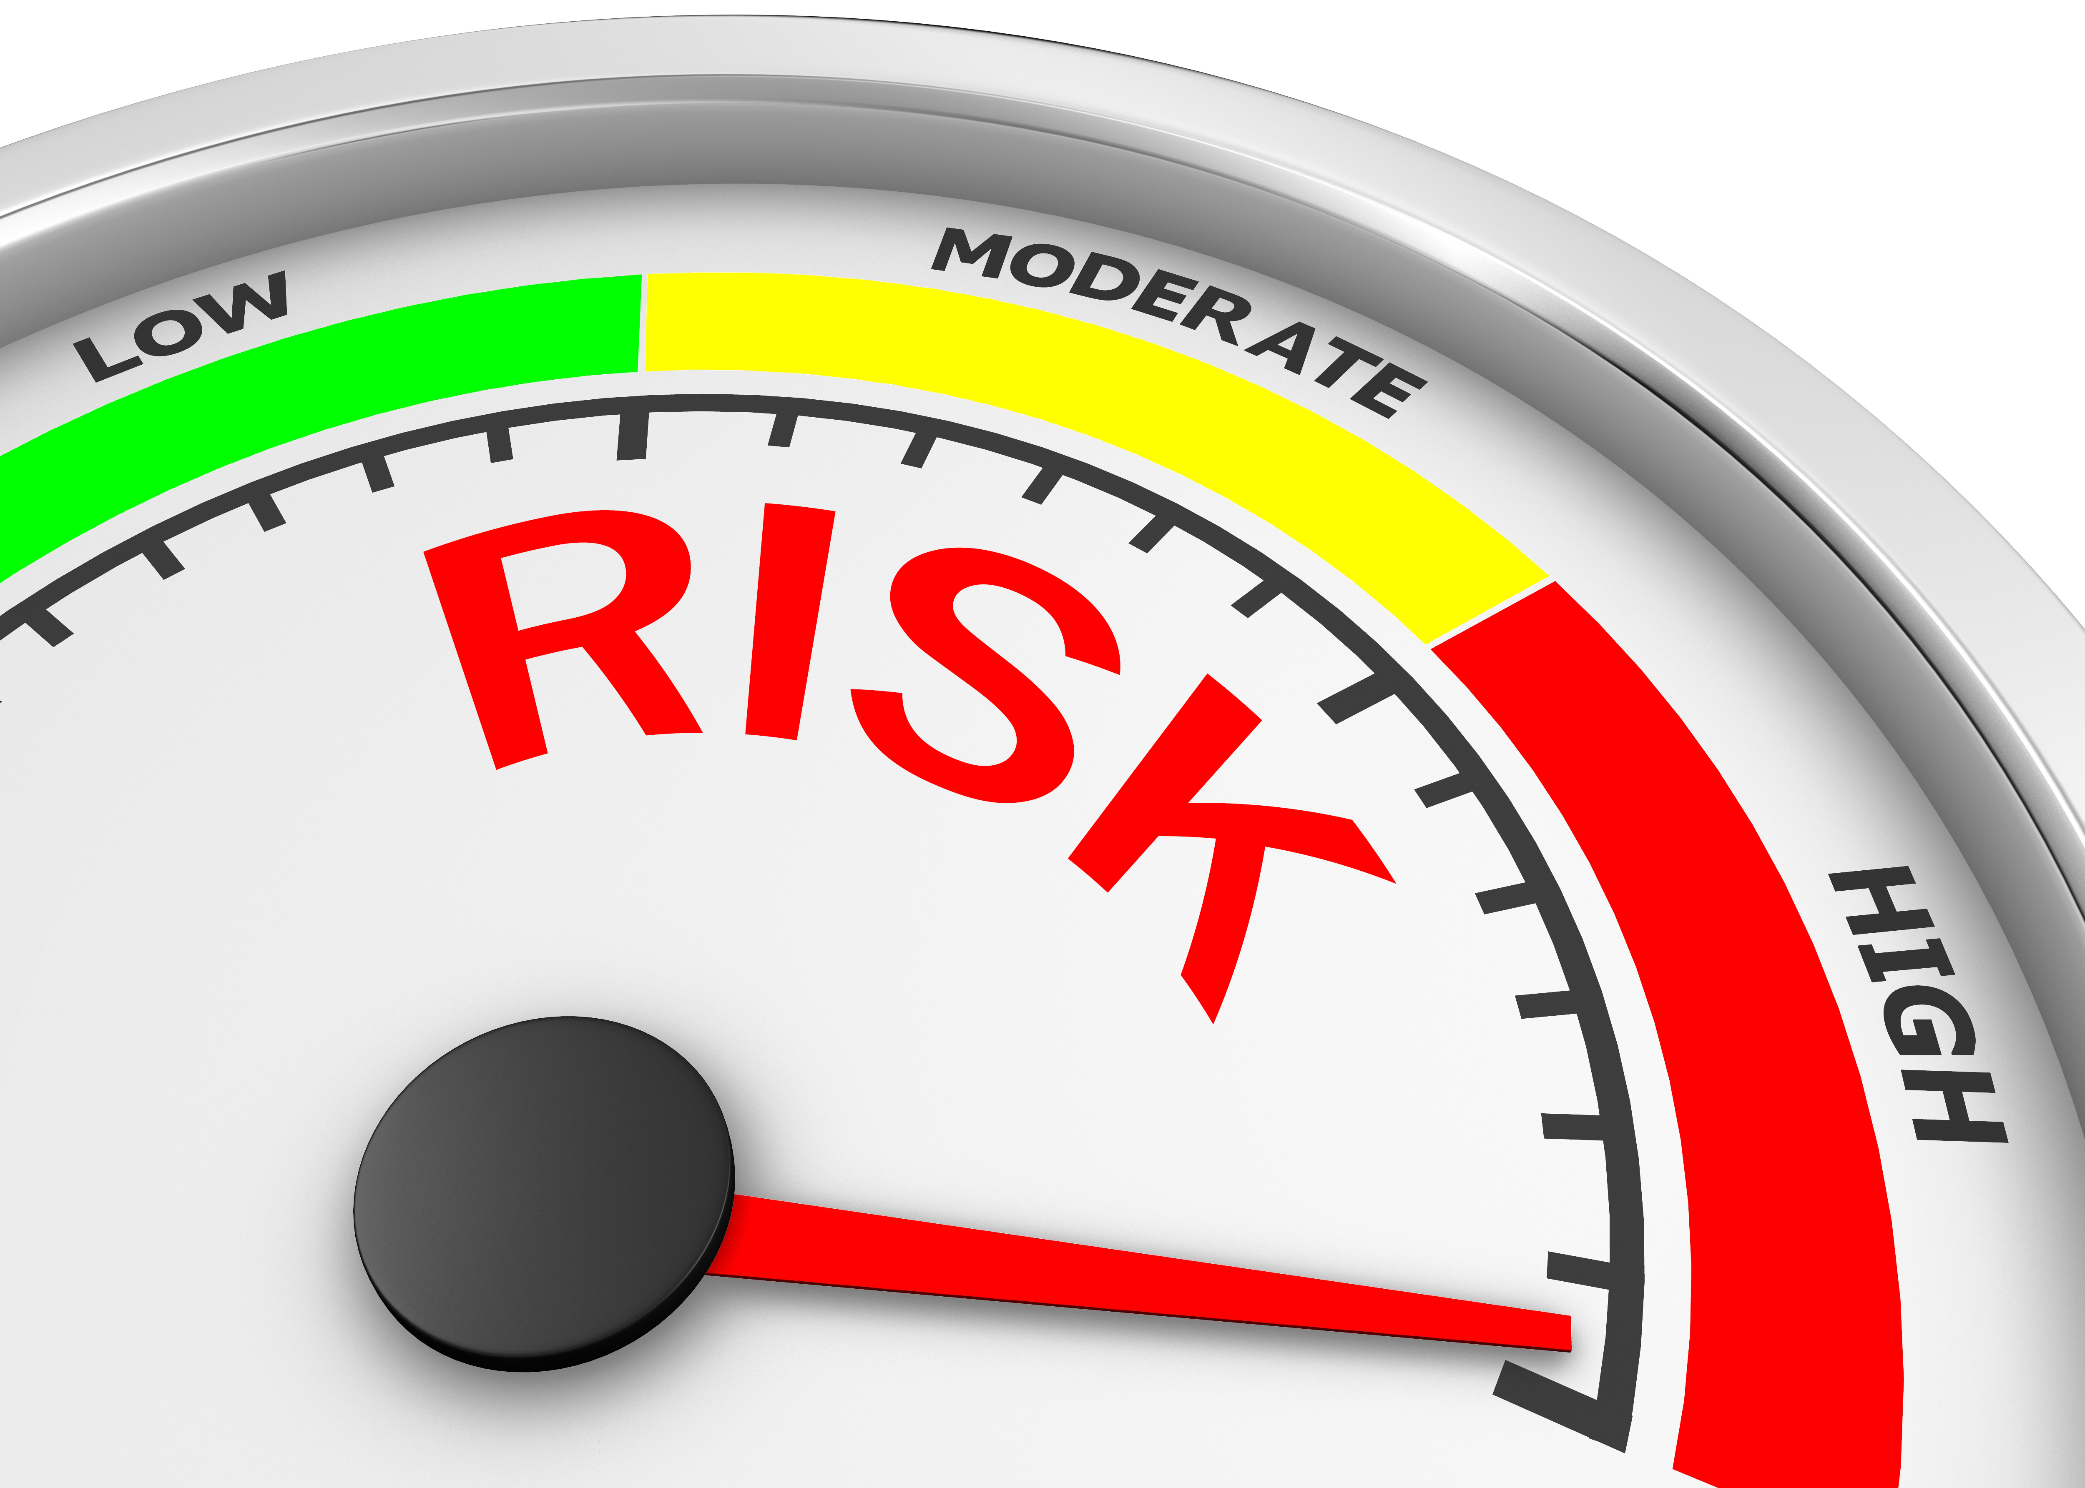
“The Executive Order is forcing industry to adopt security practice that should have been adopted 20 years ago. We want to actually be more secure [reduce software supply chain risk], not just comply.”
Struggle for software security as a priority
Executive Order on Improving the Nation’s Cybersecurity
Executive Order = produce Software Bill of Materials (SBOM)
Executive Order [Self-Attestation] = SSDF > SBOM
Software Supply Chain Risk Management (SSCRM > SSDF > SBOM)
Point of View: The SSDF is a lot, but not enough
!!
chrt2hrt / stock.adobe.com
Notes:
Participants are free to use the information received, but neither the identity not the affiliation of the speaker(s) n or those of any other participants may be revealed to encourage honest, intimate sharing in a trusted environment.
Diverse domains, company sized, geographies, company maturity – though all from the US.

Slide 14
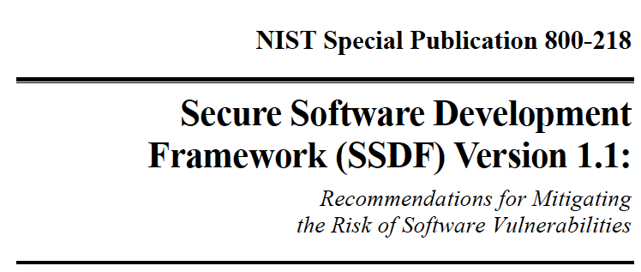
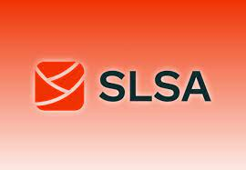
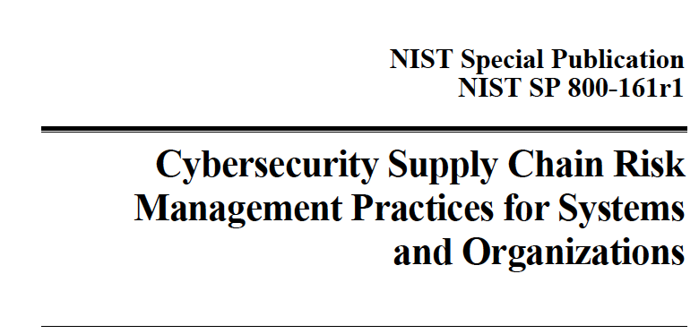
What ”should” we DO about software supply chain security?
Notes:
standards, processes, education, and tooling to mitigate risks to global supply chains

Slide 15
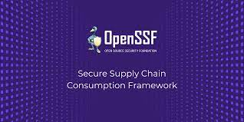
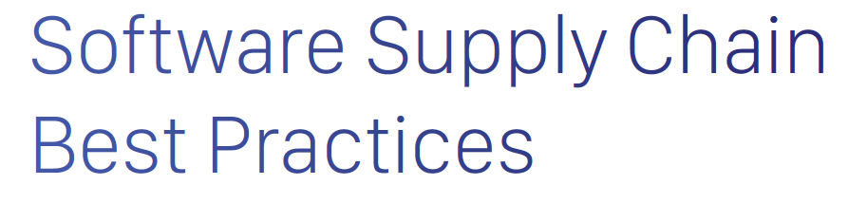

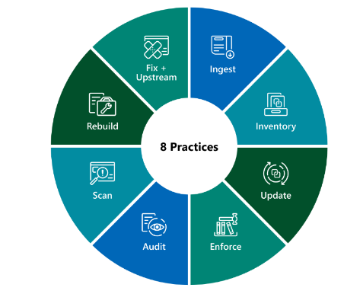
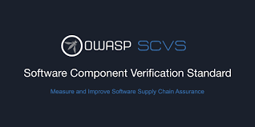
And also …

Slide 16
Vision: Proactive Software Supply Chain Risk Management (P-SSCRM) framework
P-SSCRM is a holistic framework that industry uses to proactively mitigate software supply chain risk through guided adoption of tasks; and that supports assessment, scoring, and comparison against industry peers, standards, and guidelines.

Slide 17
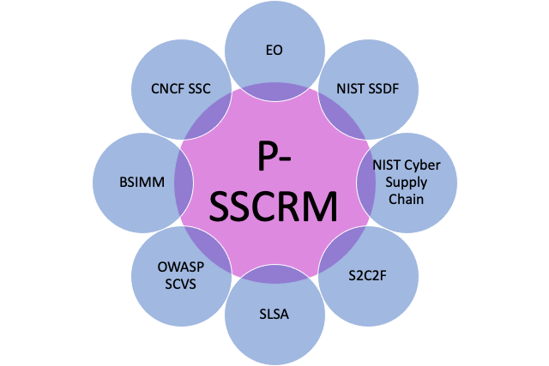
P-SSCRM: The union of the frameworks
800-161

Slide 18
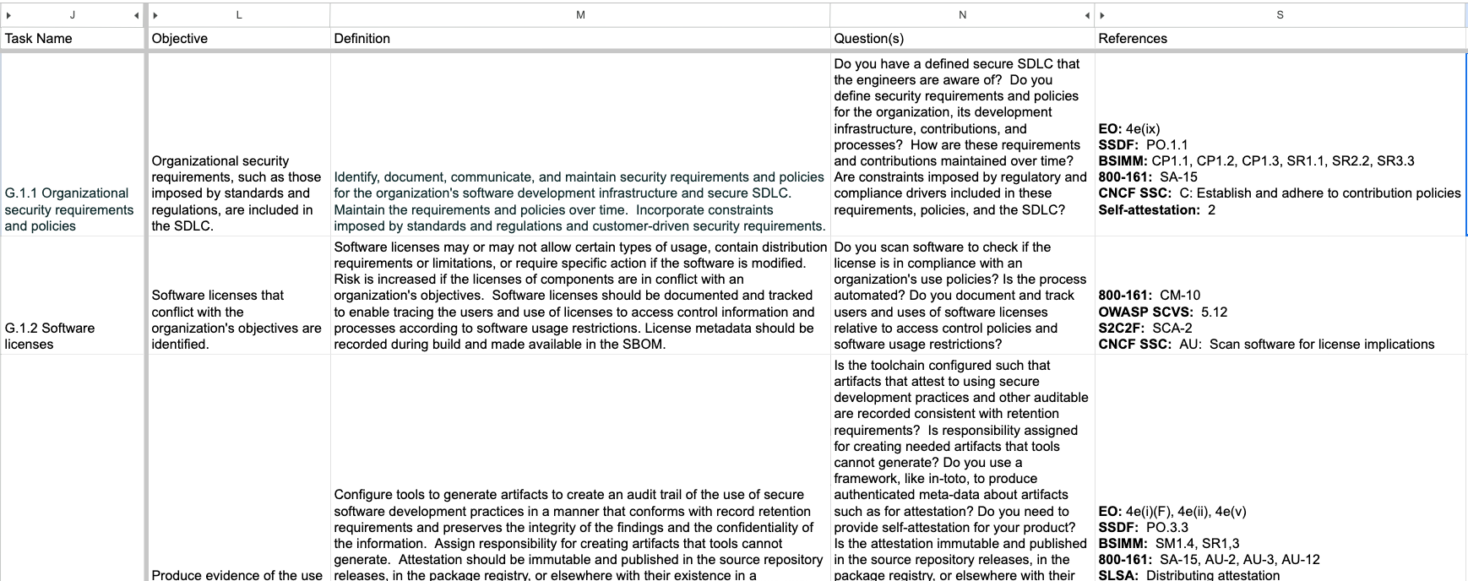
Layout of P-SSCRM (v0.3)

Slide 19
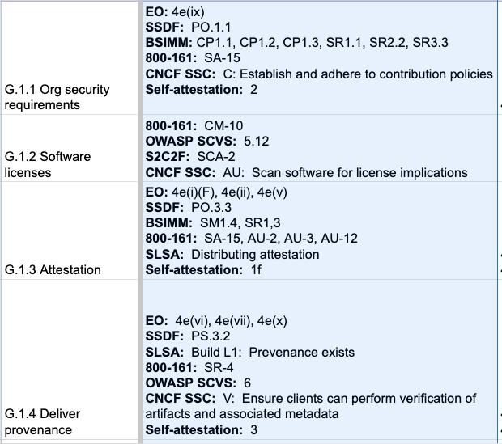
Mapping of “all the things” to “all the things”
Bi-directional
equivalence
Feedback
welcome!

Slide 20
P-SSCRM Framework (4 Groups, 15 Practices, 72 Tasks)
Governance (23 tasks) | Product (19 tasks) | Environment (22 tasks) | Deployment (8 tasks)
Tasks that focus on the organization and measurement of a secure software supply chain and of policies for decision making, accountability to third-party obligations, and remaining compliant with legal and regulatory requirements. | Tasks to lead to the deployment of a secure product with minimal vulnerabilities with associated required attestations and artifacts. | Tasks to protect the confidentiality and integrity of source code, software components, and the build infrastructure from tampering and unauthorized access. | Tasks for identifying, analyzing, and addressing vulnerabilities in products.
Perform compliance (5) Develop security policies (6) Manage suppliers (5) Train (3) Assess and manage risk (4) | Develop security requirements (2) Build security in; software security (5) Make good component choices (5) Discover vulnerabilities (4) Manage vulnerable components (2) | Safeguard artifact integrity (6) Safeguard build integrity (7) Secure environment (9) | Respond to vulnerabilities (6) Monitor intrusions/violations (2)

Slide 21
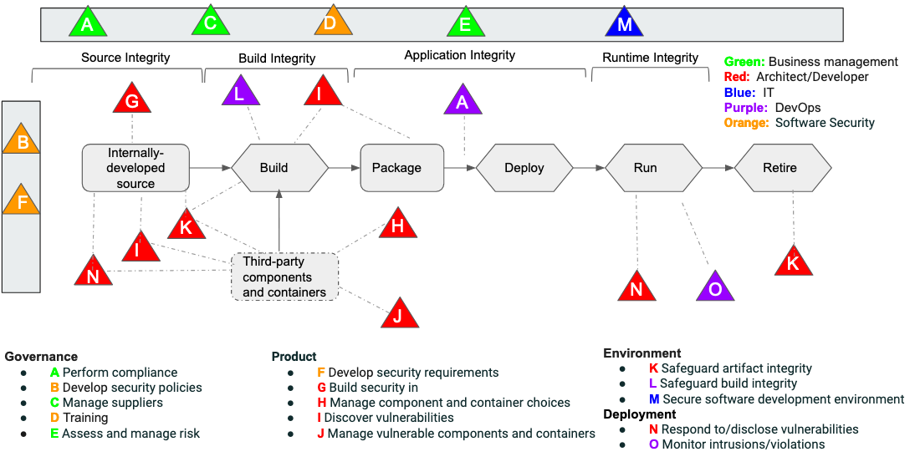
P-SSCRM Framework - Lifecycle View
R
Notes:
https://slsa.dev/spec/v0.1/#supply-chain-threats
https://medium.com/read-the-source/comparing-slsa-to-the-cncf-software-supply-chain-best-practices-recommendations-46988f781426
https://github.com/cncf/tag-security/blob/main/supply-chain-security/supply-chain-security-paper/CNCF_SSCP_v1.pdf

Slide 22
Task coverage with all the frameworks #[#unique]
Framework | Governance | Product | Environment | Deployment | Total
P-SSCRM | 23 | 19 | 22 | 8 | 72
EO / SSDF | 11 | 14 | 4 | 5 | 34/34
Self-attestation | 8 | 12 | 4 | 5 | 23/34 SSDF
BSIMM | 17 [1] | 14 | 2 | 4 | 37/125
SLSA | 2 | 1 | 3 | 0 | 6/6
NIST 800-161 | 20 [5] | 10 | 9 | 5 [1] | 44/183
OWASP SCVS | 1 | 5 | 5 | 0 | 11/11
S2C2F | 3 | 7 [1] | 3 | 2 [1] | 15/15
CNCF SSC | 4 | 6 | 13 [8] | 1 [1] | 24/24

Slide 23
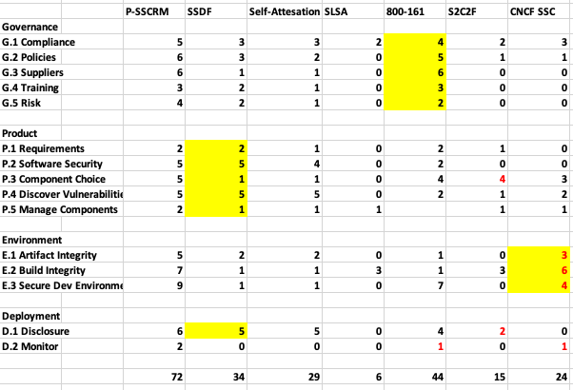
At the practice level

Slide 24
Empiricism
Andrey Kiselev/stock.adobe.com

Slide 25
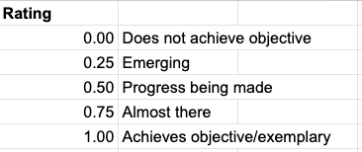
Where everybody’s at

Slide 26
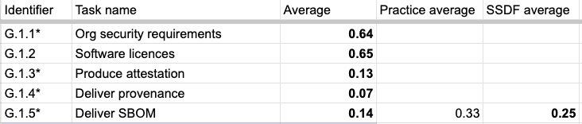
Governance: perform compliance
In general, organizational security requirements = defined software development lifecycle (SDLC)
Checking licenses (via Software Compositional Analysis (SCA tools) is pretty mature, pre-dates this supply chain security mess
Just starting to think about attestation and delivering provenance and SBOM
  Most are experimenting with or are already producing SBOM
    Sharing, delivering … not so much

Slide 27
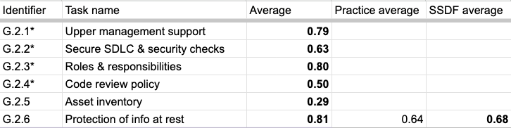
Governance: develop security policies
Code review policy doesn’t always involve security checking
Current-day asset inventory is confusing and dynamic – some don’t really understand what to do
  Containers
  Ephemeral environments
  Cloud resources

Slide 28
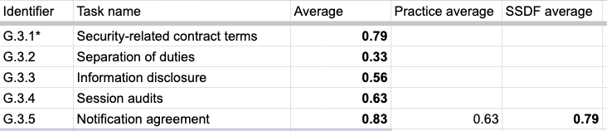
Governance: manage suppliers
Vendor managers seem to be pretty good at imposing “all the things” on the vendors
Less mature at more than one person reviewing contractors and contracts
  Exemplary – collaboration between contract manager and software security

Slide 29
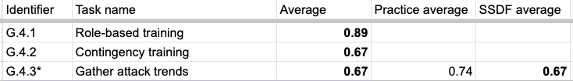

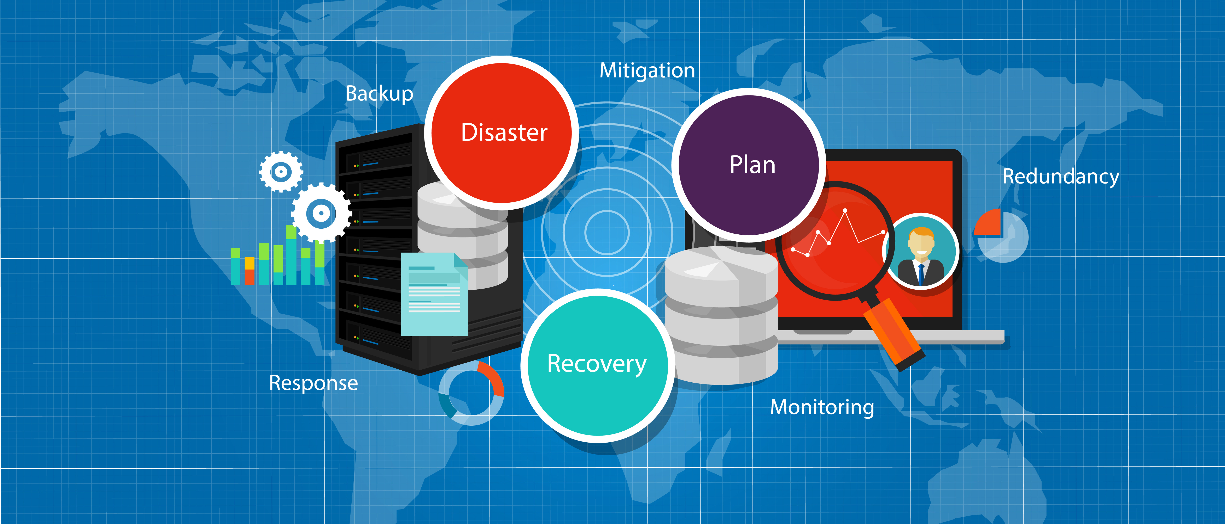
Governance: training
Prevent, detect, respond
Room for improving:
  Procedures in the event of a security emergency
    Some do table-top exercises and simulations
  Studying cyberthreat intelligence, attending conferences, etc., and getting trends out to the organization

Slide 30
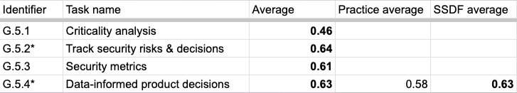

Governance: assess and manage risk
Everybody knows they need to do these, the actual processes are less structured, repeatable, objective
Security metrics = hard problem
  Are we getting more secure? Less secure? Are the tasks working?

Slide 31

Product: develop security requirements
Specifying product-specific security requirements less mature than organizational (SDLC) requirements
  Architectural
  Memory-safe languages
  Sandboxing/isolation
  Modularity
  Security features
Providing “customers” assurance your software is legit
  Such as signing code

Slide 32
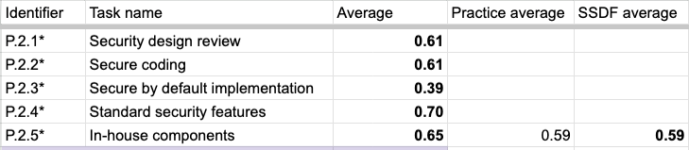
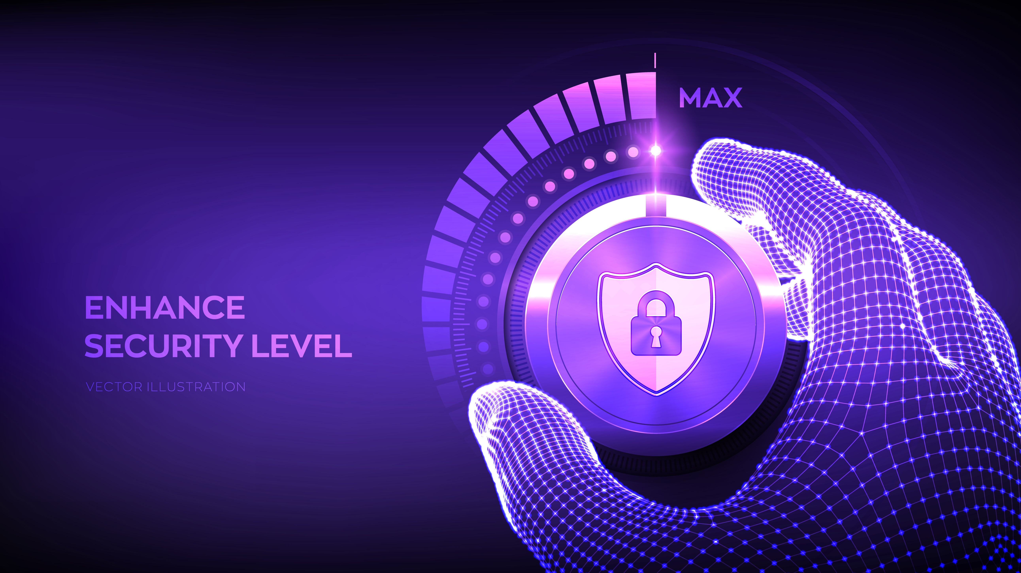
Product: build security in
“Getting there” with lots of proactive software security practices
Secure by default versus usability is the general
dilemma
Sometimes in-house components are forgotten and
not scanned, can get stale, and not maintained

Slide 33
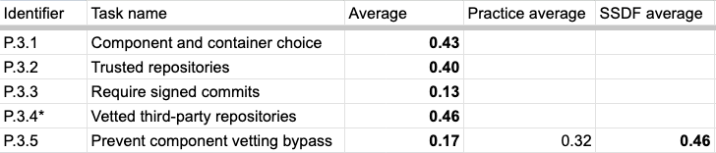
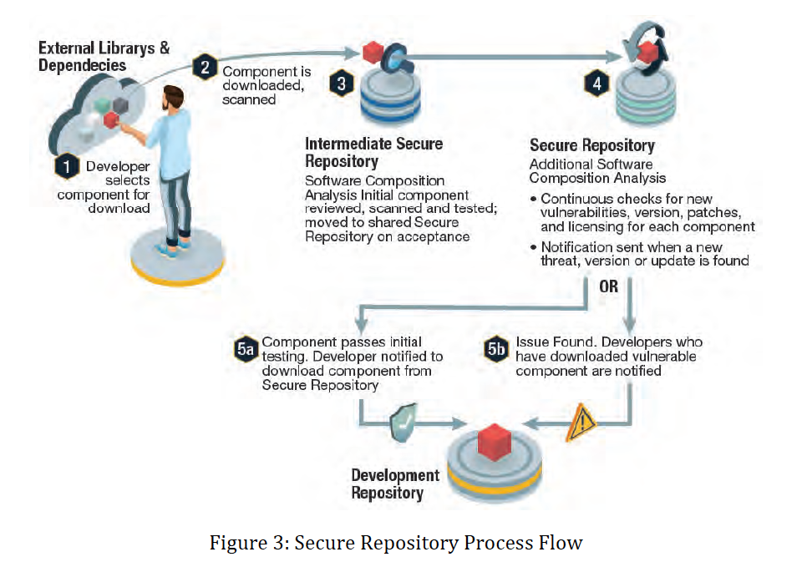

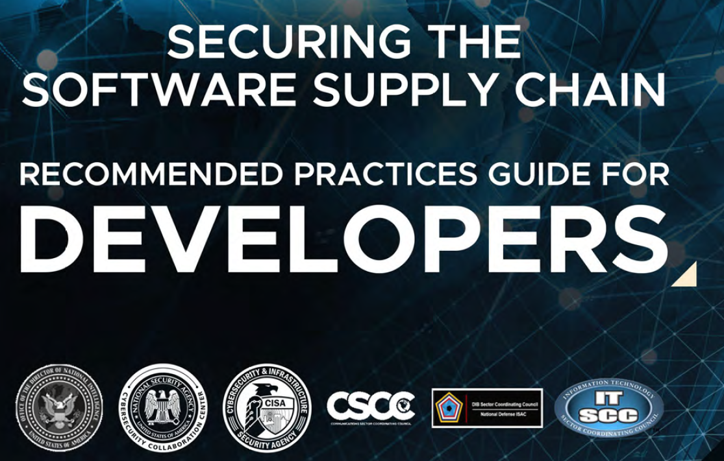
Product: manage component and container choices
(second to last)
Components > Containers

Slide 34
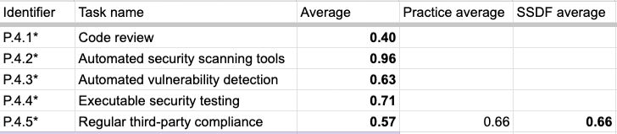

Product: discover vulnerabilities
Prevent, detect, respond
Code review …. “for every PR”, but unsure of how enforced in reality
Have lots of tools, but run regularly and vulnerabilities fixed, less so
External pen test, bug bounty – yes, internal red team, testing less
Review of third-party compliance to contract lacking
Review of “are open source components abandoned” type of checks lacking
  Relying on SCA tools to find vulnerabilities

Slide 35


Product: manage vulnerable components
Not really doing anything with SBOM (or real plans to)
Dependency update = drinking from the firehose
  Not a systematic process for handling this overwhelm

Slide 36
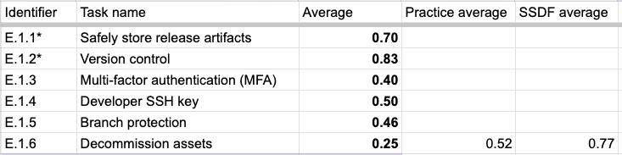

Environment: safeguard artifact integrity
Advanced authentication maturing
Lack of security checks enforced in branching process
  Especially with mono repo
Security risks of end-of-life systems, program, assets
  Just added to P-SSCRM, so low sample size
  Not a task in any of the originating frameworks

Slide 37
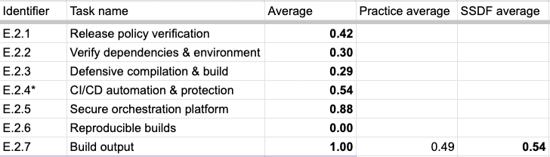
Environment: safeguard build integrity
Automated release policy verification could be better
  “as code”, templated, standardized
Verifying dependencies & environment on build could be better
Don’t utilize compiler, interpreter, such as to fail rather than give a security warning
Ephemeral builds pretty good
Hermetic, parameter-less builds emerging

Slide 38
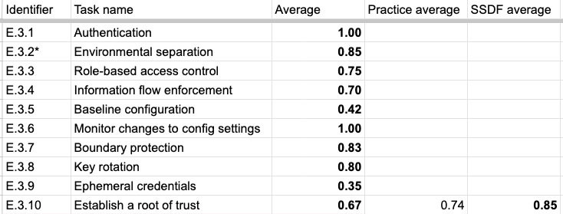

Environment: secure software development environment
Prevent, detect, respond
RBAC: maybe too widespread “everyone can read everything” and not enough least privilege
Could use more baseline configuration, use of ephemeral credentials

Slide 39
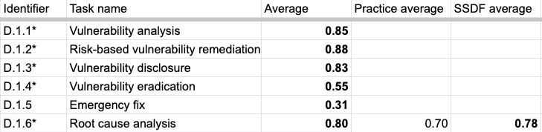


Deployment: respond to/disclose vulnerabilities
Prevent, detect, respond
Emergency fix (from S2C2F) = what to do if the component supplier won’t fix?
Could be more proactive eradication
  One company said “… if we don’t, the bug bounty people will just keep finding more of the same.”

Slide 40

Deployment: monitor intrusions/violations
Solarwind, Codecov … need to get better at monitoring for build process intrusions

Slide 41
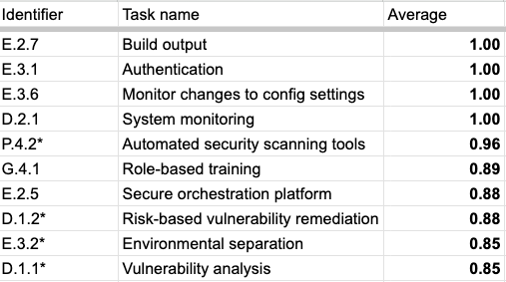
Top 10 Tasks (1G, 1P, 5E, 3D)

Slide 42
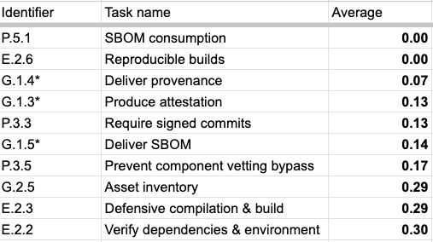
Bottom 10 Tasks (4G, 3P, 3E, 0D)

Slide 43
Code dependencies as an attack vector
Code dependencies as a weapon
Siridhata/stock.adobe.com
Sergey Nivens /stock.adobe.com
Notes:
On this slide are headlines that appear to the general public - in places like CBS News and Fortune that are actually supply chain attacks. Both the log4j and the Russian protestware headlines are instances of vulnerabilities in the code dependencies of the software supply chain - the log4j vulnerability accidentally injected by a well-meaning developer and this vulnerability was exploited by attackers once discovered. The protestware is an instance of a vulnerability maliciously and intentionally injected to cause harm.

Slide 44
What’s Next?
Finalizing this round of interviews
Mapping tasks to specific attack vectors … to specific attacks. Could the adoption of the tasks have prevented the attack?
  What are the most critical tasks for reducing software supply chain risks?
More empirical studies – a longitudinal study of adoption

