Slide 1


National Science Foundation USA and
Department of Science and Technology India
NSF-DST Dear Colleague Letter
NSF 2023-114
Mohan Kumar and Bridget Turaga
National Science Foundation
India-collaboration@nsf.gov
Praveen Kumar Somasundaram
Department of Science and Technology
Government of India
praveen@nic.in

Slide 2
WEBINAR AGENDA
Presentation by NSF and DST on the Joint Funding Opportunity
Question & Answer Period
Please put questions in the Q&A, and NSF and DST staff will answer them aloud during the Q&A period or in writing in the Zoom Q&A function.

Slide 3
RESEARCH AGENCY PARTNERSHIP
In January 2023, the U.S. National Science Foundation (NSF) and the Department of Science and Technology (DST) of the Government of India signed an Implementation Arrangement on research cooperation.
The Implementation Arrangement (IA)
  Framework to encourage collaboration between U.S. and Indian research communities
  Investigators from both countries collaborate to write a single proposal
  Single review process at NSF, the Coordinating Agency
  U.S. researchers receive funding from NSF
  India researchers receive funding from DST

Slide 4
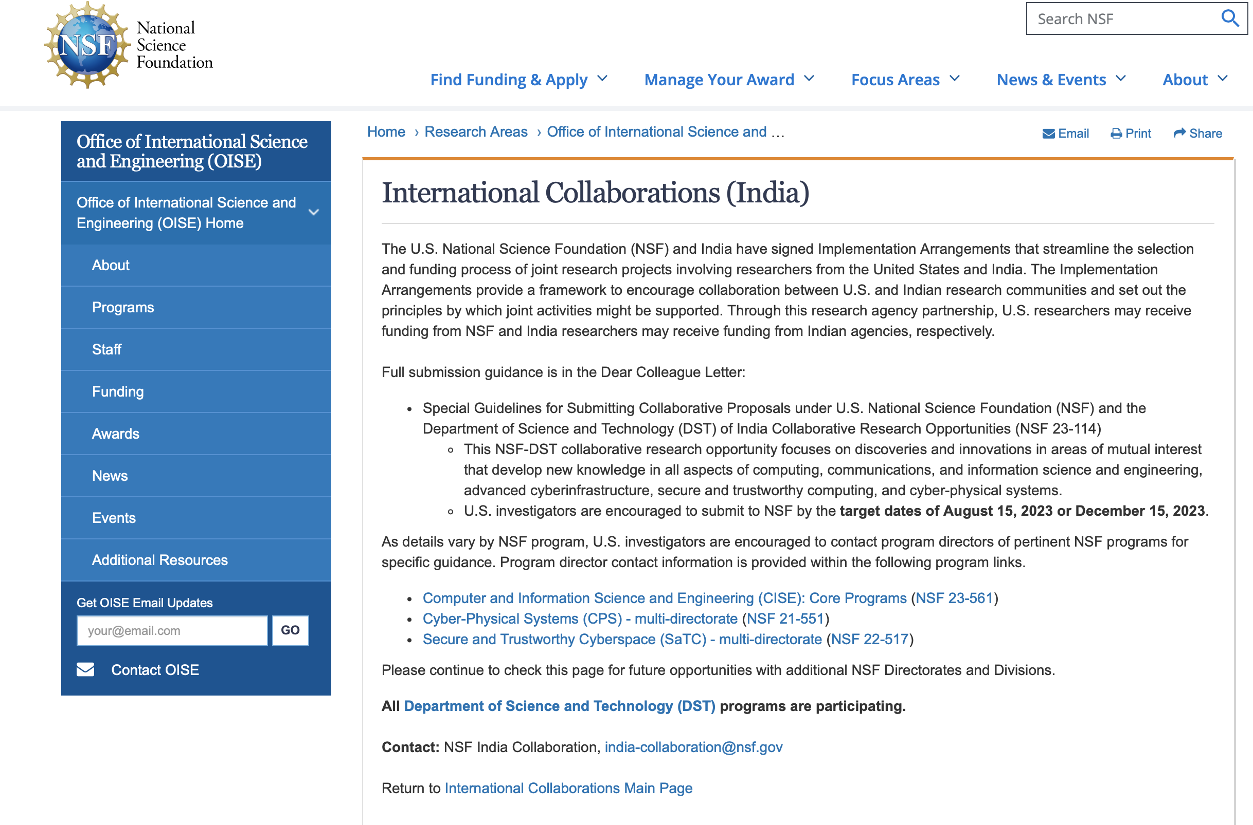
NSF DEAR COLLEAGUE LETTER
https://www.nsf.gov/pubs/2023/nsf23114/nsf23114.jsp

Slide 5
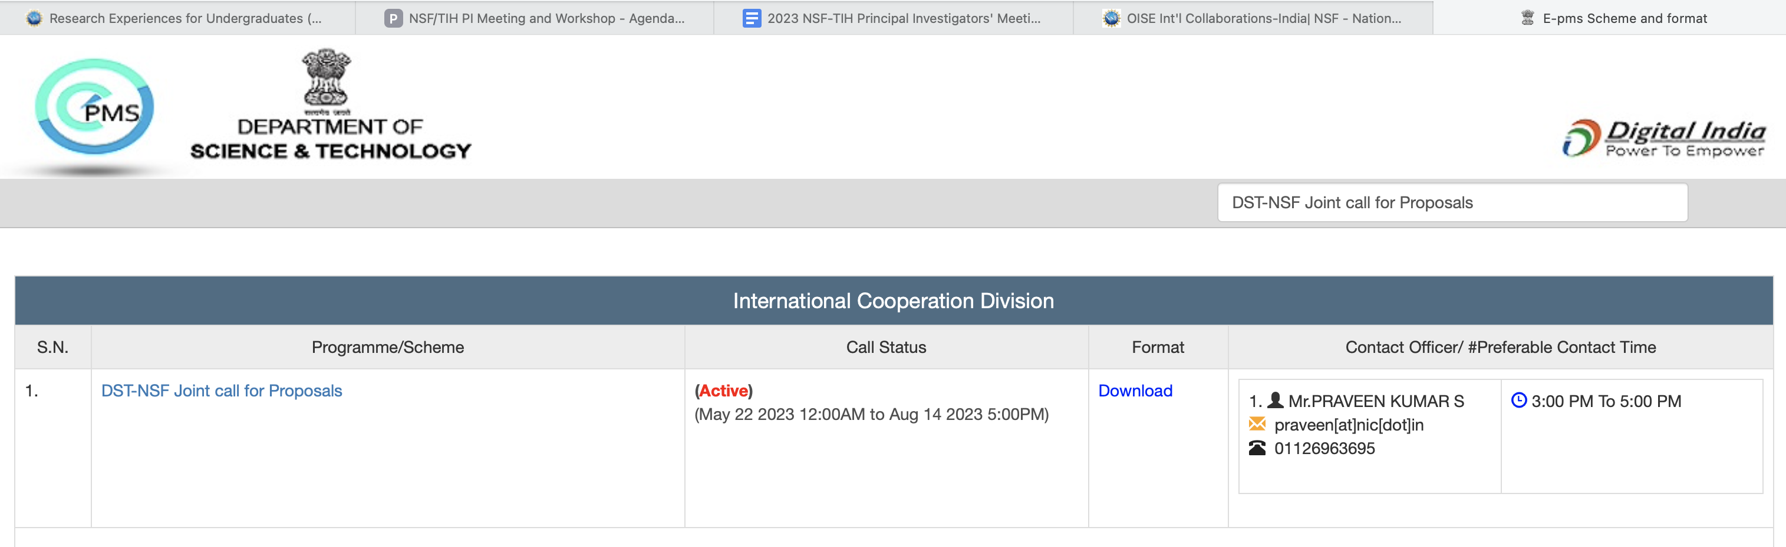
DST CALL FOR PROPOSALS
https://onlinedst.gov.in/Projectproposalformat.aspx?Id=DST-NSF%20Joint%20call%20for%20Proposals

Slide 6
FOCUS AREAS
This NSF-DST collaborative research opportunity focuses on
  areas of mutual interest that develop new knowledge in:
  Computing
  Communications
  Information science and engineering
  Advanced cyberinfrastructure
  Secure and trustworthy computing
  Cyber-physical systems.
CISE Core programs - Directorate of Computer and Information Science and Engineering
(https://beta.nsf.gov/funding/opportunities/computer-information-science-engineering-core)
Cyber-Physical Systems (CPS) program – Directorate of Computer and Information Science and Engineering and Directorate of Engineering
(https://beta.nsf.gov/funding/opportunities/cyber-physical-systems-cps)
Secure and Trustworthy Cyberspace (SaTC) program – Directorates of Computer and Information Science and Engineering, Engineering, and Mathematical and Physical Sciences
(https://beta.nsf.gov/funding/opportunities/secure-trustworthy-cyberspace-satc)

Slide 7
CISE CORE PROGRAMS
Computing and Communication Foundations (CCF)
Algorithmic Foundations (AF) program
Communications and Information Foundations (CIF) program
Computer and Network Systems (CNS)
Computer Systems Research
Networking Technology & Systems
Foundations of Emerging Technologies (FET) program
Software and Hardware Foundations (SHF) program
Information and Intelligent Systems (IIS)
Office of Advanced Cyberinfrastructure (OAC)
Human-Centered Computing (HCC) program
Information Integration and Informatics (III) program
Robust Intelligence (RI) program
OAC Core Research (OAC Core) program
https://beta.nsf.gov/funding/opportunities/computer-information-science-engineering-core

Slide 8




What are Cyber-Physical Systems
Deeply integrating computation, communication, and control into physical systems everywhere
Characteristics of CPS
Pervasive computing, sensing and control
Networked at multi-&-extreme scales
Dynamically reorganizing/reconfiguring
High degrees of automation
Dependable trustworthy operations
High assurance and formal verification
Scalable, interoperable, safe, usable
Autonomy & human-in/on-the-loop
Conventional and unconventional substrates / platforms
Application Domains
Critical Infrastructures
Energy & Industrial Automation
Healthcare and Biomedical
Transportation Systems

Slide 9
Overview of the CPS Program
The goal of the CPS program is to develop the core system science needed to engineer complex cyber-physical systems upon which people can depend with high confidence
Reveal cross-cutting fundamental scientific and engineering principles that underpin the integration of cyber and physical elements across all application sectors
Multi- agency: NIFA, DOT, NIH, DHS
More than $400M, over 200 active projects since program start
Some revisions to solicitation in progress
Notes:
9
The CPS program aims to develop the core research needed to engineer these complex CPS, some of which may also require dependable, high-confidence, or provable behaviors. Core research areas of the program include control, data analytics, autonomy, design, information management, internet of things (IoT), mixed initiatives including human-in- or on-the-loop, networking, privacy, real-time systems, safety, security, and verification. By abstracting from the particulars of specific systems and application domains, the CPS program seeks to reveal cross-cutting, fundamental scientific and engineering principles that underpin the integration of cyber and physical elements across all application domains. The program additionally supports the development of methods, tools, and hardware and software components based upon these cross-cutting principles, along with validation of the principles via prototypes and testbeds. This program also fosters a research community that is committed to advancing education and outreach in CPS and accelerating the transition of CPS research into the real world.

Slide 10
SECURE AND TRUSTWORTHY CYBERSPACE (SaTC):
One of NSF’s Largest Research Programs
SaTC approaches security and privacy as a socio-technical problem involving deep scientific and engineering problems as well as vulnerabilities that arise from human behaviors
CISE
Computer & Information Science & Engineering
SBE
Social, Behavioral, and Economic Sciences
EDU
STEM Education
MPS
Math and Physical Sciences
ENG
Engineering

Slide 11











OVER 1000 ACTIVE AWARDS IN THESE TOPICAL AREAS
Slide 1 of 2
Authentication
Biometrics
Cryptography
Applied and Theory
Cyber Physical Systems
Cybersecurity
Education
Data Science
Hardware Security Design
Information Authenticity
Formal Methods
Hardware Security
Architecture

Slide 12











OVER 1000 ACTIVE AWARDS IN THESE TOPICAL AREAS
Slide 2 of 2
Intrusion Detection
Language-Based
Security
Mathematics and
Statistics
Networking
Privacy
Wired and Wireless
Applied and Theory
Social, Behavioral and Economic
Sciences
Transition to Practice (TTP)
Usability and Human Interaction
Software
Systems

Slide 13
FUNDING LIMITS and DATES
Small Project Class only
  No separate Call for US Investigators
  U.S. Investigators funded by the NSF
    NSF funding limit - USD 600 K
  India Investigators funded by DST
    DST funding limit - INR 2 Crores
U.S. Investigators submit to
  Research.gov (https://www.research.gov), or Grants.gov (https://www.grants.gov/).
India investigators submit to
  https://onlinedst.gov.in/
NSF Target Date: August 15, 2023
DST Deadline: August 14, 2023

Slide 14
PROPOSAL SUBMISSION
Proposals will be submitted to NSF by U.S. investigators
A separate copy of the same proposal to be submitted by the India investigators to DST
  Identical – Summary, Description and References
  Agency specific – Budget, Supplementary and other documents

Slide 15
PROPOSAL REVIEW
DST will check that the Indian investigators have active and appropriate roles and confirm their eligibility at the onset of the process
Proposals will be reviewed by experts contacted by NSF
  DST may recommend experts from India
  Proposals will compete with other proposals received for the same funding round of the program to which the proposal is submitted
DST officials may attend and observe any discussions as part of the merit review
  Not conduct a parallel review

Slide 16
PROPOSAL FUNDING
NSF will share outcome of review process with DST
DST will honor the NSF review process
NSF will honor DST inputs and insights
NSF intends to make awards to the U.S. investigators
DST intends to make awards to the Indian investigators

Slide 17



Thank you!
Questions?

Slide 18

End

