Slide 1
Campus Cyberinfrastructure (CC*)
Area 3: Network Integration & Applied Innovation
NSF 23-526
Webinar: 26 July 2023

Slide 2
Program Directors
Area-3
  Deep Medhi (CNS)
  Nicholas Goldsmith (CNS)
Other Areas
  Kevin Thompson (OAC)
  Subrata Acharya (CNS)
  Pinhas Ben-Tzvi (ESPCoR)

Slide 3
Overview of CC*

Slide 4
NSF 23-526 – Campus Cyberinfrastructure (CC*)
The CC* solicitation invests in coordinated campus-level cyberinfrastructure improvements, innovation, integration, and engineering for science applications and distributed research projects. Science-driven requirements are the primary motivation for any proposed activity. All projects supported by CC* must be driven by STEM research and education needs that require the support of networking, computing, and storage infrastructure on campuses.

Slide 5
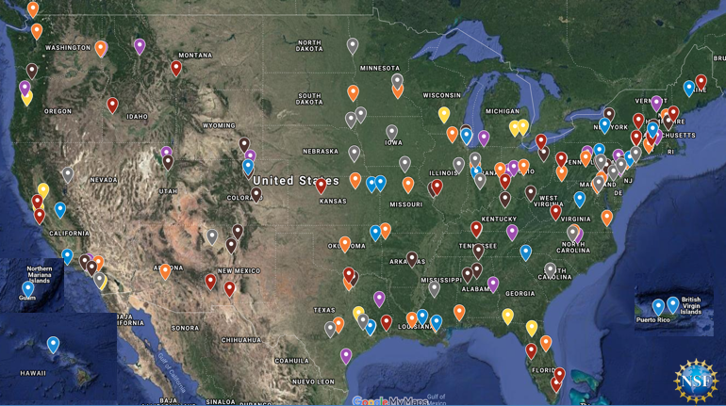
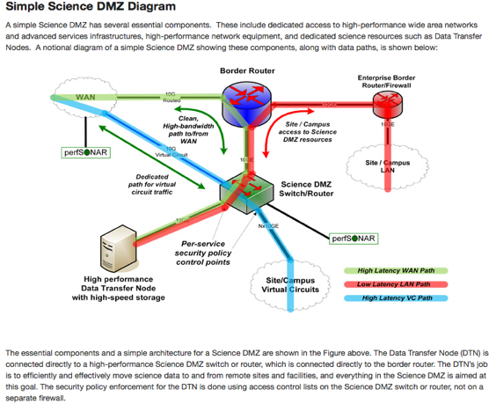
The Campus Cyberinfrastructure (CC*) Program
Networking as a fundamental layer and underpinning of Cyberinfrastructure, driven by scientific R&E needs
Most awards go to High Speed Campus networking upgrades, external connectivity to the national R&E fabric, and campus border redesign prioritizing science traffic.
Program is in its 12th year with different program areas expanding into other components of CI including computing and data
CC* emphasizes strong campus level partnerships between researchers/teachers and campus IT leadership

Slide 6
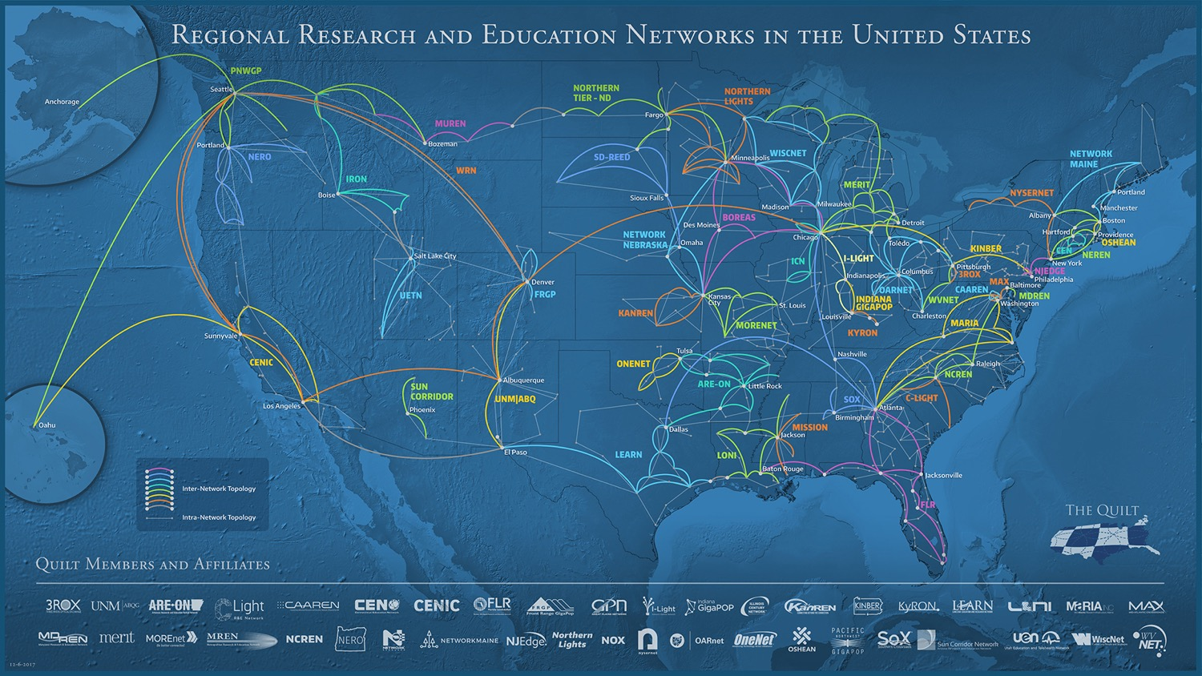
State and Regional R&E Fabric

Slide 7
CC* 23-526 - Campus Cyberinfrastructure
https://www.nsf.gov/pubs/2023/nsf23526/nsf23526.htm
$15M-$20M in expected award funding across all areas
30-50+ expected awards across all areas
Proposals due September 11, 2023
Area #1 – Campus Network upgrades
Area #2 – Regional Connectivity for Small Institutions
Area #3 – Networking Integration and Applied Innovation
Area #4 – Campus Computing
Area #5 – Regional Computing
Area #6 – Data Storage
Area #7 – Planning Grants and CI-Research Alignment

Slide 8
CC* Area 3

Slide 9
Network Integration & Applied Innovation Awards
Supports end-to-end network CI through integration of existing and new technologies and applied innovation.
The goal is to take advantage of research results, prototypes, and emerging innovations to use them to enable specified researchers in a networking context.
Proposals in this area may leverage new and existing investments in network infrastructure, services, and tools by combining or extending capabilities to work as part of the CI environment used by scientific applications and users.
Proposals in this area are expected to reflect innovation in advanced networking. As a result, this area is not appropriate for projects whose costs are dominated by equipment purchases.
Proposals in this area support the development and integration of innovative networking capabilities and network-related software development, and deployment activities resulting in an operational environment prototype are expected to be part of the proposed activities.
Additionally, proposals are encouraged to perform experimental deployment, protocol prototyping and testing, and evaluation using FABRIC (https://www.fabric-testbed.net)

Slide 10
A broad range of activities is covered by this area, including but not limited to:
Integration of networking protocols and technologies with science application layer processes and workflows, for instance, for large-scale shared scientific datasets and/or large-scale remote computational resources;
Transition of successful research prototypes in Software-Defined Networking (SDN) and wireless networking technologies to distributed scientific environments and campus infrastructure;
Applications of networking hardware and software developed on NSFFutureCloud facilities (e.g., ChameleonCloud and CloudLab), including the integration of new technologies such as programmable network interfaces;
Networking solutions exploiting virtualization, distributed computing and Software-Defined Infrastructure (SDI), including cloud services and direct campus-to-cloud connections;
Innovative research prototypes integrating programmable packet processing components into campus infrastructure or exploring applications of software-defined data planes in support of high-performance data distribution; and
Network engineering support through the creation and application of new and novel procedures and tools and network measurement and monitoring software for solving end-to-end network performance issues, especially for dynamically constructed network services.

Slide 11
Area 3 Award Details
Two categories:
  Small: up to $500,000
  Large: $500,001 to $1,000,000
Duration: up to 2 years
Only Institutions of Higher Education are eligible to submit proposals in this program area
Proposals due September 11, 2023

Slide 12
Proposal Requirements

Slide 13
CC* Area 3 Proposal Requirements
Identify supported science or engineering research projects/applications and describe how the proposed network integration and applied innovation activities will support those projects
Involve and support graduate students where appropriate
Include a Project Plan addressing clear project goals and milestones resulting in a working system in the target environment
Define base metrics; address measurement and evaluation of the system
Open-source license for any software development under proposed activities
Include a Campus CI plan as a Supplementary Document (see next slide)
Titles begin with:
  "CC* Integration-Small": for proposed budgets of up to $500,000
  "CC* Integration-Large:" for proposed budgets of between $500,001 and $1,000,000

Slide 14
Campus Cyberinfrastructure Plan
The proposed cyberinfrastructure improvements are conceived, designed, and implemented in the context of a coherent campus-wide strategy
An approach to cyberinfrastructure that is integrated horizontally intra- campus and vertically with regional and national cyberinfrastructure investments and best practices
Must include sustainability of the proposed work in terms of ongoing operational and engineering costs
Included as a Supplementary Document
No more than 5 pages.
Example CI Plans: https://fasterdata.es.net/nsf-docs/campusCIplanning/

Slide 15
Review Criteria

Slide 16
National Science Board Merit Review Criteria
Intellectual Merit:
  The potential to advance knowledge
Broader Impacts:
  The potential to benefit society and contribute to the achievement of specific, desired societal outcomes

Slide 17
CC*-wise Solicitation Specific Review Criteria
The extent to which the work provides a needed capability required by science, engineering and education.
The expected impact on the deployed environment described in the proposal, and potential impact across a broader segment of the NSF community.
Where applicable, how resource access control, federated identity management, and other cybersecurity related issues and community best practices are addressed.

Slide 18
Cyberinfrastructure Plan Review Criteria
To what extent is the planned cyberinfrastructure likely to enhance capacity for discovery, innovation, and education in science and engineering?
How well does the plan as presented position the proposing institution(s) for future cyberinfrastructure development?
How well does the cyberinfrastructure plan support and integrate with the institutions' science and technology plan?
Are IPv6 deployment and InCommon Federation addressed?
Are the activities described in the proposal consistent with the institution's cyberinfrastructure plan?

Slide 19
CC* Area 3 Solicitation Specific Review Criteria
A Project Plan addressing clear goals and milestones resulting in a working system in the target environment.
Tangible metrics to measure the success of the integrated systems and any associated software developed, and the steps necessary to take the systems from prototype status to production use.

Slide 20
Examples

Slide 21
Examples of Funded Projects
CC* Integration-Large: Q-Factor: A Framework to Enable Ultra High-Speed Data Transfer Optimization based on Real-Time Network State Information provided by Programmable Data Planes
  PI: Jeronimo Bezerra, Institution: Florida International University, Award Number: 2018754
CC* Integration-Large: mGuard: A Secure Real-time Data Distribution System with Fine-Grained Access Control for mHealth Research
  PI: Lan Wang, Institution: University of Memphis, Award Number: 2019085
CC* Integration-Large: Robust and Predictable Network Infrastructure for Wide-Area Hybrid Sensor Networks
  PI: Engin Arslan, Institution: University of Nevada - Reno, Award Number: 2019164
CC* Integration-Small: A Software-Defined Edge Infrastructure Testbed for Full-stack Data-Driven Wireless Network Applications
  PI: Flavio Esposito, Institution: Saint Louis University, Award Number: 2201536

Slide 22
Examples of Funded Projects with FABRIC
CC* Integration-Small: Integrating Application Agnostic Learning with FABRIC for Enabling Realistic High-Fidelity Traffic Generation and Modeling
  PI: Deniz Gurkan, Institution: University of Houston, Award Number: 2018472
CC* Integration-Small: Harnessing FABRIC for Scalable Human Genome Sequence Analysis
  PI: Praveen Rao, Institution: University of Missouri, Award Number: 2201583
CC* Integration-Large: Prototyping a Secure Distributed Storage Infrastructure for Accelerating Big Science
  PI: Susmit Shannigrahi, Institution: Tennessee Technological University, Award Number: 2126148

Slide 23
Questions?
Proposals due September 11, 2023
dmedhi@nsf.gov
nicgolds@nsf.gov
https://www.nsf.gov/pubs/2023/nsf23526/nsf23526.htm

