Slide 1

Smart Health and Biomedical Research in the Era of Artificial Intelligence and Advanced Data Science (SCH)
NSF 23-614
Goli Yamini, PhD and Tom Martin, PhD
National Science Foundation
Dana Wolff Hughes, PhD and Yanli Wang, PhD
National Institutes of Health
Webinar
September 25th, 2023
1
Notes:
Goli and then everyone introduce

Slide 2
The NSF Smart Health Team
Goli Yamini, CISE/IIS
Thomas Martin, CISE/IIS
Steven J Breckler, SBE/BCS
Yulia Gel, MPS/DMS
James Fowler, CISE/CCF
Georgia-Ann Klutke, ENG/CMMI
Tatiana Korelsky, CISE/IIS
Vishal Sharma, CISE/CNS
Sylvia Spengler, CISE/IIS
Betty Tuller, SBE/BCS
Christopher Yang, CISE/IIS
Notes:
Goli

Slide 3
The NIH Smart Health Team
Dana Wolff-Hughes, NCI
Yanli Wang, NLM
James Gao, NEI
Erin Iturriaga, NHLBI
Lyndon Joseph, NIA
Wilbert Van Panhuis, NIAID
Aron Marquitz, NIAMS
Qi Duan, NIBIB
Samantha Calabrese, NICHD
Susan Wright, NIDA
Roger Miller, NIDCD
Noffisat Oki, NIDCR
Xujing Wang, NIDDK
Christopher Duncan, NIEHS
David Leitman, NIMH
Deborah Duran, NIMHD
Leslie C Osborne, NINDS
Kristopher Bough, NINR
Emrin Horguslouglu, NCCIH
Christopher Hartshorn, NCATS
Joseph Monaco, BRAIN
Robert Cregg, OAR
Beth Jaworski, OBSSR
Jacqueline Lloyd , ODP
Fenglou Mao, ODSS
Nicholas Jury, ONR
Jamie White, ORWH
Adam Berger, OSP
Christopher Barnhart, SGMRO
Notes:
Dana

Slide 4
What is the goal of Smart Health?
To support research and development of transformative high-risk, high-reward advances in computer and information science, engineering, mathematics, statistics, behavioral and/or cognitive science to address pressing questions in the biomedical and public health communities.
Proposals must include & address:
  Research gaps in science & engineering
  A key health/biomedical problem
  Include a team with appropriate research expertise in the major areas involved in the work
Activities should complement rather than duplicate core programs of NSF & NIH as well as those of other agencies (e.g., VA and AHRQ)
Notes:
Goli
You might ask why are NSF and NIH coming together for the smart health program.
we've seen computing and engineering, and mathematics and social behavioral sciences really are transforming the world. We haven't seen that in health in the same ways. so the goal of this initiative in part is to try to bring some of the transformation we've seen in other areas to the area of health.

Slide 5
Smart Health and Biomedical Research in the Era of Artificial Intelligence and Advanced Data Science
A cross-cutting program supported by NSF and NIH
Proposals due to NSF on November 9th, 2023 at 5:00pm local
The program funds:
  Integrative Projects with ≤ $1,200,000 total cost
  $300,000/year up to 4 years
  Interdisciplinary teams
  Contribution to fundamental science from at least two NSF sciences
SCH is a case of use-inspired basic research
Notes:
Goli : Highlight that its total cost for 4 years, NIH does direct and indirect

Slide 6
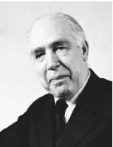
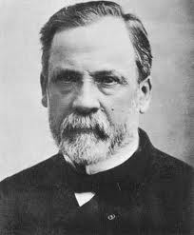
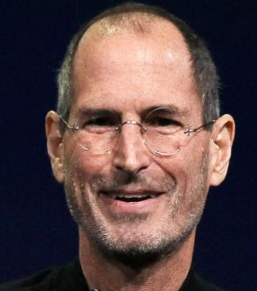
Pasteur’s Quadrant
This is the SCH quadrant: use-inspired basic research
Neils Bohr
Luis Pasteur
Quest for Basic Understanding
Low High
Steve Jobs
Low High
Application Inspired: Consideration of Use
Donald E. Stokes, Pasteur's Quadrant – Basic Science and Technological Innovation,
Brookings Institution Press, 1997
Notes:
Tom

Slide 7
Smart Health Research Themes
Robotics
Transformative Analytics in Biomedical and Behavioral Research
Fairness and Trustworthiness
Your Idea
Cyber-Physical Systems
Next Generation Multimodal and Reconfigurable Sensing Systems
Unpacking Health Disparities and Health Equity
Biomedical Image Interpretation
7
Notes:
Tom

Slide 8

Fairness and Trustworthiness
Real World Considerations Beyond Conventional Analytics Approaches
New directions for computational science
Realize the benefits of algorithmic and data fairness and trustworthiness.
Develop novel approaches to causality in AI/ML models
New methods to address disparities and improve equity, such as by:
  integrating social and economic data;
  systematically accounting for a broad range of uncertainties; and/or
  new insights into human-AI systems for clinical decision support.
Notes:
Dana

Slide 9





Transformative Analytics
Novel computational approaches for fusion and analysis of multi-level and multi-scale clinical, behavioral, biomedical and image data to improve inference accuracy, especially in scenarios of noisy and limited data records
Fusion and Analysis
Robust knowledge representations, visualizations, reasoning algorithms, optimization, modeling and inference methods to support development of innovative predictive models
Visualization and Modeling
Visualization and Modeling
Visual, Behavioral Contextual & Multimodal data
Computational models using non-traditional data
Personalized models that focus on the context of health
Longitudinal models focusing on human behavior and health
Notes:
Dana

Slide 10
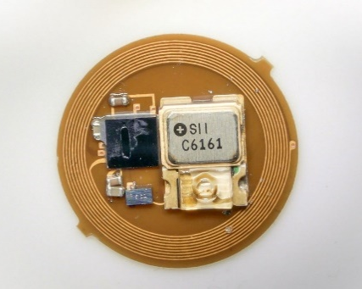
Next Generation Multimodal and Reconfigurable Sensor System
Addresses the need for new multimodal and reconfigurable sensing systems/platforms and analytics to generate predictive and personalized models of health. This thrust could include a combination of:
  Just-in-time implantable, wearable, or mobile monitoring of biomarkers from multiple sensor modalities
  Miniaturized sensor microsystems with integrated communication
  Multimodal or reconfigurable sensor systems with dramatically reduced power consumption
  Integration of data from multimodal sensor systems and other sources
Multimodal and Reconfigurable Sensing Systems and Platforms
Notes:
Tom

Slide 11
Cyber-Physical Systems
Deep integration of computation, communication, and control into biomedical physical systems
Core research areas include:
  Pervasive computing, sensing, control
  Networked at multi-&-extreme scales
  Dynamically reorganizing/reconfiguring
  High degrees of automation
  Dependable trustworthy operations
  High assurance and formal verification
  Scalable, interoperable, safe, secure, resilient, usable
  Autonomy & human-in-the-loop
  Conventional and unconventional substrates / platforms
Closed-Loop and Human-in-the-Loop
Notes:
Tom

Slide 12

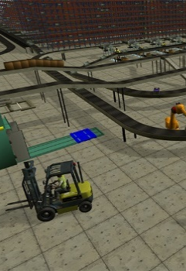
Robotics
Computational and physical complexity
Intelligence embodied in engineered construct, able to process information, sense, plan, and move within or substantially alter its working environment
Novel robotics to enhance health, lengthen lifespan, reduce illness, improve social connection, and reduce disability
Intelligence, computation, embodiment
Range of Robotic areas
Human-robot interaction
Beyond the current robotic devices in health (surgical, etc.)
Enhanced usability and effectiveness via human-robot interaction
Notes:
NSF - Tom

Slide 13
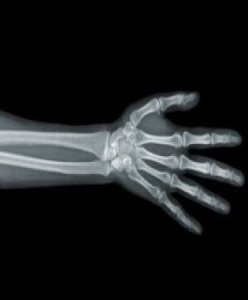
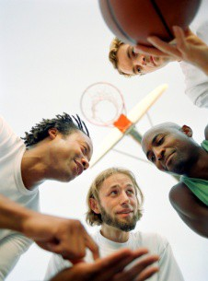

Biomedical Image Interpretation
Develop knowledge on how human pattern recognition, visual search, perceptual learning, attentional biases, etc. can be used to improve presentation modalities and identify the sources of inter- and intra-observer variability
Image Presentation
Generate new models of how non-visual contextual information or environmental variations impact the perception of complex images
Context and Environment
Exploiting Implicit knowledge
New methods to exploit experts’ implicit knowledge to improve perceptual decision making
Research on optimal methods for conveying 3D (and 4D) information
Notes:
Goli
how human pattern recognition, visual searches, perceptual learning, attentional biases, things like that, can really affect how observers are understanding images.
We really want to understand the context. when you're doing an image analysis or when you're looking at an image, what kind of things, effective, both in the context and the environment
But also ways to exploit these this understanding. Can we do a better job at providing images in a way that they help perceptual decision making and this could be in 3D or 40 models

Slide 14
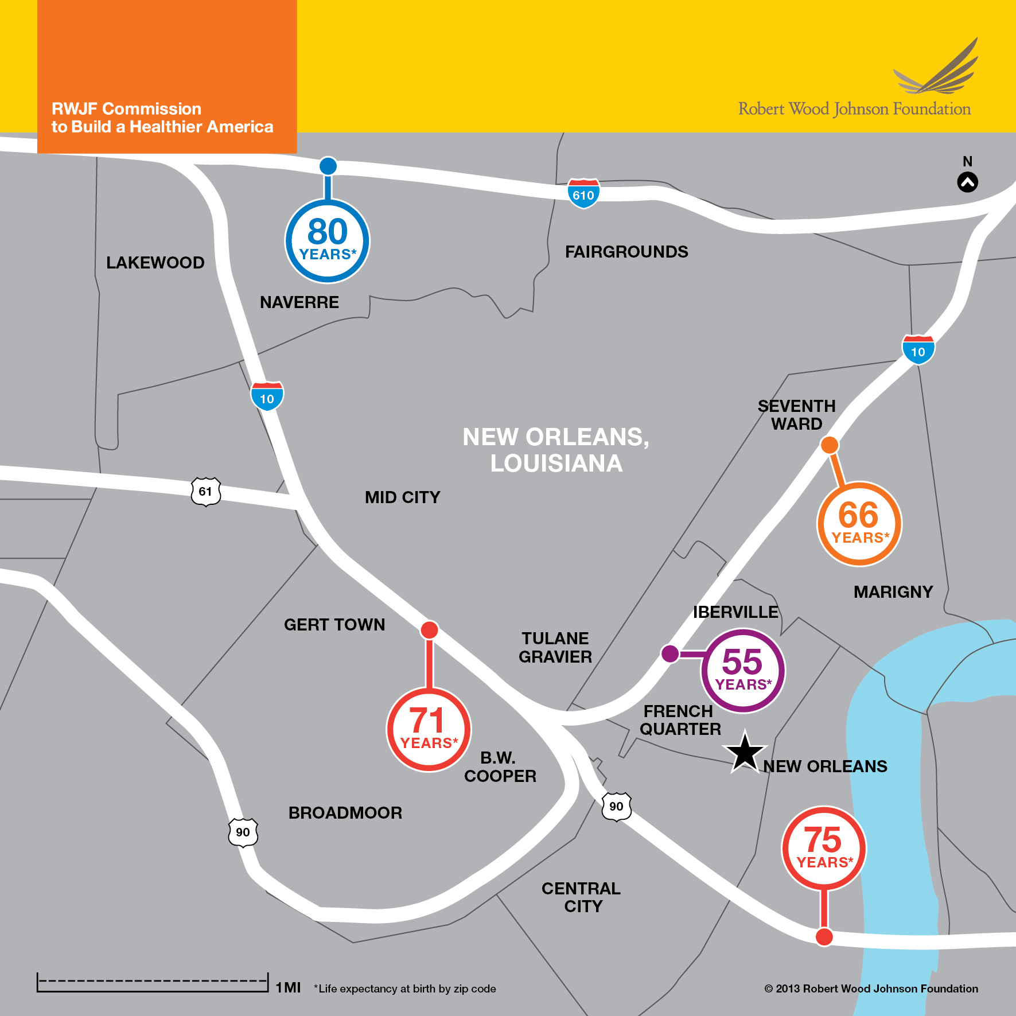
Unpacking Health Disparities and Health Equity
Develop holistic, data-driven AI/ML or mathematical models to address the structural and/or social determinants of health.
Proposers can also develop novel and effective strategies to measure, reduce, and mitigate the effects and impacts of discrimination on health outcomes.
Computational approaches with social and behavioral models to better understand culture, context and person-centered solutions with diverse communities.
Development of novel methods of distinguishing the complex pathways between and/or among levels of influence and domains.
Reduce,
Assess and Mitigate
Notes:
Goli – where you live determines your life expectancy and relates to social determinants of health

Slide 15
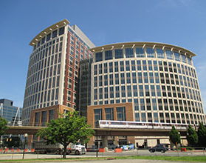
Review Process
Interagency funding meeting
NSF/NIH joint review panels
NSF award recommendations
NSF proposals
reviews, ratings, summaries,
NSF qualitative recommendations
missions and priorities
reviews, summaries,
NIH quantitative scores
NIH award recommendations
Reviewers
NSF PDs
NIH SROs
(For proposals that NIH would like to fund, PIs will be asked to submit them to NIH in the NIH format)
15
Notes:
Goli, Tom hand to Dana for NIH part (awards in Fall)

Slide 16
NSF Merit Review Elements:
Intellectual Merit and Broader Impacts
What is the potential for the proposed activity to
  Advance knowledge and understanding within its own field or across different fields (Intellectual Merit); and
  Benefit society or advance desired societal outcomes (Broader Impacts)?
To what extent do the proposed activities suggest and explore creative, original, or potentially transformative concepts?
Is the plan for carrying out the proposed activities well-reasoned, well-organized, and based on a sound rationale? Does the plan incorporate a mechanism to assess success?
How well qualified is the individual, team, or organization to conduct the proposed activities?
Are there adequate resources available to the PI (either at the home organization or through collaborations) to carry out the proposed activities?
Consider in top-down order.
Apply to broader impact activities as well as research.
Notes:
Tom

Slide 17
What are Broader Impacts?
Implicit (new knowledge, field, benefits to society …)
Explicit (technology transfer, results dissemination …)
Integration of Research and Education
  Development of curriculum and supporting materials
  Student involvement in emerging research and technology
  Postdoctoral training (plan required if the proposal requests funding for one or more postdocs)
  Data management (plan required)
Broadening participation of underrepresented groups
  Computer Science education, computer systems workforce
  Gender, ethnicity, disability, geographic, etc.
…. (not an exhaustive list)
CANNOT JUST BE THE BIOMEDICAL/HEALTH IMPACT
Notes:
Tom

Slide 18
Smart Health Specific Review Criteria
Scientific Requirement
Collaboration & Management Plan
Evaluation Plan
18
Notes:
Goli, Tom with comments from Dana

Slide 19
Proposals advance two fundamental science/engineering areas:
  Computer and Information Science, e.g., artificial intelligence, machine learning, informatics, computer architecture, databases, natural language technology, networks, robotics, etc.
  Engineering, e.g., multimodal sensor technology, signal processing, optimization, operations research, closed loop systems, dynamic systems analysis, materials, etc.
  Mathematics and Statistics, e.g., stochastic modeling, analysis, interpretation and characterizing uncertainty, etc.
  Social, Behavioral and Cognitive Sciences, e.g., perception, social psychology, cognition, emotion, economics, ethics, linguistics etc.
Notes:
Goli: Doesn’t have to be ENG/CS or Math/CS it can be different areas of CS or ENG
Looking for things in the Pasteur quadrant
Not using chatgpt to deal with suicidal ideation.

Slide 20

Collaboration Plan
All proposals must include a Collaboration and Management Plan as supplementary document (no more than two pages)
The plan must describe:
The description of the team and their roles.
A plan for integration and ways to support interdisciplinary collaboration.
The team member’s expertise for the project.
Notes:
Goli

Slide 21
Data Management Plan
All proposals must include a Data Management Plan
Up to 2 pages
Describe how the proposal will conform to NSF policy on the dissemination and sharing of research results
https://new.nsf.gov/policies/pappg/23-1/ch-2-proposal-preparation#2D2i-ii
https://www.nsf.gov/cise/cise_dmp.jsp
Projects that are selected for NIH funding will be required to comply with the NIH Data Management and Sharing Policy
https://sharing.nih.gov/data-management-and-sharing-policy
Notes:
Tom and then Dana and Yanli will add their specifics for those picked by NIH

Slide 22
Evaluation
All proposals must include an evaluation component
Evaluation can target multiple areas:
  Technical functioning,
  Validity and reliability,
  Usability; and,
  Impact on biomedical/health outcomes
Evaluations SHOULD NOT include randomized clinical trials
Notes:
Tom

Slide 23
Final Comments
23
Notes:
Goli

Slide 24
What proposals are not appropriate for this solicitation?
Focus only on advancing biological, biomedical and/or public health research without new fundamental science or engineering.
Propose an application of existing fundamental science to the biomedical domain.
Focus on a topic that fits the mission of another agency.
Notes:
Goli
Add examples of what is not appropriate for SCH (not repurposing an app for health condition, not incremental work)

Slide 25

Useful Website: www.nsf.gov
25
Notes:
Goli

Slide 26
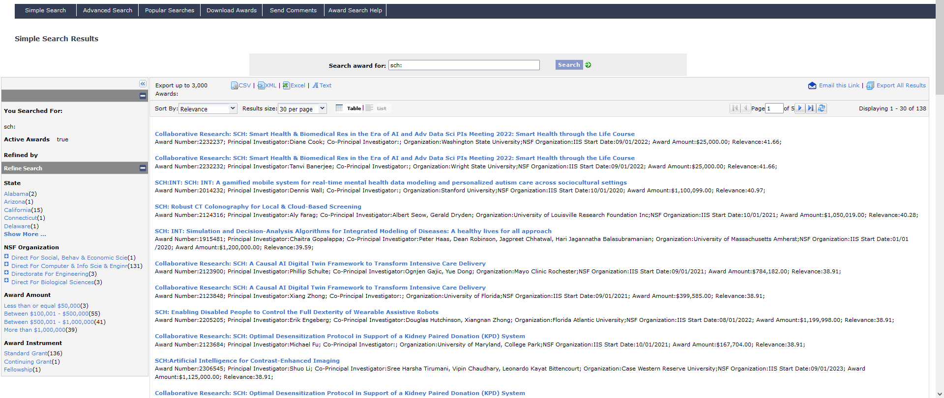
www.nsf.gov/awardsearch
’SCH:’
Click on any grant
26
Notes:
Be familiar with projects that have succeeded - Award Abstracts at http://www.nsf.gov/awardsearch
Goli

Slide 27
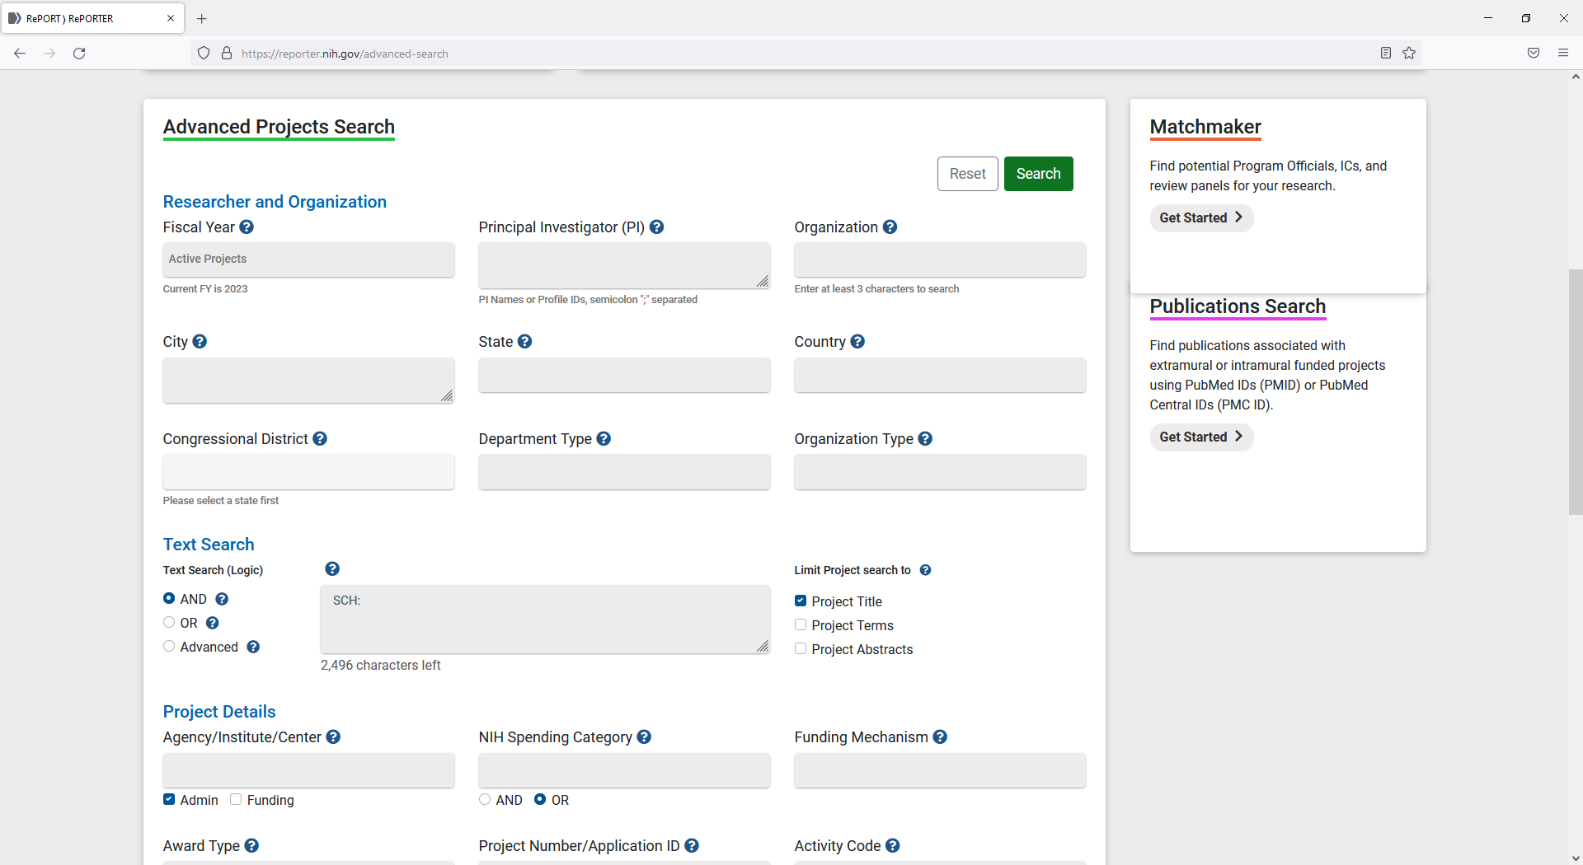
Useful Website: reporter.nih.gov/advanced-search
’SCH:’
Searching just the title
27
Notes:
Dana

Slide 28
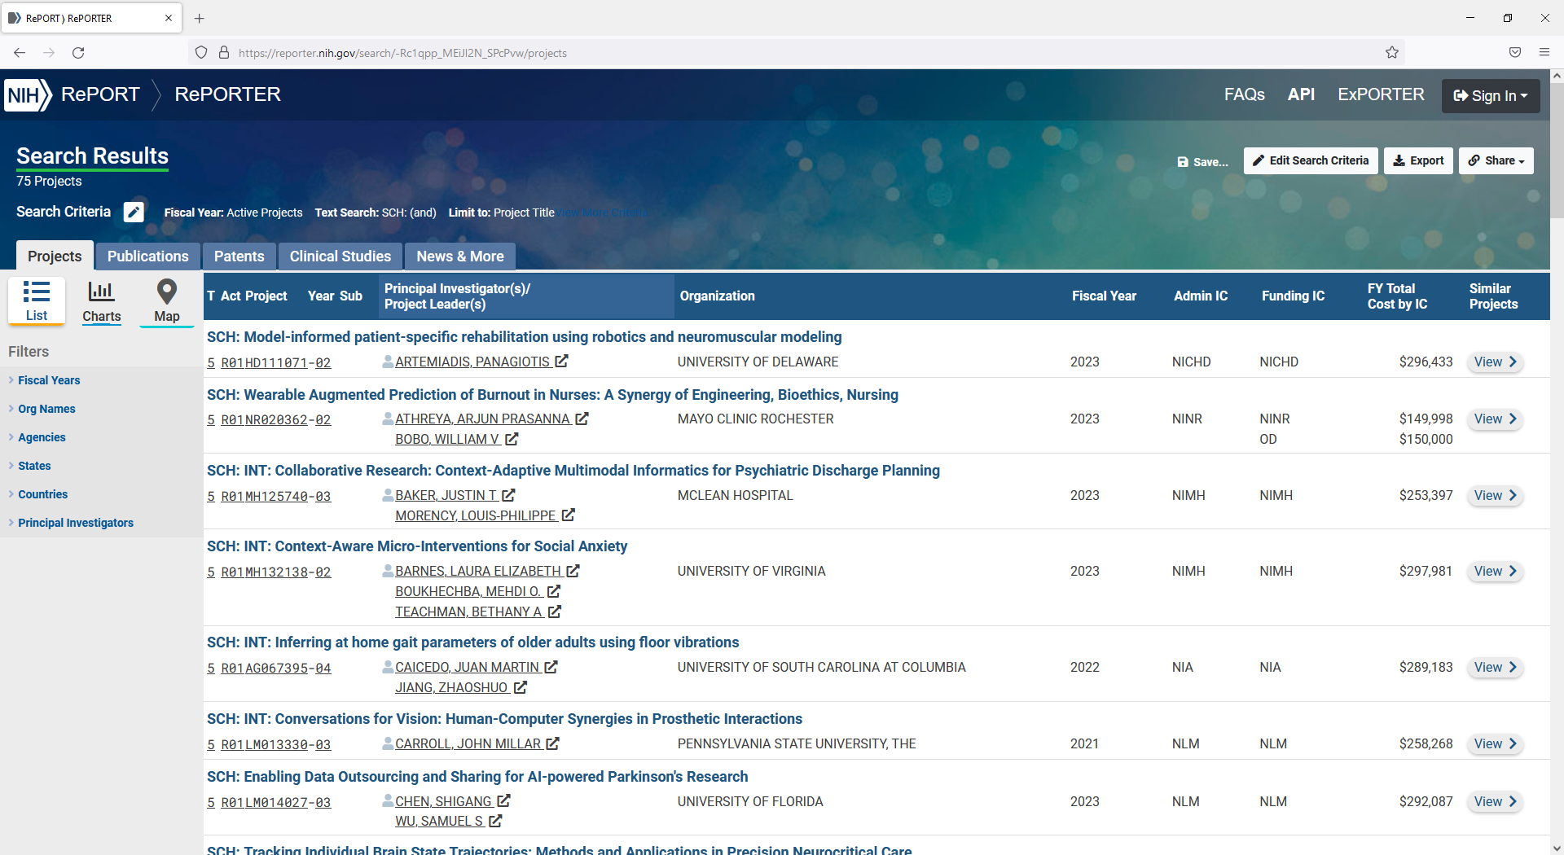
https://reporter.nih.gov/advanced-search
Click on any grant
28
Notes:
Dana

Slide 29


Getting Feedback for your proposal
Send a one-page summary to NSF SCH-Correspondence@NSF.gov of your idea that briefly describes:
The Project
The Intellectual Merit (specific advances you expect to make in fundamental science/engineering)
The Broader Impacts (health outcomes, outreach and education)
Do not send an NIH Specific Aims page!
Description of the one-page summary can be found at: https://new.nsf.gov/policies/pappg/23-1/ch-2-proposal-preparation#2D2b
Notes:
Tom then Dana: Will jump in and tell them to got to NSF first

Slide 30
How does one apply?
NSF: https://www.nsf.gov/pubs/2023/nsf23614/nsf23614.htm
  For a list of NIH Institute-specific interests: https://grants.nih.gov/grants/guide/notice-files/NOT-OD-23-165.html
Refer to NSF “Proposal and Award Policies and Procedures Guide”
Email NSF at: SCH-Correspondence@NSF.gov
Notes:
Goli - NIH bullet is specific interest, you can incorporate. But it needs to be written in NSF form and include transformative science aspects.

Slide 31
Join our Listserv
SMARTHEALTH_COMMUNITY
  Join the electronic mailing list (LISTSERV) for forthcoming announcements by — Sending an e-mail message to LISTSERV@LISTSERV.NSF.GOV from the mailing address at which you want to receive announcements.
  The body of the message should read Subscribe SMARTHEALTH_COMMUNITY [your full name].
  The message is case sensitive; so capitalize as indicated!
  Don't include the brackets.
  The Subject line should be blank
  For example, for Robin Smith to subscribe, the message would read
  Subscribe SMARTHEALTH_COMMUNITY Robin Smith.
  You will receive a confirmation of your subscription along with instructions on using the listserv.
Notes:
Goli

Slide 32
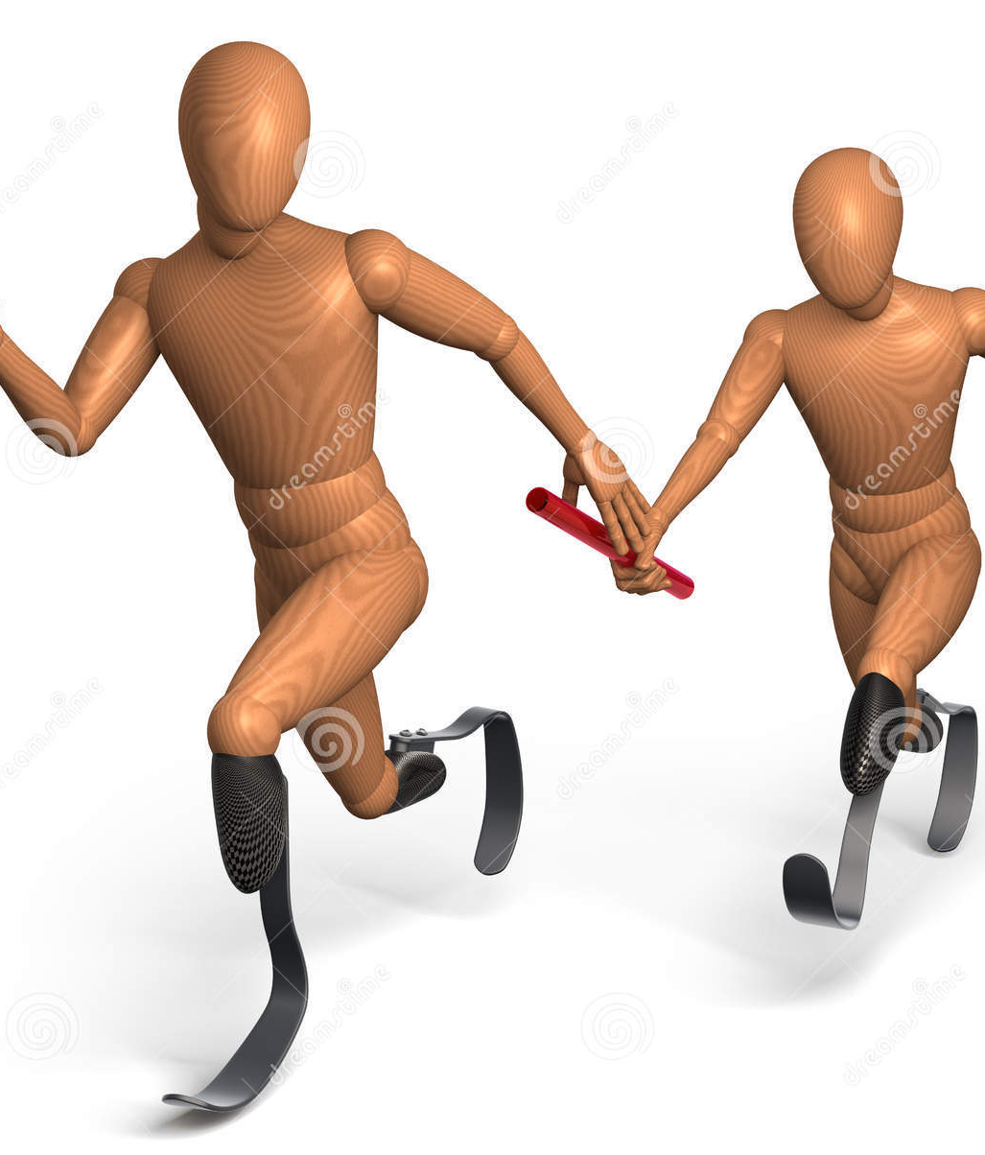
Effective Research is a relay between basic and applied science
Notes:
Goli

Slide 33
Thank you!
Questions or Comments?
Email:
SCH-Correspondence@NSF.gov
Notes:
Goli

