Slide 1

National Artificial Intelligence (AI) Research Institutes Accelerating Research, Transforming Society, and Growing the American Workforce
James Donlon, CISE/IIS
Program Webinar, September 5, 2023
https://new.nsf.gov/funding/opportunities/national-artificial-intelligence-research
Slides will be linked to the program page within a day or two after the Webinar
Notes:
Good afternoon and thank you for joining. I am Jim Donlon, a program director in the NSF Division of Information and Intelligent Systems and lead program director for the National AI Research Institutes program. On behalf of the entire program working group, I am pleased to present to you this Webinar.
The webinar is scheduled to begin at 1:30 eastern time, and it will end between 2:30 and 3:00, depending on how long question and answer continues. We will present for approximately 50 minutes, and then we’ll take questions for the remainder of the time.

Slide 2

Questions
Submit your questions using the Q&A module
Will answer questions live (perhaps some in the module)
Theme leads are here to address your theme questions
If your question is not answered, feel free to email programmatic questions to AIInstitutesProgram@nsf.gov; theme-related questions to relevant program contacts
Webinar materials (slides, script, and audio recording) will be linked on the program/webinar web page
Notes:
You may submit questions through the “Q&A” module in your Zoom toolbar.
Questions will be addressed live, in the Q&A period; and the answers to some questions may be entered directly into the Q&A module. We plan to address as many program-wide questions and theme questions as we can, with particular attention to those relevant to a broad community. If we do not get to your question during the webinar, feel free to email your question to the email address shown (AIInstitutesProgram@nsf.gov) or directly to the relevant program contacts found in the solicitation.

Slide 3
Program/Theme Leads
Theme | Principal contacts
Program-Wide | James Donlon, CISE/IIS
1. AI for Astronomical Sciences | Andreas Berlind, MPS/AST
2. AI for Discovery in Materials Research | Serdar Ogut, MPS/DMR
3. Strengthening AI | Hector Munoz-Avila, CISE/IIS
Notes:
National AI Research Institutes is a multi-sector program, represented by program directors across NSF, as well as by program contacts representing the artificial intelligence priorities of our partners. Several program contacts are attending the webinar. Today you will hear from the contacts listed here – they are the principal coordinators of their respective themes. We are also joined by representatives from partner organizations. In the program solicitation you will find a full list of program contacts for the themes and their organizational affiliations.

Slide 4
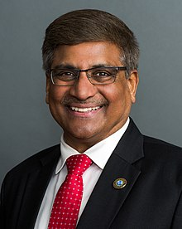
Welcome
Dr. Sethuraman “Panch” Panchanathan
Director, National Science Foundation

Slide 5

Next Steps in the AI Institutes Program
Dr. Margaret Martonosi
NSF Assistant Director for Computer and information Science and Engineering (CISE)
5
Notes:
Thank you Dr. Panchanathan for your encouragement and leadership.
To start the webinar, I would next like to invite Dr. Margaret Martonosi, the NSF Assistant Director for CISE, to frame this new funding opportunity in terms of our broader AI strategy and chart the next steps for AI institutes within that strategy. Margaret, thanks for joining us.
Margaret:
Thanks, Jim. I am happy to join and welcome you not only as the AD for the program’s home directorate, but on behalf of the other Assistant Directors, each of which is a partner in this NSF-wide initiative.
… [any other welcoming comments and on to the next slide].

Slide 6
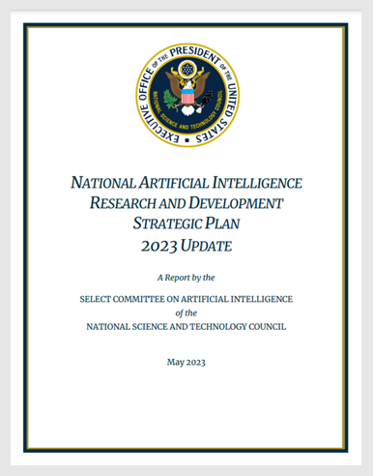
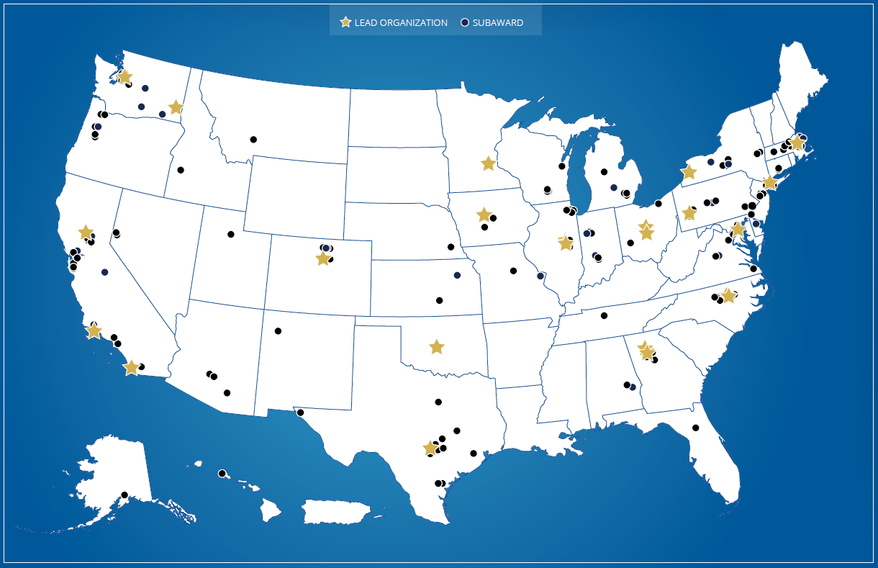
National Artificial Intelligence (AI) Research Institutes
Founded on National AI R&D Strategic Plan
Partnership among federal agencies and with the private sector
6
Notes:
Margaret:
• As Dr. Panchanathan emphasized, this program is a joint effort between NSF, partners in the interagency, and the research community to establish AI Institutes that serve as national nexus points for collaborative AI efforts, spanning institutions of higher education, federal agencies, industry, and nonprofits/foundations. The program and the institutes funded by it align in some significant way with each of the objectives in the National AI R&D Strategic plan that inspired the AI Institutes.

Slide 7





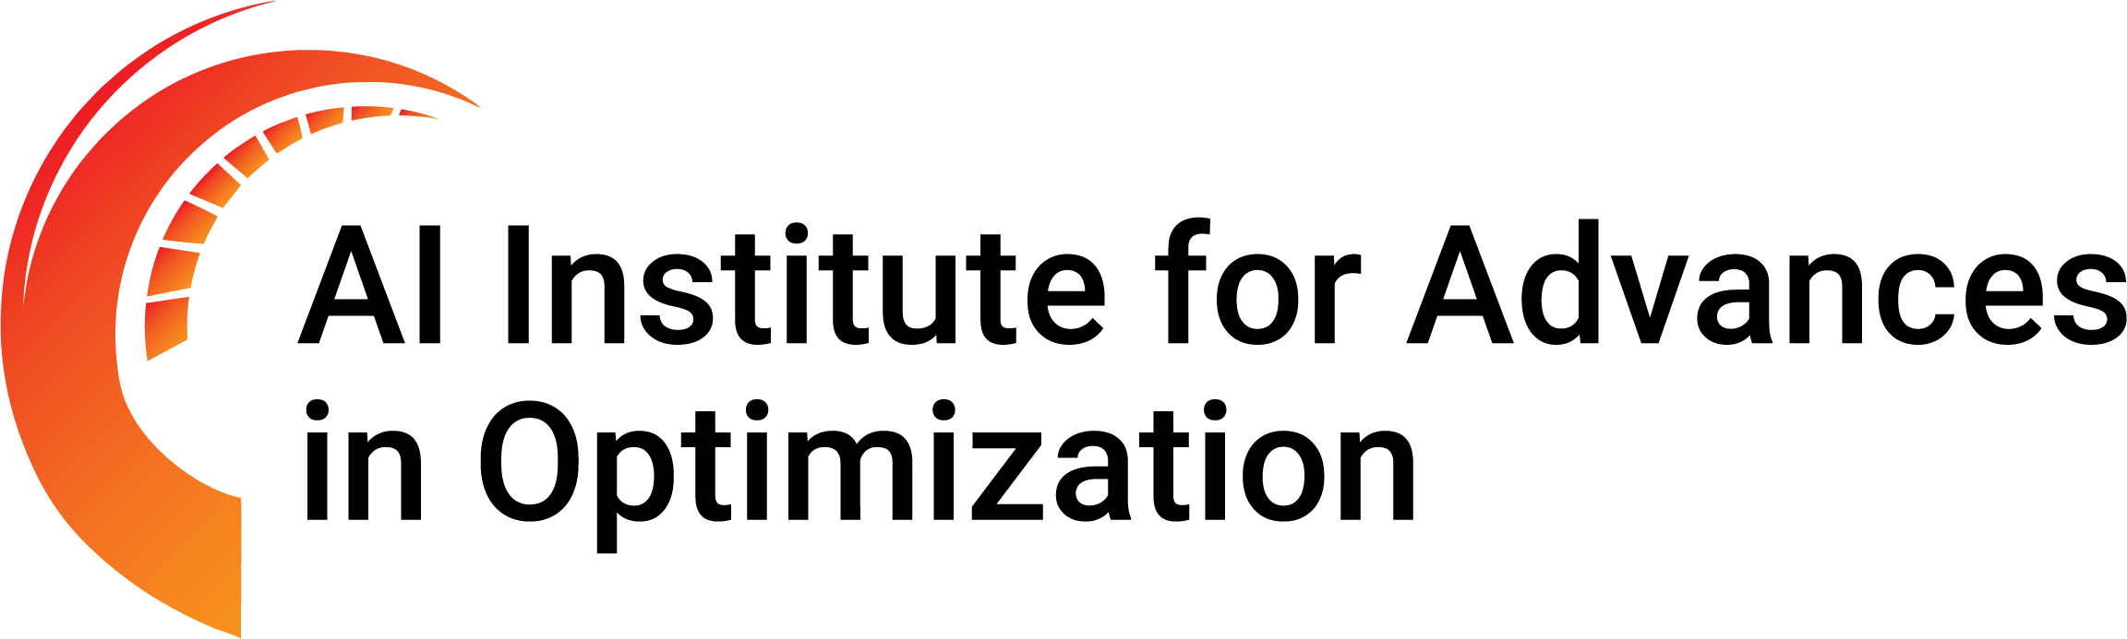



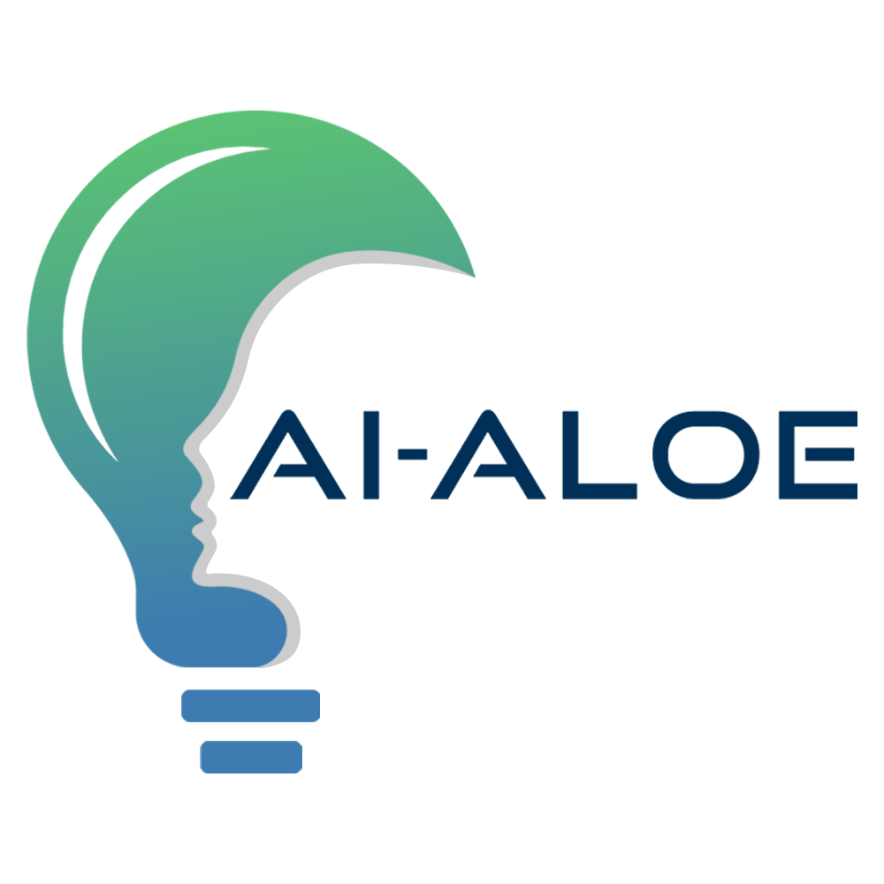













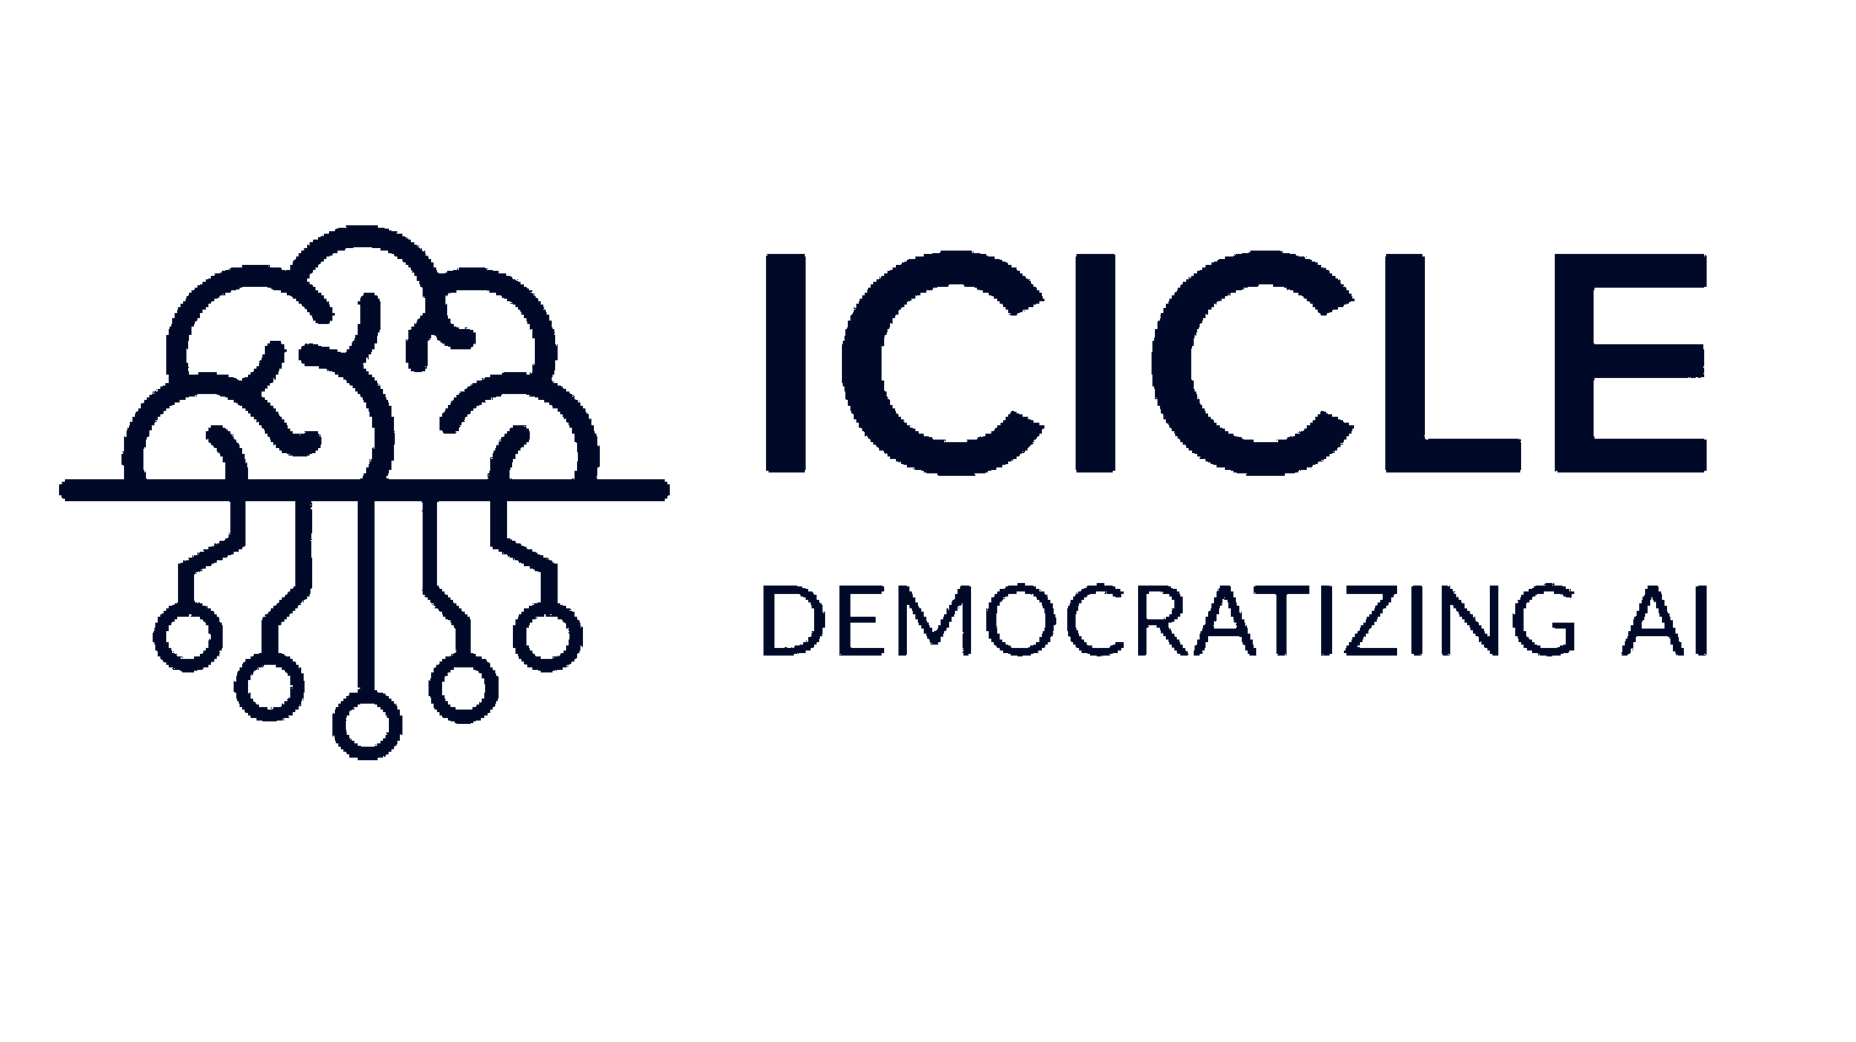

25 Active Institutes
2020: First cohort of Institutes (5 NSF, 2 NIFA)
2021: Second cohort of Institutes (9 NSF, 2 NIFA)
2022: AI Institutes Virtual Organization established
2023: Third cohort of Institutes (6 NSF, 1 NIFA)
AI Institutes directory and news: https://aiinstitutes.org
Notes:
• I will reemphasize that we are immensely proud of the 25 institutes funded to date in the program, over the previous three rounds and continuing with this new funding opportunity. Each Institute is a multidisciplinary, multi-stakeholder team focused on advancing our understanding of AI and developing the future AI workforce while addressing some of society’s grand challenges.

Slide 8





This Solicitation – NSF 23-610
Advance AI through use-inspired research
Astronomical Sciences
2024: AI advances for by mining, analyzing, and extracting knowledge from astronomical data
Materials Research
2025: AI advances that revolutionize materials discovery and understanding, builds upon the Materials Genome Initiative (MGI)
Strengthening AI
2025: Toward AIs that understand the concepts they reason over, change their behavior in response to users, and align with societal expectations
Notes:
• In this new solicitation you will see that the funding opportunities span new Institutes to be created over the coming two years.
o NSF is partnering with the Simons Foundation with a goal to fund two institutes in 2024 that advance AI and the astronomical sciences together to unlock new discoveries from the high volume of high-quality and multispectral data that is coming from major astronomical facilities.
o Intel Corporation has joined NSF to fund an Institute in 2025 focused on AI advances and discovery in materials research. Today’s materials research opportunities can push our quest for the advancement of AI knowledge and methods for scientific discovery, while AI has great potential to help us discover the building blocks for beneficial new products and technological capabilities.
o And in Strengthening AI we are pleased to partner with Capital One and potentially with one or more federal agencies to fund two or more institutes in 2025 to tackle what will certainly be a continuing and long-range project in AI research. That is, how do we improve the fundamental design and understanding of rapidly advancing AI models so that we guide and prioritize development of AI capabilities in the most desirable directions? This will require AI that is “grounded” in a true understanding of the world, meaning that it understands the concepts that it reasons over; 2. is “instructible” in that it responds appropriately to human feedback or instruction, and that we can ensure will operate consistent with human values and societal expectations, or what is referred to in the AI community as, the “alignment” imperative. This theme is explicitly aligned with the ever-present imperative that we attain high levels of trust in the technologies that we develop. The theme aspires to trust via these principles of grounding, instructibility, and alignment with our values. Such strong and robust AI can be better made to “implement more effective and trustworthy assistance to humans (e.g., in instruction, tutoring, and training) or in explaining their understanding or recommendations.”
• You will hear about all these themes in greater detail from the program contacts.

Slide 9

AI Institutes advance trustworthy AI that protects people’s rights and safety, and accelerates the Nation’s progress
https://www.whitehouse.gov/wp-content/uploads/2023/08/FY2025-OMB-OSTP-RD-Budget-Priorities-Memo.pdf
9
Notes:
• As I turn this back over to the program team, I would like to leave you with this call to action – [which is rooted in an Executive Order recently released through the Office of Science and Technology Policy, and in conjunction with the Office of Management and Budget. That order (linked on the slide), lists Trustworthy AI as the first among the list of seven multi-agency research priorities given to us by the Administration.] I am proud of how our AI Institutes and other federally funded research projects lead in laying the groundwork for trustworthy and beneficial AI. We hope to continue to see the effect continue to grow as this program expands.
• Thank you to the whole team of program contacts and thank you to our partners for your work toward this ideal,
• and of course, thank you all for joining us.
Image credits:
Credit: Shutterstock/everything possible

Slide 10

Outline
National Artificial Intelligence (AI) Research Institutes Accelerating Research, Transforming Society, and Growing the American Workforce
PROGRAM SOLICITATION NSF 23-610
Program overview and structure
Requirements for all AI Institutes
Theme-specific guidance
Proposal submission considerations
Questions
Notes:
[Jim]
Thank you, Margaret.
This webinar is intended to familiarize participants with the new solicitation in the program, and to help you prepare and submit proposals that are consistent with the goals of the program. We’ll continue with the overview and structure of the program and focus right away on the important aspects of responsiveness to the funding opportunity. Those are -- The requirements for all AI Institutes that are critical to your success, and then a presentation in turn from each of the three themes about the specific requirements of each. As you attend this webinar and later study the solicitation, we cannot stress enough how important it is that responsiveness to a theme can only be successful if the proposal is responsive to the full range of institute desiderata. After that discussion of program scope, we will highlight important aspects of the mechanics and requirements of proposal preparation and submission. Because those highlights cannot be exhaustive, we would again urge you to read carefully the solicitation requirements and the incredibly important NSF Proposal & Award Policies & Procedures Guide or PAPPG.
Once we get through that material, the remaining time will be spent engaging with you in Q&A, As mentioned prior to the start of the presentation, we will take questions via the Zoom Q&A feature, and we will address as many of those questions as we can at the end.

Slide 11
National Artificial Intelligence (AI) Research Institutes
Sustained investments in AI research in areas with the potential for long-term payoffs. Emphasis on convergent foundational and use-inspired research focused on societal challenges and enhancing national competitiveness in AI.
Goals of each Institute:
Significantly advance research in AI in a multi-disciplinary, multi-institutional collaborative setting
Accelerate the development of transformational, AI-powered innovation
Grow a workforce of future AI researchers and practitioners
Nexus points for Institute-level collaboration between universities, federal agencies, industries, and nonprofits
11
Notes:
We begin with the program at a glance.
As you heard in the welcome, the program seeks to deliver on a national strategy to make sustained investments in AI research in areas with the potential for long-term payoffs and national competitiveness in AI.
The emphasis on convergent foundational and use-inspired research is clear – each institute has a critical goal the significant advancement in the methods and understanding of foundational AI.
The concept of the AI Institute is that these AI advances are sought in a use-inspired context – that is, with an emphasis on convergent research focused on important application areas, scientific discovery, and societal challenges, which leads to not only foundational advances, but also AI-powered innovation.
AI Institutes leverage their scale and leadership position to nurture and grow the next generation of talent, for our AI-powered future.
And AI Institutes can be seen to lead in their chosen areas of AI research and innovation as they establish themselves as nexus points for continuous growth in their collaborative efforts.

Slide 12
New/changes
Program structure and requirements remain largely unchanged from previous solicitation
Take note of these revisions
New themes for Institute proposals
New NSF funding partners
Enhanced description of "use inspired research" to emphasize research convergence as a means for foundational AI goals
Different submission timelines for two different funding years
Notes:
We are now in our fourth issuance of solicitations in this program for the next two rounds of awards to be made in 2024 and 2025. As in all previous rounds in the program, we have been intentional in maintaining a consistent definition of what it is to be an AI institute, and this solicitation continues that. However, while the identity of the program remains largely constant, things do change over time and you must be attentive, especially if you have previously engaged with the program. In the revision notes for this solicitation, we call your attention to several notable changes. There will also be small revisions to solicitation text throughout. As always, even if you are returning to the program and have been familiar with previous solicitations, it is vital that you take the time to read the new solicitation carefully. If you take the time to read this release carefully, you will have a much better chance to be compliant and responsive.
Now to highlight the most notable changes,
First, as usual, we solicit proposals guided by several theme descriptions, and we will expand on those in detail in the webinar.
Second, in each theme, NSF is joined by funding partners, some new and some returning. There are some nuances to how some partnerships work and what that means for your potential proposals, and we will go over that today.
Third, we call your attention to some expansion we have added to the way we describe use-inspired research. This does not change the definition of use-inspired research by any means, but later we will emphasize the convergent, deeply integrated relationship between your foundational research goals and your chosen use-inspired domain.
Finally, I mentioned up front that this solicitation covers “the next two rounds” of Institute awards anticipated in this program. This means two different submission and review timelines. And I am going to cover that next in detail.

Slide 13
Program Timeline
Milestone | 1. Astronomy | 2. Materials 3. Strengthening AI
Solicitation release/ | Jul 31, 2023 | Jul 31, 2023
Webinar | Today | Today
Preliminary proposals due | Oct 31, 2023 | Jan 12, 2024
Results of preliminary proposal review | Early Dec 2023 | Mid-Feb 2024
Full proposals due | Feb 16, 2024 | May 17, 2024
Schedule Reverse Site Visits | Apr-May 2024 | Oct 2024
Reverse Site Visits | May-Jun 2024 | Nov-Dec 2024
Anticipated start date of awards | Oct 1, 2024 | Jun 1, 2025
Notes:
In the solicitation, at the end of the Program Description, you will see a program timeline reflected, divided into groups according to the year in which awards are anticipated. In short, the Astronomy theme is in Group 1 as shown here, and the others are in Group 2.
This timeline reflects the Review and Selection Process as presented in that section of the solicitation.
In both groups, all themes, there is the requirement to submit Preliminary proposals – Oct 31 for Astronomy, Jan 12 for the others. The intent is to return the results of preliminary proposal review to you within a month’s time as you can see.
Full Proposal due dates are Feb 16 for Astronomy, and May 17 for others.
Merit review takes place after proposal submission of course. During that period, the program is likely to continue the practice of inviting some proposing teams for a Reverse Site Visit (RSV) prior to final selection of Institutes. Such teams are asked to choose key project personnel to meet with program officials via video teleconference. Reflected here are the anticipated timelines for scheduling and conduct of these RSVs. If there are changes to this schedule, all lead PIs who have submitted to the program will be notified by email.
Awards made in Astronomy are anticipated to start Oct 1, 2024; and awards in the other themes will start June 1, 2025.

Slide 14
Requirements for All AI Research Institutes
Advance foundational AI research
Conduct use-inspired research
Grow the next generation of talent
Be multidisciplinary
Leverage multiple organizations
Be nexus points for collaborative efforts
Notes:
We now turn our attention to the activities that constitute an AI Research Institute in this program. This is what we think of as the “global scope” of the program. The vision for the program is broad and ambitious. It is expected that each AI Research Institute will pursue this vision in a unique way, but it is critical that you understand that every AI Institute is selected for and evaluated on their impact in this this full range of activities.

Slide 15
1. Advance Foundational AI Research
Add significant new knowledge and understanding to artificial intelligence and demonstrate the potential to radically advance areas beyond the state of the art.
Address new foundational AI research priorities that arise from rapid advances in AI and the increasing ubiquity of AI-enabled technology.
Address areas in clear need of larger efforts over longer timeframes; the research will have broad and lasting impact.
Institute proposals that do not describe a clear plan to achieve ambitious advances in foundational AI research are not likely to be responsive to this program
Notes:
The first function of Institutes, and critical to all proposals to this program, is that AI Research Institutes must advance foundational AI research. This means adding significant new knowledge and understanding to the AI research central to your Institute’s vision. Institutes might address new foundational AI research priorities that arise from rapid advances in AI and the increasing ubiquity of AI-enabled technology; or challenge disciplinary divisions that result from the current state of specialization, or promote the establishment of new science, engineering and educational communities that better reflect the long-term research needs for future AI.
It is very important to emphasize that Institute proposals that do not describe a clear plan to achieve ambitious advances in foundational AI research are not likely to be responsive to this program.

Slide 16
1. Advance Foundational AI Research: Scope of AI
Understanding the mechanisms underlying thought and intelligent behavior and their implementation in machines.
“Core” theory and methods that give rise to these abilities and their implementation in machines
Research in all matters of learning, abstraction, and inference required for intelligent behavior.
General architectures for intelligence, integrated intelligent agents, and multiagent systems.
Notes:
To understand the foundational AI research that is the scope of this program, we summarize here the definition of AI provided in the solicitation. This definition helps to scope what the program is looking for in seeking to “significantly advance research in AI”.
In a broad sense, AI is concerned with understanding the mechanisms underlying thought and intelligent behavior and their implementation in machines. What we often refer to as “core” AI research are methods pertaining to the learning, abstraction, and inference considered essential for the implementation of intelligent behavior in machines. Core AI research also includes the study of architectures intended to directly manifest that behavior, including general architectures for intelligence, integrated intelligent agents, and multiagent systems.

Slide 17
1. Advance Foundational AI Research: Scope of AI, continued
AI is a multidisciplinary endeavor
Computational methods draw insight from fields such as biology, neuroscience, behavioral and cognitive science.
Computer vision and human-language technologies provide critical capabilities to many AI systems.
Robotics is closely aligned with but not identical to embodied AI. AI systems may be able to act upon the world through embodiment.
Notes:
The modeling and implementation of intelligent behavior in machines began as, and has continued to be, a multidisciplinary endeavor.
Many computational models of intelligence have drawn inspiration from living systems, drawing from biologically-inspired computing, computational neuroscience, and behavioral and cognitive science.
Computer vision and human-language technologies have a high overlap with artificial intelligence, inasmuch as they provide methods for the perceptual and communications capabilities critical to intelligent systems.
Robotics is closely related to, but not identical to, AI. Robotics can provide the embodiment critical for intelligent systems to be able to act upon the world. While an embodied AI may be a robot, this solicitation’s focus is on the AI aspect of the research. For example, this solicitation does not include in its scope development that is mainly focused on teleoperated robots or robots that repeat programmed instructions in controlled environments.

Slide 18
2. Conduct Use-Inspired Research
Use-inspired AI research is basic research that has use for society in mind.
Use-inspired research is a context that informs foundational AI advances and drives innovations in related sectors through use cases, affording:
Clear and compelling goals to advance AI and to accelerate the fielding of AI-powered innovation.
The transfer of knowledge through the meaningful exchange of scientific and technical information with internal participants and external stakeholders.
The potential for the creation and sharing of community infrastructure, including data and software, to further research, promote reproducibility, and support education.
Within the use-inspired context, balance the application of AI with the advancement of foundational AI as appropriate to your Institute vision
Notes:
Second, AI Research Institutes will conduct use-inspired research. In the AI Institutes program, this means that a use-inspired context both informs the foundational AI research we just discussed and drives innovations in the related sectors through focus on use cases or application. The solicitation emphasizes that this should be conveyed in terms of clear and compelling goals, can enhance knowledge transfer, and create the potential for shared community infrastructure.
It is important to understand that use-inspired research is a means of achieving the first goal of advancing foundational AI, further expanding the context and value of the Institute’s vision. And the foundational AI goals are a means for achieving transformative advances in the use-inspired sector. A compelling use-inspired context should balance the application of AI with the advancement of foundational AI in a way that is appropriate to your Institute vision.

Slide 19
Foundational and Use-Inspired AI Research
Use-inspired, e.g.,
Foundational
AI results
…
Use-inspired AI research
environmental protection
civic & public good
scientific discovery
enginnered systems
manufacturing
health and wellbeing
learning, abstraction, and inference
Use cases
agents and multiagent systems
…
AI foundations, e.g.,
reasoning, uncertainty, causality
grounding, instructibility, alignment
Notes:
Use-inspired AI research refers to basic research that has use for society in mind. The conceptual depiction on the right shows the broad potential for a broad range of use-inspired “verticals” (if you will) to inform and benefit from a wide range of potential foundational AI priorities. Institutes established in the program to date have found many unique intersections in this conceptual space. As before, we have taken inspiration from partners and the larger community to invite you, the proposing community, to come at this from different directions. In the Astronomy and Materials themes in this solicitation, we will soon see that their intended domains of scientific discovery are largely defined in the scope of the theme. Yet consider that there may be room for more institute-specific visioning within those pursuits. In Strengthening AI, where the theme scope is strict only in terms of AI goals, the potential for use-inspired inspiration and impact is limitless.
The goal in this program is that each institute conducts foundational AI research within the use-inspired context in a deeply integrated way, forming a virtuous cycle. The resulting Use-Inspired research context is one in which:
The domain reveals needs and opportunities that motivate the proposed foundational AI advances and
those foundational AI advances in turn contribute to the sectors that define the use-inspired context.
Ideally the results from use-inspired application areas are generalized and even made foundational.
Before we move on this is a good time to point out that generally, Institutes have found that a team science orientation greatly contributes to their effectiveness at achieving this. Effective use-inspired research does not happen without committed and sustained effort to achieve synergy among a group of researchers from diverse perspectives.

Slide 20
“Foundational AI” and “use-inspired research” requirements are not in opposition to one another
Not “separate from”, and not merely “applied” →
Solicitation Introduction:
Use-inspired research is an expected modality of an Institute's foundational AI research… Ideally there is a virtuous cycle resulting from deeply integrated convergent research in which AI advances are motivated by domain challenges, and those domains benefit from new AI advances.
Program Description:
It is critical that proposals clearly specify how the use-inspired context for Institute research reveals the opportunities for foundational AI advances and how those foundational AI advances in turn contribute to the related sectors that define the use-inspired context.
Solicitation Specific Review Criteria:
How well does the proposed Institute leverage the use-inspired research context to both advance AI and drive innovations in related sectors of science and engineering, segments of the economy, or societal needs?
Notes:
Sometimes we are asked about how to select an appropriate balance between foundational AI and other domains. We want to warn against inappropriately putting these concepts in opposition to one another and instead recall the “virtuous cycle” we aspire to. Not likely competitive for this program is a proposal in which AI is merely applied to the domain, or even in which the AI goals are foundational and yet seem not well integrated with the domain.
Animation 1. In the Introduction to the solicitation, we identify the preferred convergent approach as being at the very heart of the program’s identity. Use-inspired research is an “expected modality of, or means by which, we wish to see you propose the foundational AI advances.
Animation 2. The program description expands on the program requirement, defining the virtuous cycle in a non-superficial way. The use-inspired context “reveals the opportunities for foundational AI advances” and those “foundational AI advances in turn contribute to” the domain.
Animation 3. Finally, keep in mind that NSF and reviewers will evaluate proposals – and later, Institutes – on how well the activity leverages this use-inspired context consistent with the program vision.

Slide 21
3. Grow The Next Generation of Talent
Drive education about AI across educational levels and institution types, including post-secondary, workforce training, and other public education.
Develop innovative pedagogy and instructional materials, advanced learning technologies, project-driven training, cross-disciplinary and collaborative research, industry partnerships, and new career pathways.
Offer broad, deep, and diverse experiences with a focus on broadening participation among the full range of groups traditionally under-represented in science and engineering.
Leverage the visionary research focus and integrate education and workforce development for a whole “greater than the sum of its parts.”
Notes:
Third, AI Research Institutes are expected to maximize their unique position to grow the next generation of talent for a diverse, well-trained workforce that will provide new discoveries and leadership.
Specifically, these Institutes should leverage the visionary nature of their research foci to drive new and innovative education and development tailored toward the Nation's undergraduates, graduate students, and post-doctoral researchers, as well as through community colleges and skilled technical workforce training and other opportunities that advance knowledge and education of AI, including public understanding of AI.
This could include innovative pedagogy and instructional materials, advanced learning technologies, project-driven training, cross-disciplinary and collaborative research, industry partnerships, and new career pathways. Institutes should offer broad, deep, and diverse experiences to build the next generation of the AI workforce, with a focus on broadening participation among groups historically under-represented in science and engineering, including women, people with disabilities, and people from other minoritized groups.
Institutes must propose meaningful plans for these activities, and the solicitation describes required sections on “Education and Workforce Development” and the Broadening Participation Plan that focus on education and workforce development. We caution proposers, however, against seeing these as separate from other proposal activities. Rather, education, training, and inclusion plans should be well-integrated with other research and coordination activities described in the proposal, forming a whole that is greater than the sum of its parts.

Slide 22
4. Be Multidisciplinary
Coherent multidisciplinary groups of scientists, engineers and educators appropriate for a large-scale, long-term research agenda for the advancement of AI and the fielding of AI-powered innovation.
Catalyze foresight and adaptability beyond what is possible in single research projects.
Significant integration of multidisciplinary research can be a significant basis of confidence that your proposed Institute will be “greater than the sum of its parts”.
Notes:
The fourth desideratum we shorthand here as, AI Institutes should “Be Disciplinary”, AI Research Institutes are coherent multidisciplinary groups of scientists, engineers, and educators appropriate for a large-scale, long-term research agenda for the advancement of AI and the fielding of AI-powered innovation in application sectors of national importance. The multidisciplinary nature of these Institutes will catalyze foresight and adaptability beyond what is possible in single research projects.
This objective echoes the program’s observation that AI itself has traditionally been highly multidisciplinary, and that use-inspired research requires synergy among a group of researchers to enable transformative advances in AI, related sectors, and the interfaces between these areas.
In reviewing Institute proposals, reviewers and panels look for signs that the individual projects of an Institute will be meaningfully integrated resulting in contributions beyond the sum of the individual projects. Significant integration of multidisciplinary research can be a significant basis of confidence in this regard.

Slide 23
5. Leverage Multiple Organizations
Create significant new research capabilities in new centers of AI leadership.
Create a network for broadening participation from underrepresented groups and diverse institutions.
Multiple organizations meaningfully integrated into a diverse Institute is another way to form a whole “greater than the sum of its parts”.
Will be staffed with a Managing Director or Project Manager (distinct from the lead PI) and a suitable Management Team.
Will have an External Advisory Board - non-collaborators who are a source of objective, external advice
Potential Advisory Board members should not be approached or identified until the Institute is funded
Notes:
Fifth, AI Research Institutes are expected to be comprised of multiple organizations working together to create significant new research capabilities. NSF and partner organizations seek to grow the network of National AI Research Institutes in lead organizations distributed throughout the country to grow new centers of AI leadership, leveraging existing centers of excellence as appropriate. Institutes are strongly encouraged to include organizations that can directly contribute to NSF’s commitment to broadening participation by engaging a diverse, globally engaged research community, integrating research with education, and building capacity, and expanding efforts to broaden participation from underrepresented groups and diverse institutions across all geographical regions.
We again draw your attention to the importance of demonstrating that your proposed Institute be “greater than the sum of its parts – here by meaningfully leveraging and integrating diverse organizations.
In addition to a lead PI suitable to lead an Institute, each Institute will also be staffed with a Managing Director or Project Manager.
It is important to emphasize – While an External Advisory Board is required, please do not contact, invite, or identify in your proposals any potential Advisory Board members. This step should be taken after the merit review and selection process is complete.

Slide 24
6. Nexus Points for Collaborative Efforts
As nexus points, Institutes have the potential to continue to connect with new partners for continued growth and opportunities -- another way to be “greater than the sum of its parts”.
The "nexus point" function in this program is not a mere state of being for an Institute. You should describe as appropriate your priorities, programs, mechanisms, and other considerations for operating as a nexus point.
Continuing growth of collaborations with external partners can bring together people, ideas, problems, and technical approaches for maximum impact and for broadening participation beyond the members and the boundaries of the Institute itself.
Promote organizational collaborations among the best teams and approaches from institutions of higher education, federal agencies, industry, and nonprofits/foundations.
Notes:
Sixth, AI Research Institutes are expected to be nexus points for collaborative efforts. By “nexus point”, we refer to the role that an Institute can play in creating an organization that encourages the continuing growth of collaborations – especially with external partners that can further enhance the impact of the Institute.
The "nexus point" function in this program is not a mere state of being. In other words, when you have assembled your multi-organizational AI Institute, you don’t point to it and say, look at our Nexus Point. Being a nexus point is an active set of priorities, programs, mechanisms, etc. whereby an AI Research Institute
- establishes itself as a thought and research leader in their chosen area of innovations, and
- pursues the continuing growth of collaborations with external partners to bring together people, ideas, problems, and technical approaches for maximum impact beyond the members and the boundaries of the Institute itself.
Consider even at proposal time, what kinds of priorities, programs, and mechanisms your Institute could use to connect with new partners and create organizational collaborations and linkages with a range of organizations.

Slide 25
This solicitation’s Institute themes
This year, proposals are being solicited in three high-priority areas:
NSF estimates approximately 5 awards: two in theme 1, one in theme 2, two+ in theme 3, all subject to availability of funds.
AI for Astronomical Sciences | Preliminary proposals: October 31, 2023 Full proposals: February 16, 2024 Anticipated Start date: October 1, 2024
AI for Discovery in Materials Research Strengthening AI | Preliminary proposals: January 12, 2024 Full proposals: May 17, 2024 Anticipated Start date: June 1, 2025
Notes:
Having emphasized the essential nature of all institutes, we are now ready to turn our attention to the three specific themes, or high-priority areas, in which proposals are solicited for these next two rounds of awards. They are themes representing a subset of research areas that NSF and partners support, and which were determined to be both an immediate priority for funding partners and for which the research community was judged to be ready to respond this year.
NSF estimates approximately 5 awards as shown here. Funding partners may fund more or fewer institutes based on agency priorities, quality of proposals received, and availability of funds.
Before I invite the theme leads to describe the scope of each funding opportunity and some special instructions and considerations pertaining to them, I would like to preface that by addressing a common question about the potential for proposals to respond to multiple themes…

Slide 26
Responsiveness to themes
Can I submit an Institute proposal that responds to multiple themes? Is it a good idea?
The solicitation does not prohibit this, but it is not encouraged, either.
It is most effective to respond as fully as possible to the scope of the theme you addressed.
Relevance to other themes might be identified in the proposal text and/or keywords included in the Project Summary.
Consult program contacts in the respective themes for advice
Notes:
Some may wonder if it is possible or even a good idea to address multiple themes in a single proposal. Our answer here is, while it is possible of course to scope your proposal this way, your proposal must be submitted to one theme as the primary one you are submitting to.
Such overlaps may not hurt your responsiveness if you have done nothing to compromise your focus on the theme you submitted to. However, consider each theme to be an independent funding pool as you think about relevance to multiple themes. Viewed that way, you can see that it is not necessarily the case that special effort to make a proposal relate to the goals of another theme will make it more likely to succeed overall. It is most effective to respond as fully as possible to the scope of the theme you addressed. Relevance to other themes might be identified in the proposal text and/or keywords included in the Project Summary. Where such relevance is particularly strong, NSF and partners may co-review such proposals in the secondary theme(s).
It is a good idea to consult with the respective program contacts for each theme to get advice about your specific situation.
And with that bit of preamble out of the way, I would like to turn the presentation over to my colleagues, starting with Andreas Berlind from the Division of Astronomy, who will describe Theme 1 in detail. Andreas…

Slide 27





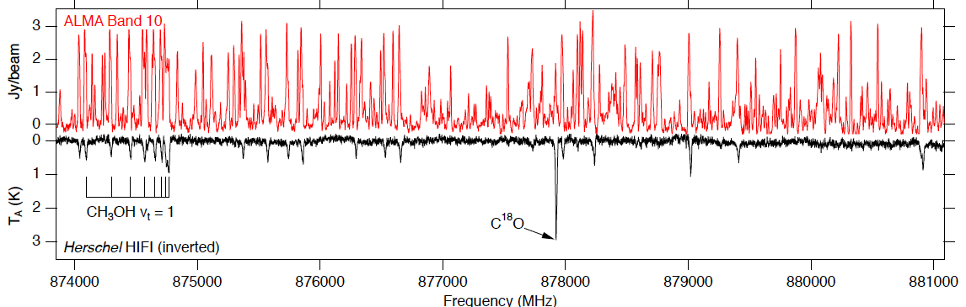
1: AI for Astronomical Sciences
Preliminary Proposals Oct 31, 2023
Full Proposals Feb 16, 2024
Start Date Oct 1, 2024
DKIST
NOAO
EHT
DES
ALMA
N-body
Current and future astronomical experiments are poised to provide a firehose of data over a wide range of wavelengths of light and with high temporal cadence.
AI will be essential for mining, analyzing, and extracting knowledge from these data.
In partnership with the Simons Foundation, we aim to fund up to two institutes to help address these challenges and to elevate AI research and education within the astronomy community.
Notes:
Hello everyone, I am Andreas Berlind, Program Director in the Astronomy Division here at the NSF, and I am the lead for the Astronomy theme of this solicitation. This is the first time that AST has participated in this program.
Astronomy is a research field that is extraordinarily data rich, with data coming in rapidly from a number of telescopes around the world and future experiments will accelerate this dramatically. These data cover a wide range of wavelengths of light and will come at high temporal cadence. Theoretical models that are attempting to simulate the data are also producing massive volumes of data.
AI technology is rapidly entering our research field and will be essential for mining, analyzing, and extracting knowledge from these data. Many astronomers are applying AI methods already and we fund many of these efforts through our AST grants. However, solving the biggest challenges will require advances in foundational AI that are inspired by them. This is challenging because there is not enough interdisciplinary collaboration between astronomers and AI researchers. In addition, education in AI within the astronomy community is not done uniformly and is not always informed by the state of the art.
To address these challenges, the NSF and the Simons Foundation aim to fund up to two institutes. We hope that these institutes will tackle important research challenges in astronomy through multidisciplinary collaboration and will serve as hubs of knowledge and education in AI for the broader astronomical community.

Slide 28
1: AI for Astronomical Sciences
Proposals to this theme should
Identify important challenges in astronomy research that will be addressed by the proposed institute.
Describe the advances in foundational AI that will be needed to tackle these challenges.
Foundational AI and astronomy work should be well integrated
Present an ambitious plan for the proposed institute to serve as a hub of AI knowledge and education for the broader astronomical community, including researchers and institutions that do not have easy access to cutting-edge data and methods.
Clearly describe the organization and management structure of the institute, including the roles of the different organizations and team members.
Notes:
Competitive proposals to the astronomy theme of this solicitation will identify important challenges in astronomy research that will be addressed by the proposed institute. The research plan should be appropriately ambitious given the scale of the grants.
Proposals should also describe the advances in foundational AI that will be needed to tackle these challenges. The foundational AI and astronomy research should be well integrated. Proposals that describe application of off-the-shelf AI models to astronomy problems are not likely to be responsive to this solicitation.
Competitive proposals will also present a plan for the proposed institute to serve as a hub of AI knowledge and education for the broader astronomical community. We would like the two institutes that emerge from this competition to have a broad impact and to elevate the level of AI research within astronomy. We encourage proposals to include activity that reaches researchers and institutions that do not have easy access to cutting-edge data and methods.
Proposals should clearly describe the organization and management structure of the institute, including the roles of the different organizations and team members. The proposed collaborations should be motivated by the science and education goals of the institute and should add up to more than the sum of their parts.

Slide 29
1: AI for Astronomical Sciences Common questions
What areas of astronomy are eligible?
All areas of astronomy that are supported by the AST Division: planetary, solar, stellar, Galactic, extragalactic, cosmology; multi-messenger; theory
What about research that touches on neighboring fields, like physics?
Research activity in other fields is ok as long as the main focus is astronomy
What about space-based astronomy?
This is not restricted. The proposed AI work can involve space-based as well as ground-based data. The important thing is that the proposed research is sufficiently ambitious given the size and scale of these awards.
Is it better for a proposal to tackle one astronomy challenge in depth or to touch on a broad set of topics?
The solicitation does not restrict this. It is most important that your chosen astronomy research is sufficiently impactful and well-integrated with foundational AI work.
Do the NSF and SF have different priorities in this solicitation that need to be balanced?
No. The theme is intended to be broad and both funding partners welcome all ideas from the research community.

Slide 30
1: AI for Astronomical Sciences Simons Foundation specific considerations
Half of the proposed budget (up to $10M) must be prepared by following instructions from the Simons Foundation, included with the announcement of this funding opportunity at the Simons Foundation website and submitted as a supplementary document. (https://www.simonsfoundation.org/mathematics-physical-sciences/funding/request-for-applications/).
Note that the Simons Foundation has a specific indirect cost rate policy.
Award budgets must reflect a clear delineation between NSF-funded effort/activities and SF-funded effort/activities, with no overlap between the two budgets.
In addition to the NSF PI meetings, SF will organize and fund annual PI meetings at SF in New York City as a part of the report requirements for awards made by SF.
SF personnel may observe panels and participate in NSF merit review deliberations as a funding entity.
Both NSF and SF will evaluate the proposal and budget as a whole. The way in which the budget is split among the two portions will not affect proposal review.
Notes:
The partnership with Simons Foundation includes a funding model not previously seen in the AI Institutes Program, and we want to take some time to explain the implications for proposals to the theme.
Half of the proposed budget (up to $10M) must be prepared by following instructions from the Simons Foundation, included with the announcement of this funding opportunity at the Simons Foundation website and submitted as a supplementary document. (https://www.simonsfoundation.org/mathematics-physical-sciences/funding/request-for-applications/).
Note that the Simons Foundation has a specific indirect cost rate policy. Please be sure to follow the link in the solicitation for details on that.
Award budgets must reflect a clear delineation between NSF-funded effort/activities and SF-funded effort/activities, with no overlap between the two budgets.
In addition to the NSF PI meetings, SF will organize and fund annual PI meetings at SF in New York City as a part of the report requirements for awards made by SF. Be sure to allow for that in your SF budget request.
Finally, we would like to note that SF personnel may observe panels and participate in NSF merit review deliberations as a funding entity.
It is important to state that both the NSF and the Simons Foundation will evaluate proposals and budgets as a whole. There will be a single review process and it is not the case that each funder will evaluate the activity on their portion of the budget. The way in which the budget is split among the two portions will be important for project management and bookkeeping, but it will not affect the proposal review.

Slide 31
1: AI for Astronomical Sciences Individuals affiliated with Simons Foundation
You are strongly encouraged to consult with SF and ensure compliance with SF’s policy on the Eligibility of SF Employees for External Funding or Resources.
Individuals affiliated with SF may participate in proposals to Theme 1 on an unfunded basis if they
(i) hold another appointment at another organization (e.g., an academic appointment at an institution of higher education), as applicable to and defined by that organization, and
(ii) do so strictly in their capacity at that other organization.
Individuals may not participate in a proposal to Theme 1 in their capacity with SF.
Notes:
We would also like to emphasize here the solicitation’s guidelines regarding participation of individuals who are employed by or otherwise have an organizational affiliation with SF and its associated activities, including Flatiron Institute. You are encouraged to consult the full text of the solicitation, and if you have further questions, to consult with program contacts at NSF and SF to ensure compliance.
If you are an individual affiliated with SF your participation in proposals to Theme 1 is restricted. You may not do so in your capacity at SF or its organizations.
You MAY participate in a proposal if you are doing so in your capacity at some other, non-SF organization. Specifically, in this scenario you would have to:
(i) hold another appointment at another organization (e.g., an academic appointment at an institution of higher education), and
(ii) do so strictly in your capacity at that other organization, and
(iii) not receive salary in the proposal budget.

Slide 32
2: AI for Discovery in Materials Research
Preliminary Proposals Jan 12, 2024
Full Proposals May 17, 2024
Start Date June 1, 2025
Powerful AI technologies have the potential to revolutionize materials discovery and understanding.
This theme builds upon DMR’s current impactful efforts on the Materials Genome Initiative (MGI) and expands the scale and integration of scientific challenges to enable disruptive AI-based breakthroughs in materials research.
A successful Materials AI institute is expected to transform the materials discovery landscape, enable new AI-based capabilities, and be responsive to societal challenges and industrial needs.
Intel Cooperation is providing partial support for this institute theme.
Proposals that advance both foundational AI and fundamental materials research in domains supported by DMR will be most responsive to this theme. Contact program officers in this theme to address specific questions about responsiveness.
Notes:
Hello everyone, I am Serdar Ogut, a Program Director in the Condensed Matter and Materials Theory program of the Division of Materials Research at NSF and one of the contacts (along with Silvia Spengler from CISE) for Theme 2 of this solicitation.
As Jim already mentioned earlier, this is the fourth round of NAI Research Institute solicitations and the first one in which the Division of Materials Research will directly participate. DMR’s participation in this solicitation is based on the recognition that AI has been playing an increasingly important role in materials research, as more and more materials scientists, physicists, and chemists are realizing the power of AI technologies to revolutionize materials discovery and understanding.
This theme builds upon DMR’s current impactful efforts on the Materials Genome Initiative (MGI) and expands the scale and integration of scientific challenges to enable AI-based transformative advances in materials research. We expect a successful materials AI institute to make breakthrough advances in materials discovery and understanding, enable new AI-based capabilities, push the boundaries of foundational AI, while being responsive to societal challenges and industrial needs.
As mentioned earlier, Intel Cooperation is providing partial support for this institute theme.
Overall, proposals that advance both foundational AI and fundamental materials research in domains supported by DMR will be most responsive to this theme. I emphasize “fundamental” materials research to distinguish it from areas that typically lie within the engineering domains.

Slide 33
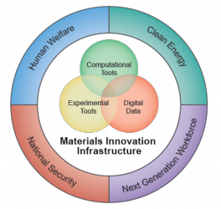
Materials Genome Initiative (MGI)
https://www.mgi.gov/
The MGI is a federal multi-agency initiative for discovering, manufacturing, and deploying advanced materials twice as fast and at a fraction of the cost compared to traditional methods. The initiative creates policy, resources, and infrastructure to support U.S. institutions in the adoption of methods for accelerating materials development.
2021 MGI STRATEGIC PLAN: 3 GOALS
Unify the Materials Innovation Infrastructure (MII), a framework of integrated advanced modeling, computational and experimental tools, and quantitative data
Harness the power of materials data
Educate, train, and connect the materials research and development workforce
DMREF
https://dmref.org/
Notes:
As mentioned earlier, we envision the Materials AI institute to expand DMR’s ongoing efforts in MGI. To those who may not be familiar, MGI is a federal multi-agency initiative, launched in 2011, for discovering, manufacturing, and deploying advanced materials twice as fast and at a fraction of the cost compared to traditional methods. The DMREF program, short for Designing Materials to Revolutionize and Engineer Our Future, has been running for the last 10 years as DMR’s primary response to MGI. I should mention in passing that DMR is a major partner in DMREF, but there are other directorates and programs at NSF that participate in it. In the 2021 MGI Strategic Plan, “Harnessing the power of materials data” has been identified as one of the primary goals. The objectives in this goal are centered on AI-driven Materials R&D for materials discovery and manufacturing. The new Materials AI institute that will be funded in this solicitation can be viewed as part of DMR’s continued efforts in advancing the MGI approach and vision.

Slide 34
2: AI for Discovery in Materials Research
The theme description is material and application-domain agnostic.
The list in the solicitation is meant to stimulate thought on research at the intersection of AI and materials and is not prescriptive.
* Multi-modal data integration & dataset development
* Foundational AI advances driven by materials research
* First synthesis to synthesis at scale
* Human-augmented materials design
* Interpretable materials AI
The proposals responsive to this theme can address any area(s) of materials research aligned with DMR and may employ tools for experiment/theory/computation).
Potential generalizability of the choice of materials/materials problems/AI research to other materials science problems and foundational AI research is likely to align with the AI ambition to generalize from data.
Notes:
The description of the Materials theme in the new solicitation is, by design, material and application-domain agnostic. By specifically not focusing on some subset of material problems and research modes or tools, we wanted to solicit ideas from the entire materials research community on what “burning” materials research problems they think would benefit the most from recent advances in foundational AI, and in turn push the boundaries of foundational AI to address challenges and opportunities in material research.
However, we wanted to provide some guidance, geared more toward stimulating thought on research at the intersection of AI and materials. Hence, we provided this list of five potential lines of research, as you can read from the solicitation.
Proposals that would be responsive to this theme can focus on any area(s) of fundamental materials research aligned with DMR and employ various research modes.
From a practical perspective, even though a particular institute proposal may focus on some subset of materials problems and modes of research, the potential generalizability of this focus choice to other materials problems and research modes will align with the AI ambition to generalize from data.

Slide 35
2: AI for Discovery in Materials Research Industry Funding Partner
Intel will not participate in or observe panels/merit review.
Individuals affiliated with Intel are not allowed to participate in proposals to Theme 2 in their capacity at Intel (but may be able to do so in their capacity at another organization).
Proposers should NOT contact Intel about proposals to this theme or make any prior arrangements for collaborations in this theme during the proposal process.
After award, Intel may offer collaboration opportunities to the funded Institute(s) in the theme, including software, data sets, other computing infrastructure, and/or researchers-in-residence.
Notes:
Here we want to thank again our Industry funding partner, Intel, for joining NSF in this important AI Research priority. This slide summarizes the nature of Intel’s participation. More details are in the solicitation. Proposals to this theme should be careful not to add conflicts of interest with this partner in the ways shown here. See the solicitation for full details and contact us with questions.
One of the common questions that we have received so far pertains to whether the involvement of Intel as an industry funding partner would mean that the proposed research should have a projection on semiconductor research. As mentioned earlier, this is not the case at all. Partnership of Intel does not restrict the materials research theme(s) of the Institute proposal.

Slide 36
3: Strengthening AI
Preliminary Proposals Jan 12, 2024
Full Proposals May 17, 2024
Start Date June 1, 2025
AI systems built with multilayer architectures trained on massive datasets have become increasingly capable of producing useful and impressive outputs.
Unfortunately, these systems are not always reliable and may not exhibit justification for their behavior that is understandable to the people who interact with them.
These systems can be brittle, susceptible to manipulation or anti-machine strategies, and produce outputs that do not align with human expectations of truth or human values.
AI systems of the future will need to be strengthened if they are to be as robust as we would like and if we are to keep such technology well-aligned with society’s intended uses
Notes:
Motivations for theme 3:
AI systems built with multilayer architectures trained on massive datasets have become increasingly capable of producing useful and impressive outputs.
Unfortunately, these systems are not always reliable and may not exhibit justification for their behavior that is understandable to the people who interact with them.
These systems can be brittle, susceptible to manipulation or anti-machine strategies, and produce outputs that do not align with human expectations of truth or human values.
AI systems of the future will need to be strengthened if they are to be as robust as we would like and if we are to keep such technology well-aligned with society’s intended uses

Slide 37
3: Strengthening AI
Institutes funded under this theme must lead advances in theory, methods, or integrative approaches that strengthen AI in all three of the goals listed below:
Grounding
Instructability
Alignment
Notes:
Basic requirements for Theme 3
Institutes funded under this theme must lead advances in theory, methods, or integrative approaches that strengthen AI in all three of the goals listed below:
Grounding
Instructability
Alignment
Now, I will briefly explain each

Slide 38
3: Strengthening AI
Institutes funded under this theme must lead advances in theory, methods, or integrative approaches that strengthen AI in all three of the goals listed below:
Systems must understand the concepts they reason over and operate with.
Allows AI system to demonstrate connection between its outputs and the abstract concepts that they operate with.
It will also enable systems to understand their risks and limitations.
Grounding
Instructability
Alignment
Notes:
Grounding means that systems must understand the concepts they reason over and operate with.
Grounding allows AI systems to demonstrate connection between its outputs and the abstract concepts that they operate with.
Grounding will also enable systems to understand their own risks and limitations.

Slide 39
3: Strengthening AI
Institutes funded under this theme must lead advances in theory, methods, or integrative approaches that strengthen AI in all three of the goals listed below:
Systems can be proven experimentally to change their behavior appropriately in response to explicit feedback provided by even non-expert users.
Systems implement more effective and trustworthy assistance to humans
Grounding
Instructability
Alignment
Notes:
Instructability enables systems that can be proven experimentally to change their behavior appropriately in response to explicit feedback provided by even non-expert users.
Instructability also enables systems implementing more effective and trustworthy assistance to humans

Slide 40
3: Strengthening AI
Institutes funded under this theme must lead advances in theory, methods, or integrative approaches that strengthen AI in all three of the goals listed below:
Systems must be judged by how well their operations align with expectations of objective truths in a domain and correspond to societal expectations and human intentions in their operations
Grounding
Instructability
Alignment
Notes:
By alignment we mean that systems must be judged by how well their operations align with expectations of objective truths in a domain and correspond to societal expectations and human intentions in their operations

Slide 41
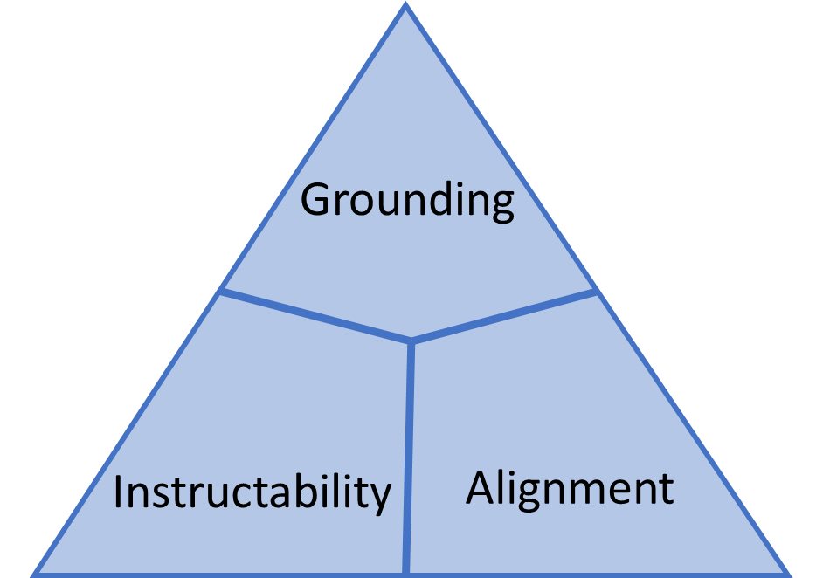
3: Strengthening AI
Any AI approaches that contribute to any of these goals are in scope.
This might include but is not limited to neuro-symbolic approaches, hybrid integrated architectures, or multi-representational learning methodologies.
Proposals that rely mainly on continuing growth of data-driven models and their access to more data are not responsive to the three goals above
Notes:
Any AI approaches that contribute to these three goals are in scope.
This might include but is not limited to neuro-symbolic approaches, hybrid integrated architectures, or multi-representational learning methodologies.
Proposals that rely mainly on continuing growth of data-driven models and their access to more data are not responsive to the three goals above

Slide 42
3: Strengthening AI Industry Funding Partner
Partners (including Capital One) are expected to contribute to a single Institute awarded under this theme.
Capital One will not participate in or observe panels/merit review.
Individual affiliated with Capital One are not allowed to participate in proposals to Theme 3 in their capacity at Captial One (but may be able to do so in their capacity at another organization).
Proposers should NOT contact Capital One about proposals to this theme or make any prior arrangements for collaborations in this theme during the proposal process.
After award, the Capital One may offer collaboration opportunities to the funded Institute(s) in the theme, including software, data sets, other computing infrastructure, and/or researchers-in-residence.
Notes:
Here we want to thank again our Industry funding partner for joining NSF in this important AI Research priority. This slide summarizes the nature of the partner’s participation. More details are in the solicitation. In a nutshell, proposals responding to this theme should be careful not to add conflicts of interest with this partner in the ways shown here. See the solicitation for full details, and contact us with questions.

Slide 43
3: Strengthening AI Agency Funding Partners
OUSD (R&E) and NIST have partnered with NSF to potentially contribute funding to Institutes funded under this theme. This is not a firm agreement to participate in the funding of awards.
Submitters to Theme 3 may submit an optional supplementary document (at both prelim and full proposal stage) to indicate relevance of your proposal to one or more partners. See solicitation.
Submitters to Theme 3 may submit an optional single-copy document (at both prelim and full proposal stage) to indicate an objection to partner funding. See solicitation.
Documents submitted with the preliminary proposal pertain only to that proposal. Those submitted with the full proposal pertain only to that proposal.
Notes:
As you have seen mentioned earlier, The Office of the Under Secretary of Defense for Research and Engineering (OUSD (R&E)) and NIST have partnered with NSF to potentially contribute funding to Institutes funded under this theme. These agencies may participate at the award phase contingent on relevance to their missions and funding availability.
There are two ways you can communicate with NSF and partners about this.
If you wish to identify aspects of your theme 3 proposal that you believe are relevant to one or more partners, you have the option to submit a supplementary document (at both prelim and full proposal stages) to indicate relevance of your proposal to one or more partners. See solicitation for full instructions and details.
If you wish to indicate an objection to receiving funding in a theme 3 proposal that originates from one of these two patners, you may submit an optional single-copy document (at both prelim and full proposal stage) to indicate that your organization intends to decline an award that includes such funding. Again, see solicitation for full instructions and details.
Finally, we note here that either type of document described here submitted with a proposal (prelim or full) pertains only to that proposal. Documents submitted with the preliminary proposal do not pertain to the full proposal. You may change or clarify your position on these issues at the full proposal stage.

Slide 44
Contacting the program about themes
Can we consult with program contacts about our proposal plans?
Yes! Program contacts prefer that you email your questions.
Send email to AIInstitutesProgram@nsf.gov for program-wide and submission questions
Send to all listed theme contacts for those questions
You might include a project summary of up to two pages if asking about responsiveness
AFTER THE PRELIMINARY PROPOSAL DEADLINE, interaction will be limited to clarification of the feedback received on the preliminary proposal.
Notes:
Thank you, Colleagues. Now that we have finished looking at the individual themes, we are almost ready for Q&A. First let us encourage you to contact us if you have questions about the program or the themes.
Where the themes are concerned, our program contacts will advise you on questions of responsiveness to the theme and compliance with the solicitation. We cannot give you judgements or advice about the competitiveness of your idea.
We encourage you to make contact with us prior to submitting your preliminary proposal – especially if you have questions about the responsiveness of your idea. We prefer that you email your theme-specific questions to all program contacts listed for that theme so that we may give you a coordinated and complete response. For feedback on the responsiveness of a proposal idea, you should include a project summary of up to two pages.
AFTER THE PRELIMINARY PROPOSAL DEADLINE: Proposal-specific inquiries to program contacts should be limited to requests for clarification of the feedback received on the preliminary proposal. These requests for clarification must be submitted to Theme contacts (again, please address all program contacts in the theme).

Slide 45
Structure and budget:
Cooperative Agreements for 4-5 yr/$16-20M institutes to award in 2023
Average $4m/year – year-to-year budgets may vary, as long as the total request does not exceed $20M.
Include travel budgets for applicable personnel to attend annual PI meetings, attendance at up to three site visits (and/or reverse site visits) as well as other planned cross-Institute meetings, to include the retreat required in Special Award Conditions.
It is recommended that you include budget as needed for institute administration, including the required Managing Director
Notes:
Institute awards will be in the form of cooperative agreements of up to $20,000,000 for up to five years (with average yearly budgets around $4,000,000). Do not submit total budgets outside of the range specified in the solicitation.
In addition, some special instructions pertain to the way budgets in theme 1 are to be structured, as we will cover later.
The solicitation requires that you plan for travel budgets for your personnel. These will be key to enabling an effective multiorganizational synergy, so plan according to what fits your proposal. At a minimum, the solicitation requires that you plan for site visits and for PI meetings.
Please also anticipate that Institute operations require a significant investment in administration. The solicitation anticipates this with the requirement that a Managing Director or Project Manager (who is distinct from the lead PI) be provided for. In addition to this role, you may wish to plan for supporting administrative roles of various kinds. What is appropriate depends on your proposal and the resources available to you at your local institutions. But be sure to account for these costs in your proposal and demonstrate how this will facilitate your institute’s effectiveness.

Slide 46
Preliminary Proposals - Requirements
MUST be submitted prior to a full proposal
6-page project description: Primary focus on the scope of proposed research activities and the suitability of personnel to carry them out
Sections:
Vision.. research goals
Foundational AI research
Use-Inspired Research
Broader Impacts
Key Personnel / organization
Do not include:
Results from Prior NSF Support
Budget and Budget Justification
Data Management Plan
Postdoc Mentoring Plan
Current and Pending Support
Facilities, Equipment, …
Letters of Collaboration
Notes:
Now let us turn to the proposal steps, and we will start with the first major milestone, the submission of the Preliminary proposal. Preliminary proposals are required as a condition for submitting a full proposal. The preliminary proposal consists mainly of a 6-page project description. The description is intentionally very short, and within it we ask that you focus on the intended scope of proposed research activities. Therefore, we require these sections. Please read carefully the description of these sections in the submission instructions, and what we are looking for.
Vision and integrated research goals of the Institute,
Foundational AI research,
Use-Inspired Research,
Broader Impacts, and
Key Personnel and prospective organization.
Those section headers are mandatory and must be in that order.
The page limit and suggested section lengths are intended to keep the focus of your preliminary proposals on your intended research scope and the suitability of the proposal personnel to carry out those activities. This is not the stage where we expect to review detailed plans for research and other activities.
The submission guidelines also list sections not to include. This includes the section, “Results from Prior NSF Support,” in the Project Description, as well as the standard proposal sections you see excluded here. Do NOT include these in the preliminary proposal.

Slide 47
Preliminary Proposals – Process and Benefit
Submitted to a theme
Reviewed internally at NSF with applicable partners
Advisory (i.e., non-binding) “Encourage”/“Discourage” decision
~ 1 month turnaround
Benefits of Preliminary Proposal Stage:
Affords more time for high quality proposal development
Early feedback about responsiveness to the solicitation
Allows teams to adjust proposals and plans based on feedback
Reduces effort preparing proposals unlikely to succeed in a competition with few awards.
More NSF policy on preliminary proposals in the PAPPG.
Notes:
Again, we emphasize that the preliminary proposal is required, meaning a full proposal will not be accepted if not following a preliminary proposal reviewed under this solicitation. You will submit it to a theme, and the full proposal will be submitted by the same lead organization to the same theme.
Preliminary proposals will be internally reviewed by program officers, who are primarily looking for responsiveness and the likelihood that the concept is likely to be competitive. After just a few weeks, we will send an advisory determination by email to the PI and the Authorized Organizational Representative listed on the proposal. In addition, narrative feedback may also be sent by email directly to the lead PI. The advisory type of determination indicates whether we “Encourage” or “Discourage” the submission of a Full proposal. This is a non-binding determination, meaning even if you have received a determination of “Discourage”, you may submit a full proposal that further develops the preliminary.
NSF intends to provide these determinations within a month’s time, to provide you this feedback as early as possible in your continuing proposal development. Our experience with this same process in the last round showed this stage to be beneficial in proposal preparation and review. The Preliminary proposals stage allows you to propose early plans to NSF, builds in more time for proposal development, and allows proposers to adjust plans based on the feedback received, whether that be toward improvement of the preliminary idea or to avoid the effort in preparing proposals unlikely to succeed in a competition such as this in which there are few awards.

Slide 48
About non-binding decisions
May submitters who receive an unfavorable (“Discourage”) review of the Preliminary proposal nonetheless submit a Full proposal?
Yes, this is allowable.
Make your decisions carefully -- each theme is highly selective.
For discouraged proposals, it is assumed that significant revision would be needed to have a chance to succeed as a Full proposal.
Notes:
We want to re-emphasize that preliminary decisions are non-binding, meaning that you may still submit a full proposal after receiving an unfavorable (or “Discourage”) determination. In any case, the decision to prepare and submit a full proposal should be taken carefully. Please note that the program will provide “Discourage” determinations to help members of the research community to make informed decisions about expending effort preparing proposals unlikely to succeed in a competition in which few awards are expected. Significant revision would be needed to make a subsequent Full proposal more likely to succeed. In addition, personnel associated with discouraged proposals might consider joining other proposals. Remember to consult the PAPPG guidance on Preliminary proposals if you have questions.

Slide 49
Changes from Preliminary to Full?
What can change from the Preliminary to the Full proposal?
The Full proposal must be submitted by the same lead organization and to the same theme.
Many other aspects may change as appropriate
It is permissible for subawardee organizations and anticipated partnerships or collaborations to change.
Your proposal title may change
You may change personnel and their roles.
You will summarize significant updates in the Full proposal in a required (1 page) single copy document
Notes:
Other questions arise about how your plans may change between submission of the Preliminary and the Full proposal.
The Full proposal must be submitted by the same lead organization, and it must be submitted to the same theme. Aside from that, it is expected that a great many things might change when you submit the Full proposal, including scope of activities, personnel, organizations, collaborations, and more. A required single-copy document in the Full proposal provides a place for you to identify significant changes since the Preliminary, and we will look at that requirement more closely when we discuss the full submission.

Slide 50
Personnel moves – i.e., to a different proposal between prelim and full proposal
May an individual be listed as Senior Personnel on a Preliminary proposal, and then later listed as Senior Personnel on a Full proposal from another submitter (i.e., based on a different Preliminary proposal)?
Yes, this is allowable, as long as the individual is listed on at most one proposal at each stage.
Notes:
Another question that might arise is whether an individual may be listed as Senior Personnel on a Preliminary proposal, and then later listed as Senior Personnel on a Full proposal from another submitter (that is, a submission based on a different Preliminary proposal).
Yes, this is allowable, as long as the individual is listed on at most one proposal at each stage.

Slide 51
Full Proposals – Requirements
Must be linked to a Preliminary Proposal submitted to same theme by same lead organization (more info on next slide)
25 pg. Project Description. Must include sections listed
Overview and Rationale for Institute Approach
Description of the Research Plan of the Institute
Broader Impacts
Education and Workforce Development
Broadening Participation Plans
Collaboration and Knowledge Transfer
Key Personnel, Management and Integration Plan
Results of Prior NSF Support may now be moved to a 1-pg Supp Doc
Several Other required and optional supplementary docs and single-copy docs required
Follow all PAPPG guidance for items not specified in the instructions
Include each of these headings
Reorder if you want
Add others as needed
Number as you wish
Notes:
We now turn our attention briefly to the proposal preparation instructions for the Full proposal. Here let me preface by reminding everyone that the proposal preparation in the PAPPG apply – the solicitation addresses special instructions or deviations from that procedure. Be sure to consult the PAPPG where the solicitation does not have such special instructions.
The Project Description is the key element of your proposal, and it may be up to 25 pages. Here at a very high level are the required sections of the project description. Please include these headings as shown – Note that we ask you to address several desiderata that we group together as the strategic impact of the institute to address under the PAPPG-required section, “Broader Impacts”.
Though we think this high-level organization is a sensible order of the major sections, it is up to you how you order and number any of these, and you may add other sections as you see fit.
In this solicitation, you may include the required Results of Prior NSF Support in a one-page supplementary document rather than squeeze this in with the rest of your project description. There are several other important instructions related to other required or optional supplementary and single-copy documents.
As with all proposal submission instructions, read carefully all instructions in the PAPPG and in the solicitation so that you submit a complete and compliant proposal.

Slide 52
Identifying updates in the Full proposal
Required single-copy* document in the Full proposal):
Update since preliminary proposal (1 page max). Identify the required preliminary proposal submission for this full proposal and summarize updates in three additional sections:
Preliminary proposal #: (NSF-assigned proposal #)
Changes to PI/Co-PIs: (list additions, deletions, changes of role)
Changes to funded collaborative organizations: (listed added/deleted subawardee, contract, or otherwise-funded organizations)
Summary of significant changes in research scope: (no more than 250 words, bulleted)
* “Single-copy” documents are for NSF-use only, and are not provided to reviewers
Notes:
As mentioned in the discussion on Preliminary Proposals, the Full proposal preparation instructions for this solicitation require that you submit a single-copy document to help you link your Full proposal submission to your Preliminary proposal and to call program officers’ attention to the significant changes. (We put an asterisk there to remind us to clarify that a so-called “single-copy” document is one that is seen by NSF program officials only.)
This document will identify the elements you see here:
the preliminary proposal #
Changes to PI and Co-PIs. You do not have to report on other senior personnel here, but you may in the summary if helpful there.
Changes to funded collaborative organizations: here you will list additions or deletions of subawardee organizations or those otherwise funded through contracts).
Finally, you will provide a brief (250 word) bulleted summary of significant changes in research scope. Here again the brevity is an indicator of what we are looking for. Naturally, the Full proposal is a significant development beyond what was in the Preliminary. Here we wish for you to summarize at a very high level the changes that depart noticeably from what had originally been envisaged in the preliminary proposal.

Slide 53
Letters of collaboration
Should I obtain letters of collaboration from organizations appearing in the budget as collaborating organizations?
No, their participation is explicit in your proposal.
Can the letter include statements of support or capability?
No. Follow the guidance in the PAPPG (see section)
Can/Should I obtain one from any of the programs’ funding partners?
No. Collaborations with NSF’s funding partners may take place post-award.
Notes:
Letters of collaboration are allowed for the full proposal. These letters are most helpful for you to substantiate the broader range of partners you will engage in your institute and are therefore appropriate for such things.
They are not necessary from the organizations that are proposing as awardee and subawardee, as their roles and commitments should be clear in your proposal. Including too many of those can distract from the ones that are truly value-added.
We emphasize here that letters of collaboration are encouraged, but letters of SUPPORT are not allowed. The inclusion of endorsements or statements of enthusiasm for the project or its personnel will make a letter of collaboration noncompliant. The letter should also not contain descriptions of the partner’s organization or personnel.
Finally, do not include letters from any of the funding organizations listed at the top of the proposal.

Slide 54
Letters of collaboration
"If the proposal submitted by Dr. [insert the full name of the Principal Investigator] entitled [insert the proposal title] is selected for funding by NSF, it is my intent to collaborate and/or commit resources as detailed in the Project Description or the Facilities, Equipment and Other Resources section of the proposal."
Notes:
In short, the PAPPG provides this as a recommended format for a letter of collaboration. We do check for this and will flag your whole submission if you have noncompliant letters. Stick to this and they will be both easy to collect and avoid compliance issues.
This letter is for proposal documentation only, serving to demonstrate that you have a substantive potential to collaborate. Sometimes, proposers have difficulty getting a letter writer to stick to this because they mistakenly believe that the letter could obligate them to do a thing. Over such concerns, they might wish to state additional limitations on the letter of collaboration, specifying the nature of the agreement to collaborate. We can tolerate that if the statements are brief and if they refer only to activity that is fully described in the proposal as required.
If the letter describes plans and capabilities that are not fully documented in the appropriate places in the proposal (such as in the project description or the facilities, equipment, and other resources document), it will be considered noncompliant.
If the letter contains statements from the writer describing their organization and their capabilities, the letter will be considered noncompliant.
If the letter includes statements of support, it will be considered noncompliant.

Slide 55
Notes on Submission and Eligibility
Institutions who may apply.
Institutions of Higher Education (IHEs)
Non-profit, non-academic organizations
Other organization types may be included as subawardees on proposals
Limit on Number of Proposals per Organization: 2
Collaborative proposals are to be submitted from a single organization.
Limit applies to the submitting (i.e., “lead”) organization
No limit on participation as non-lead (collaborating) organizations
Limit on Number of Proposals for Senior Personnel: 1
Senior personnel defined in PAPPG, includes but not limited to PI/co-PI
PI/co-PI are subset of “senior personnel”
Eligibility and submission limits apply to both Preliminary proposals and Full proposals
Notes:
Here we emphasize some of the important submission and eligibility requirements in the solicitation. These requirements apply at both the Preliminary proposal deadline and at the Full proposal deadline.
Two types of organization may apply in the role of lead organization, as shown. Other organization types MAY be included as subawardees on proposals.
Further clarification on these types of organization can be found in the PAPPG.
Where submission limits are concerned, the number of proposals per organization is limited to two. For context, note that all proposals to this program are to be single-organization proposals. That is to say, collaborators from multiple organizations will submit a single proposal from a lead organization, with collaborations configured as subawards. So, the submission restriction refers to submission as lead organization. There is no limit on participating as a collaborative organization in other proposals, including as sub-award. Also note that this limitation has no relationship to proposals submitted to or funded under other solicitations, including prior rounds of this program.
There are also limits on the number of proposals for senior personnel. An individual may be on at most one preliminary proposal, and at most one full proposal to this solicitation. This includes but is not limited to the roles of PI and co-PI. Consult the PAPPG for definition of the role Senior Personnel. This also makes no reference to submissions or awards to the prior solicitation.
In the event that either of these limits is exceeded, compliant proposals will be accepted based on date and time of proposal submission and remaining noncompliant proposals will be returned without review.

Slide 56
Campuses of the same university system
How do the submission limits apply to campuses of the same university system?
Follow the PAPPG and consult the related FAQ https://www.nsf.gov/bfa/dias/policy/papp/pappg23_1/faqs23_1.pdf
Eligibility: “Can different campuses of the same university system submit separate proposals in response to a program solicitation that limits the number of proposals to one per organization?”
A distinct organization for this purpose:
Has its own DUNS and is registered via an NSF electronic system using that;
has separate Sponsored Projects Offices that can submit proposals directly to NSF;
is listed as the awardee organization on the NSF Cover Sheet;
and can therefore submit up to two proposals to this solicitation.
Notes:
Questions about the application of organizational submission limits to campuses within the same university system SHOULD BE FIRST ADDRESSED TO YOUR AUTHORIZED ORGANIZATION REPRESENTATIVE in (for example) your office of sponsored research.
Questions to NSF about this should come from the AOR. In short, what we will tell them is that the FAQ published by NSF pertaining to the PAPPG addresses this under “Eligibility” and that guidance is summarized here.

Slide 57
Questions
Submit your questions using the Q&A module
Will answer questions live (not in the module)
Program-wide questions are encouraged
Theme leads are here to address your theme questions
If your question is not answered, feel free to email programmatic questions to AIInstitutesProgram@nsf.gov; theme-related questions to relevant program contacts
Webinar materials (slides, script, and audio recording) will be posted on the program/webinar web page https://new.nsf.gov/funding/opportunities/national-artificial-intelligence-research
Notes:
And now we are ready for your questions, and we have plenty to start with.
You may continue to submit questions through the “Q&A” module in your Zoom toolbar.
We will address live as many as we can, with particular attention to those relevant to a broad community. If we do not get to your question during the webinar, feel free to email your question to the email address shown or directly to the relevant program contacts found in the solicitation.

Slide 58
Selected Frequently-Asked Questions* 1/2
Where can I find information on current Institutes? The AI Institutes Virtual Organization (AIVO) is a great resource: https://aiinstitutes.org/
Can personnel who are active or otherwise associated in currently funded Institutes participate in proposals to this solicitation? The program solicitation does not restrict this. Be sure to demonstrate capacity to perform proposed role. It is also recommended you coordinate openly with current collaborators!
Can I submit an Institute proposal that responds to multiple themes? Is it a good idea? The solicitation does not prohibit this, but it is not encouraged, either. It is most effective to respond as fully as possible to the scope of the theme you addressed.
Can a proposed AI research Institute focus on only a subset of the desiderata spelled out in the solicitation? AI Research Institutes must excel at all six of the desiderata outlined in the Program Description.
Notes:
Some frequently asked questions to support Q&A, 1 of 2.

Slide 59
Selected Frequently-Asked Questions* 2/2
The solicitation restricts the number of submissions by "senior personnel.” Can you clarify what constitutes "senior personnel"? See the PAPPG, Exhibit II-3
Is there a limit on the number of PIs, co-PIs, or Senior Personnel on my proposal? You can list one PI and up to four co-PIs, who will appear on the cover sheet of the proposal. There is no limit on the number of additional senior personnel who can be listed on the proposal.
Is it advantageous to have a Managing Director identified at the proposal stage? It is not necessary in the proposal. However it is advantageous to have a clear idea of what you intend for the MD to do, sufficient allocation of effort to that role, and a plan to fill it soon upon startup.
Are AI Research Institutes awards going to be renewable for an additional five years? The potential for renewal in AI Institutes will be determined during the initial award period for an Institute. DCL NSF 23-048 describes the process disseminated to previous AI Institutes awards.
Notes:
Some frequently asked questions to support Q&A, 2 of 2.

