Slide 1


NSF ExpandAI Program (Solicitation NSF 23-506)
Webinar Jan 25, 2024

Slide 2
Webinar Outline
Part I: Introduction (Dilma) 5 -10mins?
Part II: AI Institutes Program Overview (Jim) 5-6 5 mins
Part III: Expand AI Program Overview (Abi) 7-13 8 mins
Part IV: Eligibility – COs, CAP & PARTNER Proposals (Dillon) 14-16 2 mins
Part V: Concept Outlines (Dillon) 17-20 5mins
Part VI: Full Proposal Preparation and Submission (Dillon) 5 mins
Part VII: Capacity Building Pilots (CAP) Track (Subrata?) 10 mins
Part VIII: Partnership (PARTNER) Track (Stacey) 10 mins
Part IX: Expand AI FY 2024 - Important Dates (Dillon)
Q&A Remainder

Slide 3
Part I: Introduction

Slide 4

Dr. Dilma Da Silva
NSF Assistant Director for Computer and information Science and Engineering (CISE)

Slide 5
Part II: AI Institutes Program Overview

Slide 6
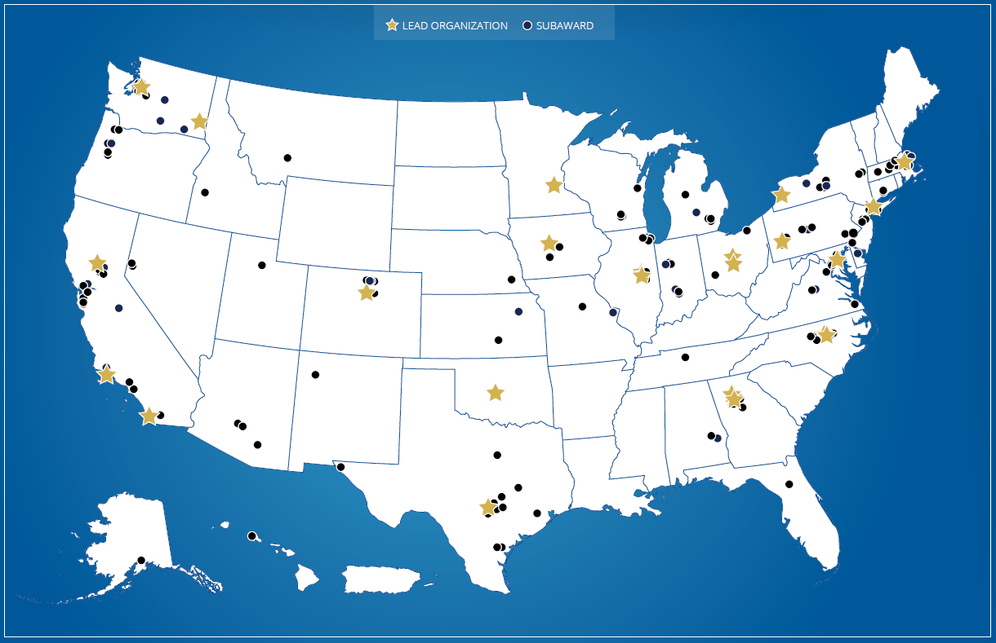
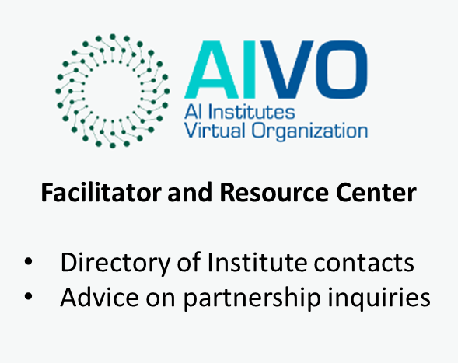

National Artificial Intelligence (AI) Research Institutes
$20M (~4M/year) over 5 years
Foundational and use-inspired AI research
Innovation in AI education and workforce development
New partnership development
AI Institutes and Funding Partners
Community Portal
Learn more about AI Institutes at https://aiinstitutes.org

Slide 7

























25 Active Institutes
2020: First cohort of Institutes (5 NSF, 2 NIFA)
2021: Second cohort of Institutes (9 NSF, 2 NIFA)
2023: Third cohort of Institutes (6 NSF, 1 NIFA)
AIVO: https://aiinstitutes.org
Link to all awards: NSF Award Search

Slide 8
Part III: ExpandAI Program Overview

Slide 9
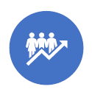
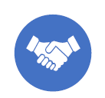
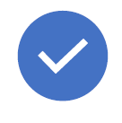
ExpandAI Program Overview
Program Goal: Diversify participation in AI research, education, and workforce development through (1) Capacity Building and (2) Partnerships with the National AI Research Institutes
NSF supports growth of interdisciplinary research by diverse community for advancement of AI-driven innovation
MSIs are source of untapped talent critical to future AI innovation/responsible AI research
Many minority-serving institutions (MSIs) are not yet significantly engaged in AI research and education. However, there is enormous potential to develop talent through federally supported AI research that is critical to future AI innovation and responsible AI research
ExpandAI promotes capacity development for new AI programs at Minority Serving Institutions (MSIs), as well as partnerships between MSIs and AI Institutes
Capacity
Partnership
Approach
Build AI capacity
MSI-specific goals
Institutional Change
Potential Path
to Partnership
Leverage AI Institutes
MSI-led awards
AI Institute subawards
Shared vision and goals
Institute integration plans
Lower barriers to success
Concept outlines
Submission windows
Flexible submissions

Slide 10
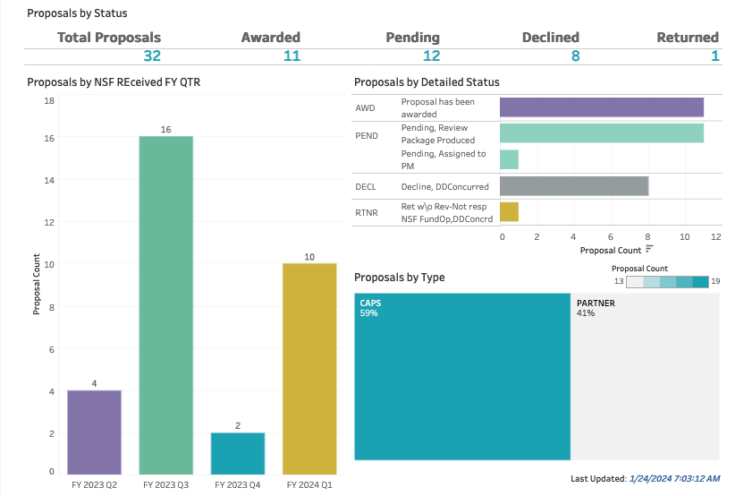
Program Highlights
Program Highlights
Launched Oct 17, 2022: ExpandAI Program (solicitation 23-506) under CISE’s AI Institutes program (NSF 23-610)
Flexible Submission windows, no single date deadline, 2-page concept outlines, MSI-specific goals and MSI-led awards
Outreach: Live Webinars, Monthly Office Hours, Presentations at MSI PI Meetings, 1-on-1 virtual meetings with POs
Enthusiastic MSI Response! 115 Concept outlines, 45 proposal invitations, 32 proposal submissions, 11 awards, 10 declines, 8 pending, last panel review 1/17/24
Source: ExpandAI Dashboard (Tableau, Jan 9, 2024)

Slide 11


Track 1 - CAP
Track 2 - PARTNER
CAPACITY BUILDING – INSTITUTIONAL CHANGE
NEW COLLABORATIONS WITH AI INSTITUTES
Establishment of new AI research, education, workforce development, and/or infrastructure
Leverage AI Institutes as new collaborations for MSIs to scale up established AI research and/or education
Planning and growth efforts focused on establishment of AI activities at MSI and early exploration of future partnerships
Multi-organization collaborations submitted by the MSI with subaward to the AI Institute

Slide 12
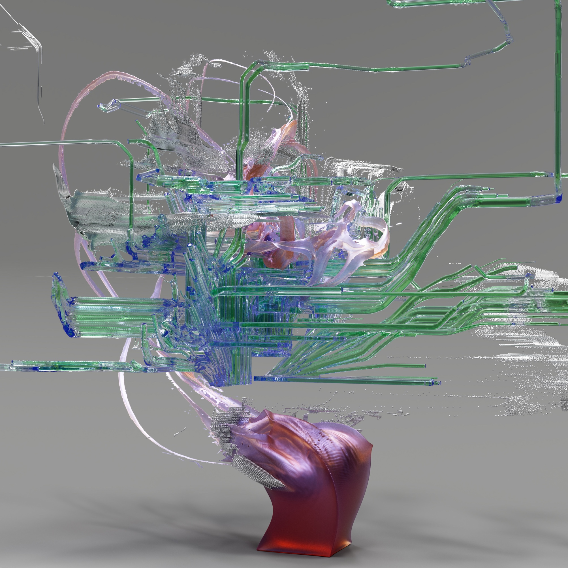







FY 2023 ExpandAI Awards
$16.3 million in awards (6 CAPs, 5 PARTNERs)
AI Research
AI Education
AI Workforce
11 Awards in 6 US states/territories including,
  2 EPSCoR awards (TN and PR)
  2 HBCUs (TN and TX)
  9 HSIs
Cross-NSF directorate funding partnerships
CISE
TIP
EDU
GEO
Image: Google DeepMind
MPS
Notes:
ExpandAI supports capacity-development projects and partnerships within the National AI Research Institutes ecosystem that help broaden participation in artificial intelligence research, education and workforce development. These concepts are all connected and support each other.
ExpandAI: Expanding AI Innovation through Capacity Building and Partnerships
HIS: Hispanic-serving institute
EDU funding programs include HBCU-UP and LSAMP
HBCU-UP: Historically Black Colleges and Universities - Undergraduate Program
LSAMP: Louis Stokes Alliances for Minority Participation
University List:
Texas State University - San Marcos
The University of Texas Rio Grande Valley
Meharry Medical College
Texas A&M University-San Antonio
California State University San Marcos Corporation
Prairie View A&M U
University of Puerto Rico Mayaguez (IAIFI)
Florida International University (AI2ES)
University of Texas at San Antonio (ATHENA)
CUNY City College (AI-EDGE)
San Diego State Univ Fdn (AI2ES)

Slide 13





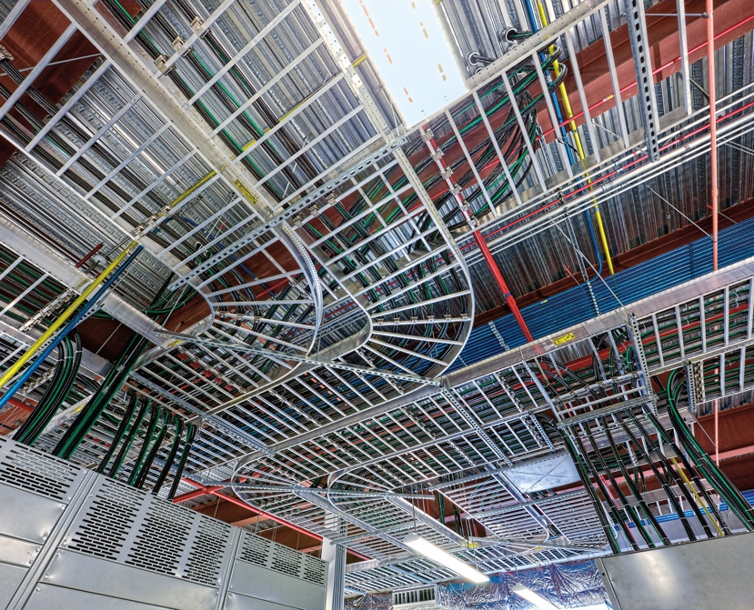


FY 2023 ExpandAI Award Topics
AI Curriculum Development
Trustworthy AI in Medical Systems
Social Media for Juvenile Justice
Wind Farm Grid Connection
Cardiovascular Disease
Security
AI Infrastructure
Coastal and Atmospheric Environmental Modeling
Neuro-Inspired AI
Notes:
ExpandAI supports capacity-development projects and partnerships within the National AI Research Institutes ecosystem that help broaden participation in artificial intelligence research, education and workforce development. These concepts are all connected and support each other.
ExpandAI: Expanding AI Innovation through Capacity Building and Partnerships
HIS: Hispanic-serving institute
EDU funding programs include HBCU-UP and LSAMP
HBCU-UP: Historically Black Colleges and Universities - Undergraduate Program
LSAMP: Louis Stokes Alliances for Minority Participation
Topics include:
AI Curriculum and Infrastructure development, Trustworthy AI in Medical Systems, Security, Wind Farm Grid Connection, Social Media for AI-Enhanced Juvenile Justice, efficient data transformation, Coastal Environmental Modeling, Neuro-Inspired AI, cardiovascular disease, modeling of precipitation and other atmospheric variables
University List:
Texas State University - San Marcos
The University of Texas Rio Grande Valley
Meharry Medical College
Texas A&M University-San Antonio
California State University San Marcos Corporation
Prairie View A&M U
University of Puerto Rico Mayaguez (IAIFI)
Florida International University (AI2ES)
University of Texas at San Antonio (ATHENA)
CUNY City College (AI-EDGE)
San Diego State Univ Fdn (AI2ES)
*images from NSF media site and Google DeepMind

Slide 14

ExpandAI Approach
Do Not Invite - Revise and Resubmit or New Idea
Send CO as PDF to expandaiprogram@nsf.gov
Concept Outline
NSF Internal Review
Idea
DECLINE
INVITE Full Proposal
Submit full proposal to research.gov
NSF
Review
Full Proposal
AWARD

Slide 15
Part IV: Eligibility - CAP & PARTNER Proposals

Slide 16


Eligibility Information
What organizations can submit
Who may serve as PI
  Proposals may be submitted only by a minority-serving college or university meeting the criteria listed under 'Eligible Institutions of Higher Education' in this program solicitation.
  Only eligible organizations that have received an official Program Officer Concurrence Email inviting a full proposal may submit a full proposal. To receive the invitation, potential proposers must submit a Concept Outline document and receive an official response (via email) from a cognizant Program Director. Please see section V.A for details.
  The Principal Investigator must hold a full-time faculty appointment or be a senior administrator at an eligible Institution as defined in the 'Eligible Institutions of Higher Education' section.
  In PARTNER proposals only, a co-PI must be identified to represent each partnering AI Institute. That co-PI must be verified by the Institute Director in the Institute Integration Plan as being among the senior personnel of the institute.
Limit on Number of Proposals per Organizations:
  An organization may submit one proposal per submission window
  An organization must wait for a determination from NSF (e.g., Award, Decline, or Returned Without Review) on the pending proposal before submitting a new proposal in the next window.
  Declined proposals require a new invitation to submit (via the Concept Outline process) and significant revision.
  An organization that has received an invitation to submit a full proposal must wait for that proposal to be submitted and resolved before submitting another Concept Outline

Slide 17
Institutional Eligibility
ExpandAI proposals may be submitted by accredited Institutions of Higher Education that belong to at least one of the following classifications as a minority-serving institution (MSI):
  Alaska Native Serving Institutions (ANSI)
  Hispanic Serving Institutions (HSI)
  Historically Black Colleges and Universities (HBCU)
  Predominantly Black Institutions (PBI)
  Native Hawaiian Serving Institutions (NHSI)
  Native American-serving, non-Tribal Institutions and Tribal Colleges and Universities (TCU)
  Other Minority-Serving Institutions (MSI)
Eligibility as a minority-serving institution may be determined by reference to the Integrated Postsecondary Education Data System (IPEDS) of the US Department of Education National Center for Education Statistics (http://nces.ed.gov/ipeds/).
Please review solicitation NSF 23-506 for more details.

Slide 18
Part V: Concept Outlines (CO)

Slide 19
Concept Outlines
All proposers must receive an official invitation via the Concept Outline (CO) process to submit a full proposal to the solicitation
Two-page concept outline
NSF will review Concept Outlines on an ongoing basis for potential to be responsive to ExpandAI program objectives
Ensures proposers do not expend time or resources preparing full proposals that do not have strong potential to be responsive to the program objectives
COs are required for both tracks (CAP and PARTNER)
COs must be sent as PDF attachment in an email sent to: expandaiprogram@nsf.gov
Format SUBJECT line: “CO: [Title as it appears in Concept Outline]”
  SUBJECT: CO: CAP: AI Capacity Building in XYZ University
If the Concept Outline is not responsive to ExpandAI program objectives, proposer will receive notice not to submit a proposal
Proposers not invited to submit a full proposal in response to a Concept Outline may submit a new Concept Outline after the start of the next submission window (sooner, by exception, if specifically invited by the program)
Resubmitted COs need to have been substantially revised according to reviewers' comments.

Slide 20
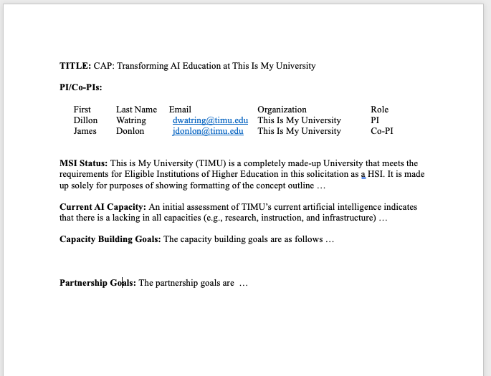
Anatomy of a Concept Outline
  1. Title: [CAP or PARTNER] Concise, descriptive title of project proceeded by CAP: or PARTNER: for each respective track.
  2. Name of PI and co-PIs: List up to 5 personnel. For PARTNER COs, include a co-PI from the partnering AI Institute
  3. MSI Status: (250 words) Briefly describe the submitting institution’s current AI capacity in research, instruction, and infrastructure as it relates to the proposed CO.
  CAP Track: Demonstrate a compelling institutional need for capacity building in AI.
  PARTNER Track: Describe a suitable foundation for success in collaboration detailed in the CO.
2-page maximum

Slide 21
Anatomy of a Concept Outline
  4. Goals:
  CAP Track: (500 words) Describe the outcomes and benefits of capacity building to the MSI. Outline goals and any preliminary plans that will be fully described in the full proposal’s Capacity Building Plan.
  PARTNER Track: (500 words) Identify the organizations and the prospective collaborative work in a unifying theme or focus. Outline shared goals and identify prospective projects that might be fully described in the Partnership Roadmap in the full proposal. Clearly highlight the mutual benefit and outline the potential benefits of the concept to both the MSI and the AI Institute.
2-page maximum

Slide 22
Part VI: Full proposal preparation and submission

Slide 23
Proposal Submissions
An official email from the ExpandAI team inviting a concept outline to submit a full proposal.
The ExpandAI program has recurring proposal submission windows. Unlike deadlines, submission windows allow proposers the flexibility to submit a full proposal at any time during the specific dates listed.
On each submission window closing date, the proposal submission system will shut down at 5:00 p.m. submitter's local time.
The system will then reopen for new submissions the morning of the next window, with the exception of the final submission window.
An organization may submit one proposal per submission window. An organization must wait for a determination from NSF (e.g., Award, Decline, or Returned Without Review) on the pending proposal before submitting a new proposal in the next window.
Declined proposals require a new invitation to submit (via the Concept Outline process) and significant revision, while proposals Returned Without Review may be submitted using the same invited Concept Outline (assuming that the proposal is received within one year of the original Concept Outline invitation)
Also, an organization that has received an invitation to submit a full proposal must wait for that proposal to be submitted and resolved before submitting another Concept Outline
Limit on Number of Proposals per PI or co-PI: There are no restrictions or limits.

Slide 24
Proposal Submission Windows
Eligible MSIs can submit a Concept Outline at any time. MSIs that have been invited to submit a full proposal can submit a proposal based on the Concept Outline at any time during one of the submission windows listed below:
Proposal Submission Windows
        January 08, 2024 - March 11, 2024
        March 12, 2024 - June 24, 2024
        June 25, 2024 - October 18, 2024
        January 06, 2025 - March 10, 2025
        March 11, 2025 - June 23, 2025
        June 24, 2025 - October 17, 2025

Slide 25
Sections of the proposal
  Title: [CAP or PARTNER] Concise, descriptive title of project proceeded by CAP: or PARTNER: for each respective track.
  Project Summary (1-page limit): Overview, Statement on Intellectual Merit, Statement on the Broader Impacts
    Must include:
      Overview
      Statement on Intellectual Merit
      Statement on Broader Impacts
  Project Description (15 pages): Must follow the requirements of the PAPPG except where this solicitation deviates.
    Project description must use the sections below for the applicable track. Name the sections as indicated below, in capital letters. You may add other sections and order sections as you see fit.
Track 1: CAP
NEED AND POTENTIAL
CAPACITY BUILDING PLAN
BROADER IMPACTS
PERSONNEL
Track 2: PARTNER
AI CAPACITY
COLLABORATION PLAN
BENEFITS TO AI CAPACITY
BROADER IMPACTS
PERSONNEL

Slide 26
Sections of the proposal
  References Cited: List only references cited in the Project Description or supplementary documents
  Budget and Budget Justification:
  Facilities, Equipment, and Other Resources:
  Senior Personnel Documents
  Data Management Plan
  Postdoctoral Researcher Mentoring Plan
  Other Supplementary Documents
    Institutional Need and Support Statement (3 pages)
    Institute Integration Plan (PARTNER TRACK ONLY, 3 pages/ AI Institute)
    Results from Prior NSF Support
    Cloud Computing Resources
    Letters of Collaboration
  Single Copy Documents
    Required:
      Program Officer Concurrence Email
This is just a brief overview. Please follow guidelines laid out in the Solicitation (NSF 23-506). If solicitation is not followed, then proposal risks RWR.

Slide 27
Preparation of the full proposal
For CAP and PARTNER proposals:
Full Proposals submitted via Research.gov - NSF Proposal and Award Policies and Procedures Guide (PAPPG) guidelines apply. The complete text of the PAPPG is available electronically on the NSF website at: https://www.nsf.gov/publications/pub_summ.jsp?ods_key=pappg.
Full Proposals submitted via Grants.gov: NSF Grants.gov Application Guide: A Guide for the Preparation and Submission of NSF Applications via Grants.gov guidelines apply (Note: The NSF Grants.gov Application Guide is available on the Grants.gov website and on the NSF website at: https://www.nsf.gov/publications/pub_summ.jsp?ods_key=grantsgovguide).

Slide 28
Part VII: Capacity Building Pilots (CAP)

Slide 29
Capacity Building Pilots (CAP) Track
6 CAPs AWARDED FY 23
10-15 Capacity Building Pilots (CAP) awards are anticipated in FY 2023.
Planning and growth efforts focused on AI capacity building
Successful CAP tracks will result in institutional change and establishing new AI research capacity, education/workforce development in AI, and/or AI infrastructure capacity
CAP activities should plan for engaging appropriate communities to test the feasibility of partnerships as well as developing plans for continuing capacity development.
Plans should consider required research infrastructure, plans to leverage established groups in related research areas, and inclusion of faculty training and research experiences that emphasize the diversification of investigators.

Slide 30
What needs to be demonstrated for CAP COs and Proposals
Concept Outline
  Demonstrate a compelling institutional need for capacity building in AI
  Articulate clear vision motivating the capacity building activities with a focus on long-term benefits to the MSI
Full Proposals
  Same as the concept outline
  Benefits to MSI include enhanced faculty capacity for foundational and/or use-inspired AI research or new effective models for increased education and career pathways in AI.
  Proposals to this track must include a strong Institutional Need and Support Statement containing
    an assessment of the current AI research and instructional capacity and infrastructure, a demonstration of institutional need for capacity building in AI
    a statement of the commitment of institutional support for the proposed activities.
  Proposals that substantiate a strong case in the need and support statement are likely to be the most competitive.
  Successful proposals will feature a Capacity Building Plan that features clear and measurable outcomes/benefits of capacity building.

Slide 31
Effective Capacity Building Plan
Successful proposals will feature a Capacity Building Plan that features clear and measurable outcomes/benefits of capacity building. Suitable activities for such a plan are:
  establishment or significant enhancement of foundational or use-inspired AI research, marked by increased faculty research output
  design of academic pathways or innovative models for teaching and learning in AI, incorporating how students learn effectively in AI activities, and bringing AI disciplinary advances into the undergraduate and graduate experience
  establishment or significant expansion of AI career pathways for students resulting from new AI activities
  enhancement of AI research infrastructure
  significant increase in participation of investigators and students who have been traditionally underserved and underrepresented in AI
  a plan for objective process evaluation in support of the proposed efforts
Above list representative of suitable activities and outcomes for CAP track, however, activities need not be limited to list. Proposers encouraged to select and integrate activities most appropriate for their institutional context and vision for capacity building toward partnerships
Early partnership development between the proposing MSI and one or more AI Institutes is neither required nor encouraged in a CAP proposal.

Slide 32
Competitive CAP Proposals
Strong Project Motivation
demonstrate a compelling institutional need for capacity building in AI
submitted by MSIs that are resource-challenged in AI but have faculty enthusiastic to grow AI capacity
Alignment with ExpandAI goals
clearly articulate key institutional goals for AI capacity building
include faculty training and research experiences that emphasize diversification of investigators
Creativity/knowledge generation
maximize institution-wide AI growth
describe how institutional goals will be achieved
Operational issues
demonstrate support from University
focus on short and long-term benefits to the MSI
Successful CAP proposals will result in establishment of new AI research capacity, education/workforce development in AI, and/or AI infrastructure capacity at the proposing MSI

Slide 33
Part VIII: Partnerships (PARTNER)

Slide 34
Track 2: Partnerships (PARTNER)
PARTNER track is opportunity to scale up already-established AI research/education/workforce development and to initiate new collaborations with AI Institutes
Multi-organization collaborations submitted by MSI and will include subaward to AI Institutes
PARTNER projects are centered around shared, complementary goals
Proposing MSI in this track is not required to have previously been awarded a CAP project under this program
Must include:
  Collaboration with one or more AI institutes
  An authentic and significantly new partnership that has clear potential to build on the institution’s current AI capacity and leverage the intrinsic strengths and talents of the MSI

Slide 35
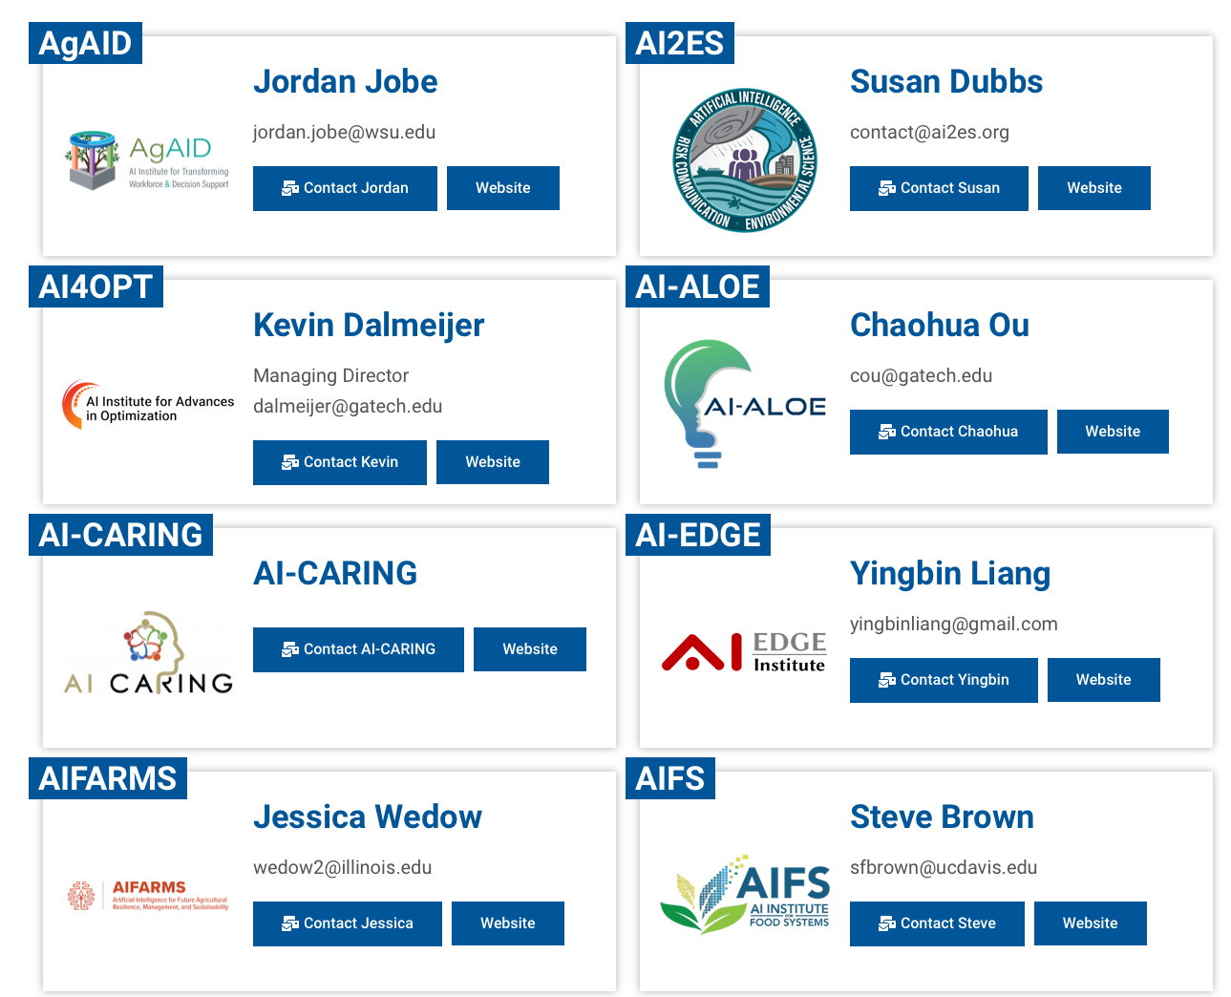
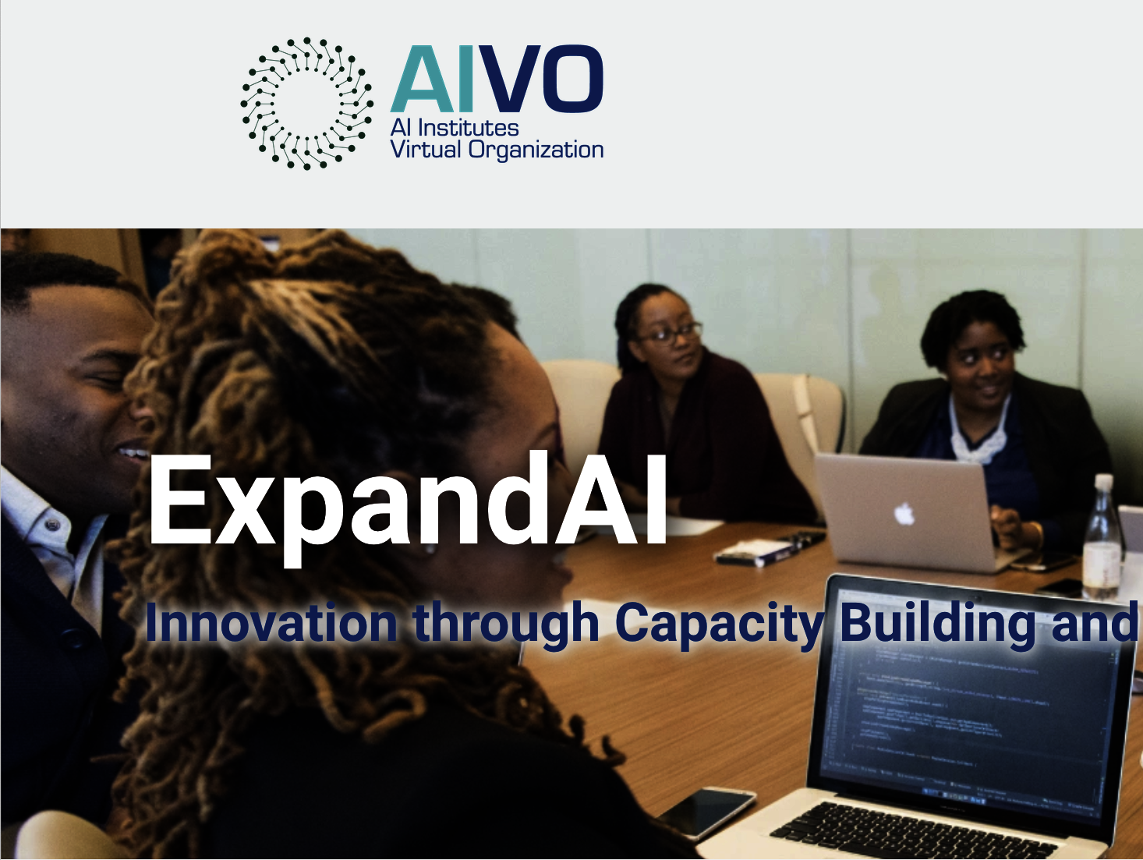
Finding an AI Institute to PARTNER with
Subaward may be made to the AI Institute lead organization or any of the sub-awardee organizations in that Institute’s award budget
Current AI Institutes
  AI Institutes Virtual Organization (AIVO) Website
  Expand AI Page: https://aiinstitutes.org/expandai/
ETC…

Slide 36
What needs to be demonstrated for PARTNER COs and Proposals
Concept Outline
  MSI capacity is suitable for the PARTNER track
  Clearly identified and described Partnership goals that demonstrate benefits to both the submitting MSI and the partnering AI Institute
Full Proposals
  MSIs must demonstrate readiness to leverage new partnerships to develop AI capacity
  Benefits of collaboration to the proposing MSI(s) are clearly articulated
  Connections between the identified research efforts and AI institute research are strong
  Compelling Partnership Roadmap - joint strategy for collaborative work clearly laid out
  Arrangements described significantly scale up AI capacity at the proposing MSI (growth in AI capacity is substantial)
  Activities described are AI-related
  PARTNER proposals must feature a compelling Partnership Roadmap for collaborative work in some unifying theme or focus
  Proposals to this track must include a strong Institutional Need and Support Statement from proposing MSI which demonstrates institutional commitment for proposed activities as well as contain an assessment of
    current AI research and instructional capacity infrastructure
    progress in AI capacity development and how that relates to the outlook for partnership development
  PARTNER proposals must include an Institute Integration Plan submitted by the collaborating institute demonstrating thoughtful and well-resourced commitment to coordination mechanisms that will bring together the various participants of the project.

Slide 37
Effective PARTNER Roadmaps
Effective roadmaps should be depicted visually (e.g., conceptual diagram, logic model, table, etc.) as well as fully explained by a descriptive narrative.
Specifically, Roadmaps might address:
  enhancement of existing projects by virtue of new collaboration
  initiation of new projects made possible by the collaboration
  community building activities (e.g., workshops) to further develop common interests, objectives, and further growth of the partnership
  potential and plans for scaling nascent programs
  an evaluation plan for measuring the growth and mutual benefit of activities in all projects

Slide 38
Questions?
Important Dates and contact information
Full proposal submission windows:
  January 8, 2024 – March 11, 2024
  March 12, 2024 – June 24, 2024
  June 25, 2024 – October 18, 2024
  January 6, 2025 – March 10, 2025
Office hours:
  Monday, February 26, 2024, 3:00-4:00pm EST
Contact Information:
ExpandAI Team expandaiprogram@nsf.gov
James Donlon (co-lead) jdonlon@nsf.gov
Abiodun Ilumoka (co-lead) ailumoka@nsf.gov
Dillon Watring dwatring@nsf.gov

