Slide 1


Civic Innovation Challenge (CIVIC) Webinar
A research and action competition driven by community priorities
U.S. Department of Agriculture
Co-Lead and Co-Funder
U.S. Department of Energy
Co-Lead and Co-Funder
National Science Foundation
Challenge Lead and Funder
U.S. Department of Homeland Security
Co-Lead and Co-Funder
February 22, 2024
David Corman, Ph.D. and Vishal Sharma, Ph.D.
Program Directors
National Science Foundation
Computer and Information Science and Engineering Directorate

Slide 2

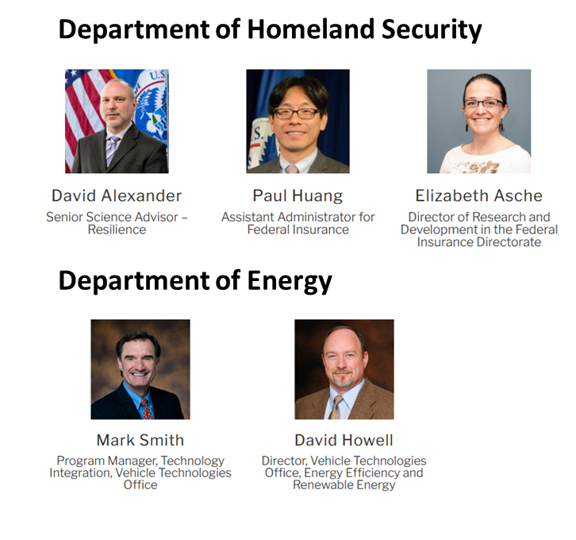



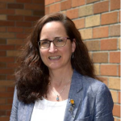








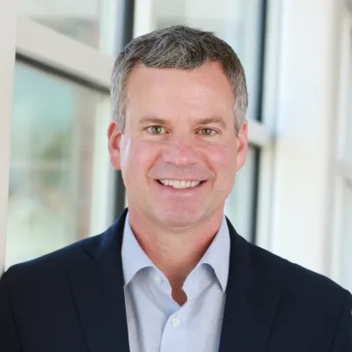
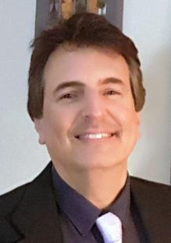

CIVIC Program Team
National Science Foundation
Department of Homeland Security
David Corman
Program Director
(CISE)
Vishal Sharma
Program Director
(CISE)
Jacob Kravetz
AAAS STPF Fellow
(CISE)
Linda Bushnell
Program Director
(CISE)
Ralph Wachter
Program Director
(CISE)
Norman Speicher
Program Manager, S&T
Department of Energy
Siqian Shen
Program Director
(ENG)
Daan Liang
Program Director
(ENG)
Barbara Ransom
Program Director
(GEO)
Sara Kiesler
Program Director
(SBE)
Chris Balakrishnan
Program Director
(BIO)
Kirsten Schwarz
Program Director
(BIO)
MetroLab Network
Department of Agriculture
David Rowe
Chief of Staff
Steve Thomson
National Program Leader,
Division of Agricultural Systems

Slide 3





Program Goals
Address local priorities and challenges through research-based pilot projects
Accelerate transition to practice of foundational research and emerging technologies into local government and community organizations
Pilot projects must be co-created and executed as partnerships between researchers and a range of stakeholders on the front lines of their community challenge
Projects outcomes must have potential to be scaled and sustained in the pilot communities, with transferability across the US
Website: https://nsfcivicinnovation.org/

Slide 4

Program Structure
Focused track themes, developed with input from local government and community organizations and the priority areas of the co-funding federal agencies
Broad outreach to solicit project proposals with a focus on outreach to local government, community organizations, and research institutions
Project selection through NSF merit review involving civic and academic reviewers
Stage 1 Planning Grant Awards
($75K for 6-month awards, for team capacity building and to refine pilot project ideas)
Down-selection
Stage 2 Pilot Awards
($1M for 12-month awards, to execute fast-paced pilot project)
Community of Practice to facilitate knowledge sharing, training, and networking
between CIVIC teams

Slide 5
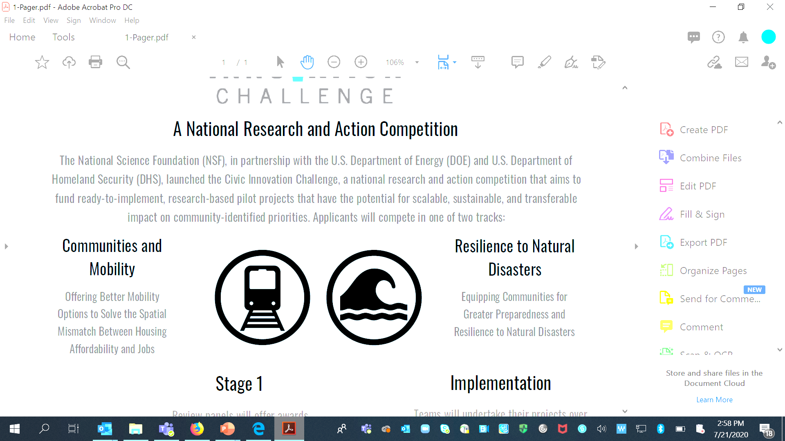
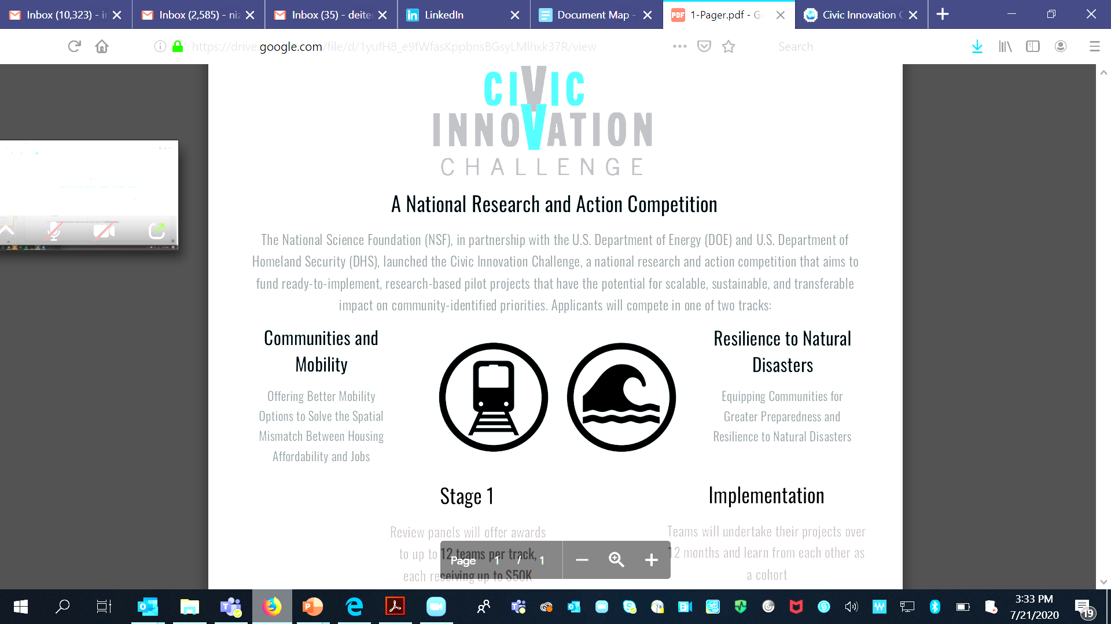
CIVIC 1.0 (2020-22)
Track A:
Communities and Mobility
Track B:
Resilience to Natural Disasters
Offering better mobility options to solve the spatial mismatch between housing and jobs
Equipping communities for greater preparedness and resilience to natural disasters
Stage 1 | Stage 2
21 Awards | 6 Awards
Stage 1 | Stage 2
31 Awards | 11 Awards
Stage 2 Application Domains:
On-Demand Multi-Modal Transit
Micromobility
Smart Mobility Hubs
Microtransit
Stage 2 Application Domains:
Food Security
Disaster Evacuation
Post-Disaster Aid Distribution
Infrastructure Resilience
Resilience Education
Resilience Hubs
Flooding – Modeling, Planning, and Response

Slide 6








CIVIC 2.0 (2022-24)
Track A: Living in a Changing Climate
Track B: Bridging the gap between essential resources and services & community needs
Adaptation, mitigation, and resilience in community systems, services, and economic drivers that are vulnerable in the face of a changing climate.
Enhancing peoples’ access to essential resources and services (e.g., food and housing) where better accessibility could significantly improve quality of life and community resilience.
Program Timeline:
Stage 1: October 2022 – March 2023
Stage 2: October 2023-2024

Slide 7
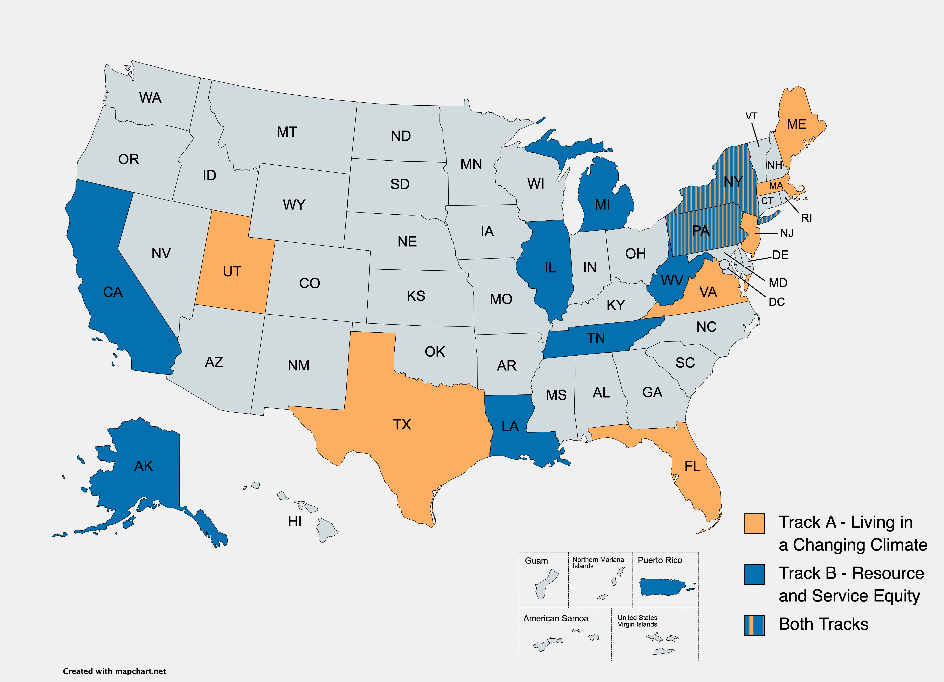
CIVIC 2.0 (2022-24)
Stage 2 Pilot Location Map
56 Stage 1 Planning Awards
22 Stage 2 Pilot Awards
Track A (Climate): 10 awards
Track B (Resource and Service Access): 12 awards
Start Date for Stage 2: October 1, 2023
3
2
2
Website: https://nsfcivicinnovation.org/

Slide 8
NEW CIVIC SOLICITATION (NSF 24-534)
Refer to guidance and requirements in the solicitation, as well as NSF’s Proposal and Award Policies and Procedure Guide (PAPPG)
PAPPG Link: https://nsf.gov/publications/pub_summ.jsp?ods_key=pappg

Slide 9
SOLICITATION OVERVIEW
Updates to the Program Solicitation:
The NSF Directorate for Biological Sciences has joined the program.
The solicitation includes updated language for both Track A and Track B.
Maximum allowable budgets for Stage 1 Planning Grants have been increased to $75,000.
The solicitation includes an update to the solicitation-specific review criteria.
The Dear Colleague Letter (NSF 23-027) on USDA/NIFA participation in Stage 2 of the program does not apply to this solicitation.

Slide 10
SOLICITATION OVERVIEW
This round of CIVIC has two focused track themes that teams can apply to:
Track A: Climate and Environmental Instability
Track B: Bridging the gap between essential resources and services & community needs
Strengthening the resilience of a community and its economy to climate- and associated environmentally-related instability and disasters such as extreme heat events, flooding, wildfires, etc.
Projects may target specific function(s) and aspects of a community such as (but not limited to):
utilities, communications, and other critical infrastructure
public health
transportation and mobility
food and agriculture
water security
ecosystem services
financial services
Enhancing peoples’ access to essential resources and services (e.g., food, housing, broadband and mobile technologies) where better access could significantly improve quality of life and community resilience.
Projects may consider gaps and inequities in resource and service allocation resulting from (for example):
Long-standing, systemic issues around accessibility
Economic disparities
Poorly designed interfaces
Disruptions caused by a shock or disaster.

Slide 11
SOLICITATION OVERVIEW
Stage 1 Planning Grants
Proposals due: May 1, 2024
Anticipated Awards: ~35-40 awards, $75K per award
Stage 1 timeline: October 2024 - March 2025
Planning grants will enable teams to strengthen collaborations with relevant partners and stakeholders, solidify their deliverables and the academic and civic partner team members’ roles, and refine the vision and plan for executing the research-centered pilot project.
Stage 2 Full Awards
Proposals due: Feb 10, 2025
Anticipated Awards: ~15-20 awards, $1M per award
Only Stage 1 Awardees can submit proposals for Stage 2
Full awards will enable teams to execute a research-centered pilot project in either one of the two tracks specified in this solicitation and develop pathways for scaling and sustaining the outcomes of their pilot beyond the period of the NSF award.

Slide 12
PROPOSAL PREPARATION
Key parts of a CIVIC Planning Grant proposal:
  Project Summary
  Project Description (this is primary section of the proposal with various subcomponents; 7 pages maximum for planning grants)
    Vision for a Research-Centered Pilot Project
    Civic Partnerships and Engagement
    Broader Impacts (must include content described in PAPPG)
    Results from Prior NSF support (must include content described in PAPPG)
  Facilities --- may describe further information about facilities and resources available to the team (including physical and personnel)
  Project Personnel and Partner Institutions
  Biographical sketches
  Letters of Collaboration --- some may be NSF standard letter, others may be descriptive --- they are both ok
  Data Management Plan
  Post-doctoral Mentoring Plan (only required if funding support is requested for post-doctoral researchers)
  Current and Pending Support

Slide 13
PROPOSAL PREPARATION
Proposers will describe their project ideas, goals, and activities in the “Project Description” section of their proposals.
As stated in section V.A of the solicitation , teams can refer to these questions as they get started with formulating their ideas:
Vision for a research-centered pilot project that would be carried out within a real-world context in Stage 2
  In what ways does the envisioned Stage 2 pilot project go beyond the state-of-practice and state-of-the-art?
  Is the envisioned Stage 2 pilot project suitable for the fast-paced timeline of CIVIC?
  Who are the members of the team, including academic and civic partners, and why is each relevant for the project? Are there gaps in expertise that will be addressed during the planning period?
  What are the activities to be undertaken during the Stage 1 PG to prepare the team to propose a competitive Stage 2 proposal?
The strength of the project’s civic-academic partnerships and engagement with the pilot community;
  Do the civic partners adequately represent the perspective of the community and enable the project to achieve its desired impact?
  What combination of civic partner(s), civic engagement activities, and research outputs will enable the project team to "close the loop" and achieve significant impact with their proposed activities?
  How will the project collaborate across academia, community organizations, and local/state government?

Slide 14
PROPOSAL PREPARATION
Additional sections to build on the strength of your project ideas and partnerships:
Biosketches
Letters of Collaboration (limited to two pages per letter)
Facilities, Equipment or Other Resources
Refer to Section V.A under “Supplementary Documents” for guidance on Biosketches, Letters of Collaboration, and Facilities, Equipment or Other Resources

Slide 15
MERIT REVIEW CRITERIA
Proposals will be reviewed for intellectual merit and broader impacts following NSF’s general review process.
Intellectual Merit: The Intellectual Merit criterion encompasses the potential for the proposed project to advance knowledge and understanding within its own field or across different fields.
Broader Impacts: The Broader Impacts criterion encompasses the potential to benefit society and contribute to the achievement of specific, desired societal outcomes.
In addition to assessing a proposal's intellectual merit and broader impacts, the following elements are considered for both review criteria (in context of the unique CIVIC solicitation and program goals):
  To what extent do the proposed activities suggest and explore creative, original or potentially transformative concepts?
  Is the plan for carrying out the proposed activities well-reasoned, well-organized and based on a sound rationale? Does the plan incorporate a mechanism to assess success?
  How well qualified is the individual, team or organization to conduct the proposed activities?
  Are there adequate resources available (either at the proposer's home organization or through collaborations) to carry out the proposed activities?
Information about the NSF merit review process can be found in section VI.A of the solicitation.

Slide 16
MERIT REVIEW CRITERIA
Additional solicitation-specific review criteria:
Is it evident that the envisioned CIVIC project is:
  (a) addressing a community priority with an impactful pilot that has the potential to be scaled and sustained, and
  (b) driven by strong partnerships between the necessary set of civic institutions and organizations, researchers, and other partners and other community partners?
Is the proposed pilot project well-suited for execution in the fast-paced 12-month timeframe of the CIVIC program, including a rapid start-up at the onset of Stage 2?
Does the proposal clearly articulate the desired impact of its planning activities or envisioned pilot, with well-defined metrics and benchmarks for evaluating progress and success?
Information about the NSF merit review process can be found in section VI.A of the solicitation.

Slide 17
GUIDANCE FOR ORGANIZATIONS NEW TO NSF
The proposal submission process to NSF can take time and teams that have not previously submitted to NSF are strongly encouraged to initiate it early in the proposal submission window.
As a starting place, teams may refer to the following:
  Refer to the section titled “Proposal Preparation and Submission Instructions” in the solicitation for guidance on submission requirements
  NSF’s Proposal and Award Policies and Procedure Guide (PAPPG): https://nsf.gov/publications/pub_summ.jsp?ods_key=pappg
Teams are also strongly encouraged to visit the CIVIC FAQ webpage and refer to question 11 in the “Proposals” section for additional detailed guidance on the submission process for organizations new to NSF.
Questions regarding research.gov and grants.gov submission process or getting set up to propose to NSF should not be directed to NSF Program Director’s for CIVIC.

Slide 18
ADDITIONAL RESOURCES
Serve on an NSF Review Panel
Sign up at this link to be considered as a reviewer for the CIVIC program and please share with others who may be interested.
CIVIC Webinar Recording
A recording of this webinar and a copy of these slides will become available at the NSF program page for CIVIC a few days after this webinar.
CIVIC Office Hours
CIVIC Program Directors are available for 1-1 calls with prospective proposers to answer questions regarding the program and proposal ideas. Meetings can be scheduled using this link.
Additional Resources
Sign up for the CIVIC mailing list to receive further updates about the program, including, future webinars, information on program office hours, and ways to participate as a reviewer
Visit nsfcivicinnovation.org to learn more about the program, including previous awards
For questions about the program email civic@nsf.gov

