Slide 1


NSF CISE Research Expansion Program
(Webinar: Solicitation NSF 24-536)

Slide 2
Webinar Outline
Mission
Program Overview
Eligibility and Deadlines
Resources and Events
Q&A
Notes:
Orient potential proposers
Summarize the MSI program and review criteria
Answer questions
Improve the quality of proposals

Slide 3
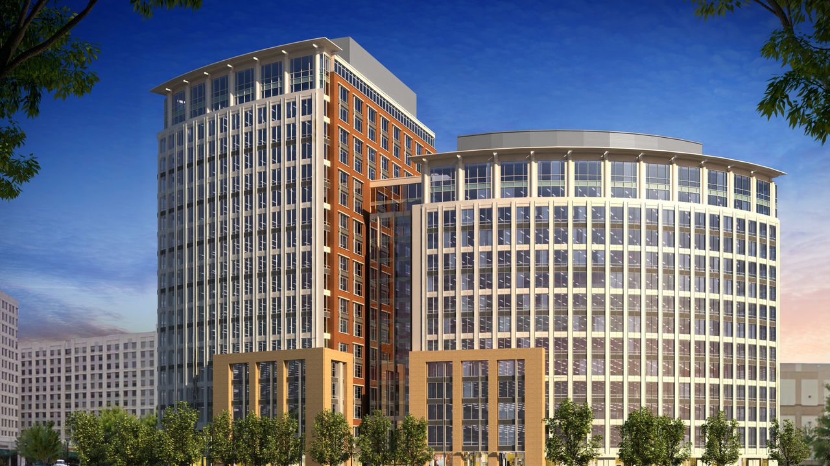
National Science Foundation’s Mission
“To promote the progress of science; to advance the national health, prosperity, and welfare; to secure the national defense...”

Slide 4
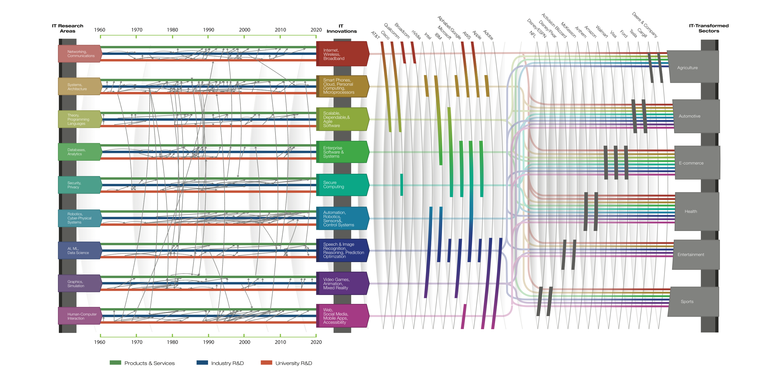

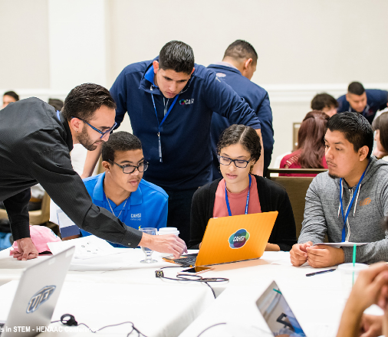
NSF-funded Foundational, Translational, Societal Impacts
Foundational
CISE-funded research has
led the world in fundamental work on how information is gathered, analyzed, and communicated.
44 of the 72 Turing Awardees have received NSF funding
Translational
CISE-funded research has changed how the world computes and communicates.
>$1Trillion of economic impact via the IT sector and beyond.
Societal
CISE-funded research is benefitting American communities
Changing the face of computing and changing the world
https://www.nationalacademies.org/our-work/depicting-innovation-in-information-technology

Slide 5









CISE by the Numbers
NSF funds 80% of federally-funded CS in the US at academic institutions.
48 states
+ D.C.
+ 1 territory
371
Institutions supported
$1,035.9 M
FY2023 enacted budget
6,401
Proposals evaluated
6,647
Grad students
89
Minority-serving Institutions
29% Funding rate
21, 623
Individuals from senior researchers to undergrads
1,847 Awards made
62
Institutions funded in EPSCoR states
All data depicted is for fiscal year 2023.

Slide 6



NSF's priorities for 2030 Vision
STRENGTHENING ESTABLISHED NSF
INSPIRING THE MISSING MILLIONS
ACCELERATING TECHNOLOGY AND INNOVATION
Notes:
National Science Foundation (NSF) priorities do not change with the passage of the CHIPS and Science Act. This law supports and further enables our three pillars.
Strengthening the established NSF; and
Inspiring the Missing Millions;
Accelerating technology and innovation

Slide 7





“CHIPS and Science” and NSF
Authorizes a doubling of the NSF budget over 5 years | Strengthens fundamental research | Establishes Technology, Innovation & Partnerships
Invests in STEM Education | Advances diversity in STEM | Addresses research security

Slide 8
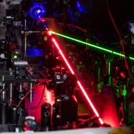

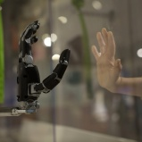

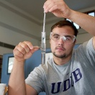
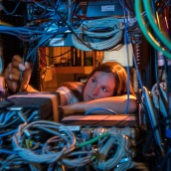


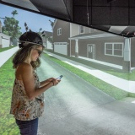
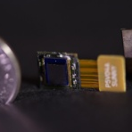
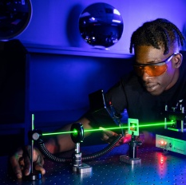
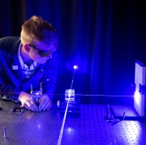
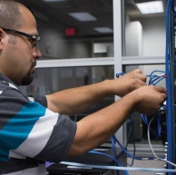


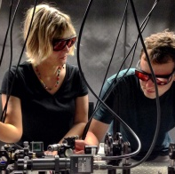
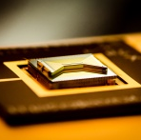
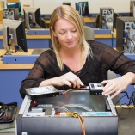
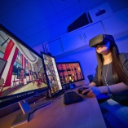
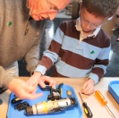

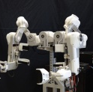
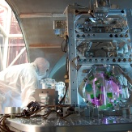



Investment Need
Create a workforce prepared for the jobs of today and tomorrow.
Create the technologies and jobs of the future.
Notes:
If the United States wants to continue to lead in research and innovation, we need to invest in both fundamental research and translation. We need to create the technologies and jobs of the future through such investments. We also need to ensure that we have a workforce – a broad workforce – who are prepared for the jobs of today and tomorrow. NSF is uniquely positioned to build the workforce for the future. Technology, Innovation and Partnerships (TIP) is not just a directorate. It is a concept that permeates throughout NSF.
TIP leverages everything we do and takes it to the next level. It ENRICHES the fundamental research to make the industries of the future a reality.
The concept of TIP supports FUNDAMENTAL research with IMPACT.
Innovation is infused all through NSF. Same with partnerships. Technology does not limit itself. It’s not just gadgets and prototypes. It’s throughout all that we do.

Slide 9
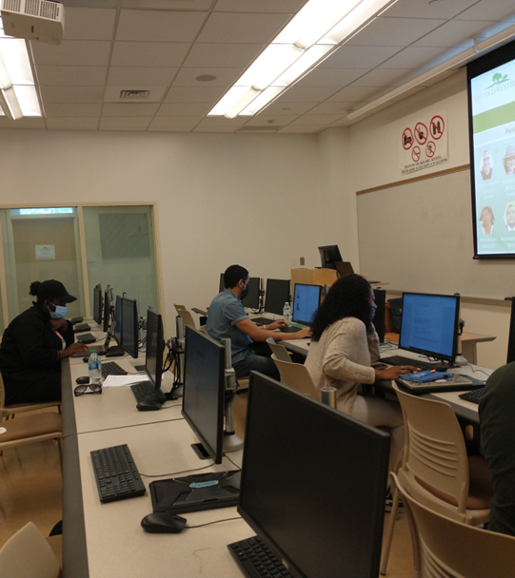
CISE Research Expansion
Mission & Vision
To build research capacity and enhance institutional research infrastructure at MSIs in support of their transition into the CISE CORE programs.
To stimulate rigorous research advances at MSIs and thus address the challenges faced by the nation’s STEM competitiveness.
To fill the gap in funding of MSIs, as they are central to promoting inclusive excellence, thus enabling CISE research access and inclusion.
Bridge Program: Eight Old Westbury students conduct research engagement
Notes:
CISE Research Expansion Mission and Vision
To build research capacity and enhance institutional research infrastructure at MSIs in support of their transition into the CISE CORE programs.
To stimulate rigorous research advances at MSIs and thus address the challenges faced by the nation’s STEM competitiveness.
To fill the gap in funding of MSIs, as they are central to promoting inclusive excellence, thus enabling CISE research access and inclusion.

Slide 10
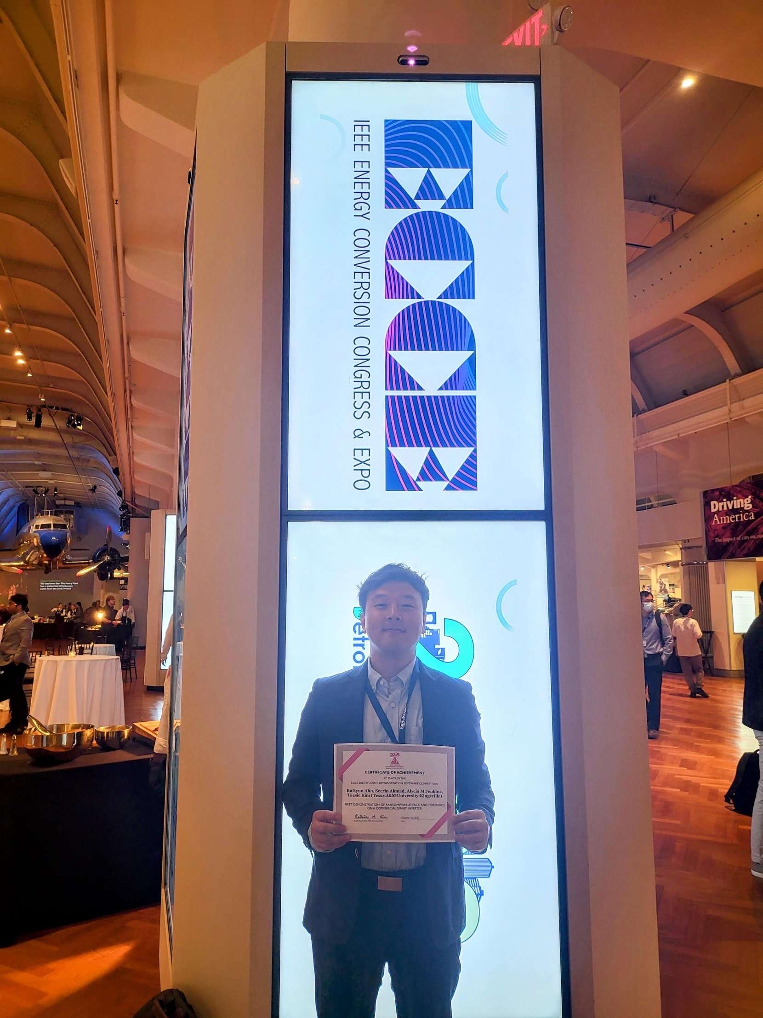
CISE Research Expansion Program
Launched in 2021
Series of CISE MSI workshops took place in 2019-2020 involving MSI faculty to encourage collaborations, partnerships and ideation.
Need for research expansion and infrastructure support for MSIs
CISE wide focus
Representation from SaTC, CNS, CCF, IIS, OAC
~105 awards, $40M to date (ranging from 300K to $1.2M)
Student BoHyun Ahn,
1st Place in the IEEE ECCE 2022
Student Demonstration Project Software Competition
(October 2022)

Slide 11
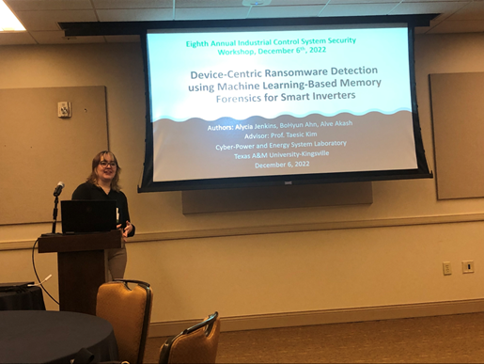
CISE Research Expansion: Transition to CISE Core
Support the success of institutions and investigators towards the CISE Core & participating programs portfolio
CISE Directorate Core programs within:
  Division of Computing and Communication Foundations (CCF)
  Division of Computer and Network Systems (CNS)
  Division of Information and Intelligent Systems (IIS)
  Office of Advanced Cyberinfrastructure (OAC)
Faculty Alycia Jenkins
Eighth Annual Industrial Control System Security (ICSS) Workshop,
Austin, TX, USA (December 2022)
Notes:
CISE Research Expansion Mission and Vision
To build research capacity and enhance institutional research infrastructure at MSIs in support of their transition into the CISE CORE programs.
To stimulate rigorous research advances at MSIs and thus address the challenges faced by the nation’s STEM competitiveness.
To fill the gap in funding of MSIs, as they are central to promoting inclusive excellence, thus enabling CISE research access and inclusion.

Slide 12
Participating NSF Divisions and Office
Directorate for Computer and Information Science and Engineering (CISE)
  Division of Computing and Communication Foundations (CCF)
  Computer and Network Systems (CNS)
  Division of Information and Intelligent Systems (IIS)
  Office of Advanced Cyberinfrastructure (OAC)
Other programs spanning multiple CISE divisions:
  Cyber-Physical Systems (CPS)
  Secure and Trustworthy Cyberspace (SaTC)
  Smart and Connected Communities (S&CC)
  Smart and Connected Health (SCH)

Slide 13
CISE Research Expansion Program Threads​
Thread 1: Research Capacity Building Planning Projects (RCBPP)
Project length: Two years. Award size: Up to $400,000
Thread 2: Demonstration Projects (DP)
Project length: Three years. Award size: Up to $600,000
Thread 3: Research Partnerships Enhancement Projects (RPEP)
Project length: Up to four years. Award size: Up to $1,200,000
Project length: Up to two years. Award size: Up to $200,000
Thread 4: Research Planning Projects (RPP)
Who can propose:
Institutions with two or more active RCBP awards are ineligible to be leads for new RCBP proposals.
Institutions with two or more active DP awards are ineligible to be leads in new DP proposals.
Institutions with one or more active RPEP awards are ineligible to be leads for new RPEP proposals.
https://www.nsf.gov/publications/pub_summ.jsp?ods_key=nsf24536

Slide 14
Thread 1: Research Capacity Building Planning Projects (RCBPP)
  Develop infrastructure elements to support research.
  Describe how funds for infrastructure elements will help to build research capacity.
  Describe how the proposed work will provide new and/or ongoing research opportunities for student engagement at the MSIs, or engagement across the partnering research-intensive organizations.
  Detail and promote sustainability of the anticipated outcomes
  Standalone (or single-PI) research projects do not qualify for this Thread

Slide 15
Thread 2: Demonstration Projects (DP)
Expand or develop research collaborations involving multiple departments at a single MSI, multiple MSIs, or one or more MSIs and other research-intensive organizations.
Focus on research aligned with one or more CISE programs identified in the solicitation.
Strengthen partnerships among the proposing teams to promote long-term relationships.
Engage undergraduate and/or graduate students from the MSIs in research efforts.

Slide 16
Thread 3: Research Partnerships Enhancement Projects (RPEP)
Include partnerships between a MSI and a NSF-funded research center, a research-intensive organization, and/or a national laboratory.
Identify one or more MSIs, without recent funding through the CISE programs noted in the solicitation, to lead the project.
Demonstrate prior success via collaborative projects.
Include undergraduate and/or graduate students in research activities and conferences.
Demonstrate that the collaborative project team will enhance research capacity at the MSIs.
Demonstrate that the collaborative research team could successfully compete in the larger size classes of the CISE programs noted in the solicitation.

Slide 17
Thread 4: Research Planning Projects (RPP)
  Designed for MSIs for planning efforts to build research capacity for submission to the CISE MSI and/or other CISE core research programs.
  May include but not limited to establishing, planning, and expanding on efforts focused on activities at the MSI
  Describe how funds for infrastructure elements will help to build research capacity.
  Describe a plan for engaging appropriate communities to test the feasibility of partnerships as well as developing plans for continuing capacity development.
  Describe the required research infrastructure, plans to leverage established groups in related research areas, and inclusion of faculty training and research experiences that emphasize the diversification of investigators.
  This type of project is not a prerequisite to participate in a future CISE MSI competition.
  Prior NSF support is not required to be eligible for a Planning Grant.

Slide 18
CISE Research Expansion: Proposal Preparation
The NSF proposal and award process is detailed in the Proposal & Award Policies & Procedures Guide (PAPPG, NSF 24-1): https://new.nsf.gov/policies/pappg/24-1
The next slides include aspects that are specific to this solicitation.

Slide 19
Solicitation Eligibility
Proposals may only be submitted by:
  Universities and Colleges
  Non-profit, non-academic organizations
  NSF-sponsored federally funded research and development centers (FFRDCs) may apply, provided that that they are not including costs for which federal funds have already been awarded or are expected to be awarded.
Limit on Number of Proposals per PI/Co-PI/Senior Personnel: 2
  An individual may participate as Principal Investigator, co-Principal Investigator or other Senior Personnel in at most two full proposals across all categories of proposal for each deadline.
A MSI faculty member should serve as the lead principal investigator(s) on any proposal submission.
Refer NSF 24-536 solicitation for additional details

Slide 20
Institutional Eligibility
Proposals may be submitted by accredited Institutions of Higher Education that belong to at least one of the following classifications as a minority-serving institution (MSI):
  Alaska Native Serving Institutions (ANSI)
  Hispanic Serving Institutions (HSI)
  Historically Black Colleges and Universities (HBCU)
  Predominantly Black Institutions (PBI)
  Native Hawaiian Serving Institutions (NHSI)
  Native American-serving, non-Tribal Institutions and Tribal Colleges and Universities (TCU)
  Other Minority-Serving Institutions (MSI)
Eligibility as a minority-serving institution may be determined by reference to the Integrated Postsecondary Education Data System (IPEDS) of the US Department of Education National Center for Education Statistics (http://nces.ed.gov/ipeds/).
Please review solicitation NSF 24-536 for more details.

Slide 21
Additional Eligibility Information
Proposals may be submitted only by accredited Institutions of Higher Education (IHEs) that are recognized as Minority Serving Institutions (https://www2.ed.gov/about/offices/list/ocr/edlite-minorityinst.html).
Institutions must satisfy the definition of an MSI defined earlier in this solicitation (See Section I). The MSI Certification Form is required with submission of the proposal. (See Section V of the solicitation.)
For MSI certification, a representative of the institution (e.g., Sponsored Research Officer or higher) must sign a Certification of MSI Eligibility (see Section V below for the required template) to be included in the Supplementary Documentation section of the proposal.
Institutions that have received NSF awards totaling more than $2 million dollars, within the past five years (from the fiscal year deadline date) from the CISE programs listed in Section II combined, are not eligible to serve as lead institutions, but may participate as non-lead collaborators. (See Section II Program Description).

Slide 22
Proposal Cover Sheet
NSF Unit of Consideration (Division/Office):
  The proposals should choose CISE division or office (or eligible cross-division program) as unit of consideration.
    Divisions/Office include: CCF, CNS, IIS, OAC
    Cross-division programs include: SaTC, CPS, S&CC, SCH
Proposal Title
  Proposal titles should begin with “CISE-MSI:”, then the Thread acronym, then the intended CISE program (Core program or eligible cross-division program)
  Examples:
    CISE-MSI:RPEP:CCF:ProjectTitle
    CISE-MSI:DP:SaTC:ProjectTitle

Slide 23
Project Description
In the first paragraph of the Project Description, identify the intended CISE program(s) (e.g., CPS, SaTC). The description must indicate how the proposed research will foster department and/or organizational research capacity.
In addition to the guidance specified in the PAPPG, address:
  Institutional Data Narrative - The Project Description must include institutional data with a narrative describing and contextualizing the institution's need for the proposed project and potential to build research capacity and partnerships.

Slide 24
Supplementary Documents (1/4)
A list of Project Personnel and Partner Institutions (Note: In collaborative proposals, the lead institution should provide this information for all participants)
Collaboration Plan (2-page limit)
Data Management Plan (2-page limit)
Cloud Computing Resources (if applicable)
Departmental Letter (1-page limit)
Certification of MSI Eligibility

Slide 25
Supplementary Documents (2/4)
Collaboration Plan (2-page limit) should include:
  the specific roles of the PI, co-PIs, other senior personnel and paid consultants at all institutions involved
  how the project will be managed across all the investigators, institutions, and/or disciplines
  identification of the specific coordination mechanisms that will enable cross-institution and/or cross-discipline scientific integration
  pointers to the budget line items that support these management and coordination mechanisms

Slide 26
Supplementary Documents (3/4)
Data Management Plan (2-page limit) should include:
  This supplementary document should describe how the proposal will conform to NSF policy on the dissemination and sharing of research results.
  For specific guidance for Data Management Plans submitted to the Directorate for Computer and Information Science and Engineering (CISE) see: https://www.nsf.gov/cise/cise_dmp.jsp.
  See Chapter II.C.2.j of the PAPPG for full policy implementation.
  For additional information on the Dissemination and Sharing of Research Results, see: https://www.nsf.gov/bfa/dias/policy/dmp.jsp.

Slide 27
Supplementary Documents (4/4)
Cloud Computing Resources: if requesting cloud resources through CloudBank only, a supplementary document (not to exceed 2 pages) should be included
  The anticipated annual and total costs for accessing the desired cloud computing resources, based on pricing currently available from the public cloud computing providers
  Which public cloud providers will be used
  A technical description and justification of the request, along with how the cost was estimated.
  The NSF Budget should not include any such costs for accessing public cloud computing resources via CloudBank.org. The total cost of the project, including this cloud computing resource request from CloudBank.org, may not exceed the budget limit described in this solicitation.

Slide 28
CloudBank (www.CloudBank.org)
NSF
NSF PIs
Commercial Cloud Resources
NSF PIs
NSF PI
CloudBank
NSF PIs
Democratize access to researchers
PI-centric program
NSF PI
Cloud Providers available: Amazon Web Services, Google Cloud Platform, IBM Cloud, Microsoft Azure

Slide 29
Benefits
For CISE researchers and educators
  Remove the “friction” associated with cloud access and account management; hide cloud contract negotiation
    (Many institutions do not have one-on-one agreement with cloud providers; at most, they might have with just one, not all of them)
  Help educate them how to use the cloud with appropriate documentation
  Multiple cloud provider access
For the NSF
  Create an entity that will facilitate the use of cloud for CISE-funded PIs
  Track cloud usage, trends, and project future usage
  Demonstrate the viability of a Cloud Access Entity (CAE)
For cloud providers
  Access to new users and communities
  Help with offloading the “high touch” nature of working with individual researchers

Slide 30
How does a request work?
- Solicitation announces CloudBank
If cloud computing resources are being requested from CloudBank, then the keyword "CloudAccess" (one word without space) should be included at the end of the Overview section (before the section on Intellectual Merit) of the Project Summary page.
A CloudBank-based cloud resource request is not part of the main proposal body. It is a (max 2-page) supplement, to include these two elements
  Estimated annual and total cost for identified cloud computing resources
    Use current provider costs to estimate
    This does not oblige the PI to a particular provider
  Technical description / justification for requested cloud resources
The NSF proposal budget should not include these cloud costs. However: The total cost of the project including cloud resource cost must not exceed the budget limit described in the solicitation.

Slide 31
Example
A proposal submitted to Thread 2 of the CISE MSI program, namely a Research Demonstration Project (RDP), has a total proposal budget limit of $600,000.
If a PI wishes to request $50,000 in commercial cloud computing resources through CloudBank, then the CISE MSI program solicitation specifies that the proposal budget should not exceed $550,000 in the PI's NSF budget request (i.e., the NSF Budget and Budget Justification)
The remaining $50,000 for commercial cloud computing resources should be specified in the Supplementary Document.

Slide 32
CloudBank Supplement DCL (forthcoming)
Named in CISE Core solicitation, CISE-MSI, 10+ other solicitations and DCLS
No Indirect Cost -- ~50-60% “discount”
Request NSF award supplements for CloudBank credits at any time, not just proposal time.

Slide 33
Important Deadlines: NSF 24-536
Full Proposal Deadline(s) (due by 5 p.m. submitter's local time):
May 02, 2024
February 07, 2025
February 06, 2026
FY24 Review Schedule:
    Proposals due: May 02, 2024
    Announcement of awards: August 2024
Notes:
CISE Research Expansion Mission and Vision
To build research capacity and enhance institutional research infrastructure at MSIs in support of their transition into the CISE CORE programs.
To stimulate rigorous research advances at MSIs and thus address the challenges faced by the nation’s STEM competitiveness.
To fill the gap in funding of MSIs, as they are central to promoting inclusive excellence, thus enabling CISE research access and inclusion.

Slide 34

CISE Regional Research Expansion Aspiring Investigators Conferences/Workshops
Upcoming Regional Conferences/Workshops
April 8-9, 2024
University of Alabama (TN, MS, GA, AL)
June 13-14, 2024
University of Hawaiʻi at Mānoa (HI, GU)
August 5-6, 2024
University of Alaska Anchorage ((AK)
Southwest Regional Conference, December 4-5, 2023
University of Arizona (NV, AZ, NM, CA)
“Resource Link: https://tinyurl.com/join-cise-southwest”

Slide 35
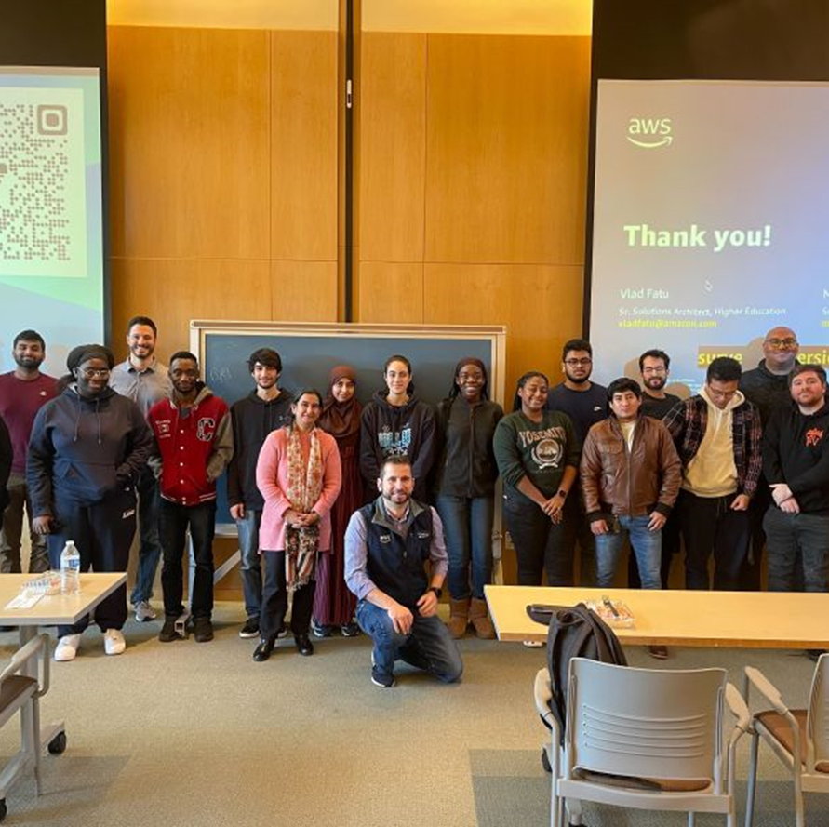
Recap: NSF investments towards transition to CISE Core
Building on technical themes and responding to research and societal opportunities
Building out cross-cutting efforts in infrastructure and people
Engaging in broad conversations with the research community, with industry, with other US agencies, and internationally
CISE Research Expansion Program NSF 24-536
Students, Faculty & the Amazon team at the AWS Sagemaker Workshop (December 2022)

Slide 36
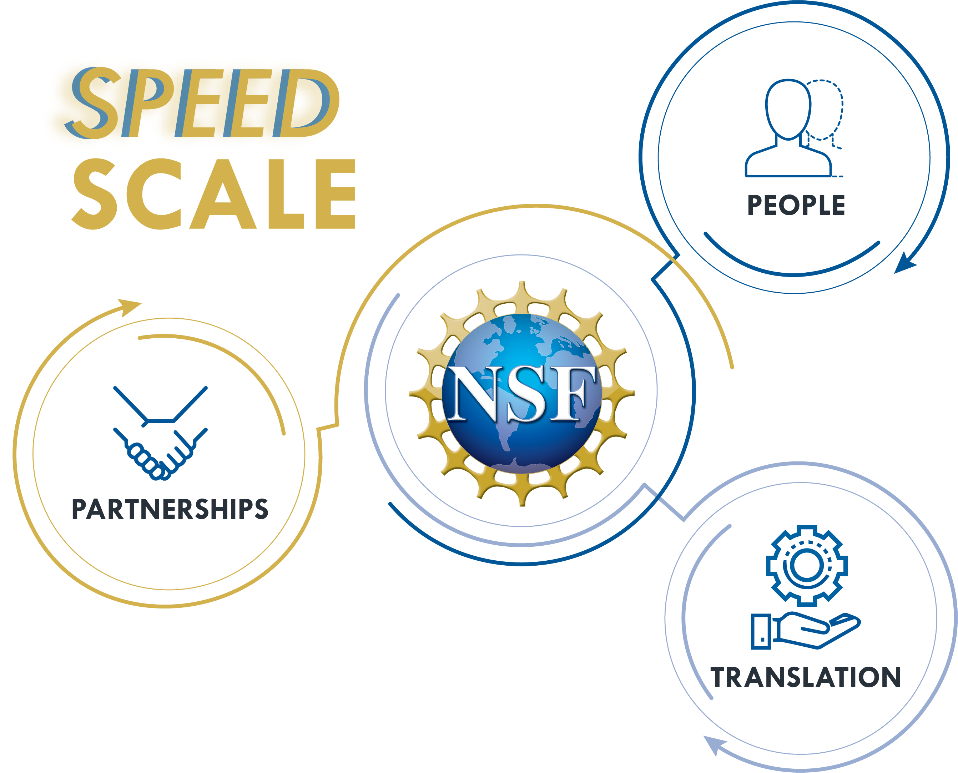
Q&A Session

Slide 37
Recap: Information And Revision
The Research Capacity Building Planning (RCBP) Thread was separated into 2 threads rather than having 2 tracks underneath the RCBP heading.
Thread 1 has been simplified and will only cover 1 area of research – Research-Focused Capacity Building (Previously Track 1B).
Track 1A will now be captured in Thread 4 aimed specifically at research planning (RPP).
The Institution eligibility criterion has been updated to cap the maximum amount an institution may have received from CISE core funding listed in Section II to no more than $2 million within the past five years.

