Slide 1

ACED:
Accelerating Computing-Enabled Scientific Discovery
NSF 24-541
Webinar
March 12, 2024
1

Slide 2
The NSF ACED Team
  CISE/IIS: Christopher C. Yang, ccyang@nsf.gov; Thomas Martin, tmartin@nsf.gov
  CISE/CNS: Jason O. Hallstrom, jhallstr@nsf.gov
  CISE/CCF: Damian Dechev, ddechev@nsf.gov
  CISE/OAC: Ashok Srinivasan, asriniva@nsf.gov
  BIO/DBI: Jennifer W. Weller, jweller@nsf.gov; Charlotte Roehm, croehm@nsf.gov
  MPS/DMS: Stacey Levine, slevine@nsf.gov; Yulia Gel, ygel@nsf.gov
  MPS/PHY: Vyacheslav Lukin vlukin@nsf.gov; James T. Shank jshank@nsf.gov
  MPS/CHE: Laura Anderson, laanders@nsf.gov; Ryan Jorn, rjorn@nsf.gov
  ENG/ECCS: Anthony Kuh, akuh@nsf.gov
  TIP/ITE: Waleed Nasser, wnasser@nsf.gov; David Darwin, ddarwin@nsf.gov

Slide 3
A New Vision for Accelerating Scientific Discovery?
Science → Computing:
  Scientific exploration driving new computing innovation
  E.g. data science, modeling, simulation, analysis, reasoning, and prediction
Computing → Science:
  Computing technologies already accelerating new scientific advances
  E.g. AlphaFold2, Sagittarius A* black hole, Human Genome Project, Kepler conjecture
Can we harness the full power of computing to fundamentally revolutionize the scientific method, across all fields of science and engineering?

Slide 4
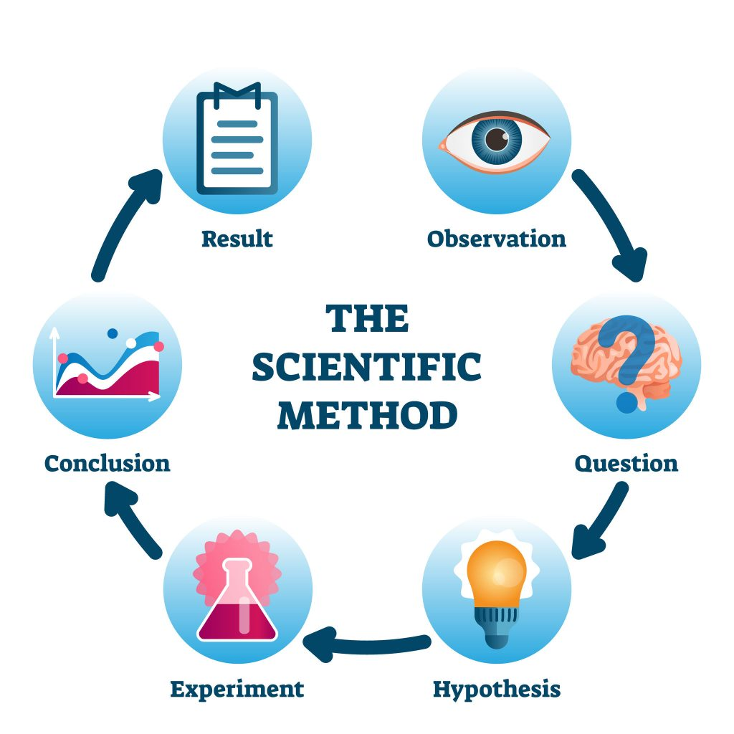
Data Driven Scientific Workflows/Methods
Data Curation
Hypothesis Generation
Artificial Intelligence
Smart Sensors
Visualization
Wireless Technologies
Computational modeling
Cloud
Infrastructure
High Precision Simulation
Robotics
Verification & Validation
Autonomous
Systems
Rigorous Reasoning
Security
Reproducibility

Slide 5
Synergies with existing programs
Many NSF programs that focus on similar topics
  Core programs, HDR, CDS&E, AI Institutes, Tripods, etc
Can we leverage and build on these programs?
  Identify promising cross-cutting technology areas with the potential to benefit from interaction with multiple science and engineering disciplines, and with the potential to benefit multiple disciplines
  Identify new collaborative research directions in experimental, computational, and data-enabled science to accelerate scientific discovery
  Explore when and why certain computing techniques work well in some contexts & not others
  Continue to build and grow an interdisciplinary community

Slide 6





Accelerating Computing-Enabled Scientific Discovery (ACED)
Engaging the Community through 5 Workshops:
Data, AI and Machine Learning
Chemistry
Environmental Science
Materials Science
Genomics
Computer Systems
Mathematics
Your Science Here!
Digital Twins
Smart Sensing and Analytics
…
Rigorous & Reproducible Reasoning
Programmable/Self-Driving Labs
6
Notes:
Can we harness the full power of computing to fundamentally revolutionize the scientific method, across all fields of science and engineering?

Slide 7
Accelerating Computer-Enabled Discovery (ACED)
Data, AI and Machine Learning
Digital Twins
Smart Sensing and Analytics
Rigorous & Reproducible Reasoning
Programmable/Self-Driving Labs
Meta-workshop bringing together leaders of specific domains in data science, AI and ML. Majority of attendees will be core organizers from recent workshops and meetings around the heart of data-intensive discoveries. They will include the most important findings from their events, bring them to this meta-workshop, and collaborate with other participants to generate new insights.
The workshop aims to identify research gaps in digital twin technologies that are common across application domains and that may benefit from crosscutting interdisciplinary research efforts. The workshop will focus on four methodological themes: models; data; decisions; and verification, validation, and uncertainty quantification, across diverse application domains.
This workshop will bring together stakeholders with domain expertise in sensing systems together with experts on signal processing, optimization, machine learning, and control theory to address a number of present and future challenges in smart sensing and analytics.
This workshop will explore rigorous and reproducible approaches to increase confidence in the outcomes of data driven scientific workflows/processes. The focus will be on development and use of rigorous methods to ensure correctness, reliability, robustness, reproducibility, safety, security, and efficient resource usage.
This workshop will convene experts in laboratory automation, data-driven methods, robotics, manufacturing, and human-machine interaction to identify the major challenges facing self-driving and automated experimental laboratories that can dramatically shorten the time between iterations of experiments or make it possible to conduct experiments that would be too dangerous for human technicians.
Notes:
Organizer names may need to be removed.

Slide 8
ACED Solicitation
Announced on Feb 13
NSF 24-541: ACED: Accelerating Computing-Enabled Scientific Discovery
https://new.nsf.gov/funding/opportunities/aced-accelerating-computing-enabled-scientific/nsf24-541/solicitation
Emerging Ideas Proposals Deadline: May 13, 2024
Discovery Proposals Deadline: January 14, 2025; January 14 2026

Slide 9
Participating Directorates and Divisions
Directorate for Computer and Information Science and Engineering
  Division of Information and Intelligent Systems
  Division of Computing and Communication Foundations
  Division of Computer and Network Systems
  Office of Advanced Cyberinfrastructure
Directorate for Biological Sciences
  Division of Biological Infrastructure
  Division of Environmental Biology
  Division of Integrative Organismal Systems
  Division of Molecular and Cellular Biosciences
Directorate for Engineering
  Division of Electrical, Communications and Cyber Systems
Directorate for Mathematical and Physical Sciences
  Division of Mathematical Sciences
  Division of Chemistry
  Division of Physics
Directorate for Technology, Innovation and Partnerships
  Innovation and Technology Ecosystems

Slide 10
ACED Goals
Harness the power of computing to accelerate scientific discovery while driving new computing advancements
  transform scientific disciplines through computational technologies
  foster novel computing technologies that will enable advances far beyond the specific use cases or domains originally targeted.
Emerging Ideas Proposals
  Limited to $500K in total budget
  18 - 24 months
Discovery Proposals
  $750K/year
  Up to $3M in total budget
  Up to 4 years

Slide 11
ACED is a Cross-cutting Program
ACED seeks continuous collaborations between at least two groups of researchers
  One group is expected to consist of researchers in computing (the disciplines supported by the Core Programs of CISE)
  The other group of researchers are expected to represent another scientific or engineering discipline (the disciplines supported within existing programs of BIO, ENG, MPS, TIP)

Slide 12
Intertwined between Scientific Discovery and Computational Advancements
Scientific discovery and computational advancements have long been intertwined, catalyzing mutual progress.
Scientific exploration has driven computing innovations, and the resulting technologies have enabled new scientific advances, fueling a virtuous cycle of discovery.
  Supercomputing arose to meet the challenge of performing massive numeric simulations in the sciences
  the World Wide Web (WWW) was initiated to share scientific data from the European Organization for Nuclear Research (CERN);
  the Human Genome Project provides an example of novel systems thinking that led to new, collaborative ways of tackling grand challenges in genetics and beyond.
  In turn, these scientific endeavors motivated further advancements in computer algorithms, architectures, and systems, with areas of application extending far beyond the original scientific targets.
Recent breakthroughs:
  AI systems have been used to predict a protein's 3D structure solely from its primary sequence,
  automated reasoning tools have been used to resolve Keller’s long-unproved conjecture in geometry
  computational analysis has been used to create unprecedented telescopic imagery, including of the Sagittarius A* black hole at the center of our galaxy
Such examples point to an opportunity to facilitate the next leap forward in harnessing computing to accelerate scientific discovery, inspiring reciprocal innovations in computing, which may benefit a broad set of domains

Slide 13
Accelerate Scientific Discoveries
Foster Novel Computing Technologies
Coevolution to Generalize Across Multiple Scientific Domains
The ACED program seeks to catalyze reciprocal advancements that
  accelerate scientific discoveries through computational technologies
  foster novel computing technologies that will enable advances beyond the specific use cases or domains originally targeted.
While there are active research communities developing new computing technologies for workflows, use cases, and problems within specific domains, there are relatively few cases where technological innovations are purposely designed to be transferred across disciplinary boundaries.
The coevolution of the scientific method and the next generation of computing techniques has the potential to generalize across multiple scientific domains, leading to parallel advances in the sciences and computing.

Slide 14
Non-exhaustive list of representative research questions
Non-exhaustive list of representative research questions;
  What novel in situ or remote sensing techniques are needed to enable efficient, accurate scientific data collection, unlocking new scientific frontiers?
  What new data curation, aggregation, and analytics techniques are needed to enable predictable, high-accuracy learning and inference based on large volumes of heterogeneous sensor data?
  What novel and generalizable artificial intelligence techniques are needed to accelerate scientific discovery?
  What new methods are needed to ensure correctness, reliability, robustness, reproducibility, safety, and efficiency of workflow across multiple scientific domains?
  What are the theoretical foundations and technological innovations needed to enable digital twins that far exceed the capabilities of traditional modeling and simulation frameworks?
  What is needed to enable programmable scientific laboratories that are partially or fully automated, with or without scientist in the loop, to allow faster and more efficient ways to design and conduct experiments?

Slide 15
ACED Requirements
ACED projects should address specific challenges that include
  Overcoming technological bottlenecks,
  Accelerating scientific workflows,
  Improving performance, productivity, reliability, and reproducibility, and/or
  Facilitating knowledge sharing and interoperability

Slide 16
Track I and Track II
Track I: Emerging Ideas Proposals
  Speculative multidisciplinary projects that explore bold new research directions
  The goal is
    obtaining preliminary results, refine the overall research plan based on these results
    Garner insights into whether these advances generalize beyond the targeted use case or domain
Track II: Discovery Proposals
  Transformative interdisciplinary research that will significantly advance both computing and the scientific discipline(s) to be studied
  Proposals should have
    Clearly identified scientific problem(s) to be addressed
    Specific computing techniques to be developed
    Supported by preliminary collaborations and/or result that demonstrate the potential of the proposed ideas
Estimated Number of Awards: 42
  30 Track I in Year 1
  ~12 Track II in Year 2 and 3

Slide 17
Eligibility
Institutions from Higher Education (IHEs)
Non-profit, non-academic organizations
PIs
  At least one researcher from CISE discipline and one researcher from another NSF discipline
No limits on number of proposals per organization
Limit on number of proposals per PI and co-PI: 1

Slide 18
Proposal Preparation and Submission Instructions
Submit through Research.gov or Grants.gov
Collaboration Proposals submitted as separate submission from multiple organization must be submitted via Research.gov
All Track I and II proposals must contain a sperate section in the Project Description titled “Contributions to Computing and Scientific Discovery”
  Describe the novel contributions to both the computing and the scientific discipline and how these advances could generalize to other scientific domains
Collaboration Plan must be included as a supplementary document (2 pages) for both Track I and II
Proposal Title: begin with ACED, followed by a colon and the title of the project (ACED: Title)
  Collaborative proposals should begin with Collaborative Research (Collaborative Research: ACED: Title)

Slide 19
Proposal Review
Comprehensive description of NSF merit revie process is available at https://www.nsf.gov/bfa/dias/policy/merit_review/
Intellectual Merit: The Intellectual Merit criterion encompasses the potential to advance knowledge
Broader Impacts: The Broader Impacts criterion encompasses the potential to benefit society and contribute to the achievement of specific, desired societal outcomes

Slide 20
NSF Merit Review Elements:
Intellectual Merit and Broader Impacts
What is the potential for the proposed activity to
  Advance knowledge and understanding within its own field or across different fields (Intellectual Merit); and
  Benefit society or advance desired societal outcomes (Broader Impacts)?
To what extent do the proposed activities suggest and explore creative, original, or potentially transformative concepts?
Is the plan for carrying out the proposed activities well-reasoned, well-organized, and based on a sound rationale? Does the plan incorporate a mechanism to assess success?
How well qualified is the individual, team, or organization to conduct the proposed activities?
Are there adequate resources available to the PI (either at the home organization or through collaborations) to carry out the proposed activities?
Notes:
Tom

Slide 21
What are Broader Impacts?
Implicit (new knowledge, field, benefits to society …)
Explicit (technology transfer, results dissemination …)
Integration of Research and Education
  Development of curriculum and supporting materials
  Student involvement in emerging research and technology
  Postdoctoral training (plan required if the proposal requests funding for one or more postdocs)
  Data management (plan required)
Broadening participation of underrepresented groups
  Computer Science education, computer systems workforce
  Gender, ethnicity, disability, geographic, etc.
…. (not an exhaustive list)
Notes:
Tom

Slide 22
Solicitation Specific Review Criteria
Solicitation Specific Review Criteria
  the importance and novelty of the problems to be addressed in both the computing and scientific domains
  the demonstrated strength of a virtuous cycle of innovation likely to lead to significant scientific and computational advances that span multiple domains
  the effectiveness of the proposed collaboration mechanisms in ensuring project outcomes
  For Track II: Discovery Proposals only: The quality of a plan, if appropriate, for developing a substantial field demonstration. All Track II proposals will also be evaluated along with a detailed evaluation plan that discusses the scope of applicability, trade-offs, and limitations.
Some Track II proposals may be selected for a Reverse Site Visit (RSV) prior to final selection

Slide 23
BIO
Biological Sciences (BIO)
  Division of Biological Infrastructure
    Human resources, research resources, bio centers, facilities, and additional research infrastructure
  Division of Environmental Biology
    Ecosystems sciences, evolutionary processes, population and community ecology, systematics and biodiversity science
  Division of Integrative Organismal Systems
    Behavioral systems, developmental systems, neural systems, physiological and structural systems, plant genome research program
  Division of Molecular and Cellular Biosciences
    Cellular dynamics and function, genetic mechanisms, molecular biophysics, systems and synthetic biology

Slide 24



CISE: Computer and Information Science and Engineering Directorate
https://new.nsf.gov/cise
Division of Computer and Network Systems (CNS)
CNS invents new computing and networking technologies, while ensuring their security and privacy, and finds new ways to make use of current technologies.
Division of Computing and Communication Foundations (CCF)
CCF advances computing and communication theory, algorithms for computer and computational sciences and architecture and the design of computers and software.
Division of Information and Intelligent Systems (IIS)
IIS studies the interrelated roles of people, computers and information to increase the ability to understand data, as well as mimic the hallmarks of intelligence in computational systems.
Office of Advanced Cyberinfrastructure (OAC)
OAC supports and coordinates the development, acquisition and provision of state-of-the-art cyberinfrastructure resources, tools and services essential to the advancement and transformation of science and engineering.

Slide 25
ENG
Engineering (ENG)
  Division of Electrical, Communications and Cyber Systems
    Future of semiconductors, SemiSynBio, quantum manufacturing, semiconductor fabrication, AIM photonics

Slide 26
MPS
Mathematical and Physical Sciences (MPS)
  Division of Mathematical Sciences
    Algebra and Number Theory, Analysis, Applied Mathematics, Combinatorics, Computational Mathematics, Foundations, Geometric Analysis, Mathematical Biology, Probability, Statistics, Topology
  Division of Chemistry
    Chemical Catalysis, Chemical Measurement and Imaging, Chemical Structure Dynamics and Mechanisms B, Chemical Synthesis, Environmental Chemical Sciences, Macromolecular Supramolecular and Nanochemistry, Chemical Structure Dynamics and Mechanisms A, Chemical Theory Models and Computational Methods, Chemistry of Life Processes
  Division of Physics
    Atomic, Molecular and Optical Physics , Elementary Particle Physics, Gravitational Physics, Nuclear Physics, Particle Astrophysics and Cosmology, Physics of Living Systems, Plasma Physics, Quantum Information Science

Slide 27



Visit https://new.nsf.gov/tip/latest
DIRECTORATE FOR TECHNOLOGY, INNOVATION AND PARTNERSHIPS
TIP harnesses the nation's vast and diverse talent pool to advance critical and emerging technologies, address pressing societal and economic challenges, and accelerate the translation of research results from lab to market and society. TIP improves U.S. competitiveness, growing the U.S. economy and training a diverse workforce for future, high-wage jobs.
TIP advances U.S. competitiveness​ and societal impact by nurturing partnerships that​ drive and accelerate:
Diverse Innovation Ecosystems
Technology Translation and Development
Workforce Development
Funding opportunities
Sign up for our newsletter
Resources and upcoming events
Notes:
In 2022 in the CHIPs and Science Act, Congress authorized the establishment of NSF’s new Technology, Innovation and Partnerships directorate, or TIP to “advance research and development, technology development, and related solutions to address United States societal, national, and geostrategic challenges, for the benefit of all Americans.”
Through TIP, NSF supercharges research outcomes and speeds the cycle of discovery and innovation. TIP allows research to more quickly become useful to people and the planet – accelerating breakthrough technologies that address our important national, societal, and geostrategic challenges – while also getting every American, regardless of background or location, involved and trained in these critical areas.
TIP is seizing a generational opportunity to focus on these pivotal challenges, enhancing the fundamental research that powers future technologies and solutions. And by tapping into the full breadth of the nation's demography and geography, TIP shapes the nation's competitiveness as well as infuses diverse thinking and expertise into the development of new technologies and solutions — ensuring U.S. leadership and security for decades to come.​
TIP integrates with NSF's existing directorates and fosters partnerships—with government, industry, nonprofits, civil society and communities of practice—to leverage, energize and rapidly bring to society use-inspired research and innovation.
TIP programming has three primary foci:
First, cultivating innovation ecosystems throughout the U.S. that allow us to be able to advance use inspired research with a particular focus on the breakthrough technologies and societal and economic challenges that we face, and how those technologies can help to address those societal and economic challenges – often identified at the local or regional level. The NSF Regional Innovation Engines (NSF Engines) program, launched shortly after the establishment of the directorate, is designed to drive research and development in critical technology areas, nurture a diverse and inclusive workforce, and foster economic development around important national, societal, and geostrategic challenges across the U.S., particularly in regions that have not benefited fully from the recent technology boom.
Second, accelerating the translation and development of technologies by building out new translation pathways to help researchers develop and prototype new technologies and solutions, such building capacity and infrastructure at universities to support translational research (e.g., through NSF’s new Accelerating Research Translation, or ART, program, which aligns with Sec. 10391 of the CHIPS and Science Act), fostering open source ecosystems (e.g., through NSF’s new Pathways to Enable Open-Source Ecosystems, or POSE, program), and through a pilot with NobleReach Emerge, which pairs researchers with entrepreneurial expertise and assistance to commercialize promising biotechnology breakthroughs (aligned with Sec. 10389 of the CHIPS and Science Act, calling for Translation Accelerators). These new investments build upon a long history of investment in translational research by NSF, including through our SBIR/STTR programs. The SBIR/STTR programs fund startups across nearly all technology areas and markets like artificial intelligence, energy, medical devices, robotics, semiconductors, and many more.
Third, leveraging partnerships to help the US prepare the workforce of tomorrow. People need training to get good, high-paying jobs in STEM fields like semiconductors, AI, biotech. TIP aims to provide opportunities with industry, universities, community colleges, etc. to help people have opportunities to get skilled, reskilled or upskilled, such as partnerships with Micron and Intel to support development of the semiconductor design and manufacturing workforce and establishment of an experiential learning program (i.e., ExLENT) that connects companies, governments and nonprofits with individuals looking to explore STEM career paths, reskilling or develop new skills.

Slide 28
Office Hours
Bio office hour
  March (TBD)
CISE office hour
  11 AM to 12 PM ET, March 15 (Friday)​
EGN office hour
  March (TBD)
MPS office hour
  March (TBD)

Slide 29
Contact
ACED, ACED@nsf.gov
Research.gov Help Desk: rgov@nsf.gov
PDs
  CISE/IIS: Christopher C. Yang, ccyang@nsf.gov; Thomas, Martin, tmartin@nsf.gov
  CISE/CNS: Jason O. Hallstrom, jhallstr@nsf.gov
  CISE/CCF: Damian Dechev, ddechev@nsf.gov
  CISE/OAC: Ashok Srinivasan, asriniva@nsf.gov
  BIO/DBI: Jennifer W. Weller, jweller@nsf.gov; Charlotte Roehm, croehm@nsf.gov
  MPS/DMS: Stacey Levine, slevine@nsf.gov; Yulia Gel, ygel@nsf.gov
  MPS/PHY: Vyacheslav Lukin vlukin@nsf.gov; James T. Shank jshank@nsf.gov
  MPS/CHE: Laura Anderson, laanders@nsf.gov; Ryan Jorn, rjorn@nsf.gov
  ENG/ECCS: Anthony Kuh, akuh@nsf.gov
  TIP/ITE: Waleed Nasser, wnasser@nsf.gov; David Darwin, ddarwin@nsf.gov

