Slide 1
All About The National AI Research Resource (NAIRR) Pilot Effort
February 2024

Slide 2
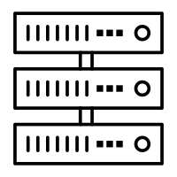







Vision for the National AI Research Resource
A widely-accessible, national research infrastructure that will advance the U.S. AI R&D environment, discovery, and innovation by empowering a diverse set of users through access to:
Secure, high-performance, privacy-preserving computing
  High-quality datasets
Catalogs of testbeds and educational materials
Training tools and user support mechanisms
Goals:
Spur innovation
Increase the diversity of talent in AI
Improve U.S. capacity for AI R&D
Advance trustworthy AI
2
Notes:
Katie will present
A widely-accessible, national cyberinfrastructure that will advance and accelerate the U.S. AI R&D environment and fuel AI discovery and innovation in the United States by empowering a diverse set of users across a range of fields through access to:

Slide 3






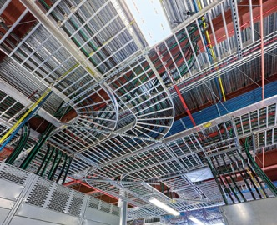

Why do we need a NAIRR?
AI Curriculum Development
Wind Farm
Grid Connection
AI holds potential to solve critical societal and global challenges
Many potential contributors lack access to requisite resources
Researchers investigating AI to serve the public good and to train the next generation of researchers need access to essential resources
Juvenile Justice
Trustworthy AI in Medical Systems
Cardiovascular Disease
Atmospheric Modeling
Neuro-Inspired AI
Security
Power grid
grid infrastructure
Notes:
Katie will present
it is has come up a few people have asked, why do we need a NAIRR, there is lots of computing out there
Resources, large computing and data resources are increasingly concentrated in the the most well resourced companies, universities and and remain inaccessible ….
And now, more than ever it is increasingly important that researchers that are investigating areas societal interest, conducting basic research and doing research for the public good, have the resources necessary to not only conduct their own research but to train the next generation.

Slide 4
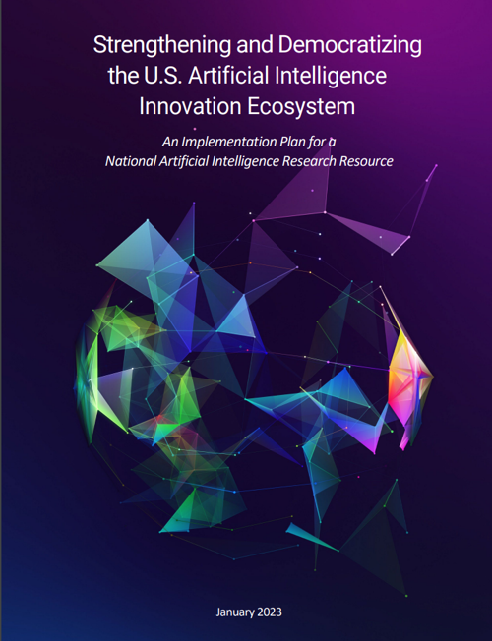
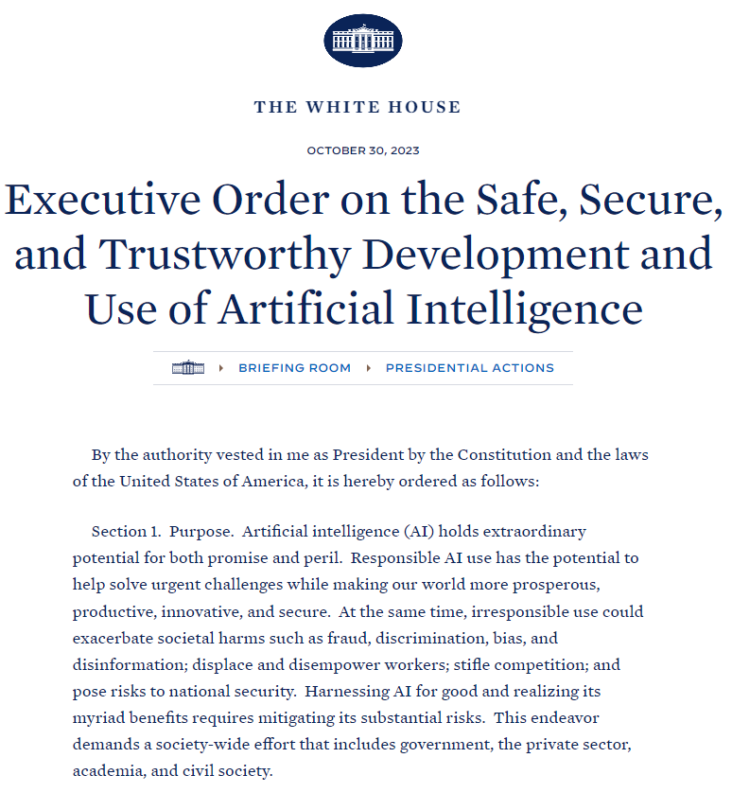
How did we get here?
2020 AI Initiative Act created a congressionally mandated NAIRR Task Force
June 2021 - NAIRR Task Force launched to examine the feasibility of a NAIRR
Jan 2023 - Task Force final report provides implementation plan including optional pilot
March 2023 - NAIRR Interagency Working Group established with 14 agencies - led by OSTP & NSF
October 30, 2023 - President's Executive Order on Trustworthy AI directs NSF and collaborating agencies to launch NAIRR pilot within 90 days
Notes:
Katie will present

Slide 5
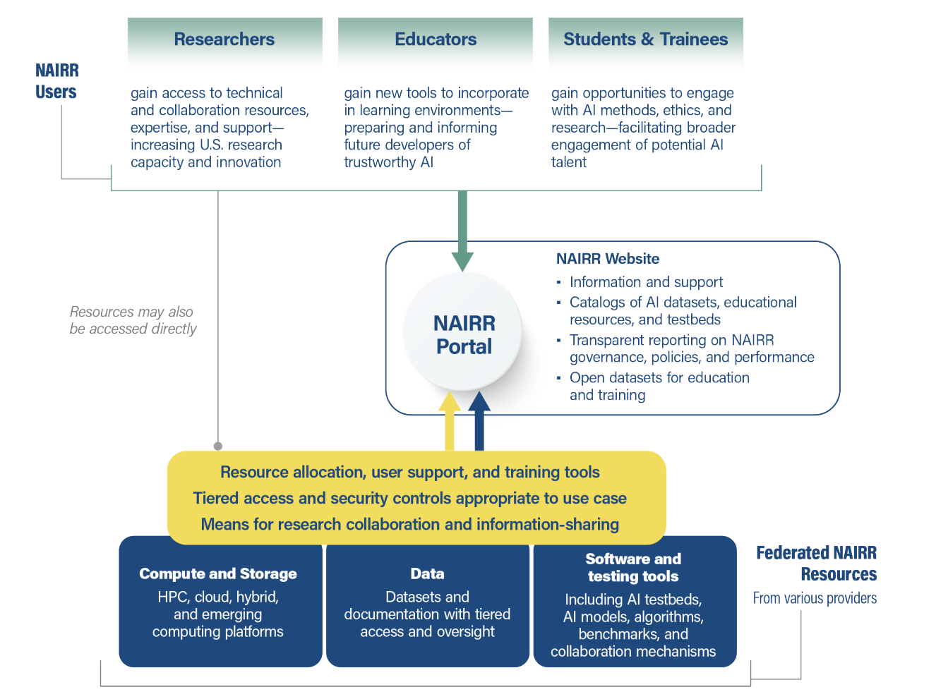
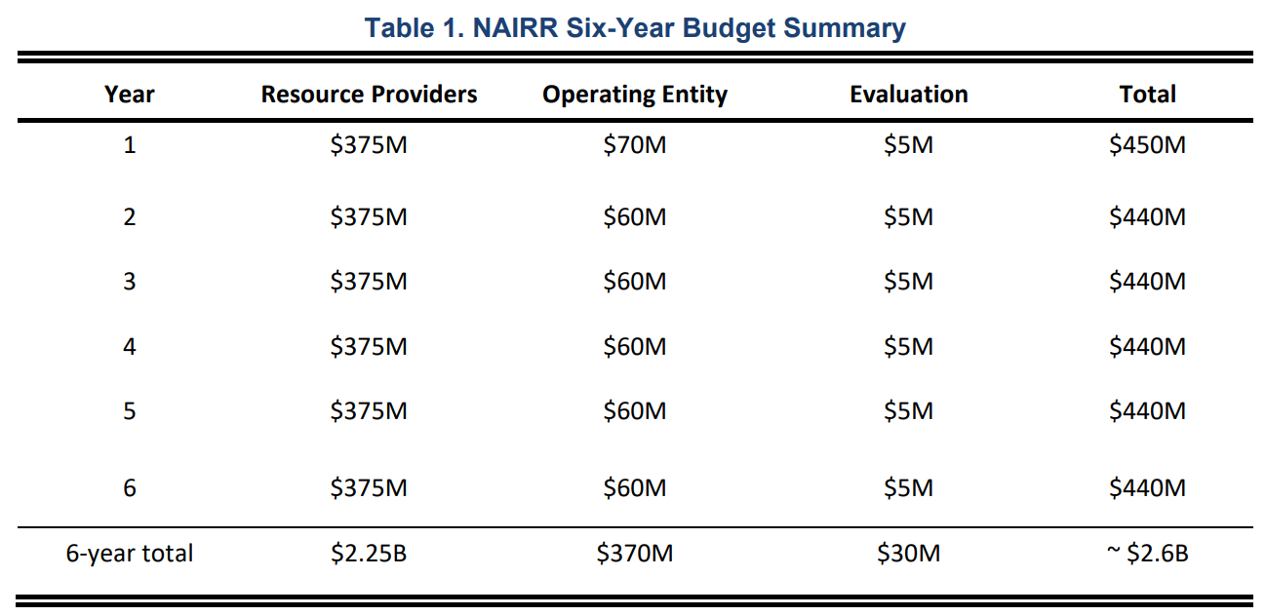
What is the scope and scale of the full NAIRR?
*
* NOTE: only an estimate from the Task Force. No funding has yet been appropriated for NAIRR.
Notes:
Compute and storage.
Datasets and Models
Advanced Testbeds
Secure computing environments
Software, tools, services.
User support and classroom education Resources.
All served through a NAIRR portal
The scope envisioned in the task force report is quite ambitious, with

Slide 6

NAIRR Pilot Goals
  Demonstrate the value & impact of the NAIRR concept.
  Support novel & transformative AI research and education with participation from broad communities.
  Gain initial experience to advance and refine the NAIRR design in preparation for a full NAIRR implementation.
The pilot will demonstrate or investigate all major elements envisioned in the NAIRR, but at a limited scale:
A best effort, proof of concept approach leveraging agency-supported resources and in-kind contributions from industry and non-profits.
Notes:
Katie will present

Slide 7

Launched on January 24th
NSF Site Describing Pilot https://bit.ly/4bedykr
NAIRR Pilot Portal for researcher community nairrpilot.org
  First opportunity to apply for computing resources on NSF and DOE funded systems. Targeting responsible and trustworthy AI research
  Highlight datasets and other AI resources available from federal partners
  RFI – requests priority use cases for NAIRR Pilot from researcher and educator community (Announced via DCL at https://bit.ly/3SvXT8C)
Public and private sector partners announced https://bit.ly/3wpqQu9

Slide 8

  More details about contributions at:
  https://bit.ly/4bedykr ​
Agencies
Non-governmental orgs
US National Science Foundation
Defense Advanced Research Projects Agency
Department of Agriculture
Department of Defense
Department of Energy
Department of Veterans Affairs
National Aeronautics and Space Administration
National Institutes of Health
National Institute of Standards and Technology
National Oceanic and Atmospheric Administration
US Patent and Trade Office (USPTO)
​More Joining! ​
AI2: Allen Institute for AI
AMD
Amazon Web Services
Anthropic
Cerebras
Databricks
Datavant
EleutherAI
Google
Hewlett Packard Enterprise
Hugging Face
IBM
Intel
Meta
Microsoft
MLCommons
NVIDIA
Omidyar Networks
OpenAI
OpenMined
Palantir
Regenstrief Institute
SambaNova Systems
Vocareum
Weights & Biases
More Joining!

Slide 9
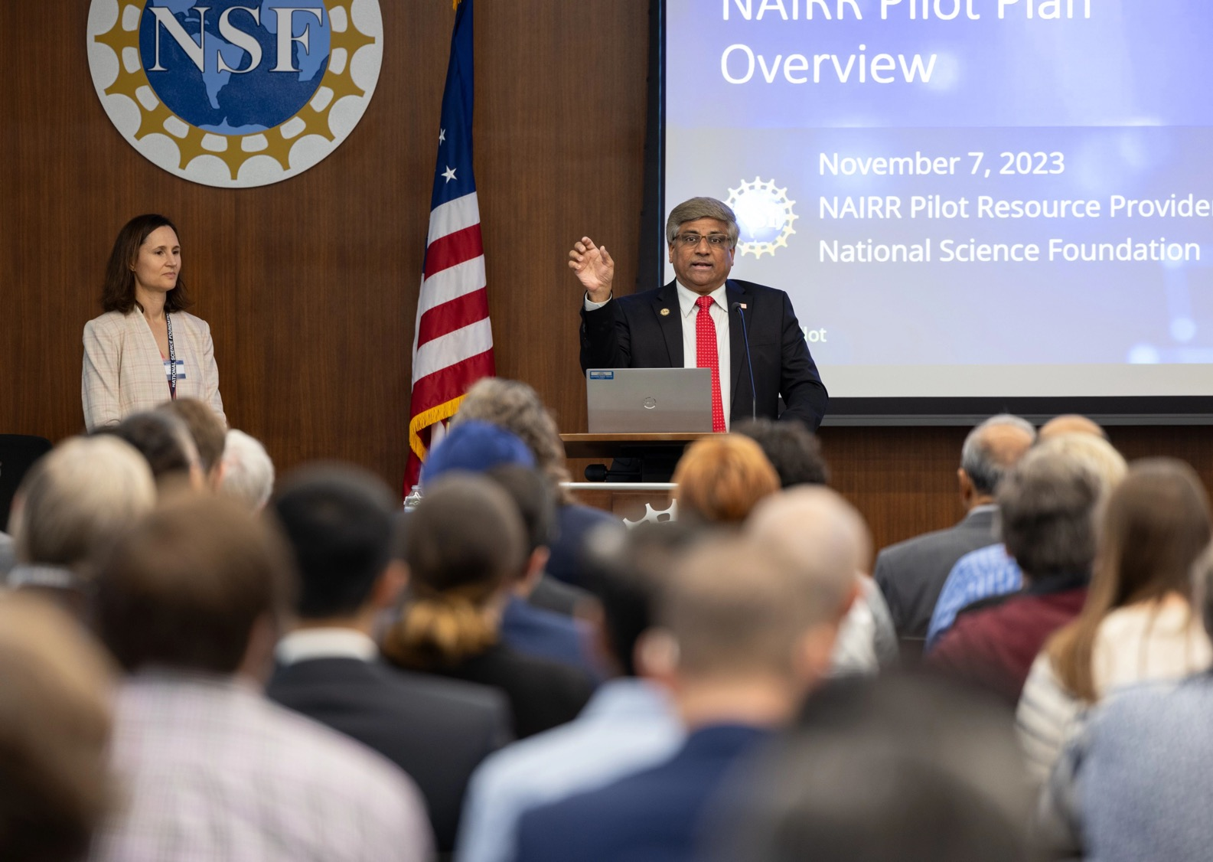
Types of Contributions
Cloud computing credits and access to associated models, data and software platforms
Access to computing hardware, systems and testbeds
Software/platform licenses for NAIRR Pilot users
Open large language models, datasets, software libraries and privacy-enhancing platforms
API access and research collaborations on closed models
Educational platforms ‘notebooks’ for classrooms and students
Enhanced training, expertise and user support.
Notes:
These are coming soon

Slide 10



NAIRR Pilot Users
US-Based Institutions including:
Academic institutions
Non-profits
Federal agencies or federally-funded R&D centers
State, local, or tribal agencies
Startups and small businesses with Federal grants
AI Researchers
Domain Scientists Applying AI
Students and
Educators

Slide 11
Initial priority areas as pilot is scaled
Initial themes will frame the first open calls for proposals and scope activities
Safe, Secure, and Trustworthy AI
  Testing, evaluating, verifying and validating AI systems
  Improve accuracy, validity and reliability of model performance, while controlling bias
  Advance the ability to assure model functionality and align output with human values and safety guardrails
Healthcare
  Cancer treatment
  Individual health outcomes
Environment and infrastructure
  Advance resilience and optimization of agricultural, water, and grid infrastructure
  Address earth, environmental, and climate challenges via integration of diverse data and models
AI Education
  Enable training and education of a cohort of scholars at universities across the country in AI technologies and their responsible use
Notes:
Note that these are not NSF research priorities, just priorities for usage of this government-side resource

Slide 12







NAIRR Pilot Organization
The NAIRR Pilot provides infrastructure and resources; it does not fund end-user research.
User Journey
US-based Researchers, Educators & Students
Portal
https://nairrpilot.org
Pilot Resources and Opportunities
NAIRR
Open
NAIRR
Secure
NAIRR Software
NAIRR Classroom
Governance
Operations
Enable open AI research and access to diverse AI resources via a central portal and coordinated allocations
Enable AI research needing privacy and security-preserving resources. Assemble exemplar privacy preserving resources.
Facilitate use of AI software, platforms, tools and services across platforms
Reach new communities through education, training, user support and outreach
Community Design Process
Notes:
NAIRR Open
Key components and activities
Early user program
NAIRR pilot portal
Integration of diverse resources
NAIRR Secure
Key components and activities
Assemble exemplar privacy/security-preserving resources (e.g., data enclaves, secure compute resources, and privacy preserving tools)
Refine the requirements and infrastructure design patterns for the future NAIRR Secure resources. Integration of diverse resources
Pilot goals:
Investigating new opportunities for combining data in ways that preserve privacy and security.
Investigating challenges and opportunities for interoperability of tools, software & other resources between NAIRR Secure enclaves & NAIRR Open.
Identifying research and training use cases to inform the development of the future NAIRR Secure
NAIRR Software
Explore software landscape for the NAIRR pilot
Investigate open-source options and community domain software
Identify the challenges and approaches to enable interoperability of diverse resources
Pilot Goals
Enable a Beta NAIRR Software Stack
Key activities
Partner with universities to provide AI research resources to students and educators
Provide training and outreach to students and researchers
Pilot Goals
Reach broad communities
Train new users

Slide 13






Computing Resources Available in First Phase
Frontera / Lonestar6
  CPU /GPU Computing Platform
Delta
  Large scale GPU access
Neocortex
  Wafer-scale AI accelerator
Summit
  Large capacity CPU/GPU system
ALCF AI Testbed
  Various Experimental AI Accelerators

Slide 14

What’s next after the launch?
Integrate partner resources
Continue building governance structures, advisory groups and technical working groups
User support and outreach to new communities
Community meetings and technical workshops

Slide 15
Integrating partner contributions into the NAIRR ecosystem
Array of resources
Broad categories
Approaches to utilization
Cloud computing
Advanced computing systems and testbeds
Datasets
Pretrained models
Software and platforms
Training and expertise
Other
"Allocatable" (limited capacity/controlled access) subject to request
advanced computing, cloud credits, model access, licenses, select opportunities for training/engagements,...​
Open and/or accessible without specific request
  open datasets and models, software installed for pilot users, community platforms, training sessions, ...​
Open calls for access to NAIRR allocatable resources: researchers submit requests
Registry of open resources on the NAIRR pilot portal
Demonstration projects to build out novel science pathways between and among resources​.

Slide 16
Scaling the NAIRR Pilot
Pilot Launch
Jan. 24, 2024
Enhanced Pilot
Spring 2024
NAIRR Pilot Portal goes live
Call for access to NSF and DOE high performance computing systems targeting responsible and trustworthy AI research
Initial datasets available from agencies and partners
RFI Survey of Researcher and Educator use cases
Projects supported ~25-50
Integrating industry and agency partner resources
Future calls for access to resources with targeted topics
Enhanced user functionality
Projects supported: ~100-300

Slide 17
Support NAIRR Pilot users and outreach to new communities
Build out support and community for NAIRR pilot users
Outreach to new communities, working through consortia, state and regional networks
Pilot classroom resource support targeting rural and underserved institutions

Slide 18

Engaging Communities
Community engagement is critically important in this fast-moving field!
In planning:
Joint agency workshop on Trustworthy AI
NAIRR Software: Joint agency workshop on NAIRR Pilot software stack
NAIRR Classroom: Outreach and pilot resources for researchers, educators, students, and underserved institutions
External webinar (NEXT week)
NAIRR Pilot (Public) Webinar
Wednesday February 21
3:00-4:30PM Eastern
NSF Event page:
https://bit.ly/3OOmTpl
Subscribe to the NAIRR pilot announcement list to receive updates:
send a blank email to nairr_pilot_announcements-subscribe-request@listserv.nsf.gov

Slide 19













The NSF NAIRR Pilot Team
Katie Antypas
Office Director
Office of Advanced Cyberinfrastructure
Amy Walton
Deputy Office Director
Office of Advanced Cyberinfrastructure
William Miller
Senior Advisor
Office of Advanced Cyberinfrastructure
Tess deBlanc-Knowles
Special Assistant to the Director for Artificial Intelligence
Varun Chandola
Program Director
Office of Advanced Cyberinfrastructure
Dan Bullock
AAAS Fellow
Office of Advanced Cyberinfrastructure
Sharon Geva
Program Director
Office of Advanced Cyberinfrastructure
Alajandro Suarez
Program Director
Office of Advanced Cyberinfrastructure
Marlon Pierce
Program Director
Office of Advanced Cyberinfrastructure
Maria Fernanda Pembleton
Communications Specialist
CISE Directorate
Sheikh Ghafoor
Program Director
Office of Advanced Cyberinfrastructure
Juan (Jen) Li
Program Director
Office of Advanced Cyberinfrastructure

Slide 20
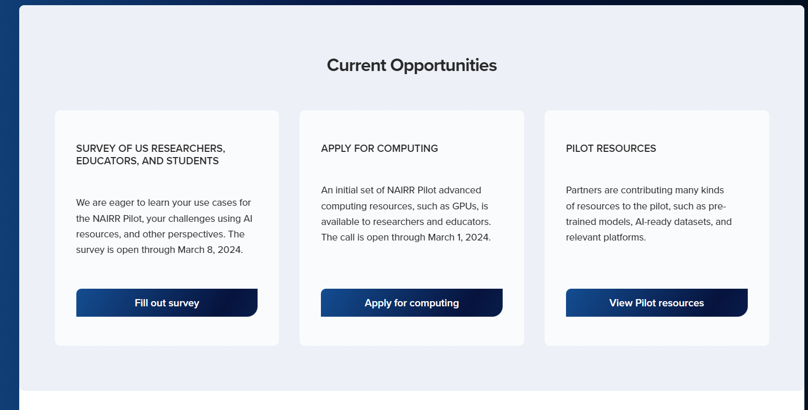
Built by SGX3
https://nairrpilot.org/
Portal
Powered by XRAS

Slide 21

NAIRR Pilot resources are available today with a broader opportunity for the community in late March.
Available to research community today:
Access to high performance computing systems and testbed architectures from DOE and NSF
Select datasets from agency partners
Available in late March
2nd open opportunity to access resources
Wider range of capabilities, including cloud computing, API access to trained models, community platforms and collaboration opportunities
Portal
https://nairrpilot.org/
Built by SGX3

Slide 22


Survey
Deadline 5:00 PM ET on March 8, 2024
Encourages responses from researchers, educators and students
Barriers, challenges, and priorities for accessing and using AI resources and tools.
Results will guide the NAIRR pilot, eventually full NAIRR and other investments.
https://bit.ly/3SvXT8C

Slide 23
For Discussion: How to get involved
How could your research communities’ AI infrastructure needs be served by the NAIRR pilot?
How could your programs’ resources integrate into the Pilot?
  e.g. AI-ready datasets, trained models, research platforms, educational materials
How could the Pilot leverage NSF expertise or currently funded programs?
Send us your throughs at NAIRR_Pilot@nsf.gov
Notes:
NSF is exploring processes to equitably assess and integrate resources into the Pilot, including from NSF-funded programs.
Right now there is no money involved
Mechanisms could include:
Requesting supplemental funding requests from existing resources to integrate into NAIRR Pilot offerings
Identifying demonstration projects that could use NAIRR Pilot resources for the benefit of their research
Calling out NAIRR Pilot Resources as available in future solicitations
Initiating governance mechanisms through an interim coordinating entity
Including

Slide 24
Questions and Discussion

Slide 25
NAIRR Pilot Survey of Educator and Researcher Use Cases
https://bit.ly/3SvXT8C

Slide 26
Initial NAIRR Pilot Components and Operations
Pilot Users
Community Design Process
Pilot Governance
NAIRR Pilot will provide infrastructure to researchers. The NAIRR Pilot will not fund end-user research.
NAIRR Pilot Portal
Computing, testbeds, datasets, models, software, user support, training materials

Slide 27

Focus areas to organize the NAIRR Pilot effort
NAIRR
Open
NAIRR
Secure
NAIRR Software
NAIRR Classroom
Enable open AI research and access to diverse AI resources via a central portal and coordinated allocations
Enable AI research needing privacy and security-preserving resources. Assemble exemplar privacy preserving resources.
Facilitate use of AI software, platforms, tools and services across platforms
Reach new communities through education, training, user support and outreach
Notes:
NAIRR Open
Key components and activities
Early user program
NAIRR pilot portal
Integration of diverse resources
NAIRR Secure
Key components and activities
Assemble exemplar privacy/security-preserving resources (e.g., data enclaves, secure compute resources, and privacy preserving tools)
Refine the requirements and infrastructure design patterns for the future NAIRR Secure resources. Integration of diverse resources
Pilot goals:
Investigating new opportunities for combining data in ways that preserve privacy and security.
Investigating challenges and opportunities for interoperability of tools, software & other resources between NAIRR Secure enclaves & NAIRR Open.
Identifying research and training use cases to inform the development of the future NAIRR Secure
NAIRR Software
Explore software landscape for the NAIRR pilot
Investigate open-source options and community domain software
Identify the challenges and approaches to enable interoperability of diverse resources
Pilot Goals
Enable a Beta NAIRR Software Stack
Key activities
Partner with universities to provide AI research resources to students and educators
Provide training and outreach to students and researchers
Pilot Goals
Reach broad communities
Train new users

Slide 28
Near-term NAIRR Pilot Timeline
AI Executive Order Released Oct 30, 2023
Within 90 days NSF will in coordination with other agencies, launch a pilot program implementing the NAIRR
Next opportunity to apply for NAIRR Pilot resources with additional capabilities
Pilot Launch Jan 24, 2024
Finalize leading industry/non-profit partner contributions
Integrate govt, industry and non-profit partner contributions
Fall 2023
Winter 2024
Spring 2024
Evolve to tighter governance, integration and allocations model over the two-year pilot

Slide 29

Integrate partner contributions
Cloud computing
Open opportunity for researchers to access Pilot resources in spring 2024 timeframe
Research community submits requests for access to a menu of computing, data, software, platform resources and partnership opportunities
Advanced computing systems and testbeds
Datasets
Build and demonstrate pathways between resources
Models
Software/Platforms
Training/expertise
Other

Slide 30
Pilot Launch January 24th
NAIRR Pilot .gov site goes live (https://new.nsf.gov/focus-areas/artificial-intelligence/nairr)
NAIRR Pilot Portal goes live (where researchers go for access nairrpilot.org)
  First opportunity to apply for resources on NSF and DOE high performance computing systems targeting responsible and trustworthy AI research
  Initial datasets available from agencies and partners
  RFI – requests priority use cases for NAIRR Pilot from researcher and educator community
Partners are announced
This earliest phase of the project expected to support: 25-50 project

