Slide 1

EducateAI
Improving Undergraduate STEM Education: Computing in Undergraduate Education (IUSE: CUE)
National AI Research Resource (NAIRR) Pilot Classroom
Directorates for:
Computer and Information Science and Engineering (CISE)
STEM Education (EDU)

Slide 2
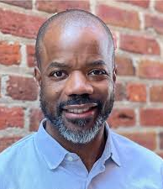


Today’s Presenters
Jeff Forbes
(CISE/CCF)
jforbes@nsf.gov
Allyson Kennedy
(CISE/CCF)​
aykenned@nsf.gov
Katie Antypas
(CISE/OAC)
kantypas@nsf.gov

Slide 3

EducateAI
PHASE 1:
EducateAI DCL (24-025)
Invites submission of proposals that advance inclusive AI education for 2-year and 4-year college students through IUSE: CUE
EducateAI enables educators to make state-of-the-art, inclusive artificial intelligence educational experiences available nationwide to K-12, community college, four-year college and graduate students, as well as adults interested in formal training in AI.
Notes:
The EducateAI Dear Colleague Letter (24-025) seeks to support:
Professional learning opportunities & communities;
Inclusive AI educational resources (curricula, tools, data sources, assessments, etc)
Educational infrastructure needed to support AI education across institutions;
and build upon/contribute to:
Research on broadening participation to better understand and inform efforts to support students from groups historically underrepresented in computing; and
Research and development needed to make state-of the art, inclusive AI education available to all students in preK-12 schools, 2-year colleges, and 4-year colleges and universities.
Proposals may also address data science skills and practices relevant to AI careers

Slide 4
EducateAI Goals
EducateAI DCL seeks to support:
  professional learning opportunities & communities
  inclusive AI educational resources (curricula, tools, data sources, assessments, etc.)
  educational infrastructure needed to support AI education across institutions;
and build upon/contribute to
  research on broadening participation to better understand and inform efforts to support students from groups historically underrepresented in computing
  research and development needed to make state-of-the-art, inclusive AI education available to all students in preK-12 schools, 2-year colleges, and 4-year colleges and universities.

Slide 5
EducateAI Goals 2
Incorporate AI material into computing courses to
  enable students to progress in AI education pathways
  are responsive to the quickly changing needs of the AI workforce
  aim to broaden participation in the AI workforce
Proposals may
  Incorporate perspectives of stakeholders such as AI subject matter experts, industry professionals, and educators in formal and or informal settings
  Address data science skills and practices relevant to AI careers
  Connect to existing National AI Research Institutes and other NSF-funded AI research projects

Slide 6
Goals of IUSE: CUE program

Slide 7
Overall goal of the IUSE: CUE program
Re-envision how to teach computing effectively in a scalable manner focusing on those undergraduate students from groups underserved by traditional computing courses and careers

Slide 8
CUE proposal tracks
Transformation
  Addressing key challenges in undergraduate education (CS+X, updating courses, holistic degree support, inclusive online teaching)
Pathways
  Effective pathways involving 2-year colleges (entry points, transitions)
Mobilize
  Developing a national vision through convening the CISE community

Slide 9
CUE Transformation proposals address key challenges in undergraduate education
Make a substantial regional or national impact on some aspect of computing pathways
Innovative ideas in computing education
  new approaches and action
  produce fundamental, structural change
  go outside of or beyond existing norms and principles

Slide 10
CUE Pathways proposals support and explore effective pathways to computing degrees and careers involving two-year colleges
Must include a two-year college as part of the partnership
Encourage synergistic partnerships with industry

Slide 11
CUE Mobilize proposals will develop a shared national vision around innovation and inclusion in undergraduate computing education
Curricular supports in key areas
Transformation across institutions
Development of a common, scalable educational infrastructure

Slide 12
Who can apply?
Proposals may be submitted by:
  Institutions of Higher Education
  Non-profit, non-academic organizations
  For-profit organizations
  State and Local Governments
Transformation and Pathways proposals must
  Have an impact across multiple institutions
  Include a multi-institutional partnership, with a lead IHE and at least two other IHEs or other organizations

Slide 13
NAIRR Classroom

Slide 14








Vision for the National AI Research Resource
A widely-accessible, national research infrastructure that will advance the U.S. AI R&D environment, discovery, and innovation by empowering a diverse set of users through access to:
Secure, high-performance, privacy-preserving computing
  High-quality datasets
Catalogs of testbeds and educational materials
Training tools and user support mechanisms
Goals:
Spur innovation
Increase the diversity of talent in AI
Improve U.S. capacity for AI R&D
Advance trustworthy AI
14
Notes:
A widely-accessible, national cyberinfrastructure that will advance and accelerate the U.S. AI R&D environment and fuel AI discovery and innovation in the United States by empowering a diverse set of users across a range of fields through access to:

Slide 15

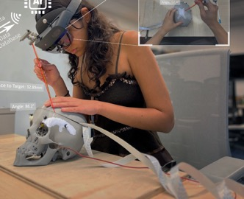




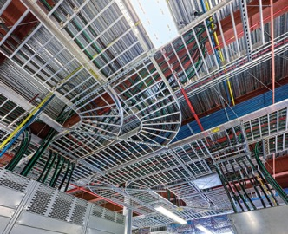

Why do we need a NAIRR?
AI Curriculum Development
Wind Farm
Grid Connection
Many potential contributors lack access to requisite resources which can be costly as well as hard to navigate
Researchers investigating AI to serve the public good require access to resources
To train the next generation of researchers and AI leaders
Juvenile Justice
Trustworthy AI in Medical Systems
Cardiovascular Disease
Atmospheric Modeling
Neuro-Inspired AI
Security
Power grid
infrastructure

Slide 16



NAIRR Pilot Users
US-Based Institutions including:
Academic institutions
Non-profits
Federal agencies or federally-funded R&D centers
State, local, or tribal agencies
Startups and small businesses with Federal grants
AI Researchers
Domain Scientists Applying AI
Students and
Educators

Slide 17






Initial NAIRR Pilot Architecture
US-based Researchers, Educators & Students
Note, NAIRR Pilot will provide infrastructure to researchers. The NAIRR Pilot will not fund end-user research.
Pilot Governance
Community Design Process
Portal
Computing, testbeds, datasets, models, software, user support, training

Slide 18

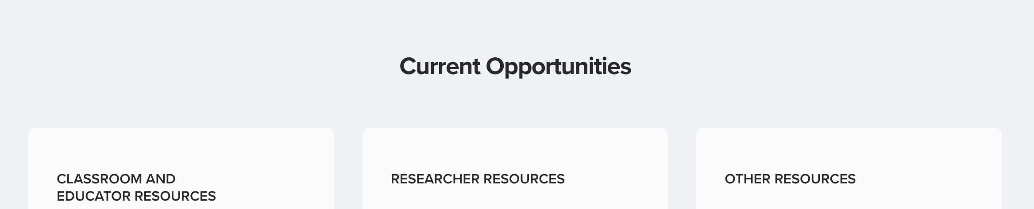

Apply for resources at nairrpilot.org (Opened May 6!)
https://nairrpilot.org/
Portal
Built by SGX3
Initial datasets and trainings opportunities
Educators
Researchers
Notes:
One highlight since our last all-hands was the launch of the National AI Research Resource pilot.
NAIRR will be a widely accessible, national infrastructure for AI research
It will provide access to computing, datasets, testbeds, and educational materials.
Pilot launched a couple weeks ago providing some initial offerings of computing and datasets
This effort aligns with
Strengthening research infrastructure obviously
Emerging industries – driving innovation in AI and innovation from AI
Opportunities Everywhere – a central goal is to democratize access to state-of-the art research infrastructure

Slide 19
Applying is simple for educators
https://nairrpilot.org/opportunities/education-call
Currently there are 2 resources:
Vocareum notebooks
  (integrates with learning management systems, NAIRR pilot provided GPUs not yet integrated)
National Research Platform Juypter notebooks
  Simple Juypter notebooks, some GPUs integrated
To Apply:
Need course/training description and draft syllabus
Number of students
Estimate of computing/storage needs

Slide 20


EducateAI and NAIRR Classroom
NAIRR Classroom
Educator Resources
Interactive notebooks: integrated hardware and software environments
Two ways to look at opportunity
Opportunity for educators who need computing, data, software, AI resources
Also an opportunity for PIs with infrastructure to provide it to the education community in a novel way
(Not an opportunity to augment computing/data infrastructure)
Notes:
Another recently announced effort is EducateAI.
This is an effort to support educators in making high-quality, audience-appropriate AI educational experiences available nationwide.
This was announced as part of CS Education Week on December 5.
As a first step, we released a DCL calling for proposals to our CSforAll and Computing in Undergraduate Education programs.
Aligns with
Advancing emerging industries and creating opportunities everywhere
As well as strengthening research infrastructure, as our intention is to leverage the NAIRR effort to make AI research resources available for education and training activities.

Slide 21
Proposal preparation

Slide 22

The Proposal & Award Policies & Procedures Guide (version 24-1)
Provides proposal preparation and submission guidance
Describes review process and criteria
Outlines why a proposal may not be accepted or returned without review
Describes process for withdrawals, returns, and declinations
Policies to guide, manage, and monitor NSF awards
Updates for 2024:
  *Need for mentoring plan for postdoctoral researchers or graduate students
  *Changes to biographical sketches

Slide 23
Project Description: Merit review criteria
Intellectual Merit: the potential to advance knowledge​
Broader Impacts: the potential to benefit society and contribute to the achievement of specific societal outcomes​
Solicitation Specific Criteria:
    Does the proposal identify the characteristics and needs of the intended population(s) to be served?​
    Does the proposal include specific plans or strategies for addressing or accommodating the particular needs of participants of the intended populations?​

Slide 24
Key Components of CUE Proposals 1
Knowledge Base
Work is grounded in relevant literature and prior work
Evaluation Plan
Independent evaluator
Description of expertise and relation to project goals/objectives
Reporting and use of results

Slide 25
Key Components of CUE Proposals 2
Relevant Research Questions
Aligned with research plan, project activities, and expected outcomes
Answerable through data generated by activities
Dissemination Plan
Identify appropriate channels of dissemination
Must use Creative Commons licensing for new materials

Slide 26
Key Components of CUE Proposals 3
Sustainability
Consider sustainability of activities after funding
Design of hardware/software

Slide 27
Key Components of CUE Proposals 4
Collaboration Plan:
Description of partnership, relevant characteristics of members, and specific roles
Initial statement of common goals and examples of possible common metrics
Plans for communication and convenings of members
Descriptions of any management and administrative structures
Methods that will be used in assessing/evaluating the success of the collaboration
Specific references to the budget line items that support collaboration and coordination mechanisms

Slide 28
Important Dates
IUSE: CUE Solicitation (NSF 24-553):
  https://new.nsf.gov/funding/opportunities/improving-undergraduate-stem-education-computing
Next deadline: May 30, 2024, 5 pm local submitter's time
Future deadlines:
  April 29, 2025
  Last Tuesday in March, thereafter

Slide 29
















NSF Review Process Timeline
NSF
Announces Opportunity
Can be returned without review/withdrawn
Research & Education Communities
Submit
Division of Grants & Agreements
Award
Research.GOV
Ad Hoc
NSF Program Officer
Panel
Program Officer Analysis &
Division Director
Combination
Recommendations
Concurrence
Internal
Decline
Organization
Proposal Receipt
DD Concur
90 Days
6 Months
30 Days
Award
Proposal Preparation
Proposal Receipt to DD Concurrence of PO Recommendation
DGA Review & Processing
Notes:
When can you expect to hear the results of the review?

Slide 30
Questions?

