Slide 1
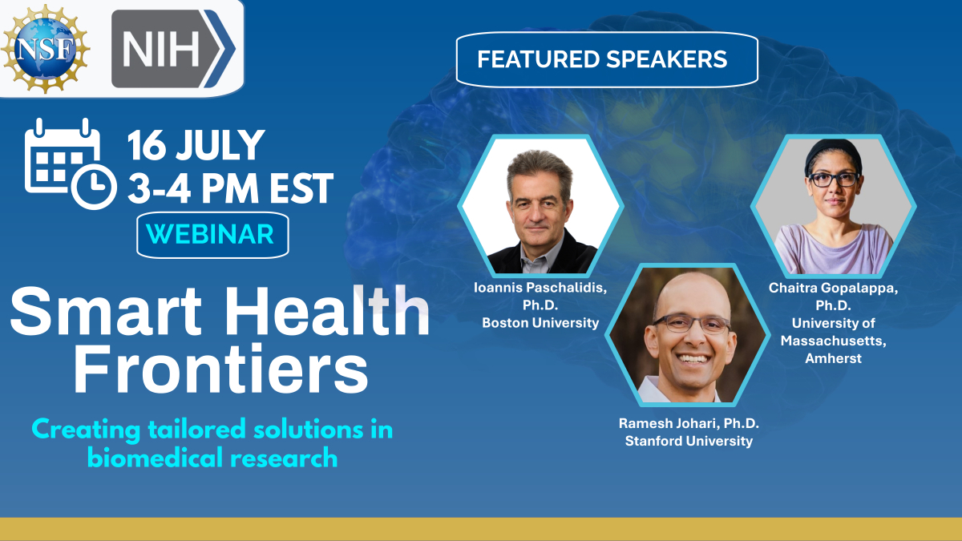
Featured Speakers

Slide 2
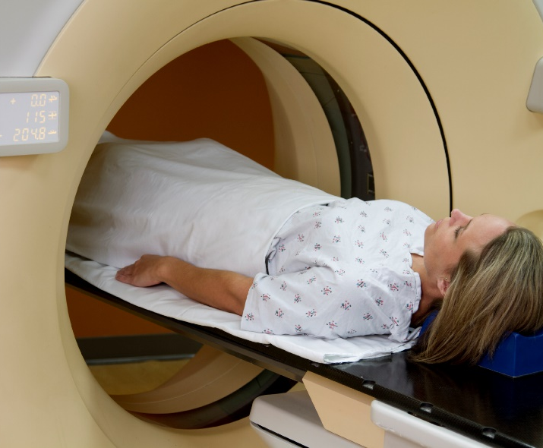
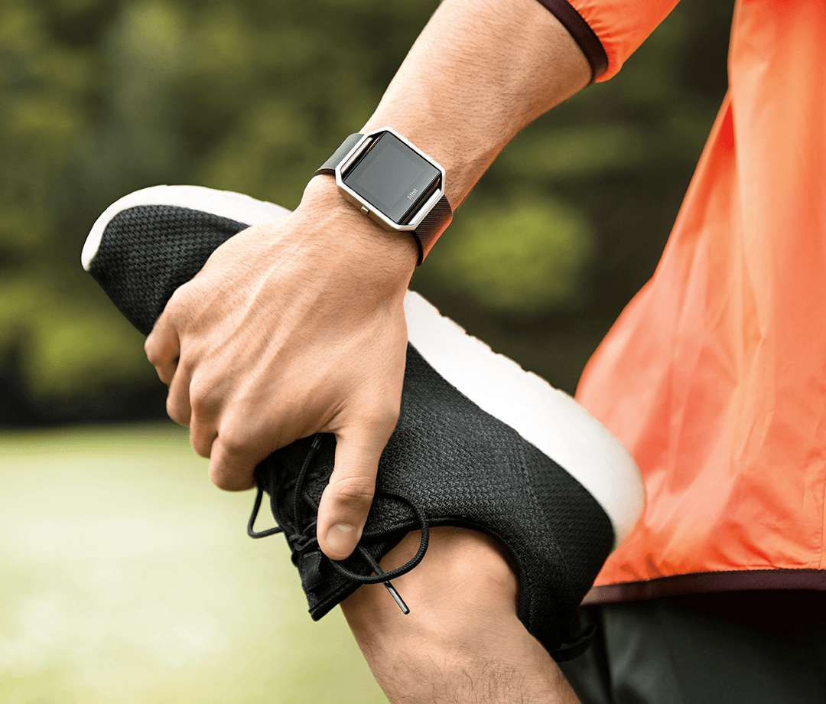

Smart Health
User-inspired Basic Research
Transformative opportunities through fundamental scientific advances while targeting a key health problem.

Slide 3
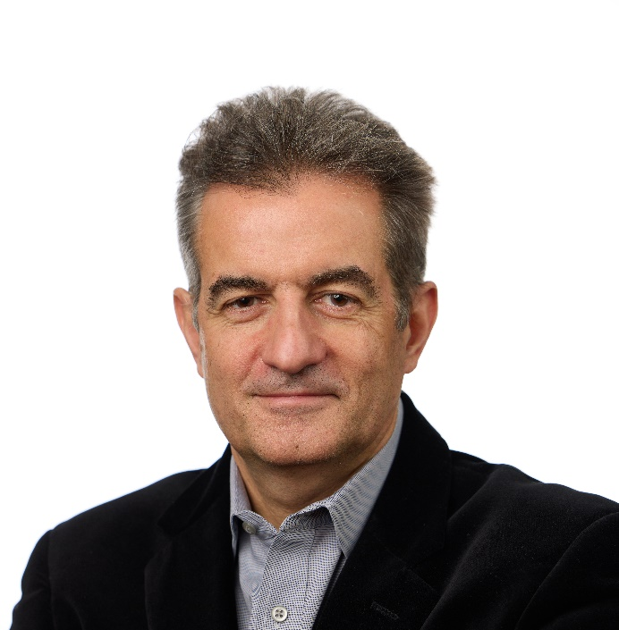

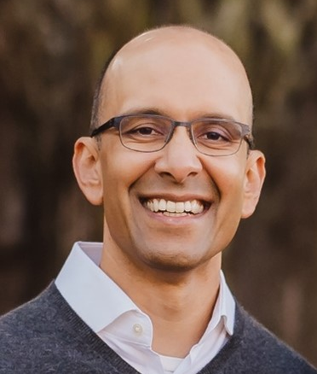
Images of speakers
Yannis Paschalidis, PhD
Professor
Boston University
Chaitra Gopalappa, PhD
Associate Professor
University of Massachusetts, Amherst
Ramesh Johari, PhD
Professor
Stanford University

Slide 4


Predictive Models of Pregnancy and Health Conditions Associated with Infertility
Yannis Paschalidis yannisp@bu.edu, http://sites.bu.edu/paschalidis/
Department of Electrical and Computer Engineering, Division of Systems Engineering,
Department of Biomedical Engineering,
Faculty of Computing & Data Sciences, and
Hariri Institute for Computing and Computational Science & Engineering Boston University
July 16, 2024
NSF Smart Health Frontiers Symposium

Slide 5

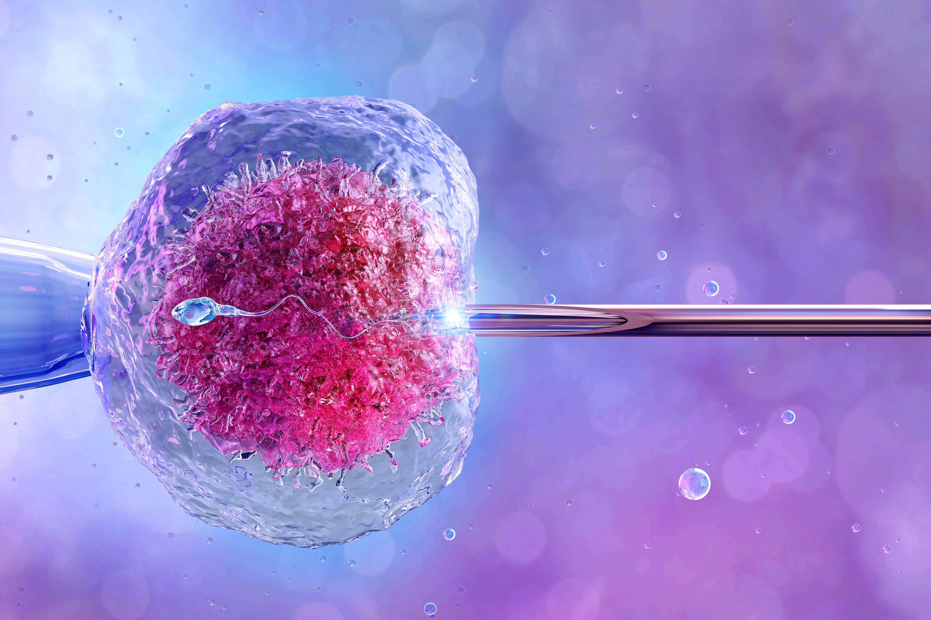

Accelerating challenges for family planning
Average age of first mothers in the U.S.: 21.4 years (1970) ⇒ 27.3 years (2021).
Probability of conceiving (naturally) after 3 cycles: 58% (at 23 yrs)
⇒ 14% (at 40 yrs).
Infertility and subfertility affecting 15% of couples in the U.S. About 12% of women and 9.4% of men use infertility services.
Assisted Reproductive Technologies (ART) (e.g., IVF) lead to pregnancy with a 33% probability. Cost of an IVF cycle: $15K –
$30K. Variable insurance coverage creates disparities.
Polycystic Ovary Syndrome (PCOS) affects 15% of women and is the leading cause of ovulatory infertility, also causing long-term health issues at a cost of $4.37 billion annually in the U.S.
AI for Fertility: Intro

Slide 6


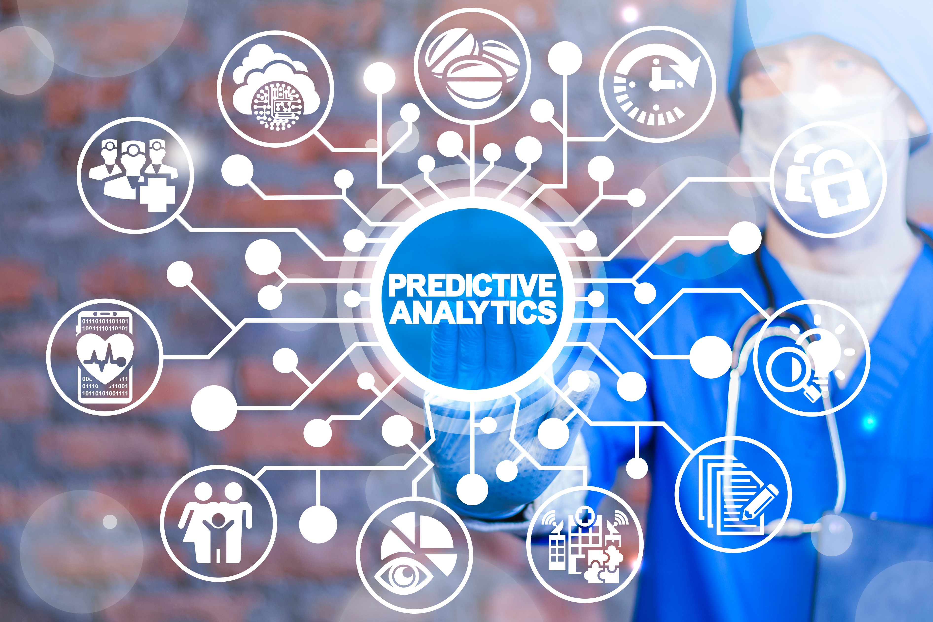
What can we (NSF SCH community) do to help?
Intro Pregnancy IVF PCOS DRL End Motivation Scope
Leverage streams of data and unleash the power of AI/ML algorithms to develop predictive analytics.
3/12
AI for Fertility: Intro

Slide 7
What can we (NSF SCH community) do to help?
Intro Pregnancy IVF PCOS DRL End Motivation Scope
Leverage streams of data and unleash the power of AI/ML algorithms to develop predictive analytics.
Models:
1
Predicting pregnancy outcomes. Enhances family planning and elucidates important factors affecting fecundability.
Predicting IVF outcomes. Enhances planning and financial decision-making when seeking ART treatment.
Predicting PCOS. Helps to discover many undiagnosed cases to enable
early intervention and addressing long-term health risks.
2
3
3/12
AI for Fertility: Intro

Slide 8


Pregnancy Study Online (PRESTO)
PRESTO, a web-based preconception cohort study of women aged 21–45 in the U.S. and Canada, actively trying to conceive and not using ART (led by Lauren Wise).
Online questionnaire at enrollment and every 2 months for up to 12 months or until getting pregnant. Opportunity for male partners to participate.
N = 4, 133 and 163 predictive variables: Sociodemographic factors, lifestyle and behavioral factors, dietary factors, medical history, and selected male partner characteristics.
Earlier work in the mold of epidemiological research, looking at one factor at a time.
Intro Pregnancy IVF PCOS DRL End
Data Models
AI for Fertility: Pregnancy

Slide 9
Predictive models ¹
Intro Pregnancy IVF PCOS DRL End
Data Models
Model I (Pregnancy within 6 months) & Model II (Pregnancy within 12 months)
Model I Model II
AUC F1-weighted AUC F1-weighted Full Model 70.5% (1.2%) 82.0% (0.5%) 65.9% (1.3%) 67.1% (1.4%)
Sparse/Robust Model 71.2% (1.0%) 82.0% (0.6%) 67.1% (1.5%) 67.7% (0.3%)
Key predictors of pregnancy within 12 cycles
Variable | β | p-value | Y1-mean | Y0-mean
Menstrual cycle length (days) | 0.27 | 3.72E-03 | 29.7 | 28.7
Female age at baseline (years) | -0.26 | 4.13E-04 | 29.7 | 30.6
Rural area (ref = urbanized area) | 0.25 | 9.96E-03 | 0.05 | 0.01
Previously tried to conceive for ≥ 12 months: “yes” (ref = “no”) | -0.24 | 1.12E-07 | 0.04 | 0.10
One menstrual cycle of attempt time at study entry (ref = 0) | -0.23 | 5.04E-05 | 0.56 | 0.68
Daily use of multivitamins/folic acid | 0.22 | 2.02E-09 | 0.85 | 0.73
Last method of contraception: hormonal IUD | 0.19 | 1.21E-02 | 0.12 | 0.07
Female BMI (kg/m²) | -0.19 | 1.05E-05 | 26.3 | 28.4
Ever breastfed an infant | 0.18 | 1.64E-04 | 0.32 | 0.22
¹Yland, Wang, Zad, ..., Wise, ICP, Human Reproduction, 2021, (“Tweetutorial” by ESHRE – 1K tweets, 1M impressions).
AI for Fertility: Pregnancy

Slide 10

IVF dataset
Intro Pregnancy IVF PCOS DRL End
Data Models
Multiple IVF clinics using eIVF platform from MA, NY, CA; records during 2001–2018.
N = 22, 413 first autologous oocyte IVF cycles. Variables: demographics, BMI, oocyte & embryo, sperm characteristics, lifestyle, hormones, medical diagnoses.
Outcome to predict: pregnancy after the 1st IVF cycle.
Existing models use basic demographics and medical history but not in-cycle information (e.g., peak estradiol levels, oocytes retrieved, etc.).
AI for Fertility: IVF

Slide 11
Predictive models ²
Key predictors
Intro Pregnancy IVF PCOS DRL End
Data Models
Variable | β | p-value | Y1-mean | Y0-mean
Age 42+ | -0.314 | < 0.001 | 0.02 | 0.07
No. of cryo-preserved embryos | 0.256 | < 0.001 | 2.33 | 1.29
Age 41–42 | -0.248 | < 0.001 | 0.05 | 0.11
Age 38–40 | -0.172 | < 0.001 | 0.16 | 0.21
Count of transferred Embryos | 0.156 | < 0.001 | 1.89 | 1.94
Max Estradiol | 0.1 | < 0.001 | 1.89 | 1.94
Diagnosis of Unexplained Infertility | 0.090 | < 0.001 | 0.17 | 0.14
Race White/Caucasian | 0.089 | < 0.001 | 0.22 | 0.18
Age 35–37 | -0.077 | 0.048 | 0.23 | 0.22
Currently Exercise | 0.072 | < 0.001 | 0.31 | 0.25
Diagnosis of Tubal Disease | -0.071 | 0.007 | 0.04 | 0.04
No. of retrieved oocytes | 0.057 | < 0.001 | 12.74 | 10.37
Sperm concentration | 0.047 | < 0.001 | 28.53 | 27.04
Sperm volume | 0.038 | < 0.001 | 1.27 | 1.17
Race Black/African American | -0.036 | 0.013 | 0.01 | 0.01
Model performance
AUC
Linear/Robust
66.3% (0.8%)
Nonlinear (XGBoost)
67.8% (1%)
²Xu, ..., ICP, Mahalingaiah, Scientific Reports, 2022.
AI for Fertility: IVF

Slide 12
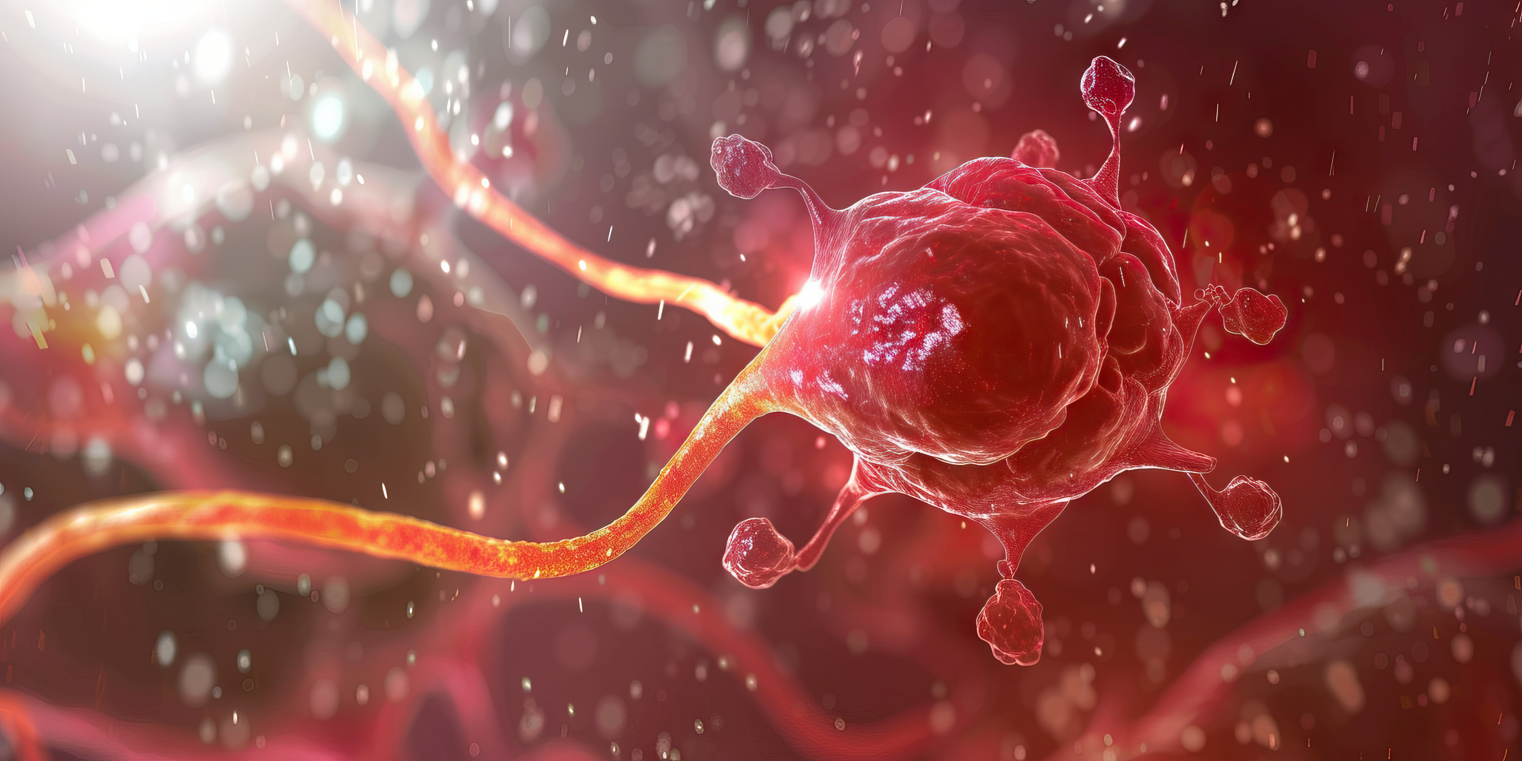

PCOS dataset
Intro Pregnancy IVF PCOS DRL End
Data Models
PCOS dataset
Electronic Health Records (EHR) from Boston Medical Center (BMC).
N = 30, 601 women, 18–45 years of age, 2003–2016. 51 predictive variables: Socioeconomic, lifestyle, demographic variables, anthropometrics, cardiovascular health, and reproductive endocrine variables.
Outcome: Patients who have Irregular Menses (IM) and hyperandrogenism (HA) who were not checked for polycystic ovarian morphology (PCOM) and should have a PCOS diagnosis (Rotterdam criteria – underdiagnosed patients).
Existing models focusing more on the development of PCOS, rather than helping identify undiagnosed cases.
AI for Fertility: PCOS

Slide 13
Predictive models ³
Intro Pregnancy IVF PCOS DRL End
Data Models
Key predictors
Variables β p-value Y1-mean Y0-mean
MLP Score 0.60 < 0.001 0.10 0.04
Model performance
AUC
Age | -0.25 | < 0.001 | 31.16 | 33.79
Gravidity | -0.24 | < 0.001 | 1.46 | 2.08
Nonlinear (GBM) Linear/Robust | 79.8% (0.1%) 72.9% (2.1%) | Positive beta human chorionic gonadotropin (bHCG) level | -0.20 | < 0.001 | 0.11 | 0.23
Linear/Robust |  | Obesity | 0.19 | < 0.001 | 0.34 | 0.27
with MLP hormone score | 77.4% (1.6%) | Normal BP | 0.17 | < 0.001 | 0.60 | 0.51
 |  | Hispanic/Latina Race | -0.15 | 0.002 | 0.06 | 0.10
 |  | Normal BMI | 0.14 | < 0.001 | 0.33 | 0.26
ML
P score: combining 4 hormone levels Black/African American Race 0.13 0.002 0.46 0.40
using a neural network. | Negative beta human chorionic
 | gonadotropin (bHCG) level | 0.12 | < 0.001 | 0.37 | 0.23
 | High Density Lipoprotein HDL | 0.09 | < 0.001 | 52.04 | 51.59
³Zad, ..., ICP, Mahalingaiah, Frontiers in Endocrin | ology, 2024.
AI for Fertility: PCOS

Slide 14

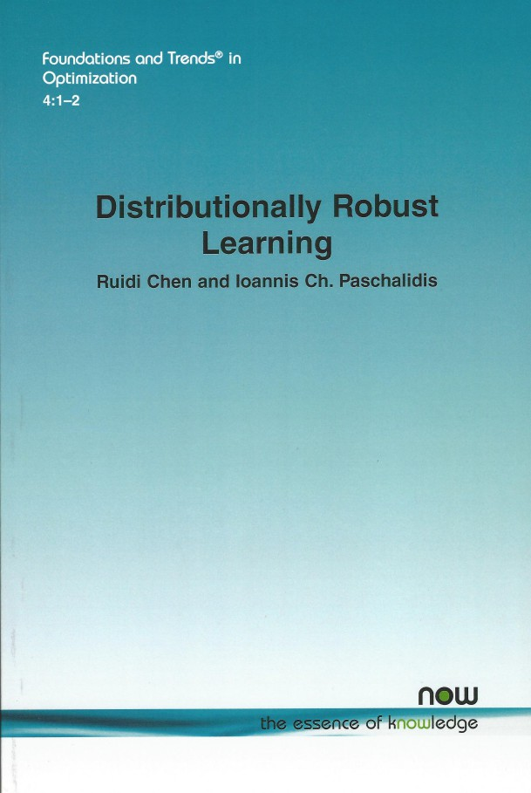
Challenges with medical data
Intro Pregnancy IVF PCOS DRL End
Feature Selection DRL
Large number of predictive variables. Need to avoid overfitting and optimize out-of-sample performance.
Interpretability: sparse, linear models.
Observation: with proper feature selection (through statistics, optimization) linear models can do as well as much more complex nonlinear and non-interpretable models.
Presence of outliers (missing values, errors, domain misalignment). Need for robustness!
AI for Fertility: DRL

Slide 15
Distributionally Robust Learning
Intro Pregnancy IVF PCOS DRL End
Feature Selection DRL
Distributionally Robust Learning ⁴
Minimize the worst-case loss over a set of distributions:
inf sup E^{Q}ℓ(f (x; β), y ).
β∈B _{Q∈Ω}
z = (x, y ) ∈ Z : (features, response),
β model parameters.
⁴Chen & ICP, JMLR, 2018; Esfahani & Kuhn, 2017; Gao, Chen, Kleywegt, 2017;
H∞ control; minimax: Blackwell, 1956; von Neumann & Morgenstern, 1944.
11/12
AI for Fertility: DRL

Slide 16
Distributionally Robust Learning ⁴
Minimize the worst-case loss over a set of distributions:
Intro Pregnancy IVF PCOS DRL End
Feature Selection DRL
inf sup E^{Q}ℓ(f (x; β), y ).
β∈B _{Q∈Ω}
Nature
z = (x, y ) ∈ Z : (features, response),
β model parameters.
⁴Chen & ICP, JMLR, 2018; Esfahani & Kuhn, 2017; Gao, Chen, Kleywegt, 2017;
H∞ control; minimax: Blackwell, 1956; von Neumann & Morgenstern, 1944.
11/12
AI for Fertility: DRL

Slide 17
Distributionally Robust Learning ⁴
Minimize the worst-case loss over a set of distributions:
Intro Pregnancy IVF PCOS DRL End
Feature Selection DRL
Model
inf sup E^{Q}ℓ(f (x; β), y ).
β∈B _{Q∈Ω}
Nature
z = (x, y ) ∈ Z : (features, response),
β model parameters.
⁴Chen & ICP, JMLR, 2018; Esfahani & Kuhn, 2017; Gao, Chen, Kleywegt, 2017;
H∞ control; minimax: Blackwell, 1956; von Neumann & Morgenstern, 1944.
11/12
AI for Fertility: DRL

Slide 18
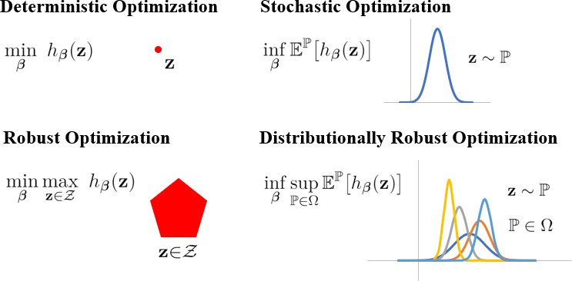
Model
Intro Pregnancy IVF PCOS DRL End
Feature Selection DRL
Distributionally Robust Learning ⁴
Minimize the worst-case loss over a set of distributions:
inf sup E^{Q}ℓ(f (x; β), y ).
β∈B _{Q∈Ω}
Nature
z = (x, y ) ∈ Z : (features, response),
β model parameters.
⁴Chen & ICP, JMLR, 2018; Esfahani & Kuhn, 2017; Gao, Chen, Kleywegt, 2017;
H∞ control; minimax: Blackwell, 1956; von Neumann & Morgenstern, 1944.
11/12
AI for Fertility: DRL

Slide 19
AI for Fertility: DRL
Intro Pregnancy IVF PCOS DRL End
Feature Selection DRL
Distributionally Robust Learning ⁴
Minimize the worst-case loss over a set of distributions:
Model
inf sup E^{Q}ℓ(f (x; β), y ).
β∈B _{Q∈Ω}
Nature
z = (x, y ) ∈ Z : (features, response),
β model parameters.
Ω is the Wasserstein ball of distributions with radius ϵ:
Ω ≜ {Q ∈ M (Z ) : W₁(Q, P^{ˆ}_{N} ) ≤ ϵ}.
⁴Chen & ICP, JMLR, 2018; Esfahani & Kuhn, 2017; Gao, Chen, Kleywegt, 2017;
H∞ control; minimax: Blackwell, 1956; von Neumann & Morgenstern, 1944.
11/12

Slide 20
Distributionally Robust Learning ⁴
Minimize the worst-case loss over a set of distributions:
Intro Pregnancy IVF PCOS DRL End
Feature Selection DRL
Model
inf sup E^{Q}ℓ(f (x; β), y ).
β∈B _{Q∈Ω}
Nature
z = (x, y ) ∈ Z : (features, response),
β model parameters.
Ω is the Wasserstein ball of distributions with radius ϵ:
Ω ≜ {Q ∈ M (Z ) : W₁(Q, P^{ˆ}_{N} ) ≤ ϵ}.
⁴Chen & ICP, JMLR, 2018; Esfahani & Kuhn, 2017; Gao, Chen, Kleywegt, 2017;
H∞ control; minimax: Blackwell, 1956; von Neumann & Morgenstern, 1944.
11/12 Yannis Paschalidis, Boston University AI for Fertility: DRL

Slide 21
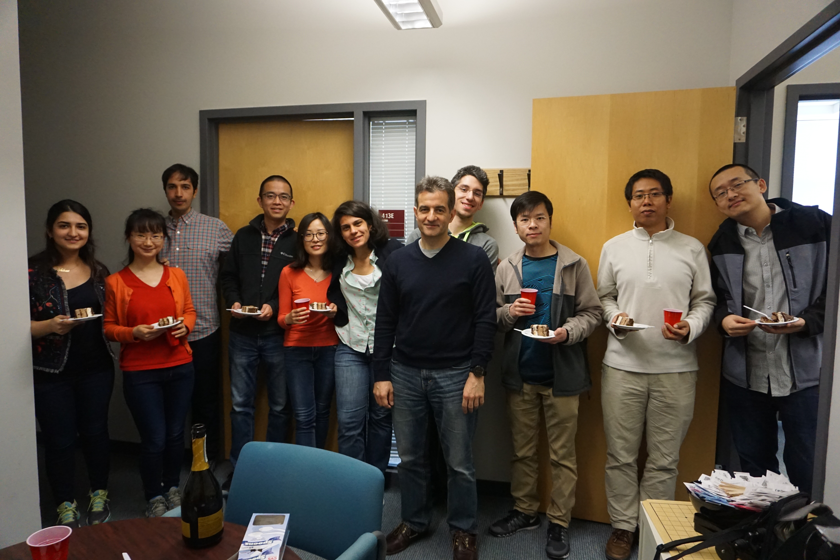
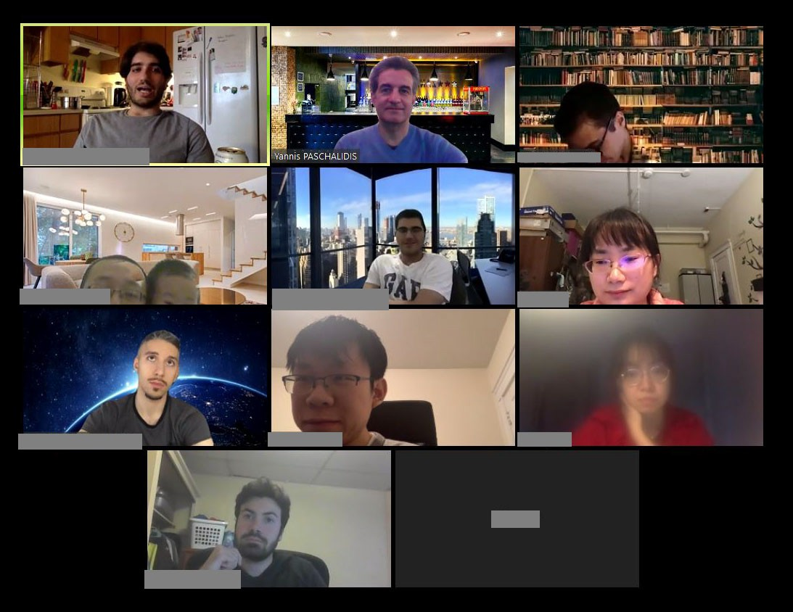

Acknowledgments
Intro Pregnancy IVF PCOS DRL End
Network Optimization & Control (NOC) Lab: 15 Ph.D. students, 32 doctoral alumni, and 12 post-doctoral alumni.
DRL: Dr. Ruidi Chen, Boran Hao
Healthcare applications: Dr. Taiyao Wang, Dr. Tingting Xu, Dr. Zahra Zad
Colloborators: Dr. Lauren Wise (BU), Dr. Shruthi Mahalingaiah (Harvard), Dr. Alex Olshevsky (BU).
Website: http://sites.bu.edu/paschalidis/
12/12
Yannis Paschalidis, Boston University
AI for Fertility: End

Slide 22

Simulation and Decision-Analysis for Integrated Modeling of Diseases: A Healthy Lives For All Approach
Chaitra Gopalappa
Associate Professor of Industrial Engineering

Slide 23
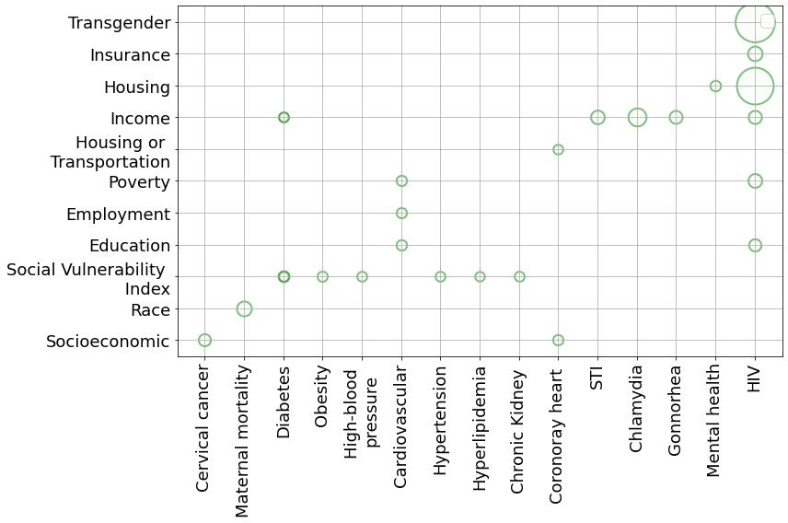
MOTIVATION
INTERVENTION ANALYSES MODELING
OBSERVATIONAL STUDIES
Social Determinants
Social Determinants
…….
Behaviors
Behaviors
associations
associations
predict
predict
…….
Disease 1
Disease 2
Disease 1
Disease 2
Features associated with health disparities →
SDH (social determinants of health)
Note: Only a sample list
Inform structural
interventions (e.g., food assistance through SNAP, housing assistance through HUD)
Inform behavioral and pharmaceutical interventions
SILOS
FRAGMENTED
Lack of coordinated care can amplify inequity
Note: Only a sample list; Data from different studies that use different metrics;
Values not directly comparable across diseases;

Slide 24
GOAL: Integrated approach to disease intervention
INTEGRATED / SYNDEMIC / MULTISECTORAL / MULTISCALE / SYSTEMS
LONG-TERM
SHORT-TERM
GOAL
Optimize health and social equity
NSF SCH
Social Determinants
Physics-based models
Predict joint intervention needs
for
Health + Social burden
Housing
Poverty…
Transportation
Observational studies
AI
ML
Expert opinion
Behaviors
B1
B2……
BN
Mechanistic models
(SDH→ Behavior→ Health Outcomes)
Population-level / Individual level
Diseases
Learning
D1
D2……
DN
Inter-agency programs and policies, and resource allocation decisions
Care systems’ operations and infrastructure planning
Validity / Interpretability /
Explainability
AI (scalability)
APPROACH

Slide 25
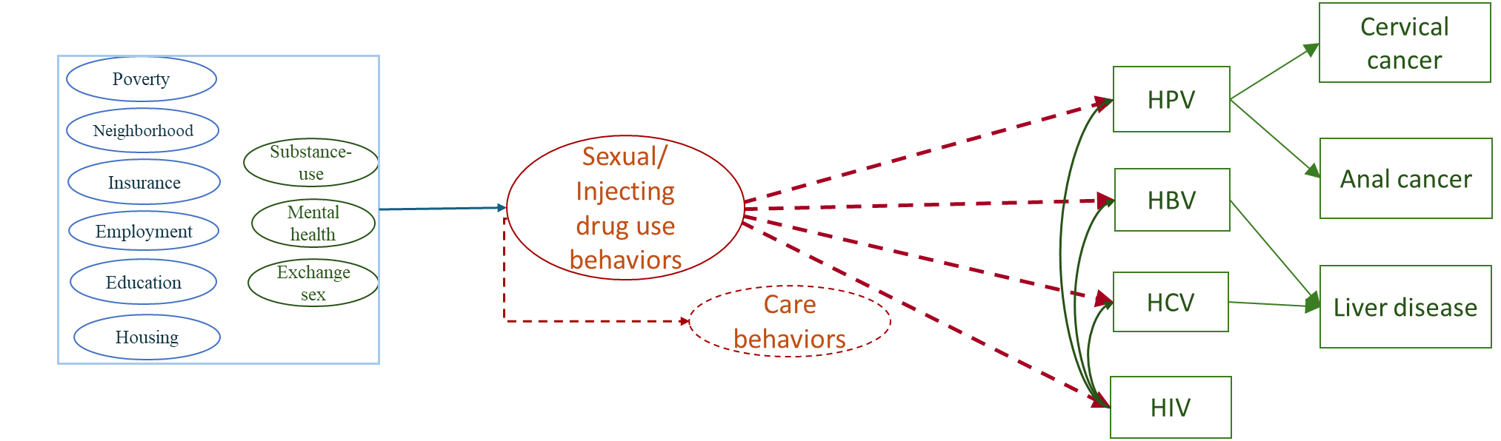
CASE STUDY-
Sexually or intravenously transmitted infections
HPV: human papillomavirus virus
HBV: hepatitis B virus
HCV: hepatitis C virus
HIV: human immunodeficiency virus
Social determinants of behaviors
Biological disease interactions
Common behavioral mechanisms of disease risk

Slide 26
CASE STUDY-
Sexually or intravenously transmitted infections
HIV: human immunodeficiency virus
HPV: human papillomavirus
HBV: hepatitis B
HCV: hepatitis C
Social determinants of behaviors
Biological disease interactions
Common behavioral mechanisms of disease risk
Structural Interventions
Behavioral Interventions
Pharmaceutical Interventions
Housing and food assistance
Addiction treatment
Mental healthcare
Harms reduction
Behavioral health
Testing
Treatment
Care
Screening

Slide 27
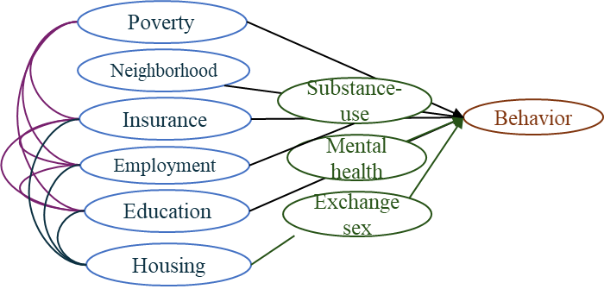
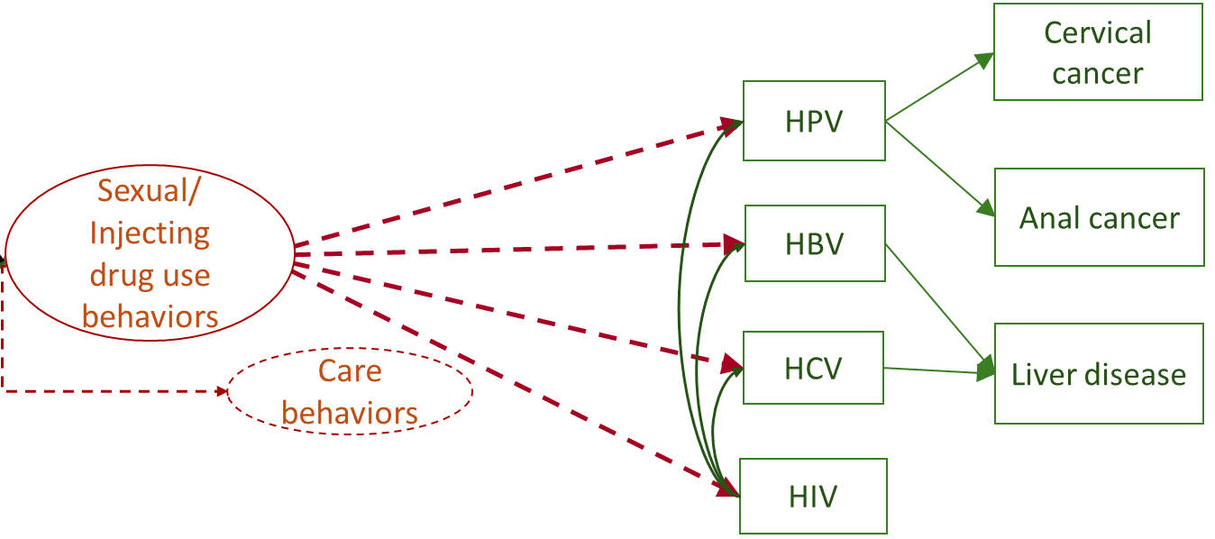
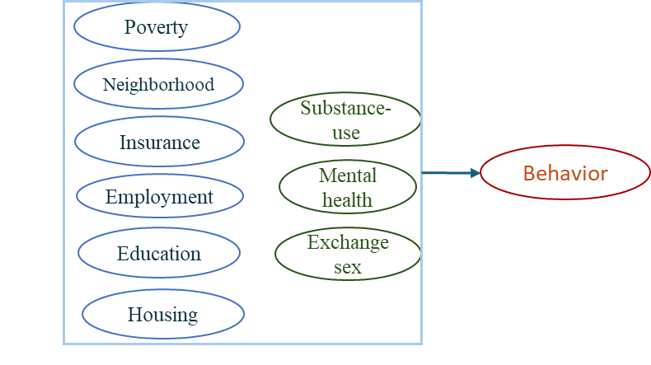
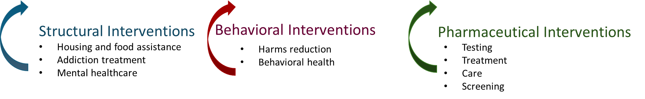
Challenges and approaches
2.
Complex dependency between features
(Statistical ML to estimate joint distributions)
1.
Complex system dynamics
(Multi-scale simulation technique)
Transform
3.
Complex intervention combinations, disease syndemics, and epidemic dynamics
(Artificial intelligence and machine learning (AI/ML))

Slide 28
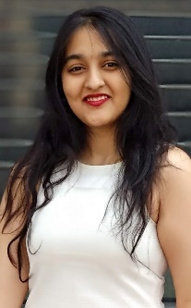

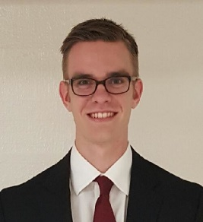

Multi-scale simulation to joint model related diseases
Sonza Singh,
PhD student
Rebecca Castonguay, UG student
Matthew Eden,
UG student
Xinmeng Zhao,
PhD student
Challenge 1:
Complex system dynamics

Slide 29
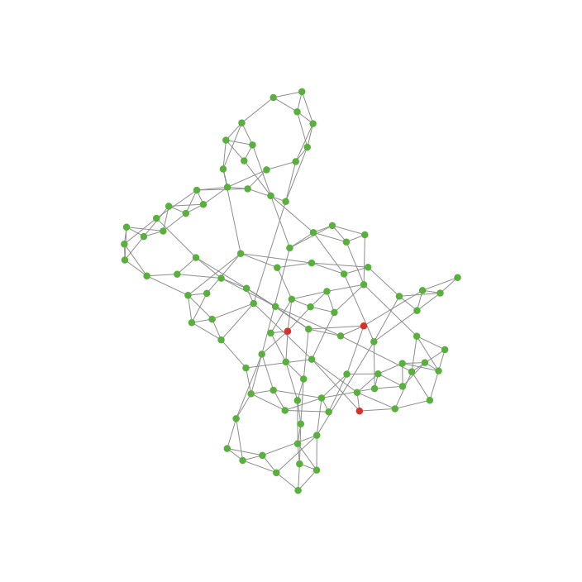
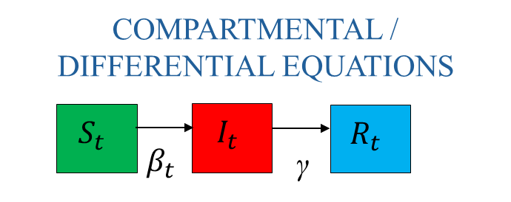
GOAL: Simulation technique for joint modeling interacting diseases
AGENT-BASED NETWORK
Sufficient for fast spreading infections: HPV, syphilis, gonorrhea, chlamydia
Not suitable for slower spreading infections (HIV, HepB, HepC)
Suitable for all
Challenges in application to multi-disease
STIs have varying epidemiology, e.g.,
13million (HPV) to 35K (HIV) cases per year
Simulate 100,000 nodes →
~3900 HPV v. ~10 HIV cases per year

Slide 30

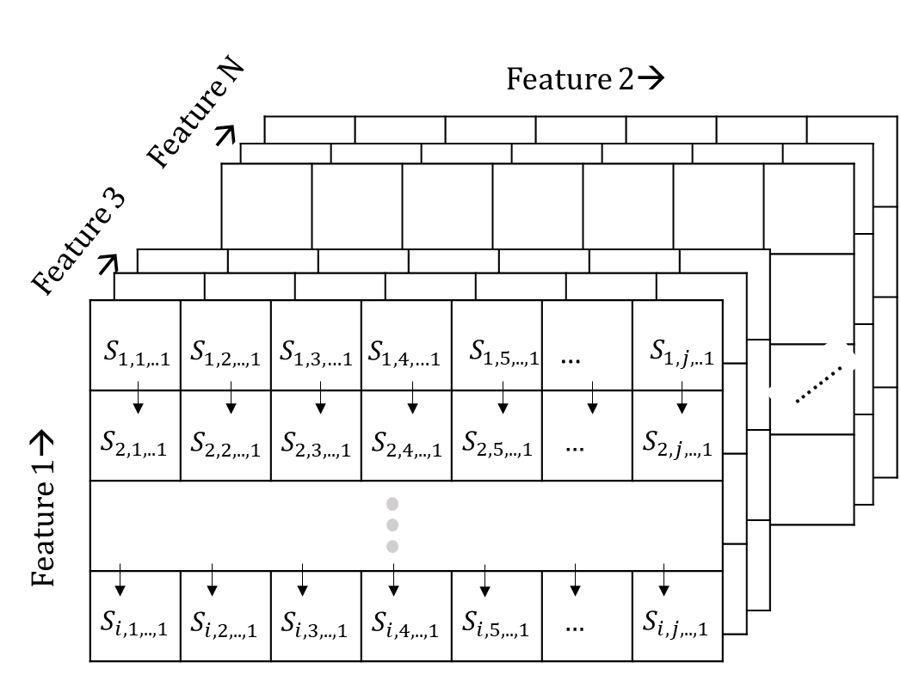
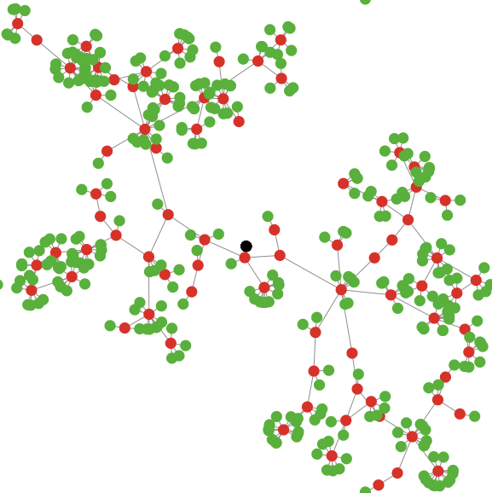
APPROACH: Mixed agent-based compartmental (MAC)
Infected with >0 slow spreading disease
All other persons of the population
Sample simulation
Contacts exposed to slow spreading disease
Agent-based network
Compartmental model
Nodes in network and people in compartmental may both have fast spreading infections
Evolve network
(as new slow spreading infections occur)
Novelty: Evolving network algorithm
Deep learning (MLP) + Optimization + Markov processes
Eden, M., et. al., Healthcare Management Science, 2022
Singh, S., et. al., Mathematical Biosciences and Engineering, 2022
Zhao, X. et. al., C. PLoSOne, 2023
Gopalappa, C., et. al., Infect Dis Model, 2023

Slide 31
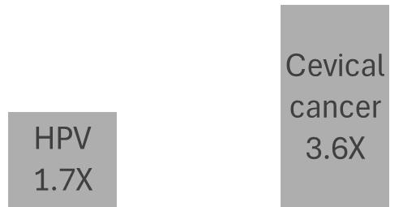
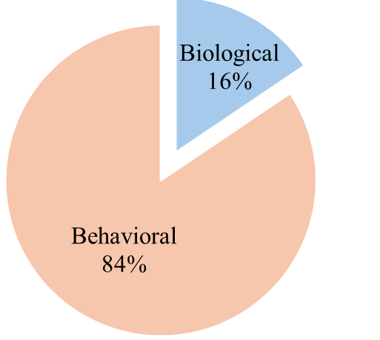
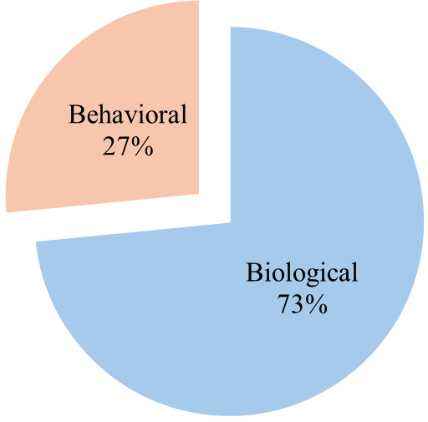
APPLICATIONS
National-level validated model of HIV, HPV, and cervical cancer
Structural + Behavioral Interventions
Pharmaceutical Interventions
Pharmaceutical Interventions
Disease risk in women with HIV compared to general population
Structural +
Behavioral Interventions
Attribution
Attribution
Zhao, X. et. al., C. PLoSOne, 2023

Slide 32
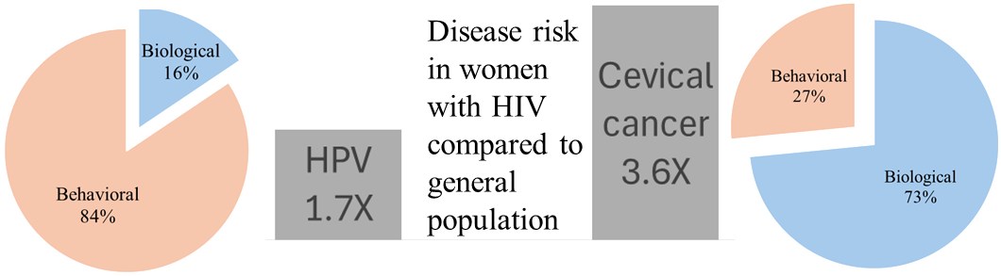
APPLICATIONS
National-level validated model of HIV, HPV, and cervical cancer
NSF SCH
First US national-level model that accurately replicated HIV clusters used for detection (recent outbreaks) and response (CDR); CDR are conducted using HIV nucleotide-sequences of new diagnoses.
France et.al., JAIDS, 2024
Panneer et. al., AIDS poster, Munich, Germany 2024
Zhao, X. et. al., C. PLoSOne, 2023
NIH R01,
CDC
HIV cluster prediction (future outbreaks) and prevention
FUTURE DIRECTION

Slide 33
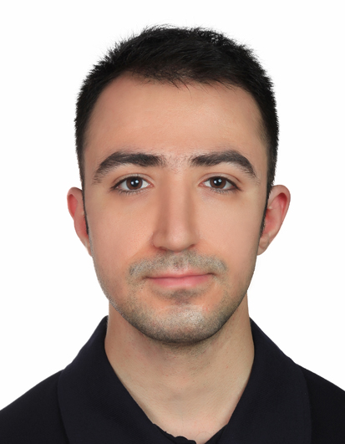
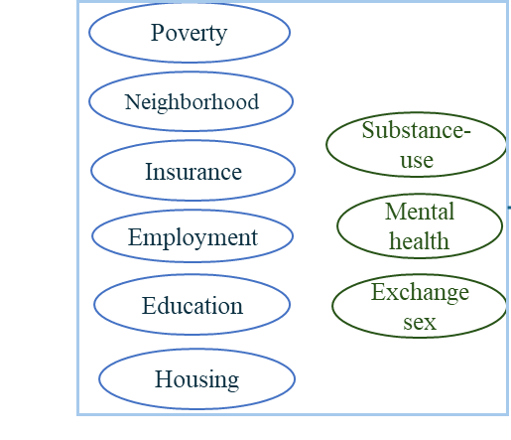
Statistical ML to estimate joint distributions
Amir Khosheghbal
PhD Student
Xinmeng Zhao,
PhD student
Challenge 2:
Dependency between features
Transform

Slide 34
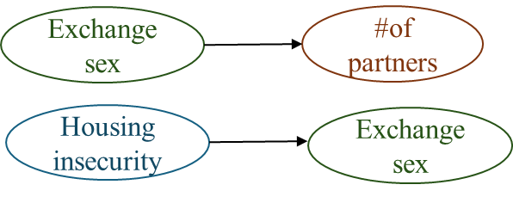
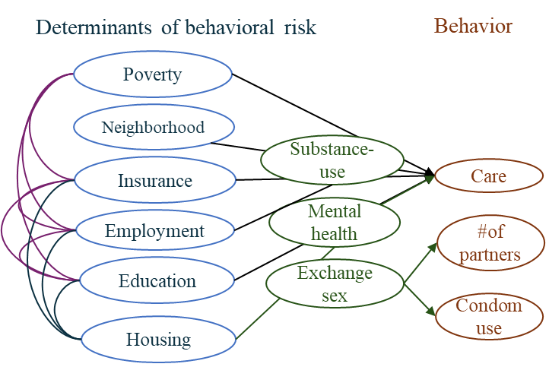
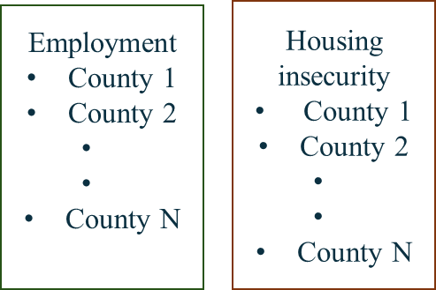
GOAL: Estimate joint distribution to parameterize simulation model
DATA
Identify dependency (joint distribution)
Parameterize simulation
Bivariate associations from observational studies, e.g.,
Behaviors ~g(SDH)
Behavioral risk
Sexual behavior
Exchange sex
homeless
homeless
poverty
Marginal dependent samples
(e.g., jurisdiction)
poverty
Care behavior
Infected
Uninfected
Simulate
Infection risk ~f(behaviors)

Slide 35
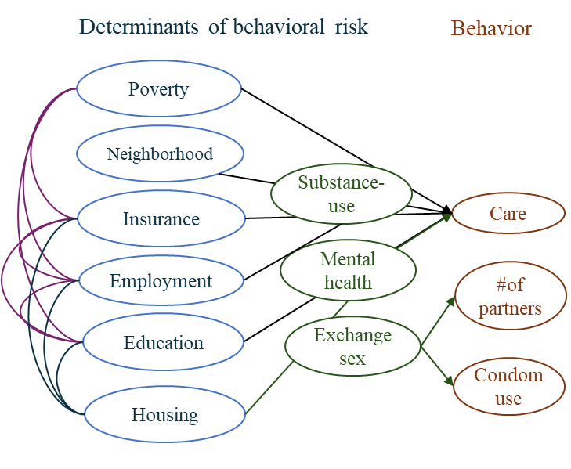
APPROACH: Integrated Copula and Probabilistic Graphical Models for Joint Distribution Estimation
Bivariate associations from observational studies, e.g.,
Exchange sex
#of partners
Joint distributions
Housing insecurity
Exchange sex
Probabilistic graphical models
Marginal dependent samples
(e.g., jurisdiction)
Copula
(Continuous to Discrete)
Employment
County 1
County 2
County N
Housing insecurity
County 1
County 2
County N
Employment
Housing
Solved using iterative proportional fitting
Solved using maximum entropy
Khosheghbal, C., et. al., In Review

Slide 36
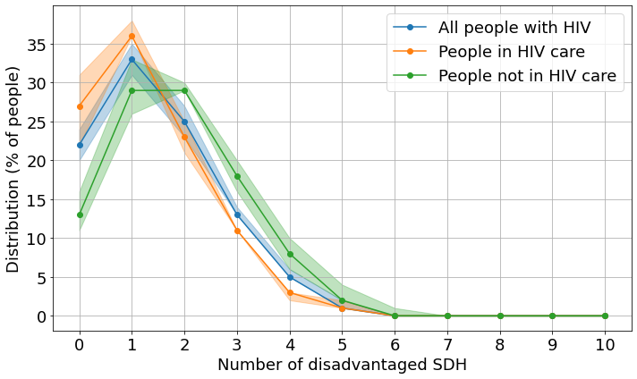
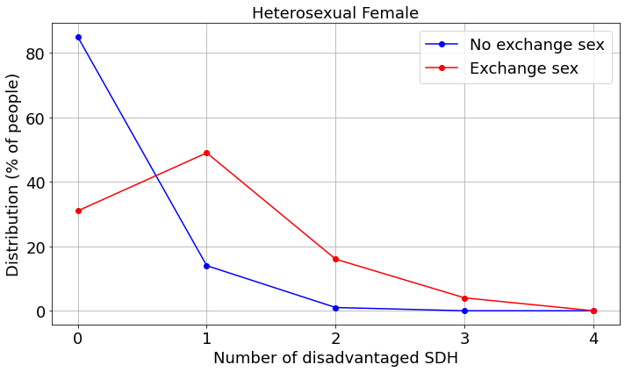
APPLICATIONS: Using two sample populations for a case study
SDH burden in women who exchange sex (for money or drugs)
FUTURE DIRECTION
SDH burden in people with HIV
Mechanistic model
(SDH: social determinants of health)
Joint distributions
Threshold impact analyses
(100-31%)=
69% had at least 1 SDH
Identify viable joint interventions
(100-13%) = 87% had at least 1 SDH
Design
Controlled studies/ Observational data collection
Limitation: Data not available for all SDH;
Suppose a hypothetical 100% efficacious structural intervention
modifies HIV care behavior in people with > 0 SDH to become equal to behavior in people with 0 SDH.
modifies sexual behavior in people who exchange sex to become equal to behavior in people who do not.
+
Evidence
Mechanistic model
Analyze
35% (29% to 41%) fewer HIV
Intervention optimal decisions
4 % (1% to 6 %) fewer HPV
17% (1% to 30%) fewer cervical cancer
in women with HIV
Khosheghbal, C., et. al., In Review
Zhao, X., et.al., Under preparation

Slide 37
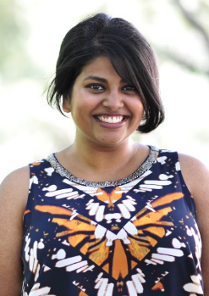


AI/ML for control optimization
Hanisha Tatapudi,
PhD student
Nazanin Khatami,
PhD student
Dinesh Sharma,
PhD student
Sonza Singh,
PhD student
Challenge 3:
Complex intervention combinations

Slide 38
GOAL: What is optimal intervention combinations?
Geographical Jurisdiction 1
Jurisdiction 2
Multi-disease
Multi-level
Multi-level
Multi-disease
Structural
Behavioral
Pharmaceutical
Demographic
Interventions at multiple scales
Multi-level, multi-disease, multi-jurisdiction
Dynamic-decision making
Adapt to epidemic changes
Jurisdiction 3
Epidemic mixing
Multi-level
Multi-disease
Jurisdiction J
Multi-disease
Multi-level
Jurisdiction …
Multi-level
Multi-disease

Slide 39
APPROACH: Deep reinforcement learning (DRL)
Multi-agent (jurisdiction) DRL
Tatapudi et. al., 2022
Sharma et. al., 2024, Preparation
Jurisdiction 1
Khatami et. al., 2021
Single agent RL
Multi-level
Jurisdiction 2
Novelty:
Identify efficient formulations (for convexity of policy function to improve convergence)
Application
MARL: each county is an agent
Environment: simulation model of HIV (national model as a composition of 96 interacting sub-models (jurisdictions))
Multi-level
Structural
Behavioral
Pharmaceutical
Demographic
Jurisdiction 3
Epidemic mixing
Multi-level
Jurisdiction J
Challenge: Complexity with number of agents (multi-jurisdiction/ multi-disease)
Multi-level
Jurisdiction …
NIH R01
National Institute of Allergy and Infectious Diseases
Multi-level

Slide 40
ONGOING: New Multi-agent DRL Algorithm
New algorithm
Leverage physics-based knowledge of the systems (epidemiological and behavioral systems) for coordinated learning of the policy or value networks, but each agent is executing its own policy using local observations
Type of coordinated learning + decentralized execution
Jurisdiction 1
Jurisdiction 2
Multi-level
Multi-level
Structural
Behavioral
Pharmaceutical
Demographic
Jurisdiction 3
Epidemic mixing
Multi-level
Jurisdiction J
Multi-level
Singh, et.al., Under preparation
Jurisdiction …
Multi-level
NSF Smart and Connected Health

Slide 41






Collaborators
Disclaimer: The findings and conclusions in this report are those of the presenter and do not necessarily represent the official position of the organizations
Contributions (on NSF SCH)
Publications
2. Statistical machine learning approach
1. Multi-scale simulation technique
3. Multi-agent reinforcement learning algorithm
https://diseasemodeling.github.io/
Chaitra Gopalappa, chaitrag@umass.edu

Slide 42


The Digital Transformation of Diabetes Care Delivery Insights From Practice and Future Challenges
Prof. Ramesh Johari
rjohari@stanford.edu
Management Science and Engineering
Stanford University
NSF SCH Award 2205084: Improving Patient Health and Equity through the Digital Transformation of Diabetes Care Delivery

Slide 43

Diabetes in the US…
Source: American Diabetes Association

Slide 44
Disparities abound: By race, by SES, by education
38.4M
U.S. population with diabetes
97.6M
U.S. adults with prediabetes
304,000
U.S. youth with type 1 diabetes (T1D)
Source: American Diabetes Association

Slide 45
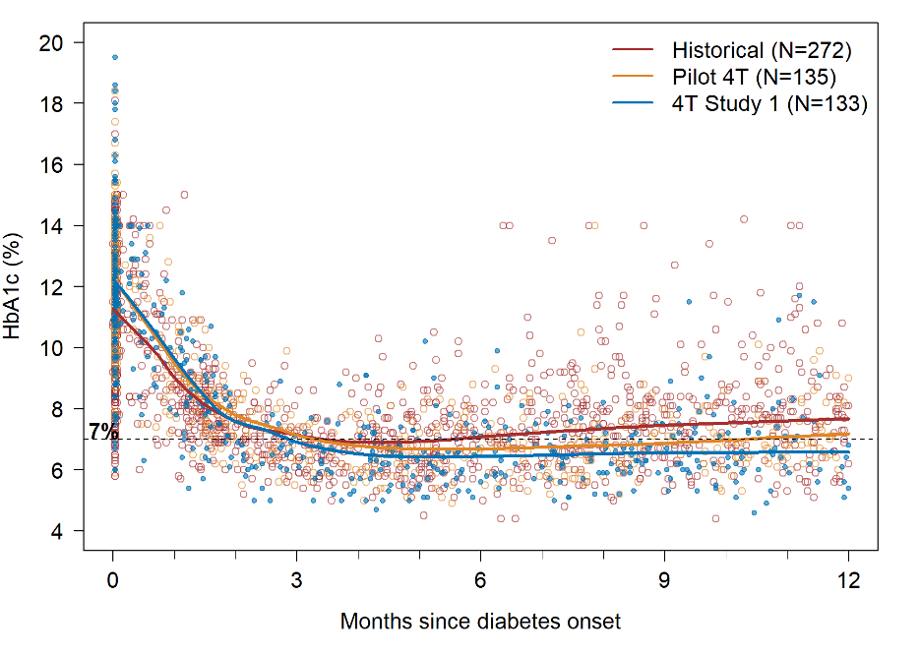
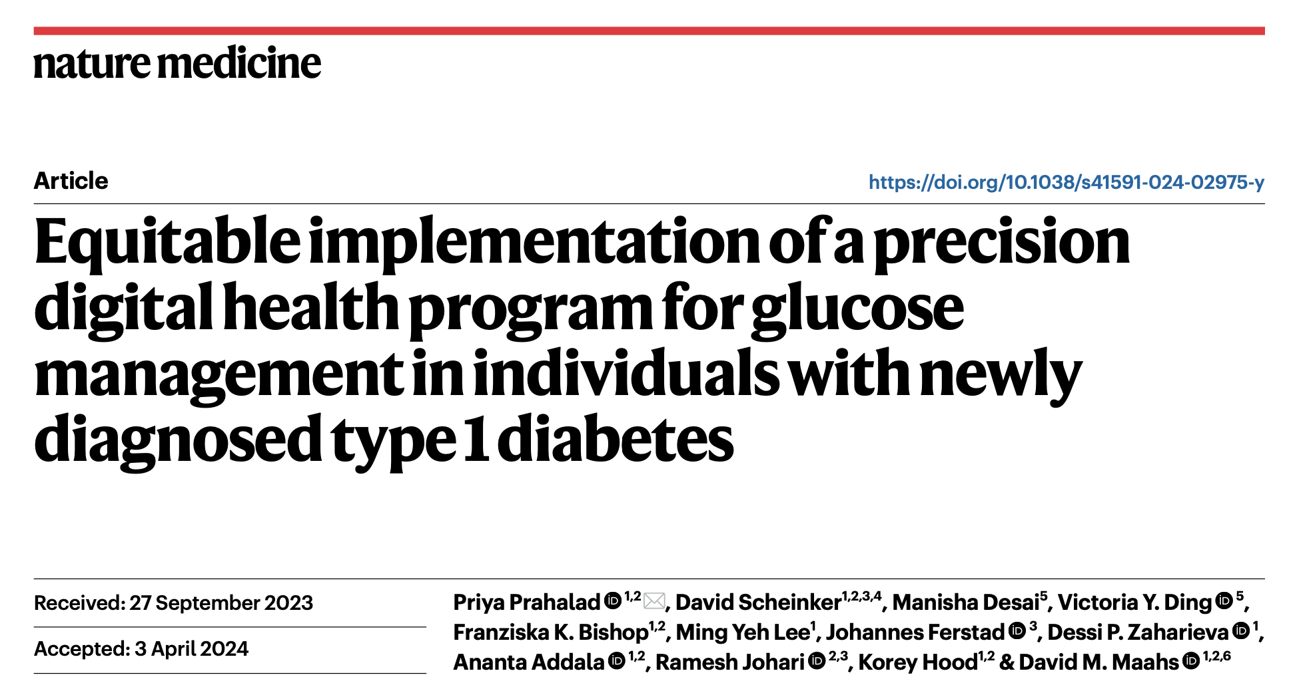
The Stanford 4T Study
The 4 T’s: Teamwork, Targets, Technology, and Tight Control
Outcomes in newly diagnosed youth:

Slide 46
The Stanford 4T Study
The 4 T’s: Teamwork, Targets, Technology, and Tight Control
Outcomes in newly diagnosed youth:
From HbA1c = 7.68% at 12 months in historical controls …
To HbA1c = 6.58% at 12 months in 4T (Study 1) !!

Slide 47
What is the role of Technology?
What are feasible and efficient innovations?
Clinical context: Patients, providers, devices, data, interventions…
Algorithm-augmented improvements in care
What have we learned? What worked, and what didn’t?

Slide 48
What is the role of Technology?
Clinical context: Patients, providers, devices, data, interventions…
Algorithm-augmented improvements in care
This talk: Improving care for children with T1D

Slide 49
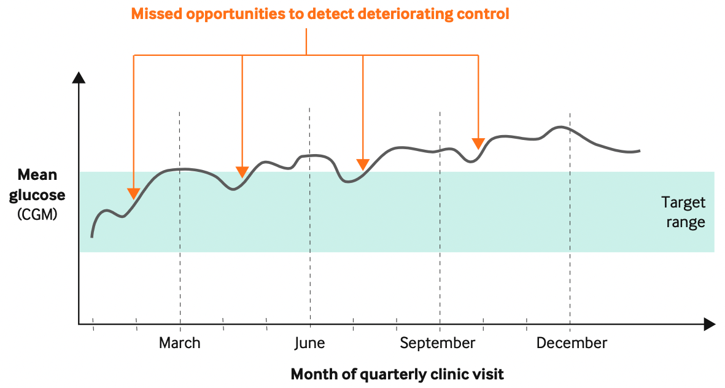
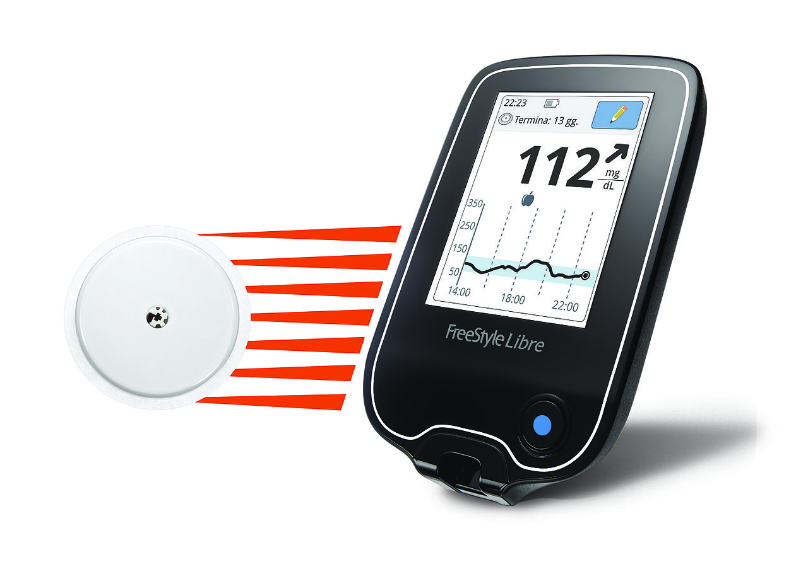
The challenge: Devices aren’t enough!
Status quo ante: Even with continuous glucose monitors (CGM), data only reviewed at clinic visits every 3 months

Slide 50
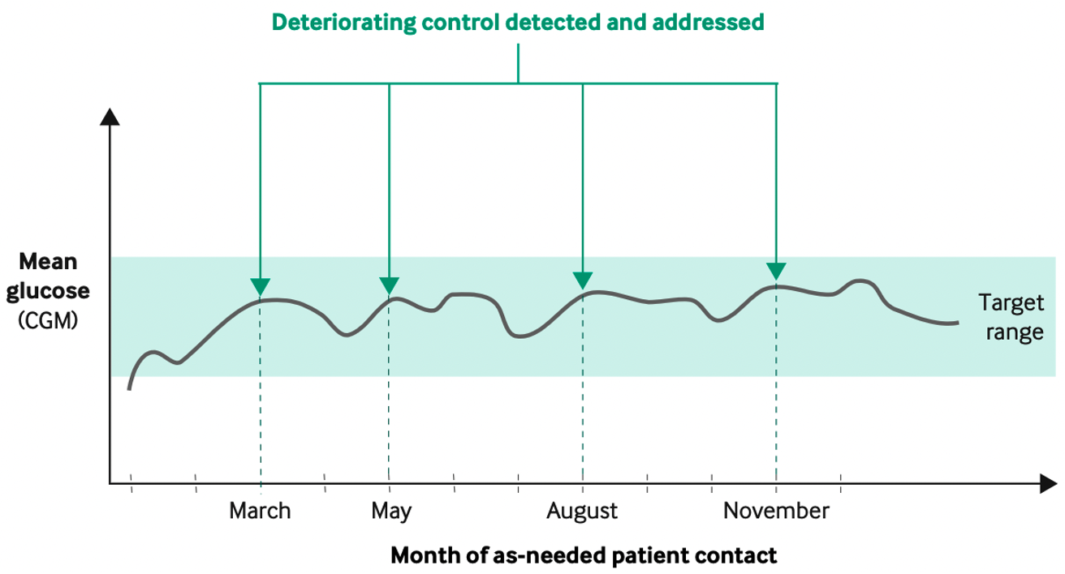
The challenge: Devices aren’t enough!
What if: Patient data could be reviewed more frequently?

Slide 51
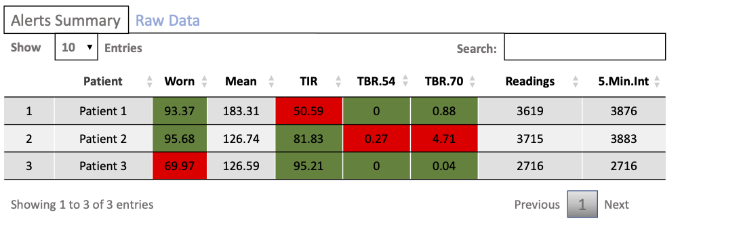
2020: The launch of TIDE
Working closely with clinical care providers, TIDE (“Timely interventions for diabetes excellence”) is deployed in < 1 month as an R Shiny dashboard on a single laptop (!):

Slide 52
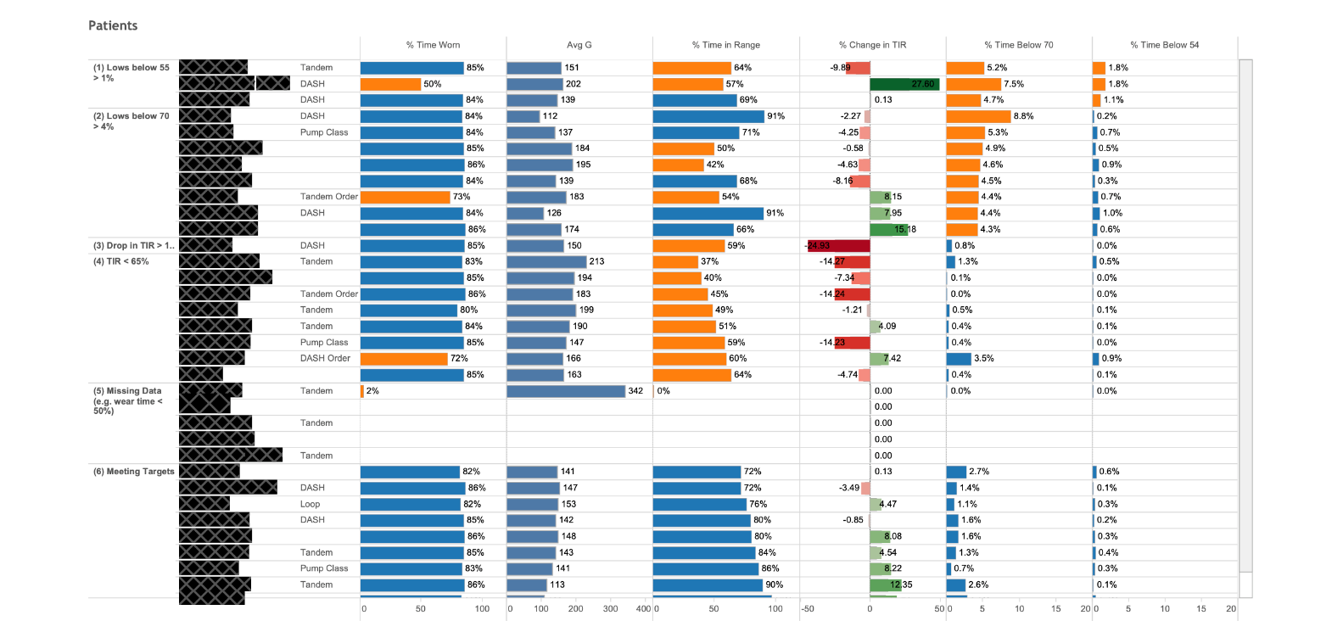
2021: A robust version of TIDE
Buy-in from providers, iterative improvement ⟹ new version of TIDE: Tableau server deployment, contextual ranking, and stratification

Slide 53
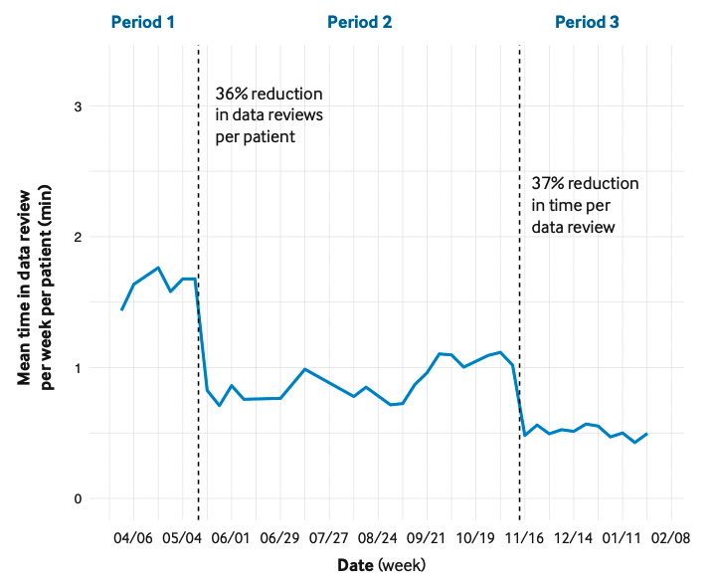
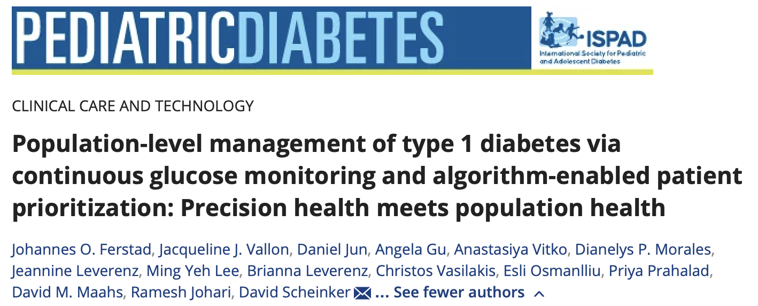
Improved care and more efficient care
Revised flagging criteria
Deployment via Tableau

Slide 54
Learning from what we’ve built
Clinical context: Patients, providers, devices, data, interventions…
TIDE: Population-level remote patient management for T1D
What can we learn from TIDE?

Slide 55


Optimizing care under capacity constraints
Few providers…
…many patients

Slide 56

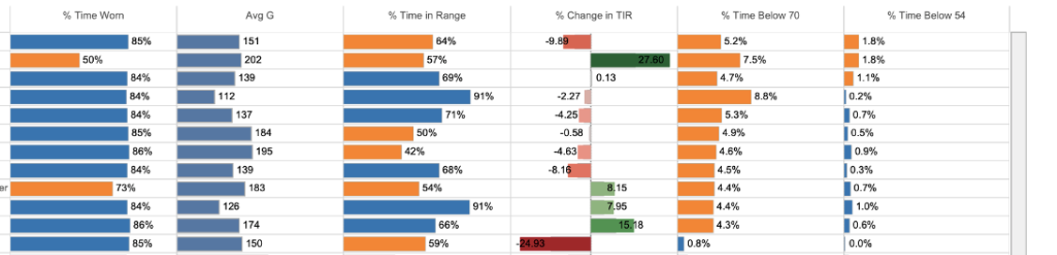
(1) Learning personalized treatment policies
Given patient state (i.e., demographics, CGM readings), which patients should be prioritized for review and/or contact?
Key challenge: Learning useful representations of patient states and actions (treatment recommendations) to optimize policies

Slide 57
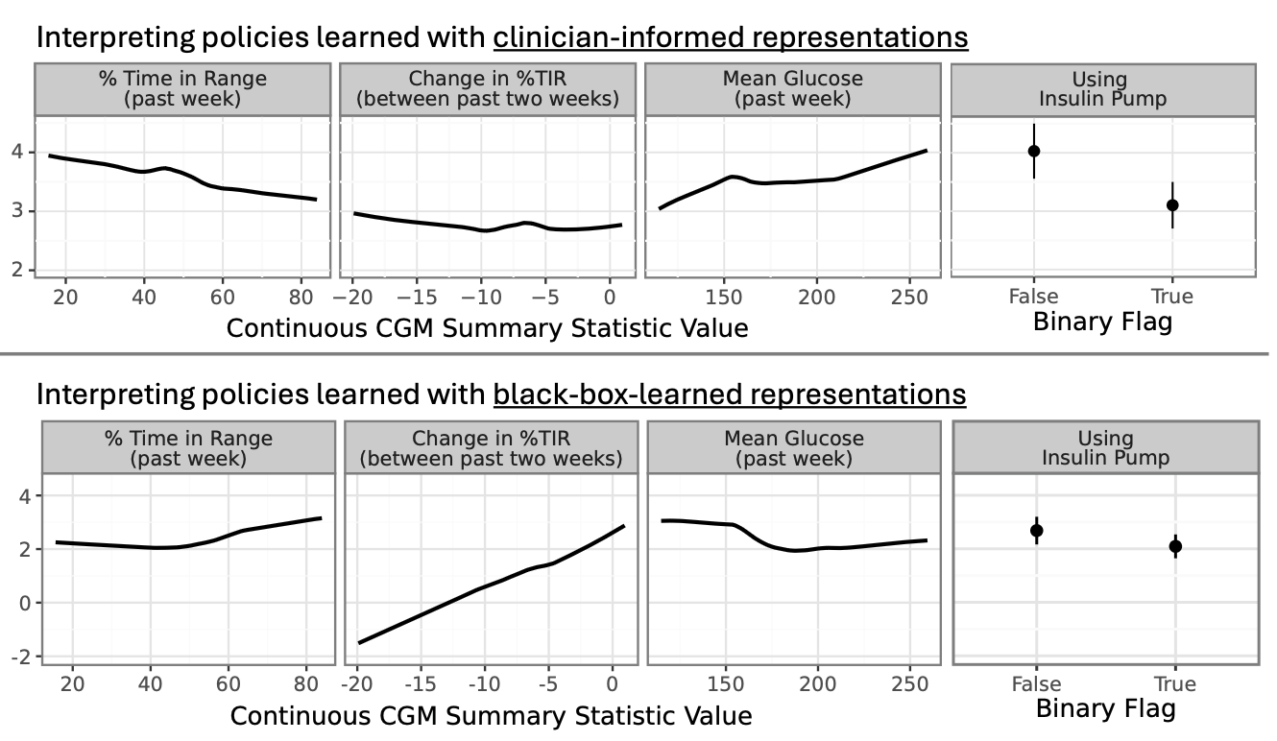
(1) Learning policies: Clinician-knowledge is crucial
Clinician-informed representations are aligned with guidelines (and perform well!),
“black-box” representations do not
Patient priority

Slide 58
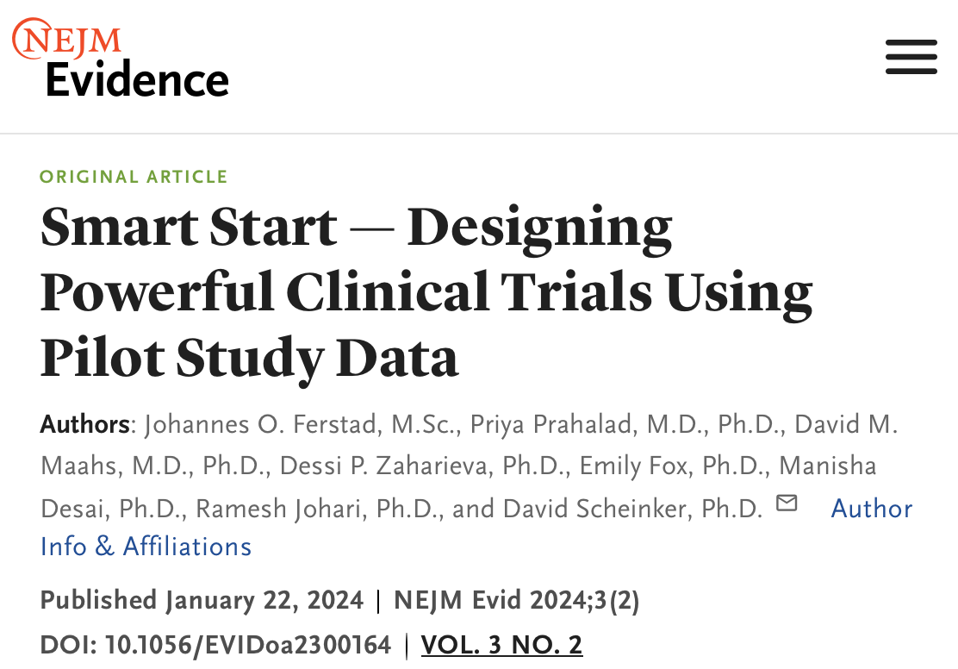
(2) Optimization trials
Platforms like TIDE open up the possibility of optimization trials (e.g., micro-randomized trials) to improve patient prioritization.
Implicit and explicit randomization in the data from TIDE enables prospective simulation of such trial designs to maximize targeting efficacy.

Slide 59
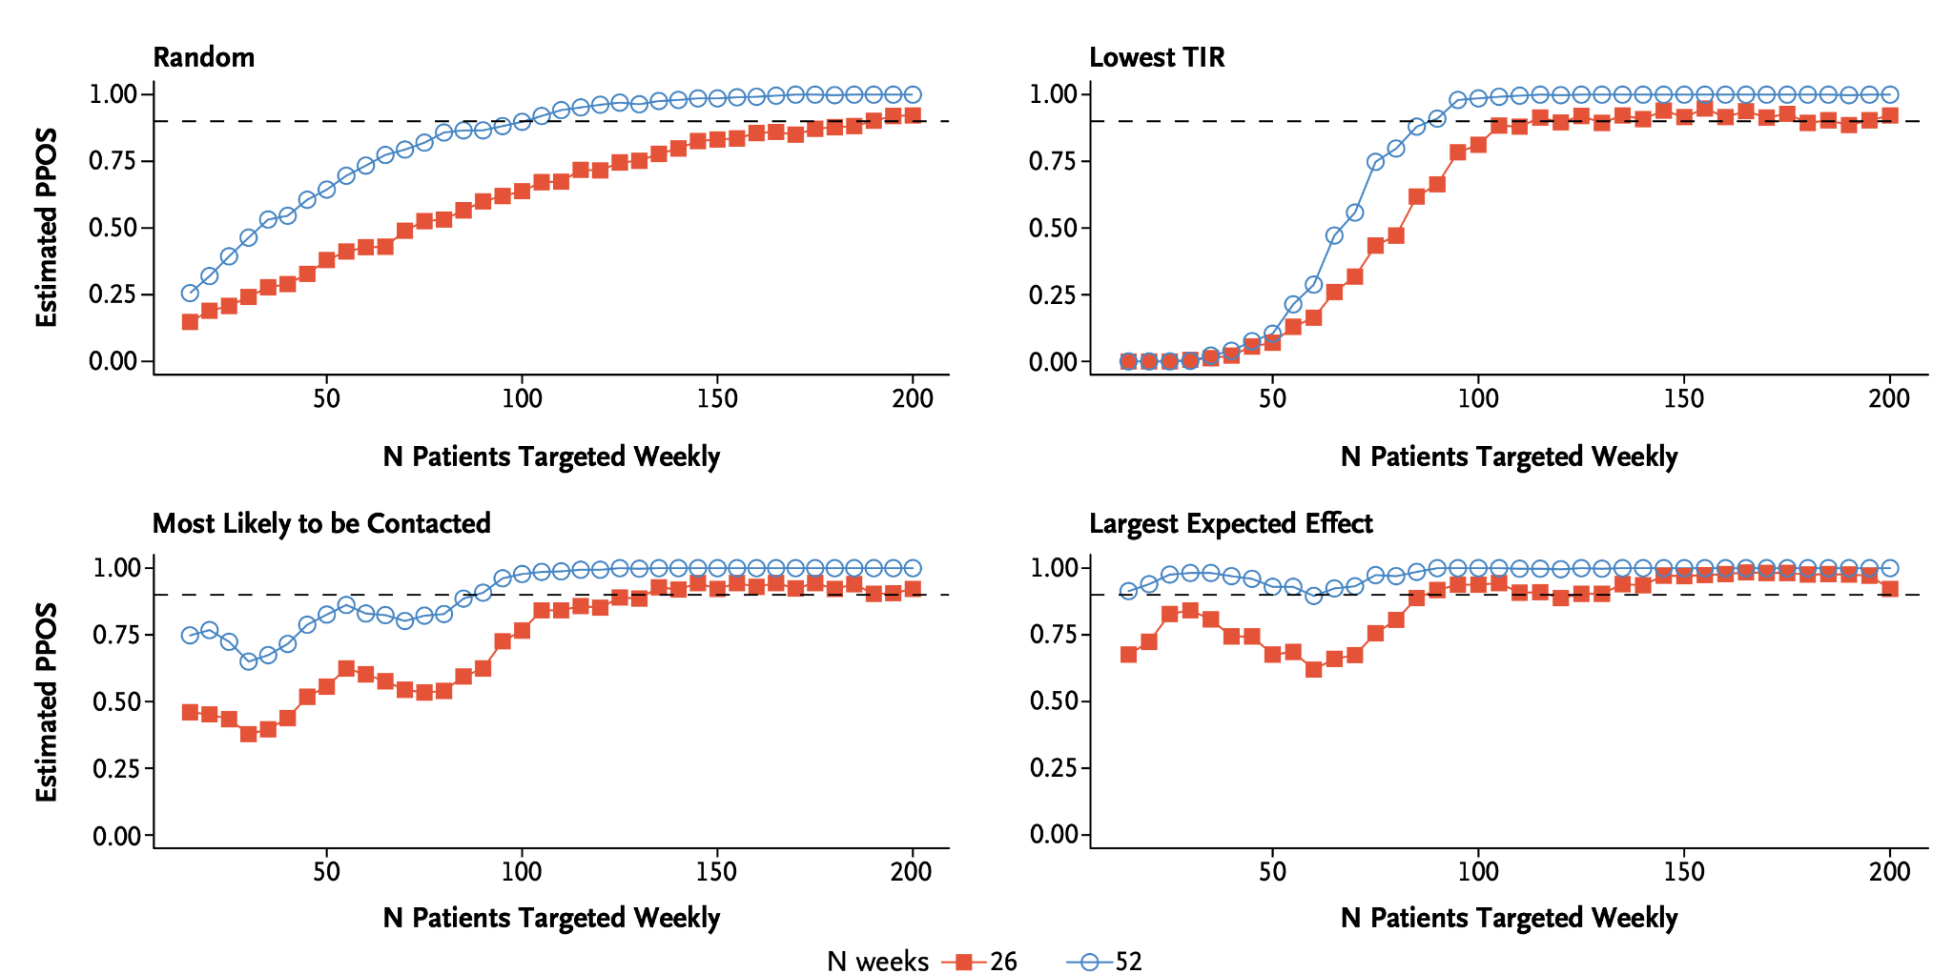
(2) Optimization trials: PPOS
Estimated predictive probability of success (PPOS) of an optimization trial, by targeting policy:
Note: Targeting should not be at the expense of equitable care!

Slide 60

The future: Scaling the model
TIDE deployment via the nonprofit Tidepool:
Turnkey at ~12,000+ active monthly clinics
Formal clinic and population management
User feedback and logging
Pseudo-randomization for clinical trials

Slide 61
TIDE and 4T: Continuous improvement
Scale
Hardware
Patients
Care team
Wearable sensors
Decision support
Algorithms
Clinic optimization
Data sharing
Smarter technology

Slide 62

(Partial) References
Improved, sustained outcomes:
P Prahalad, D Scheinker, M Desai, VY Ding, F Bishop, MY Lee, J Ferstad, DP Zaharieva, A Addala, R Johari, K Hood, DM Maahs. The 4T Study: Equitable implementation of a precision digital health program for glucose management in individuals with newly diagnosed type 1 diabetes. In press, Nature Medicine, 2024.
P Prahalad, VY Ding, M Desai, DP Zaharieva, A Addala, R Johari, F Bishop, E Fox, C Guestrin, K Hood, R Johari, D Scheinker, M Desai, DM Maahs, 4T Study Group. Sustained Improvements in Glycemia Over 3-Years in the Teamwork, Targets, Technology, and Tight Control (Pilot 4T) Study. To Appear, American Diabetes Association Meeting 2024
Continuously learning:
Scheinker, D., Prahalad, P., Johari, R., Maahs, D.M. and Majzun, R., 2022. A new technology-enabled care model for pediatric type 1 diabetes. NEJM Catalyst Innovations in Care Delivery, 3(5), pp.CAT-21.
Ferstad, J.O., Prahalad, P., Maahs, D.M., Zaharieva, D.P., Fox, E., Desai, M., Johari, R. and Scheinker, D., 2024. Smart Start—Designing Powerful Clinical Trials Using Pilot Study Data. NEJM Evidence, 3(2), p.EVIDoa2300164.
Ferstad, J.O., Fox, E.B., Scheinker, D., Johari, R. Policies from interpretable state and action representations for digital health interventions using causal machine learning. In preparation.
Financially sustainable:
Dupenloup, P., Pei, R.L., Chang, A., Gao, M.Z., Prahalad, P., Johari, R., Schulman, K., Addala, A., Zaharieva, D.P., Maahs, D.M. and Scheinker, D., 2022. A model to design financially sustainable algorithm-enabled remote patient monitoring for pediatric type 1 diabetes care. Frontiers in Endocrinology, 13, p.1021982.
Dupenloup, P., Brandeau, M., Prahalad, P., Maahs, D.M. and Scheinker, D. Cost-effectiveness of algorithm-enabled remote patient monitoring for type 1 diabetes care. In preparation.
Equitable:
Addala, A., Ding, V., Zaharieva, D.P., Bishop, F.K., Adams, A.S., King, A.C., Johari, R., Scheinker, D., Hood, K.K., Desai, M. and Maahs, D.M., 2023. Disparities in hemoglobin A1c levels in the first year after diagnosis among youths with type 1 diabetes offered continuous glucose monitoring. JAMA Network Open, 6(4), pp.e238881-e238881.

Slide 63









Acknowledgments
David Maahs, MD, PhD
Priya Prahalad, MD, PhD
David Scheinker, PhD
Manisha Desai, PhD
Korey Hood, PhD
Ananta Addala, DO, MPH
Ramesh Johari, PhD
Dessi Zaharieva, PhD, CDCES
Diana Naranjo, PhD
Systems Utilization Research for Stanford Medicine (SURF):
Johannes Ferstad, (PhD student)
Paul Dupenloup, (PhD student)
Gloria Kim, MS
Alex Wang (PhD student)
Isha Thapa, MS (PhD student)
Pierre-Amaury Laforcade, (MS student)
Jamie Kurtzig (undergraduate)
Daniel Miller, PhD
And many others!
T1D Working Group (Statistics):
Emily Fox, PhD
Carlos Guestrin, PhD
Johannes Ferstad, MS
Ransalu Senanayake, PhD
Juan Langlois, MS
Alex Wang, MS
Joseph Futoma, PhD
Matthew Levine, PhD
Arpita Singhal, BS
Yujin Jeong, BS
Matthew MacKay, MS
Quantitative Sciences Unit (QSU):
Victoria Ding, MS
Rebecca Gardner, MS
Victor Ritter, PhD
Bryan Bunning, MS
Staff Scientist:
Franziska Bishop, MS, CDCES
Coordinators:
Julie Hooper, MPH, RD
Brianna Leverenz, BS
Ana Cortes, BS
Nora Arrizon-Ruiz
Erica Pang, BS
Carolyn Herrera, BS
Dom Mitchell, BS
Andrea Bonilla Ospina, BS
Clinical Staff:
Jeannine Leverenz, RN, CDCES
Piper Sagan, RN, CDCES
Anjoli Martinez-Singh, RD, CDCES
Annette Chmielewski, RD, CDCES
Barry Conrad, RD, CDCES
Kim Clash, NP
Julie Senaldi, RN, CDCES
Erin Hodgson, RD, CDCES
Molly Tanenbaum, PhD
Hospital Operations and Informatics:
Rick Majzun, COO
Natalie Pageler, MD
Simrat Ghuman, PhD
Michelle Wiedmann, BS
Connor Brown, BS
Brendan Watkins, MBA
Glenn Loving, MS
Collaborators:
New York University:
Michael Riddell, PhD
Children’s Mercy:
Mark Clements, MD, PhD
Brent Lockee, BS
Avinash Kollu, MS

Slide 64
Please use the Q&A function to ask any questions of our speakers!
Yannis Paschalidis, PhD
Professor
Boston University
Chaitra Gopalappa, PhD
Associate Professor
University of Massachusetts, Amherst
Ramesh Johari, PhD
Professor
Stanford University

