Slide 1
CyberTraining Webinar October 7, 2024
Office of Advanced Cyberinfrastructure (OAC)
Cognizant Program Directors: S. Bagchi-Sen, Sheikh Ghafoor, Jenny Li, Marlon Pierce
Panelists: Puri Bangalore, Varun Chandola, Sharon Geva, Tom Gulbransen, Wen-wen Tung
NSF23-520 Solicitation deadline: 16 Jan 2025
https://new.nsf.gov/funding/opportunities/training-based-workforce-development-advanced

Slide 2
Webinar Goals
Orient potential proposers
Note: Submissions led by teams located in Established Program to Stimulate Competitive Research (EPSCoR) jurisdictions and from Minority Serving Institutions are encouraged to seek out this opportunity.
Summarize the CyberTraining program & its goals
Present the review criteria
Q&A
https://new.nsf.gov/funding/opportunities/training-based-workforce-development-advanced

Slide 3
Advanced Cyberinfrastructure
Funding Opportunities
Advanced Computing
Networking & Cybersecurity
Learning & Workforce Development
National research workforce for creating, utilizing, supporting advanced CI: SCIPE, CyberTraining
Software & Data CI
Strategic
Investments
Supports development and deployment of robust, reliable, sustainable data and software CI
Special opportunities, cross-cutting and national initiatives, CI for open science and public access
Advanced networking and security infrastructure, research and communities of practice capabilities
Production and operational level advanced computing and data capabilities and services
Notes:
We have various opportunities. Cybertraining is part of the Learning and WD group of programs.

Slide 4
Cyberinfrastructure (CI)
CI is broadly defined as (i) the set of resources, tools, methods, and services for advanced computation, (ii) large-scale data handling and analytics, (iii) networking and (iv) security for large-scale systems that collectively enable potentially transformative fundamental science and engineering research and education.
https://allocations.access-ci.org
Notes:
For the solicitation, CI is defined as …

Slide 5
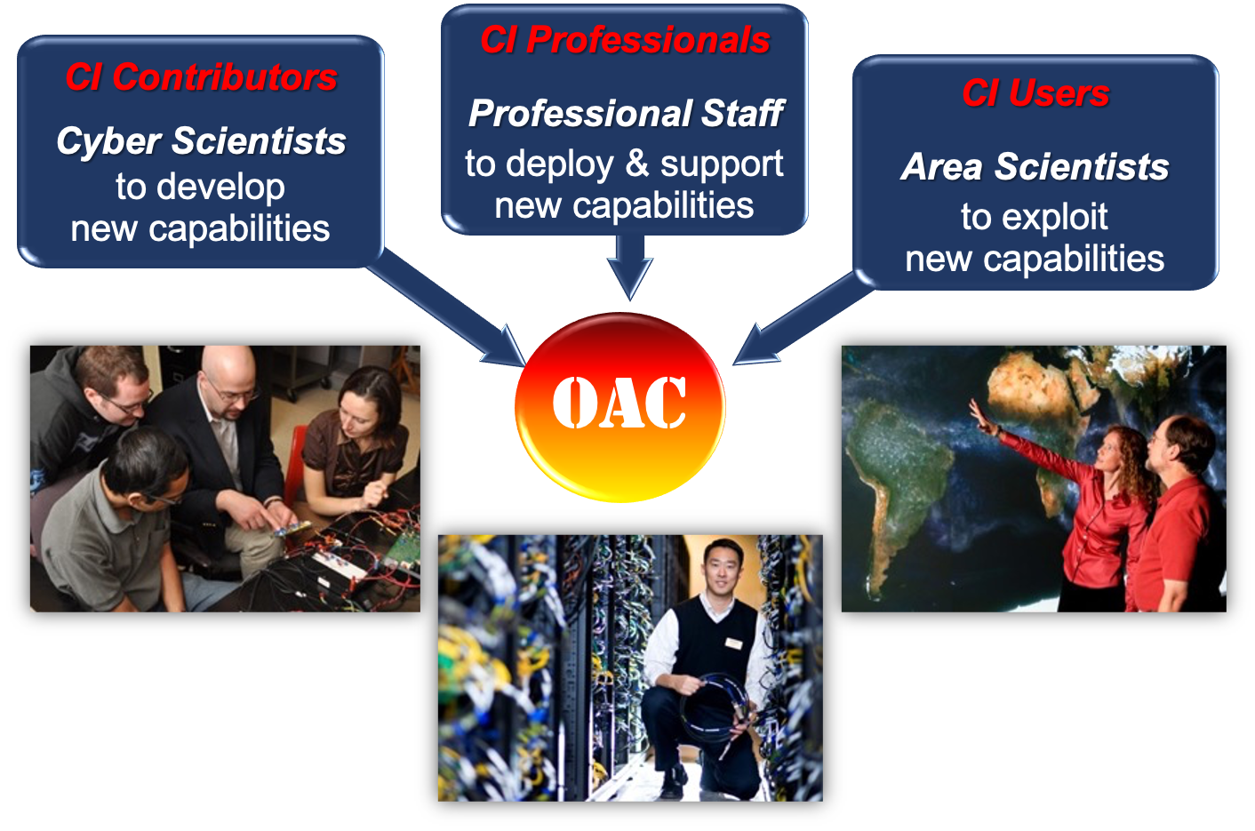
Communities
CI Professionals: Those who deploy, manage, and collaboratively support the effective use of research CI. A CI Professionals-related project can address technical and research CI professional skills of current and future CI Professionals, including undergraduate and graduate students, postdoctoral fellows, and research scientists.
CI Contributors: This is the community of computational, data, and domain scientists and engineers who research and develop new CI capabilities, approaches, and methods. A CI Contributors-related project is for discipline-appropriate contributor-level CI skills and advanced domain skills development; the target population spans graduate and undergraduate students, postdoctoral fellows, and researchers who are current and future CI Contributors.
CI Users: This is the community of domain scientists and engineers who effectively exploit advanced CI capabilities and methods for research. A CI Users-related project is for user-level core literacy in discipline-appropriate advanced CI as well as computational and data-driven S&E skills; the target population spans undergraduate and graduate students, postdoctoral fellows, and researchers who are current and future CI Users.
https://allocations.access-ci.org
Notes:
We welcome proposers from three communities

Slide 6
Relevant CI-Related Programs
What will your project focus on?
Develop software or data repository
Perform research that will enable future CI
Deploy CIPs; foster CIP careers
Provide training to any of the three target communities
What need will you fill?
Need for community CI for research or education
Need for knowledge required for CI
Need for supporting research by diverse groups & CIP careers
Need for workforce that can leverage CI for research
What will your project deliver?
Community-sustained CI
Techniques that will enable CI and a CI prototype
Support for research that uses CI; CIP career paths
Scalable and sustainable training program
CSSI
OAC CORE
SCIPE
CyberTraining
Programs have specific purposes; however, are not necessarily mutually exclusive
Notes:
OAC has several programs related to CI that may include some overlap in goals. We present a somewhat idealized view that may enable you to choose the right program for your needs.
However, this is a simplified view, and the solicitations would provide more detailed guidance. So, please use this only as a high-level view.
If you want to develop a software or data repository, then you may wish to look at the CSSI program. You would produce a community-sustained CI to enhance the CI ecosystem available for research or education.
If you want to perform research that will enable future CI, you may want to look at the OAC Core program. You would typically develop techniques and a CI prototype that will yield the knowledge needed for future production-CI.
If you want to deploy CI professionals and also foster their careers, then the SCIPE program may suit you. Your CIPs would support research that leverages CI, and you would establish career paths for them. This may particularly benefit groups that are currently underserved with respect to the use of CI for research.
If you want to provide training on CI for research purposes, then the CyberTraining program may interest you. You would deliver scalable and sustainable training to help increase the research workforce that can leverage CI. Note that this is for research workforce development, rather than a general workforce, and that it should be for research that is enabled by CI.
The text in bold are crucial to distinguishing these programs. For example, if your focus is on providing training, then you would probably choose the CyberTraining program over CSSI. A CSSI project may also involve some training, but this would be incidental; development of a CI would me the main focus. Similarly, a CyberTraining proposal may have incidental software development, but training would be the focus.

Slide 7
Cybertraining
Motivation
Advanced CI has a transformative impact on a variety of scientific research domains
The research workforce would benefit from innovative discipline-appropriate training and curriculum materials
There is a need to foster broad adoption of CI resources, tools, and methods by diverse research communities
https://allocations.access-ci.org

Slide 8
Cybertraining
Goals
The CyberTraining program seeks to prepare, nurture, and grow the national scientific research workforce for creating, utilizing, and supporting advanced cyberinfrastructure to enable and potentially transform fundamental science and engineering research and contribute to the nation's overall economic competitiveness and security.
  The projects should aim to contribute to the larger goal of an educational ecosystem enabling “Computational and Data-driven Science for All scientists and Engineers”
  This embraces computation as the third pillar and data-driven science as the fourth pillar of the scientific discovery process -- in addition to the traditional first and second pillars of theory and experimentation.
https://allocations.access-ci.org

Slide 9
Cybertraining NSF23-520
The specific goals of this solicitation (NSF23-520) are:
(i) to ensure broad adoption of CI tools, methods, and resources by the research community in order to catalyze major research advances; and
(ii) to integrate core literacy and discipline-appropriate advanced skills in advanced CI as well as computational and data-driven science and engineering into the nation’s educational curriculum and instructional fabric, spanning both undergraduate and graduate courses to advance fundamental research.
Through the above goals, we also intend to broaden CI access to groups that are currently underserved in its use.
More specifically, the solicitation calls for innovative and scalable training, education, and curriculum and instructional materials - targeting one or both of the solicitation goals - to address emerging needs and unresolved bottlenecks in S&E research workforce development, from the postsecondary level to the level of active researchers.
https://allocations.access-ci.org

Slide 10
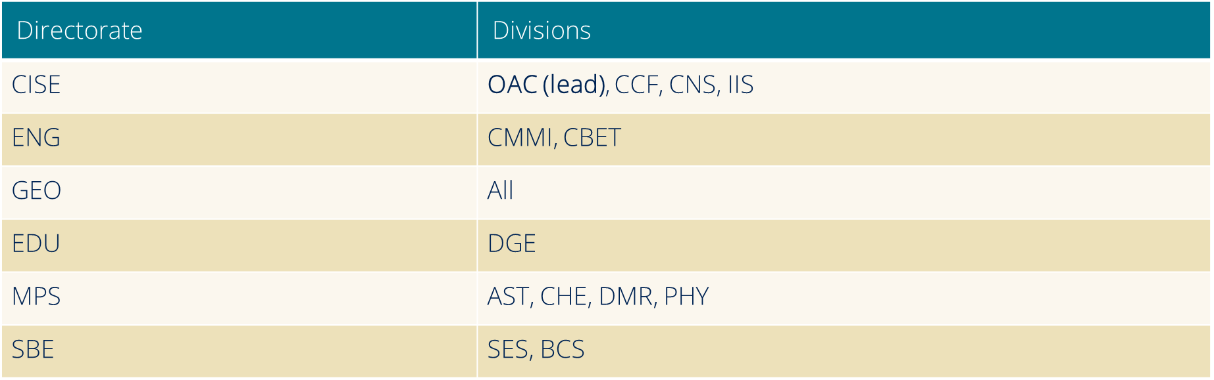
Cybertraining: NSF-wide participation
Notes:
See the solicitation for more details on programmatic areas

Slide 11
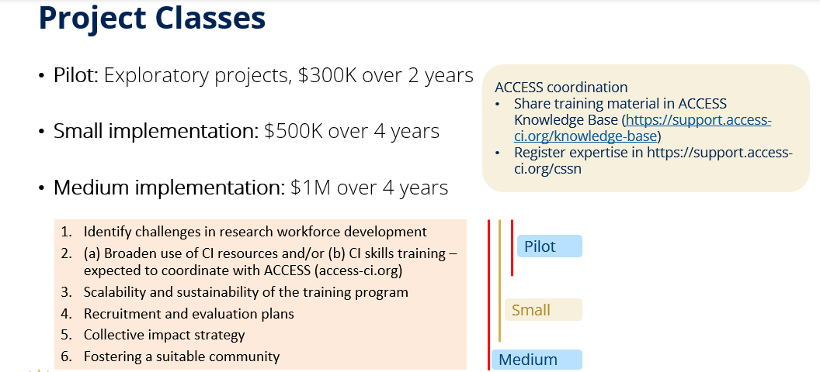
https://new.nsf.gov/funding/opportunities/training-based-workforce-development-advanced
Notes:
We now review the key provisions for the current solicitation.
There are three project classes, defined as:
Pilot projects, with total budgets of up to $300,000 and with duration up to two years, are exploratory activities that may lead to Implementation projects.
Implementation projects can be either Small (with total budget up to $500,000) or Medium (with total budget up to $1,000,000) with duration up to four years. Implementation projects make CI training and educational activities or curricular and instructional materials broadly accessible to a significant portion of a community for one or more disciplines.
Medium Implementation projects also foster a community to catalyze the adoption of advanced CI methods or to incorporate training resources and materials into the curriculum.
All proposals should have well-identified proposal elements that clearly address the solicitation-specific review criteria listed here, in addition to addressing the standard NSF intellectual merit and broader impact criteria.
Reviewers will be asked to evaluate these aspects by addressing the following questions:
A rationale for challenges identified for research workforce development;
The strength of the project’s plan to address one or more of the solicitation goals, namely (a) to broaden the use of CI methods and resources by the research community, and/or (b) to integrate CI skills into the institutional and disciplinary curricular and instructional fabric,
Note that at least one goal must be addressed.
Strong implementation projects, though, tend to have both components.
The potential for scalability and sustainability;
The soundness of the participant recruitment and project evaluation plan;
The effectiveness of the proposed “collective impact” strategy to establish a coordination network and a backbone organization (or, the Effectiveness of an alternative strategy);
The soundness of plans for fostering a suitable community;
Pilot projects must address items 1 and 2. Small Implementation projects must address items 1-5, and Medium Implementation projects must also address item 6.
- I want to clarify that research in education is outside the scope of this solicitation.

Slide 12
NSF-supported Advanced CI Resources
Learn how to access resources at access-ci.org
Leadership-class
Frontera | U of Texas, Austin
Capacity Systems
Anvil | Purdue University
Bridges 2 | Carnegie-Mellon University
Delta | U of Illinois, Urbana-Champaign
Expanse | U of California, San Diego
Jetstream 2 | University of Indiana + Partners
Stampede 2 | U of Texas, Austin
Innovative Prototypes/Testbeds
Neocortex | Carnegie-Mellon University
Voyager | U of California, San Diego
Ookami | Stonybrook University
NRP | U of California, San Diego
ACES | Texas A&M University
Cloud resources
Cloudbank | U of California, San Diego
CloudLab | University of Utah
Chameleon | University of Chicago
Distributed Services
PATh/OSG | U of Wisconsin, Madison
ACCESS | Several Partners

Slide 13
Computing Resource Opportunities
HPC resources through ACCESS
  https://allocations.access-ci.org
  Apply independently for an allocation through a 1 – 10 page allocation proposal
High-throughput computing resources
  https://path-cc.io
  May include a description in a supplementary document
Cloud computing resources
  https://new.nsf.gov/funding/opportunities/enabling-access-cloud-computing-resources-cise
  May include a description and budget in a supplementary document
https://allocations.access-ci.org

Slide 14
Computing Resource Opportunities
Four allocation opportunities to suit a variety of needs
Explore ACCESS (small)
  best-suited for endeavors with light resource requirements
    graduate students can lead allocation for dissertation-related work with a letter of collaboration from their advisor
Discover ACCESS (medium)
  minimal effort to perform mid-scale research activities
    small-scale research, growing Science Gateways
Accelerate ACCESS (large-ish)
  more substantial resource requirements
    multi-grant research, Science Gateways, etc.
Maximize ACCESS (XL)
  for large-scale research projects with extreme resource needs
    will largely resemble XRAC process
Proposal lengths: abstract, 1-page, 3-pages, and 10-pages, respectively.
https://allocations.access-ci.org

Slide 15
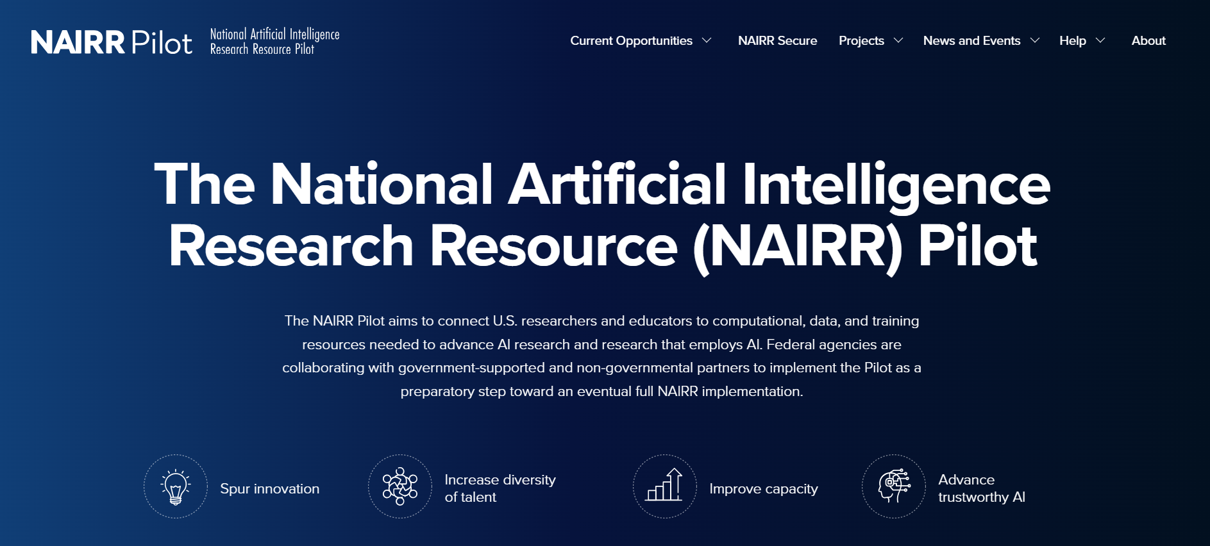
National AI Research Resource (NAIRR)

Slide 16
Navigating NSF
  Full Proposals submitted via Research.gov: NSF Proposal and Award Policies and Procedures Guide (PAPPG) guidelines apply. The complete text of the PAPPG is available electronically on the NSF website at: https://nsf-govresources.nsf.gov/files/nsf24_1.pdf (https://new.nsf.gov/policies/pappg/24-1)
  Full Proposals submitted via Grants.gov: NSF Grants.gov Application Guide: A Guide for the Preparation and Submission of NSF Applications via Grants.gov guidelines apply (Note: The NSF Grants.gov Application Guide is available on the Grants.gov website

Slide 17
How do I know if the program is a good fit for my project?
Read the solicitation carefully
  Check for program resources
  Check the NSF Awards Search Page
  Read sample proposals if available
Talk to NSF Program Officers (and your colleagues) about your ideas
  Prep a 1-2 page writeup in advance (not required)
  Key questions, contributions, activities.
  PO contacts: S. Bagchi-Sen, Sheikh Ghafoor, Marlon Pierce

Slide 18
What factors are considered for funding a proposal?
Available funding
Responsiveness to the solicitation
Panel Advice on...
  Intellectual Merit
  Broader Impacts
  Solicitation-specific Criteria
Notes:
Panel Recommendation
Review Analysis...

Slide 19
Merit Review: Intellectual Merit & Broader Impacts
What is the potential for the proposed activity to:
    Advance knowledge and understanding (intellectual merit)?
    Benefit society or advance desired societal outcomes (broader impacts)?
To what extent do the proposed activities suggest and explore creative, original, or potentially transformative concepts?
Is the plan for carrying out the proposed activities well-reasoned, well-organized, and based on a sound rationale?
Does the plan incorporate a mechanism to assess success?
How well qualified is the individual, team, or institution to conduct the proposed activities?
Are there adequate resources available to the PI (either at the home institution or through collaborations) to carry out the proposed activities?
  Source: PAPPG https://new.nsf.gov/policies/pappg/24-1

Slide 20
Solicitation-specific Criteria (PAPPG)
A rationale for challenges identified for research workforce development;
The strength of the project’s plan to address one or more of the solicitation goals, namely (a) to broaden the use of CI methods and resources by the research community, and/or (b) to integrate CI skills into the institutional and disciplinary curricular and instructional fabric,
  Note that at least one goal must be addressed.
  Strong implementation projects, though, tend to have both components.
The potential for scalability and sustainability;
The soundness of the participant recruitment and project evaluation plan;
The effectiveness of the proposed “collective impact” strategy to establish a coordination network and a backbone organization (or, the Effectiveness of an alternative strategy);
The soundness of plans for fostering a suitable community;
NOTE: Pilot projects must address items 1 and 2. Small Implementation projects must address items 1-5, and Medium Implementation projects must also address item 6.
Notes:
Research in education is outside the scope of this solicitation.

Slide 21
Proposal writing issues …
Ignoring requirements stated in the solicitation and/or PAPPG.
The “Trust Me” approach. Provide citations or evidence for critical assertions made, and details of work.
The “Oversell” of yourself or your project. Persuade with the quality of the proposal, not glitzy/sales language.
General, vague, or rambling narrative; low precision/details.
Too much background/prior work, not enough on what will actually be done.
RWR

Slide 22
Questions?
.
Please post your questions in the
Question&Answer window
<<You may also email us later>>
Notes:
Many Cognizant Program Directors could not be here, but their directorates’ and divisions’ programmatic areas of interest are in the solicitation, which we encourage you to read carefully.
Q1. Is consultation with a Cognizant Program Officer required?
No. But it is is strongly encouraged that you consult with me (with OAC leading this solicitation) and any other Cognizant Program Officer by sending a 1-page project summary containing sections on project overview, intellectual merit and broader impact and a few keywords at least a month in advance of the solicitation deadline, and include this in a Single Copy Document submitted as part of your proposal.

Slide 23
Common Questions
Q1. Is consultation with a Cognizant Program Officer required?
  No, but it is strongly encouraged that you consult with us (with OAC leading this solicitation) and any other Cognizant Program Officer at least a month in advance of the solicitation deadline, and note this in a Single Copy Document.
Notes:
Many Cognizant Program Directors could not be here, but their directorates’ and divisions’ programmatic areas of interest are in the solicitation, which we encourage you to read carefully.
Q1. Is consultation with a Cognizant Program Officer required?
No. But it is is strongly encouraged that you consult with me (with OAC leading this solicitation) and any other Cognizant Program Officer by sending a 1-page project summary containing sections on project overview, intellectual merit and broader impact and a few keywords at least a month in advance of the solicitation deadline, and include this in a Single Copy Document submitted as part of your proposal.

Slide 24
Common Questions
Q2. Can my project primarily train/re-train for jobs in the IT industry?
  No, all proposals, including cybersecurity proposals, must be relevant to
    Scientific Research Workforce Development, and
    Advanced Cyberinfrastructure
  Cybersecurity proposals must be relevant to the scientific research workflow
  This relevance will vary from undergraduates, to graduates, to CI professionals, and across disciplines.
Notes:
Q2. Can my project primarily train or re-train for jobs in the IT industry?
No, ALL proposals, including cybersecurity proposals, must be relevant to
Scientific Research Workforce Development, and
Advanced Cyberinfrastructure.
Cybersecurity proposals must be relevant to the scientific research workflow.
This relevance will, of course, vary from undergrad students to grad students, to postdocs, to CI professionals, and across disciplines.

Slide 25
Common Questions
Q3. Must you already have a Small-size Implementation award before seeking a Medium-size Implementation award?
  No
  References:
  Proposal & Award Policies & Procedures Guide (PAPPG) (NSF 24-1) https://new.nsf.gov/policies/pappg/24-1
  NSF23-520 https://new.nsf.gov/funding/opportunities/training-based-workforce-development-advanced
  THANK YOU!
Notes:
Q3. Do you need to have a Small-size Implementation award before proposing a Medium-size Implementation project?
No.

