Slide 1

DCL: Planning Grants to Create AI-Ready Testbeds (NSF 24-111) September 30, 2024
Directorate for Computer and Information Science and Engineering Division of Information and Intelligent Systems (IIS)
and the
Directorate for Technology, Innovation and Partnerships (TIP)
1

Slide 2
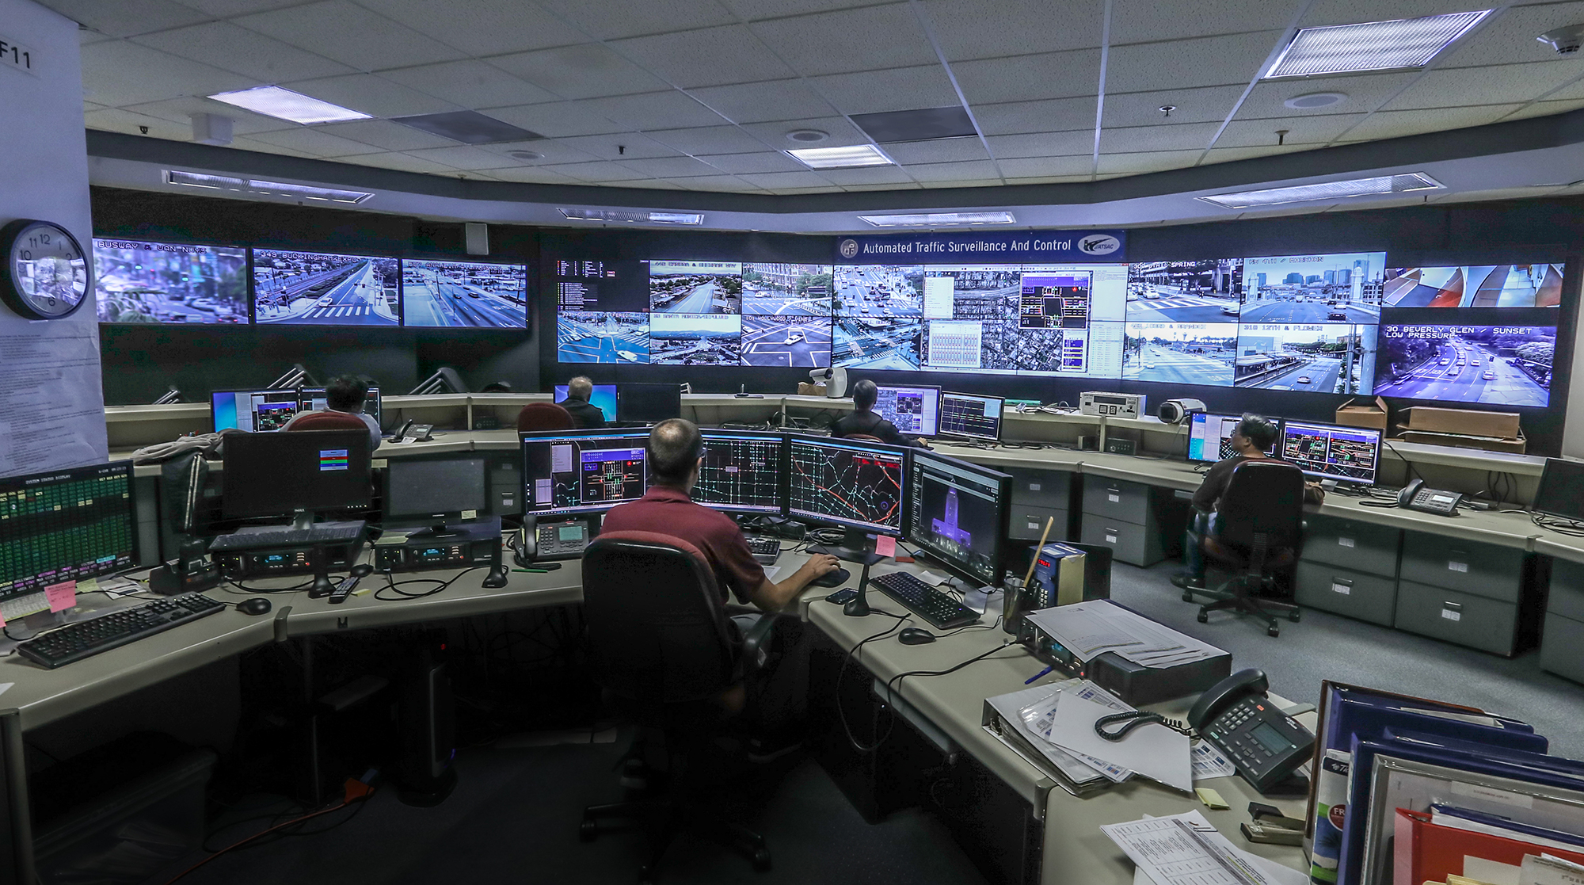
Why AI-Ready Test Beds?
AI has jumped from the lab into the world. Consequences for society are profound.
To better understand how AI technology can be best adopted in high-impact (human, economic ...) settings, we need to address some challenges:
Dynamic, connected, domain data streams
Technologist and domain experts to guide researchers to easily connect to the domain
Allow researchers to embed with front-line service providers and domain experts
Lower cost and communication barriers at entry to application domain
Ensure privacy/safety/equity
Notes:
UPDATE SLIDE:
How can researchers work on these society-facing problems:
- static data, but then relatively untethered to the domains. Ends up not being relevant.
- living lab, on site technologists work as nexus between task domain and researchers.
- researcher embeds with front-line service providers / domain experts. Very time-consuming.
Feedback loops important: Key elements of NIST’s RMF require evaluating how effective recommendations are. Impacts back on the front-line domain.

Slide 3
What are AI-Ready Testbeds?
Shared infrastructure at a specific locale with support for AI research and remote access
Focus on AI impact in real world use-cases in the context of a Living Lab.
Software and hardware allowing access to archival data, live sensor data streams, sensor reconfiguration, actuators
Technologists and domain experts on site supporting research projects from external teams
Multiple projects and teams (some remote) promoting inter-project collaboration and nexus-building.
Shared Infrastructure
Living Lab Model
Workforce Development
Nexus-Building Environment
Notes:
UPDATE SLIDE:
How can researchers work on these society-facing problems:
- static data, but then relatively untethered to the domains. Ends up not being relevant.
- living lab, on site technologists work as nexus between task domain and researchers.
- researcher embeds with front-line service providers / domain experts. Very time-consuming.
Feedback loops important: Key elements of NIST’s RMF require evaluating how effective recommendations are. Impacts back on the front-line domain.

Slide 4
Benefits
Economy of scale achieved as each team doesn’t have to recreate infrastructure --- allows funding to provide new insights rather than repetitive infrastructure development.
Aids reproducibility through common infrastructure and data-sharing
Collaboration and nexus-building as a natural (but not automatic) bonus. AI-Ready sites will provide a natural vehicle for nexus-building.
Inter-agency partnering --- Provides domain and concrete infrastructure to further inter-agency collaborations (e.g., Dept. of Transportation, state and regional transportation authorities…)
Notes:
--- picture a living lab where a dozen different research teams work on projects with different facets but a common deployment domain

Slide 5
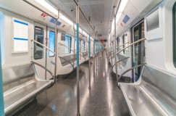




Example – for concreteness
AI Ready Transportation Hub

Slide 6
Example: AI-Ready Transportation Hub
Could provide:
Access to multiple data sources (live sensor feeds and archival data) --- traffic, air quality, noise, emergency vehicle presence and access, public transportation utilization and state, repair effects on traffic and metro
Access to cyber-controls --- sensor reconfiguration, mobile sensor placement, modulate traffic control
Support for multiple projects concurrently --- navigation; traffic management (everyday, special events, and emergencies); improving environmental factors; last-mile delivery; mixed autonomous/standard vehicle traffic
…

Slide 7



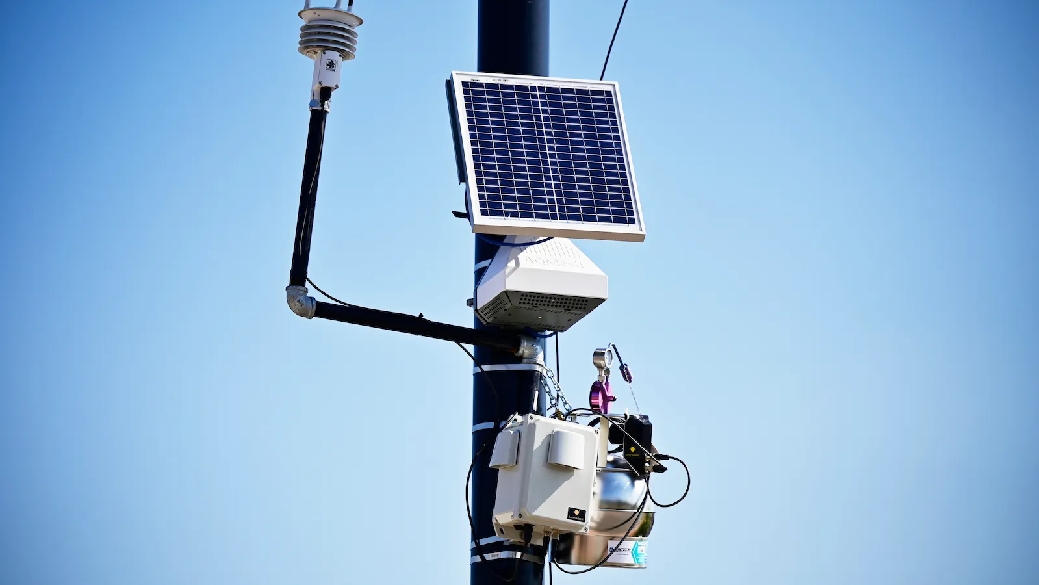
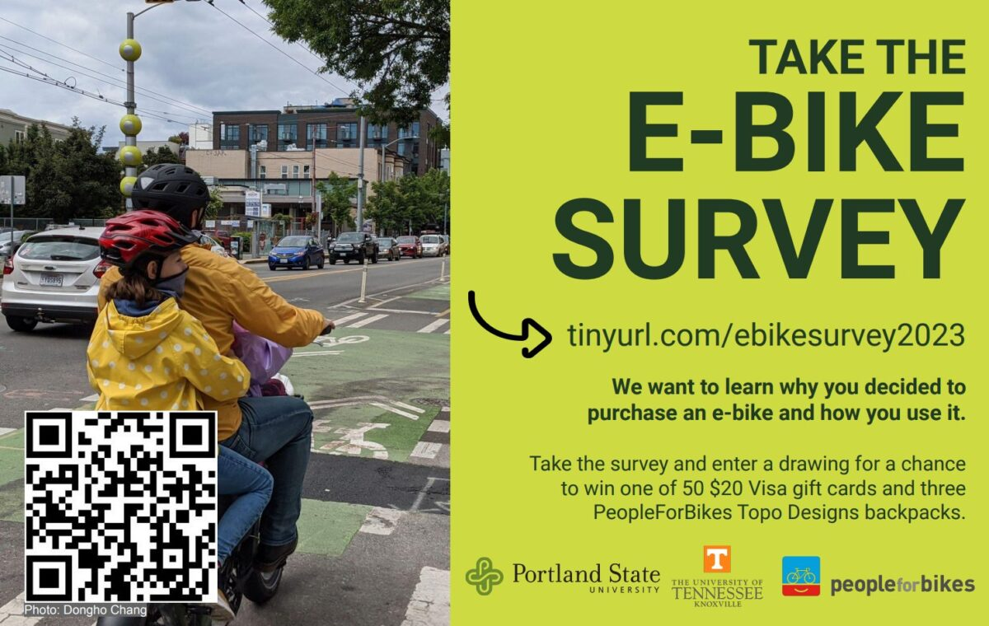
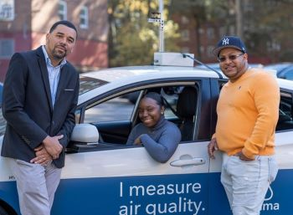
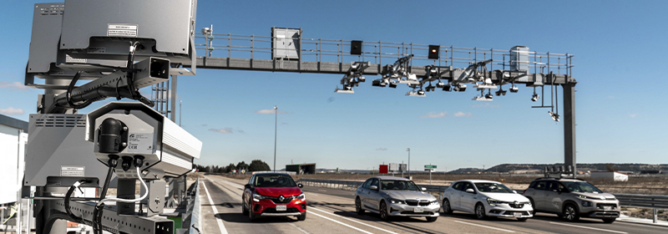


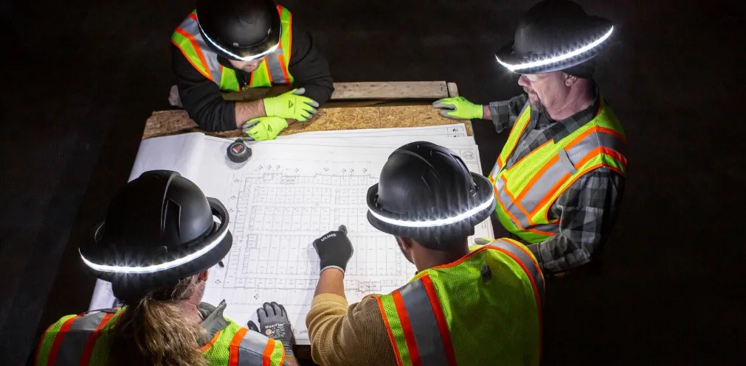
Example: AI Ready Transportation Hub
Demo Project Researchers
Guest Project Researchers
Shared Data --- archives, sensor streams, surveys …
Infrastructure Designers and Builders
...
Domain Experts
CUI Contact: cui@nsf.gov
Notes:
Should show People involved: folks running the facility, remote guests using the data/control interfaces, local researchers using data/control at facility.
Different people involved in the research – front line workers – guest projects – to create impact – how do they fit together? TRANSPORTATION HUB

Slide 8
Other Example Themes
Many areas have potential for real-world impact, a need for research to better understand how AI can help, challenges regarding privacy/safety/equity, and a distinct lack of integration with AI researchers.
AI-Ready Assistive Living
AI-Ready Education
AI-Ready Labs
AI-Ready Emergency Response Systems*
AI-Ready Public Safety
AI-Ready Finance and Banking
AI-Ready Weather Center*
AI-Ready Power Grid Control Center*
AI-Ready Farming*
AI-Ready Space Operations
AI-Ready Criminal and Juvenile Justice
Robot-ready Manufacturing
AI-Ready Urban Services (infrastructure repair and maintenance, social services …)
AI-Ready Wireless/Networking Platforms
* Priority areas for US-EU Cooperative Agreement on AI

Slide 9
Planning Grant Requirements and Program Vision
Planning grant proposals must identify an existing testbed that will be enlarged or enhanced to be AI-ready.
Proposals must focus efforts on providing a platform and supporting infrastructure (technological and human) that supports access by the broader research community. Proposals must make the case that your testbed will enable exceptional research for others in the community. (This will be the primary consideration for the full-proposal program to follow.)
Proposals should include evidence of community need (e.g. through surveys, through publications, workshops or symposia previously organized, direct communications)

Slide 10
Planning Grant Requirements and Program Vision
Some degree of modification and control over inputs and outputs such as sensors, communications, physical actuators, manufacturing flow and such should be available. Trade-off with risks should be considered.
Sweet spot
Utility of testbed
In situ testing impossible
Risks too great
Degree of control/modification by external researchers

Slide 11
Planning Grant Requirements and Program Vision
Scale of domain should facilitate multiple research questions and broad community interest --- e.g. entire power grid vs focus on wind turbine control; mixed transportation system vs focus on autonomous vehicle simulation …
Planning grant activities will include identifying and cultivating the researchers who will use the testbed and ascertain their needs (through workshops and such).
Full proposal program --- to follow --- will fund living lab environments for the entire community, not primarily the host’s and their already existing collaborators’ research. We anticipate multi-million-dollar awards over a 5- year period.

Slide 12
DCL: Planning Grants to Create AI-Ready Test Beds (NSF 24-111)
Planning Grants will support costs associated with forming teams, planning of envisioned AI-Ready infrastructure, cultivating an external user community, collection of preliminary pilot data and demonstrations, and creation of governance and management plans.
Planning Grants should cultivate research teams to actively address the expansion or enhancement of an existing test bed to implement and evaluate impact of applying novel AI methods to the domain. The proposals should articulate the types of research questions the AI-Ready Testbed will support.
Planning Grants will support organizing activities to help form AI-Ready Test Bed teams and crystalize ideas and infrastructure development and research plans to be presented in a future AI-Ready Test Bed Full Proposal.

Slide 13
FAQ
Q: Does the existing testbed have to have computational components in place, or is the domain function (e.g. a warehouse or farm cooperative without existing automation) sufficient? A: The strongest proposed projects will enhance or enlarge testbeds that already have some computational components, making them AI-Ready for a broad research community.
Q: Can the existing testbed be at a for-profit business? If so, can some of the planning grant funds be used to support personnel from the business? A: Yes, NSF encourages teaming with industry facilities. However, NSF does not typically fund the activities carried out by a for-profit business. (Please consult the PAPPG NSF 24-1 section I-E-2(a) for details.)
Q: Can we submit a Planning Grant proposal if we received a “discourage” or “do not encourage” decision on our Concept Outline? A: No, see PAPPG sections I-D-1 Concept Outlines and II-F-1 Planning.

Slide 14
FAQ
Q: How many planning grants will NSF support? A: Up to ten.
Q: When will funding decisions on Planning Grant applications be made? A: May or June 2025
Q: Is support for graduate students appropriate in Planning Grant proposals? A: If there is an appropriate research role for the GRA, yes.
Q: The DCL stresses that AI-Ready testbeds are expected to primarily support projects from researchers outside the group that constructs the testbed. How will those research projects be supported? How will ongoing operations and maintenance of the AI-Ready testbeds be supported? A: That will be articulated in the future solicitation for the full AI-Ready project proposals.

Slide 15
DCL: Planning Grants to Create AI-Ready Test Beds (NSF 24-111)
Planning Grant budgets may be up to $100,000 per year, with total funding of up to $200,000 for up to 24 months.
Planning Grant proposals must be submitted by 5:00pm, submitting organization’s local time, on November 13, 2024.
For further information, contact AI-Ready_testbeds@nsf.gov
QUESTIONS?

Slide 16
Ancillary Material

Slide 17
AI-Ready Sites
Opportunity to engage research community in answering questions like:
Does following the NIST AI Risk Management Framework lead to safer/better systems?
What mechanisms lead to community engagement and acceptance?
Do off-line learned AI control systems translate to beneficial systems?
Can we evaluate safe learning-enabled systems in the field?
There is a demand to engage a broader set of people in deployment questions and positive social impact. AI-Ready Sites will let us meet them partway.
Notes:
Instead of "AI-Ready Sites will let us meet them partway", how about "AI-Ready Sites will help them engage."

Slide 18
For Further Thought
Tiers for Planning grants, possibly tiers for full grants (see CIRC)
Mechanisms for guest project bidding, selection, and funding
Mechanisms to ensure infrastructure utility beyond grant lifetime

Slide 19
Appendix 1 - Further Thoughts on AI-Ready Transportation Hub
Urban/Metro – data on traffic flow, buses and subway utilization, schedule interruptions, equip failures, rider safety (accidents and harassment), weather disruptions, attitudes and perceptions to public transport, equity (access, last mile delivery), interaction with ride share, air quality monitoring, role for autonomous vehicles, multi-traffic interactions (autonomous – e.g. for last mile, human driver, micro-mobility)
Evaluation of interventions – interdisciplinary, what kind of infrastructure supports data gathering.
State, actions, perceptions, rewards – what information can you gather,
Successful proposal – makes useful information available to research community. Needs national advisory committee of people who have worked in similar domains – to guide infrastructure.
Making data shareable vital – what data is broadly useful --- attention to data model to ensure broad utility, accessible
AI to help people PLAN to use public transportation – can public transport become more flexible – encouraging rider use. Transient bus routes created on-the-fly to serve instant needs.
Spin some stories around transportation that highlight utility of research hub.
Planning
Construction for local use
Extension to broad use
Dissemination of knowledge about building the facility

Slide 20
Appendix 2
Further Thought
Tiers for Planning grants, possibly tiers for full grants (see CIRC)
Mechanisms for guest project bidding, selection, and funding
Mechanisms to ensure infrastructure utility beyond grant lifetime

Slide 21
Appendix 1 - Further Thoughts on AI-Ready Transportation Hub
Urban/Metro – data on traffic flow, buses and subway utilization, schedule interruptions, equip failures, rider safety (accidents and harassment), weather disruptions, attitudes and perceptions to public transport, equity (access, last mile delivery), interaction with ride share, air quality monitoring, role for autonomous vehicles, multi-traffic interactions (autonomous – e.g. for last mile, human driver, micro-mobility)
Evaluation of interventions – interdisciplinary, what kind of infrastructure supports data gathering.
State, actions, perceptions, rewards – what information can you gather,
Successful proposal – makes useful information available to research community. Needs national advisory committee of people who have worked in similar domains – to guide infrastructure.
Making data shareable vital – what data is broadly useful --- attention to data model to ensure broad utility, accessible
AI to help people PLAN to use public transportation – can public transport become more flexible – encouraging rider use. Transient bus routes created on-the-fly to serve instant needs.
Spin some stories around transportation that highlight utility of research hub.
Planning
Construction for local use
Extension to broad use
Dissemination of knowledge about building the facility

Slide 22
Concept
Shared Infrastructure
AI has jumped from the lab into the world. Consequences for society are profound.
To better understand how AI technology can be best adopted in high-impact social settings, we propose creating
AI-Ready Sites
Shared Infrastructure at specific locale (with support for remote access)
Focus on AI research and AI impact in the world in the context of a Living Lab.
Multiple projects and teams at one locale => collaboration and nexus-building.
Living Lab Model
Natural
Nexus-Building Environment
Workforce Development
Notes:
UPDATE SLIDE:
How can researchers work on these society-facing problems:
- static data, but then relatively untethered to the domains. Ends up not being relevant.
- living lab, on site technologists work as nexus between task domain and researchers.
- researcher embeds with front-line service providers / domain experts. Very time-consuming.
Feedback loops important: Key elements of NIST’s RMF require evaluating how effective recommendations are. Impacts back on the front-line domain.

Slide 23





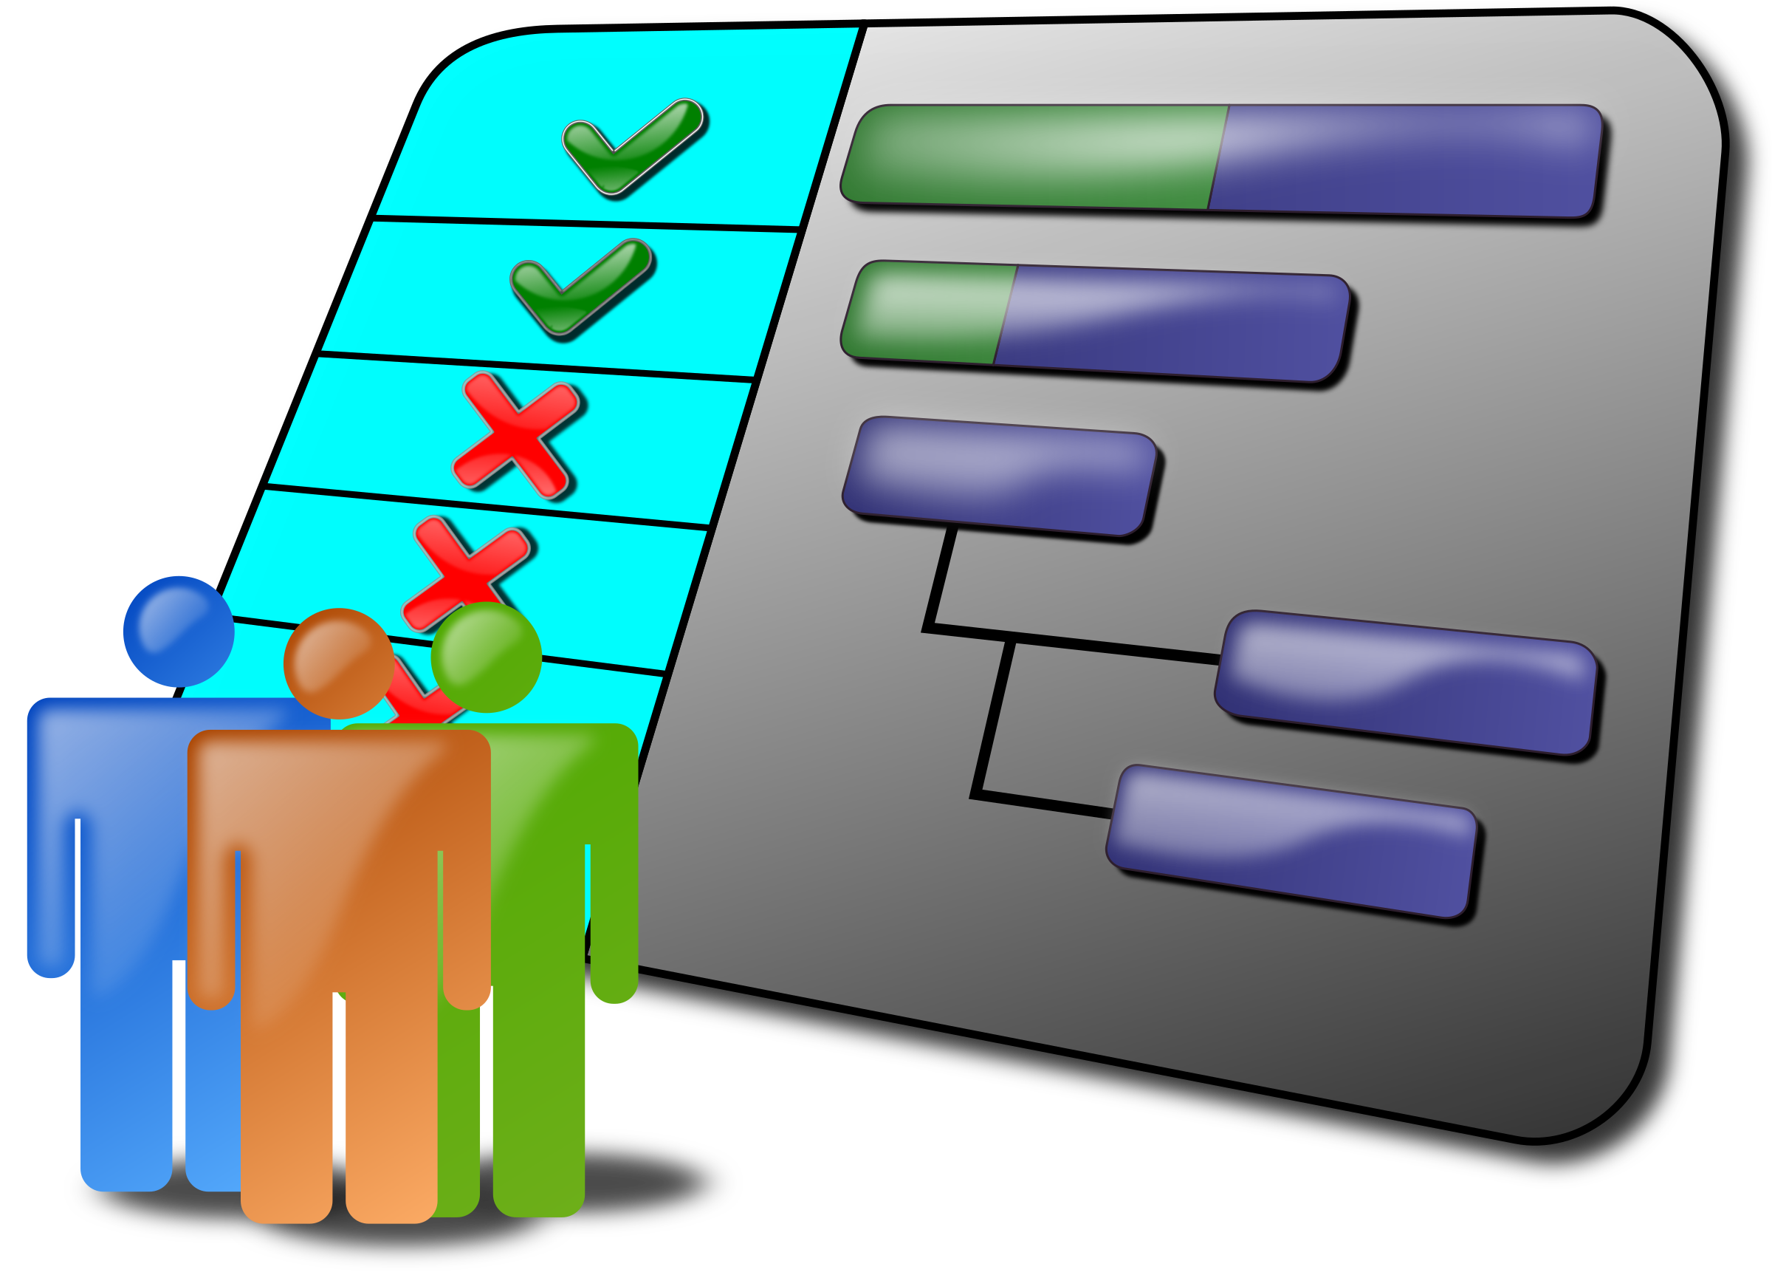

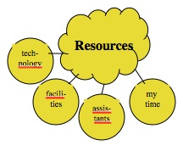




AI Ready Living Lab for AI-Transportation Research
CUI//PRVCY
Communities
Shared Datasets
and Knowledge
Industry Partners
Core and
Guest Projects
Academic Researchers
Shared Resources
and Infrastructure
Government Partners
CUI Contact: cui@nsf.gov
Notes:
This slide should visually talk to the points in slide 6 – MAKE MORE VISUALLY CONGRUENT Should show People involved: folks running the facility, remote guests using the data/control interfaces, local researchers using data/control at facility.
Different people involved in the research – front line workers – guest projects – to create impact – how do they fit together? TRANSPORTATION HUB

Slide 24


AI-Ready Transportation Hub
AI-Ready Transportation Hub Theme
AI-Ready Living Lab Transportation Hub
Building Community
Infrastructures around
Themes for Transformative Real-World Impacts
1.
2.
Real-World Living Lab Environment
Established and Maintained in One Location by Theme Topic
Central Hub for Data Collection, Research, User Studies, Information Sharing
One Facility Management and Oversight Staff
Academic Teams of Researchers gain access to real world data, personnel, activities, and research through core projects
Other Researchers use facilities and resources for real-world data collection and research through guest projects
Notes:
1. https://www.technology-innovators.com/wp-content/uploads/2023/05/AI-and-Transportation-Addressing-Safety-Privacy-and-Ethical-Challenges.jpg
2. https://www.hfmmagazine.com/ext/resources/images/2018/magazine/jan_feb/0118_SpecialReport_Sidebar_NerveCenter_700x468.jpg

Slide 25
Vision – Improves Project Synergies AI Ready Sites can encourage projects to enhance one-another
Test deployments in a common research facility will provide exciting breadth of functionality to test users, and experience with interactions between advanced technologies and apps.
Common research infrastructure can naturally promote new collaborations (nexus-building).
Notes:
Maybe hold this out for closing impact statement and check against content with previous slides.

Slide 26
Program Design - Sustainability
Projects need plan for sustainability: user fees, ongoing support from partner agencies ...
Notes:
Discuss potential options for sustainability models – more details.

Slide 27
Program Design - Sustainability
Projects need plan for sustainability: user fees, ongoing support from partner agencies ...
Notes:
Strengthen and complete

Slide 28
Interaction, not Static Data
Building AI systems using data is relatively well understood at this point.
Less understood is how the decisions create impact and change the data.
Living lab lets researchers study:
The effectiveness of following risk-management frameworks.
The technical feasibility of “bill of rights” type requirements.
Strengths and weaknesses of evaluation methodologies like red teaming.
Users adjust their behavior to align with system
Data collected on user behavior
Data used to modify system behavior

Slide 29
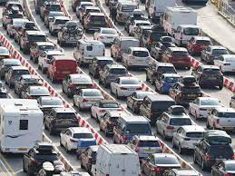
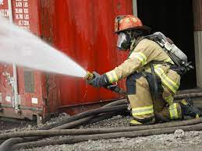
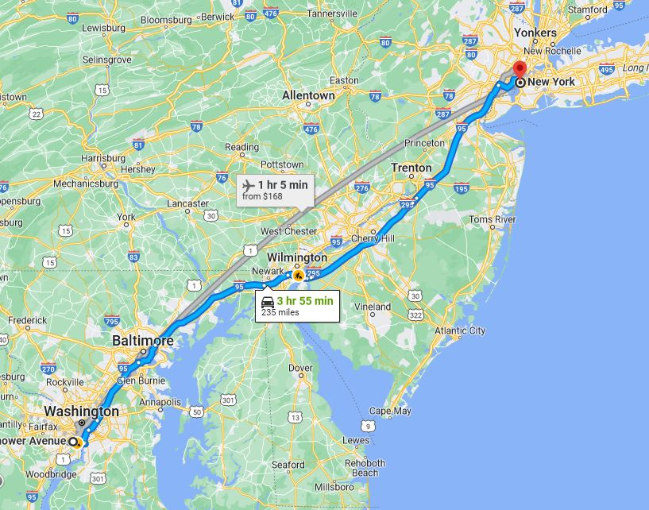
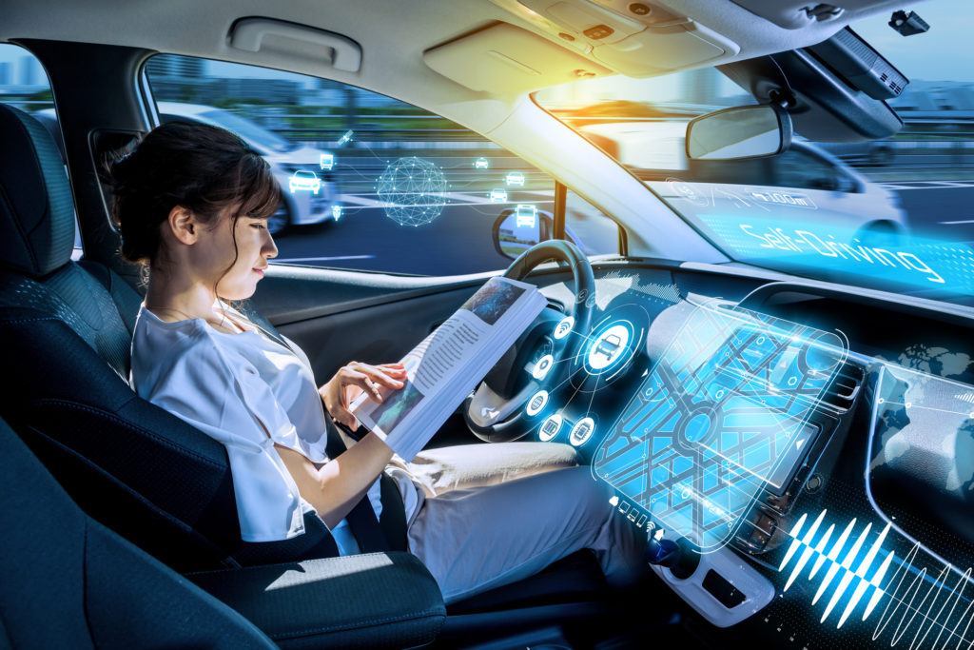
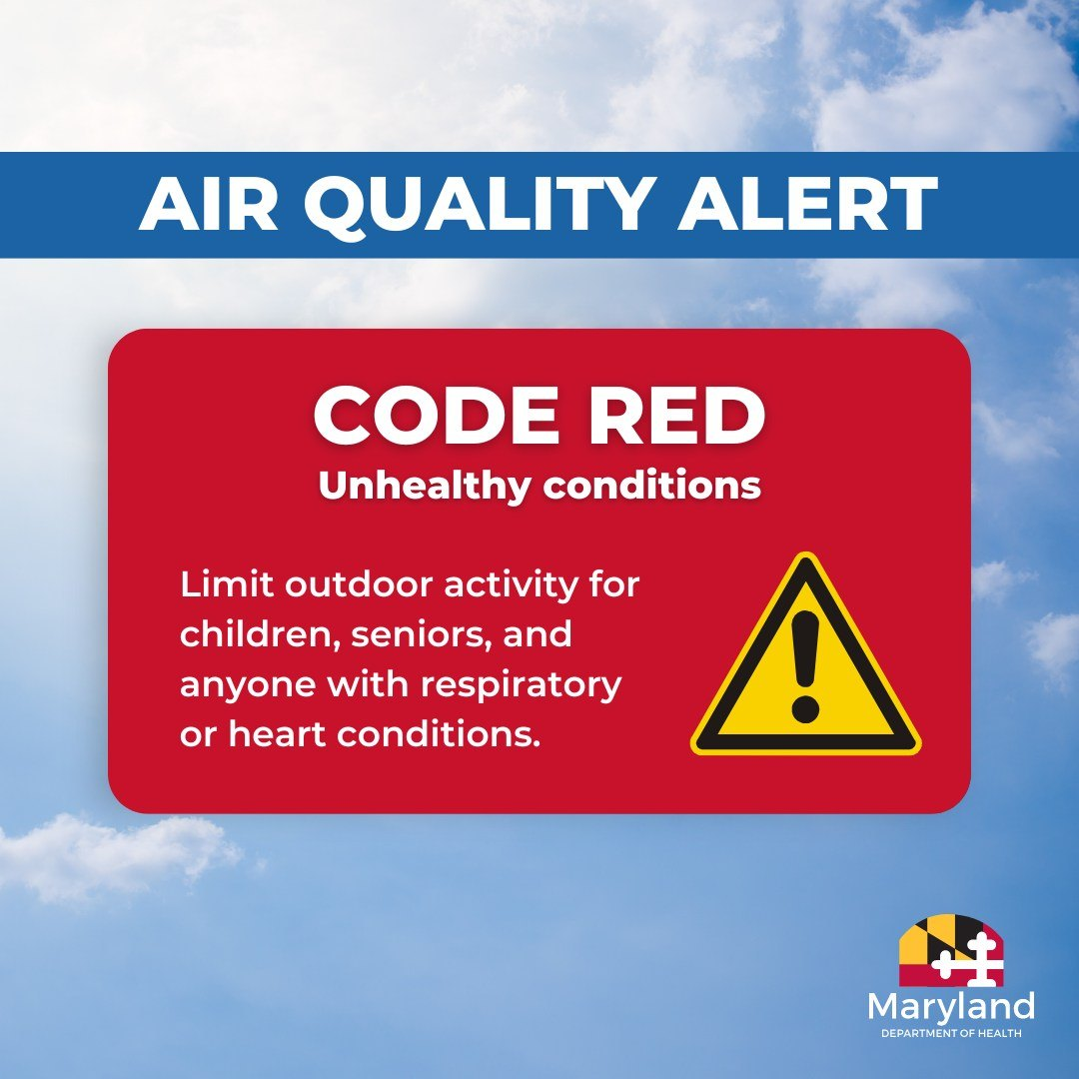
Vision
Traffic Conditions
Emergency Info.
Imagine navigation and other transportation apps enhanced by:
Air quality information
Predictions of traffic conditions hours in advance
Real-time emergency information
Options for last-mile transport
Reports on autonomous vehicle presence and tolerance
Multiple stop route planning that integrates all of these
Equitable deployment of infrastructure (street repairs, bus routes, last-mile solutions) enhancing fairness.
Autonomous Vehicle Presence
Air Quality Alerts

Slide 30
Program Design $3-$6.5M over up to 5-6 years + follow-on
Infrastructure Building and Living Lab Development. ~$2-5M up to 5 years
Pilot Demo Projects in the Living Lab to prove and adjust infrastructure – years 3-6 (depending on scale of total award), additional ~$1-$1.5M
Original Grant
Follow-On Funding
Guest Projects from groups other than primary proposal team, e.g., through supplements or external partner funding at $300-$600k per project
OR …

Slide 31
Vision – Improves Project Synergies AI Ready Site can encourage projects to enhance one-another
Test deployments in a common research facility will provide exciting breadth of functionality to test users, and experience with interactions between advanced technologies and apps.
Common research infrastructure can naturally promote new collaborations (nexus-building).
Notes:
Integrate concepts with prior slides and make sure not repetitive.

Slide 32
Program Design $3.5-$7M over up to 5-7 years
Infrastructure Building and Living Lab Development. ~$2-5M up to 5 years
Pilot Demo Projects in the Living Lab to prove and adjust infrastructure – years 3-6 (depending on scale of total award), additional ~$1-$1.5M
Guest Projects from groups other than primary team, at $300-$600k per project
Combined
Notes:
Guarantees that guest projects happen, but harder to ensure they are at arm’s length. Trade off worth considering.
Make sure terminology is consistent throughout the slides.

Slide 33
Program Design
Specified Themes in Solicitation (e.g. Transportation, Power Grid, Emergency Response, …), changes every year or two.
Planning Grants --- smaller scale, perhaps $ as CIRC to develop collaborations, drive new themes …
Notes:
Need more information and opportunities.
Look at CIRC and at SCC planning grants --- and formulate our own design for them.
Planning grants could introduce new themes.

Slide 34
Contrast with Other NSF Programs
Civic Innovation Challenge (CIVIC): 1-year awards up to $1M. Proposal needs to plan for sustainability beyond that time.
Smaller scale program – does not build the infrastructure and provide a mechanism for other community members outside of the grant to participate. Not focused on advances in AI.
Smart and Connected Communities (SCC):
Track (1) - $1.5M-$2.5M four years
Track (2) - up to $1.5M three years + planning grants – one year – up to $150k.
Not focused on living lab, guest projects, or user-research based on community infrastructure
Notes:
Must participate in MetroLab Network cohort activities

Slide 35
Contrast with Other NSF Programs
Community Infrastructure for Research in Computer and Information Science and Engineering (CIRC): Planning awards, development awards, medium (3 years $2M), grand awards 5 years $5M. “Drives discovery and learning in core CISE.” Requires sustainability plan. (Just within CISE)
Similar scale program, similar model. Not focused on AI, doesn’t include Pilot Demo Project
AI Institute: $20M awards, no mandate to form infrastructure suitable for extended community.
AI-Ready could be a new program or fold into AI Institute program or CIRC as a different thread.

Slide 36
Program Design --- Internal Partners
Office of Integrative Activities
CISE --- all divisions
SBE – for ethical and social impact aspects, including techniques for measurement of
impacts to enable evidence-based policy
ENG
CMMI – manufacturing; civil infrastructure; disasters and built environment; robotics (e.g. warehouse and manufacturing)
CBET – environmental (e.g. disaster readiness and recovery), biosensing (e.g. for farming)
ECCS (?)
Emerging Frontiers and Multidisciplinary Activities (EFMA)
GERMINATION: Germination of research Questions for Addressing Critical Societal Challenges
GEO
TIP – AI Ready is part of the translational pipeline
Expand AI
Office of International Science and Engineering --- leverage recent CISE activities (Australia, U.K. …)

Slide 37
Program Design --- Solicitations
Ramp-up Model: 2 themes in first year, 3-4 each year in following years. (Specified themes for each competition improves review quality and selection process.)
Solicitation-Specific Review Criteria (named sections of proposal)
Societal Impact
Why this locale for site, why this team? (Including cross-disciplinary composition where appropriate)
Explicit plan for years 4-6 Pilot Demo Projects
Explicit plan for out-year financial sustainability
Responsible and Ethical Computing Section --- AI Ready infrastructure offers unique opportunity to measure (positive and negative) societal impacts, test social theory. Encourage participation of social scientists for authoritative evaluation of social impacts
Nexus-Building plan – describes how project will promote collaboration between user projects to increase synergy value.
Data Plan: More elaborate than standard Data Management Plan to address data privacy, dissemination, and user agreements, including budget allocation for data operations.

Slide 38
Contrast with Other NSF Programs
AI READY builds infrastructure in the community for research.
Real World Deployment for grounding
Exploratory scale allows evaluation of concept without huge economic investment.
Will naturally promote cross-fertilization of groups and nexus-building.
Will multiply effects of user’s individual projects providing for evaluation of simultaneous deployment of multiple novel AI technologies (intersectionality)
Will provide substrate for teaming between federal agencies, and between NSF and city/regional authorities

Slide 39





Program Design --- External Partners
D.O.T. for transportation hub facility
D.O.E. for power grid
D.H.S for emergency response
D.O.A. and NIFA for farm operations and food security
NASA for space operations, NASA and EPA for environmental health monitoring
NIST – ethics and societal impact, partially funding new Trustworthy AI center, a connection we can continue to grow.
State agencies and municipal partners
39

