Slide 1


NSF ExpandAI Program (Solicitation NSF 23-506)
Webinar Tuesday Oct 29, 2024

Slide 2
Webinar Agenda
Opening Remarks
Presentation
Partnership Opportunities
Q&A

Slide 3
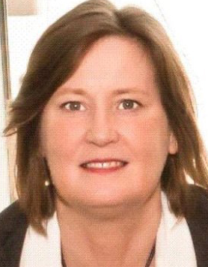
Opening Remarks
Wendy Nilsen, Deputy Division Director
Directorate for Computer and Information Science and Engineering (CISE) Division of Information and Intelligent Systems (IIS)

Slide 4
Presentation
Part I: AI Institutes Program Overview​ (Jim, 3 min)
Part II: Expand AI Program Overview​ (Abi, 4 min)
Part III: Eligibility ​(Subrata, 3 min)
Part IV: Crafting Quality Concept Outlines (Al, 5 min)
  Capacity Building Pilots (CAP) and Partnerships (PARTNER) ​
Part V: Full Proposal Preparation and Submission ​
General (Nick, 3 min)
Capacity Building Pilots (CAP)​ (Jim, 2 min)
Partnership (PARTNER) ​(Erion, 4min)

Slide 5
Part I: AI Institutes Program Overview​

Slide 6
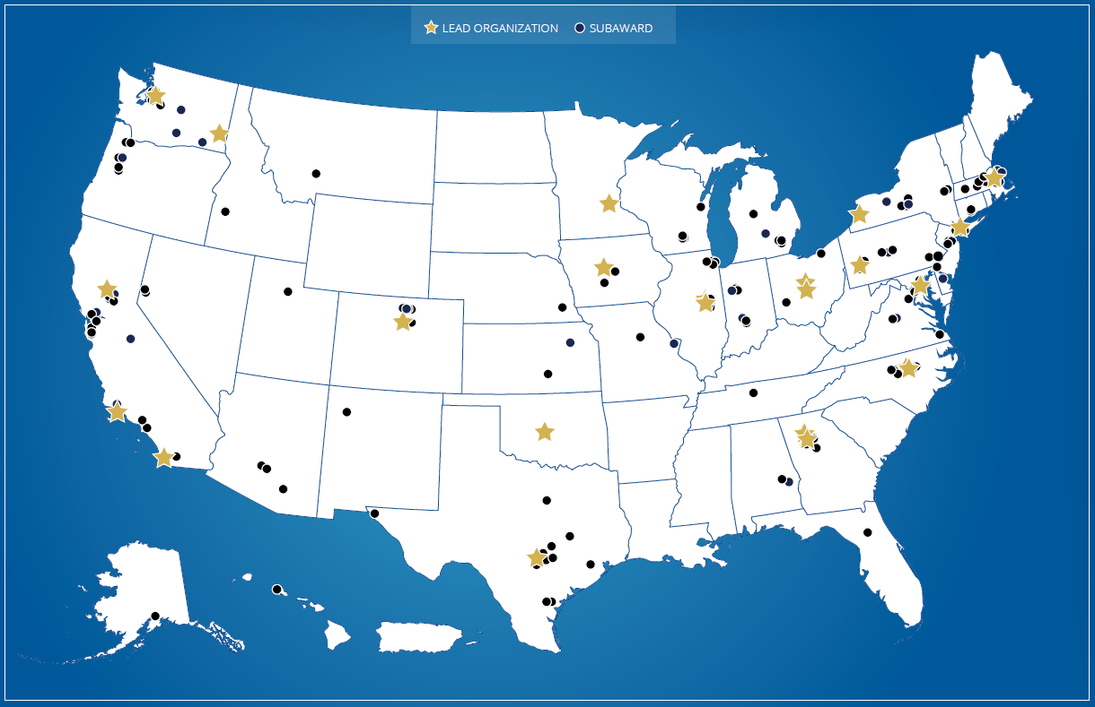
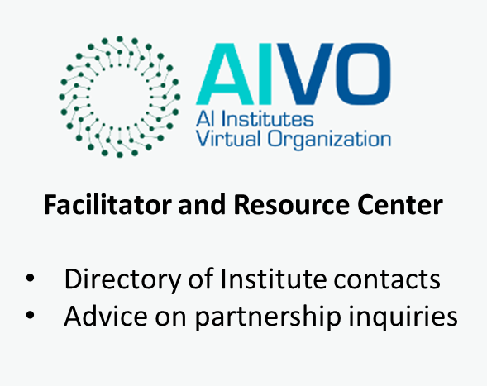

National Artificial Intelligence (AI) Research Institutes
$20M (~4M/year) over 5 years
Foundational and use-inspired AI research
Innovation in AI education and workforce development
New partnership development
AI Institutes and Funding Partners
Community Portal
Learn more about AI Institutes at https://aiinstitutes.org

Slide 7



























27 Active Institutes
2020: First cohort (5 NSF, 2 NIFA)
2021: Second cohort (9 NSF, 2 NIFA)
2023: Third cohort (6 NSF, 1 NIFA)
2024: Fourth cohort (2 NSF-Simons Foundation)
AIVO: https://aiinstitutes.org
Link to all awards: NSF Award Search

Slide 8
Part II: ExpandAI Program Overview

Slide 9
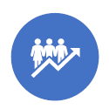
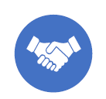
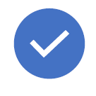
ExpandAI Program Overview
Program Goal: Diversify participation in AI research, education, and workforce development through (1) Capacity Building and (2) Partnerships with the National AI Research Institutes
NSF supports growth of interdisciplinary research by diverse community for advancement of AI-driven innovation
MSIs are source of untapped talent critical to future AI innovation/responsible AI research
Many minority-serving institutions (MSIs) are not yet significantly engaged in AI research and education. However, there is enormous potential to develop talent through federally supported AI research that is critical to future AI innovation and responsible AI research
ExpandAI promotes capacity development for new AI programs at Minority Serving Institutions (MSIs), as well as partnerships between MSIs and AI Institutes
Capacity
Partnership
Approach
Build AI capacity
MSI-specific goals
Institutional Change
Potential Path
to Partnership
Leverage AI Institutes
MSI-led awards
AI Institute subawards
Shared vision and goals
Institute integration plans
Lower barriers to success
Concept outlines
Submission windows
Flexible submissions

Slide 10
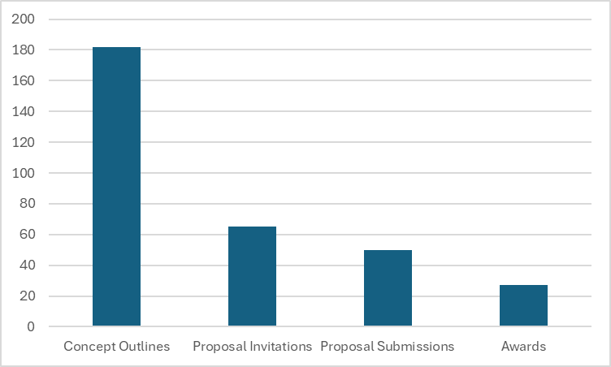
Program Highlights
Launched Oct 17, 2022: ExpandAI Program (solicitation 23-506) under CISE’s AI Institutes program (NSF 23-610)
Flexible Submission windows, no single date deadline, 2-page concept outlines, MSI-specific goals and MSI-led awards
Outreach: Live Webinars, Monthly Office Hours, Presentations at MSI PI Meetings, 1-on-1 virtual meetings with POs
Enthusiastic MSI Response!

Slide 11

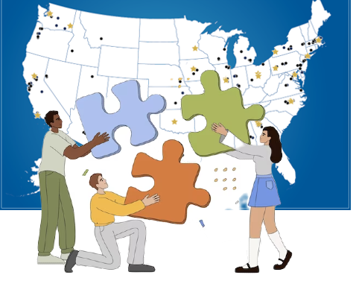
Track 1 - CAP
Track 2 - PARTNER
CAPACITY BUILDING – INSTITUTIONAL CHANGE
NEW COLLABORATIONS WITH AI INSTITUTES
Establishment of new AI research, education, workforce development, and/or infrastructure
Leverage AI Institutes as new collaborations for MSIs to scale up established AI research and/or education
Planning and growth efforts focused on establishment of AI activities at MSI and early exploration of future partnerships
Multi-organization collaborations submitted by the MSI with subaward to the AI Institute

Slide 12
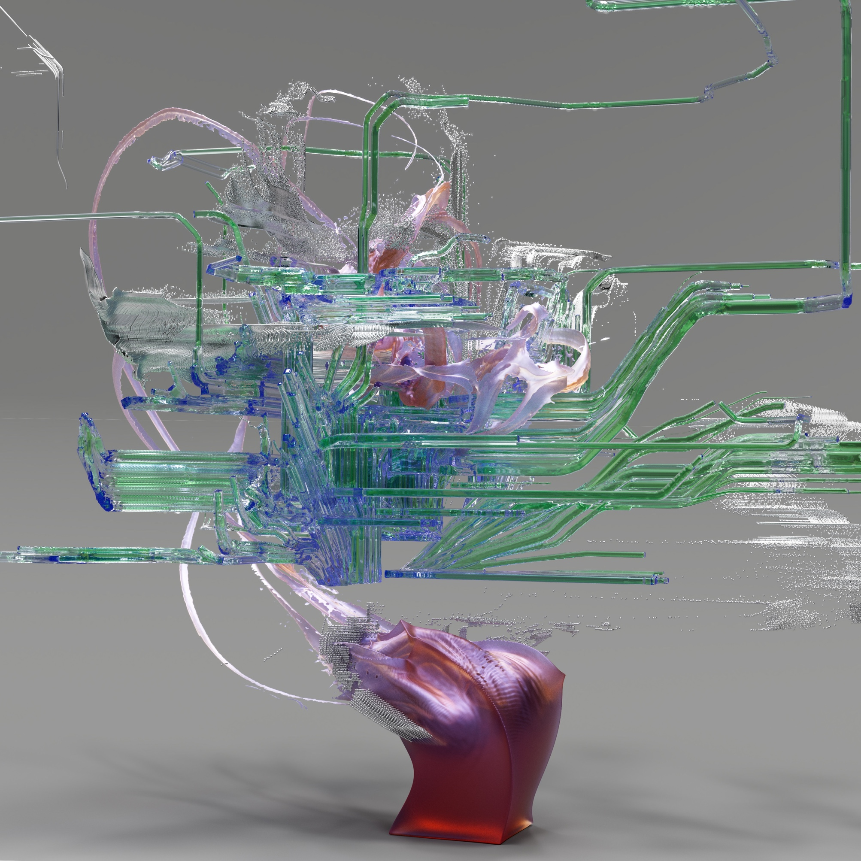







FY 2024 ExpandAI Awards
$31.8 million in awards (11 CAPs, 4 PARTNERs)
AI Research
AI Education
AI Workforce
15 Awards in 10 US states/territories including,
  3 EPSCoR awards (1 to AK, 2 to AL)
  5 HBCUs (AL, GA, MD, NC, and VA)
  6 HSIs (2 CA, IL, 2 TX, VA)
Cross-NSF directorate funding partnerships
CISE
EDU
Image: Google DeepMind
ENG
GEO
Notes:
ExpandAI supports capacity-development projects and partnerships within the National AI Research Institutes ecosystem that help broaden participation in artificial intelligence research, education and workforce development. These concepts are all connected and support each other.
ExpandAI: Expanding AI Innovation through Capacity Building and Partnerships
HIS: Hispanic-serving institute
EDU funding programs include HBCU-UP and LSAMP
HBCU-UP: Historically Black Colleges and Universities - Undergraduate Program
LSAMP: Louis Stokes Alliances for Minority Participation
University List:
Texas State University - San Marcos
The University of Texas Rio Grande Valley
Meharry Medical College
Texas A&M University-San Antonio
California State University San Marcos Corporation
Prairie View A&M U
University of Puerto Rico Mayaguez (IAIFI)
Florida International University (AI2ES)
University of Texas at San Antonio (ATHENA)
CUNY City College (AI-EDGE)
San Diego State Univ Fdn (AI2ES)

Slide 13
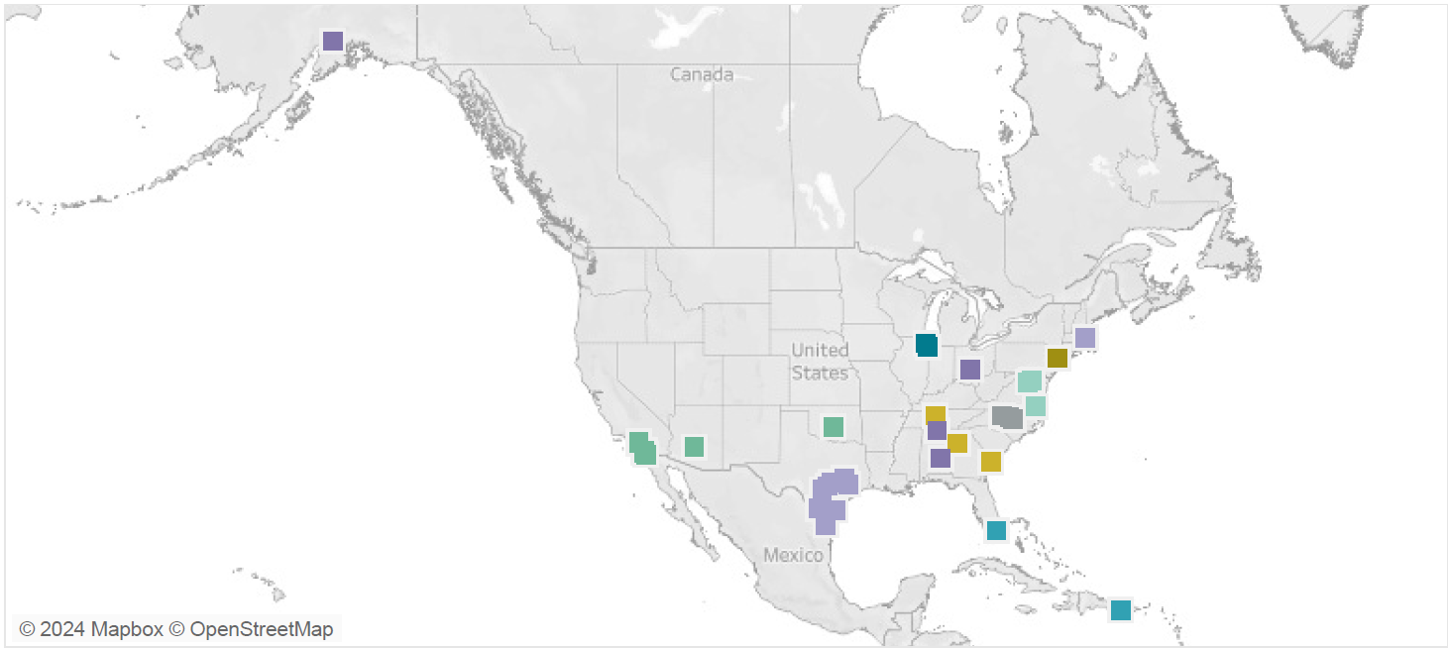
ExpandAI Awards to Date
$32.3 million in awards (18 CAPs, 9 PARTNERs)
26 Awards in 13 US states/territories including,
9 HBCUs (8 CAPs, 1 PARTNER)
17 HSIs (8 CAPs, 9 PARTNERs)
AI Research
AI Education
AI Workforce
Notes:
Highlighting the fact that any aspect of AI capacity building can be pursued.

Slide 14






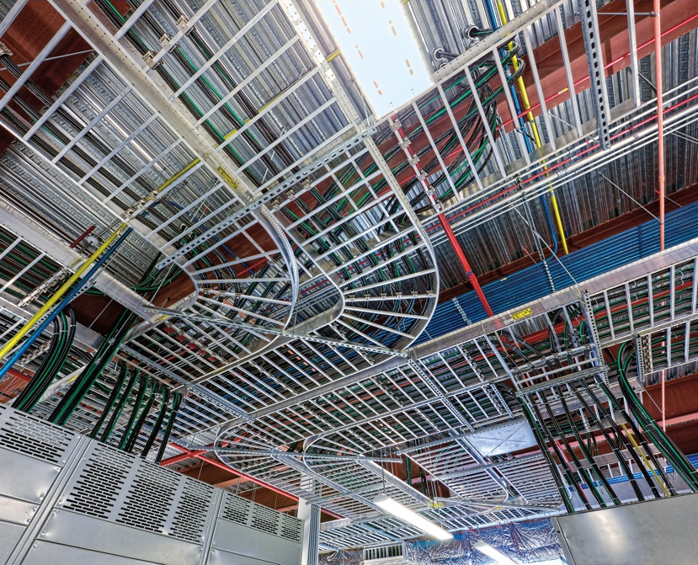


FY 2024 ExpandAI Award Topics
Transportation Infrastructure Monitoring
AI Curriculum Development
Traffic Safety
Disease Diagnostics
Robotics
Cybersecurity
AI Infrastructure
Durability in Extreme Cold
Trustworthy AI
Notes:
ExpandAI supports capacity-development projects and partnerships within the National AI Research Institutes ecosystem that help broaden participation in artificial intelligence research, education and workforce development. These concepts are all connected and support each other.
ExpandAI: Expanding AI Innovation through Capacity Building and Partnerships
HSI: Hispanic-serving institute
EDU funding programs include HBCU-UP and LSAMP
HBCU-UP: Historically Black Colleges and Universities - Undergraduate Program
LSAMP: Louis Stokes Alliances for Minority Participation
Topics include:
AI Curriculum and Infrastructure development, Trustworthy AI in autonomous systems, Cybersecurity, Robotics, Traffic safety, Durability in extreme cold, Coastal environmental modeling, Neuro-Inspired AI, Disease diagnostics, modeling of precipitation and other atmospheric variables
University List:
Texas State University - San Marcos
The University of Texas Rio Grande Valley
Meharry Medical College
Texas A&M University-San Antonio
California State University San Marcos Corporation
Prairie View A&M U
University of Puerto Rico Mayaguez (IAIFI)
Florida International University (AI2ES)
University of Texas at San Antonio (ATHENA)
CUNY City College (AI-EDGE)
San Diego State Univ Fdn (AI2ES)
*images from NSF media site, Google DeepMind, Motion AI, Pipeline Technology Journal, Rhoads and Rhoads, P.S.C, and openPR

Slide 15

ExpandAI Approach
Do Not Invite - Revise and Resubmit or New Idea
Send CO as PDF to expandaiprogram@nsf.gov
Concept Outline
NSF Internal Review
Idea
DECLINE
INVITE Full Proposal
Submit full proposal to research.gov
NSF
Review
Full Proposal
AWARD

Slide 16
Estimated Program Budget FY 2025
Overall: $10-17million available to support 15 – 25 awards:
10-15 Capacity Building Pilots (CAP) awards
5-10 Partnership (PARTNER) awards
CAP award - standard grant up to $400,000 total budget over two years
PARTNER award - continuing award in the range of $300,000 to $700,000/year for up to 4 years

Slide 17
Part III: Eligibility
Concept Outlines and Proposals
CAP & PARTNER

Slide 18


Eligibility Information
What organizations
can submit?
Who may serve as PI?
Limit on Number of Proposals per Organizations:
  An organization may submit one proposal per submission window
  An organization must wait for a determination from NSF (e.g., Award, Decline, or Returned Without Review) on the pending proposal before submitting a new proposal in the next window.
  Declined proposals require a new invitation to submit (via the Concept Outline process) and significant revision.
  An organization that has received an invitation to submit a full proposal must wait for that proposal to be submitted and resolved before submitting another Concept Outline

Slide 19
Institutional Eligibility
ExpandAI proposals may be submitted by accredited Institutions of Higher Education that belong to at least one of the following classifications as a minority-serving institution (MSI):
  Alaska Native Serving Institutions (ANSI)
  Hispanic Serving Institutions (HSI)
  Historically Black Colleges and Universities (HBCU)
  Predominantly Black Institutions (PBI)
  Native Hawaiian Serving Institutions (NHSI)
  Native American-serving, non-Tribal Institutions and Tribal Colleges and Universities (TCU)
  Other Minority-Serving Institutions (MSI)
Eligibility as a minority-serving institution may be determined by reference to the Integrated Postsecondary Education Data System (IPEDS) of the US Department of Education National Center for Education Statistics (http://nces.ed.gov/ipeds/).
Please review solicitation NSF 23-506 for more details.

Slide 20
PI Eligibility
  The Principal Investigator must hold a full-time faculty appointment or be a senior administrator at an eligible Institution as defined in the 'Eligible Institutions of Higher Education' section
  In PARTNER proposals only, a co-PI must be identified to represent each partnering AI Institute. That co-PI must be verified by the Institute Director in the Institute Integration Plan as being among the senior personnel of the institute.

Slide 21
Additional Information
  Only eligible organizations that have received an official Program Officer Concurrence Email inviting a full proposal may submit a full proposal
  To receive the invitation, potential proposers must submit a Concept Outline document and receive an official response (via email) from a cognizant Program Director. Please see section V.A of the solicitation for details
Limit on Number of Proposals per Organization:
  An organization may submit one proposal per submission window
  An organization must wait for a determination from NSF (e.g., Award, Decline, or Returned Without Review) on the pending proposal before submitting a new proposal in the next window.
  Declined proposals require a new invitation to submit (via the Concept Outline process) and significant revision.
  An organization that has received an invitation to submit a full proposal must wait for that proposal to be submitted and resolved before submitting another Concept Outline

Slide 22
Part IV: Crafting Quality Concept Outlines​ (COs)

Slide 23
Concept Outlines
All proposers must first submit a two-page concept outline
NSF will review Concept Outlines on an ongoing basis for potential to be responsive to ExpandAI program goals
Process ensures proposers do not expend time or resources preparing full proposals that do not have strong potential to be responsive to the program objectives
COs are required for both tracks (CAP and PARTNER)
COs must be sent as PDF attachment in an email sent to: expandaiprogram@nsf.gov
Format SUBJECT line: “CO: [Title as it appears in Concept Outline]”
  (For Example CO: CAP: AI Capacity Building in XYZ University)

Slide 24
Concept Outlines (contd.)
If Concept Outline is responsive to ExpandAI program goals, proposer will receive an official invitation to submit a full proposal - Program Officer Concurrence Email
Proposers have up to 12 months from date of Program Officer Concurrence Email to submit full proposal
If Concept Outline is not responsive to ExpandAI program goals, proposer will receive notice not to submit a proposal
Proposers not invited to submit a full proposal in response to a Concept Outline may submit a new Concept Outline after the start of the next submission window (sooner, by exception, if specifically invited by the program)
Resubmitted COs need to have been substantially revised according to reviewers' comments
Proposers who do not receive an invitation to submit a proposal are not eligible to apply for ExpandAI funding. Proposals will be RWR

Slide 25
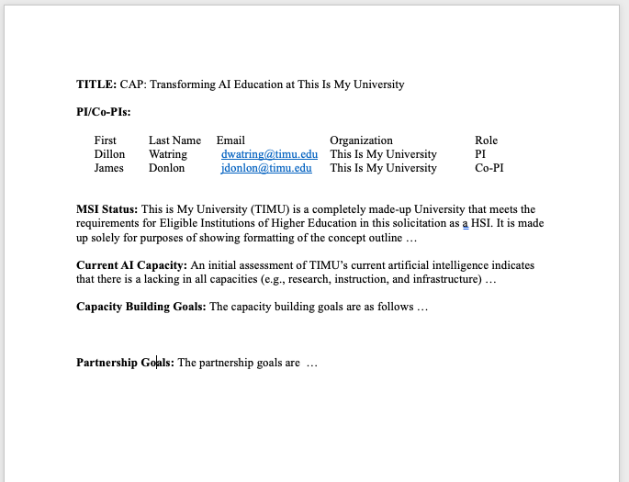
Anatomy of a Concept Outline
  1. Title: [CAP or PARTNER] Concise, descriptive title of project proceeded by CAP: or PARTNER: for each respective track.
  2. Name of PI and co-PIs: List up to 5 personnel. For PARTNER COs, include a co-PI from the partnering AI Institute
  3. MSI Status: (250 words) Briefly describe the submitting institution’s current AI capacity in research, instruction, and infrastructure as it relates to the proposed CO.
  CAP Track: Demonstrate a compelling institutional need for capacity building in AI.
  PARTNER Track: Describe a suitable foundation for success in collaboration detailed in the CO.
2-page maximum

Slide 26
Anatomy of a Concept Outline
  4. Goals:
  CAP Track: (500 words) Describe the outcomes and benefits of capacity building to the MSI. Outline goals and any preliminary plans that will be fully described in the full proposal’s Capacity Building Plan.
  PARTNER Track: (500 words) Identify the organizations and the prospective collaborative work in a unifying theme or focus. Outline shared goals and identify prospective projects that might be fully described in the Partnership Roadmap in the full proposal. Clearly highlight the mutual benefit and outline the potential benefits of the concept to both the MSI and the AI Institute.
2-page maximum

Slide 27
Hints for Preparation of Competitive CAP COs
Not too focused on individual researcher projects
involve a single MSI – preference is for a CO/proposal that seeks to build capacity distinctive to the MSI
MSI clearly has zero or under-developed AI capacity (not much current AI capacity)
Emphasizes research infrastructure institution-wide, not just in researcher lab
Focused on acquiring infrastructure/resources for a broad range of research projects
Proposes growth in AI capacity that is significant across institution
Provides a robust and accurate description of current institutional AI capacity
Institutional capacity building goals are clearly articulated
Provide sufficient details of AI research projects and curriculum development activities planned

Slide 28
Hints for Preparation of Competitive PARTNER COs
Clear connections between the identified research efforts and AI institute research
Sufficient engagement with AI Institute – convincing joint strategy for collaborative work
Benefits of collaboration to the MSI is clearly articulated
Arrangement described will clearly continue to build or mature AI capacity at MSI
Institution is NOT already a core member of the AI Institute with which it proposes to partner

Slide 29
Part V: Full Proposal Preparation and Submission

Slide 30
General: Proposal Submissions
An official email from ExpandAI PO inviting a concept outline to submit a full proposal is required
The ExpandAI program has recurring proposal submission windows. Unlike deadlines, submission windows allow proposers flexibility to submit a full proposal at any time during specific dates listed
On each submission window closing date, proposal submission system will shut down at 5:00 p.m. submitter's local time
The system will reopen for new submissions the morning of next window, with exception of final submission window
An organization may submit one proposal per submission window. An organization must wait for a determination from NSF (e.g. Award, Decline, or Returned Without Review) on the pending proposal before submitting a new proposal in the next window.
Declined proposals require a new invitation to submit (via the Concept Outline process) and significant revision, while proposals Returned Without Review may be submitted using the same invited Concept Outline (assuming that the proposal is received within one year of the original Concept Outline invitation)
An organization that has received an invitation to submit a full proposal must wait for that proposal to be submitted and resolved before submitting another Concept Outline
Limit on Number of Proposals per PI or co-PI: There are no restrictions or limits.

Slide 31
Proposal Submission Windows
Eligible MSIs can submit a Concept Outline at any time. MSIs that have been invited to submit a full proposal can submit a proposal based on the Concept Outline at any time during one of the submission windows listed below:
Proposal Submission Windows
        January 06, 2025 - March 10, 2025
        March 11, 2025 - June 23, 2025
        June 24, 2025 - October 17, 2025

Slide 32
Sections of the Proposal
  Title: [CAP or PARTNER] Concise, descriptive title of project proceeded by CAP: or PARTNER: for each respective track.
  Project Summary (1-page limit): Overview, Statement on Intellectual Merit, Statement on the Broader Impacts
    Must include:
      Overview
      Statement on Intellectual Merit
      Statement on Broader Impacts
  Project Description (15 pages): Must follow the requirements of the PAPPG except where this solicitation deviates.
    Project description must use the sections below for the applicable track. Name the sections as indicated below, in capital letters. You may add other sections and order sections as you see fit.
Track 1: CAP
NEED AND POTENTIAL
CAPACITY BUILDING PLAN
BROADER IMPACTS
PERSONNEL
Track 2: PARTNER
AI CAPACITY
COLLABORATION PLAN
BENEFITS TO AI CAPACITY
BROADER IMPACTS
PERSONNEL

Slide 33
Sections of the Proposal
  References Cited: List only references cited in the Project Description or supplementary documents
  Budget and Budget Justification:
  Facilities, Equipment, and Other Resources:
  Senior Personnel Documents
  Data Management Plan
  Mentoring Plan
  Other Supplementary Documents
    Institutional Need and Support Statement (3 pages)
    Institute Integration Plan (PARTNER TRACK ONLY, 3 pages/ AI Institute)
    Results from Prior NSF Support
    Cloud Computing Resources
    Letters of Collaboration
  Single Copy Documents
    Required:
      Program Officer Concurrence Email
This is just a brief overview. Please follow guidelines laid out in Solicitation (NSF 23-506)

Slide 34
Submission of Full Proposal
For CAP and PARTNER proposals:
Full Proposals submitted via Research.gov - NSF Proposal and Award Policies and Procedures Guide (PAPPG) guidelines apply. The complete text of the PAPPG is available electronically on the NSF website at: https://www.nsf.gov/publications/pub_summ.jsp?ods_key=pappg.
Full Proposals submitted via Grants.gov: NSF Grants.gov Application Guide: A Guide for the Preparation and Submission of NSF Applications via Grants.gov guidelines apply (Note: The NSF Grants.gov Application Guide is available on the Grants.gov website and on the NSF website at: https://www.nsf.gov/publications/pub_summ.jsp?ods_key=grantsgovguide).

Slide 35
Capacity Building Pilots (CAP) Track Proposals
11 CAPs AWARDED FY 24
10-15 Capacity Building Pilots (CAP) awards are anticipated in FY 2025.
Successful CAP tracks will result in institutional change and establishing new AI research capacity, education/workforce development in AI, and/or AI infrastructure capacity
Plans should consider required research infrastructure, plans to leverage established groups in related research areas, and inclusion of faculty training and research experiences that emphasize the diversification of investigators.

Slide 36
Attributes of Competitive CAP Proposals
  Benefits to MSI include enhanced faculty capacity for foundational and/or use-inspired AI research or new effective models for increased education and career pathways in AI.
  Proposals to this track must include a strong Institutional Need and Support Statement containing
    an assessment of the current AI research and instructional capacity and infrastructure, a demonstration of institutional need for capacity building in AI
    a statement of the commitment of institutional support for the proposed activities.
  Proposals that substantiate a strong case in the need and support statement are likely to be the most competitive.
  Successful proposals will feature a Capacity Building Plan that features clear and measurable outcomes/benefits of capacity building

Slide 37
Attributes of Competitive CAP Proposals
Examples of activities suitable for Capacity Building Plan :
  Establishment or significant enhancement of foundational or use-inspired AI research, marked by increased faculty research output
  Design of academic pathways or innovative models for teaching and learning in AI, incorporating how students learn effectively in AI activities, and bringing AI disciplinary advances into the undergraduate and graduate experience
  Significant increase in participation of investigators and students who have been traditionally underserved and underrepresented in AI
  A plan for objective process evaluation in support of the proposed efforts
Early partnership development between the proposing MSI and one or more AI Institutes is neither required nor encouraged in a CAP proposal.

Slide 38
PARTNER Track Proposals
PARTNER track is an opportunity to scale up already-established AI research/education/workforce development and to initiate new collaborations with AI Institutes
Multi-organization collaborations submitted by MSI and will include subaward to AI Institutes
PARTNER projects are centered around shared, complementary goals
Proposing MSI in this track is not required to have previously been awarded a CAP project under this program
Must include:
  Collaboration with one or more AI institutes
  An authentic and significantly new partnership that has clear potential to build on the institution’s current AI capacity and leverage the intrinsic strengths and talents of the MSI

Slide 39
Current partnerships
MSI(s) | Institute | Title
SDSU, UCI | AI2ES | Expand AI2ES for 4D space-time organization of precipitation processes and extremes, visualization tools, and workforce development
UTSA | ATHENA | Neuro-Inspired AI for the Edge at UTSA (NAIAD)
FIU, NCSU, TAMU-CC | AI2ES | An AI/ML Collaborative for Southeast Florida Coastal Environmental Data and Modeling Center
SDSU | TILOS | Expanding AI Capacity in San Diego: A Strategic Collaboration between San Diego State University and TILOS AI Institute
UTRGV | AI4OPT | AI Research and Innovation for Smart Environments - Empowering Minorities in Autonomous Robotics and Infrastructure Monitoring
ASU | IFML | Expanding AI Innovation in Pervasive Systems at Arizona State University
CCNY | AI-EDGE | AI/ML-driven edge computing for cardiovascular disease diagnosis/mechanism study
UPRM | IAIFI | Innovating AI for efficient and insightful data transformation
CAU | AI4OPT | NSF AIHUB@CAU - An AI Hub at Clark Atlanta University (CAU)

Slide 40
PARTNER Track Proposals
MSIs applying for PARTNER track must demonstrate readiness to leverage external expertise and financial resources to focus on medium- and long-range plans to leverage new partnerships to develop AI capacity
This may include (but is not limited to) further development of the MSI’s envisioned methodological thrusts, use cases, educational and/or workforce development activities, and the potential for the MSI to expand and scale these efforts through formal, mutually beneficial partnerships.
PARTNER proposals must feature a compelling Partnership Roadmap for collaborative work in some unifying theme or focus

Slide 41
Effective PARTNER Roadmaps
Effective roadmaps should be depicted visually (e.g., conceptual diagram, logic model, table, etc.) as well as fully explained by a descriptive narrative.
Specifically, Roadmaps might address:
  enhancement of existing projects by virtue of new collaboration
  initiation of new projects made possible by the collaboration
  community building activities (e.g., workshops) to further develop common interests, objectives, and further growth of the partnership
  potential and plans for scaling nascent programs
  an evaluation plan for measuring the growth and mutual benefit of activities in all projects

Slide 42
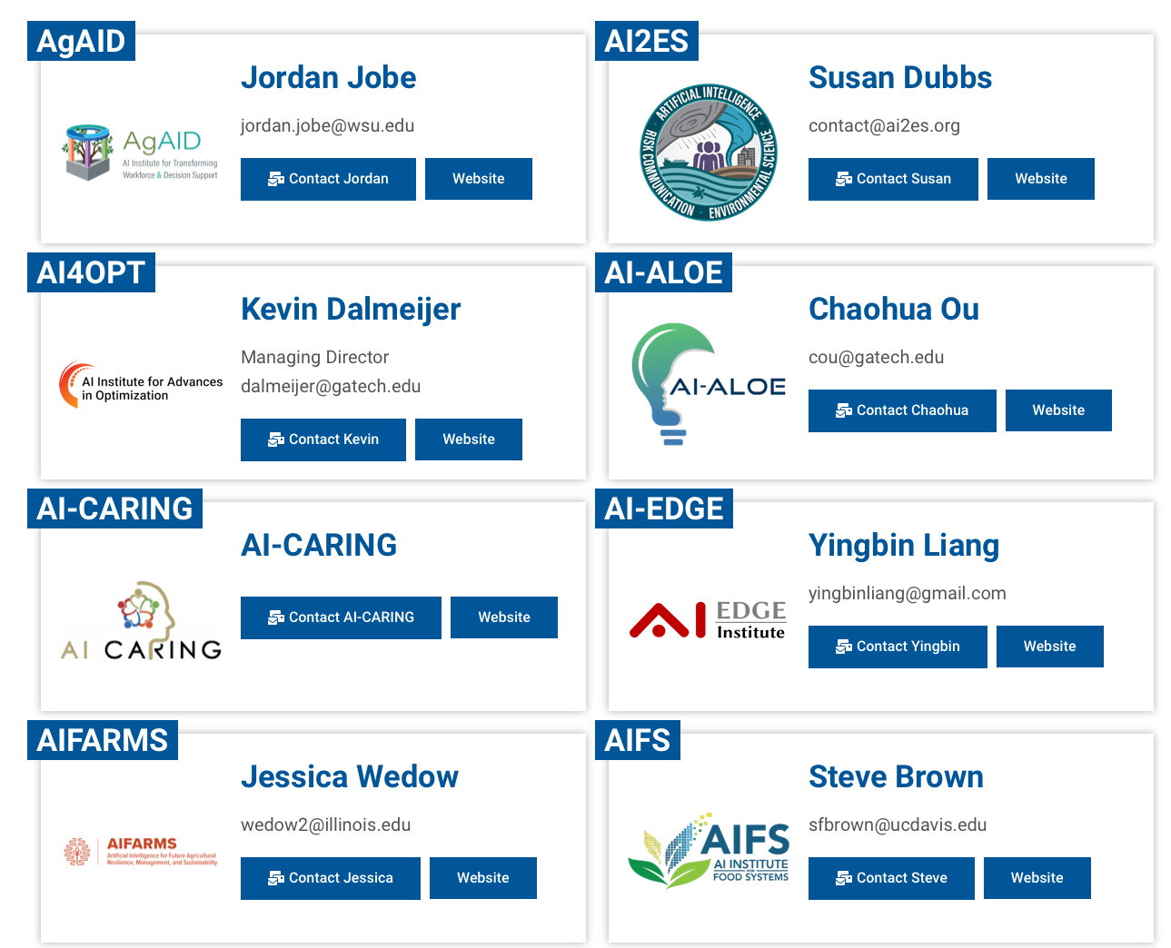
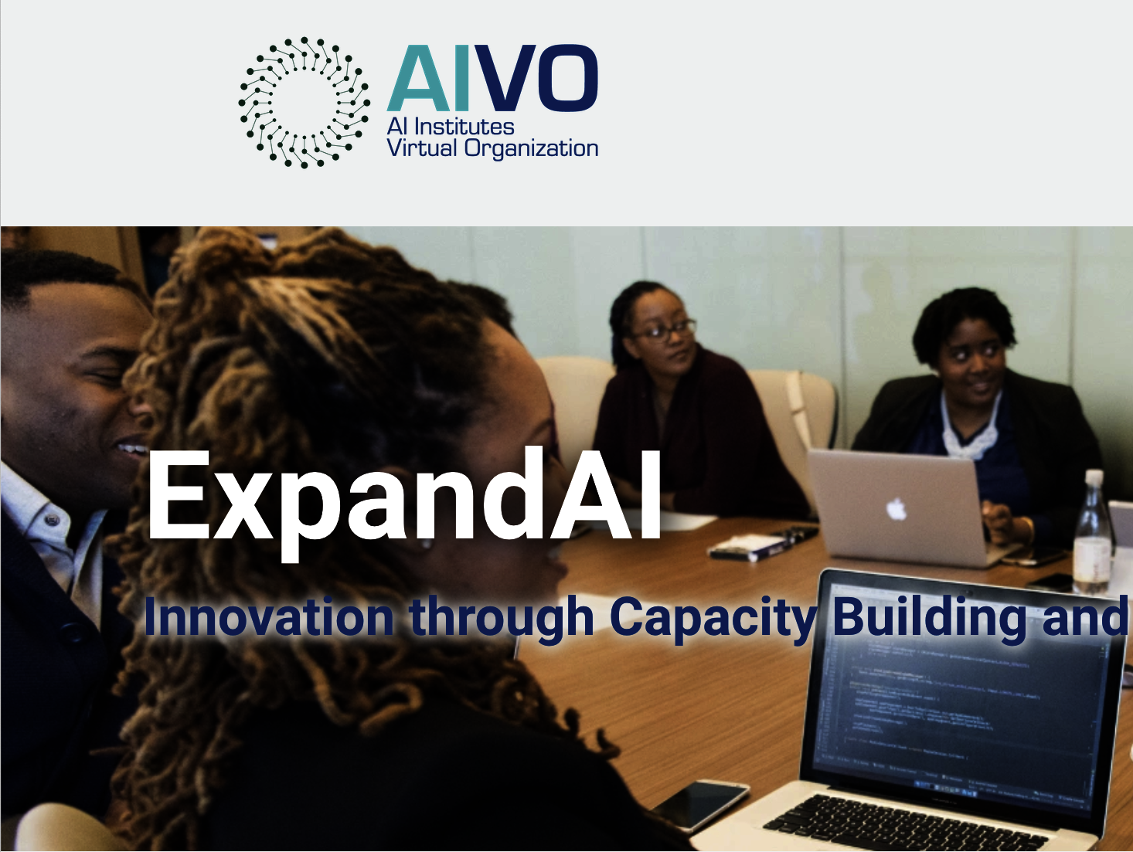
Exploring Partnership Opportunities
Subaward may be made to AI Institute lead organization or any of sub-awardee organizations in that Institute’s award budget
Current AI Institutes
  AI Institutes Virtual Organization (AIVO) Website
  Expand AI Page: https://aiinstitutes.org/expandai/
ETC…

Slide 43
Slides from TILOs and AIFS
Yusu Wang (TILOS) yusuwang@ucsd.edu
Steve Brown (AIFS) sfbrown@ucdavis.edu

Slide 44


Slide 45


Slide 46
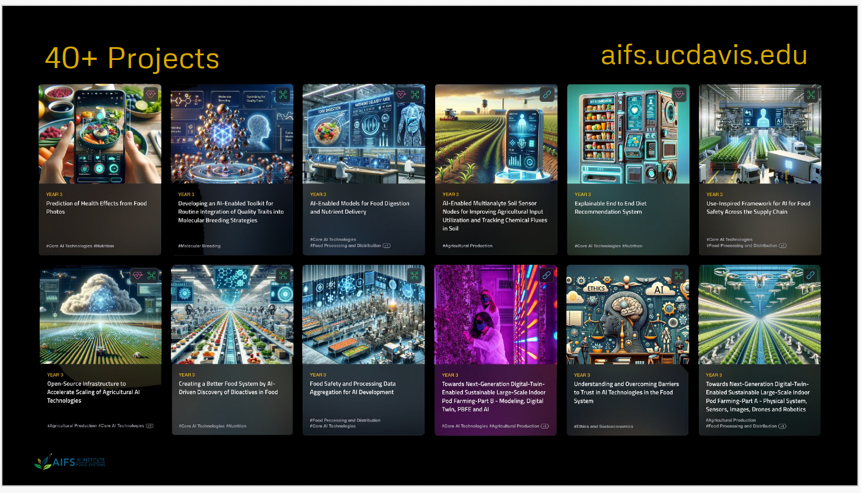

Slide 47
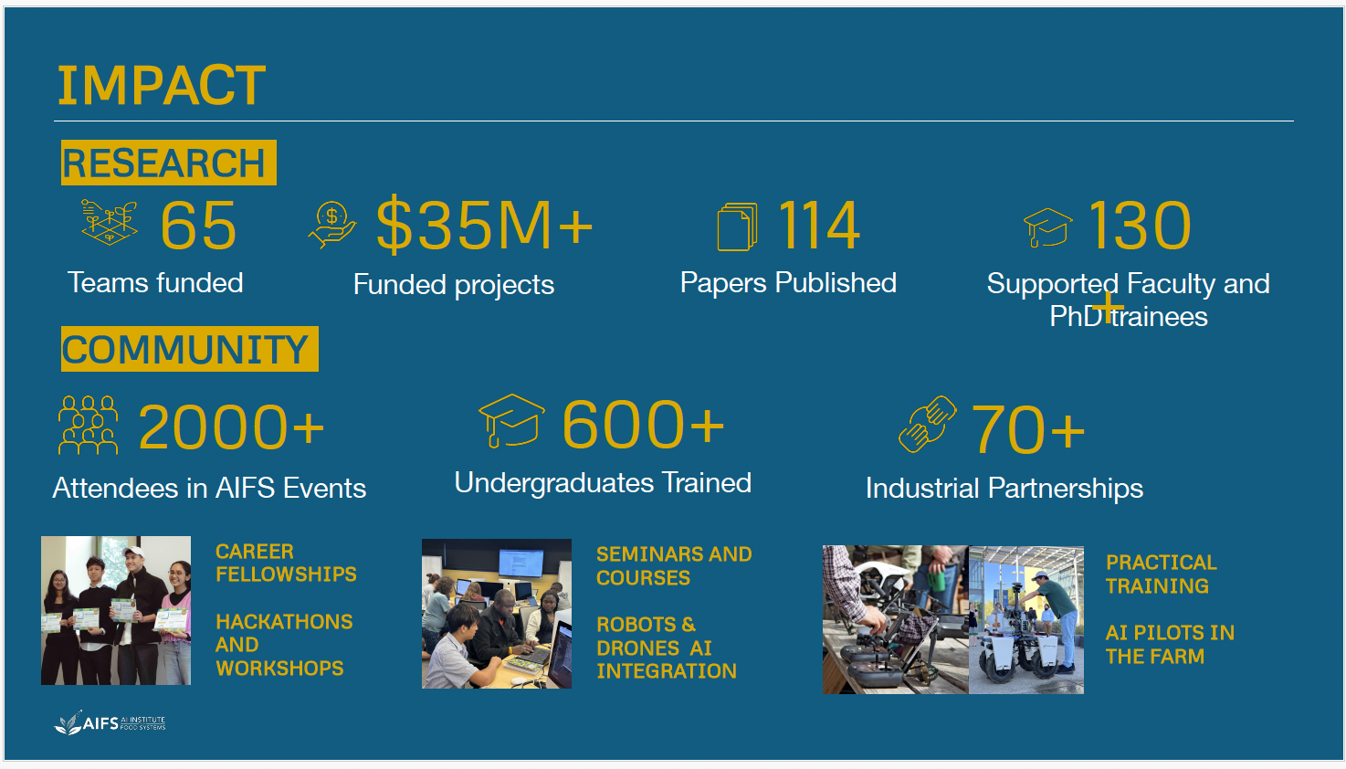

Slide 48
Questions?
Important Dates and Contact Information
Full Proposal Submission windows:
  January 6, 2025 – March 10, 2025
  March 11, 2025 - June 23, 2025
  June 24, 2025 - October 17, 2025
Office hours:
  Monday, November 18, 2024, 3:00-4:00pm EST
  Monday, December 16, 2024, 3:00-4:00pm EST
Contact Information:
ExpandAI Team expandaiprogram@nsf.gov
James Donlon (co-lead) jdonlon@nsf.gov
Abiodun Ilumoka (co-lead) ailumoka@nsf.gov
Nicholas Wagner nwagner@nsf.gov

