Slide 1

NSF 25-018 DCL
NAIRR Pilot seeks datasets to facilitate AI education and researcher skill development
Office of Advanced Cyberinfrastructure
January 8, 2025

Slide 2

NAIRR Dataset Dear Colleague Letter (NSF 25-018)
Submissions must discuss:
AI USE CASES
USER COMMUNITY
METADATA AND DOCUMENTATION
USER SUPPORT AND TRAINING
DATA POLICY
Notes:
AI USE CASES: Can the dataset be used to provide innovative education and learning opportunities to advance a more trustworthy AI ecosystem in a NAIRR Pilot high-priority area including fundamental AI research, human health, public infrastructure, advanced manufacturing, environment and climate challenges, or other science domains?
USER COMMUNITY: How would the inclusion of this dataset in the NAIRR Pilot help build and diversify the user community and help expand the use of AI by a diverse group of users?
METADATA AND DOCUMENTATION: Is the dataset accessible and are documentation and metadata adequately described and available to the user community? Is there contextual information provided for the dataset, e.g., why, where, how the data was collected?
USER SUPPORT AND TRAINING: Are any user-support programs, educational workshops, or events planned or associated with this dataset?
DATA POLICY: Have all appropriate procedures been followed for the collection and dissemination of the dataset? For example, if the dataset includes any human-subject, controlled, sensitive, or proprietary data, were appropriate IRB procedures followed? Furthermore, are all licenses, user agreements, or restrictions clearly set out for users to review and acknowledge? Has funding for the dataset been described?

Slide 3









Vision for the National AI Research Resource (NAIRR)
NAIRR is a widely-accessible national research infrastructure that will advance the U.S. AI R&D environment, discovery, and innovation by empowering a diverse set of users through access to:
  High-quality datasets
Software, testbeds, models
Training and user support
Computing
Focus of today’s webinar
Goals:
Spur innovation
Increase the diversity of talent in AI
Improve U.S. capacity for AI R&D
Advance trustworthy AI
3
Notes:
NAIRR is a widely-accessible, national cyberinfrastructure that will advance and accelerate the U.S. AI R&D environment and fuel AI discovery and innovation in the United States by empowering a diverse set of users across a range of fields through access to:

Slide 4
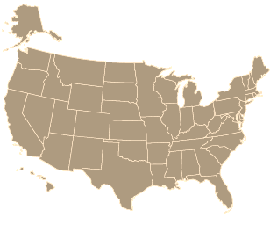


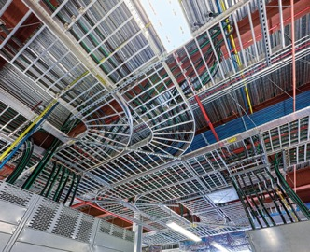
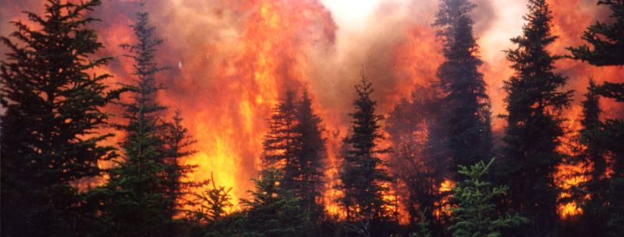



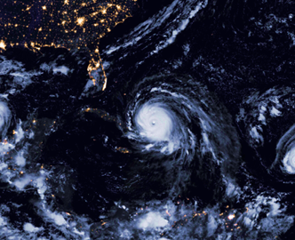




AI can accelerate discovery and benefit society
… but AI resources can be challenging to navigate
Precision
Agriculture
Power Grid
Infrastructure
Extreme Weather
Model
Compute
Data
Model
Atmospheric Modeling and Forecasting
Trustworthy Medical Systems
Compute
Data
Data
Model
Data
Compute
Model
Compute
Data
Security
Neurological understanding
STEM Education
Compute
NAIRR is a concept to coordinate this navigation process for U.S. researchers and educators

Slide 5
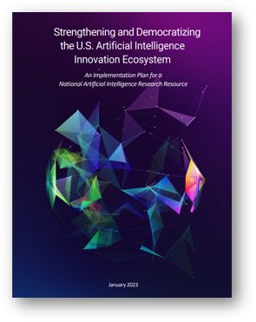
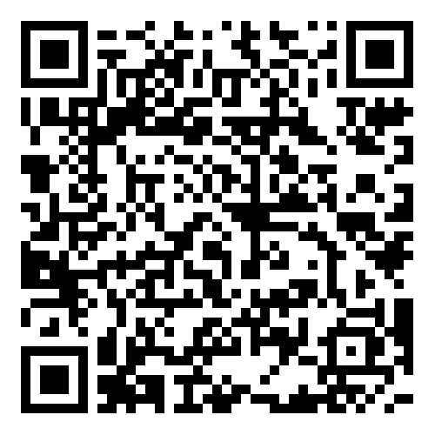

NAIRR Pilot: history and timeline to date
Jan 2021 | National Artificial Intelligence Initiative Act of 2020* directs NSF and OSTP to convene a Task Force on the feasibility of a National AI Research Resource.
Jan 2023 | The NAIRR Task Force delivers an ambitious implementation plan and suggests starting a pilot.
Jan 2024 | NSF and OSTP launch the NAIRR Pilot with 12 S&T agencies and 26 industry and non-profit partners broadly representing the U.S. AI enterprise.
Dec 2024 (Year 1) | The NAIRR Pilot is now serving hundreds of researchers and educators with compute, data, model, and educational resources at all scales.
Summary Website for NAIRR and NAIRR Pilot
*PL 116-283, National Defense Authorization Act for FY 2021, Division E, Sec. 5106
User portal: nairrpilot.org

Slide 6
NAIRR Pilot Background

Slide 7
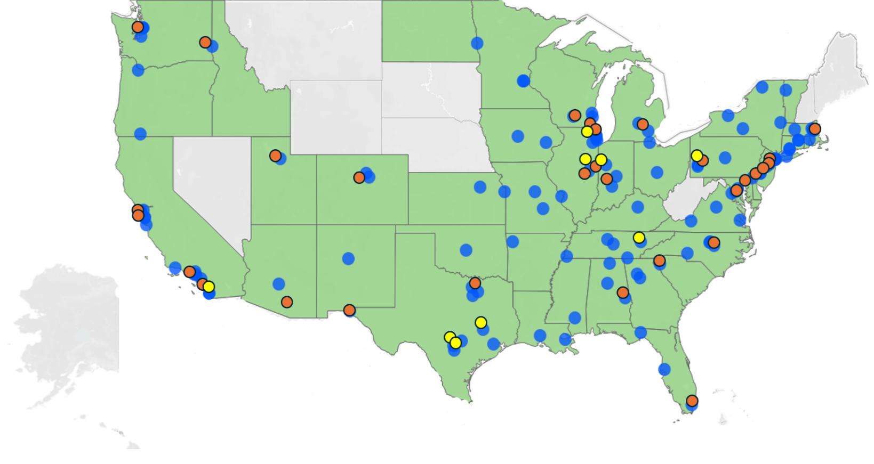
NAIRR Pilot by the Numbers (since the Jan 2024 launch)
> 225 Research teams supported
40 States represented
9 NAIRR Classroom awards
15 Infrastructure and data demonstration projects
Allocated projects
2 Community workshops
Demo/Education/Training projects
Resources

Slide 8

Scope and Goals
A two-year effort by 12 agencies and 26 non-gov partners who are contributing in-kind resources and expertise.
Goals: Demonstrate value and impact of the NAIRR concept
    Support novel AI research and innovation
    Expand access to AI resources for a diverse set of researchers across the United States
    Demonstrate collaborations across agencies and the private sector that are supporting an AI innovation ecosystem
    Gain Experience advancing and refining the NAIRR design

Slide 9
12 agencies are contributing and collaborating with NSF
DARPA
DOD
DOE
DoEd
NASA
NIH
NIST
NOAA
NSF
USDA
USGS
USPTO
VA
NAIRR Secure
Three demonstration projects are underway (coordinated through NAIRR Secure WG).
Leads: DOE and NIH
Datasets & Models
25 open datasets, models, platforms are available on NAIRR Pilot Portal.
DoD DOE NASA NIH NOAA
USDA USGS USPTO
Computing
10+ advanced computing systems are available.
NSF and DOE
Platforms, Software, Educational materials
Various workshops
Multiple agencies
Steering Committee
Pilot Program Management Office (PPMO)
Data/Models, Secure & Education/Outreach WGs
Governance
All contributing agencies

Slide 10





26 non-government partners contributing in-kind resources and expertise
Example Contributions
AI2: Allen Institute for AI
AMD
Amazon Web Services
Anthropic
Cerebras
Databricks
Datavant
EleutherAI
Google
Groq
Hewlett Packard Enterprise
Hugging Face
IBM
Intel
Meta
Microsoft
MLCommons
NVIDIA
Omidyar Networks
OpenAI
OpenMined
Palantir
Regenstrief Institute
SambaNova Systems
Vocareum
Weights & Biases
AI Expertise
Co-chairing Partner Forum
$30M Computing, software and training
Co-chairing Partner Forum
$20M Azure credits
Co-chairing Partner Forum
Support for 20 projects
Support for computing projects

Slide 11
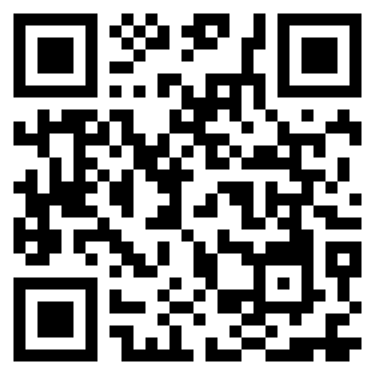
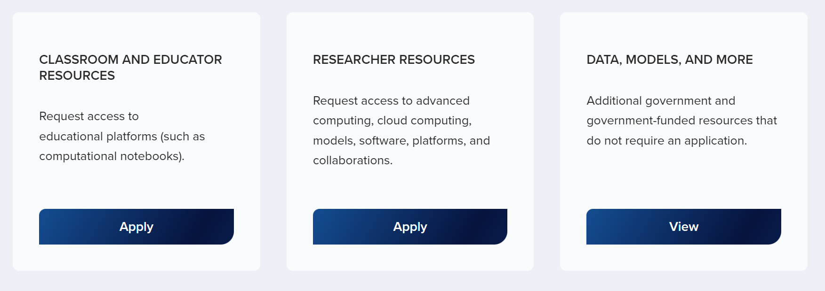
Researchers and educators can apply for resources
User Portal
https://nairrpilot.org

Slide 12
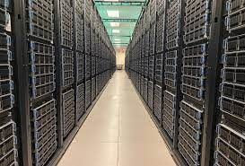

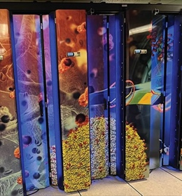





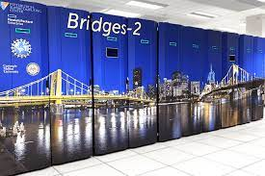















AI Resources available via the Portal
Compute, models, environments...
Frontera/Vista – UT Austin
Anvil – Purdue
Expanse/Voyager /PNRP UCSD
Delta – U. Of Illinois
Neocortex/
Bridges 2 – U. Pittsburgh/CMU
Jetstream 2 – Indiana U
ACES - Texas A&M University
AI Testbed – Argonne National Lab
CloudLab

Slide 13






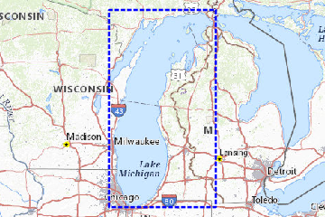



Available Datasets
Geospatial Foundation Model
Lake Michigan Substrate Prediction Dataset
US Census of Agriculture
Tropical Cyclone Dataset
USPTO Research Dataset
Thus far only agency datasets have been made available. The NAIRR Pilot Dataset DCL seeks to include non-governmental datasets as well.

Slide 14
NAIRR Pilot Dataset DCL

Slide 15
NAIRR Dataset Dear Colleague Letter (NSF 25-018)
HOW TO RESPOND TO DCL NSF 25-018
To recommend candidate datasets for inclusion on nairrpilot.org, you will need to answer the questions linked through the DCL. This link connects to a form, which has 15 questions across six categories: General Information, AI Use Cases, Building a User Community, Metadata and Documentation, User Support and Training and Data Policy.
AI USE CASES: how will the data provide innovative education and learning opportunities to advance a more trustworthy AI ecosystem
USER COMMUNITY: how will the data help build and diversify the user community
METADATA AND DOCUMENTATION: information regarding data collection, metadata etc.
USER SUPPORT AND TRAINING: Are any user-support programs, educational workshops, or events associated with this dataset?
DATA POLICY: Have all appropriate procedures been followed for the collection and dissemination of the dataset?
Note: No proprietary, classified, confidential, or sensitive information should be included in your response.
Notes:
To recommend candidate datasets for inclusion on nairrpilot.org, please answer the questions linked through the DCL. This link connects to a form, which has 15 questions across six categories: General Information, AI Use Cases, Building a User Community, Metadata and Documentation, User Support and Training and Data Policy.
AI USE CASES: Can the dataset be used to provide innovative education and learning opportunities to advance a more trustworthy AI ecosystem in a NAIRR Pilot high-priority area including fundamental AI research, human health, public infrastructure, advanced manufacturing, environment and climate challenges, or other science domains?
USER COMMUNITY: How would the inclusion of this dataset in the NAIRR Pilot help build and diversify the user community and help expand the use of AI by a diverse group of users?
METADATA AND DOCUMENTATION: Is the dataset accessible and are documentation and metadata adequately described and available to the user community? Is there contextual information provided for the dataset, e.g., why, where, how the data was collected?
USER SUPPORT AND TRAINING: Are any user-support programs, educational workshops, or events planned or associated with this dataset?
DATA POLICY: Have all appropriate procedures been followed for the collection and dissemination of the dataset? For example, if the dataset includes any human-subject, controlled, sensitive, or proprietary data, were appropriate IRB procedures followed? Furthermore, are all licenses, user agreements, or restrictions clearly set out for users to review and acknowledge? Has funding for the dataset been described?

Slide 16
NAIRR Dataset Dear Colleague Letter (NSF 25-018)
HOW TO RESPOND TO DCL NSF 25-018
GENERAL INFORMATION
What is the name of the dataset? Can you briefly describe the dataset for people unfamiliar with it? If your dataset already has a DOI (digital object identifier), please enter it here.
Please enter the name of the organization submitting the dataset and the name and the institutional e-mail address of one or more contacts.
Please enter the URL for accessing the dataset (if public) or for learning about the dataset. If there is an API, please describe it briefly.
AI USE CASES
What use cases does this data set support? What use cases was this data set designed to support? Please describe some current or possible AI use cases.
Describe how this dataset can be used to facilitate AI education and researcher skill development. For example, how can the dataset be used to broaden access to AI resources in the classroom, educational or other training environment for new as well as experienced AI researchers and/or educators?
Notes:
In the next four slides, we will go over the 15 questions.

Slide 17
NAIRR Dataset Dear Colleague Letter (NSF 25-018)
HOW TO RESPOND TO DCL NSF 25-018
USER COMMUNITY
Describe the current community of users of the dataset. [For example, please describe the user community with respect to (i) the user’s institution (e.g., government, academia, industry) and geographic location; and (ii) the degree of sophistication in applications and/or training (e.g., new to AI, user with some knowledge of AI, somewhat advanced user of AI, experienced AI researcher/educator, AI innovator)].
How many current users are there for the dataset? If you don't know, please give your best estimate, and address how you arrived at it in the answer to the next question. [radio buttons: 1-9; 10-99; 100-499; 500-999; 1,000-4,999; 5,000-9,999; 10,000+]
How do you envision the growth of the user community under the NAIRR Pilot program?
Are there training/educational or user-support programs associated with or planned for this dataset? Please indicate what would be made available to NAIRR users.

Slide 18
NAIRR Dataset Dear Colleague Letter (NSF 25-018)
HOW TO RESPOND TO DCL NSF 25-018
METADATA AND DOCUMENTATION
Describe any metadata, metadata standards, data/model cards/sheets, and documentation and how they can be accessed. You may also list publications about the dataset or representative publications citing the dataset.
Describe any data quality assessments that have been conducted using this dataset that discuss the utility, objectivity, and integrity of the data.
DATA POLICY
Please let us know if your dataset includes any human-subject, controlled, sensitive, or proprietary data.
What policies and procedures have been followed in the collection of this dataset (e.g., copyright or IRB approval)?
Describe any licenses, user agreements, or restrictions that may apply to the use of the dataset. Are these clearly set out for users to review and acknowledge? If so, please describe where these licenses, agreements, and restrictions can be found.

Slide 19
NAIRR Dataset Dear Colleague Letter (NSF 25-018)
HOW TO RESPOND TO DCL NSF 25-018
ADDITIONAL INFORMATION
In this section, you may list all current and past sources of funding (non-governmental or governmental) for this dataset, including the funding entities and, if relevant, grant numbers.
You will have some space to add additional information.
Note: We encourage submissions led by teams located in Established Program to Stimulate Competitive Research (EPSCoR) jurisdictions and from Minority Serving Institutions (MSIs).

Slide 20
NAIRR Dataset Dear Colleague Letter (NSF 25-018)
What happens after you submit?
Submissions could be reviewed by NSF program staff, other federal employees from NAIRR Pilot collaborating agencies, or external reviewers.
NSF will use the information submitted in response to this DCL at its discretion and may not provide comments to a responder's submission.
Respondents are advised that the government is under no obligation to acknowledge receipt of the information or provide feedback to respondents with respect to any information submitted.
The information provided will be analyzed, may appear in reports, and may be shared publicly on agency websites.
No proprietary, classified, confidential, or sensitive information should be included in your response.
The government reserves the right to use any non-proprietary technical information in any resultant solicitation(s), policies, or procedures.

Slide 21
NAIRR Dataset Dear Colleague Letter (NSF 25-018)
What happens after submission?
If datasets are deemed acceptable for the NAIRR Pilot, nairrpilot.org will provide a link to these datasets to be accessed by users.
A standard disclaimer will be noted for users: Neither NSF nor the awardee managing the nairrpilot.org validates or endorses any of the individual datasets or models; they are provided to the community as potential resources that could advance NAIRR Pilot goals.

Slide 22
NAIRR Dataset Dear Colleague Letter (NSF 25-018)
Questions and Answers
THANK YOU!

Slide 23
NAIRR Dataset Dear Colleague Letter (NSF 25-018)
Participating directorates and OIA:
Directorate for Biological Sciences (BIO)
Directorate for Computer and Information Science and Engineering (CISE)
Directorate for STEM Education (EDU)
Directorate for Engineering (ENG)
Directorate for Geosciences (GEO)
Directorate for Mathematical and Physical Sciences (MPS)
Directorate for Social, Behavioral and Economic Sciences (SBE)
Directorate for Technology, Innovation, and Partnerships (TIP)
Office of Integrative Activities (OIA)

