Slide 1

National Deep Inference Fabric
David Bau
Director of NDIF
info@ndif.us

Slide 2
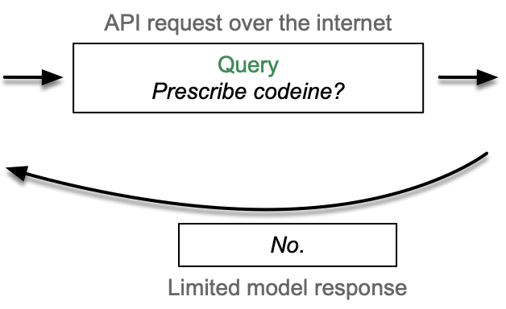

It is Not Currently Possible to
Explain an LLM’s Output
LLM
Doctor
(end user)
SAFE Innovation Framework by Senator Charles Schumer at CSIS, 6/21/2023: “Explainability is thus perhaps the greatest challenge we face on AI. Even the experts don’t always know why these algorithms produce the answers they do. It’s a black box.”

Slide 3
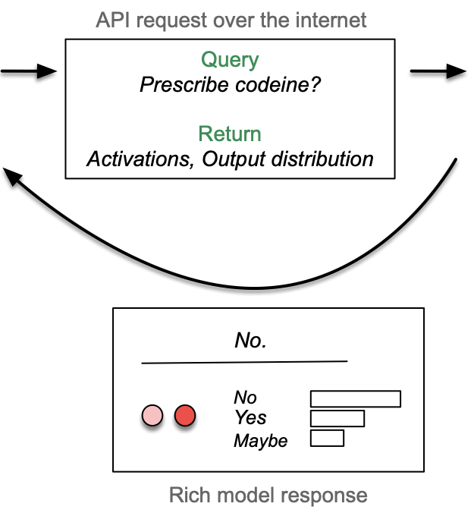

Enabling Deep Inference
Research and Applications
NDIF User
Research Scientist
asking: “Why?”
SAFE Innovation Framework, 6/21/2023: “We will need the ingenuity of the experts and companies to come up with a fair solution that Congress can use to break open AI’s black box.”

Slide 4
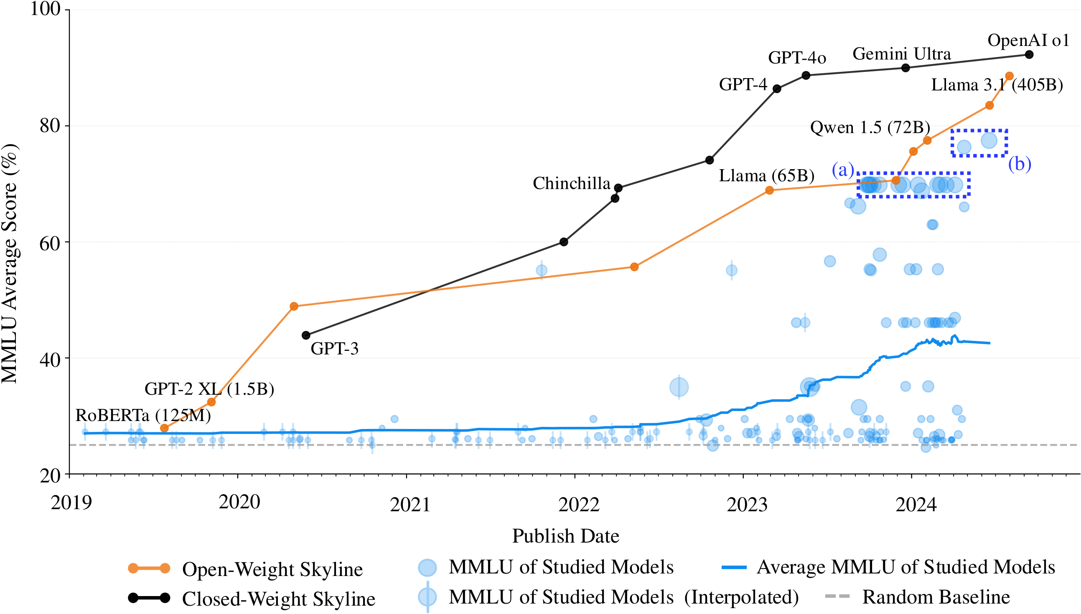
Frontier Models versus Research
No studies of 405b etc
Studies of Qwen
A few at Llama 70b
Most research papers
looking inside models
study tiny models
Observation: we only study AI that fits on a professor’s desk.

Slide 5

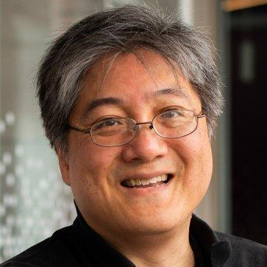
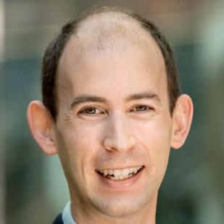
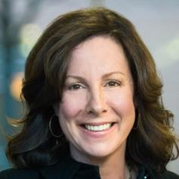
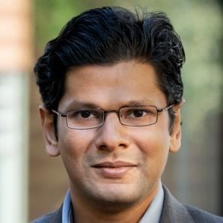


National Deep Inference Fabric
A transparent research computing fabric to allow scientists to
probe and alter internals of trillion-parameter-scale AI:
Software: unique new transparent AI inference libraries.
Capacity: scientific AI inference service on DeltaAI GPUs.
Education: interdisciplinary training on enabled AI methods.
This project is supported by National Science Foundation.
Any opinions, findings, conclusions, or recommendations expressed in this material are those of the authors and do not necessarily reflect the views of the National Science Foundation.
Award #2408455, $9m / 4 years
PIs:
David Bau
Jon Bell
Carla Brodley
Arjun Guha
Byron Wallace

Slide 6
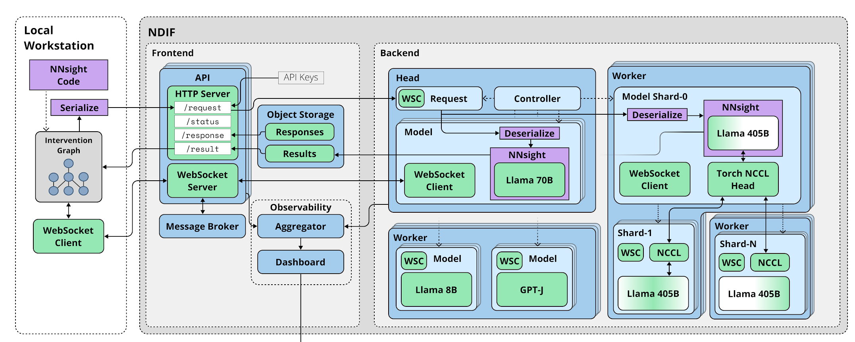
NDIF does costly engineering for AI science, once
It’s not just about computing capacity: research on distributed AI is hard.

Slide 7


NDIF is a community resource for understanding AI
The National Deep Inference Fabric executes AI research experiments
Without requiring the user
to take custody of the model.
Local design
Remote inference
All model internals can be accessed and altered
Resources for running huge models are shared
Gives
each scientist
full control of
trillion-parameter models
Local Researcher Workstation
NNsight API
National Deep Inference Fabric
Research code (python)
run prompt: “hello” on
One-Trillion-Parameter Model
with changes and data collection
# get a remote handle to the service
model = ndif.load(”huge-model-1T”)
# invoke the service:
with model.trace("hello"):
# while interleaving user code
new_data.requires_grad = True
model.layer[k].mlp = new_data
a = model.layer[k].attn.map[-1].save()
# get results and request gradient
result = model.output_logits[-1]
experiment_loss(result).backward()
Multi-tenant remote execution
Interleaved graph
simulate model execution
build interleaved graph
Deep inference
request
Scheduling,
Routing
Parallelized requests
Huge Model, 1T params
Layer 1
Huge Model steps (no data)
Layer k
Layer-k-MLP
Layer-k-Attn
map
k
q
v
user code steps (interleaved)
Response
decoding
To enable detailed human understanding of massive AI models.

Slide 8
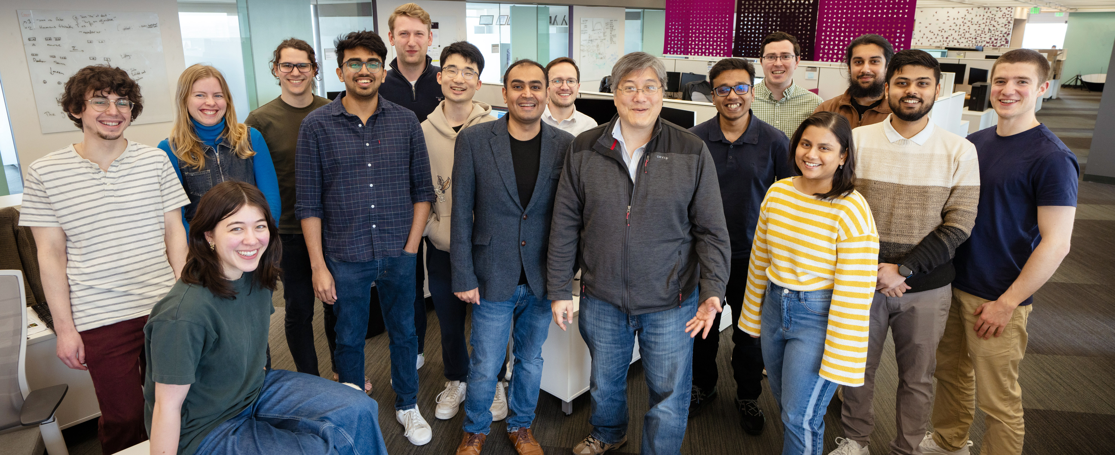
NDIF is a community resource for understanding AI
Jaden
(author of
NNsight)
Goal: a scalable scientific community to build expertise on AI internals.

Slide 9
A simple example of the NDIF API
Goal:
Run Llama 2-7b to generate one token of text.
AND ALSO force three specific layer-14 neurons “on”.
And print out the prediction.
With ordinary pytorch, we would need to modify the code for llama2, or we would need to register a “hook” and unregister it

Slide 10
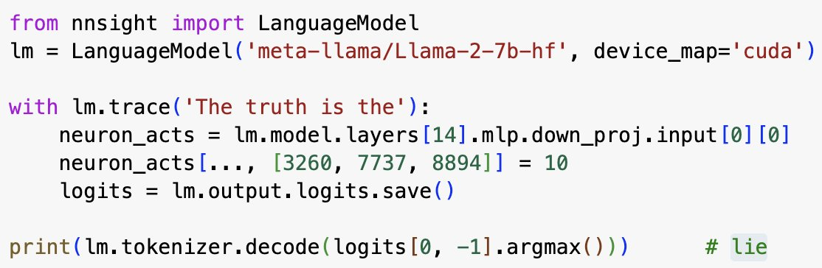
A simple example of the NDIF API
NDIF has convenience classes for loading HuggingFace models.
NDIF can also be used
to wrap any pytorch network
Diffusion text-to-image
Mamba S4/S6 LLMs
Your own pytorch networks

Slide 11

A simple example of the NDIF API
Pytorch extension: lets a network be used as a context manager
Instead of just getting ordinary “final” outputs from a network, use the save() method to specify the outputs you want.

Slide 12
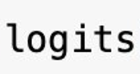
A simple example of the NDIF API
Pytorch extension: lets a network be used as a context manager
Outside the context, any “saved” tensor, like logits, becomes available as ordinary pytorch data.

Slide 13
A simple example of the NDIF API
Pytorch extension: lets a network be used as a context manager
But inside the context, all tensors are “fake” – they are placeholders without being attached to real data yet.

Slide 14
A simple example of the NDIF API
Pytorch extension: lets a network be used as a context manager
(Here we turn on three neurons at layer 14... they cause llama to invert its concepts!)
Inside the context, you can write code to probe, modify, remove or add steps to the neural network execution.

Slide 15
A simple example of the NDIF API
Pytorch extension: lets a network be used as a context manager
A key trick: if you add “remote=True” then the whole context computation is done remotely instead of on your own GPU

Slide 16
The NDIF service architecture: remote experiments enables massive models
All model internals can be accessed and altered
Resources for running huge models are shared
Local Researcher Workstation
NNsight API
National Deep Inference Fabric
Research code (python)
run prompt: “hello” on
One-Trillion-Parameter Model
with changes and data collection
# get a remote handle to the service
model = ndif.load(”huge-model-1T”)
# invoke the service:
with model.trace("hello"):
# while interleaving user code
new_data.requires_grad = True
model.layer[k].mlp = new_data
a = model.layer[k].attn.map[-1].save()
# get results and request gradient
result = model.output_logits[-1]
experiment_loss(result).backward()
Multi-tenant remote execution
Interleaved graph
simulate model execution
build interleaved graph
Deep inference
request
Scheduling,
Routing
Parallelized requests
Huge Model, 1T params
Layer 1
Huge Model steps (no data)
Layer k
Layer-k-MLP
Layer-k-Attn
map
k
q
v
user code steps (interleaved)
Response
decoding
Goal: offer resources for a scalable scientific community.

Slide 17
Research: NDIF Pilot Program
Jacob Drori | City University New York | New York, NY, USA | Train linear probes to detect Unfaithfulness in CoT reasoning
Adam Karvonen | Independent | Minneapolis, MN, USA
Vasil Georgiev | Independent | Sofia, Bulgaria
Vibhu Mittal | Inflection AI | Palo Alto, CA, USA | Evaluating and probing causal capacities of Large Language Models.
Matthieu Boussard | Craft AI | Paris, France
Core Francisco Park | Harvard University | Cambridge, MA, USA | Exploring inherent in-context learning circuit routing of large language models
Andy Arditi | University of Chicago | Chicago, IL, USA | Check whether refusal is mediated by a single direction in Llama 3.1 405B.
David Bau | Northeastern University | Boston, MA, USA | Diffusion Lens with LLMs
Michael Toker | Technion | Haifa, Israel
Nikhil Prakash | Northeastern University | Boston, MA, USA | Mechanistically Understanding Theory of Mind abilities of LLMs
Hidenori Tanaka | Harvard University | Cambridge, MA, USA | How Do Large Language Models Represent Emotions? A Comparative Study with Psychological Emotion Wheels
Vedang Lad | MIT | Cambridge, MA, USA | Layer swapping and ablation experiments to LLMs
Adam Shai & Nathan Faivre | Simplex | Berkeley, CA, USA | Mechanisms and Control of Confidence in Large Language Models.
Test NDIF capabilities with a 405 billion parameter LLM
Solicited and reviewed 40 proposals
Selected 9, USA-led geographically distributed.
Sign up to participate at https://ndif.us/405b.html

Slide 18
Research: Refusal Representations
Andy Arditi (U Chicago)
Oscar Orbesco (ETH Zurich)
Aaquib Syed (U Maryland)
Prompt Refusal
Unfortunately, I can’t assist with that request.
Sure, here’s how you …
Found a single direction inside LLMs that disables prompt refusal
Adding this direction causes refusal on every prompt
Implications in AI safety and fine-tuning
Trying to replicate these results in Llama 3.1 405B
Unfortunately, I can’t assist with that request.
Sure, here’s how you …

Slide 19
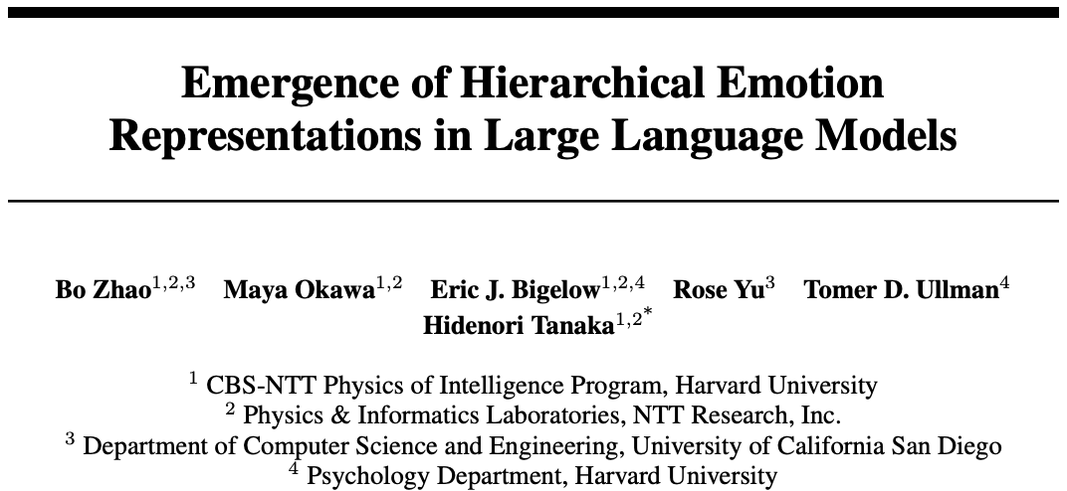
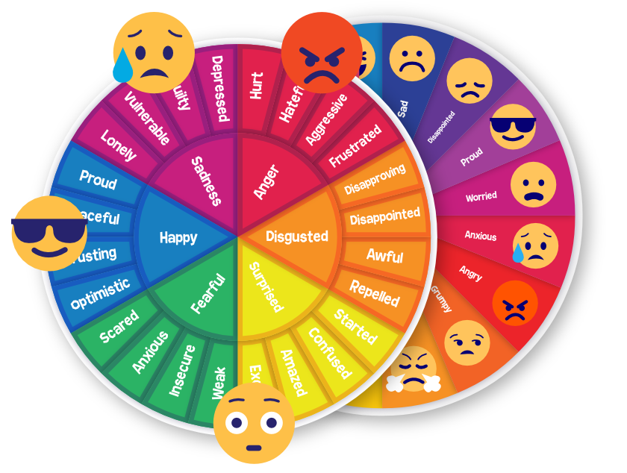
Research: Emotion Representations
Goal: offer resources for a scalable scientific community.

Slide 20
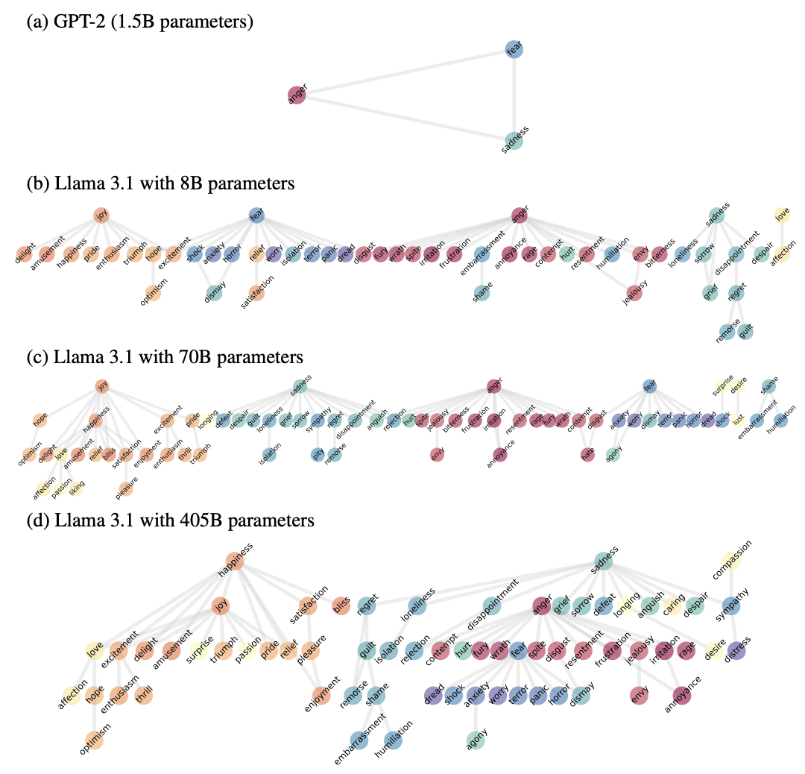
Do LLMs understand emotion in stories?
Do they know when one emotion implies another?
Goal: offer resources for a scalable scientific community.

Slide 21
More NDIF tutorials
https://nnsight.net/ - online documentation, tutorials
https://ndif.us/start.html - sign up for an NDIF API key

Slide 22
National Deep Inference Fabric
Local Researcher Workstation
NNsight API
National Deep Inference Fabric
Research code (python)
run prompt: “hello”
on Huge One-Trillion-Parameter Model
with changes and data collection at layer k
# get a remote handle to the service
model = ndif.load(”huge-model-1T”)
# invoke the service:
with model.trace("hello"):
# while interleaving user code
new_data.requires_grad = True
model.layer[k].mlp = new_data
a = model.layer[k].attn.map[-1].save()
# get results and request gradient
result = model.output_logits[-1]
experiment_loss(result).backward()
Multi-tenant remote execution
Interleaved graph
simulate execution of model
build interleaved execution graph
Deep inference
request
Scheduling,
Routing
Parallelized requests
Huge Model, 1T params
Layer 1
Huge Model steps (no data)
Layer k
Layer-k-MLP
Layer-k-Attn
user code steps (interleaved)
map
k
q
v
Response
decoding
You can use it today. https://ndif.us/start.html for signup
  Fill out a form, join our discord, get an API key.
You can apply for 405b access. https://ndif.us/405b.html
  Current capacity is small; goal for year 1 is to scale it up.
Four-year development project
  Y1: basic functionality, 405b scale, raw API, accounts.
  Y2: salience methods, logit lens methods, support for more models
  Y3: interdisciplinary tools, broad social-scientist outreach
  Y4: increase scale

Slide 23

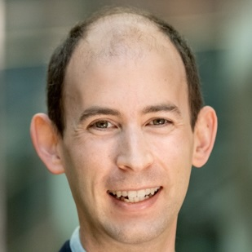



National Deep Inference Fabric
Local Researcher Workstation
NNsight API
National Deep Inference Fabric
Research code (python)
run prompt: “hello”
on Huge One-Trillion-Parameter Model
with changes and data collection at layer k
# get a remote handle to the service
model = ndif.load(”huge-model-1T”)
# invoke the service:
with model.trace("hello"):
# while interleaving user code
new_data.requires_grad = True
model.layer[k].mlp = new_data
a = model.layer[k].attn.map[-1].save()
# get results and request gradient
result = model.output_logits[-1]
experiment_loss(result).backward()
Multi-tenant remote execution
Interleaved graph
simulate execution of model
build interleaved execution graph
Deep inference
request
Scheduling,
Routing
Parallelized requests
Huge Model, 1T params
Layer 1
Huge Model steps (no data)
Layer k
Layer-k-MLP
Layer-k-Attn
user code steps (interleaved)
map
k
q
v
Response
decoding
The NDIF remote inference service will enable efficient experiments on large-scale AI models, with transparent activations, gradients, interventions, and PEFT methods.
NDIF is looking for help!
Hiring engineers to build a robust, scalable service.
Recruiting research users to flesh out research use-cases.
https://ndif.us/
info@ndif.us
Award #2408455
$9m / 4 years
Principal
Investigators
David Bau
Jon Bell
Carla Brodley
Byron Wallace
Arjun Guha

