Slide 1
NSF 23-532 Design for Environmental Sustainability in Computing (DESC)
desc@nsf.gov

Slide 2
NSF 23-532: Design for Environmentally Sustainable Computing (DESC)
Team:
Jim Fowler CCF (co-lead)
Dan Andresen CNS (co-lead)
Sharmistha Bagchi-Sen OAC
Sharmini Boghos CCF
Varun Chandola OAC
Sheikh Ghafoor OAC
Heather Masson-Forsythe OAD
Sylvia Spengler IIS
Goli Yamini IIS
2

Slide 3
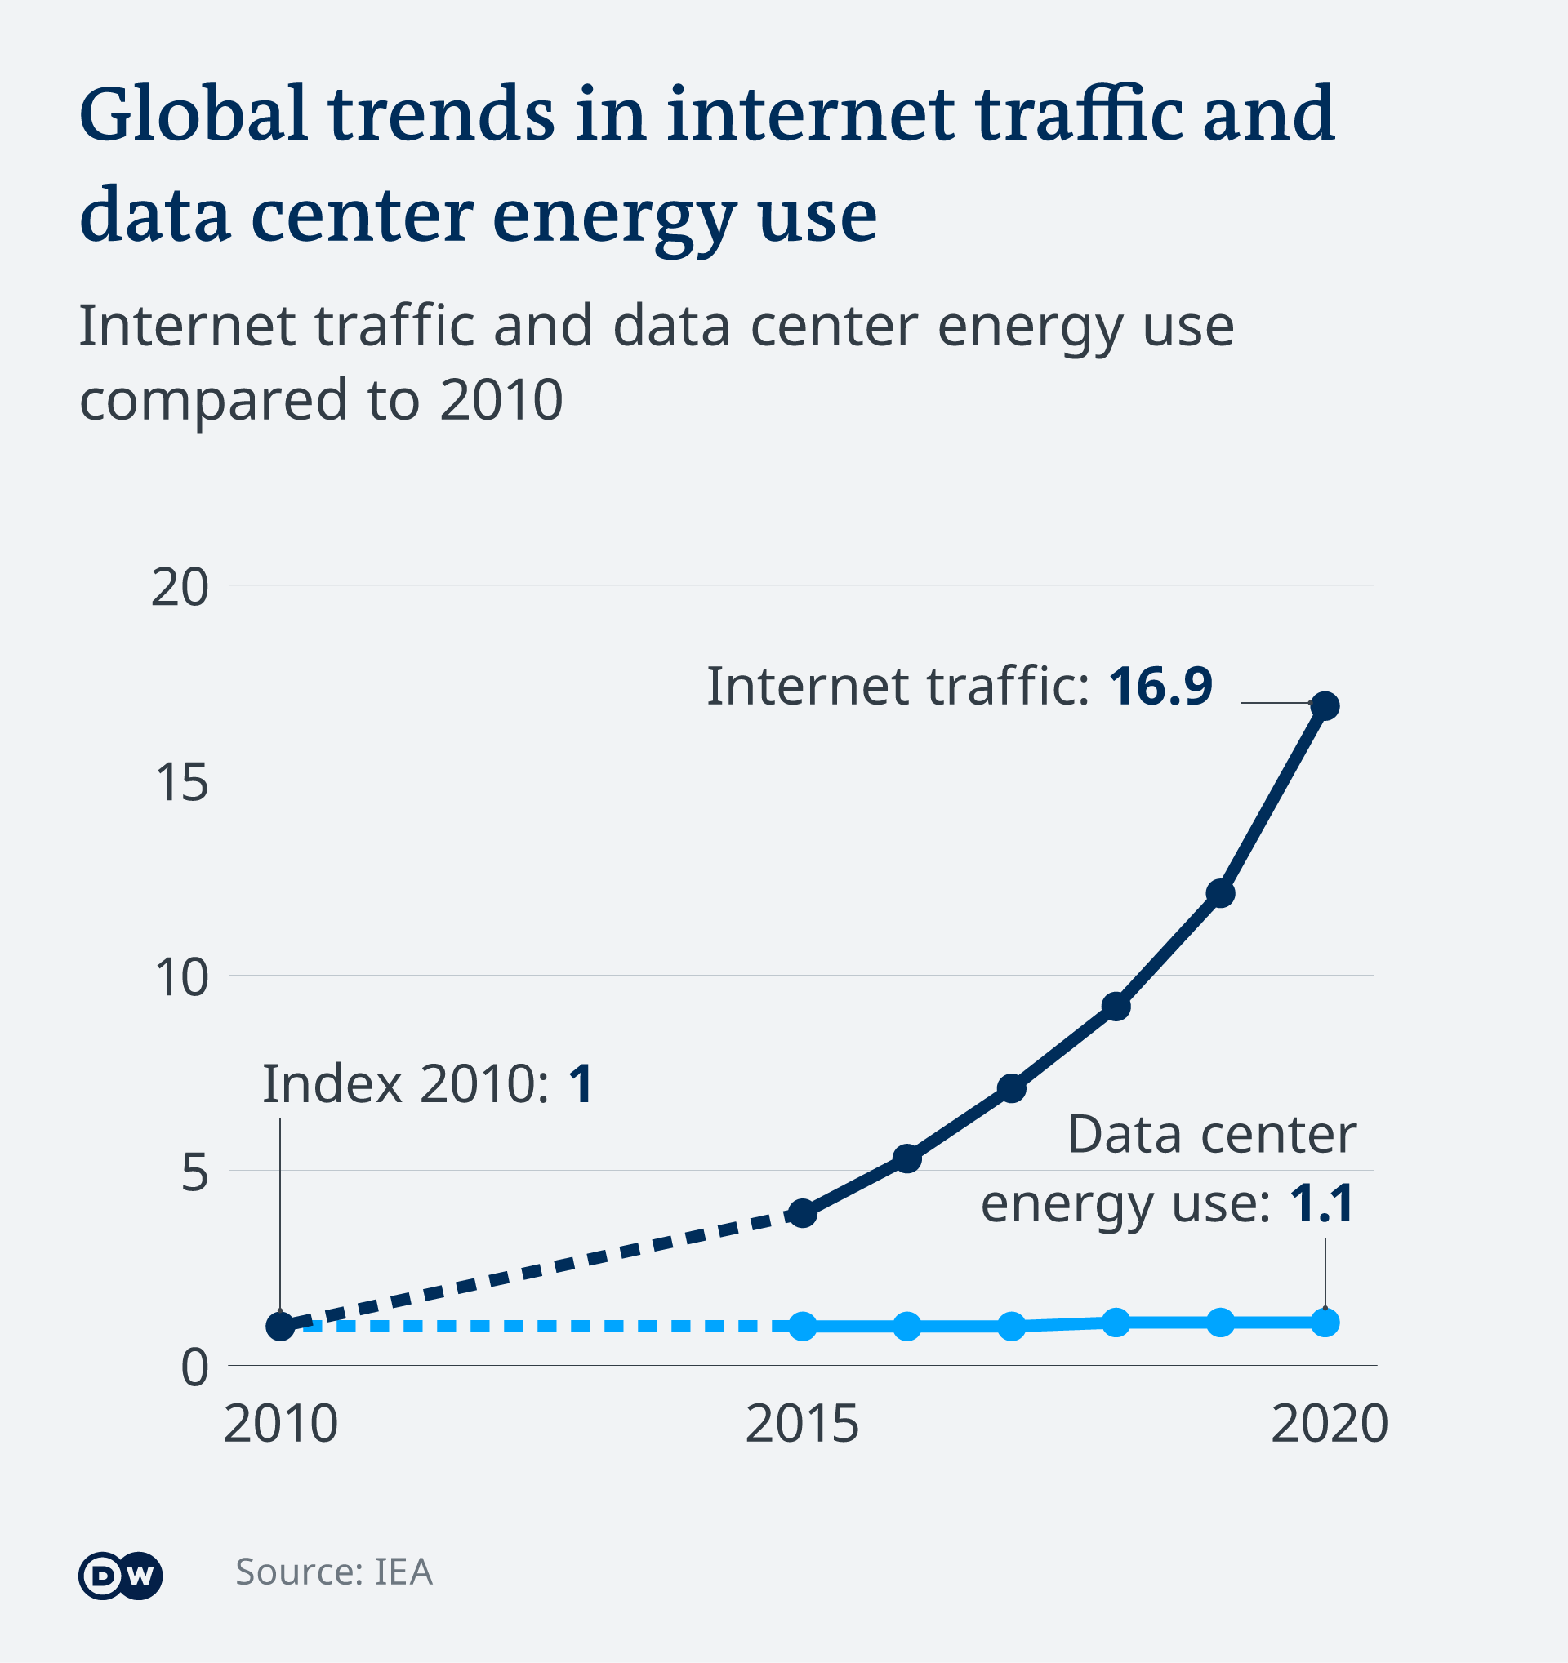
Motivation
International Energy Agency
2% of all global electricity is used by data centers in 2022
data centers to consume 4% of world's power by 2026

Slide 4
Motivation
International Energy Agency
2% of all global electricity is used by data centers in 2022
data centers to consume 4% of world's power by 2026
Embodied Energy/Carbon
Embodied carbon for servers can be 50% of total carbon
Can be much higher for energy-optimized compute
Energy-optimized Computing System
iPad life-cycle carbon emissions:
Production: 83%
Transport: 8%
Use: 8%
End-of-life processing: < 1%
iPhone 13 life-cycle carbon emissions:
Production: 81%
Transport: 2%
Use: 18%
End-of-life processing: < 1%

Slide 5
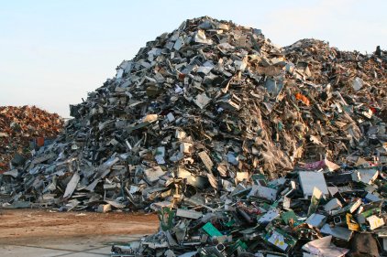
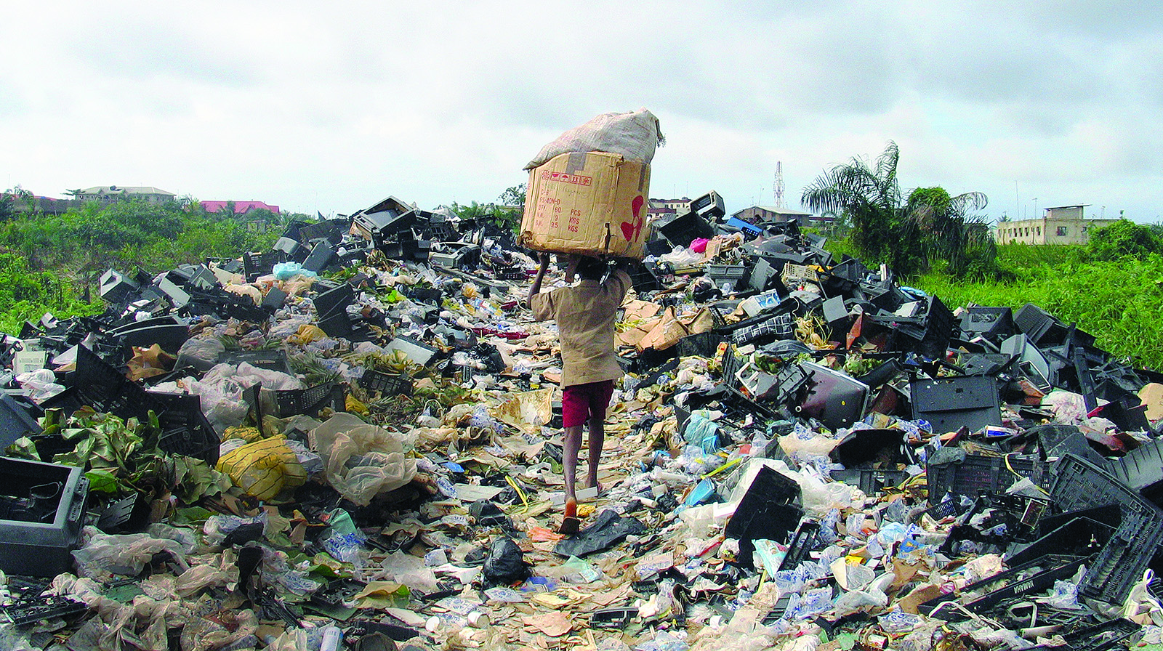
Motivation
International Energy Agency
2% of all global electricity is used by data centers in 2022
data centers to consume 4% of world's power by 2026
Embodied Energy/Carbon
Embodied carbon for servers can be 50% of total carbon
Can be much higher for energy-optimized compute
E-waste
Recovery of rare-earth materials is important
E-waste has negative environmental impacts

Slide 6
Motivation
Understudied problems
  Embodied carbon, GHG emissions, depletion of rare-earth materials, e-waste
Compounding computing-community trends
  Device proliferation, planned obsolescence, big data, dark silicon, resource-insensitive software, compute-intensive applications (AI, blockchain)
  Addressing these issues requires a mindset change, new metrics, visibility into the problem
Example: Datacenters
  2% of global electrical supply in 2022 (similar to carbon footprint of aviation industry)
  Heavy usage of batteries, diesel generators, toxic coolants, embodied carbon, etc.
Example: Embodied carbon higher than operational carbon footprint
  Half of the overall carbon footprint of datacenter class servers for a 4-year use lifetime
  4X higher for tablets and mobile phones, and 10X higher for low-cost desktop computers
Energy Efficiency alone is insufficient to solve these challenges….
6

Slide 7
NSF 23-532: Design for Environmentally Sustainable Computing (DESC)
DESC objective: build a community of interdisciplinary researchers for disruptive improvements in the sustainability of next-generation computing
Key Challenges:
Applying principles of sustainable and lifecycle science to computing
Defining, measuring, and optimizing computational sustainability
Pushing the pareto-optimal boundary
Promoting design for environmental sustainability as a top-tier goal
Leveraging opportunities for sustainability across the computing continuum
Avoiding planned obsolescence
7

Slide 8
Sustainability Projects are Solicited from and across all CISE Disciplines
Hardware Design, Architecture
Cyber-physical, to edge/cloud
Reusability across the stack
Sustainable Algorithms & Workflows
Sustainable Cyber-infrastructure Design
Languages, Frameworks,
Tools
Models and Metrics (e.g., Greenhouse Gases)
Reduce impact from resource-intensive techniques
Software and Interface Design
8

Slide 9
Boundaries for DESC
Sustainability is more than just energy efficiency
DESC projects should:
Seek transformative, potentially cross-disciplinary, and/or clean-slate approaches to improve environmental sustainability at any level across the computing continuum
Be able to quantify and measure the improvement to environmental sustainability beyond energy efficiency
Be ambitious and forward-thinking
These are out of scope for DESC:
Projects that focus exclusively on computing performance and/or energy efficiency
Projects that use computing to advance other sectors of sustainability
Projects that seek to advance economic or social justice of computing alone
9

Slide 10
Types of Projects
Type I: Small Projects
Deadline: September 12, 2025
PI, co-PI, Senior Person may submit ≤ 2
PI, co-PI, Senior Person on a large may submit ≤ 1
Research activities with 3-year duration and 1–2 PIs
Budgets up to $600,000
Type II: Large Projects
Deadline: September 12, 2025
PI, co-PI, Senior Person may submit ≤ 1
PI, co-PI, Senior Person on 2 smalls cannot submit
Interdisciplinary or cross-layer efforts requiring larger teams
Budgets up to $2,000,000 and up to 4-year duration
Type III: Workshop Projects
Proposals submitted anytime
No PI, co-PI, Senior Person limits
Workshops to catalyze research activities
Budgets up to $100,000 and up to 1-year duration
Limits are independent of other NSF programs including CISE Core Programs.
A PI/co-PI/Senior Person may participate in ≤2 small awards and ≤1 large award during the life of the program (through FY26). There are no limits on workshop awards.

Slide 11
Type I Small Projects
Deadline: September 12, 2025
Up to 10 awards expected
15-page Project Description
Type I Small projects may be standalone projects or serve as preliminary exploration for a Type II project
Small projects intending to seek Large funding:
Type I projects must be self contained
Should clearly articulate how it prepares for research to be done in the Type II project
Type I projects of this variety should present the broad vision of the entire project duration
Notes:
There are three stated submission windows for DESC. The upcoming deadline is March 17, 2023 with subsequent deadlines on September 13, 2024 and September 12, 2025. Each of these is a Friday.
Small project proposals follow the standard rules allowing a 15-page project description. Please see the new PAPPG and DESC solicitation for all logistical details. As previously mentioned, these proposals are designed to be small research investigations, however, they may also be used as preliminary explorations for a Type II project. However, unlike some programs that include a “planning” proposal to prepare for a large award, Type I projects must remain fully research projects. Thus, Type I projects must be self contained research projects. However, for Type I projects that are expecting to go on for Type II funding, it is recommended that the Type I proposal present the broad vision of the entire project and clearly articulate how the research in the Type I project prepares for the intended research in the the Type II project.
Up to 10 Type I awards are expected for each deadline.

Slide 12
Type II Large Projects
Deadline: September 12, 2025
Up to 2 awards expected
20-page Project Description
A Management of Coordination plan of up to 3 pages is required for Type II projects
Award of a Type I Small project is not a prerequisite for seeking Type II Large funding
Type II Large Projects may be supported by a prior Type I Small or related award
Awardees from the Design for Sustainability in Computing Dear Colleague Letter (22-060) could demonstrate readiness for Type II Large funding
PIs should clearly enumerate how Type II research is novel but also builds on Type I or equivalent funding.
Concurrent DSC DCL and Type I Small funding is allowed with a Type II Large award; however, Type I Small and Type II Large funding for connected projects should NOT be sought in the same funding round
Notes:
Like Type I projects, the same deadlines hold for submitting Type II projects.
Type II projects follow similar guidelines for other Large proposals. They are allowed a 20-page project description and must include an up to 3-page management and coordination plan. Of course, please see the DESC solicitation and for details and all submission requirements.
Type II Large projects do not REQUIRE previous Type I funding, however, successful Type II projects could be supported by a prior Type I Small or related award, such as funding from the Design for Sustainability in Computing DCL from last year. If a Type II project builds on a prior award, it should explain how the new research leverages the prior work but is novel and not incremental to this prior exploration. Ideally, the prior research could provide a foundational to new transformative research and results.
Concurrent/overlapping DSC DCL and Type I Small funding is allowed with a Type II Large Awards. However, this support should be dovetailing. Although Type I Small and Type II Large proposals from the same PI are allowed during the same submission window, these could only be distinct proposals. Connected Type I Small and Type II Large funding should not be submitted during the same funding round. The intent is that some of the Type I research exploration will have been completed prior to the submission of the Type II project proposal to better articulate the foundational research and the novelty and difference of the Type II funding.
Up to 2 Type II Project awards are expected for each deadline.

Slide 13
Additional Review Criteria
Type I and II Projects
Reviewers will be asked to comment on:
Whether relevant notions of environmental sustainability are addressed
  For instance, projects should not address energy efficiency exclusively
How the sustainability vision will be attained as well as evaluated both theoretically and experimentally
  The project should be impactful for environmental sustainability of computing. The proposal should clearly describe how this will be achieved in the project through theory and experiment
Definition of sustainability metrics and (1) their sufficiency to reach beyond performance and energy efficiency, (2) whether they can successfully capture impact on environmental sustainability, and (3) their ability to be quantified and evaluated
  DESC projects should be able to define reasonable environmental metrics (e.g., GHGs, wastewater, VOCs, e-waste) and use them the quantify and evaluate the project’s impact on sustainability
Notes:
The standard NSF merit review criteria of Intellectual Merit and Broader Impact will be applied to all DESC proposals. However, Type I and Type II projects will be subject to additional review criteria:
They should address relevant notions of environmental sustainability. For instance, projects that purely address performance or sustainability will be noted as out of scope for DESC.
They should articulate how the vision of sustainability with be attained both theoretically and experimentally. This is intended to allow evaluators to comment on the potential impact of the proposed work to address the challenges of environmentally sustainable computing and discuss how this can be tested quantitatively.
Finally, the proposal should define appropriate sustainability metrics that (1) reach beyond performance and energy efficiency (2) can caption the impact of environmental sustainability and (3) be quantified and evaluated. Some metrics from lifecycle science may be appropriate such as greenhouse gas emissions, but other relevant metrics may be proposed by the Pis.

Slide 14
Type III Workshops
Deadline: Submit Anytime
Subsequent Deadlines: It is expected more workshops will be funded early in the program to prepare researchers for submitting Type I and II proposals.
Up to 5 awards expected for each deadline
8-page Project Description
Type III project proposals must be prepared in accordance with the guidance for Conference Proposals contained in PAPPG Chapter II.F
Successful Type III Workshops will catalyze researchers in areas within scope of DESC
Workshops could encourage exploration of environmentally sustainable computing for a particular CISE topic area but need not directly related to a particular proposal
It is envisioned that PIs from the workshop could form teams to submit Type I and Type II proposals
There are no limits on PIs participating in Type III Workshop proposals
Notes:
Type II workshop proposals may be submitted at anytime up through and including the last stated submission date of the DESC solicitation. However, we hope to fund more Type III projects early in the program to provide an opportunity for the workshops to develop an opportunity for project teams to submit Type I and Type II projects to be formed.
Workshop Projects may include an up to 8-page project description and should generally follow the format for Conference Proposals as stated in the PAPPG in Chapter II.F
Successful Type III Workshop proposals will encourage exploration of environmentally sustainable computing in a CISE topic area, particularly those topic areas for which sustainable computing has yet to become a significant priority or for which connecting to sustainability beyond energy efficiency is more subtle or difficult to envision.
While we expect to award up to 5 workshop proposals annually, we hope to receive more Type III proposals earlier in the DESC solicitation so that these can allow for project teams to be formed for later submission deadlines.

Slide 15
Additional Review Criteria
Type III Workshop Projects
Reviewers will be asked to comment on:
The notions of environmental sustainability advanced by the workshop
  The workshop must articulate the relevance of the topic area to environmental sustainability
The vision for advancing environmental sustainability both theoretically and experimentally
  The workshop can promote discussion about how a particular field can advance sustainability and discuss strategies both conceptually and potentially in some detail related to experimentation
The potential for seeding new metrics, approaches, and research ideas in environmental sustainability for a discipline within CISE
  Workshops are a good place to discuss and settle on appropriate metrics related to the discipline being discussed and how to quantify impact on environmental sustainability
Notes:
The standard NSF merit review criteria of Intellectual Merit and Broader Impact will be applied to all DESC proposals. However, Type I and Type II projects will be subject to additional review criteria:
They should address relevant notions of environmental sustainability. For instance, projects that purely address performance or sustainability will be noted as out of scope for DESC.
They should articulate how the vision of sustainability with be attained both theoretically and experimentally. This is intended to allow evaluators to comment on the potential impact of the proposed work to address the challenges of environmentally sustainable computing and discuss how this can be tested quantitatively.
Finally, the proposal should define appropriate sustainability metrics that (1) reach beyond performance and energy efficiency (2) can caption the impact of environmental sustainability and (3) be quantified and evaluated. Some metrics from lifecycle science may be appropriate such as greenhouse gas emissions, but other relevant metrics may be proposed by the Pis.

Slide 16
Best Practices
Attend webinars/townhalls/office-hours for solicitation when available
Send questions to desc@nsf.gov
Read the solicitation closely — ensure your submission complies with all submission rules
  There are also many useful examples of topic areas of interest
Contact an NSF program director with a one-page summary before submission
Notes:
Hopefully by attending this webinar today will help to solidify the intent behind the DESC program. As with all of our solicitations we encourage you to read the written information closely, as many questions may be answered by detailed scrutiny of those materials. However, we recognize there may be many questions not directly addressed and we encourage you write questions in the Q&A box for the webinar and we will attempt to answer these questions during the Q&A part of the webinar. If we are unable to get to your question or you have questions after the conclusion of the webinar you may send email to desc@nsf.gov (where DSC stands for “Design for Sustainability”).
For interested PIs you may wish to reach out one of the program officers noted in the DESC sikucutatuib with a one-page summary on your proposal idea to get feedback on whether the proposal would be responsive to the DESC topics of interest.

Slide 17


Q&A
Make computing more sustainable with respect to broader range of environmental issues
Grow an interdisciplinary community of researchers with long-term impacts.
We are seeking your project ideas and submissions to address the key challenges of DESC. Submit one-page project ideas to desc@nsf.gov for feedback on suitability

