Slide 1
EPSCoR Collaborations for Optimizing Research Ecosystems (E-CORE) Research Infrastructure Improvement (RII) Program Developing a Centralized Jurisdictional Administrative Core in E-CORE RII Projects Sandra Richardson Section Head, Research Capacity and Competitiveness Section srichard@nsf.gov

Slide 2
Foundational Resources and References for Today
Past related EPSCoR Live! sessions (https://new.nsf.gov/funding/initiatives/epscor/epscor-live)
June 2024: Exploring EPSCoR Research Ecosystems
April 2024: E-CORE RII and E-RISE RII programs
Ecosystem Workshop Outcomes: https://yourepscorecosystem.com
E-CORE RII program solicitation: NSF 23-587
E-RISE RII program solicitation: NSF 23-588
E-CORE RII and E-RISE RII Program FAQs: NSF 23-148
DCL on cost-share and renewal period: NSF 23-487

Slide 3
Organizational Change Management
People
Process
Culture
Strategy
Ready for
Change
Notes:
Pillars of Success in Change
Communication
Readiness
Dealing with ambiguity, uncertainty, and inability to forecast the future
Culture is our set of shared values, prinsiciples, assumptions, beliegs, and behaviours

Slide 4
Inputs into Developing E-CORE RII (NSF 23-587) and E-RISE RII (NSF 23-588) Programs
NSF EPSCoR Guiding Principles in Developing New RII Programs
Keep alignment with existing programmatic goals and mission
Position jurisdictions for success in EPSCoR and beyond
Connect all RII investments in a jurisdiction
Support current awardees while expanding access to the broader EPSCoR stakeholder community
Remove barriers for participation resulting from a one size fits all prescriptive model
Notes:
To conduct this work, there must be a centralize core unit to not only carry out the functions of project management to support the project but also in administrative management of fulfilling the goals and themes on the screen. This is a reason why the admin core is a required component of the E-CORE RII program.

Slide 5
Inputs into Developing E-CORE RII (NSF 23-587) and E-RISE RII (NSF 23-588) Programs
Themes from CHIPS and Science Act (Section 10325) & Envisioning the Future of NSF EPSCoR report
Prioritize funding that enables sustainable growth in the competitiveness of EPSCoR jurisdictions
Strengthen academic resources and infrastructure
Promote partnerships between EPSCoR and non-EPSCoR jurisdictions
Build research capacity across institutions types (e.g., ERIs, HBCUs, TCUs, and MSIs)
Impact entire research ecosystem within EPSCoR jurisdictions
Expand support of human capital (e.g., workforce development, economic development, faculty hires)
Notes:
To conduct this work, there must be a centralize core unit to not only carry out the functions of project management to support the project but also in administrative management of fulfilling the goals and themes on the screen. This is a reason why the admin core is a required component of the E-CORE RII program.
Many of the recommendations and legislation input are about connecting, reaching more populations, institutions, investigators, etc. so we constructed E-RISE to go beyond the Track One.

Slide 6
E-CORE RII and E-RISE RII are designed to build a research ecosystem approach that is dynamic and can be tailored to a jurisdiction’s unique needs.

Slide 7
Key levels of developing Research Infrastructure and Competitiveness
Research (Topic) Specific Science and Technology State-wide Networks
E-RISE RII
Admin
Networks
STEM Education
Workforce Development
Broadening Participation
Partnerships
Economic Development
Community Engagement
Student Pathways
Research Facilities
E-CORE RII
Jurisdiction-wide Research Ecosystem
Notes:
E-RISE and E-CORE together tap into every part of the ecosystem
The E-CORE RII Program aims to support EPSCoR-eligible jurisdictions to:
Address challenges and opportunities in research infrastructure specific to the current and evolving needs of a jurisdiction's science and technology research ecosystem;
Build capacity for jurisdiction-wide investigator expertise into critical masses for sustained, effective, research and education partnerships and funding; and
Develop pathways to broaden the participation of institutions and individuals in the jurisdiction’s research ecosystem.

Slide 8
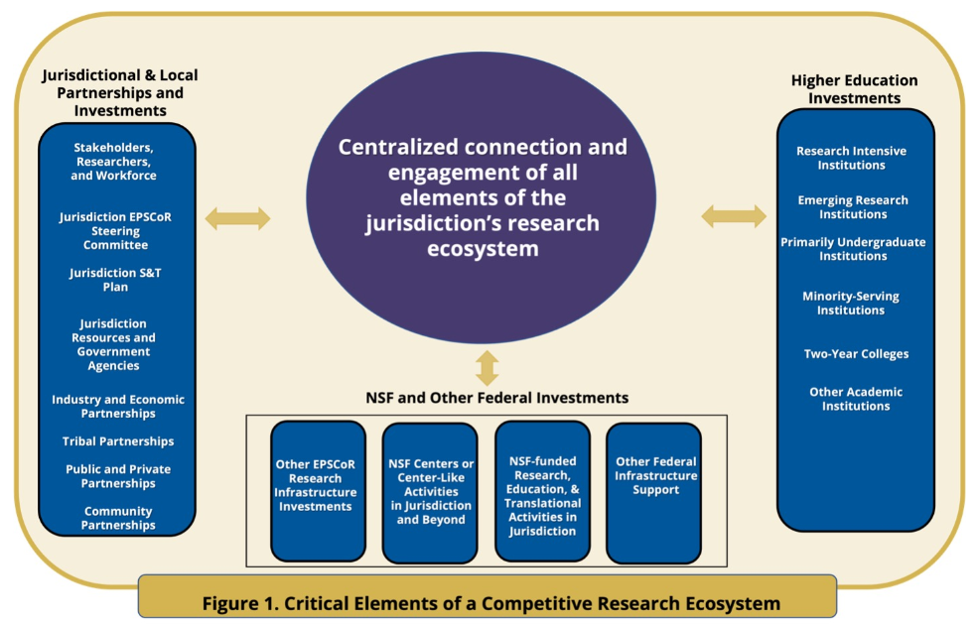
Figure 1 (from NSF 23-587). Critical Elements of a Competitive Research Ecosystem. E-CORE RII supports a centralized administrative core that connects and engages all elements of the jurisdiction's research ecosystem. E-CORE RII is designed to connect the multiple components of the research ecosystem through focused activities intended to build jurisdiction-identified research infrastructure cores.

Slide 9
E-CORE RII Project Requirement (NSF 23-587)
Each E-CORE RII project must have an Administrative Core.
The Administrative Core ”should provide mechanisms to connect individuals, teams, institutions, and sectors to improve a jurisdiction's R&D competitiveness through creating a coordinated jurisdiction-wide culture of inclusion that builds a network that connects and democratizes the research environment for all participants. This is expected to provide an opportunity for all researchers in the jurisdiction to participate meaningfully within its research ecosystem.”
May support _________________ (you fill in the blank)
Project management team + MORE
MORE = expert in connecting, facilitating, innovating, etc.
Notes:
Intentionally flexible
May support an EPSCoR Director (e.g., Program Director within RII Track 1), Administrator (e.g., Program Administrator within RII Track 1), and/or Assistant for the purposes of operating and managing activities related to developing capacity and competitiveness at the jurisdiction level.
that institutions aren’t seeing this as related to what they want to support?
Also, these types of positions have been very managerial and not necessarily innovating, connecting, facilitating, etc. Perhaps they don’t see themselves in the admin core and don’t want to do that work.

Slide 10
Critical Functions of an Administrative Core
The Admin Core has a role of establishing a foundational framework that connects groups of researchers and partners, fosters collaboration and inclusivity, and aims to make the research environment fair and accessible to all researchers.
Goal of enhancing jurisdiction's R&D by leveraging collective strengths and contributions of the research community
Connecting individuals, teams, institutions, and sectors, including building a network of connections in the jurisdiction
Improving R&D competitiveness in a jurisdiction, resulting in a benefit to society and the economy
Creating coordinated jurisdiction-wide culture of inclusion, while democratizing the research environment
Promoting meaningful jurisdiction-wide participation
Notes:
**Connecting Individuals, Teams, Institutions, and Sectors**: This core framework aims to bring together various entities involved in research—whether they are individuals (like scientists or researchers), teams (groups working together on projects), institutions (like universities or research centers), or sectors (different areas of industry or fields of study).
**Building a Network**: The core should also create a network or web of connections among all participants. This network allows for easier communication, collaboration, and sharing of ideas and resources.
2. **Improving R&D Competitiveness**: By connecting these groups, the aim is to make the region more competitive in research and development compared to other places. This competitiveness is about being able to produce high-quality research and innovations that can benefit society and the economy.
3. **Creating a Coordinated Jurisdiction-wide Culture of Inclusion**: This means establishing a shared way of working together across the entire region. It involves making sure that everyone—regardless of their background or where they work—feels included and valued in the research community.
----- **Democratizing the Research Environment**: This means making the research environment more accessible and open to everyone involved. It ensures that opportunities for research participation and contribution are available to all researchers, regardless of their status or affiliations.
4. **Meaningful Participation**: Finally, the goal is to give every researcher in the region a chance to be involved in the research ecosystem in a significant way. This means that researchers should have the opportunity to contribute their ideas, skills, and efforts effectively.
In summary, the statement is about establishing a foundational framework that connects different groups of people involved in research, fosters collaboration and inclusivity, and aims to make the research environment fair and accessible to all researchers. The ultimate goal is to enhance the region's ability to compete in research and development by leveraging the collective strengths and contributions of its entire research community.

Slide 11
Solicitation Requirements/Guidance for Key E-CORE RII Project Elements thru the Administrative Core
Broadening Participation and Collaboration
Connections
Goals, Metrics, and Evaluation
Leadership and Communication Capacity
Jurisdictional Development

Slide 12
Broadening Participation and Collaboration
Networks and partnerships should work collaboratively across the jurisdiction to develop a strategic plan centered on a shared vision to address an identified broadening participation challenge and achieve related outcomes.
E-CORE RII projects must build collaborative infrastructure into their approach to broadening participation in research and thus building and strengthening research capacity.

Slide 13
Build Connections
Project teams should consist of individuals, projects, or center-like activities across partnering organizations, which will include a diverse representation of academic institution types (e.g., research-intensive institutions, emerging research institutions, primarily undergraduate institutions, minority-serving institutions, two-year colleges) and/or sectors (e.g., non-academic, governmental, industry) within the jurisdiction.
These teams will engage in jurisdiction-wide network-building activities to accomplish project goals.
Partnerships with other federal, state, or non-profit programs are encouraged.

Slide 14
Goals, Metrics, and Evaluation
Project teams must develop a set of measurable goals and objectives aligned with jurisdictional needs.
A plan documenting the alignment of well-defined, relevant goals and objectives with project outcomes is critical.

Slide 15
Leadership and Communication Capacity
Projects must include internal and external communication plans and explain how they will develop leadership capacity and distribute leadership within and among partnering organizations.

Slide 16
Jurisdictional Development
Projects must describe their overall contribution to developing research capacity in the jurisdiction and thus contribute to the nation's STEM workforce and research ecosystem.
Seed funding and workshops are expected to be a major mechanism used in the Admin Core. Strategies for the development or use of seed funding and workshops may include:
connection of individuals or teams of individuals from multiple institution types to engage with existing research efforts in the jurisdiction;
formation of new partnerships that translate to new endeavors;
connection of individuals, labs, and networks to other efforts outside the jurisdiction;
opportunities for student and postdoctoral fellowships;
creation of workshops to bring individuals together to forge new partnerships.
Notes:
Seed funding and workshops are expected to be a major mechanism that will be used in the Administrative Core to connect and provide support for individuals and teams to engage with the jurisdiction-wide research ecosystem. Some strategies for the use of seed funding and workshops may include, but are not limited to, the connection of individuals or teams of individuals from multiple institution types to engage with existing research efforts in the jurisdiction; the development of seed funding that forms new partnerships that translate to new endeavors; the connection of individuals, labs, and networks to other efforts outside the jurisdiction; opportunities for student and postdoctoral fellowships; and the creation of workshops to bring individuals together to forge new partnerships. Chosen strategies and investments need to be clearly outlined and plans to maximize the participation across the entire jurisdiction (irrespective of institution or sector) must be clear. Seed funding should be used to connect teams and individuals across the jurisdiction in alignment with the NSF mission as outlined in the PAPPG.

Slide 17
Current Jurisdictional EPSCoR Office Models
There is no one-size fits all model; we see many variations in the roles and administration of and within the EPSCoR jurisdictional offices.
In general, jurisdictional offices have roles for:
Project Director
Project Administrator
Education, Outreach, and/or Diversity Specialist
Finance Administrator
Jurisdictional EPSCoR offices are generally housed within a university, but we’ve also seen some positioned within non-profits associated with academic administration or state agencies.
Notes:
By providing direct funding to build the administrative core within your jurisdiction, we are enabling you to shape the office in a way that best fits your jurisdiction’s needs and provides a sustainable foundation with which to build the STEM enterprise through further E-COREs, E-RISES, or other funding opportunities.

Slide 18
Diversity in Models of Existing Track-1 State Offices
Non-Profit Office
The Jurisdiction has established a non-profit entity to organize the EPSCoR activities within the jurisdiction
Multi-Agency Office
The jurisdiction organizes EPSCoR activities from multiple federal agencies but the office resides as a single unit within the jurisdiction
Institution-Led Office
An institution takes the lead on EPSCoR jurisdiction activities (Track 1 and beyond) and may be a management entity for staff but does not coordinate activities within the jurisdiction
Project Office
Staff primarily support project management for the Track 1 project but do not manage or coordinate other EPSCoR activities within the jurisdiction
System-led Office
Office serves research development activities across a system of institutions within the jurisdiction

Slide 19
EPSCoR Jurisdictional Office Funding Model
Most jurisdictions use a combination of funding to support the EPSCoR office in the jurisdiction.
57%
25%
17%
Only NSF EPSCoR Funding
NSF EPSCoR + Other
NSF Program Funding
NSF EPSCoR +
External Funding (which may include cost share)
Notes:
The three lateral bars show the variation of funding mechanisms for the EPSCoR jurisdictional office across all eligible EPSCoR jurisdictions. The stacked green bar represents the various sources of external funding used for the EPSCoR state offices.

Slide 20
Diversity in Possible Models of Administrative Cores in E-CORE Projects
Traditional Track-1 State Office Model (project management office with 2 – 4 staff )
+ more --- e.g., expert in team building/network development)
Research and Economic Development Model Spanning More than NSF EPSCoR
Shared Model
Host of Other Options
Many of which can be found in existing models for current state offices

Slide 21
Resources Available to Community to Support Transition to New EPSCoR RII Programs
Dear Colleague Letter: NSF 23-147
FAQs: NSF 23-148
Multiple live webinars: https://new.nsf.gov/funding/initiatives/epscor/epscor-live
Planning proposals (see DCL 24-097)
EPSCoR Workshop Mechanism: NSF 24-540
Exploring EPSCoR Ecosystem Workshop: https://yourepscorecosystem.com
Recurring office hours (sign up here )
Supplemental funding mechanism
Multiple proposal reviews in FY24

Slide 22
Where do you start?
Identify and use available resources
Plan and analyze within the jurisdiction
Design, build, and pilot
Implement and Transition

Slide 23
Example of using an E-CORE Admin Core to play the coordinator and capacity building function for more funding across the jurisdiction.
Assume focus on two R1 institutions, 5 emerging research institutions, and several community colleges
Project goal of engaging these institutions in the jurisdictional ecosystem
Strategy: Stand up an office in the Admin Core that provides services to help with proposal submissions coming from these institutions in the topical area of the E-CORE project (for example). Office will provide guidance, resources, and support on pre and post award management.
Tasks:
Training to support competitive submissions
Development of communications portal to share ideas in building collaboratively across the jurisdiction
Building of a core research development segment that pulls teams together, including other RII investments in the jurisdiction and beyond
Build in teams of internal reviewers for submissions
Prepare and assess: Can an E-RISE team be cultivated and developed from E-CORE work?
Notes:
Using an E-CORE Admin Core to play the coordinator and capacity building function for more funding across the jurisdiction.
In a jurisdiction with two R1 institutions and 5 emerging research institutions, several community colleges,
Goal of engaging these institutions in the jurisdictional ecosystem
Stand up an office that provides services to help with proposal submissions that gives advice around how to manage awards.
Provide some training for people to be had, they would be competitive for funding.
Set up a communications portal so that people can share what ideas that they're interested in building collaboratively across the jurisdiction.
Build a core research development segment
Pull teams together. I'm going to talk to people about what their skills are, what their talents are what their investments that they could leverage are. And then I might even have some workshops, and I could go back to EPSCOR for some workshop money and figure out what kind of priorities we want to build out. Given what we have and what institutions want to invest in, I would definitely include the E-RISE and community colleges in that regard, and then I would be able to say, alright. Out of this I see people 2 good E-RISE projects. Let's work on those together. And we're going to work on them cross institutional. And we're, going to you know, make sure our proposal development is strong. We'll have you know somewhat what are typically called red team reviews to review them before they go out to NSF. So I would use E-CORE opportunities to play the coordinator and capacity building function for more funding all across the jurisdiction.

Slide 24
Common Admin Core Questions
How will roles and responsibilities be delineated across multiple admin cores if there is more than 1 E-CORE in a jurisdiction?
How should the E-CORE admin core interact with others in the state?
What is the max budget of an E-CORE RII project for support of the Administrative Core?
How can I prepare my team to move beyond project management in the Administrative Core?
Notes:
By providing direct funding to build the administrative core within your jurisdiction, we are enabling you to shape the office in a way that best fits your jurisdiction’s needs and provides a sustainable foundation with which to build the STEM enterprise through further E-COREs, E-RISES, or other funding opportunities.

Slide 25
Contact the FY24 EPSCoR Program Team
General Inquiries: nsfepscor@nsf.gov
E-CORE RII Inquiries: EPSCoR-CORE@nsf.gov
E-RISE RII Inquiries: EPSCoR-RISE@nsf.gov
EPSCoR Live! Inquiries: epscor-live@nsf.gov
RCC Section Staff: NSF Directory
Section Head (Sandra Richardson): srichard@nsf.gov

Slide 26
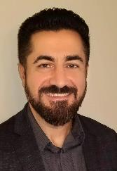
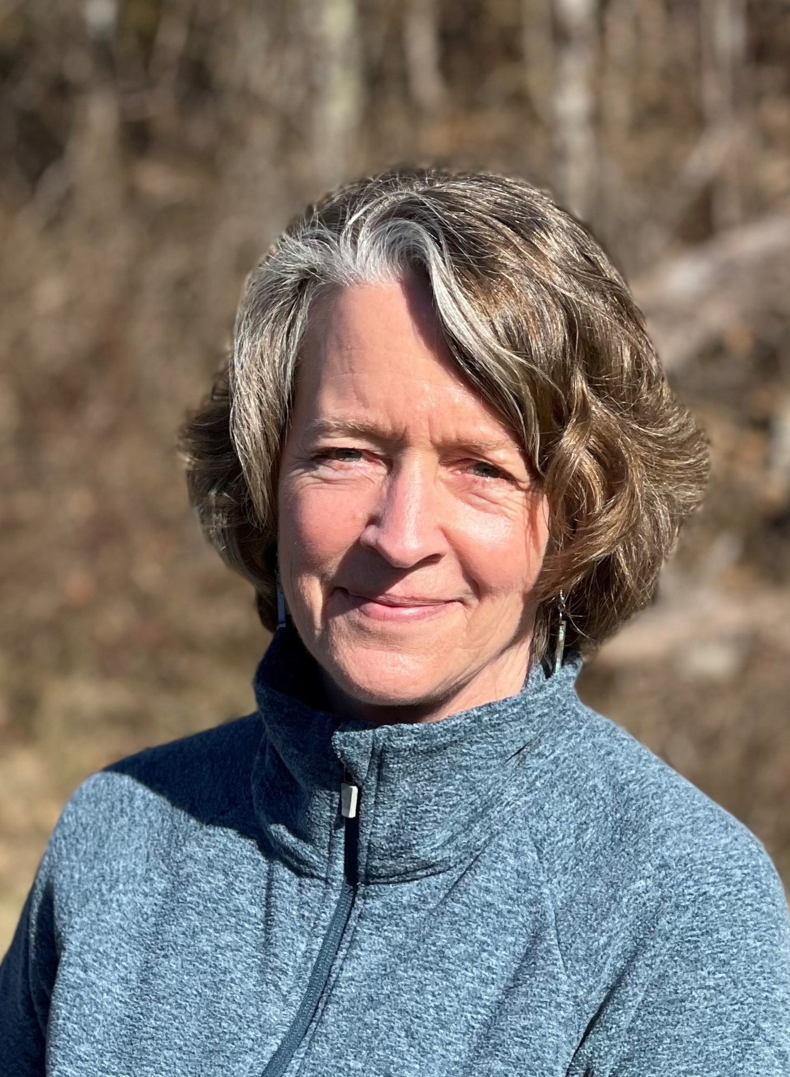
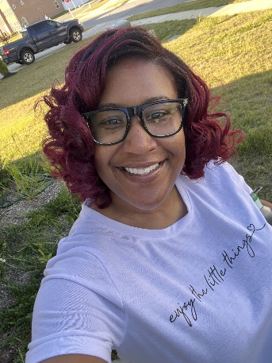
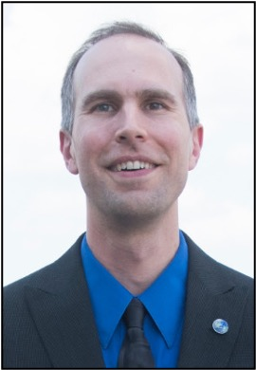
FY24 EPSCoR Program Team
Sandra Richardson
Section Head
Yolanda Allen
Program Analyst
Pinhas Ben-Tzvi
Program Officer
Lisa Cliggett
Program Officer
Jose Colom
Program Officer
Andrea Johnson
Program Officer
Casonya Johnson
Program Officer
Tori Jordan
Program Specialist
Liz Lawrence
Sr. Program Analyst
Hongmei Luo
Program Officer
Ben McCall
Program Officer
Dave Ogden
Science Analyst
Jeanne Small
Program Officer
J.D. Swanson
Program Officer
Chinonye Whitley
Program Officer
26
Notes:
Underscore that we are a collaborative team

Slide 27
New EPSCoR Program Director Opportunity
Federal AD-4 Program Director Opening in EPSCoR
Position posted at: https://www.usajobs.gov/job/800182200#hiring-paths
NSF EPSCoR Program Director Recruitment Webinar – Wednesday, August 7th from 4 – 5 pm EDT
Register here: https://nsf.zoomgov.com/webinar/register/WN_WBbLdbITSkW3sCEZ7WqjBg
Position expected to close Aug 28th

