Slide 1
NSF EPSCoR
February 20, 2024
Established Program to Stimulate Competitive Research:
Workshop Opportunities (EPS-WO)
Pinhas Ben-Tzvi
Ben McCall
Program Officers
OD/OIA/RCC/EPSCoR

Slide 2
U.S. National Science Foundation (NSF) Org Chart
Office of the Director
National Science Board
(NSF)
Office of the General Counsel (OGC)
Office of International Science and Engineering (OISE)
EPSCoR
Research Capacity and Competitiveness (RCC) Section
Office of Integrative Activities (OIA)
Office of Legislative and Public Affairs (OLPA)
HBCU-EiR
Office of Inspector General (OIG)
Office of Equity and Civil Rights (OECR)
NSF Chief Officers
Directorate for Biological Sciences (BIO)
Directorate for Computer Information Science & Engineering (CISE)
Directorate for Engineering (ENG)
Directorate for Geosciences (GEO)
Directorate for Mathematical & Physical Sciences (MPS)
Directorate for Social, Behavioral and Economic Sciences (SBE)
Directorate for STEM Education (EDU)
Directorate for Technology, Innovation and Partnerships (TIP)
Office of Info & Resource Management (OIRM)
Office of Budget, Finance and Award Management (BFA)

Slide 3
Estab­lished Program to Stim­u­late Com­pet­i­tive Research (EPSCoR)
Mission: To enhance the research competitiveness of targeted jurisdictions by strengthening science, technology, engineering and mathematics (STEM) capacity and capability through a diverse portfolio of investments from talent development to local infrastructure.
Eligibility: A jurisdiction is eligible to participate in the U.S. National Science Foundation's EPSCoR program if their most recent five-year level of total NSF funding is equal to or less than 0.75% of the total NSF budget (excluding EPSCoR funding and NSF funding to other federal agencies).
Notes:
NOTE: This eligibility information does not reflect the CHIPS+Science “freeze” in eligibility.

Slide 4
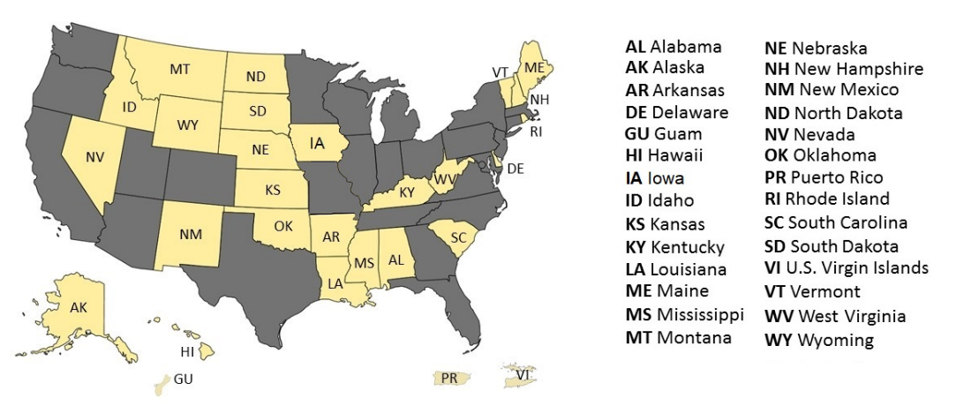
EPSCoR Jurisdictions
Notes:
There are currently 28 EPSCoR jurisdictions: 25 states, plus the commonwealth of Puerto Rico and the territories of the U.S. Virgin Islands and Guam. Part of our mission is to make sure that research funds are available for those under served states as well.
Each state is unique, and we work in helping reinforce each state’s capacity and capability to increase competitiveness in particular areas that have been identified by the state. Some example of those are in the next slide.

Slide 5
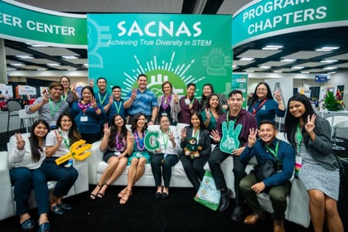
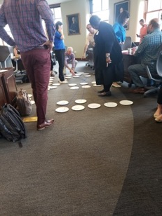
EPSCoR Investment Strategies
Research Infrastructure Improvement (RII) Programs (78-84% of EPSCoR budget)
RII Track-1 (sunsetting)
EPSCoR Collaborations for Optimizing Research Ecosystems (E-CORE)
EPSCoR Research Incubators for STEM Excellence Research (E-RISE)
Focused EPSCoR Collaborations (formerly Track-2)
EPSCoR Research Fellows (formerly Track-4)
Support physical, human, and cyber infrastructure within academic institutions across each jurisdiction
Co-Funding w/ NSF Directorates & Offices (16-22% of budget)
Meritorious proposals reviewed in other NSF programs that also satisfy EPSCoR programmatic criteria
Outreach and Workshops (0.5-1% of budget)
Interaction among EPSCoR Community and NSF to build mutual awareness and develop areas of potential strength
GU Team at SACNAS
IA Strategic Plan – Integration of Project
Notes:
EPSCoR adopted investment strategies to help us achieve our mission and goals. (Read from slide.)

Slide 6
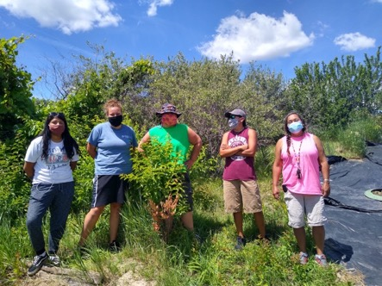
Workshop Opportunities (EPS-WO) Goals
Supports workshops in eligible jurisdictions that focus on topics of regional or national importance, and which are relevant to building EPSCoR jurisdictions’ R&D capacity.
EPSCoR welcomes proposals for workshops from institutions within EPSCoR-eligible jurisdictions.
Workshops will focus on innovative ways to address multi-jurisdictional efforts on themes of regional to national importance with relevance to EPSCoR's goals and NSF's mission.
Sinte Gleska University (SGU) and South Dakota State University. improve sustainable production of prairie turnips and buffalo berries

Slide 7
EPS-WO Solicitation (NSF 24-540)

Slide 8
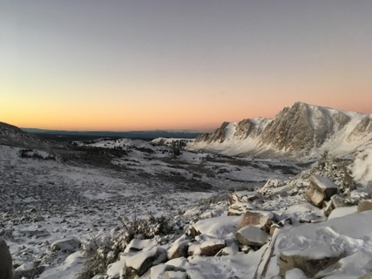
What’s New with this Solicitation
Submission of a Concept Outline, followed by an invitation from an NSF EPSCoR Program Officer to submit a full proposal, is required before the submission of a full workshop proposal.
Maximum budget for workshops has been increased to $200,000.
Virtual workshop proposals are explicitly allowed.
Institutional eligibility has been clarified.
Allowable workshop topics have been expanded to include activities for the creation of center-level partnerships.
WY - understand whether microbial communities in seasonal snow were actively contributing to nutrient cycling

Slide 9
EPSCoR Workshop Opportunities Program Description
Workshops proposals are welcome in areas of science and engineering that advance the program’s goals and engage a broad community of investigators or practitioners, while including the intentional involvement of the EPSCoR community.
Workshops aim to bring communities of thought together to discuss recent research or education findings
Explore topics in emerging areas of science and engineering
Foster innovative collaborations
Expose researchers or trainees to new research and education tools or techniques
Respond to NSF EPSCoR calls for workshops on specific topics

Slide 10
Expectations of EPSCoR Workshop Proposals
Proposals may address any topic, including the exploration of topic areas that have been described as NSF priorities.
Applicants should demonstrate how the topic is of importance to relevant STEM field(s) and include evidence that the topic will engage and be of particular interest to the greater EPSCoR community.
Topics may also include proposed activities for the creation of center-level partnerships. Topics related to center-level investments may include but are not limited to Engineering Research Centers, Science and Technology Centers, Regional Innovation Engines, and other current or future federal opportunities.
Goals and desired outcomes, anticipated products, and benefits that the workshop will have for its participants should be explicitly described
Successful proposals will also demonstrate that the team has worked to ensure that there is a diversity of participating individuals that includes groups reprepresented in STEM at every level—from the advisory committee and leadership to the speakers and participants.
A tentative agenda that includes suggested speakers, and letters of support that lend evidence of participation from key participants or collaborators
Proposals should include a plan for communicating workshop outcomes and disseminating workshop products
Proposals should include an evaluation plan that assesses whether the goals of the workshop have been achieved.

Slide 11
Successful workshop proposals will:
Include a compelling rationale, with clear goals and desired outcomes; a committed leadership team; institutional support; and leveraged resources.
Address multi-jurisdictional efforts, priorities, or interests that require collaboration for optimal success.
Address major regional or national themes of relevance to EPSCoR's goals and NSF's mission.
Describe the inclusion of individuals from groups underrepresented in STEM. Efforts to do so must be evident at all levels from the planning committee and speakers to the workshop participants.
Include institutions of higher education that serve populations that are traditionally underrepresented in STEM (defined as minority-serving institutions, women’s colleges, or institutions where the majority of students are students with disabilities).

Slide 12
Additional Guidance
Workshops are not intended for single-institution activities.
Speakers from non-EPSCoR institutions may be involved in the workshop, but funding for their travel expenses must be included in the Participant Support Cost budget category. No funds may be budgeted for non-EPSCoR institutions.
Each funded workshop should result in a publicly-disseminated workshop report that should be posted on the relevant jurisdictions' web sites and must include:
The metrics and measures of workshop programmatic success.
The extent of the inclusion of individuals from groups underrepresented in STEM through evaluation and feedback.
The extent of the inclusion of institutions of higher education that serve populations that are traditionally underrepresented in STEM (defined as minority-serving institutions, women’s colleges, or institutions where the majority of students are students with disabilities).
A plan for widespread dissemination of results.
A list of workshop participants.
A comprehensive discussion of the workshop's products and specific implementation plans for the next steps.

Slide 13
EPS-WO Concept Outline Preparation and Submission Instructions
Submission of a Concept Outline, followed by an invitation from an NSF EPSCoR Program Officer to submit a full proposal, is required before the submission of a full workshop proposal. Concept Outlines may be submitted via email to nsfepscor@nsf.gov at any time or directly to any cognizant Program Officer listed in the solicitation.
The workshop proposal development process is outlined below.
Identify and develop the workshop theme.
Identify the rationale and theme or topic of the workshop.
Convey EPSCoR community interest in the topic, which should be substantial and gauged by appropriate means (for example use of a survey or focused conversations).
Form an advisory committee to verify and develop the concept within the greater body of knowledge in the field, ensuring that it is not duplicative of other efforts, and to obtain data supporting the theme or concept.

Slide 14
EPS-WO Concept Outline Preparation and Submission Instructions
Draft a Concept Outline.
Detailed planning of the workshop, the interest of the EPSCoR community, and the workshop preparation timeline should be outlined in a Concept Outline, which must not exceed 5 pages. During the Concept Outline preparation process, proposers are encouraged to:
Develop a compelling rationale with clear goals and desired outcomes.
Determine the availability and interest of prospective speakers and participants.
Address the recruitment and inclusion of groups underrepresented in STEM areas that include the leadership team, speakers, participants.
Develop an estimated budget and budget justification, schedule of activities, and a proposed target date for the workshop.
Discuss methods of dissemination, evaluation and assessment, and desired outcomes/deliverables.
Submit a Concept Outline via email to nsfepscor@nsf.gov or directly to any cognizant Program Officer listed in the solicitation.

Slide 15
EPS-WO Full Proposal Preparation Instructions
Full proposals should:
Incorporate feedback obtained from NSF EPSCoR from the Concept Outline.
Include all five categories of information described above for Concept Outlines.
Explicitly address one or more of the EPSCoR goals listed in section I.A above.
Follow the guidelines for Conference proposals contained in the NSF PAPPG, Chapter II.F.9.
Select the “conference” proposal type in Research.gov or Grants.gov.
Include the email from a Program Officer inviting the PI to submit a full proposal as a Supplementary Document entitled "Program Officer Concurrence Email."
Typical Timeline:
One month for NSF EPSCoR to review the Concept Outline.
Six months from full proposal submission to funding decision.
It is recommended to begin the Concept Outline development process at least 12 months before the envisioned workshop, when possible, to allow ample time for proposal development and review.

Slide 16
Merit Review Criteria
All NSF proposals are evaluated through use of the two National Science Board approved merit review criteria.
Both criteria are to be given full consideration during the review and decision-making processes; each criterion is necessary but neither, by itself, is sufficient. Therefore, proposers must fully address both criteria.
When evaluating NSF proposals, reviewers will be asked to consider what the proposers want to do, why they want to do it, how they plan to do it, how they will know if they succeed, and what benefits could accrue if the project is successful.
Reviewers will be asked to evaluate all proposals against two criteria:
Intellectual Merit: The Intellectual Merit criterion encompasses the potential to advance knowledge; and
Broader Impacts: The Broader Impacts criterion encompasses the potential to benefit society and contribute to the achievement of specific, desired societal outcomes.

Slide 17
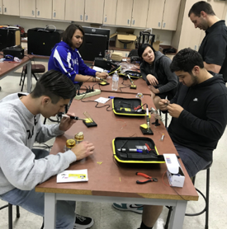
Eligibility Information
Proposals may be submitted only from institutions or organizations within EPSCoR-eligible jurisdictions. Eligibility to participate in the EPSCoR Workshop Opportunities program is described on EPSCoR’s website.
Within EPSCoR-eligible jurisdictions, proposals may be submitted only by the following:
Institutions of higher education (PhD-granting and non-PhD-granting), acting on behalf of their faculty members, that are accredited in and have a campus in the United States, its territories, or possessions.
Non-profit, non-degree-granting domestic U.S. organizations, acting on behalf of their employees, that include (but are not limited to) independent museums and science centers, observatories, research laboratories, professional societies, and similar organizations that are directly associated with the Nation's research or educational activities. These organizations must have an independent, permanent administrative organization (e.g., an office of sponsored research) located in the United States, its territories, or possessions, and have 501(c)(3) tax status.
Tribal Nations: An American Indian or Alaska Native tribe, band, nation, pueblo, village, or community that the Secretary of the Interior acknowledges as a federally recognized tribe pursuant to the Federally Recognized Indian Tribe List Act of 1994, 25 U.S.C. §§ 5130-5131.
KY – Plant Genetics
Bridge HS to BS – TCU ND

Slide 18
Proposal Preparation Instructions
Letters of Intent: Not required
Preliminary Proposal Submission: Not required
Who May Serve as PI: no restrictions or limits.
Limit on Number of Proposals per Organization: no restrictions or limits.
Limit on Number of Proposals per PI or co-PI: no restrictions or limits.
Full Proposals: Full Proposals submitted via Research.gov: NSF Proposal and Award Policies and Procedures Guide (PAPPG) guidelines apply.
NM SmartGrid-Early faculty workshop

Slide 19
Thank you!
Ben McCall
Email: bjmccall@nsf.gov
Pinhas Ben-Tzvi
Email: pbentzvi@nsf.gov

